Slide 1
Notes:
- Most images are original photos taken by Milton Smith while employed by Oracle. Images are property of Oracle. Other images are stock images provided with Microsoft PowerPoint.

Slide 3
Java and Security: Track Opening Presentation
Milton Smith
Sr. Principle Security PM
Java Platform Group
September 2014
Twitter: @spoofzu
Blog: securitycurmudgeon.com

Slide 4
Who is this Guy?
My background
Role – Strategic security leader working to influence Java team, internal teams, engage researchers, industry outreach
Background – Many years of application programming and security
Former Employer – Yahoo! Lead security for User Data Analytics property

Slide 5
Program Agenda
1
Welcome to Java and Security
Security Remediation
Security Feature Highlights
Session Highlights
Closing Thoughts and Resources
2
3
4
5

Slide 6
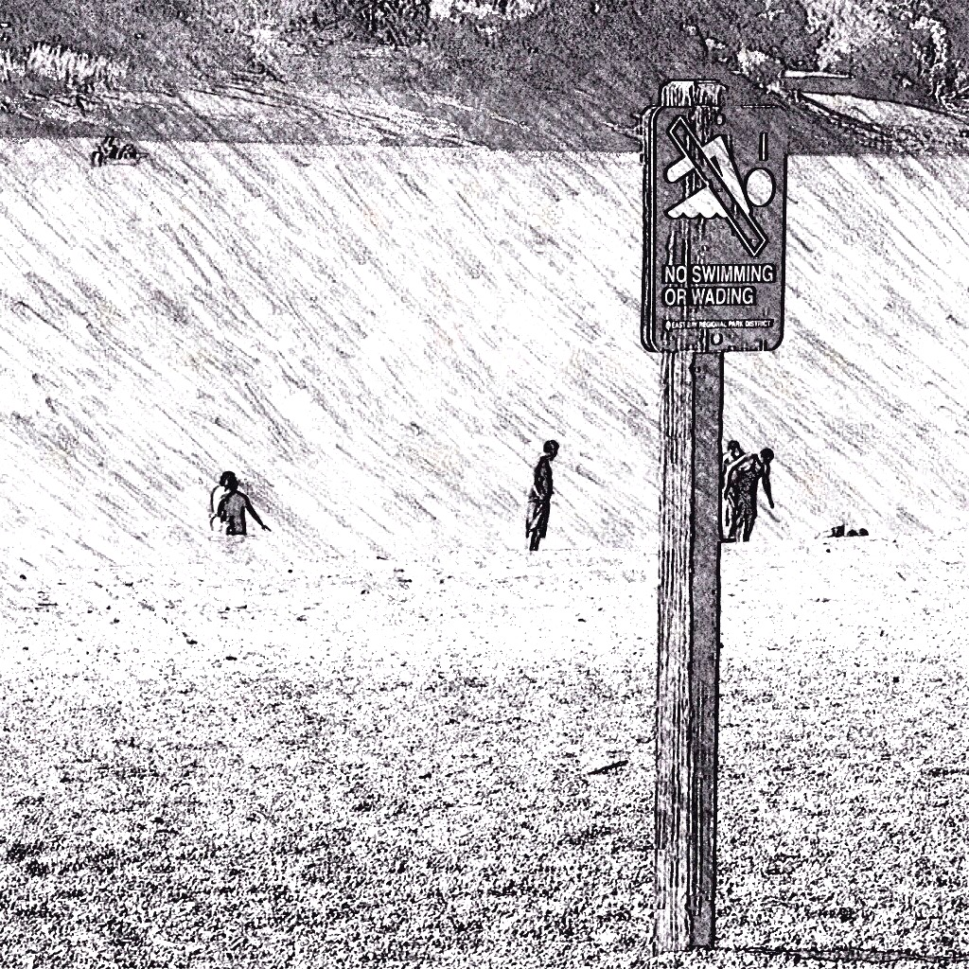
Welcome to Java and Security
Awareness, Education, Improvement

Slide 7
Why a Security Track?
Java and security at JavaOne
Strong interest in securing Java applications
Improve understanding of threat landscape, defensive measures, and new security features
Centrally organize security content vs. scattered across tracks

Slide 8
Security Track Facts
Facts about Java and Security track
JavaOne 2014 is our 2nd annual security track
Security track designed to educate - defensive only
Many interests captured like, government, financial, technology, and device makers

Slide 9
2014 Security Track Committee Transparency
Who are we?
Frank Kim – SANS Institute
Sean Mullen – Oracle
David Svoboda – Carnegie Mellon University\CERT
Eric Costlow – Oracle
Robert Seacord– Carnegie Mellon University\CERT
And me, Milton – Oracle

Slide 10
Security Remediation
Progress on security bugs over the past year…

Slide 11
Remediation at Oracle
A few notes before the slides
Oracle security patches are called Critical Patch Updates (CPUs). Data only includes CPUs
Security alerts are security “hot fixes”. Last alert for Java, March 2013
Remediation numbers include supported Java families, JRE 5, JRE 6, JRE 7, and JRE 8

Slide 12
Remediated Vulnerabilities by CPU

Slide 13
Remediated Vulnerabilities by Component Subtype

Slide 14
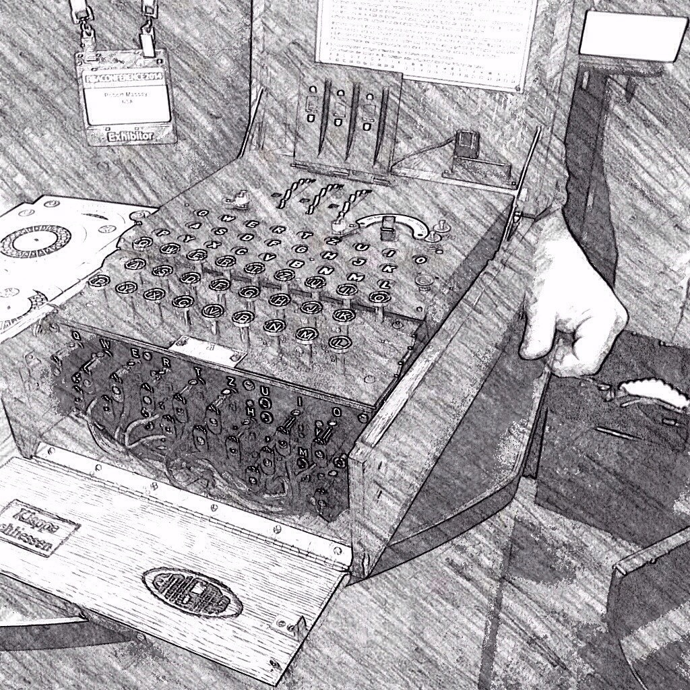
Security Feature Highlights
Security features delivered…

Slide 15
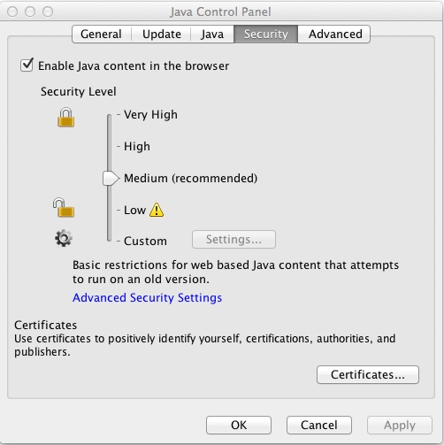
Enable\Disable Java in Web Browsers (Java 7 Update 10)
Concern: Instructions to disable Java are different on each platform
Feature: Easy way to disable Java on different platforms

Slide 16
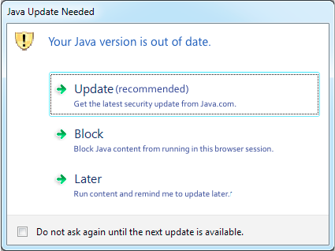
Hardcoded best before date in JRE (Java 7 Update 10)
Concern: Older versions of Java are insecure
Feature: Java should function differently when it’s operating insecurely, encourage upgrade

Slide 17
Java Security Slider (Java 7 Update 10)
Concern: Let end-users balance operational vs. security concerns in accordance with risk preferences or IT policies.
Feature: End-user adjustable plugin security levels

Slide 18
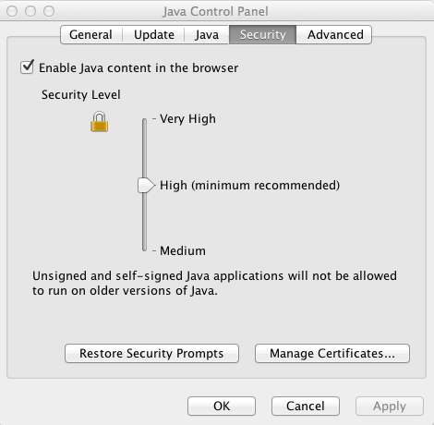
Remove “Low” and “Custom” from Slider (Java 7 Update 21)
Concern: End-users side stepping security controls. End result, more exploitation. Readjust minimum baseline security
Feature: Remove “low” and “custom” levels

Slide 19
Signing for Sandboxed Applications (Java 7 Update 21)
Concern: Establish accountability standards for software authors. Open up new enforcement options to the Java community
Feature: Signing for sandboxed applications. Separated code-signing from assigning privileges

Slide 20
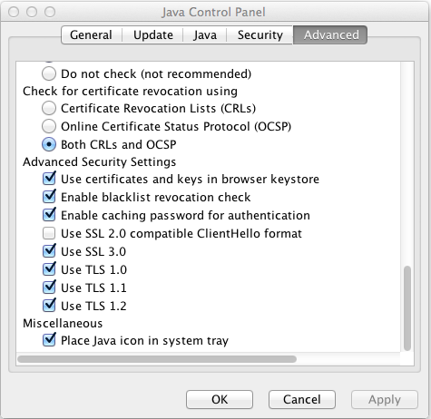
Enable Standardized Revocation Services (Java 7 Update 25)
Concern: Stolen digital certificates and impersonation
Feature: Enable standardized revocation services by default like CRL and OCSP

Slide 21
Lock JARs (Java 7 Update 25)
Concern: Deter applet code repurposing
Feature: Lock JARs to specific servers or domains

Slide 22
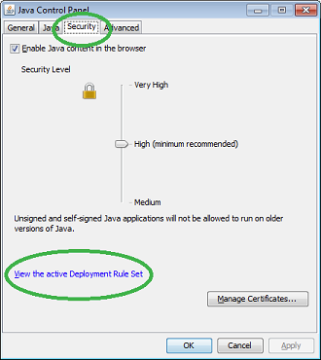
Deployment Rule Set (Java 7 Update 40)
Concern: Exploitation of desktop assets from Java malware
Feature: Add whitelisting for enterprise and partner assets
…
<rule>
<id location="http://payroll.example.org" />
<action permission="run" />
</rule>
<rule>
<id location="http://knownvendor.example.com/program" />
<action permission="run" version="SECURE-1.6" />
<!-- Application is known not to work on Java 1.7 -->
</rule>
…

Slide 23
Old JRE Warning (Java 7 Update 40)
X
Concern: Most businesses desire to manage their own update process. Balance operational vs. security concerns
Feature: Enterprise controls to disable JRE out of date warning
Optional, disable out of date warning

Slide 24
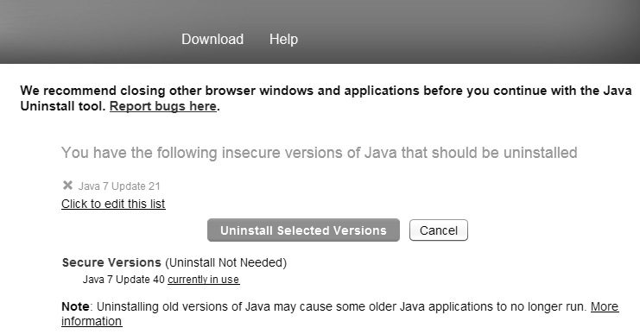
Java Uninstaller (Ongoing)
Concern: Adversaries target old versions of Java
Feature: Java Uninstaller

Slide 25
Code-signing is Java Default (Java 7 Update 51)
Concern: Reduce malware through Java community involvement (e.g., PKI benefits)
Feature: Signed-code is now the default for plugins (applet/web start)
00101011 00101011 00101011
01000011 10101001 10101011
00101011 00101011 00101011
10001011 00101011 00101011
00101011 00101011 00101011
01000011 10101001 10101011
00101011 00101011 00101011
10001011 00101011 00101011

Slide 26
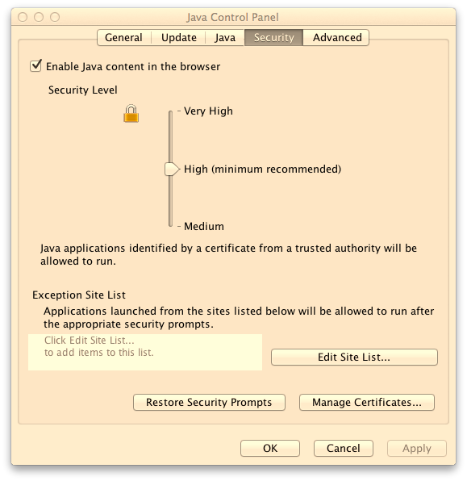
Exception Site List (Java 7 Update 51)
Concern: Balances the need for usability and legacy applet support while maintaining strong desktop security posture. Consumer DRS analog
Feature: Consumer support for legacy applets

Slide 27
What’s Included in JDK 8 Security?
All previously described JDK 7 security features,
Plus the following…

Slide 28
Move to TLS 1.2 as Default
00101011 00101011 00101011
01000011 10101001 10101011
00101011 00101011 00101011
10001011 00101011 00101011
00101011 00101011 00101011
01000011 10101001 10101011
00101011 00101011 00101011
10001011 00101011 00101011
Concern: Improve security of data in transit by moving to TLS 1.2 as default
Feature: TLS 1.2 is the platform default

Slide 29
Enhanced Support for Cert Revocation Checking (JEP 124)
Concern: Better options for developers to process revocation requests consistent with their site policies and information classification requirements
Feature: Improve revocation checking such as best-effort checking, CRL caching, OCSP, and others

Slide 30
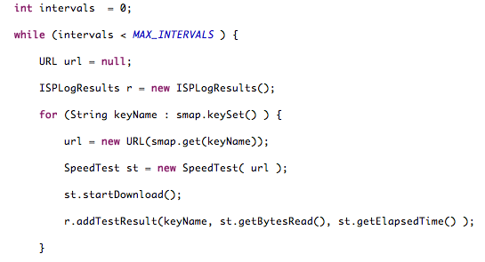
JDEPS Static Analysis Tool
Concern: Identify external dependencies negatively impacting application of latest security patches
Feature: Java class dependency analyzer

Slide 31
Type Annotations (JSR-308)
Concern: Reduce opportunity for data inconsistent with business requirements
Feature: Extensible type checking mechanism
@ReadOnly
@NonNull
@Tainted\ @Untainted

Slide 32
TLS Server Name Indication (SNI) Extension (JEP 114)
HTTPS
www.abc.com
www.xyz.com
Concern: Previously HTTPS server cannot be hosted in a virtual hosting infrastructure where multiple domains share the same IP address
Feature: TLS extension to support virtual hosting environments
192.168.1.100
Internet

Slide 33
Improvements for Applications
High Entropy Random Number Generation (JEP 123)
Support AEAD JSSE CipherSuites (JEP 115)
Implement SHA-224 in FIPS 180-3 (JEP 130)
NSA Suite B Algorithm Support (JEP 129)
64-bit PKCS11 for Windows (JEP 131)
Overhaul JKS-JCEKS-PKCS12 KeyStores (JEP 166)

Slide 34
Improvements for Applications (cont’d)
Stronger Algorithm Support to Password Based Encryption (JEP 121)
Blacklist Performance Enhancements
MS-SFU Kerberos 5 Extensions (JEP 113)
Limited doPrivileged (JEP 140)
Restrict Use Certs with RSA keys < 1024 bits
DNS Rebinding\SocketPermission Improvements (JEP 184)

Slide 35
Session Highlights
Security sessions this week you don’t want to miss…

Slide 36
Platform & Web Application Security
[CON3326] Applying Java’s Cryptography
Learn: Java’s cryptography controls
Erik Costlow, Java PM, Oracle, Oracle security blogger
[CON5320] Security Testing for Developers Using OWASP ZAP
Learn: find security bugs early in the development cycle using free security Zed Attack Proxy (ZAP)
Simon Bennetts, Security Automation Engineer, Mozilla Foundation
[CON1686] Five Keys for Securing Java Web Apps
Learn: live demos exploiting defects in Java applications, defending your apps
Frank Kim, Instructor, SANS Institute

Slide 37
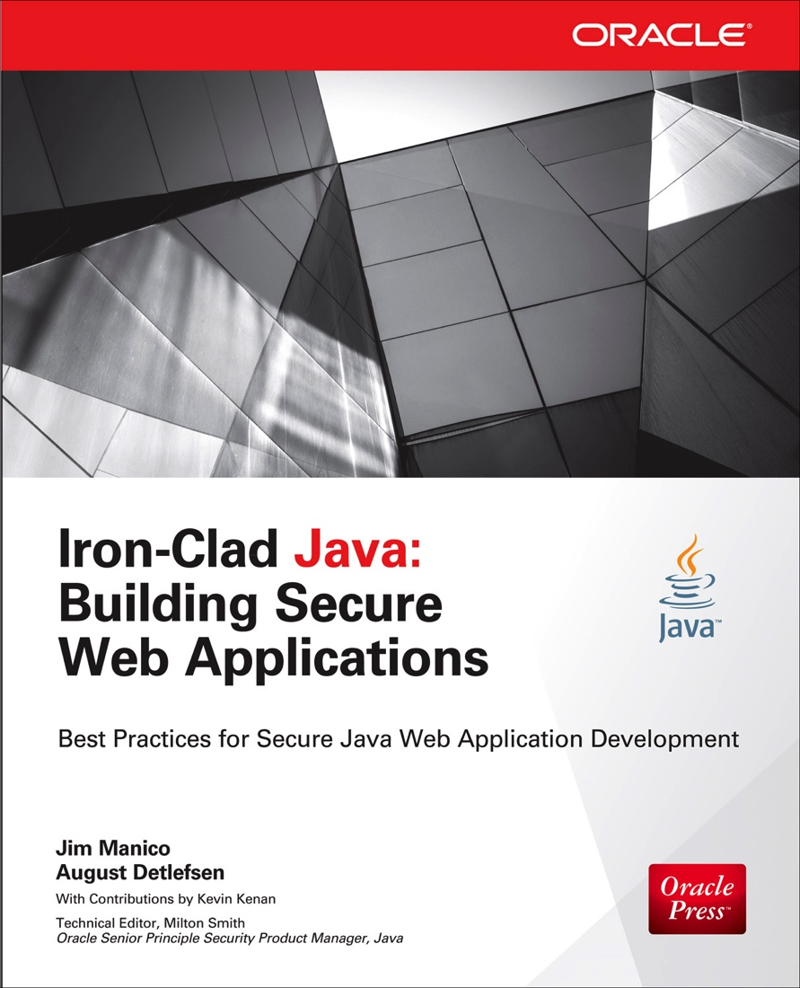
Platform & Web Application Security(cont’d)
[CON1713] Leveraging Open Source for Secure Java Website Construction
Learn: building secure Java web sites
Jim Manico, Secure Coding Instructor, Manico Security
* Available on-site at the Oracle book store

Slide 38
Platform & Web Application Security(cont’d)
[CON2788] Code-Level Security Games and Puzzles in Java
Learn: security code review principles, static analysis, and improving security culture
Brenton Phillips, Software Developer, Oracle
[CON2120] Anatomy of Another Java Zero-Day Exploit
Learn: dissect a Java exploit to see how they work
David Svoboda, Software Security Engineer, Carnegie Mellon University
Yozo Toda, Lead Analyst, JPCERT Coordination Center
[BOF5445] Q&A with the Security Group
Learn: live demos exploiting defects in Java applications, defending your apps
Sean Mullan, Consulting Member of Technical Staff, Oracle
Frances Ho, Engineer, Oracle
Brad Wetmore, Principal Member of Technical Staff, Oracle

Slide 39
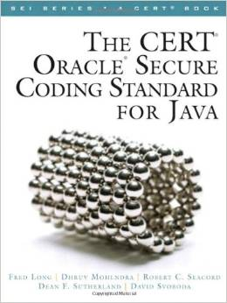
Secure Java Coding Practices
[CON6693] Java Secure Coding Guidelines
Learn: using Java-based components for IoT, monitoring and control of distributed devices
Andrew Gross, Java Engineer, Oracle
[HOL6325] Java Native Interface: Harden Your Native Code
Learn: Understand coding standards applicable to JNI and features like ASLR and DEP
Marc Schönefeld , Principal Member of Technical Staff, Oracle
[CON2368] Inside the CERT Oracle Secure Coding Standard for Java
Learn: CERT Java secure coding standards
Robert Seacord, Technical Manager, Carnegie Mellon University | David Svoboda, Software Security Engineer, Carnegie Mellon University

Slide 40
Security and the Internet of Things
[CON5948] Security and the Internet of Things: Preparing for the Internet of Stings
Learn: security in IoT, strategic security direction
Milton Smith, (Me)
* Demonstration, ADS-B Aircraft receiver on Raspberry Pi
[BOF3029] Internet of Things Security Architecture
Learn: platform security architecture, IoT attack vectors, distributed platform risks
Noel Poore, Architect, Oracle
[CON3027] Java-Based Architecture for the Internet of Things
Learn: using Java-based components for IoT, monitoring and control of distributed devices
Noel Poore, Architect, Oracle
Pete St. Pierre, Principle PM, Oracle

Slide 41
Closing Thoughts and Resources
Something we can all do…

Slide 42
Common Security Myths
Misconceptions about computer security
Misnomer | Reality | Action
Slow to upgrade or patch is best for production operations | Old school. Some operational benefit not being early adopter. At the expense of increased risk of exploitation | Keep up to date on Java CPUs (sec patches). If you run old versions of Java you need support
Hackers need my code to break into our web application | No. In fact, your code may actually confuse attackers (mine would ;o) | Integrate security testing into development processes. Address vulnerabilities early not later
Attackers are uniquely gifted individuals | Over esteeming is used to shift responsibility to attackers. Attackers are no more gifted than software developers | Perform independent assessments by different 3rd parties occasionally. Outside opinions are a worthwhile reference point

Slide 43
Common Security Myths (cont’d)
Misconceptions about computer security
Misnomer | Reality | Action
We have never had a security incident - we are secure | No noteworthy incidents is not the same thing as knowing your secure | Work to understand your threat landscape, prioritize risks, remediate/mitigate. Unknown threats are impossible to quantify
Security and compliance are the same | Audits measure conformance to policies. Security minimizes impacts to data confidentiality, availability, or integrity | Strong programs consider security from many perspectives like sec ops, sec compliance, net sec, sec arch, and implement security through entire lifecycle
Security is impossible | No, this just isn’t true. We can’t fix security like we can’t fix health but there is so much we can do! | Understand risk profile and move to remediate high risk concerns. You don’t need to fix world but you must fix what matters most

Slide 44
Announcement: Updating Outdated ActiveX Controls
Microsoft & Oracle Collaborate on Security
September 9th, Internet Explorer began blocking out of date ActiveX controls. Java Plugin is the first use case
Positive impact on millions of Windows desktops
Microsoft is Blue, Oracle is Red, we are both Red, White, and Blue on security!
http://blogs.msdn.com/b/ie/archive/2014/08/06/internet-explorer-begins-blocking-out-of-date-activex-controls.aspx

Slide 45
Java Platform Support
3 Options
Premier, 5 years from GA
Extended, Primier + 3 years
Sustaining, “as long as you own your Oracle products”

Slide 46
Upcoming CPU’s
14 October 2014
20 January 2015
14 April 2015
14 July 2015

Slide 47
Help Us Keep You Secure
End Users
Keep your JRE’s updated (auto-update on)
Practice defense-in-depth: harden OS, virus scanner, firewall, etc
To Developers
Certify on current JRE’s so enterprises and end-users can upgrade
Sign your applications and use timestamp
Review, Secure coding Guidelines for Java Language

Slide 48
Links
Java Security Resource Center
http://www.oracle.com/technetwork/java/javase/overview/security-2043272.html
Java Platform Group, PM Blog
https://blogs.oracle.com/java-platform-group/

