Slide 1
Plugging the users in
extend your application with pluggable Groovy DSL

Slide 2
Who’s talking?
@freddy33
github.com/freddy33

Slide 3
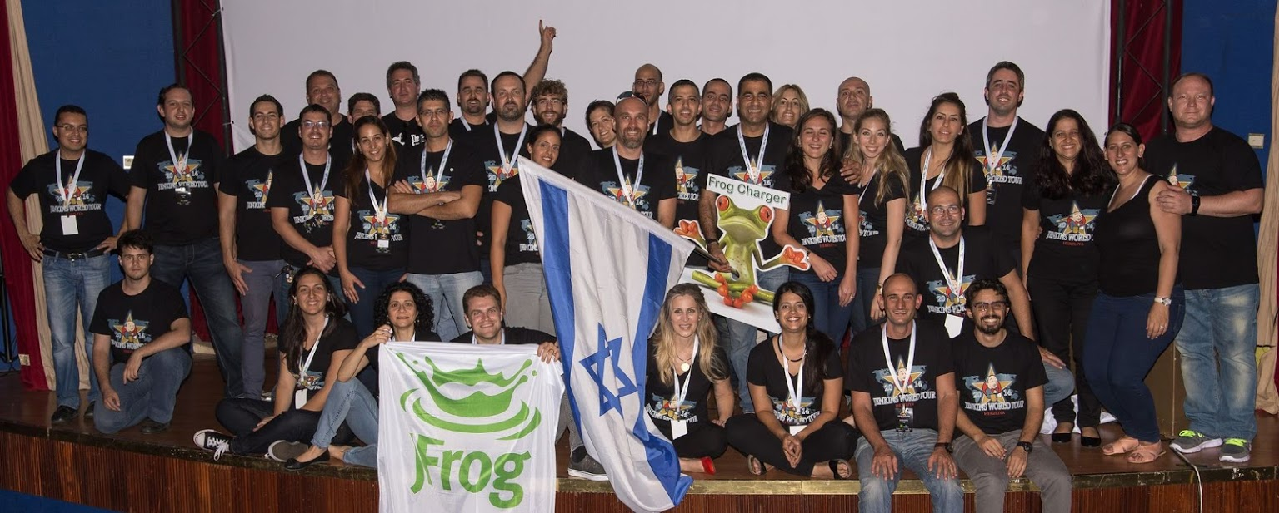
What Frog?
Notes:
CURRENT – JB
NEXT - FRED

Slide 4
What Frog?
Notes:
CURRENT – JB
NEXT - FRED

Slide 5
What Frog?
Notes:
CURRENT – JB
NEXT - FRED

Slide 6
What Frog?
Notes:
CURRENT – JB
NEXT - FRED

Slide 7
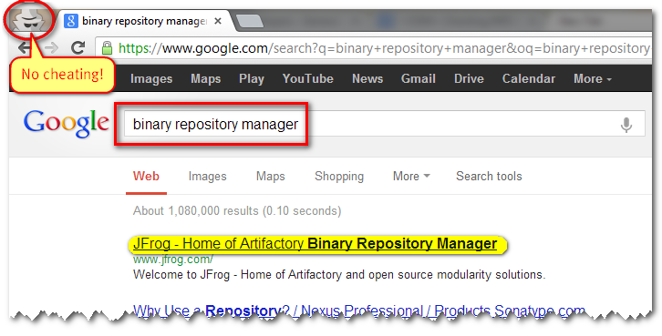
Artifactory what?
Notes:
Since 2006
Binary Repository Manager
Open Source
Standard Java Web Application

Slide 8
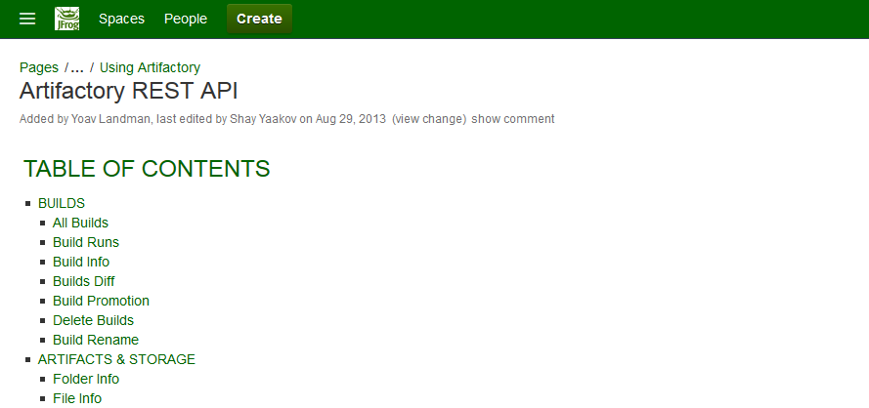
Our Imagination is Limited

Slide 9
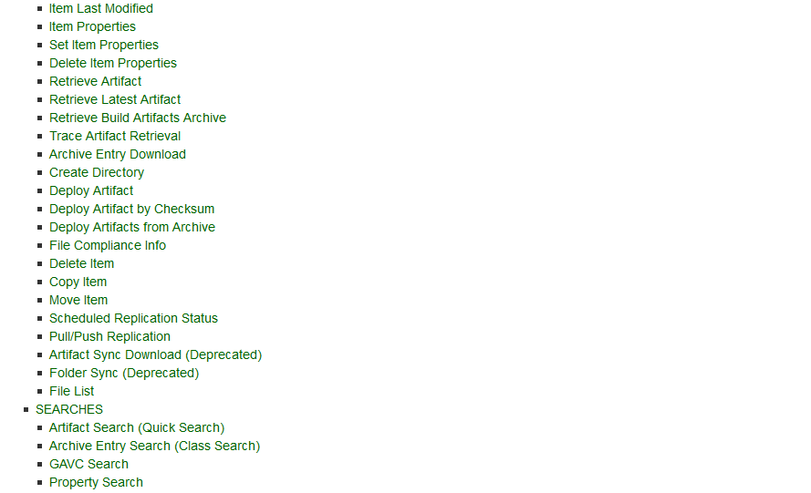

Slide 10
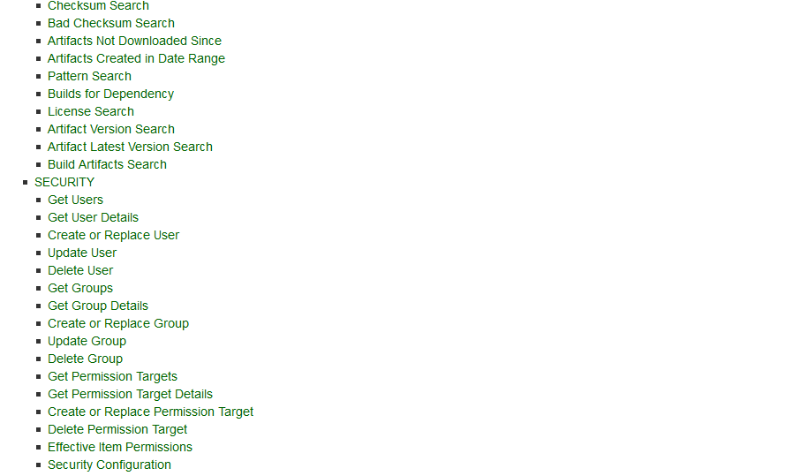

Slide 11
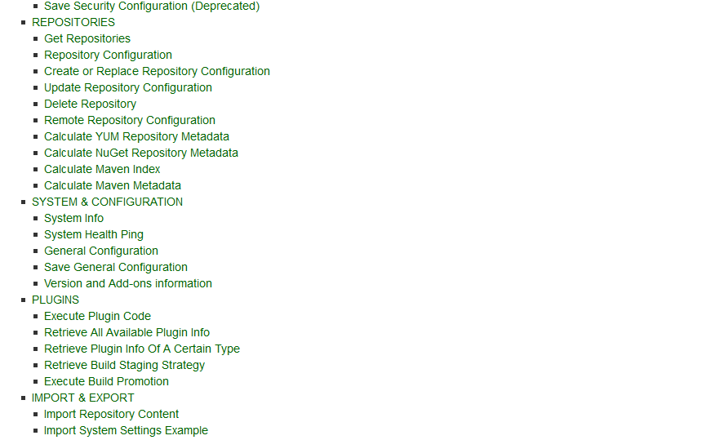

Slide 13
This is just a start

Slide 14
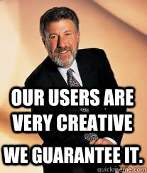
Message from our support team:

Slide 15
scheduled tasks

Slide 16
scheduled tasks
Custom security realms

Slide 17
scheduled tasks
Custom security realms
Change resolution rules

Slide 18
scheduled tasks
Custom security realms
Change resolution rules
Manipulate downloaded content

Slide 19
Custom security realms
Change resolution rules
Manipulate downloaded content
Listeners on storage events

Slide 20
Change resolution rules
Manipulate downloaded content
Listeners on storage events
searches
New rest commands

Slide 21
Manipulate downloaded content
Listeners on storage events
searches
New rest commands
Custom promotions

Slide 22
Listeners on storage events
searches
New rest commands
Custom promotions
Deploy and query artifacts and metadata

Slide 23
Etc.

Slide 25
Requirements

Slide 26
Requirements
Familiar to Java users

Slide 27
Requirements
Familiar to Java users
Simple DSL

Slide 28
Requirements
Familiar to Java users
Simple DSL
Simple deployment:

Slide 29
Requirements
Familiar to Java users
Simple DSL
Simple deployment:
No packaging

Slide 30
Requirements
Familiar to Java users
Simple DSL
Simple deployment:
No packaging
No restart

Slide 31
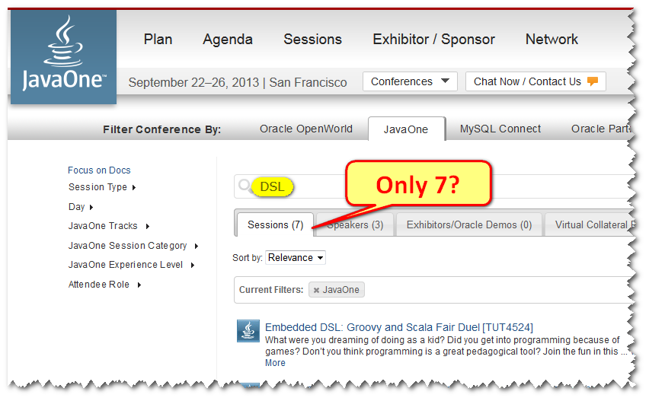
Of course you know DSL

Slide 32
But anyway…

Slide 33
But anyway…

Slide 34
But anyway…

Slide 36
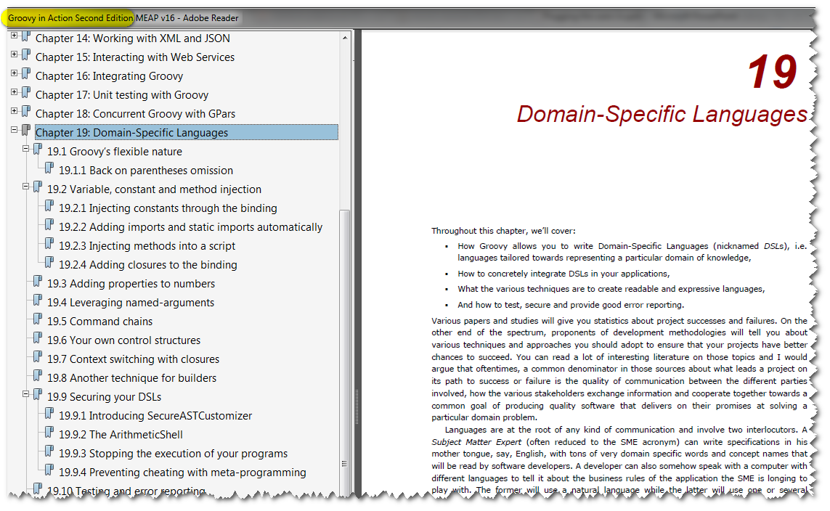

Slide 37
It’s a Range

Slide 38
It’s a Range
Small helpers

Slide 39
It’s a Range
Small helpers
Totally new language

Slide 40
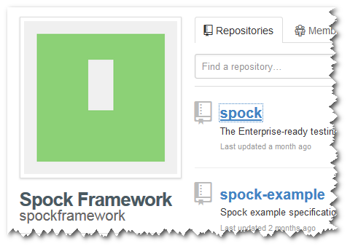
It’s a Range
Small helpers
Totally new language

Slide 41
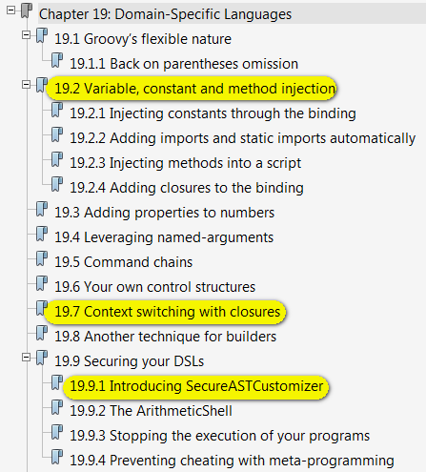

Slide 42
It’s a Range
Small helpers
Totally new language

Slide 43
ImportCustomizer

Slide 44
<3

Slide 45
Parse groovy scripts
Create closure objects
Cast to SAM
Find SAMs in classpath
SAMs map
Cast to Closure
Execute

Slide 46
Implementation
Show me the code!

Slide 47
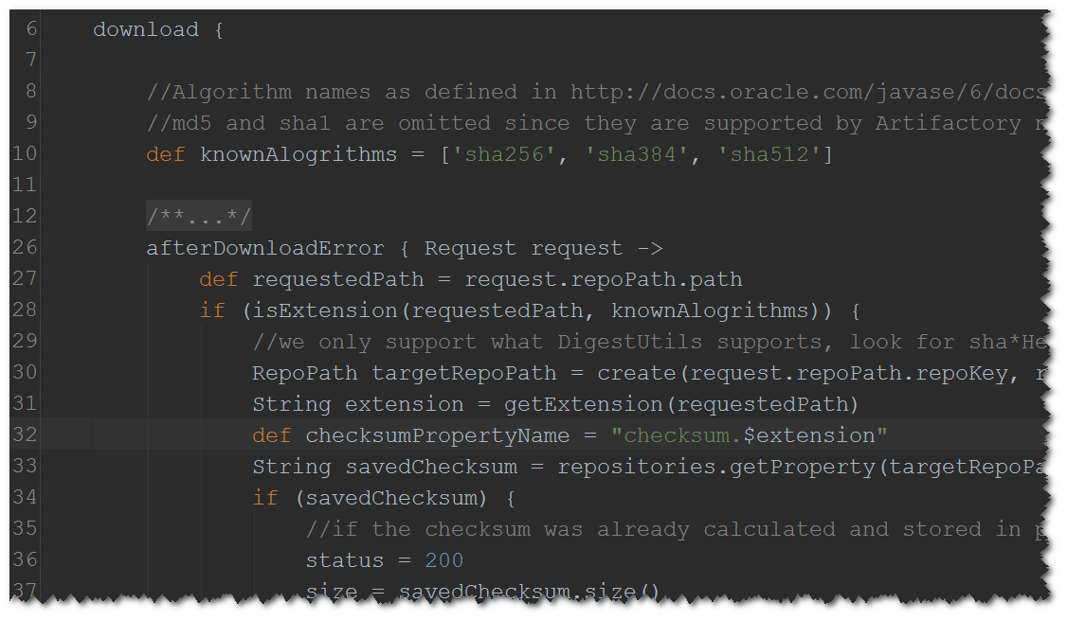
Event Listeners – Named

Slide 48
Notify Listeners, Analyze Response

Slide 49
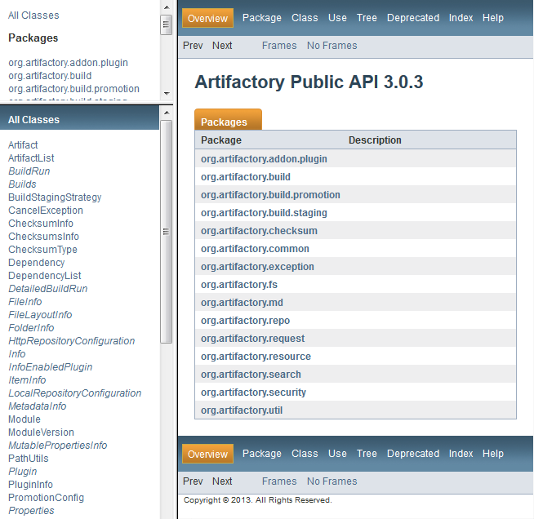
Public API

Slide 50
Public API Design

Slide 51
Public API Design
Papi is contract

Slide 52
Public API Design
Papi is contract
Maintain backwards compatibility at all costs

Slide 53
Public API Design
Papi is contract
Maintain backwards compatibility at all costs
Breaking API might crash the server!

Slide 54
Public API Design
Papi is contract
Maintain backwards compatibility at all costs
Breaking API might crash the server!
Start small

Slide 55
Public API Design
Maintain backwards compatibility at all costs
Breaking API might crash the server!
Start small
Listen to users

Slide 56
Public API Design
compatibility at all costs
Breaking API might crash the server!
Start small
Listen to users
Fluent API is your friend

Slide 57
Public API Design
Breaking API might crash the server!
Start small
Listen to users
Fluent API is your friend
Strong Java Types, compatibility

Slide 58
Implementation
Show me the code!

Slide 62
It’s their server!

Slide 63
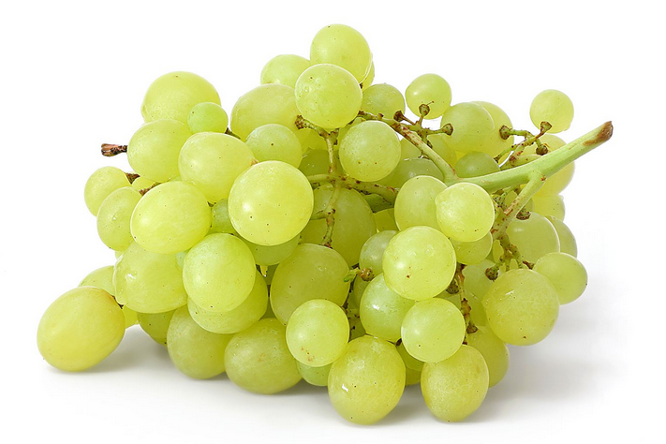
Plugin Dependencies

Slide 64
Plugin Dependencies

Slide 65
The conflict

Slide 66
The conflict
Need to access Artifactory jars (PAPI)

Slide 67
The conflict
Need to access Artifactory jars (PAPI)
Need to be isolated from Artifactory jars (3rd party)

Slide 70
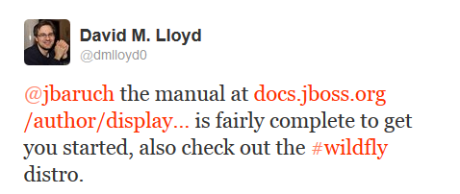
JBoss modules

Slide 71
JBoss modules

Slide 72
We’ll do it ourselves!

Slide 73
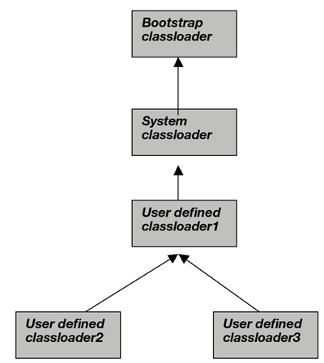

Slide 74
We’ll do it ourselves!
Pull up what’s common

Slide 75
We’ll do it ourselves!
Pull up what’s common
isolate the rest

Slide 76
We’ll do it ourselves!
Pull up what’s common
isolate the rest

Slide 77
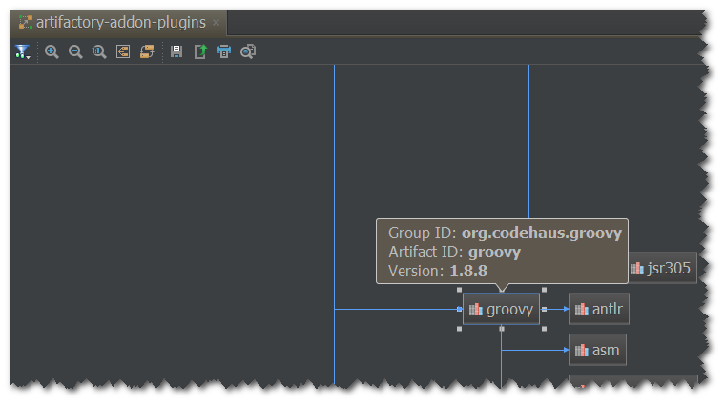

Slide 78
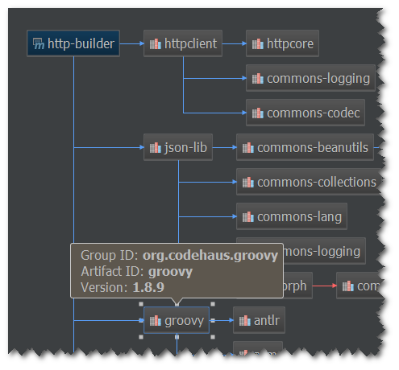

Slide 80
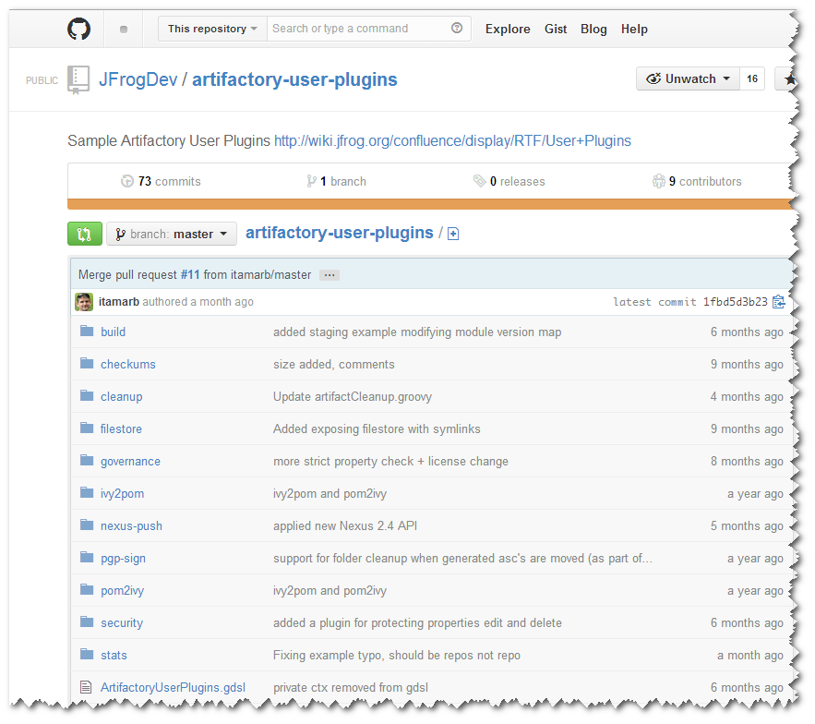
Results

Slide 81
No, thank you!

