Slide 1
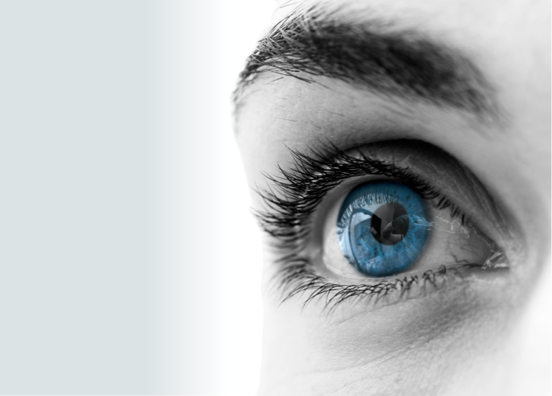
From a certain
point of view
Eye tracking with Java
Gerrit Grunwald
Java Technology Evangelist
Oracle
Simon Ritter
Head of Java Technology Evangelism
Oracle

Slide 2
Notes:
This is a Safe Harbor Front slide, one of two Safe Harbor Statement slides included in this template.
One of the Safe Harbor slides must be used if your presentation covers material affected by Oracle’s Revenue Recognition Policy
To learn more about this policy, e-mail: Revrec-americasiebc_us@oracle.com
For internal communication, Safe Harbor Statements are not required. However, there is an applicable disclaimer (Exhibit E) that should be used, found in the Oracle Revenue Recognition Policy for Future Product Communications. Copy and paste this link into a web browser, to find out more information.
http://my.oracle.com/site/fin/gfo/GlobalProcesses/cnt452504.pdf
For all external communications such as press release, roadmaps, PowerPoint presentations, Safe Harbor Statements are required. You can refer to the link mentioned above to find out additional information/disclaimers required depending on your audience.

Slide 3
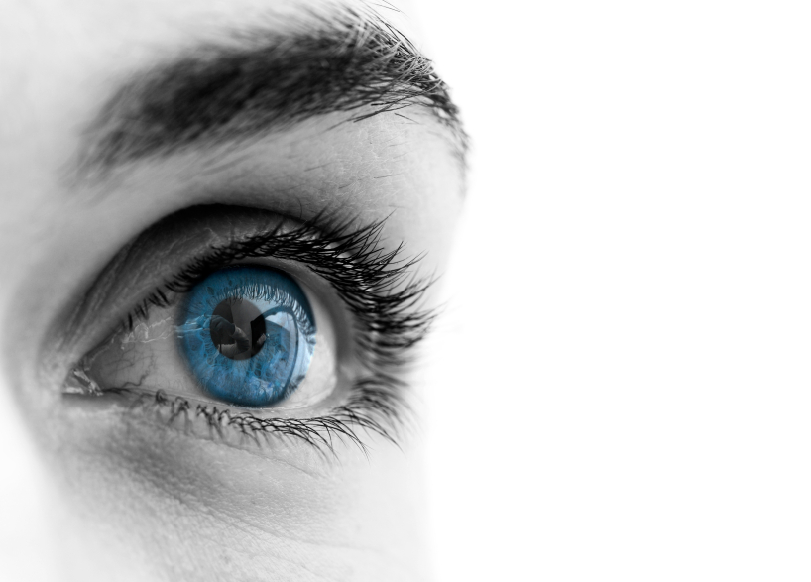
1
Human Machine Interaction
Eye tracking
TheEyeTribe
Java and Eye tracking
Demos
2
3
4
5

Slide 4
1
Human Machine Interaction
Eye Tracking
TheEyeTribe
Java and Eye tracking
Demos
2
3
4
5

Slide 5
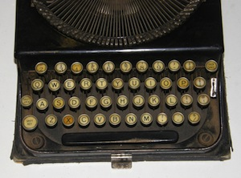
How It All Started

Slide 6
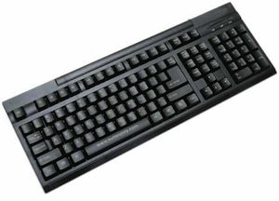
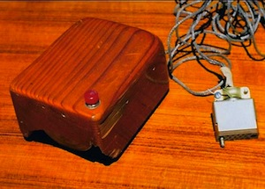
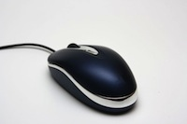
Progress Was Made…

Slide 7
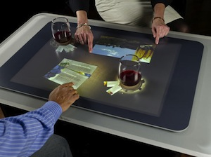
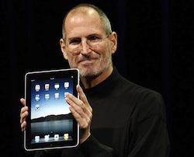
Multi-Touch Has Become Popular

Slide 8
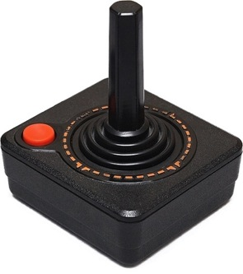
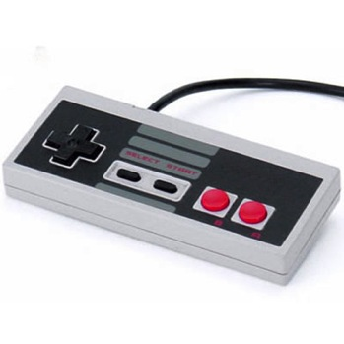
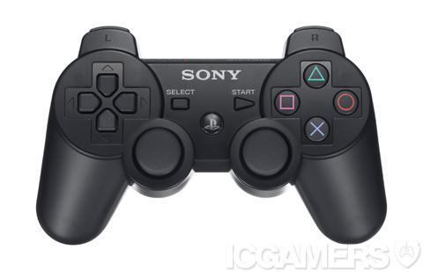
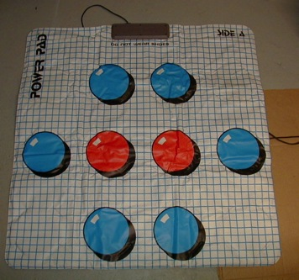
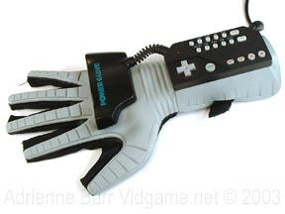
Gaming Has Driven Several Interfaces

Slide 9
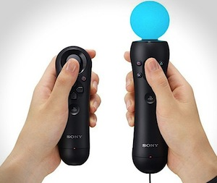
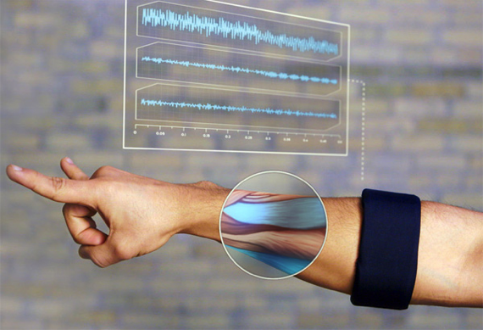
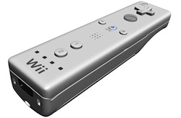
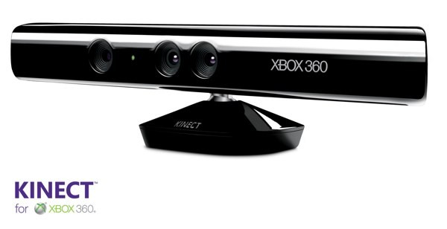
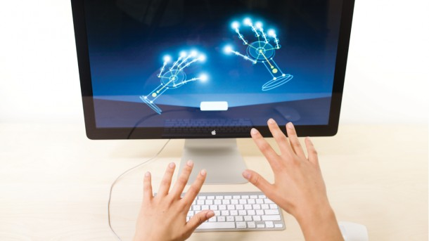
Gestures Rather Than Touch…

Slide 10
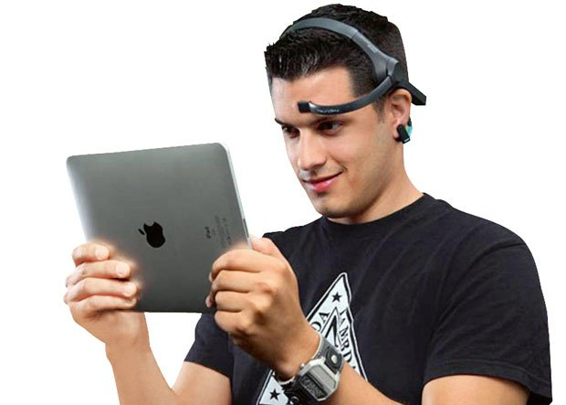
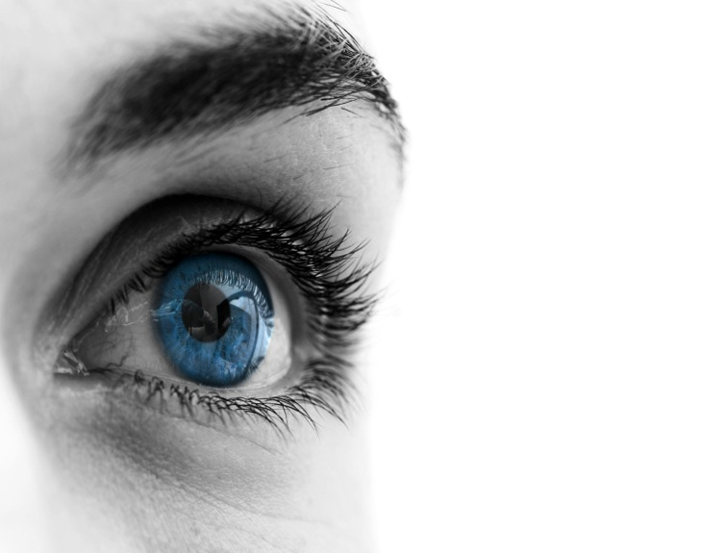
Interactions Without Hands

Slide 11
1
Human Machine Interaction
Eye Tracking
TheEyeTribe
Java and Eye tracking
Demos
2
3
4
5

Slide 12
“Eye tracking is the process of measuring either the point of gaze or the motion of an eye relative to the head.”
Wikipedia
Notes:
This is a Quote with Picture slide ideal for including a picture with a brief quotation and attribution.
To Replace the Picture on this sample slide (this applies to all slides in this template that contain replaceable pictures)
Select the sample picture and press Delete. Click the icon inside the shape to open the Insert Picture dialog box. Navigate to the location where the picture is stored, select desired picture and click on the Insert button to fit the image proportionally within the shape.
Note: Do not right-click the image to change the picture inside the picture placeholder. This will change the frame size of the picture placeholder. Instead, follow the steps outlined above.

Slide 13
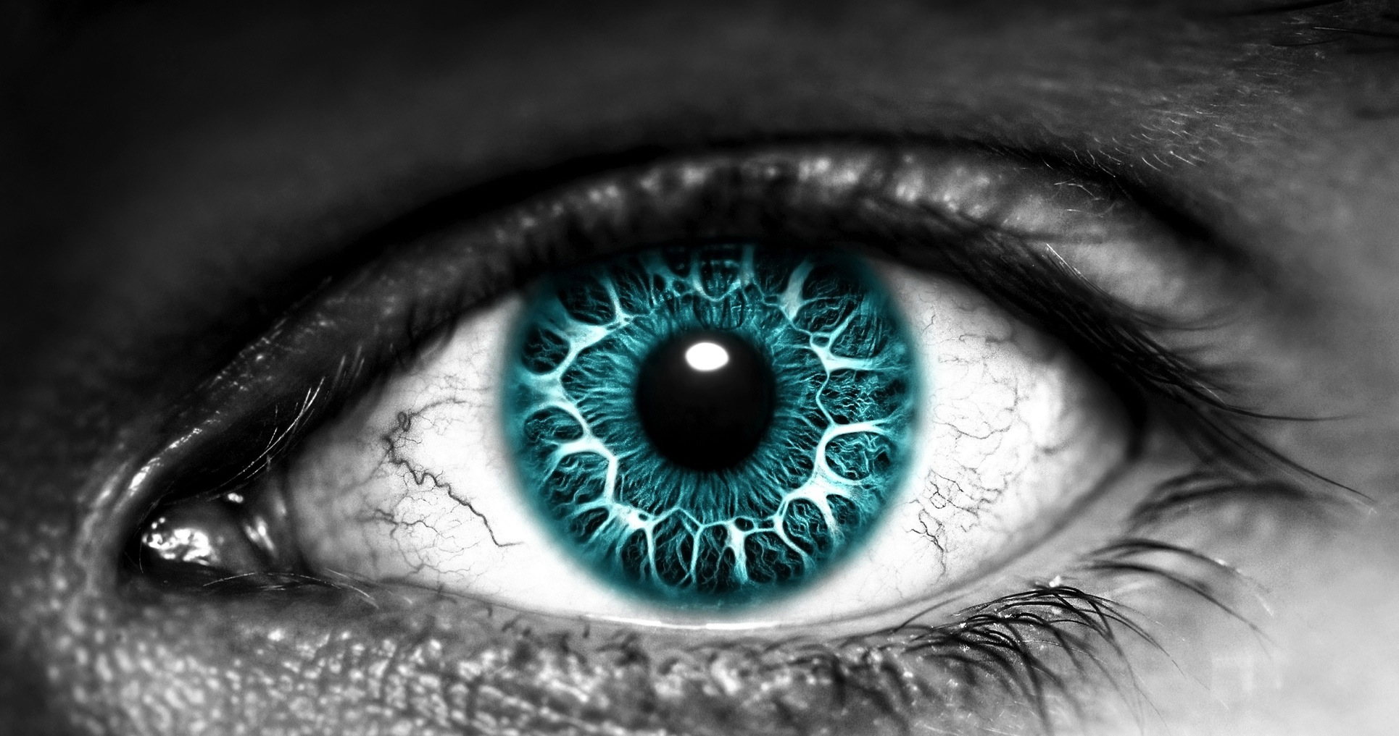
80%
The eyes are the windows to the soul
Of the stimuli that reach the brain are visual
Notes:
This is a sample Metric with Picture slide ideal for including a picture with a large metric and statement, to emphasize a percentage or figure for impact.
To customize this slide with your own picture:
Right-click the slide area and choose Format Background from the pop-up menu. From the Fill menu, click Picture and texture fill. Under Insert from: click File. Locate your new picture and click Insert.
To copy the Customized Background from Another Presentation on PC
Click New Slide from the Home tab's Slides group and select Reuse Slides.
Click Browse in the Reuse Slides panel and select Browse Files. Double-click the PowerPoint presentation that contains the background you wish to copy.
Check Keep Source Formatting and click the slide that contains the background you want.
Click the left-hand slide preview to which you wish to apply the new master layout.
Apply New Layout (Important): Right-click any selected slide, point to Layout, and click the slide containing the desired layout from the layout gallery.
Delete any unwanted slides or duplicates.
To copy the Customized Background from Another Presentation on Mac
Click New Slide from the Home tab's Slides group and select Insert Slides from Other Presentation…
Navigate to the PowerPoint presentation file that contains the background you wish to copy. Double-click or press Insert. This prompts the Slide Finder dialogue box.
Make sure Keep design of original slides is unchecked and click the slide(s) that contains the background you want. Hold Shift key to select multiple slides.
Click the left-hand slide preview to which you wish to apply the new master layout.
Apply New Layout (Important): Click Layout from the Home tab's Slides group, and click the slide containing the desired layout from the layout gallery.
Delete any unwanted slides or duplicates.

Slide 14
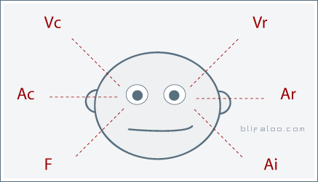
Eyes Give Clues When Answering Questions
Visually Constructed
Visually Remembered
Auditory Constructed
Auditory Remembered
Feeling/Kinesthetic
Internal Dialog
This is for a right-handed person. Positions reversed if left-handed

Slide 15
Where to use it ?

Slide 16
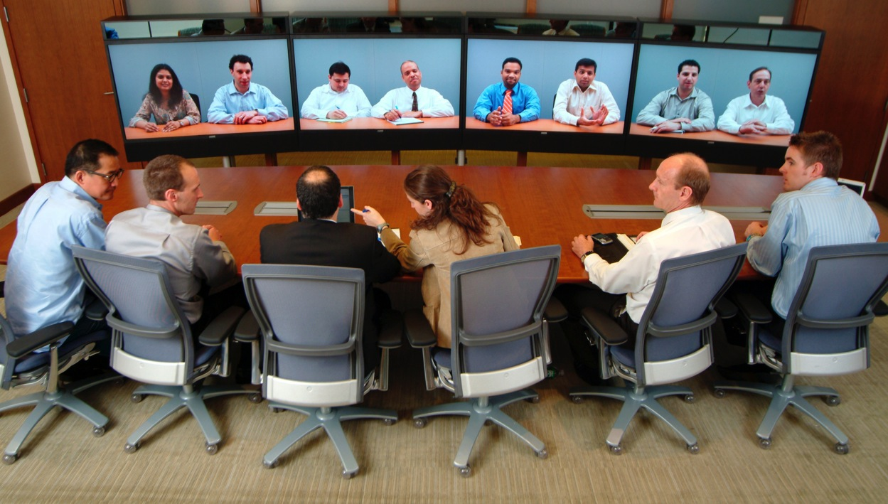
Eye gaze correction for video conferencing

Slide 17
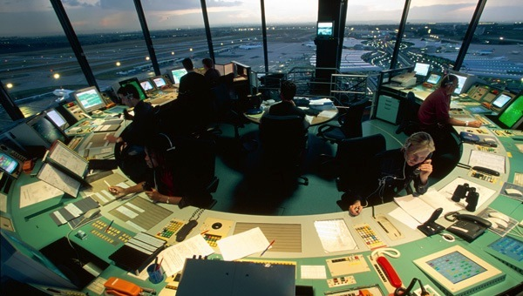
Minimize dangers in air traffic displays

Slide 18
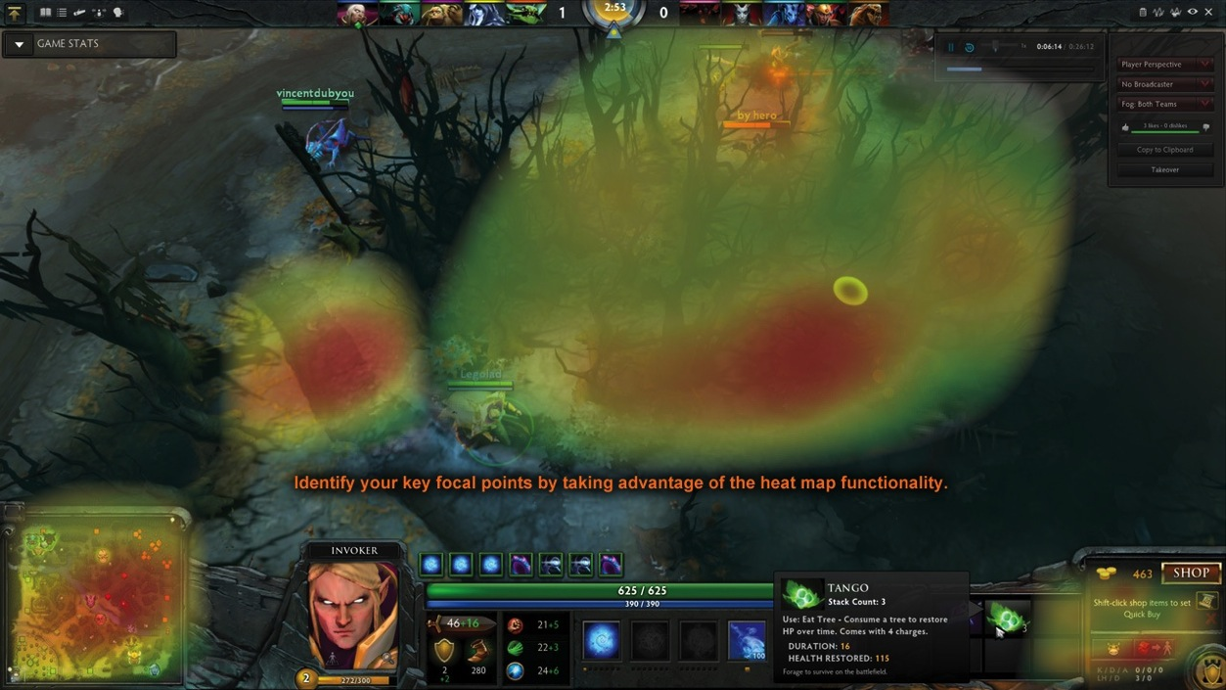
Developing Video Games and Graphics

Slide 19
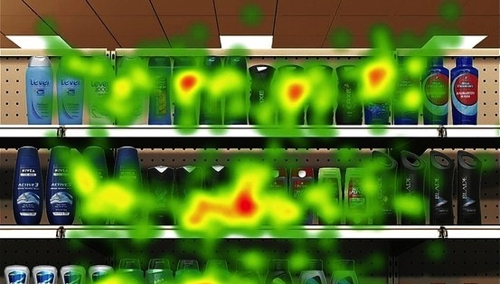
Marketing and E-Commerce website development

Slide 20
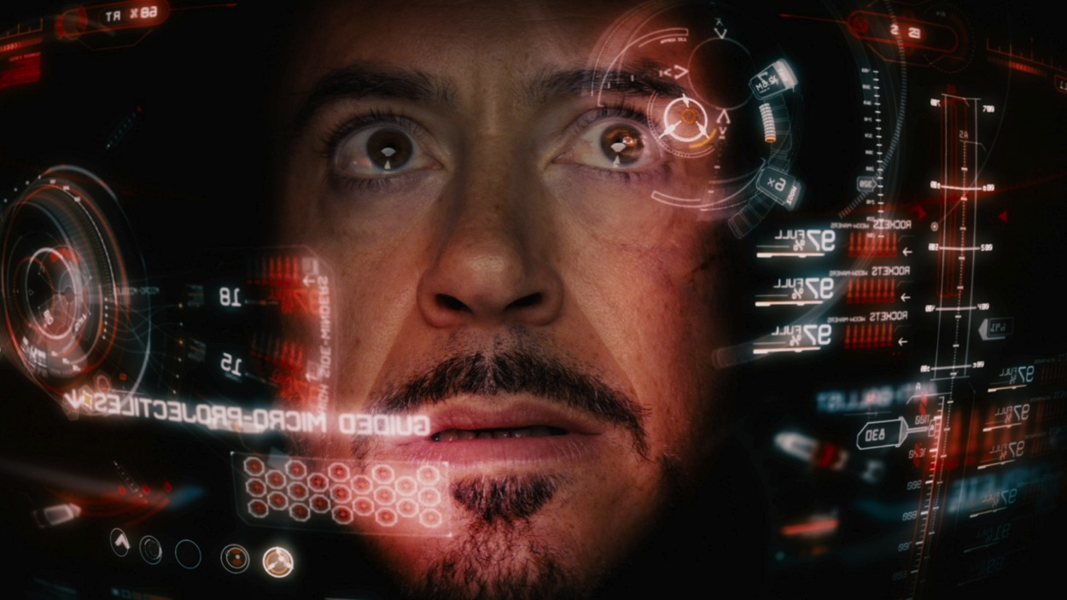
Improved computer-human interaction

Slide 21
What can it do ?

Slide 22
Capabilities
Determine whether a user is looking at the screen
Paying attention to course, video, etc
If a user is reading or scanning
Speed of movement of the eyes over text
Intensity of user’s attention
How long they look ata aprticular thing
Whether the user is searching for specific information

Slide 23
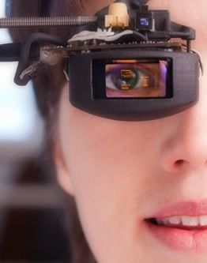
Types of Eye Trackers
Eye attached tracking
Electric potential measurement
Optical tracking

Slide 24
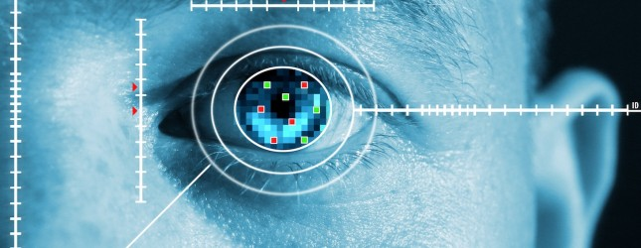
Eye attached tracking
Special contact lense with embedded mirror or sensor (magnetic search coils)
Very precise
Allows measurement in horizontal, vertical and torsion directions
Expensive

Slide 25
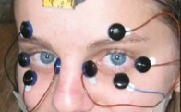
Electric potential measurement
Measures electric potential field of eyes
Can measure eye movement even if eyes are closed
Wearable method
also used in sleep research
Relatively poor accuracy in gaze direction detection
Expensive

Slide 26
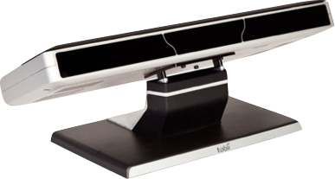
Optical tracking
Measures reflection of IR light from the front of the cornea
Contactless method
Good for fast and slow eye movements
Inexpensive

Slide 27
Optical Eye Tracking Principle

Slide 28
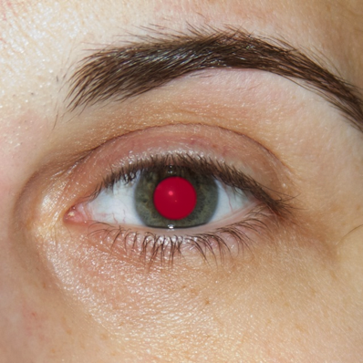
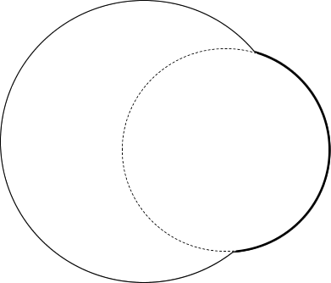
Optical Eye Tracking Principle
Cornea
Eye Tracker
Reflected IR-Light
Eyeball
IR-Light emission

Slide 29
1
Human Machine Interaction
Eye Tracking
TheEyeTribe
Java and Eye tracking
Demos
2
3
4
5

Slide 30
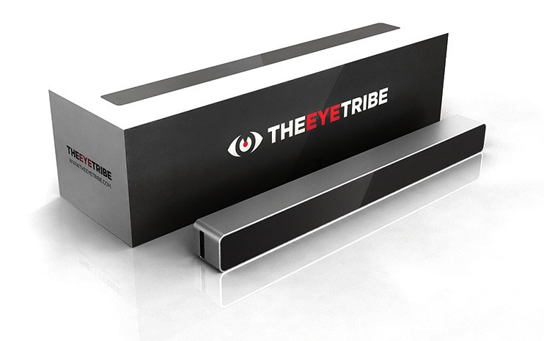
TheEyeTribe
Notes:
This is a Announcement slide ideal for including a picture and partner or product logo with a brief title and subtitle or description.
To Replace the Picture on this sample slide (this applies to all slides in this template that contain replaceable pictures)
Select the sample picture and press Delete. Click the icon inside the shape to open the Insert Picture dialog box. Navigate to the location where the picture is stored, select desired picture and click on the Insert button to fit the image proportionally within the shape.
Note: Do not right-click the image to change the picture inside the picture placeholder. This will change the frame size of the picture placeholder. Instead, follow the steps outlined above.
To Replace the LOGO on this sample slide:
Right-click the sample LOGO and choose Change Picture. Navigate to the location where the new logo is stored, select desired logo file and click on the Open button to replace the sample logo.

Slide 31
TheEyeTribe
Sampling rate
Accuracy
Latency
Operating range
Tracking area
Screen sizes
Support for
Connection
30 Hz and 60 Hz
0.5° - 1°
< 20ms at 60 Hz
45 cm - 75 cm
40 cm x 30 cm at 65 cm
up to 24"
C++, C# and Java
USB 3.0

Slide 32
TheEyeTribe
External applications (e.g. Java program)
APPLICATION
Language spec. wrappers (C++, Java etc.)
SDK
Open API
The eye tracking process.
Initializes device(s), frameworks,
servers etc.
No GUI - output goes through API
NETWORK
EyeTribe SERVER
HW
TRACKER

Slide 33
1
Human Machine Interaction
Eye Tracking
TheEyeTribe
Java and Eye tracking
Demos
2
3
4
5

Slide 34
Java and Eye Tracking
import com.theeyetribe.client.*;
public enum EyeTracker implements IGazeListener {
INSTANCE;
private GazeData gazeData;
…
private EyeTracker {
init();
initBuffers();
initEyeTracker();
timer.start();
}
private void init() {…};
private void initBuffers() {…};
}
Java package

Slide 35
Java and Eye Tracking
import com.theeyetribe.client.*;
public enum EyeTracker implements IGazeListener {
INSTANCE;
private GazeData gazeData;
…
private EyeTracker {
init();
initBuffers();
initEyeTracker();
timer.start();
}
private void init() {…};
private void initBuffers() {…};
implement Interface

Slide 36
Java and Eye Tracking
import com.theeyetribe.client.*;
public enum EyeTracker implements IGazeListener {
INSTANCE;
private GazeData gazeData;
…
private EyeTracker {
init();
initBuffers();
initEyeTracker();
timer.start();
}
private void init() {…};
private void initBuffers() {…};
}
initialize EyeTracker

Slide 37
Java and Eye Tracking
private void initEyeTracker() {
GazeManager.getInstance().activate(GazeManager.ApiVersion.VERSION_1_0,
GazeManager.ClientMode.PUSH);
}
initialize EyeTracker

Slide 38
Java and Eye Tracking
public void start() {
if (running.get()) return;
running.set(true);
GazeManager.getInstance().addGazeListener(this);
timer.start();
}
start EyeTracker

Slide 39
Java and Eye Tracking
@Override public void onGazeUpdate(final GazeData GAZE_DATA) {
gazeData = GAZE_DATA;
xBuffer.remove();
yBuffer.remove();
xBuffer.addLast(gazeData.smoothedCoordinates.x);
yBuffer.addLast(gazeData.smoothedCoordinates.y);
xAvg = xBuffer.stream().mapToDouble((x) -> x).average();
yAvg = yBuffer.stream().mapToDouble((y) -> y).average();
}
get Gaze data

Slide 40
Java and Eye Tracking
public void stop() {
GazeManager.getInstance().removeGazeListener(EyeTracker.this);
GazeManager.getInstance().deactivate();
}
stop EyeTracker

Slide 41
What data do you get ?

Slide 42
Gaze Data delivered in frames…

Slide 43
Gaze data
Tracking state
State of the eye and gaze tracking process. (e.g. Person in field of view)
Fixation
If the tracked gaze is currently fixated, the frame will contain that information
Gaze Coordinates
The point on screen (pixels) that the user is currently looking at. (Needs calibration)
Pupil coordinates
The position of a tracked persons pupil relative to the Tracker sensor

Slide 44
Problem…

Slide 45
Problem…SPEED

Slide 46
Problem…SPEED
timer = new AnimationTimer() {
@Override public void handle(final long now) {
if (now > lastTimerCall + UPDATE_INTERVAL) {
if (null == gazeData) return;
focusPoint.set(new Point2D(xAvg.getAsDouble(), yAvg.getAsDouble()));
eventCounter++;
leftEyeOpen.set(gazeData.leftEye.pupilSize > 0);
rightEyeOpen.set(gazeData.rightEye.pupilSize > 0);
state.set(gazeData.state);
lastTimerCall = NOW;
}
}
};
}
use AnimationTimer to update data in intervals

Slide 47
Conclusions And Resources
Eye tracking provides a useful and different way to interact with a UI
Control is hard, tracking a user’s interaction is easier
Many potential applications
Helping the physically challenged
Reducing potential problems in critical systems
www.eyetribe.com
dev.eyetribe.com/java

Slide 48
1
Human Machine Interaction
Eye Tracking
TheEyeTribe
Java and Eye tracking
Demos
2
3
4
5

