Slide 1
The Groovy Puzzlers
As usual - Traps, Pitfalls, and End Cases

Slide 2
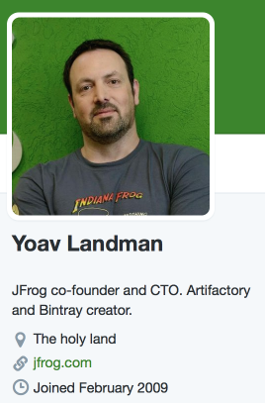
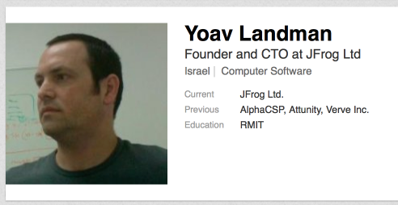
About your speaker
@_yoav_
https://github.com/yoav

Slide 3
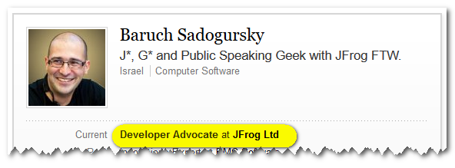
Who we are?
@jbaruch
github.com/jbaruch
linkd.in/jbaruch
stackoverflow.com/users/402053/jbaruch
Notes:
CURRENT – JB
NEXT - FRED

Slide 4
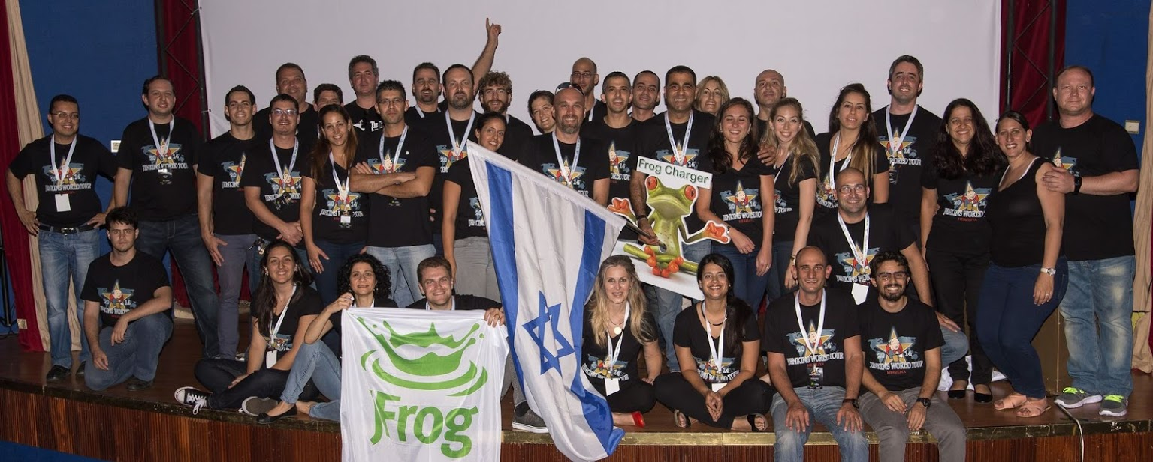
What Frog?
Notes:
CURRENT – JB
NEXT - FRED

Slide 5
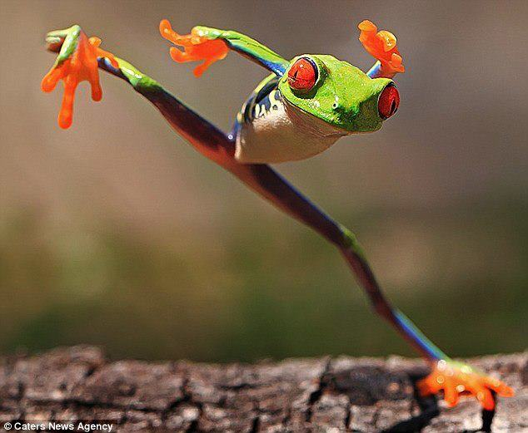
What Frog?
Notes:
CURRENT – JB
NEXT - FRED

Slide 6
What Frog?
Notes:
CURRENT – JB
NEXT - FRED

Slide 7
What Frog?
Notes:
CURRENT – JB
NEXT - FRED

Slide 8
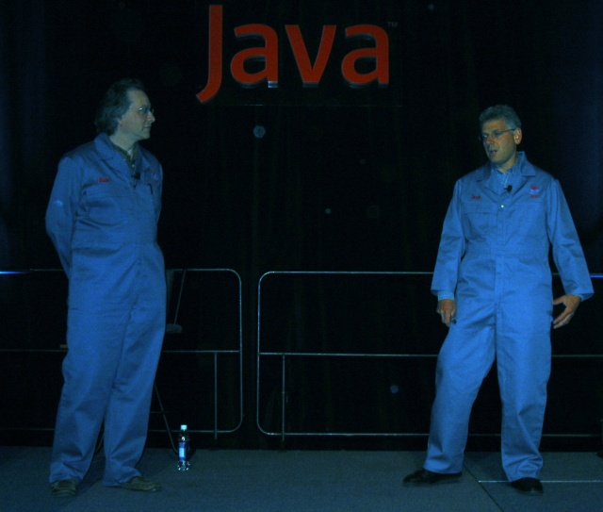
Click and hack
the typing brothers
Notes:
CURRENT – JB
NEXT - FRED
2001 OracleWorld: Joshua Bloch, Neal Gafter

Slide 9
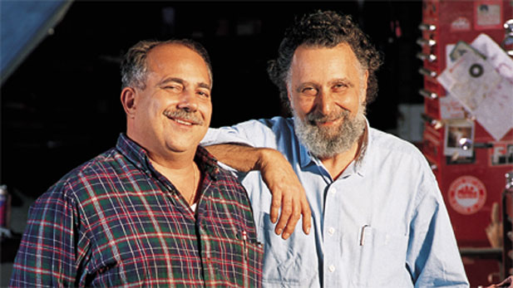
BTW…
Notes:
CURRENT – JB
NEXT - FRED
The Car Show (1977-2012) Click and Clack, the Tappet Brothers - Tom and Ray Magliozzi

Slide 10
Two entertaining guys on stage
Funny Puzzling questions
You think and vote
Lots of T-shirts flying in the air
Official twitter handle! groovypuzzlers
Notes:
CURRENT – JB
NEXT - FRED

Slide 11
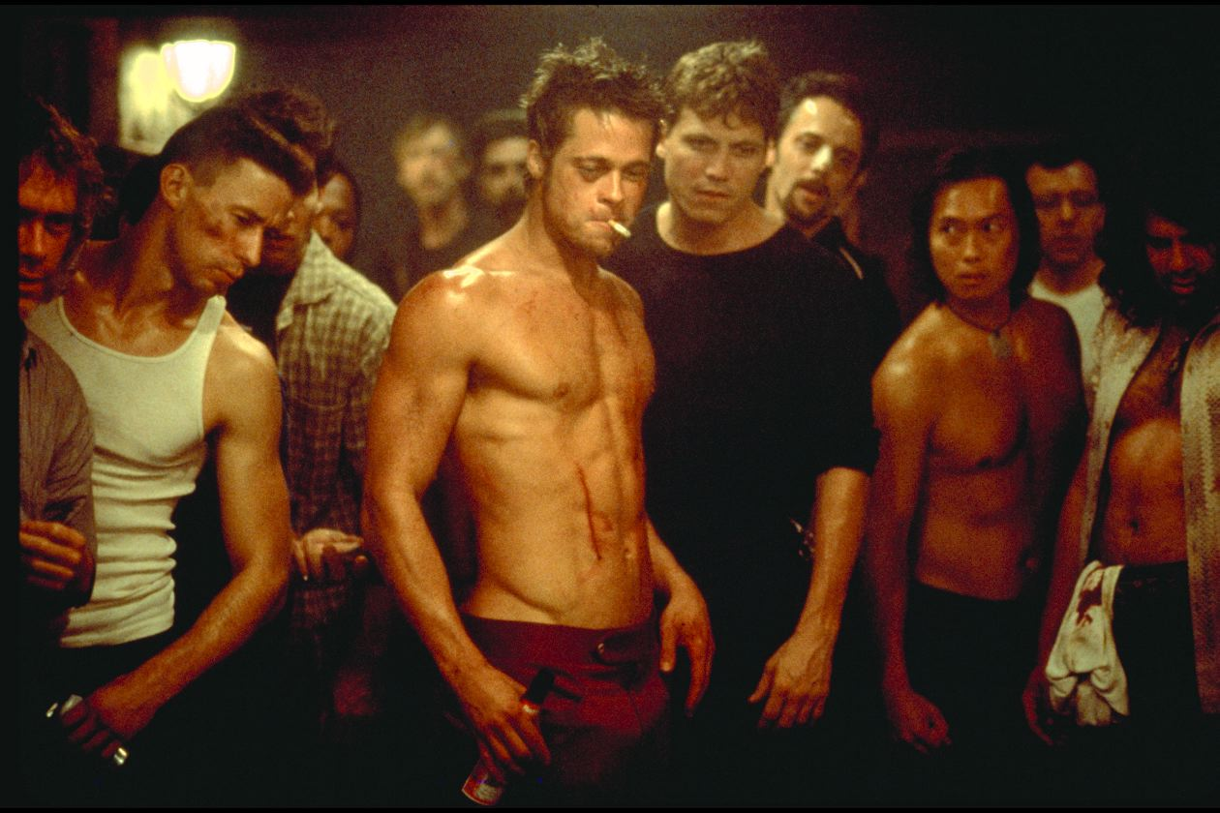
First rule of the puzzlers:
No cheating!
Notes:
CURRENT – JB
NEXT - FRED

Slide 12
First rule of the puzzlers:
Cédric?!
No cheating!
Notes:
CURRENT – JB
NEXT - FRED

Slide 13
Consider the puzzlers correct as of 2.3.7
Notes:
CURRENT – JB
NEXT - FRED

Slide 14
Notes:
CURRENT – JB
NEXT - FRED

Slide 15
Notes:
CURRENT – FRED
NEXT - FRED

Slide 16
class Conference {def name; def year} def gr = new Conference(name: 'Greach', year: 2014) gr.each {println it}
class=class Conference name=Greach year=2014
Conference@XXXXXX
Startup failure
Greach 2014
Notes:
CURRENT – FRED
NEXT - FRED

Slide 17
Not exactly iteration, is it?
Notes:
CURRENT – FRED
NEXT - FRED

Slide 18
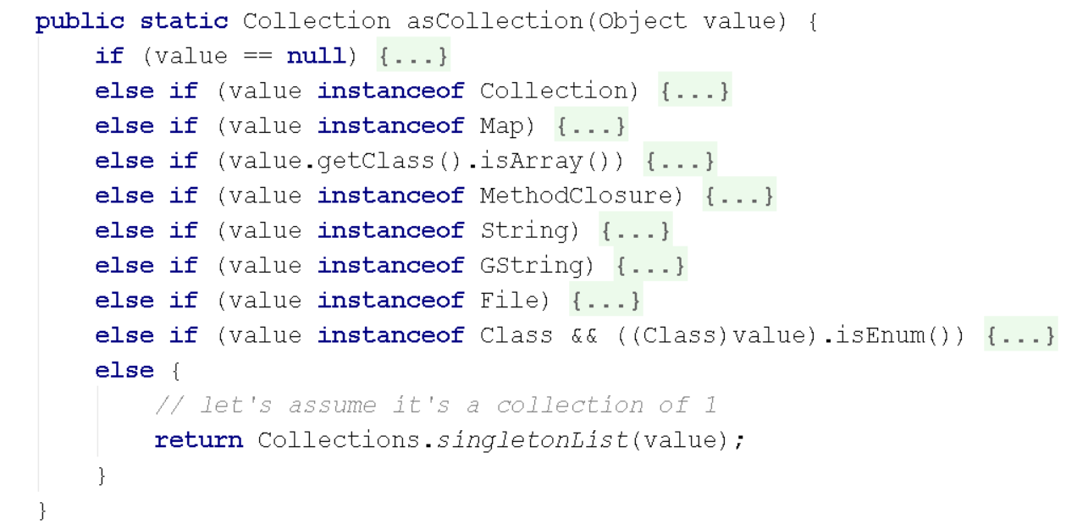
RTFS (Read the F***ing source)!
Notes:
CURRENT – FRED
NEXT - FRED

Slide 19
Absolutely Groovy
Notes:
CURRENT – FRED
NEXT - JB

Slide 20
-3.abs()
3
NoSuchMethodError
-3
Execution Failure
Notes:
CURRENT – FRED
NEXT - JB

Slide 21
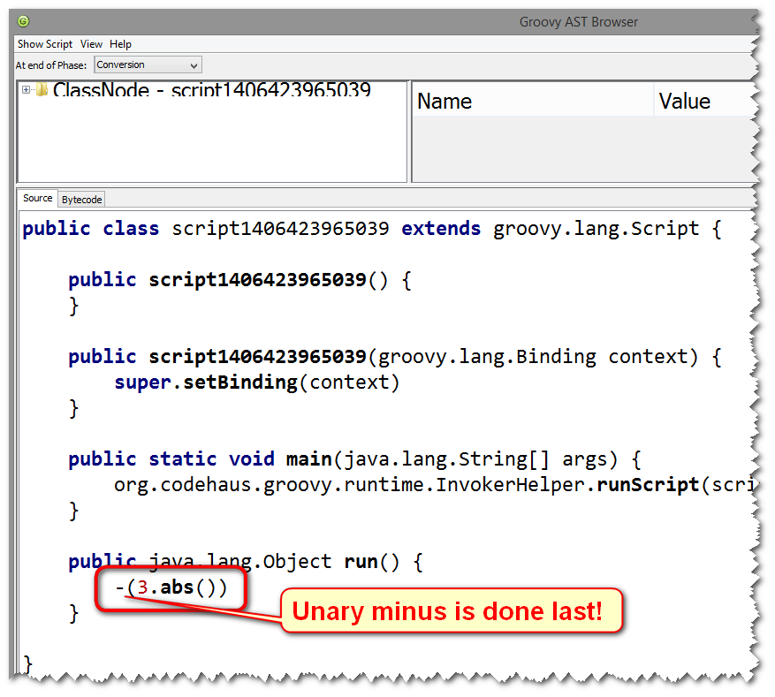
Notes:
CURRENT – FRED
NEXT - JB

Slide 22
Fix is simple
(-3).abs()
or
int value = -3 value.abs()
Notes:
CURRENT – FRED
NEXT - JB

Slide 23
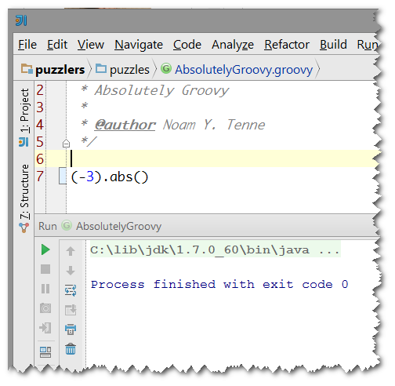
My idea prints nothing when I copy paste this code. What gives?
Notes:
CURRENT – FRED
NEXT - JB

Slide 24
Println for the rescue!
println (-3).abs()
-3
3
3 and NullPointerException
-3 and NullPointerException
Notes:
CURRENT – FRED
NEXT - JB

Slide 25
Notes:
CURRENT – FRED
NEXT - JB

Slide 26
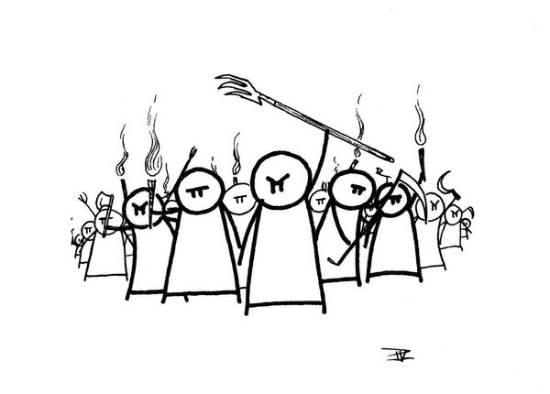
Delete all parentheses!
Compiler will figure it out!
Notes:
CURRENT – FRED
NEXT - JB

Slide 27
println (-3).abs()
-3
Caught: java.lang.NullPointerException: Cannot invoke method abs() on null object
java.lang.NullPointerException: Cannot invoke method abs() on null object
at AbsolutelyGroovy.run(AbsolutelyGroovy.groovy:7)
at com.intellij.rt.execution.application.AppMain.main(AppMain.java:134)
Notes:
CURRENT – FRED
NEXT - JB

Slide 28
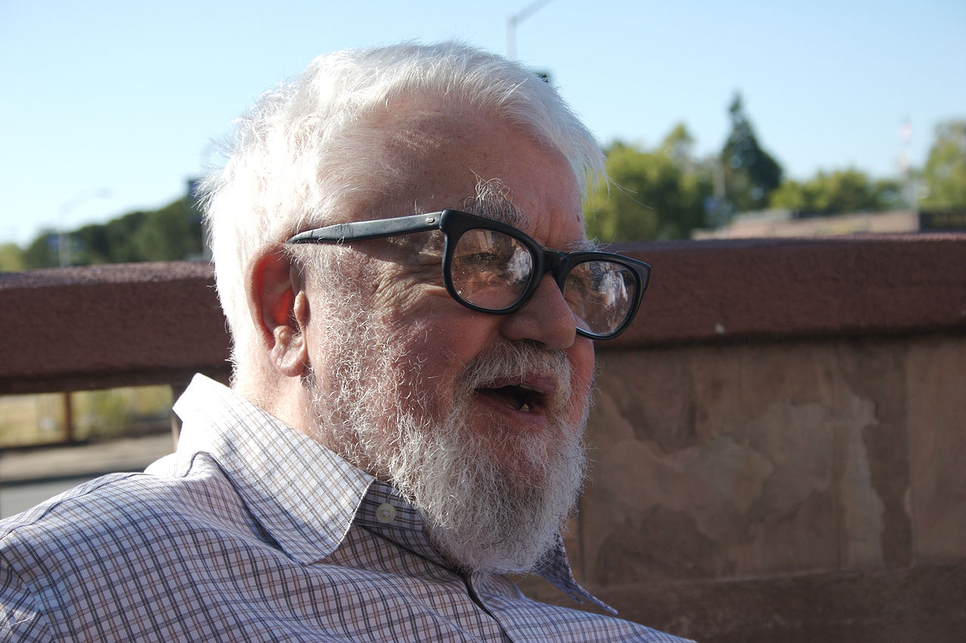
“All problems in computer science can be solved by another pair of parentheses”
John McCarthy, the inventor of LISP
Notes:
CURRENT – FRED
NEXT - JB

Slide 29
Just Throw in some more parentheses!
println ((-3).abs())
or
int value = -3 println value.abs()
Notes:
CURRENT – FRED
NEXT - JB

Slide 30
And the t-shirt goes to…
Notes:
CURRENT – FRED
NEXT - JB

Slide 31
Max power
Notes:
CURRENT – JB
NEXT - FRED

Slide 32
Max power
List<Integer> list = [56, '9', 74] def max = list.max { item -> (item < 50) ? item : null } println max
Notes:
CURRENT – JB
NEXT - FRED

Slide 33
List<Integer> list = [56, '9', 74] def max = list.max { item -> (item < 50) ? item : null } println max
ClassCastException
9
56
null
Notes:
CURRENT – JB
NEXT - FRED

Slide 34
Tricky, but I got it!
>groovysh (('9' as Character) as Integer)
===> 57
Notes:
CURRENT – JB
NEXT - FRED

Slide 35
List<Integer> list = [56, 57, 74] def max = list.max { item -> (item < 50) ? item : null } println max
Notes:
CURRENT – JB
NEXT - FRED

Slide 36
Hmm, now they all null?!
Notes:
CURRENT – JB
NEXT - FRED

Slide 37
List<Integer> list = [56, '9', 74] def max = list.max { item -> (item < 50) ? item : null } println max
ClassCastException
9
56
null
Notes:
CURRENT – JB
NEXT - FRED

Slide 38
Notes:
CURRENT – JB
NEXT - FRED

Slide 39
What the hell happened?!
def random = new Random() def randomList = [] 0..10.each {randomList << random.nextInt()} assert randomList.max{ null } == randomList[0]
Notes:
CURRENT – JB
NEXT - FRED

Slide 40
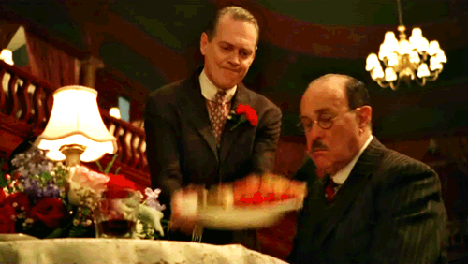
BAD default, no contract
Notes:
CURRENT – JB
NEXT - FRED

Slide 41
Why so primitive?
Notes:
CURRENT – FRED
NEXT - JB

Slide 42
Why so primitive?
def x = int println x if ((x = long)) { println x } if (x = boolean ) { println x }
Notes:
CURRENT – FRED
NEXT - JB

Slide 43
Why so primitive?
def x = int println x if ((x = long)) { println x } if (x = boolean ) { println x }
Startup Error
int, long, boolean
java.lang.Integer, java.lang.Long, java.lang.Boolean
int
Notes:
CURRENT – FRED
NEXT - JB

Slide 44
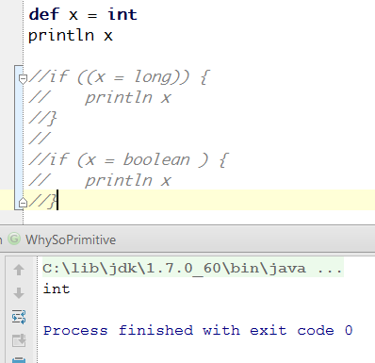
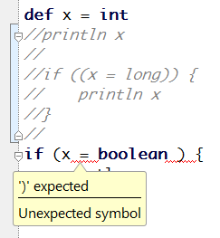
That was easy. But why?
That’s OK
That’s not OK
Notes:
CURRENT – FRED
NEXT - JB

Slide 45
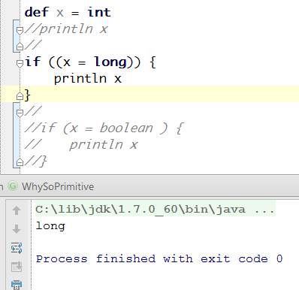
How about that:
Notes:
CURRENT – FRED
NEXT - JB

Slide 46
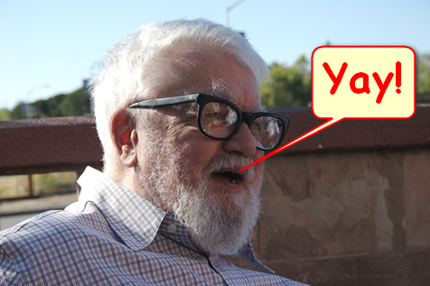
(Groovy) truth can hurt so just parentheses for a rescue (or not)
Notes:
CURRENT – FRED
NEXT - JB

Slide 47
The ghostwriter
All characters appearing in this puzzler are fictitious. Any resemblance to real persons, present or not, is purely coincidental.
Notes:
CURRENT – JB
NEXT - FRED

Slide 48
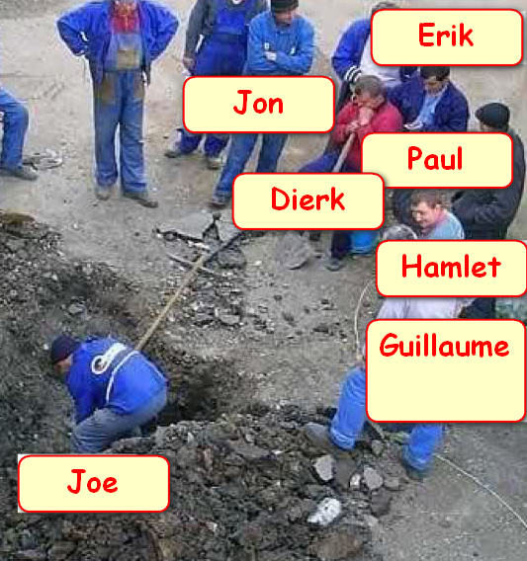
The ghostwriter
Notes:
CURRENT – JB
NEXT - FRED

Slide 49
DierkGuillaumePaulCedricHamletErikJon.groovy
import org.codehaus.groovy.tools.groovydoc.SimpleGroovyDoc as delegate def delegate = new Ghostwriter() println ({ -> delegate.class.simpleName }.call()) class Ghostwriter { String book = '****** in Action, *** Edition' }
Ghostwriter
Startup error
DierkGuillaumePaulCedricHamletErikJon
SimpleGroovyDoc
Notes:
CURRENT – JB
NEXT - FRED

Slide 50
Notes:
CURRENT – JB
NEXT - FRED

Slide 51
DierkGuillaumePaulCedricHamletErikJon.groovy
import org.codehaus.groovy.tools.groovydoc.SimpleGroovyDoc as delegate // def delegate = new Ghostwriter() println ({ -> delegate.class.name }.call()) /* class Ghostwriter { String book = '****** in Action, *** Edition' }*/
Startup error
DierkGuillaumePaulCedricHamletErikJon
SimpleGroovyDoc
Notes:
CURRENT – JB
NEXT - FRED

Slide 52
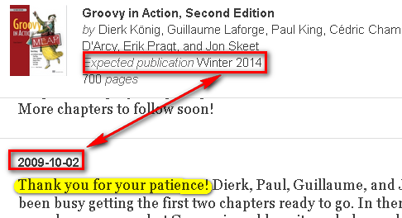
That explains *a lot*
Notes:
CURRENT – JB
NEXT - FRED

Slide 53
Notes:
CURRENT – JB
NEXT - FRED

Slide 54
Whodunit
Notes:
CURRENT – FRED
NEXT - JB

Slide 55
Whodunit
Closure whodunit() { { 'The butler did it.' } }
println whodunit()
NullPointerException
whodunitI_closure1@xxxxxxx
Startup error
The butler did it.
Notes:
CURRENT – FRED
NEXT - JB

Slide 56
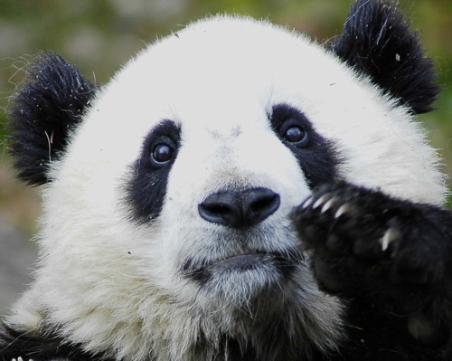
That is very sad.
Notes:
CURRENT – FRED
NEXT - JB

Slide 57
Cheer up, the fix is easy!
Closure whodunit() { { -> 'The butler did it.' } }
Notes:
CURRENT – FRED
NEXT - JB

Slide 58
And the t-shirt goes to…
Notes:
CURRENT – FRED
NEXT - JB

Slide 59
Conclusions

Slide 60
Write readable code
Comment neat tricks
Sometimes it is just a bug
Use static code analysis (intellij IDEA!)
Rtfm
Don’t code like my brother

Slide 61
We have just started! (may end up in proper uniform)
Puzzlers? Gotchas? Fetal position inducing behavior?
puzzlers jfrog.com
Groovypuzzlers

Slide 62
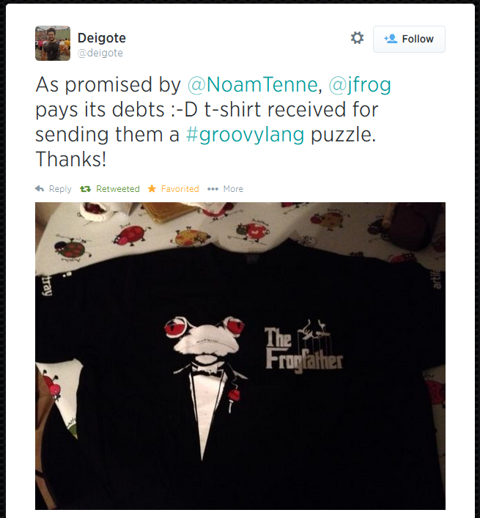
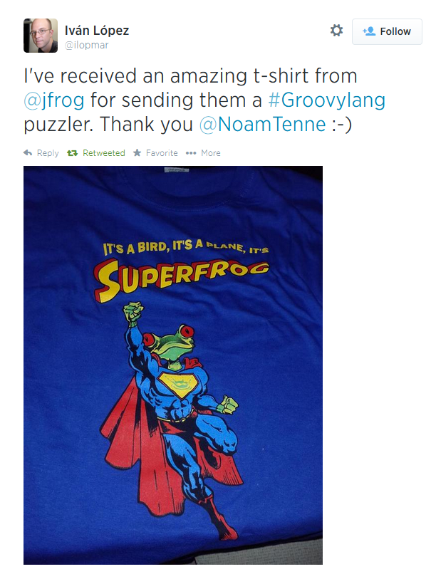
Jfrog always pays its debts

Slide 63
Positive feedback?
Praise us on twitter groovypuzzlers
Groovypuzzlers
freddy33
jbaruch
Negative feeback?
/dev/null

Slide 64
No, Thank you!

