Slide 1
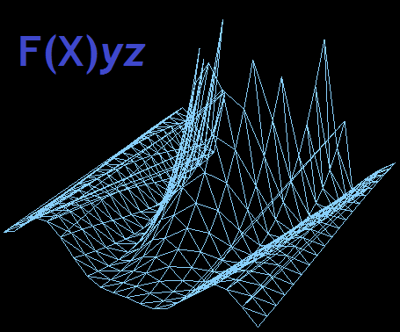


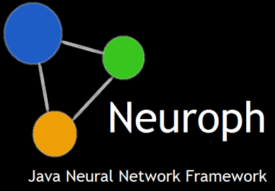

JavaFX 3d
Advanced Application Development

Slide 2
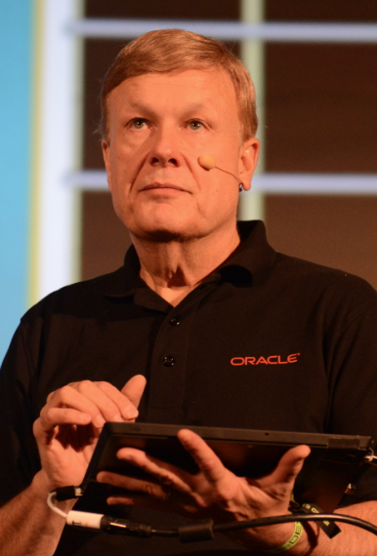
About the presenter
James Weaver
Java Technology Ambassador
Oracle Corporation
Twitter: @JavaFXpert
Email: james.weaver@oracle.com
Notes:
This is a Remote Speaker Picture slide ideal for including a picture with the speaker’s name and title and company.
To Replace the Picture on this sample slide (this applies to all slides in this template that contain replaceable pictures)
Select the sample picture and press Delete. Click the icon inside the shape to open the Insert Picture dialog box. Navigate to the location where the picture is stored, select desired picture and click on the Insert button to fit the image proportionally within the shape.
Note: Do not right-click the image to change the picture inside the picture placeholder. This will change the frame size of the picture placeholder. Instead, follow the steps outlined above.

Slide 3
Neuroph – Java Neural Network Framework
Who Am I
Zoran Sevarac,
Assistant professor at University of Belgrade,
Open Source Software Development Center at UB
Laboratory for Artificial Intelligence
Founder of the http://neuroph.sourceforge.net
Dukes Choice Winner 2013.
Easily build & use neural networks in Java
Used for machine learning tasks like classification, recognition, modeling, approximation etc.
Application domain include: image recognition, OCR, signal processing, face recognition etc.
Provides a set of jars which contain easy to use Java style API
Rich GUI Tools: Neuroph Studio, built on top of NetBeans Platform
(wizards, visual editor & visualization)
Professional support available from Net Link Solutions http://www.netlink.rs

Slide 4
Use Case Neuroph
Java neural network framework http://neuroph.sourceforge.net
Visual tools built for building and analyzing neural networks on top of NetBeans Platform – Neuroph Studio
Visualization of
data
neural network parameters (architecture, weights)
learning process

Slide 5
Visualization API
Purpose: to decouple visualization from specific frameworks, and provide reusable visualization plugins on NetBeans Platform Applications
2D and 3D visualization, static and real time
Types of graphs: histogram, scatter, line, surface
DataProvider2D, DataProvider3D, points, graph factories - Visualization API diagram
DataProvider – ChartFactory - ChartImplementation

Slide 6
Visualization API Usage
MyModel
MyDataProvider3D<Point3D>
Scatter3DFactory<C, P>
C createScatter3D(P[] points)
DataProvider3D<P>
T getData()
JFXScatter3DFactory<JFXPanel, Point3D>
ScatterPlot

Slide 7
Implementations of Visualization API
JFreeChart: 2D Line, Histogram, Scatter
http://www.jfree.org/
Jzy3d: 3D Histogram, 3D Surface, 3D Scatter
http://www.jzy3d.org/
JMonkeyEngine: 3D Real Time histogram, Histogram, 3D RealTime Scatter
http://jmonkeyengine.org/
Java FX FXyz: 3D Histogram, 3D Scatter
http://birdasaur.github.io/FXyz/

Slide 8
Java FX Visualization for Neuroph
Based on FXyz http://birdasaur.github.io/FXyz/
3D Scatter & 3D Histogram
Java FX implementation of the Visualization API
Demo

Slide 9
Summary
Whats good
- really nice looking, smooth graphics
Intuitive and simple API
better API for interacting with objects (compared to jzy3d and JME)
What could be better
- some minor things still missing from API, it feels like not mature enough
More control should be left to end user, while providing default behaviors out of the box
would be nice to have typical default implementations for interacting with graphics using mouse and keyboard out of the box
What about 3D real time visualization using FX?

Slide 10




Deep Space, JavaFX 3D and F(X)yz
Who Am I - Sean Phillips – Founder of F(X)yz, a free open source JavaFX 3D library of useful components
Principle Software Engineer with a.i. solutions, inc. Application Architect for various NASA mission ground systems and visualization software.
Find Me:
https://twitter.com/SeanMiPhillips
http://birdasaur.github.io/FXyz/
http://birdasaur.tumblr.com/
http://netbeans.dzone.com/users/seanmiphillips
Who Are We - a.i. solutions specializes in NASA/U.S. Air Force Ground Systems software and Artificial/Adaptive Intelligence
Mission Design, Analysis and Ground System Development for: LEO/GEO/HEO , Lunar, Libration Point, Deep Space

Slide 11
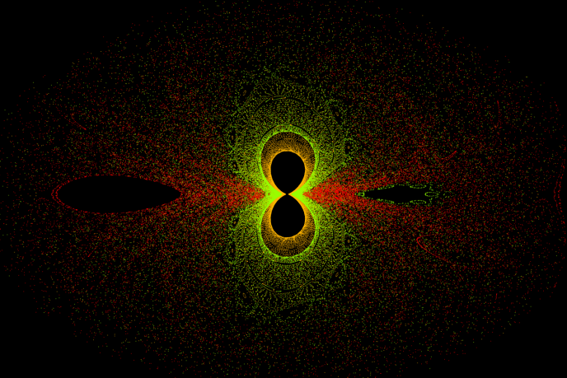
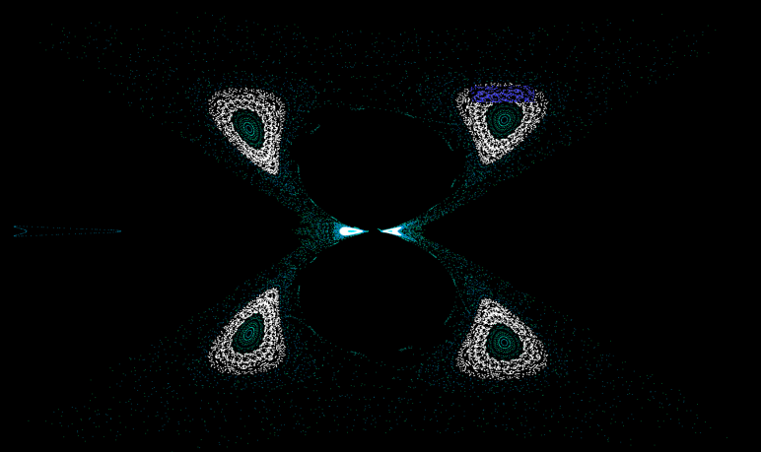
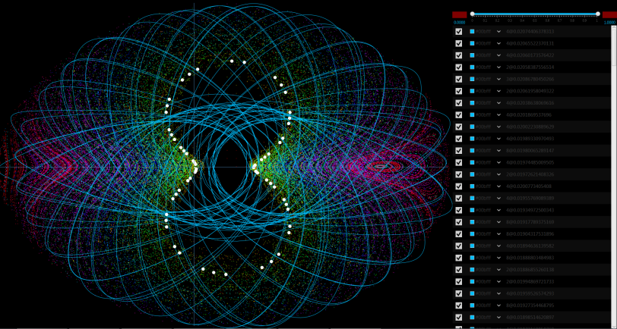
Deep Space Trajectory Exploration
Visualization software in JavaFX
a.i. solutions engineers have developed custom software in JavaFX that allows deep space mission designers to visually explore vast cross sections of potential trajectories in Two Dimensional space.
For the first time these analysts can visually and intuitively find ideal trajectories that would otherwise be grains of sand on a beach.
JavaFX 8 was perfect for this job because of its speedy Canvas and its Parallel Streams support.
This is a natural fit because often complex multi-dimensional trajectories are compared in a singular 2D plane called a Poine Carre Map.

Slide 12
But what about JavaFX 3D??
Existing and upcoming NASA missions have expressed interest in a visual tool like this but to provide immediate value beyond novel visualization they need to see the trajectory in 3D.
JavaFX 3D to the Rescue?
Maybe… but there are some things lacking in the base JavaFX 3D packages that are needed for basic Space Based 3D modeling.
Is there no hope?

Slide 13
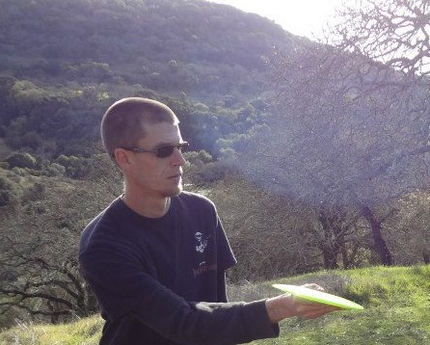
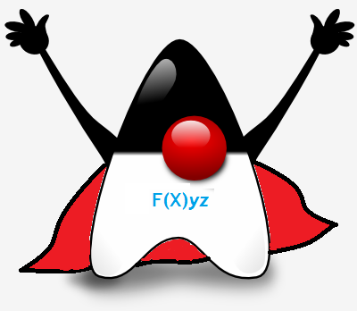
F(X)yz Co Founder – Jason POllastrini
Who Am I – 3D Enthusiast – Co-Founder of F(X)yz
…Construction Services Professional by day
Software Developer by night...
Avid 3D visualizations, UI, and Game
Engine enthusiast/developer, focused on incorporating such concepts into a pure JavaFX framework.
Find Me:
https://twitter.com/jdub1581
https://github.com/jdub1581
https://bitbucket.org/jdub158
http://birdasaur.github.io/FXyz/
Open Source Contributions:
DataFX
F(X)yz
VLCFXMediaPlayer
MapGenerator

Slide 14
F(X)yz – Free Pure JavaFX 3D Library
F(X)yz is a new JavaFX 3D library that provides additional primitives, composite objects, controls and data visualizations that the base JavaFX 8 3D packages do not have:
Billboards
Skybox
PolyLine3D
Surface, Scatter and Histogram Plots
Camera Control Classes and more
Open Source… Oh Snap. http://birdasaur.github.io/FXyz/

Slide 15
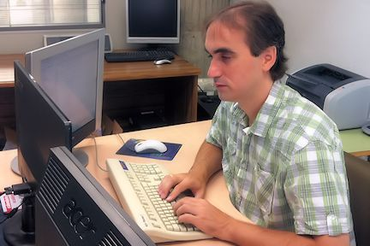
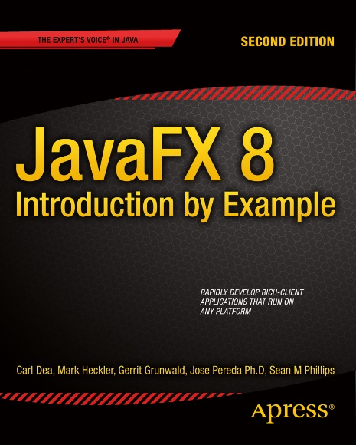
JOSÉ PEREDA
Who Am I –
Dr. Industrial Engineer in Structures
Assistant at the University of Valladolid, Spain
Passionate about JavaFX
Blog, OSS, commercial projects, book, articles
Find Me:
http://jperedadnr.blogspot.com
@JPeredaDnr
https://github.com/jperedadnr
http://www.apress.com/9781430264606

Slide 16
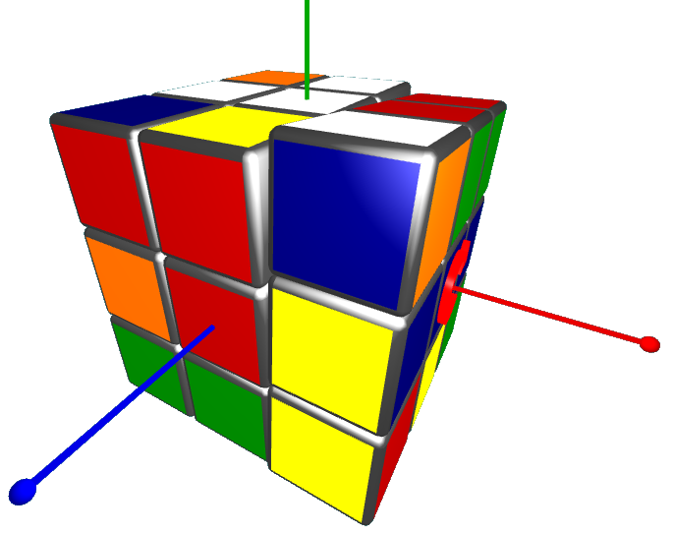
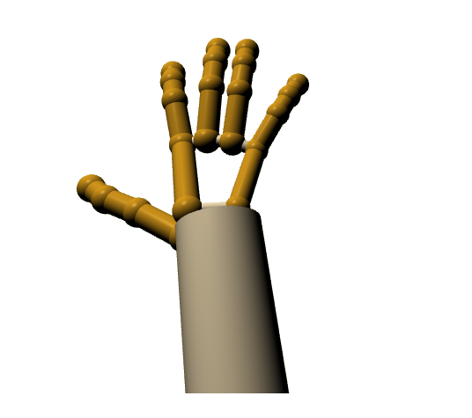
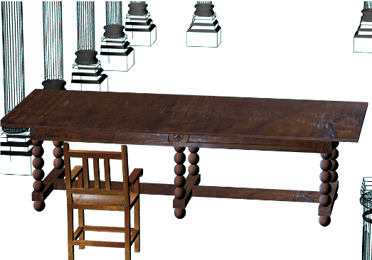
Topics
My topics:
-Rubik’s Cube: Learning JavaFX 3D through Gaming
-Leap Motion v2: Getting your hands into the scene
-Arquitectural 3D models: Taking rendering to the next level

Slide 17
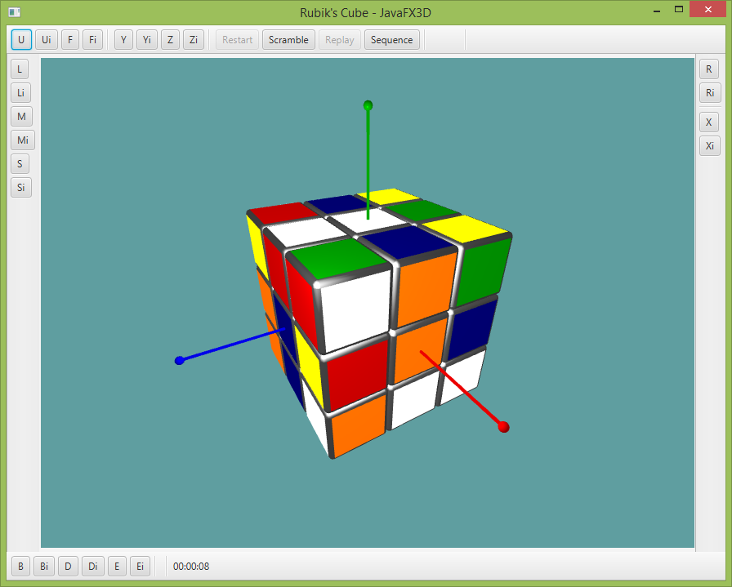
Rubik’s Cube: Learning JavaFX 3D through Gaming
What you learn:
-JavaFX 3D API. What’s in it, what’s not
-Importing 3D models with 3DViewer from OpenJFX
-Math behind the model to handle rotations of selected meshes
-Discussing transforms: add (append) or prepend?
DEMO TIME
More:
* http://hg.openjdk.java.net/openjfx/8u-dev/rt/file/8a674e9f9438/apps/samples/3DViewer
* http://jperedadnr.blogspot.com.es/2014/04/rubikfx-solving-rubiks-cube-with-javafx.html

Slide 18
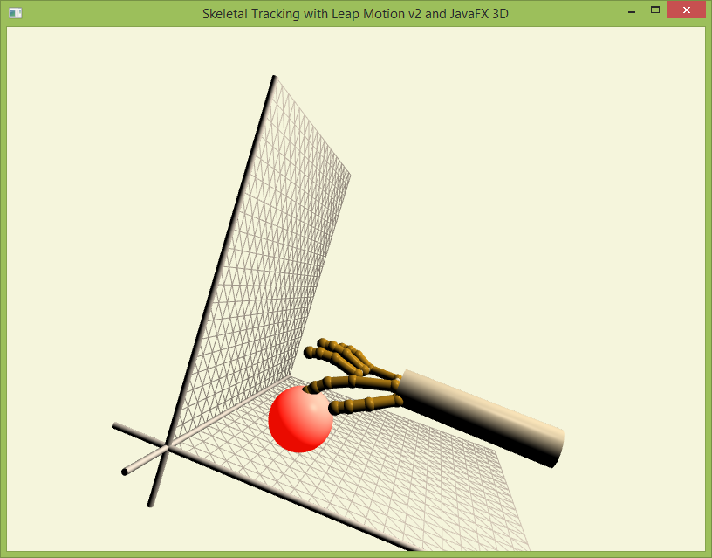
Leap Motion v2: Getting your hands into the scene
What you learn:
-Leap Motion controller can be easily mixed with a JavaFX scene (different threads)
-Leap Motion v2: skeletal tracking version, more realistic hand model
-Interaction with models is difficult. Motor 3D?
-Skinning
DEMO TIME
More:
* https://developer.leapmotion.com/documentation/skeletal/java/index.html
* http://jperedadnr.blogspot.com.es/2013/06/leap-motion-controller-and-javafx-new.html
* https://github.com/jperedadnr/LeapV2

Slide 19
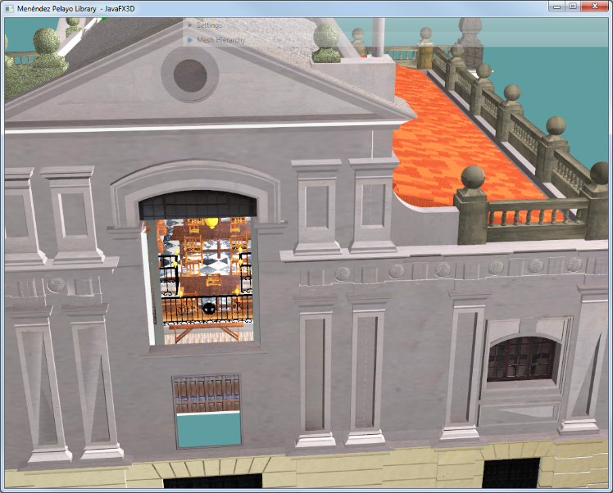
Arquitectural 3D models: Taking rendering to the next level
What you learn:
-Complex models are big, with heavy texture images
-Creating sub-scenes, loading several models, selecting models or parts of them
-Moving models by picking
DEMO TIME
More (soon): Java Magazine November/Dicember 2014

