Slide 1
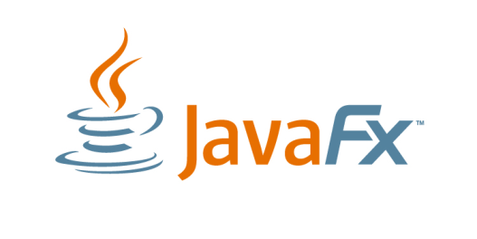
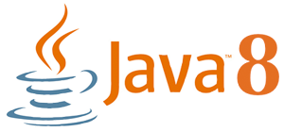
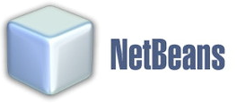
NASA Mission Software Development on the Eights
Java 8, JavaFX 8, and NetBeans 8

Slide 2
Java/Oracle in the Goddard Space Flight Center Flight Dynamics Facility
Keith Chapman
a.i. solutions, Inc.
JavaOne 2014

Slide 3
Use of the NetBeans Platform for NASA Robotic Conjunction Assessment Risk Analysis
Nick Sabey
a.i. solutions, Inc.
JavaOne 2014

Slide 4
NASA Robotic Conjunction Assessment Risk Analysis (CARA)
CARA is the process and team for:
Determining the risk of collision between two orbiting objects
Assisting with risk mitigation (typically, via an orbital maneuver)
The NASA Robotic CARA group at NASA GSFC provides this support to all operational NASA robotic (unmanned) missions
Started in January 2005
Over 65 missions in total
Over 1,000 close approach messages received per day
Maneuver recommendations result in as many as 30 realized maneuvers each year

Slide 5
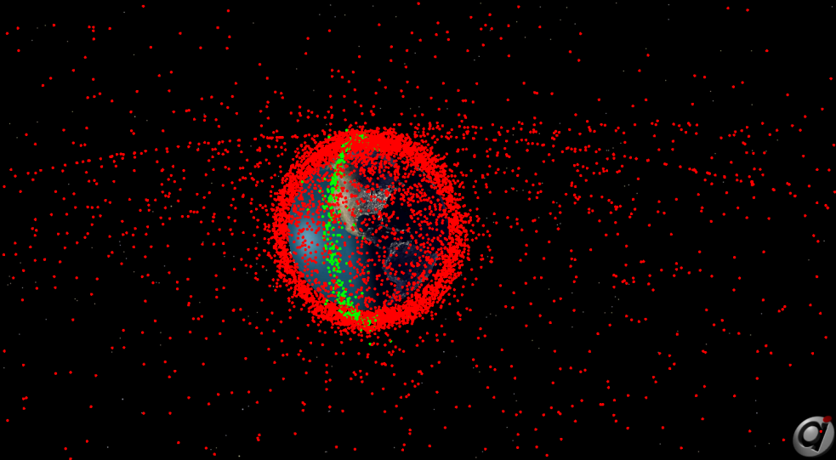
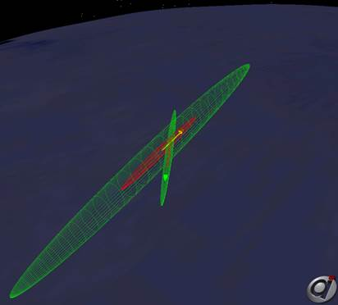
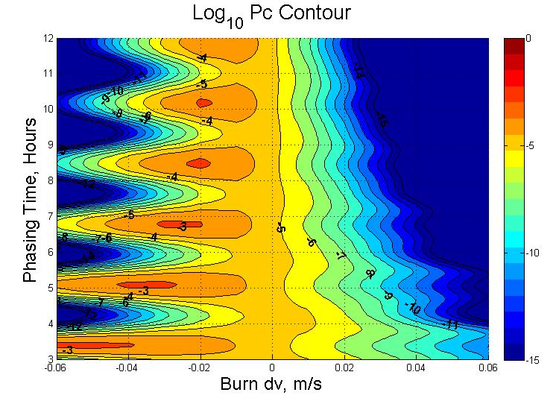
NASA Robotic Conjunction Assessment Risk Analysis (CARA)

Slide 6
NASA Robotic Conjunction Assessment Risk Analysis (CARA)
The Joint Space Operations Center (JSpOC) is a USAF operational unit that is responsible for maintaining the locations of all objects in space
For NASA, the JSpOC identifies close approaches between those objects and provides data to CARA to enable the collision risk assessment
The JSpOC operates in a secure environment
i.e. only accredited or in-house software; accreditation can take more than 6 months
CARA has an analyst/developer resident at the JSpOC to access data which cannot be sent to NASA
Able to develop NASA-specific products and services
i.e. development of space weather risk trade space, orbit quality data product
Symbiotic relationship between NASA and USAF/JSpOC
i.e. developed automation and improvements to legacy software components

Slide 7
NetBeans for CARA JSpOC Support
JSpOC development & support provided by a single developer
Scope of project would not have been possible without the use of a Rich Client Platform (RCP)
NetBeans was intuitive, and provided excellent support
Initially developed using NetBeans 7.3.1
Provided significant UI features with little to no code
Scalability from plugin architecture
Platform API reduced coding time substantially
Nodes, Module, Lookup, and FileSystems APIs used extensively
Reused existing platform modules developed for other a.i. solutions projects
Interfacing with legacy and supporting software very easy

Slide 8
Upgrading to Java 8 / JavaFX 8
No software changes required to update to JDK8
i.e. nothing broke
We are adding some of the new JDK 8 features to our application as part of the upgrade:
Stream API and Lambdas
Reduction in code / simplified syntax
Simplifies our use of collections
In the process of adding substantially more parallelism
JavaFX 8
No prior access to JavaFX on our system
JavaFX has been approved along with JDK 8
Experimenting with both 3D and 2D visualizations

Slide 9
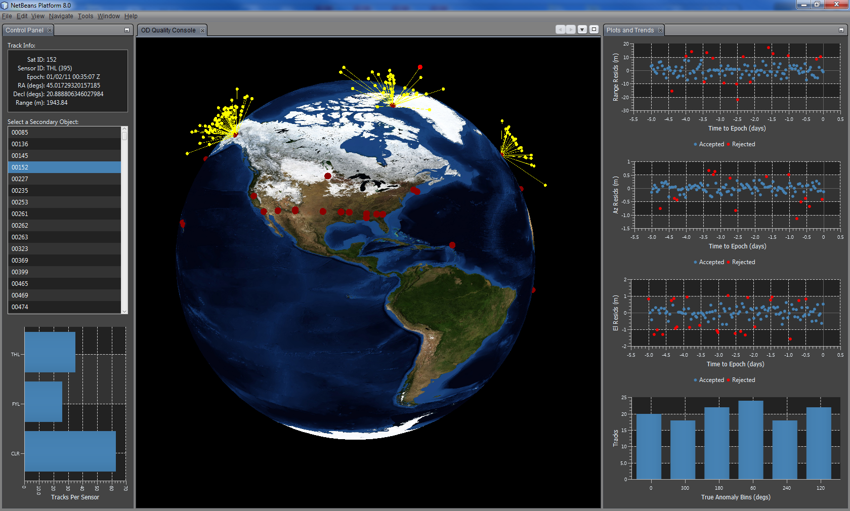
JFX 8 OD Quality Visualization Demo*
*Note: This will be an interactive demo, with all data being simulated

Slide 10
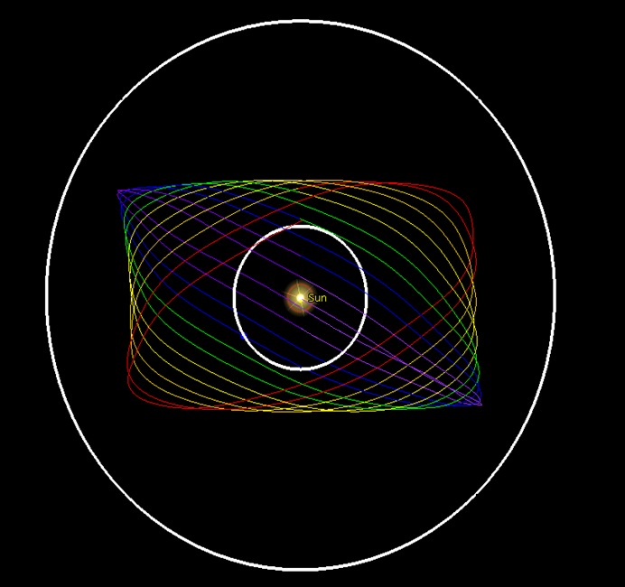
Deep Space Climate Observatory
Lagrange point orbit
Real-time solar wind data
Al Gore’s “Blue Marble”

Slide 11
Triana to GoreSat to DSCOVR
Postponed in 2001 due to administration change
In storage for 10 years
Mission was reactivated in late 2013 (due to administration change)
Scheduled for launch in early 2015
Three years of work compressed into one year

Slide 12
How Java on the 8s Helped
Customer: You have to use STK!
A JNI layer was included in STK SDK
Accessed analyst-created STK scenarios in JAVA
Analysts: We want MATLAB!
MATLAB is written in Java! (don’t tell the analysts)
Netbeans module created for previous mission
Operators: Which button do I press?
Swing-based wizards easy in Netbeans IDE
Datasystems API simplified parsing files

Slide 13
Tools Developed in Netbeans
Ephemeris generation
Ingests legacy state vector file (c. 1976)
Supports various output formats
Orbit product generation
Collates ground station contact times
Visual of proximity to Sun and Moon
Maneuver planning
Incorporate maneuvers into ephemerides
Comparisons of burn to no-burn cases

Slide 14
Benefits for DSCOVR Operations
Reduced manual steps in workflow
Without Netbeans: 100+ steps
With Netbeans: <30 steps
Reduced likelihood of error during execution
Used existing plugins wherever possible
Internally developed MATLAB plugin
3rd party plugins for file diffs, command line, etc.
Saved multiple staff-weeks of development time

Slide 15
Demo

Slide 16
JavaFX 8 and the NetBeans Platform for JWST, MMS and Deep Space
Sean Phillips
a.i. solutions, Inc.
JavaOne 2014

Slide 17
NASA Mission Operations and Analysis tools
Magnetospheric MultiScale (MMS)
GEONS Ground Support System (GGSS)
James Webb Space Telescope
Contact Analysis Visualization Tool
Launch Window Analysis Framework
Saturn/Titan Mission Design (Cassini Data)
Deep Space Trajectory Explorer

Slide 18
MMS Mission Complexity: Tetrahedron Formation
Daily Collision Avoidance, Telemetry QA and Navigation
Simultaneously for four spacecraft flying in a tetrahedron formation

Slide 19
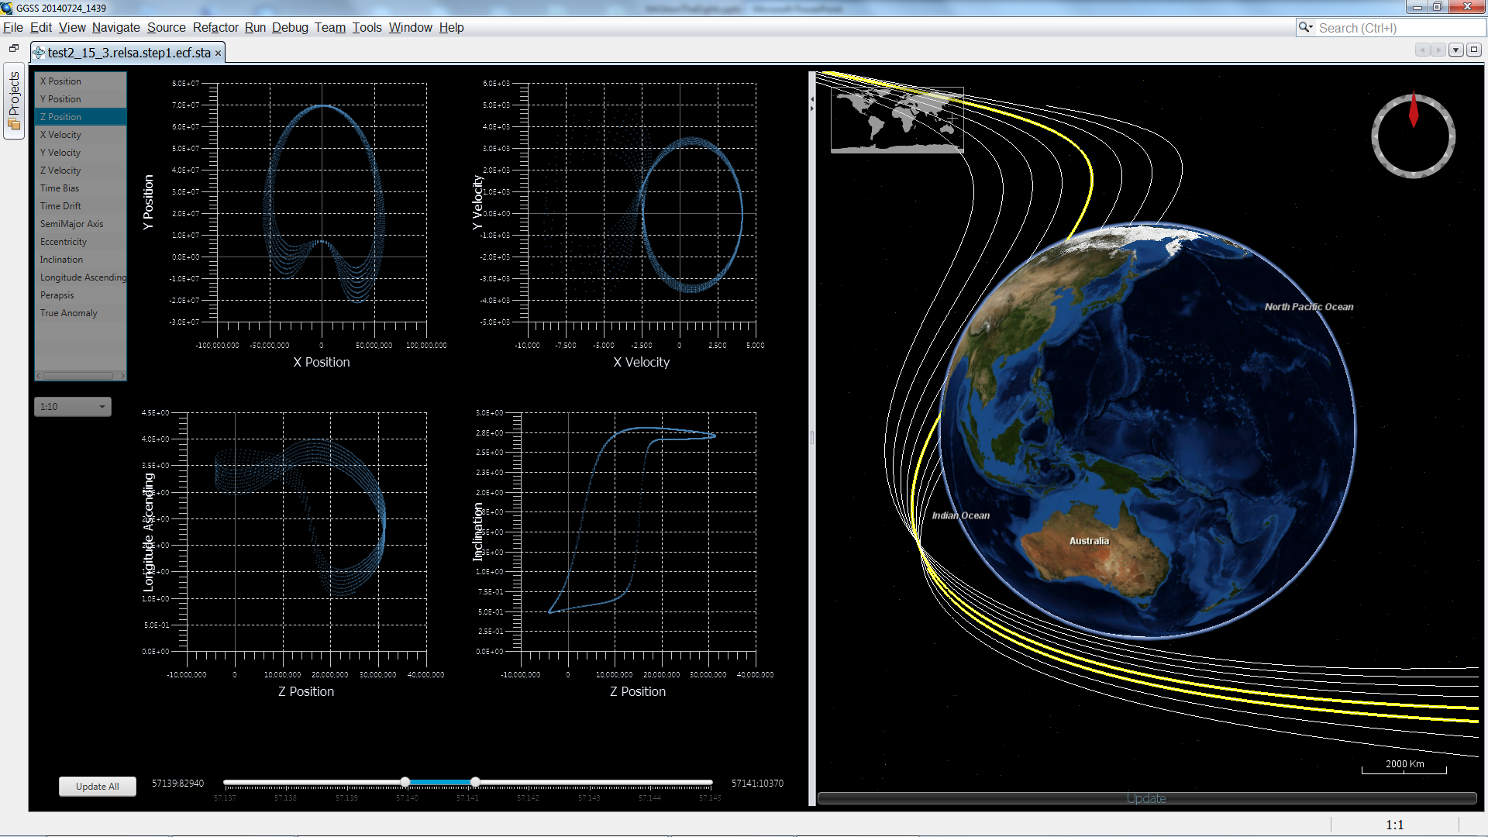
Integrated Drag and Drop Data Analysis
JavaFX provides easy drag and drop, charting and animation.
JavaFX Concurrency and Observables provide great GUI experience with large datasets.

Slide 20
JWST Java based Software Analysis
Contact Analysis Visualization Tool
Automates spacecraft radio contact simulation
Captures contact reports for dozens of ground and space assets
Correlates over 100K contact data points into interactive timelines.

Slide 21
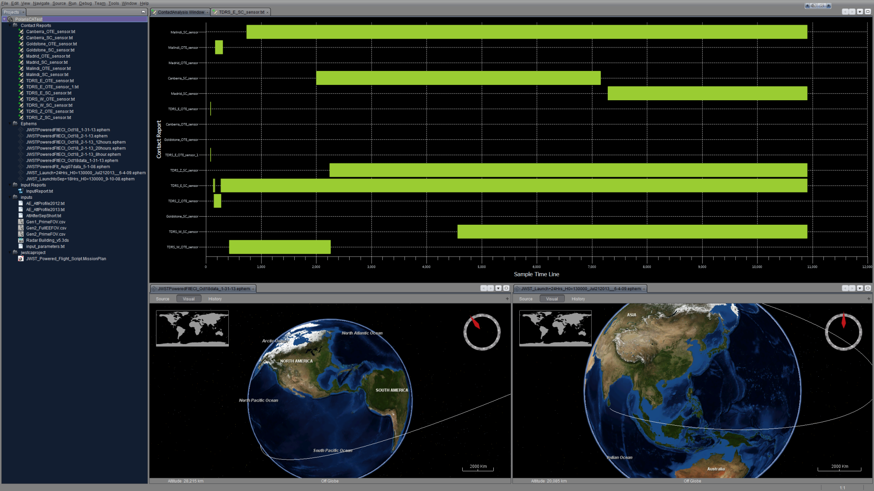
JWST: Simulation Integration and Visualization
NetBeans Platform minimizes effort for integrating simulation processes
Custom JavaFX controls combined with Java 8 parallel streams

Slide 22
Pure JavaFX Deep Space Mission Design
Deep Space Trajectory exploration of the Saturn-Titan system
Thousands of potential trajectories exist at any given position and energy level
Captures contact reports for dozens of ground and space assets
Automatic trajectory discovery, grouping and visualization
Integrated Pure JavaFX 3D Trajectory Renderings

Slide 23
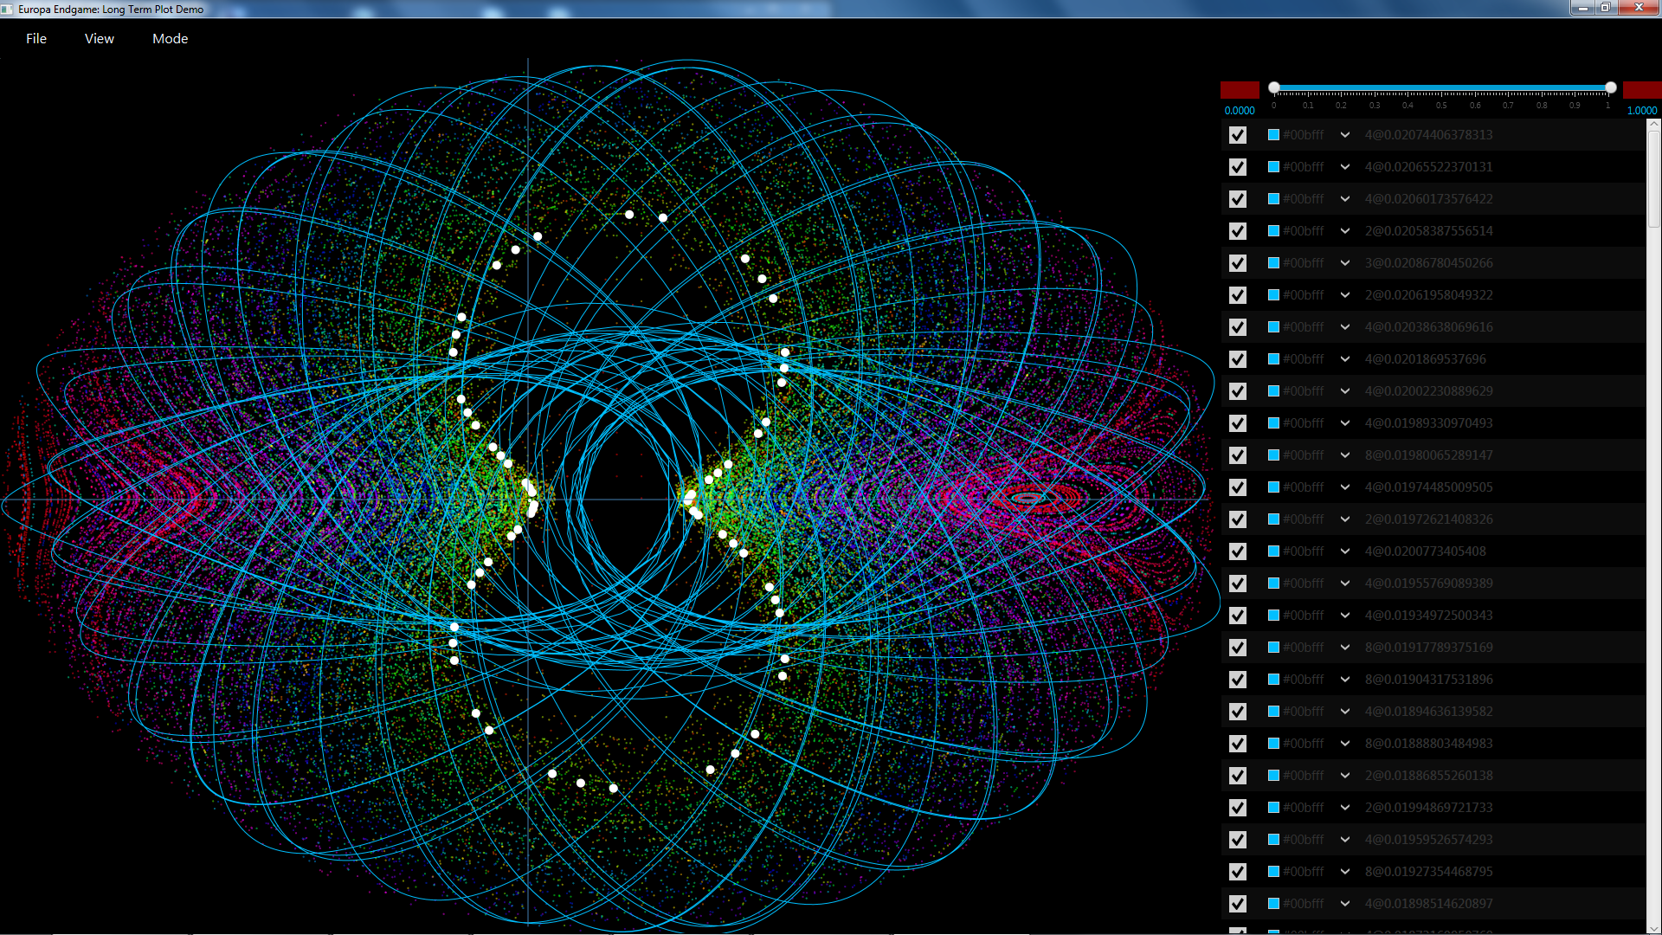
Deep Space Trajectory Explorer

Slide 24
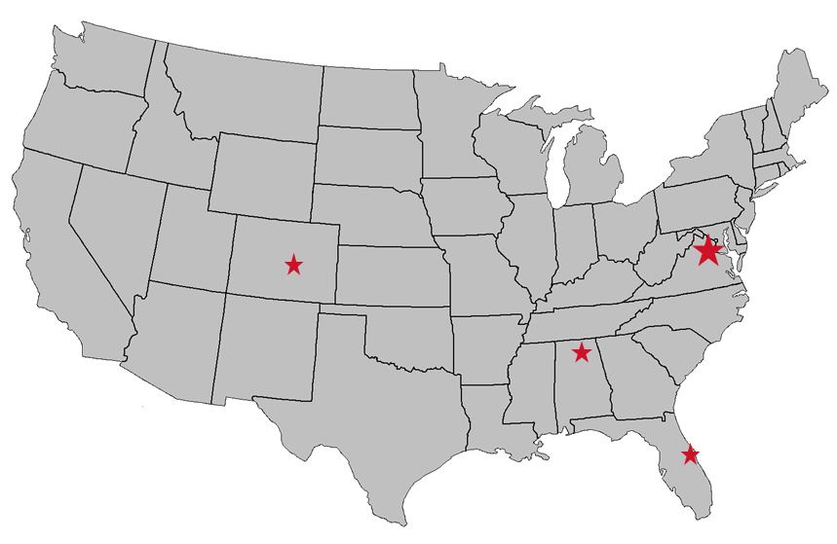
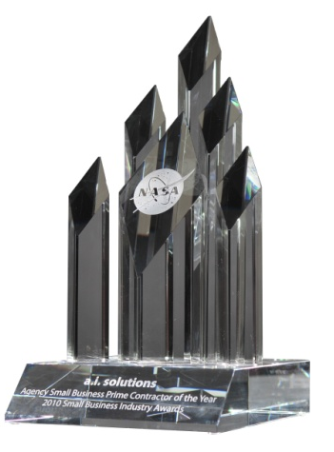
a.i. solutions Company Profile
Company Overview:
Founded in 1996
400+ Employees
Mature Small Business
Core Capabilities:
Flight Dynamics & Satellite Systems Engineering
Launch Vehicle & Missile Systems Engineering
Ground System Application Development
Information Assurance & Cybersecurity
COTS Products: FreeFlyer® Flight Dynamics Software
Customer Site
Lompoc, CA
Headquarters
Lanham, MD
Regional Office
Colorado Springs, CO
Customer Site Albuquerque, NM
Regional Office
Huntsville, AL
Regional Office
Cape Canaveral, FL
Regional Office
Houston, TX
Certifications & Awards
ISO 9001:2008 / AS9100 Certified
CMMI-Dev ML3
2010 NASA Small Business Prime Contractor of the Year

