Slide 1
Code Generation in the Java Compiler
Annotation Processors Do the Hard Work
JavaOne Conference – CON2013 – October 2014
Copyright © 2014 Accenture. All rights reserved.

Slide 2
Code Generation in the Java Compiler
Objectives for the session:
Introduce Annotations and Annotation Processors
Learn how to create Annotation Processors
Learn how to use Annotation Processors to generate source code
Connect Annotation Processors with external generation engines
Integration with IDEs and build automation tools
With lots of examples and source code

Slide 3
About the Speaker
Jorge Hidalgo @_deors
Accenture, Malaga (Spain)
Senior Technology Architect
Java Lead at the Accenture Delivery Center in Spain
15 years of IT professional experience across industries
From time to time writing a blog called Dr. MacPhail’s Trance:
http://deors.wordpress.com
Father of two children, husband, whistle player, video gamer, sci-fi junkie, Raspberry Pi fan...

Slide 4
Code Generation – Why?
To not repeat the same tasks again and again
To reduce the burden of boilerplate code
To standardize code patterns, follow common idioms
To ensure that best practices are applied
To improve the adherence to coding standards (naming, style)
...
PRODUCTIVITY
QUALITY
PREDICTABILITY

Slide 5
Poll #1
Please raise your hands if you are familiar with Annotations, know how to use them or are even capable of writing Annotation Types

Slide 6
Poll #2
Please raise your hands if you are familiar with Annotation Processors, their capabilities or know how to write new ones

Slide 7
Agenda
Annotations in the Java language
Annotation Processors
Running Annotation Processors
Generating source code using Annotation Processors
Generating source code using APs and Apache Velocity
Going forward: Modifying existing bytecodes
Summary
Q & A

Slide 8
Annotations in the Java Language
Annotations were first introduced in Java 5
Add metadata capabilities to the Java language:
Build/deployment information
Configuration properties
Compiler behavior
Quality checks
Dependency injection
Persistence mapping
...

Slide 9
Annotations in the Java Language
Annotations always appear before the annotated piece of code
Annotations can ‘decorate’...
Packages
Types (classes, interfaces, enums, annotation types)
Variables (class, instance and local variables)
Constructors, methods and their parameters
Generic type parameter (since Java 8)
Any type use (since Java 8)
Can be grouped, nested, repeated... very powerful!
Map<@NonNull String, @NonEmpty List<@Readonly Document>> docStore;

Slide 10
Annotations in the Java Language
Annotations may be used just as a ‘marker’
@NonNull String email;
They may contain name-value pairs, and arrays
@Author(name = "Albert", created = "17/09/2010", revision = 3, reviewers = {"George", "Fred"}) public class SomeClass {...}
Can be defined with default values, and then omitted when used
When it has only one attribute named value, it can be omitted, too
@DatabaseTable(“MY_TABLE”) public class MyTable {...}

Slide 11
Create an Annotation Type
A special type of interface
public @interface Author { String name(); String created(); int revision() default 1; String[] reviewers() default {}; }
Only primitives, enum types, annotation types, String, Class and arrays of them are allowed as elements
May be annotated itself, i.e. to define the retention policy or targets
@Retention(RetentionPolicy.SOURCE) @Target({ElementType.ANNOTATION_TYPE, ElementType.TYPE}) public @interface Author {...}

Slide 12
Agenda
Annotations in the Java language
Annotation Processors
Running Annotation Processors
Generating source code using Annotation Processors
Generating source code using APs and Apache Velocity
Going forward: Modifying existing bytecodes
Summary
Q & A

Slide 13
Annotation Processors
This is cool but I can add metadata information with Javadocs, so what’s the buzz?
/**
* My Class description.
* @author jorge.hidalgo
* @version 1.0
* @deprecated Use MyNewClass instead
*/

Slide 14
Annotation Processors
Annotations are first-class citizens in the Java language
Formalized in the Java Language Specification
Readable at run time:
Class.getAnnotations()
Class.getAnnotationsByType(Class<A>)
Class.getDeclaredAnnotations()
Class.getDeclaredAnnotationsByType(Class<A>)
Can trigger custom actions at compile time managed by Annotation Processors!

Slide 15
Annotation Processors
When first introduced in Java 5, the Annotation Processing API was not standard
A standalone tool, apt, was needed to process annotations
Mirror API distributed in com.sun.mirror packages
Starting with Java 6, standardized through JSR-269⁽¹⁾
apt, although still available for standalone execution, was seamlessly integrated into the Java compiler, javac
Annotation Processing API distributed in javax.lang.model packages
Since Java 8, apt is no longer available in the JDK
⁽¹⁾ JSR-269, Pluggable Annotation Processing API, can be browsed online here.

Slide 16
Annotation Processing API
Annotation Processor:
Implements javax.annotation.processing.Processor
Or extends javax.annotation.processing.AbstractProcessor
May use three annotations to configure itself:
jx.a.p.SupportedAnnotationTypes – Used to flag which Annotation Types are managed by the processor
jx.a.p.SupportedSourceVersion – Used to flag the latest Java source level supported by the processor
jx.a.p.SupportedOptions – Used to register custom parameters that may be passed through the command line
TL;DR – Implement the process() method

Slide 17
Hello Multiverse Processor
@Documented
@Target({ElementType.TYPE, ElementType.METHOD})
@Retention(RetentionPolicy.RUNTIME)
public @interface Complexity {
ComplexityLevel value() default ComplexityLevel.MEDIUM;
}
public enum ComplexityLevel {
VERY_SIMPLE, SIMPLE, MEDIUM, COMPLEX, VERY_COMPLEX;
}
@SupportedAnnotationTypes("deors.demos.annotations.base.Complexity")
@SupportedSourceVersion(SourceVersion.RELEASE_8)
public class ComplexityProcessor extends AbstractProcessor {
@Override
public boolean process(Set<? extends TypeElement> annotations, RoundEnvironment roundEnv) {
return true;
}
}
Tell the compiler this processor actually handled the annotation

Slide 18
Rounds and environment
Annotation processing happens in ‘rounds’
In each round, a subset of sources are compiled, and then processors matching the annotations found on those sources are called
Processing ends when no more sources/annotations are pending
Processors may claim all annotation types with a wildcard
process() method has two parameters:
Set<? extends jx.lang.model.element.TypeElement> – subset of annotations being processed
jx.a.p.RoundEnvironment – access to information about the current and previous round

Slide 19
Rounds and environment
When extending jx.a.p.AbstractProcessor, there is available an instance variable of type jx.a.p.ProcessingEnvironment with access to a specialized logging tool, the Messager
@Override
public boolean process(Set<? extends TypeElement> annotations, RoundEnvironment roundEnv) {
for (Element elem : roundEnv.getElementsAnnotatedWith(Complexity.class)) {
Complexity complexity = elem.getAnnotation(Complexity.class);
String message = "annotation found in " + elem.getSimpleName()
+ " with complexity " + complexity.value();
processingEnv.getMessager().printMessage(Diagnostic.Kind.NOTE, message, elem);
}
return true; // no further processing of this annotation type
}

Slide 20
Creating Files
jx.a.p.ProcessingEnvironment also provides access to the Filer utility that allows for easy file creation
Files are placed in the right folder as required by the compiler settings
Folder hierarchy matching the package name
JavaFileObject jfo = processingEnv.getFiler()
.createSourceFile(newClassQualifiedName);
Writer writer = jfo.openWriter();
...or...
JavaFileObject jfo = processingEnv.getFiler()
.createClassFile(newClassQualifiedName);
OutputStream os = jfo.openOutputStream();

Slide 21
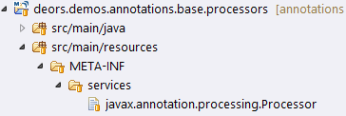
How the Compiler Knows?
Annotation Processors should be registered
The easiest way – leverage the standard services mechanism
Package the processors in a Jar file
Include file META-INF/services/javax.annotation.processing.Processor
Contents are the fully qualified names of all processors, one per line

Slide 22
Agenda
Annotations in the Java language
Annotation Processors
Running Annotation Processors
Generating source code using Annotation Processors
Generating source code using APs and Apache Velocity
Going forward: Modifying existing bytecodes
Summary
Q & A

Slide 23
Running Annotation Processors
Multiple ways:
javac
Apache Maven builds
Continuous Integration builds
IDE
...

Slide 24
Running APs with javac
Use –proc:none when compiling Annotation Processors
When compiling the annotated classes:
Annotation types in classpath → $CP
Annotation Processor and dependencies in AP classpath → $APCP
Generated sources can be placed in a different folder → -s option
javac -classpath $CP -processorpath $APCP sources -s generatedSourcesDir
Use -XprintProcessorInfo -XprintRounds and javac will print to console information about the processing (e.g. rounds)

Slide 25
Running APs with Apache Maven
Annotation Type artifacts
Don’t have any special requirement
Annotation Processor artifacts
May add -proc:none to compiler arguments to disable Annotation processing during compilation
Artifacts using the annotations
Add AP artifacts as a dependency with compile scope
Add optionally compiler arguments for -Xprint... parameters

Slide 26
Maven POM for Annotation Type
<project ...>
<groupId>deors.demos</groupId>
<artifactId>deors.demos.annotations.base</artifactId>
<version>1.0-SNAPSHOT</version>
<properties><java.version>1.8</java.version></properties>
<build><plugins><plugin>
<groupId>org.apache.maven.plugins</groupId>
<artifactId>maven-compiler-plugin</artifactId>
<version>3.1</version>
<configuration>
<compilerVersion>${java.version}</compilerVersion>
<source>${java.version}</source>
<target>${java.version}</target>
</configuration>
</plugin></plugins></build>
</project>

Slide 27
Maven POM for Annotation Processor (I)
<project ...>
<groupId>deors.demos</groupId>
<artifactId>deors.demos.annotations.base.processors</artifactId>
<version>1.0-SNAPSHOT</version>
<properties><java.version>1.8</java.version></properties>
<build><plugins><plugin>
<groupId>org.apache.maven.plugins</groupId>
<artifactId>maven-compiler-plugin</artifactId>
<version>3.1</version>
<configuration>
<compilerVersion>${java.version}</compilerVersion>
<source>${java.version}</source>
<target>${java.version}</target>
<compilerArgument>-proc:none</compilerArgument>
</configuration>
</plugin></plugins></build>
...
Don’t run AP while building AP classes

Slide 28
Maven POM for Annotation Processor (II)
<dependencies>
<dependency>
<groupId>deors.demos</groupId>
<artifactId>deors.demos.annotations.base</artifactId>
<version>1.0-SNAPSHOT</version>
<scope>compile</scope>
</dependency>
</dependencies>
</project>
Use mvn install or mvn deploy to ensure that both artifacts are accessible to users

Slide 29
Maven POM for Annotation users (I)
<project ...>
<groupId>deors.demos</groupId>
<artifactId>deors.demos.annotations.base.client</artifactId>
<version>1.0-SNAPSHOT</version>
<properties><java.version>1.8</java.version></properties>
<build><plugins><plugin>
<groupId>org.apache.maven.plugins</groupId>
<artifactId>maven-compiler-plugin</artifactId>
<version>3.1</version>
<configuration>
...
<compilerArgument>
<XprintProcessorInfo/>
<XprintRounds/>
</compilerArgument>
</configuration>
</plugin></plugins></build>
...

Slide 30
Maven POM for Annotation users (II)
<dependencies>
<dependency>
<groupId>deors.demos</groupId>
<artifactId>deors.demos.annotations.base</artifactId>
<version>1.0-SNAPSHOT</version>
<scope>compile</scope>
</dependency>
<dependency>
<groupId>deors.demos</groupId>
<artifactId>deors.demos.annotations.base.processors</artifactId>
<version>1.0-SNAPSHOT</version>
<scope>compile</scope>
</dependency>
</dependencies>
</project>
Bug 224 in maven-compiler-plugin: logged messages during AP may not be shown in console

Slide 31
Running APs with Continuous Integration
Generally, nothing to do while creating Maven jobs
I.e. Jenkins, Hudson, Travis, TeamCity...

Slide 32
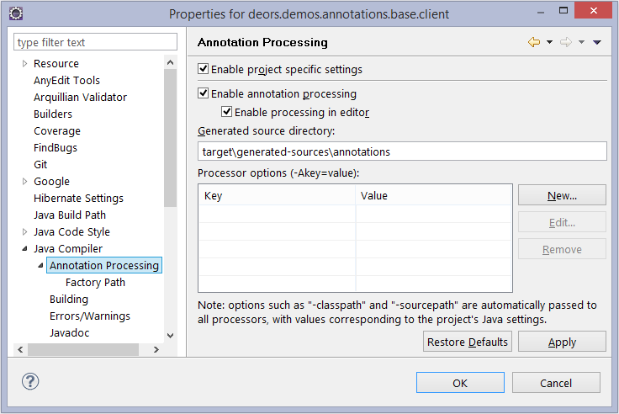
Running APs with Eclipse IDE
Configurable in detail in Java Compiler options
Whether to enable AP
Whether to enable AP automatically after changes in editors
Configure options sent to the AP
Configure target folder for generated sources
Configure AP classpath

Slide 33
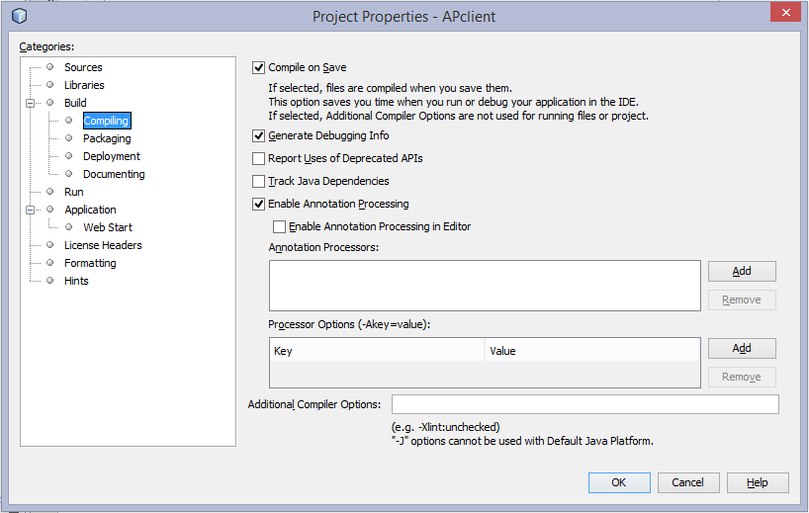
Running APs with NetBeans IDE
Configurable in detail in Java Compiler options (non-Maven only)
Whether to enable AP
Whether to enable AP automatically after changes in editors
Enable individual AP (or use auto-discovery)
Configure options sent to the AP

Slide 34
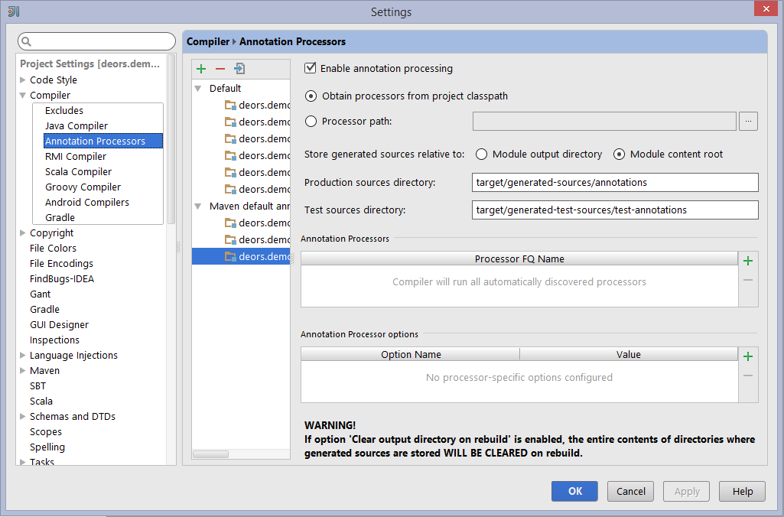
Running APs with IntelliJ IDEA
Configurable in detail in Java Compiler options
Whether to enable AP
Enable individual AP (or use auto-discovery)
Configure options sent to the AP
Configure target folder for generated sources
Configure AP classpath

Slide 35
Agenda
Annotations in the Java language
Annotation Processors
Running Annotation Processors
Generating source code using Annotation Processors
Generating source code using APs and Apache Velocity
Going forward: Modifying existing bytecodes
Summary
Q & A

Slide 36
Generating code – The BeanInfo Generator
DEMO

Slide 37
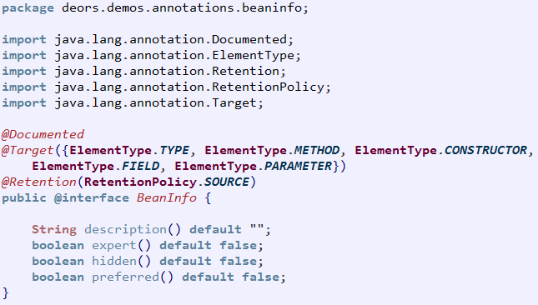
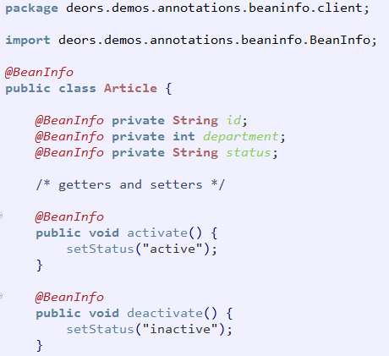
Generating code in Screenshots

Slide 38
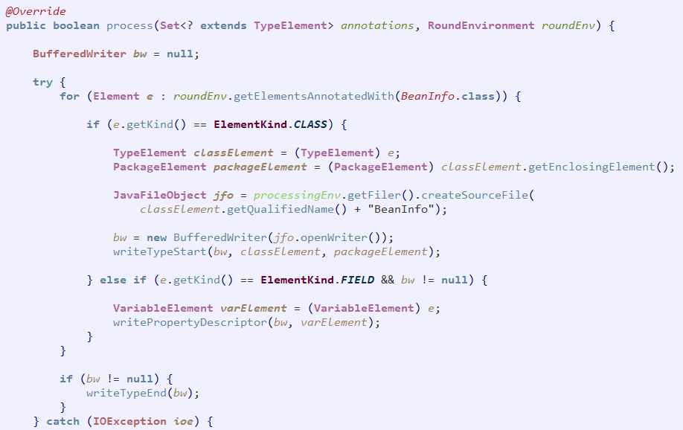
Generating code in Screenshots

Slide 39
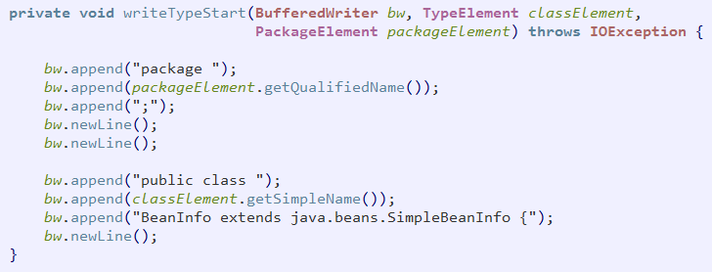
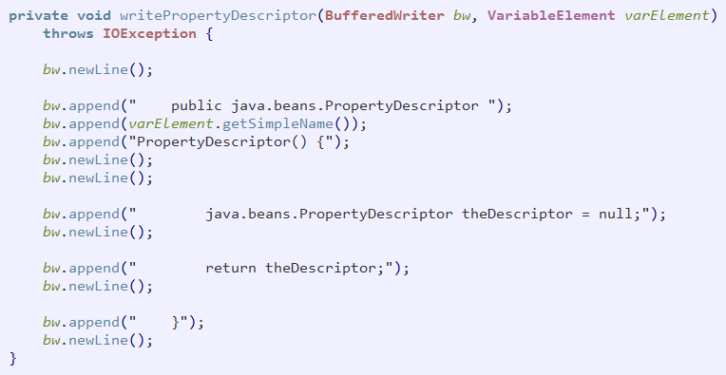
Generating code in Screenshots

Slide 40
Agenda
Annotations in the Java language
Annotation Processors
Running Annotation Processors
Generating source code using Annotation Processors
Generating source code using APs and Apache Velocity
Going forward: Modifying existing bytecodes
Summary
Q & A

Slide 41
Generating code using APs and Velocity
While the previous example is simple...
...As soon as complexity grows, it may become a mess
Designing a generator in that way is not recommended
Error prone
Hard to write, test and maintain
Model and view are highly coupled
A different approach is needed → Let’s use a template engine

Slide 42
Generating code using APs and Velocity
Why Apache Velocity?
Good balance between power/flexibility and added complexity
Older but rock solid and feature rich
Documentation, examples, community
Other options
Eclipse Java Emitter Templates → Harder to integrate with javac
FreeMarker → Still in active development
Thymeleaf → More modern (2011+), used in Spring framework examples

Slide 43
Generating code using APs and Velocity
Follow this high-level approach:
Read the model from source code
Mix information contained in Annotations with information already in the source
Store information in data structures that are easy to use
Populate derived attributes
Set up the template (don’t forget to pass the model as a parameter)
Generated code is ready
Read model
Derived attributes
Set up template
Generate!

Slide 44
The BeanInfo Generator – Revisited
DEMO

Slide 45
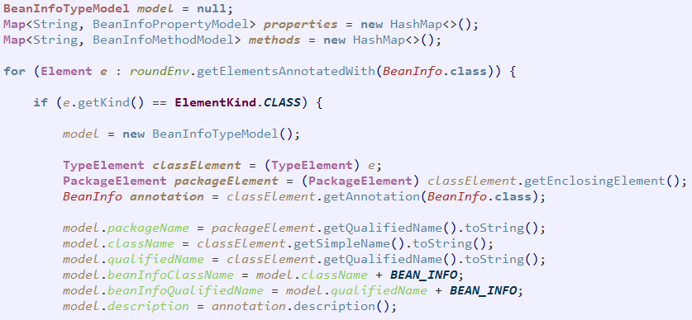
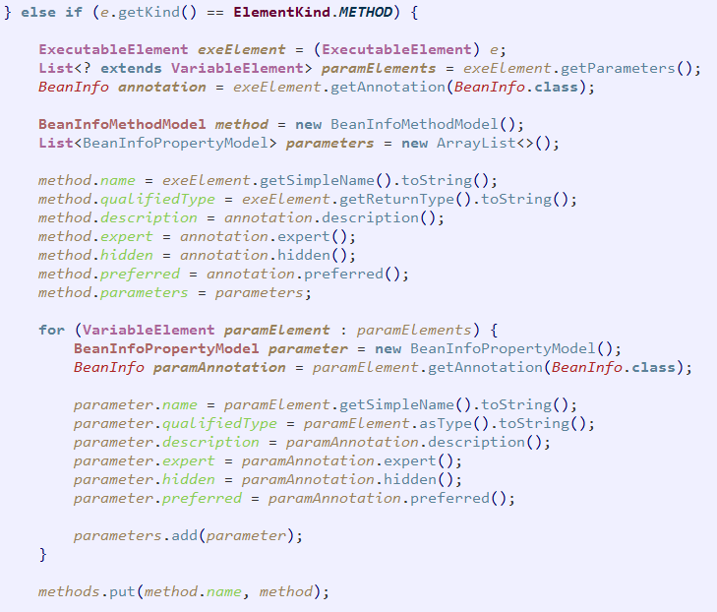
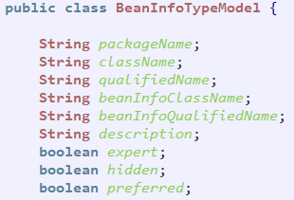
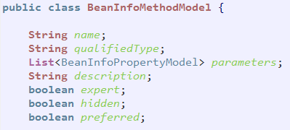
The BeanInfo Generator – Revisited

Slide 46
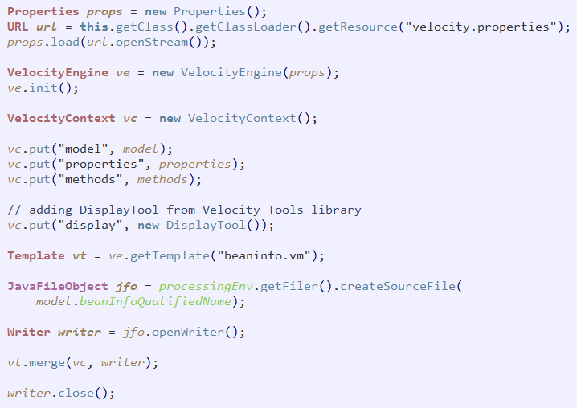
The BeanInfo Generator – Revisited

Slide 47
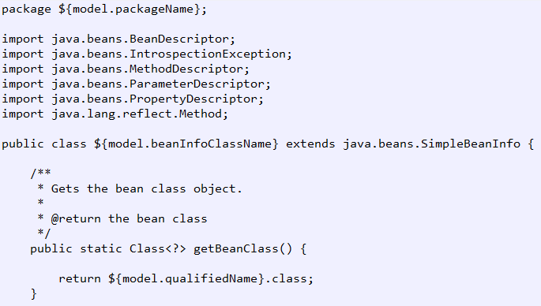
The BeanInfo Generator – Revisited
Iterators, conditional operators, etc.
Easy access to model attributes

Slide 48
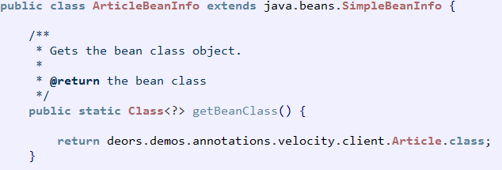
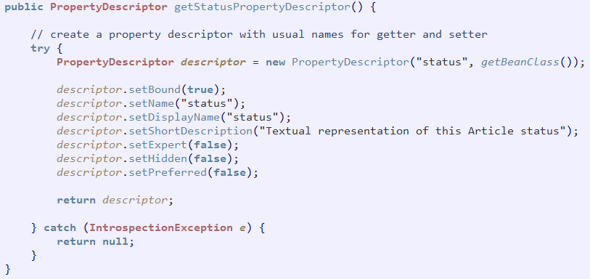
The BeanInfo Generator – Revisited

Slide 49
Agenda
Annotations in the Java language
Annotation Processors
Running Annotation Processors
Generating source code using Annotation Processors
Generating source code using APs and Apache Velocity
Going forward: Modifying existing bytecodes
Summary
Q & A

Slide 50
Going Forward – Bytecode Manipulation
The method described during the session, although direct and straightforward in concept, can only generate new sources
When the target is to modify existing classes (enhancing), a different approach is needed:
Work directly with javac API – for example Project Lombok
Bytecode manipulation with third-party libraries as ASM, cglib or Javassist – for example Datanucleus
Pros: exquisite level of control over the bytecodes
Cons: mastering bytecodes and the compiler API is not an easy task

Slide 51
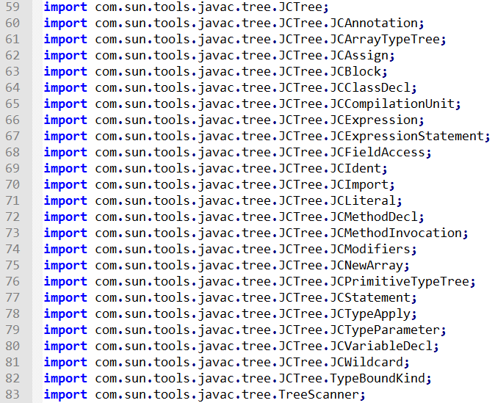
Project Lombok example
lombok.javac.handlers.JavacHandlerUtil class:
This is just a portion of the list of imports
Highly coupled with the compiler API

Slide 52
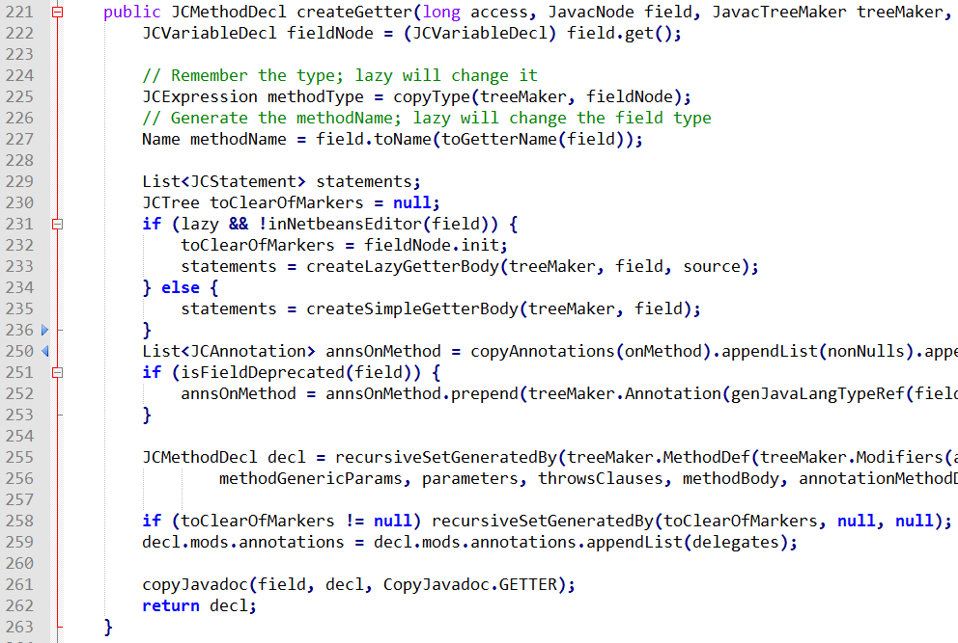
Project Lombok example
lombok.javac.handlers.HandleGetter class:
Not immediate to grasp
Requires mastery of the compiler API
Hard navigation through the AST
(abstract syntax tree) of the
existing class

Slide 53
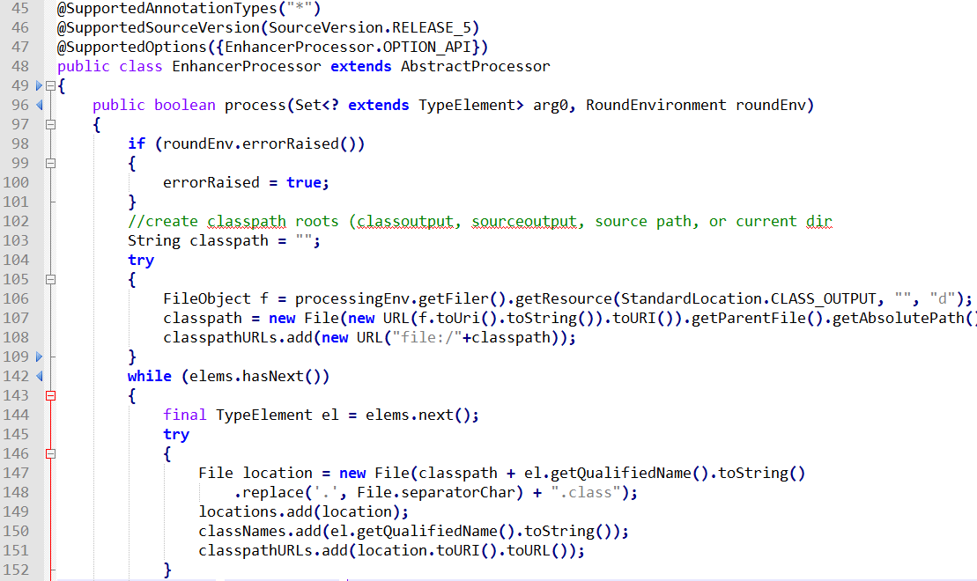
Datanucleus example
org.datanucleus.enhancer.EnhancerProcessor class:
First, locate the .class files
Classes are already compiled when
the AP is executed in each round

Slide 54
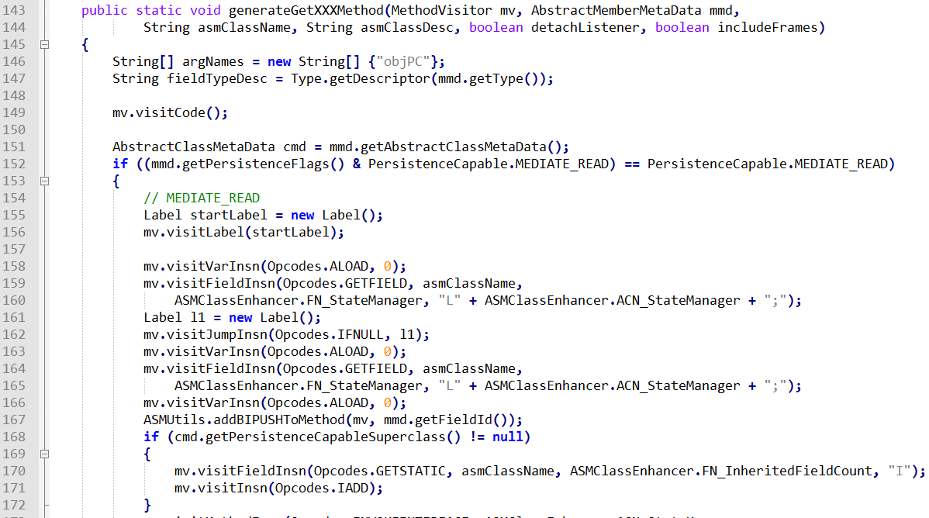
Datanucleus example
o.dn.enhancer.asm.JdoPropertyGetterAdapter class:
To modify classes, it is
required to
think in bytecodes

Slide 55
Agenda
Annotations in the Java language
Annotation Processors
Running Annotation Processors
Generating source code using Annotation Processors
Generating source code using APs and Apache Velocity
Going forward: Modifying existing bytecodes
Summary
Q & A

Slide 56
Summary
Annotation Processors facilitates generation of source code
Also configuration files or deployment information
Seamless integration with the Java compiler, build tools and IDEs
No need to tweak with complex build processes
Generated code immediately available in the IDE
Recommended to be used along with template engines
Key for managing complexity of generators under control
Easier to create, test and maintain
Cannot be used for modifying existing classes
If needed, consider using a bytecode manipulation library

Slide 57
Q & A
Many thanks for attending!
@_deors
http://deors.wordpress.com

