Slide 1
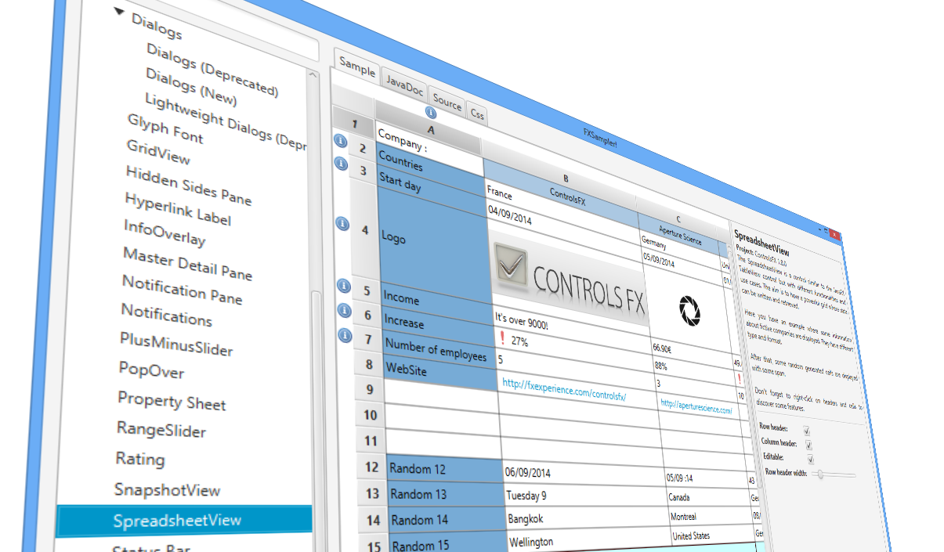
In control with ControlsFX
Eugene Ryzhikov Jonathan Giles
eryzhikov@gmail.com jonathan@jonathangiles.net
@eryzhikov @JonathanGiles
Notes:
I do the presentation while Jonathan is going to release 8.20.7

Slide 2
Session overview
ControlsFX overview
Introduction to ControlsFX features
Demonstration
How to get involved
Future plans
Wrapping up / question time
Notes:
----- Meeting Notes (9/26/14 22:26) -----
What will you see and learn in this session?

Slide 3
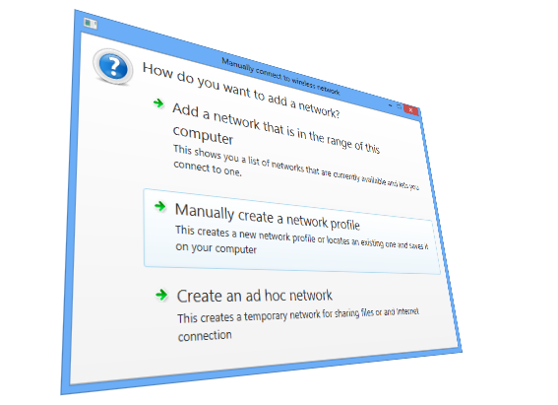
ControlsFX Overview
Notes:
----- Meeting Notes (9/26/14 22:26) -----
With that lets start!

Slide 4
Answering your burning questions
How do
I get involved?
What is it?
ControlsFX
Who is
involved?
Can it
benefit me?
Why does
it exist?
Notes:
When we were kids, we were taught: ‘who, what, when, where, and why’.
Today we will answer the following:
Who is ControlsFX?
What is ControlsFX?
When is ControlsFX?
Where is ControlsFX?
Why is ControlsFX?

Slide 5
What is ControlsFX?
Low bug count
JavaFX library
ControlsFX
Business
friendly licensing
(BSD)
Focus on
high quality API
Notes:
When we were kids, we were taught: ‘who, what, when, where, and why’.
Today we will answer the following:
Who is ControlsFX?
What is ControlsFX?
When is ControlsFX?
Where is ControlsFX?
Why is ControlsFX?

Slide 6
Who is ControlsFX?
Here today:
Eugene Ryzhikov Jonathan Giles

Slide 7
Who is ControlsFX?
Fun game #1:
Using only our voices, you’ll never guess which of us is Kiwi
and which is Russian!
Eugene Ryzhikov Jonathan Giles

Slide 8
Who is ControlsFX?
Not here today:
Sven Reimers
John Malc
Stefan Saring
Henri Biestro
Ryan Jaeb
Werner Lehmann
Jean-François Henrard
Jens Deters
Badisi
Dirk Lemmermann
Tomas Mikula
Dennis Lee
Julien Coloos
Paul Jonas
Pascal Büttiker
Pedro Duque Vieira
Dennis Fischer
Alice Sotzek
Anirvan Sarkar
Adam Kosta
Gabriel Féron
Carolina Veiga
Artur Biesiadowski
Yair Oren
Davide Nabais
Tom Eugelink
Michał Skowroński
Uwe Sander
Laurent Gebus
Geoffrey Capper
Romain Moreau
Sriram Raghuraman
Mario Voigt
Ruben Paz
jonathan millman
Michael Berry
Chen Gaofeng
Γεράσιμος Μάκης Μαρόπουλος
Ladislav Török
Tiziano Lattisi
Victor Alfonso
Pineda Orozco
Daniel Rodrigues
Christian Michelsen
Takayuki Shoji
Farzaneh Taleb
Steffen Rachner
Manel Sanchez i Ruiz
Samir Hadzic
John Zeringue
István Avramucz
Marek Budyn
George Keith Watson
Christoph Keimel
Łukasz Śliwiński
George Moralis
Yann D'Isanto
István Avramucz

Slide 9
Who is ControlsFX?
Not here today:
Sven Reimers
John Malc
Stefan Saring
Henri Biestro
Ryan Jaeb
Werner Lehmann
Jean-François Henrard
Jens Deters
Badisi
Dirk Lemmermann
Tomas Mikula
Dennis Lee
Julien Coloos
Paul Jonas
Pascal Büttiker
Pedro Duque Vieira
Dennis Fischer
Alice Sotzek
Anirvan Sarkar
Adam KOSTA
Gabriel Féron
Carolina Veiga
Artur Biesiadowski
Yair Oren
Davide Nabais
Tom Eugelink
Michał Skowroński
Uwe Sander
Laurent Gebus
Geoffrey Capper
Romain Moreau
Sriram Raghuraman
Mario Voigt
Ruben Paz
jonathan millman
Michael Berry
Chen Gaofeng
Γεράσιμος Μάκης Μαρόπουλος
Ladislav Török
Tiziano Lattisi
Victor Alfonso
Pineda Orozco
Daniel Rodrigues
Christian Michelsen
Takayuki Shoji
Farzaneh Taleb
Steffen Rachner
Manel Sanchez i Ruiz
Hadzic Samir
John Zeringue
István Avramucz
Marek Budyn
George Keith Watson
Christoph Keimel
Łukasz Śliwiński
George Moralis
Yann D'Isanto
Avramucz István
All up, there are over 60 contributors to ControlsFX!

Slide 10
Who is ControlsFX?
More importantly, it can be you!
ControlsFX welcomes contributions
Bug fixes,
Translations,
New features,
New controls
We review all code that comes in, so you can learn a lot!
We are not a dumping ground for half-implemented ideas though!

Slide 11
What is ControlsFX? - Releases
Fun game #2:
Guess when Jonathan’s son was born!
Version | Release Date | Release Gap
ControlsFX 8.0.0 Developer Preview 1 | May 7, 2013 | -
ControlsFX 8.0.0 | June 3, 2013 | ~ One month
ControlsFX 8.0.1 | July 7, 2013 | ~ One month
ControlsFX 8.0.2 Developer Preview 1 | August 11, 2013 | ~ One month
ControlsFX 8.0.2 Developer Preview 2 | September 11, 2013 | ~ One month
ControlsFX 8.0.2 | October 11, 2013 | ~ One month
ControlsFX 8.0.3 | December 4, 2013 | ~ Two months
ControlsFX 8.0.4 | December 28, 2013 | ~ One month
ControlsFX 8.0.5 | March 4, 2014 | ~ Two months
ControlsFX 8.0.6 | May 29, 2014 | ~ Two months
ControlsFX 8.20.7 | September 30, 2014 | ~ Four months
Christmas
Day!

Slide 12
What is ControlsFX? - Downloads
Fun game #3:
Guess when JavaFX 8.0 was released!
Version | Release Date | Downloads
ControlsFX 8.0.0 Developer Preview 1 | May 7, 2013 | 720
ControlsFX 8.0.0 | June 3, 2013 | 627
ControlsFX 8.0.1 | July 7, 2013 | 536
ControlsFX 8.0.2 Developer Preview 1 | August 11, 2013 | 513
ControlsFX 8.0.2 Developer Preview 2 | September 11, 2013 | 420
ControlsFX 8.0.2 | October 11, 2013 | 881
ControlsFX 8.0.3 | December 4, 2013 | 614
ControlsFX 8.0.4 | December 28, 2013 | 1382
ControlsFX 8.0.5 | March 4, 2014 | 3974
ControlsFX 8.0.6 | May 29, 2014 | 8324
ControlsFX 8.20.7 | September 30, 2014
March 14

Slide 13
What is ControlsFX? - Downloads

Slide 14
Why does ControlsFX exist?
Official JavaFX UI controls are developed slowly and their APIs are fixed once released.
Jonathan should know – He the tech lead of JavaFX UI Controls at Oracle
ControlsFX exists to fill the gaps in JavaFX UI Controls:
API is much less rigid in ControlsFX
But: API quality is required to be exceptionally high to release
We follow the same API patterns as in JavaFX for consistency

Slide 15
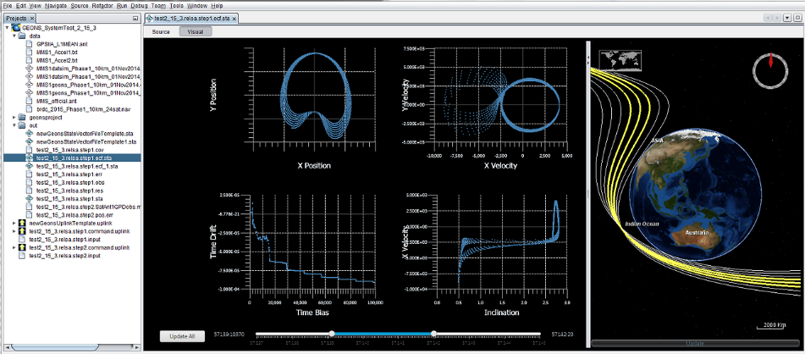
Who uses ControlsFX?
NASA Magnetospheric Multiscale
Mission Support Software
Mission info mms.gsfc.nava.gov
Developed at the Goddard Space Flight Center by ai-solutions, NASA partner
Sean Phillips, lead developer, and his team will be discussing and demonstrating some of the software developed for NASA at their session (CON1994)

Slide 16
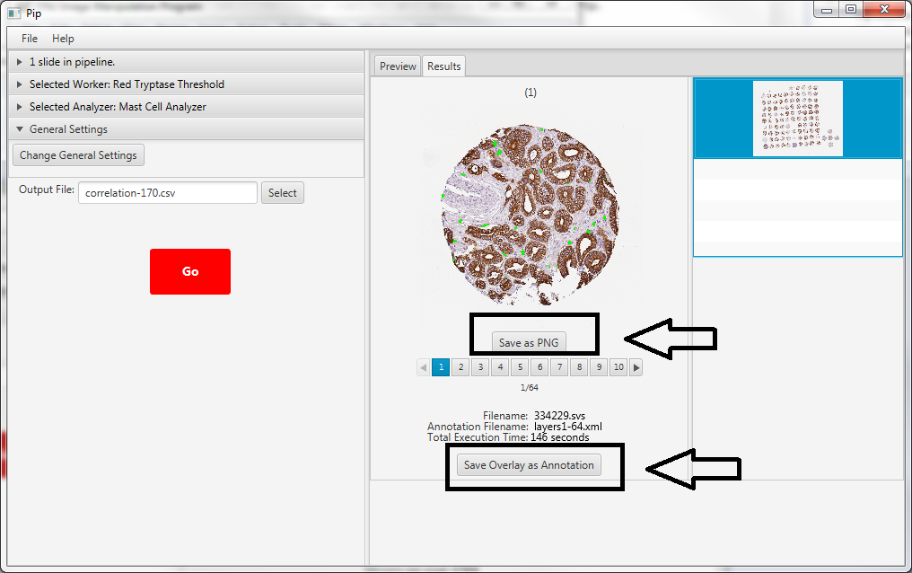
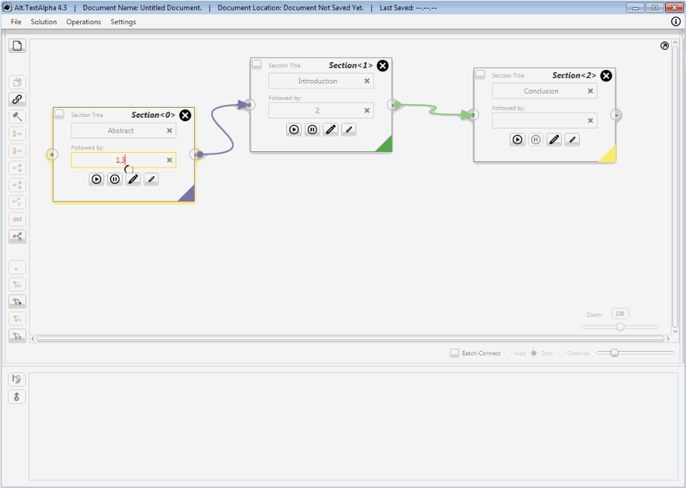
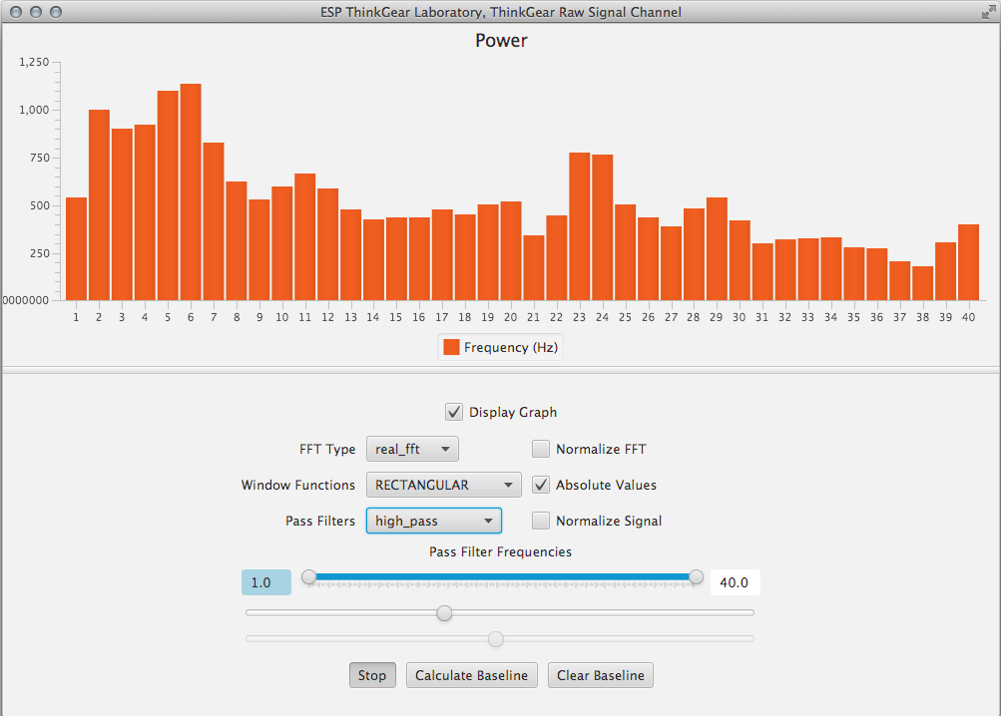
Who uses ControlsFX?
PIP – open source medical image analysis tool for for use with cancer research projects at the Department of Pathology and Laboratory Medicine of Johns Hopkins Hospital
Alt.Text – tool for exploring alternatives in text documents
ESPLab - JavaFX 8 GUI for ESP devices
We suspect there is a lot more …

Slide 17
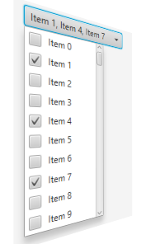
ControlsFX Features

Slide 18
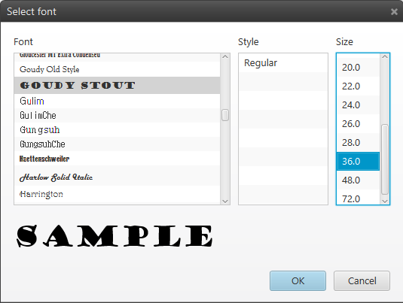
Dialog API The beginning
Featured since the first ControlsFX release
Enjoys wide popularity
Quickly became the de-facto Dialog API for JavaFX
Became a “victim of its own success”
Accepted and promoted to be a part of JavaFX, starting with JavaFX 8u40

Slide 19
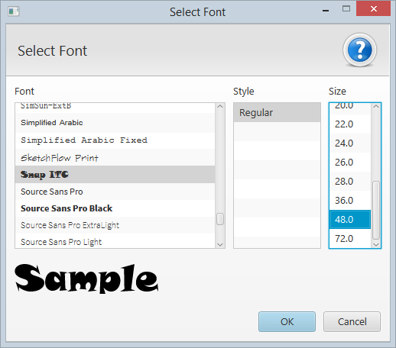
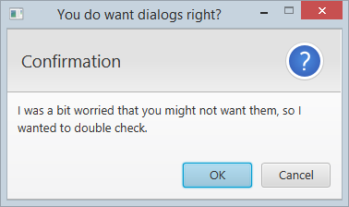
Dialog API Current status
Huge amount of API development in JavaFX 8u40.
Totally different API compared to ControlsFX (although implementation is the same).
Our plan for ControlsFX:
Fork the JavaFX 8u40 dialogs API and implementation – openjfx-dialogs
ControlsFX now has a temporary dependency on this fork
Users can choose to use the old, deprecated API or the new API
We have created additional dialogs based on the new API

Slide 20
Dialog API openjfx-dialogs
openjfx-dialogs is a fork of JavaFX 8u40 dialogs API
Works fine in 8u20
Fork is manually updated when necessary from openjfx
Available online under OpenJDK license (GPL + Classpath):
http://bitbucket.org/controlsfx/openjfx-dialogs

Slide 21
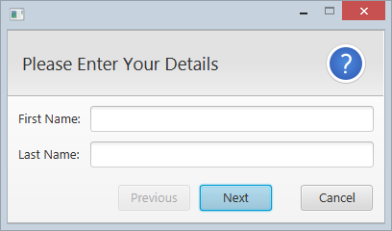
Wizard API
First iteration , based on openjfx-dialogs
WizardPane based DialogPane
Wizard.Flow interface defines the logic of page traversal
Wizard.LinearFlow – simple linear flow
Custom flows can be easily defined
Wizard handles page history automatically

Slide 22
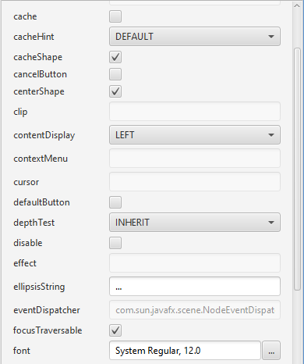
Property Sheet
Support for JavaBeans properties, as well as custom property models
Includes prebuilt editors as well as ability to register custom ones
Property grouping by name or category
Property filtering
Can also be used to implement simple forms.

Slide 23
Action API
JavaFX is missing an Action API, so we implemented it.
Action is an EventHandler<ActionEvent> implementing all common properties.
Can create UI controls such as buttons, menu items, etc from an Action
Can define an ‘action tree’ to effortlessly build ToolBar, MenuBar and ContextMenu
@ActionProxy annotation. Methods annotated with it become actions automatically

Slide 24
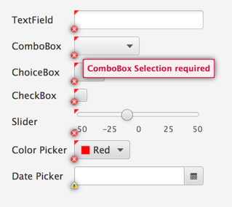
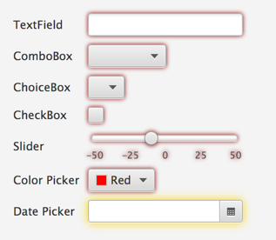
Decoration / Validation API
Can decorate nodes through CSS or graphic at predefined positions
Decoration is used as visual feedback mechanism for Validation API
Validation API is designed to be lightweight but flexible

Slide 25
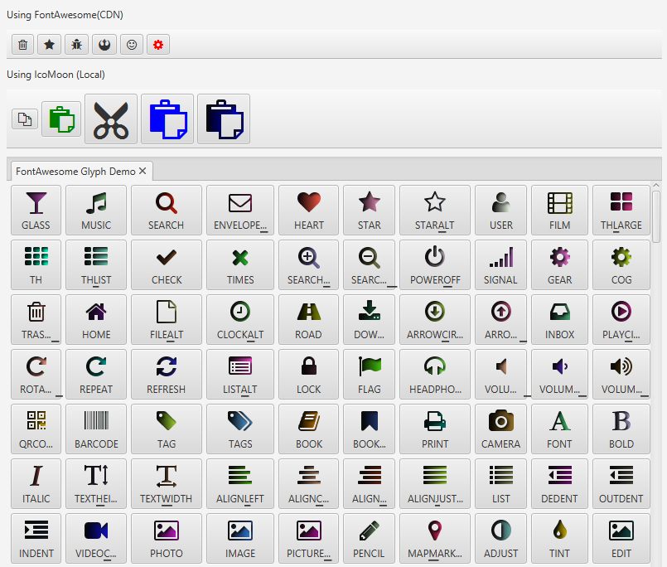
Glyph Font API
Inspired by Jens Deters’ excellent FontAwesomeFX library
Supports any icon fonts, such as FontAwesome, IcoMoon etc
Extended use of icon fonts in Action API: @ActionProxy(text=”Action Text”, image=”font>FontAwesome|STAR”)

Slide 26
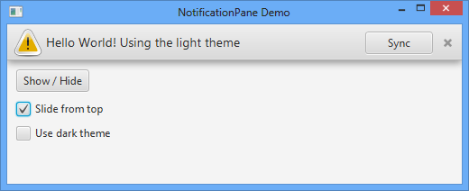
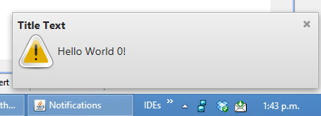
Notification API
NotificationPane: overlay pane, animates in and out, support for graphics, text, controls, has several visual styles
Notifications: Similar to NotificationPane but a separate window. Can appear in one of nine locations on the screen, support for stacking multiple notifications and showing complex screen graphs. Fades out after a set duration.

Slide 27
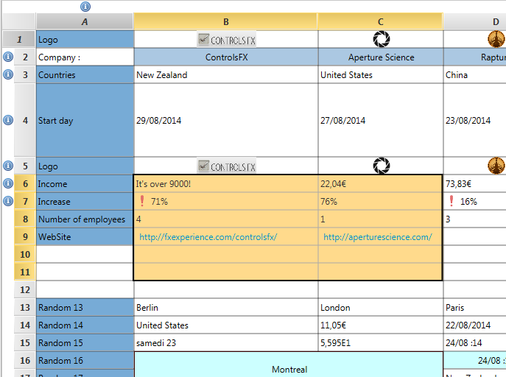
SpreadsheetView
TableView-like control that supports:
Cell spanning
Fixed rows and columns
Cell editing

Slide 28
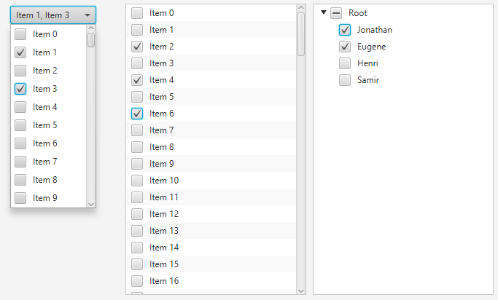
CheckComboBox CheckListView CheckTreeView
All three controls extend the standard JavaFX UI control
Adds support for a ‘check model’, to allow developers to easily
Check specific indices / items
Retrieve checked indices / items

Slide 29
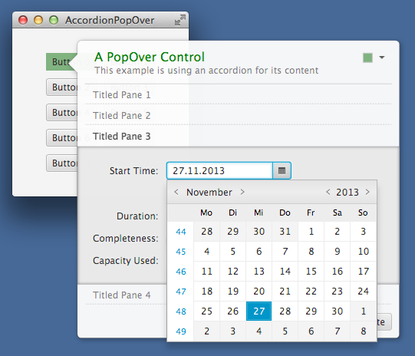
PopOver
Provides information in a visually pleasing way, without interfering with user’s workflow.

Slide 30
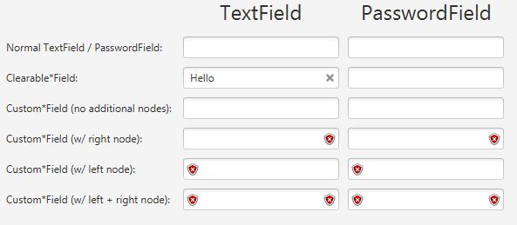
TextField API
Autocomplete TextField
Clearable Fields
Decorated Fields, where nodes can be placed within the text area.
Text does not go underneath the decoration!

Slide 31
Range Slider
Standard JavaFX slider but with two draggable thumbs, instead of one.
Thumbs represent low and high values.
User can drag range bar to concurrently adjust both values

Slide 32
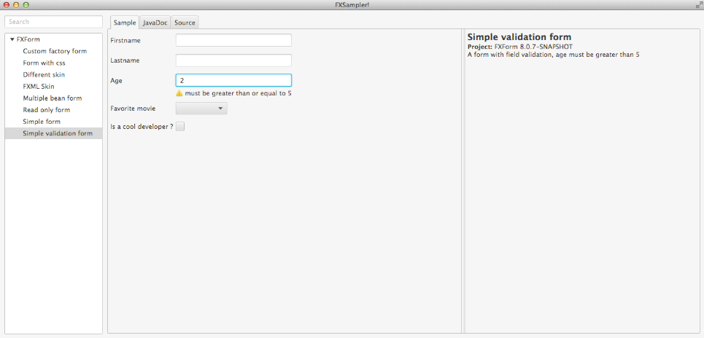
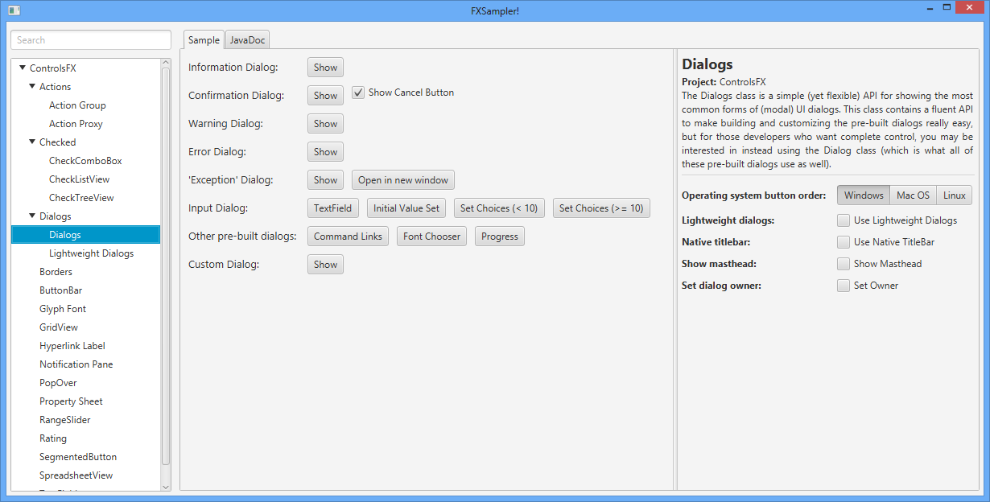
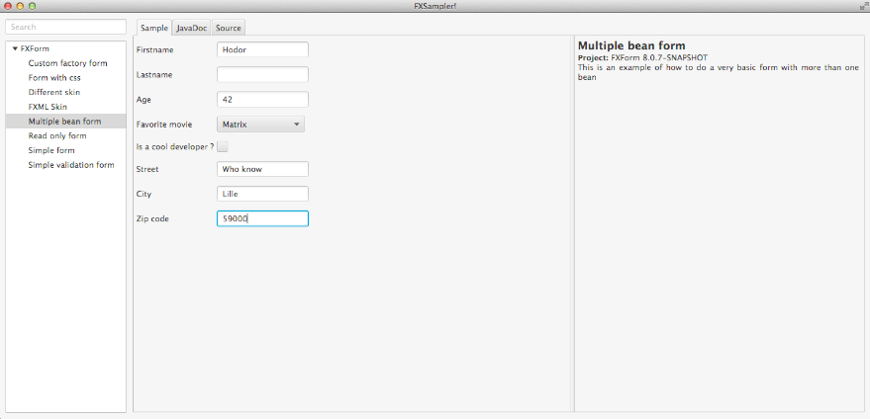
FX Sampler
To demonstrate ControlsFX, we built FX Sampler
Standalone application that detects samples at runtime
Can be used by anyone wanting to demonstrate their samples
E.g. JFXtras, FlexGanttFX and FXForm2 use it
Overall 19 downloads of the last release

Slide 33
Even more controls
Border API: wraps nodes and panes with a border
BreadCrumbBar: Simple navigator for hierarchical page structures
GridView: fast, virtualized grid container. Great for showing images
HiddenSidesPane: Pane with possible hidden side panes
HyperlinkLabel: Label with clickable links
InfoOverlay: Designed to show text comment over a node
MasterDetailPane: Details pane can be made invisible on demand.
PlusMinusSlider: Allows continuous scrolling through large datasets
Rating: Shows star rating, including partial ratings
SegmentedButton: Visually groups toggle buttons together
SnapshotView: Draw a bounding box on screen graph and get selection

Slide 34
Demonstration

Slide 35
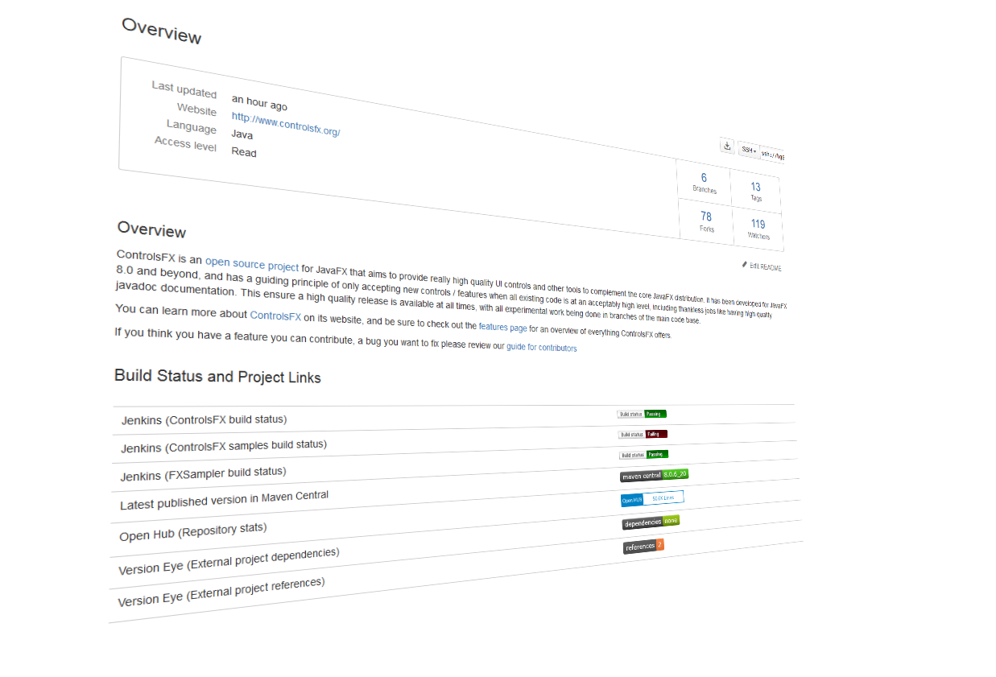
Getting Involved

Slide 36
Getting Started - In Six Simple Steps!
1
The following software is required:
Mercurial
Gradle
JDK 8u20
You’ll need a Bitbucket account
Accounts are free from http://bitbucket.org
2

Slide 37
Getting Started - In Six Simple Steps!
3
Fork the repo.
Go here to create your own fork
https://bitbucket.org/controlsfx/controlsfx/fork
Clone your fork:
hg clone https://<username>@bitbucket.org/<username>/<forkname>
e.g.
hg clone https://eryzhikov@bitbucket.org/eryzhikov/controlsfx
4

Slide 38
Getting Started - In Six Simple Steps!
5
Build your clone. From clone root directory, run:
gradle clean assemble
Run your clone:
gradle run
6

Slide 39
Where is ControlsFX?
ControlsFX.org

Slide 40
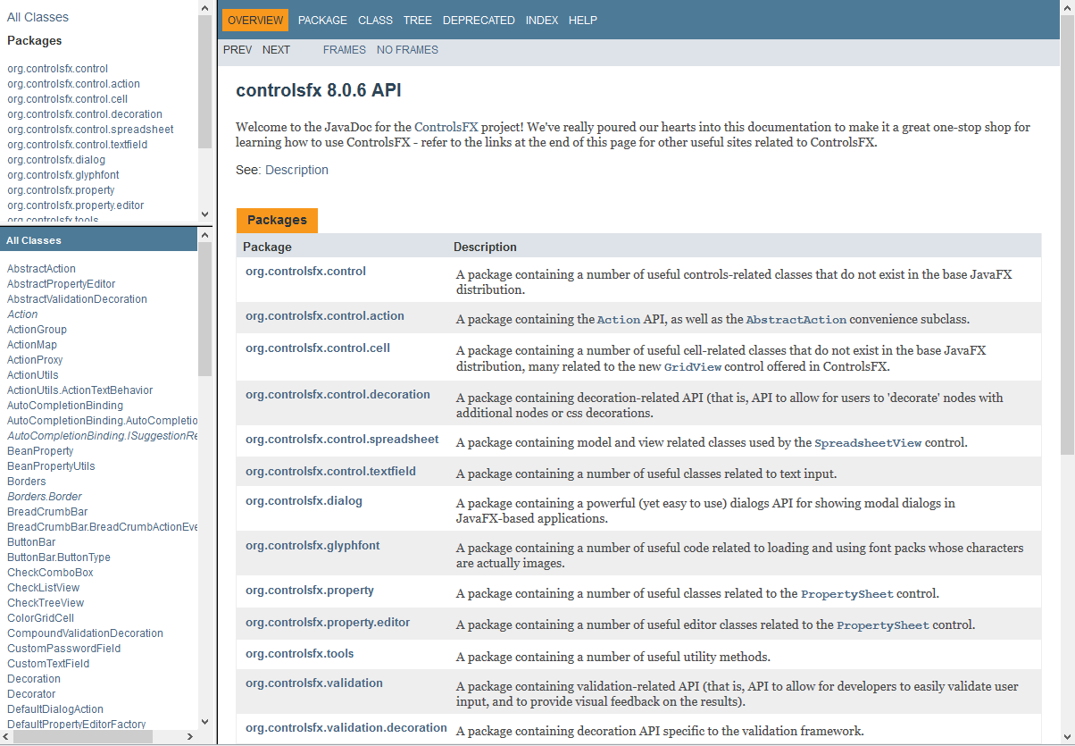
Where is ControlsFX?
docs.controlsfx.org

Slide 41
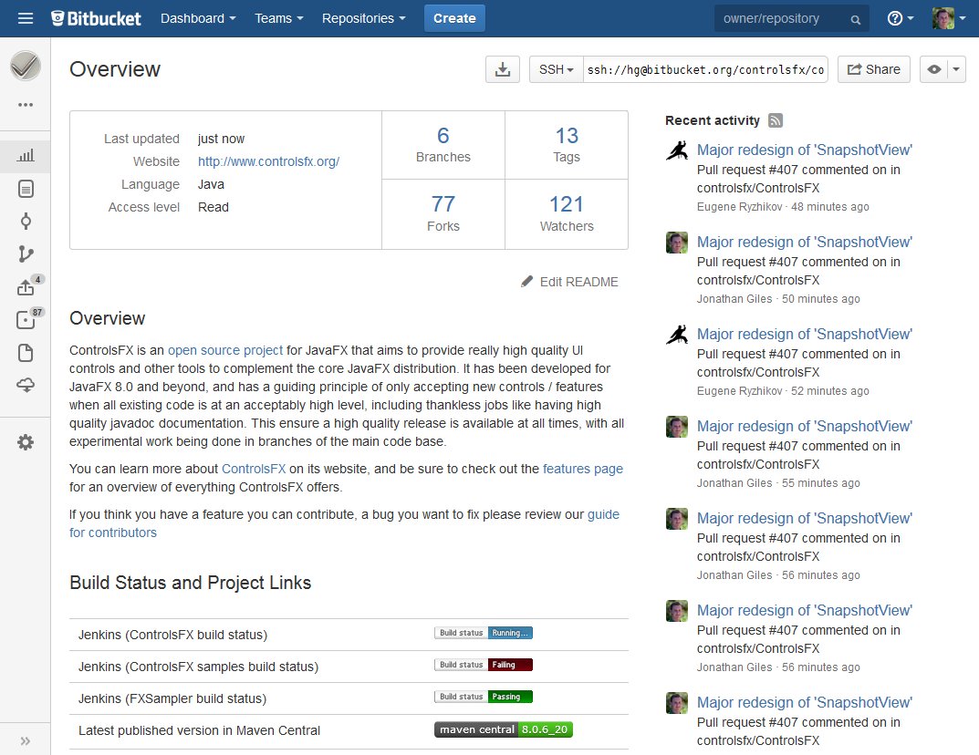
Where is ControlsFX?
code.controlsfx.org

Slide 42
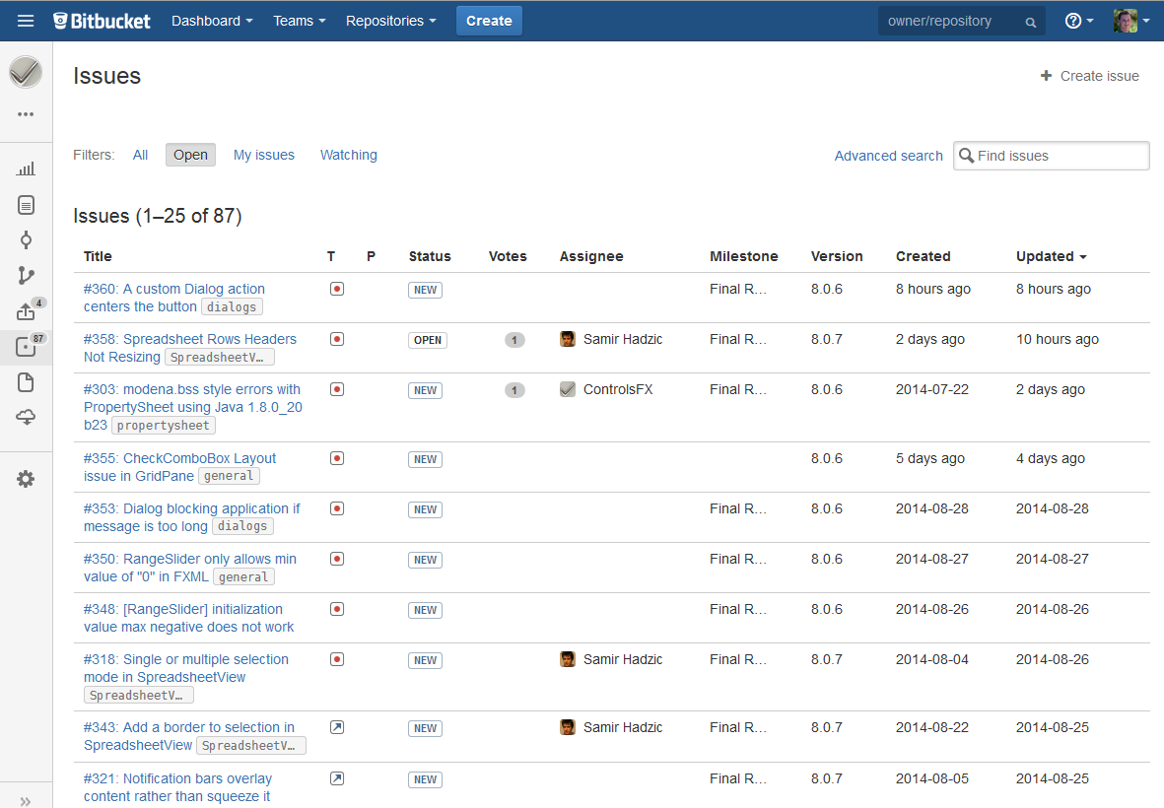
Where is ControlsFX?
issues.controlsfx.org

Slide 43
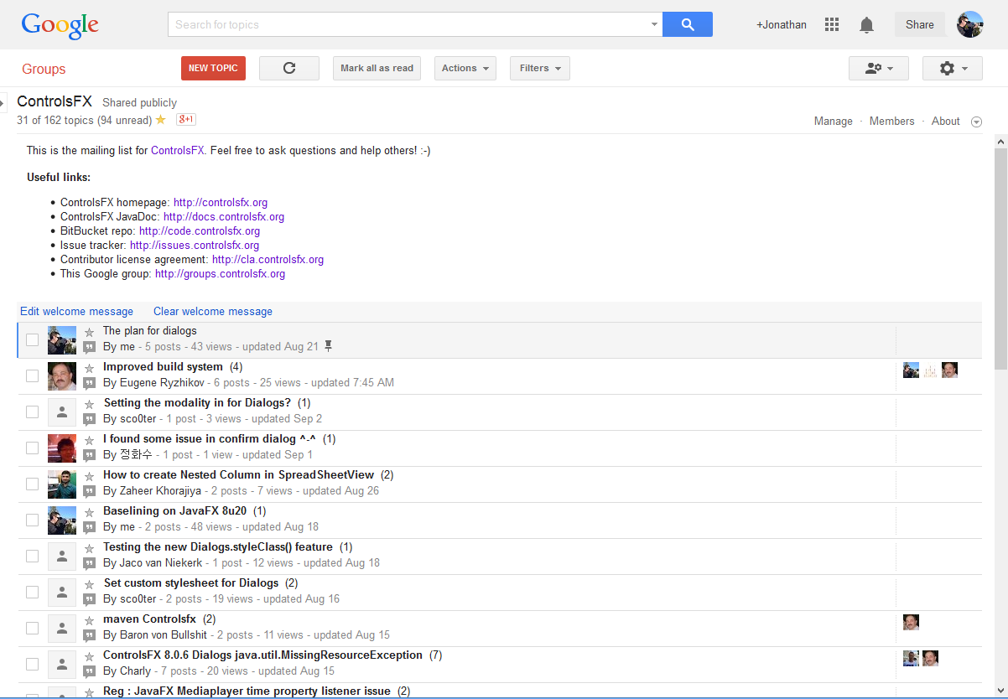
Where is ControlsFX?
Currently 182 members!
groups.controlsfx.org

Slide 44
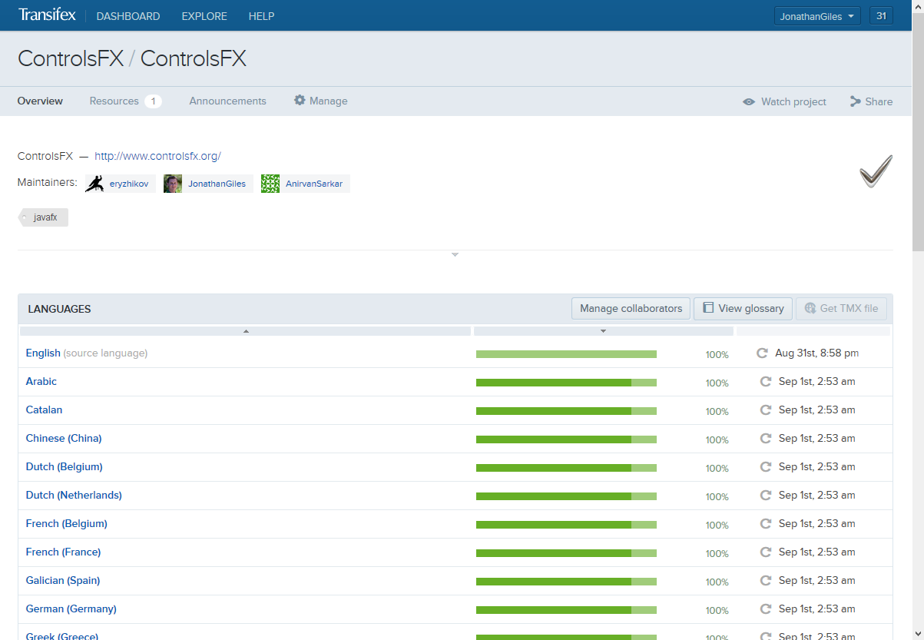
Where is ControlsFX?
i18n.controlsfx.org

Slide 45
Where is ControlsFX? - at Maven Central
Stable builds are available in Maven Central at http://releases.controlsfx.org:
groupId : org.controlsfx
artifactId : controlsfx
Our CI server pushes latest snapshots every hour to http://snapshots.controlsfx.org

Slide 46
How To Contribute
ControlsFX is open source
ControlsFX has a CLA that needs signing (http://cla.controlsfx.org)
Everyone works in their own fork
All contributions are submitted as pull requests
Pull requests are reviewed and merged ASAP.

Slide 47
What Should You Contribute
Anything!
(although acceptance is not guaranteed)
If in doubt, post to controlsfx-dev and ask
Bug fixes, javadocs, samples are just about always welcome.
New features can be discussed on a per-feature basis
Our focus on quality means we don’t want to accept all features

Slide 48
Future Plans

Slide 49
Future Plans
We have a lot still to do! Ideas include:
More prebuilt dialogs
Improve Scene Builder support
Research / implement a GlassPane API
Rewrite decoration / validation API to use this
Reintroduce lightweight dialogs
TableView improvements
Improved search / filter tools
Docking framework
Controlsfx-Mobile

Slide 50
Future Plans - JideFX
JIDE Software has contributed all their JideFX work to ControlsFX
JideFX is a huge collection of UI controls and API, including:
JideFX Common: Searchable, IntelliHints, ShapedPopup and a bunch of utilities
JideFX Converters: Collection of ObjectConverters (compatible with JavaFX StringConverter)
JideFX Comparators: Collection of comparators
JideFX Decoration: Inject a decoration node to any existing node without affecting the layout
JideFX Validation: Provides complete validation support for any JavaFX controls
JideFX Fields: Contains several TextField and ComboBoxBase subclasses such as MaskTextField, FormattedTextField, many PopupFields, FormattedComboBoxes, and Spinners for different data types.

Slide 51
Wrapping Up

Slide 52
Conclusion
ControlsFX is a growing project
It depends on the community
Don’t be a passive user – get active and help grow the project!
Development is done in lieu of family time, and is unpaid
Expectations should be calibrated accordingly.
ControlsFX would gladly accept donations from generous benefactors
Show your appreciation by ranking this session highly!

Slide 53
Conclusion
Finally, for anyone left uncertain, here’s the answers to fun game #1:
Eugene Ryzhikov Jonathan Giles
Russian Kiwi

Slide 54
Want to learn how to build custom JavaFX UI controls? Jonathan is presenting on this topic tomorrow, 3:00pm in Hilton Plaza A
Building Custom JavaFX UI Controls

Slide 55
Thanks for attending! Question Time!
http://www.controlsfx.org
http://code.controlsfx.org
http://groups.controlsfx.org

