Slide 1
Reactive UIs with the Model View ViewModel Pattern: Simple with Ankor.io
Thomas Spiegl
Manfred Geiler
Irian Solutions - The Software Experts

Slide 2
Agenda
M V V M
New concept „MVSVM“
Ankor framework
Ankor live sample
Ankor special features

Slide 3
„M V V M” ?
„Model View ViewModel“
2005 by John Gossman (Microsoft)
≅ „Presentation Model“ by Martin Fowler
Separation of Concerns
Graphical UI
UI logic

Slide 4
Controller
Model
View
Model View Controller

Slide 5
Presentation & UI Logic
View
Binding
ViewModel
Business Logic and Data
Domain Model
Service Calls
DB
Model View ViewModel

Slide 6
M V V M – The View
Graphical user interface (GUI)
User inputs
Data binding to the ViewModel
Markup
XAML
FXML
Presentation & UI Logic
View
Data Binding
ViewModel
Business Logic and Data
Model
Service Calls
DB

Slide 7
M V V M – The ViewModel
Link between View and Model
Connection to Model (service calls)
Properties and actions for the View (binding)
UI logic
UI validation
Presentation & UI Logic
View
Data Binding
ViewModel
Business Logic and Data
Model
Service Calls
DB

Slide 8
M V V M – The Model
Domain model
Data(base) access
Domain logic
Business Rules
Validation
Unit testing
Presentation & UI Logic
View
Data Binding
ViewModel
Business Logic and Data
Model
Service Calls
DB

Slide 9
MVVM solves...
Separation of concerns
Web designer ↔ UI developer
View technology ↔ Presentation logic
Testable ViewModel!
Unit tests
Mock UI
Presentation & UI Logic
View
Data Binding
ViewModel
Business Logic and Data
Model
Service Calls
DB

Slide 10
MVVM does not solve...
Model on client or server?
Communication client ↔ server
Various client technologies
HTML5
iOS
Android
JavaFX
...
Presentation & UI Logic
View
Data Binding
ViewModel
Business Logic and Data
Model
Service Calls
DB

Slide 11
Agenda
M V V M
New concept „MVSVM“
Ankor framework
Ankor live sample
Ankor special features

Slide 12
DB
Client
View
Data Binding
Server
ViewModel
ViewModel
Synchronization
Model
Model View SynchronizedViewModel

Slide 13
MVSVM - Synchronized ViewModel
Client holds:
View
ViewModel
Client technology:
Modern platform
HTML5
JavaFX
iOS, Android
...
Very latest frameworks
Cutting edge
Server holds:
ViewModel
Model
Server technology:
Java EE
Approved patterns
Stable platform
DB
Client
View
Data Binding
Server
ViewModel
ViewModel
Synchronization
Model

Slide 14
Agenda
M V V M
New concept „MVSVM“
Ankor framework
Ankor live sample
Ankor special features

Slide 15
Project „Ankor”
2013
http://www.ankor.io
Open Source (Apache License, Version 2.0)
Expandable modular framework
Event driven programming model
Asynchronous processing
Bidirectional client-server communication
Native MVSVM support

Slide 16
DB
Client
View
Data Binding
Ankor Server
ViewModel
Type-less
Only data
ViewModel
Strongly typed
Behaviour
Change Events
Action Events
Model
Ankor - Synchronized ViewModel

Slide 17
DB
ViewModel (client side)
Type-less
Only data
ViewModel (server side)
Strongly typed
Behaviour
Client
View
public class TaskListViewModel {
private List<Task> tasks;
private String filter;
private Integer itemsLeft;
// getters and setters
}
public class Task {
private String id;
private String title;
private boolean completed;
// getters and setters
}
{
"tasks": [
{"id": "dda6f7d9-8d5e-4baf-969b-110f654a64e3",
"title": "drink less coffee",
"completed": false},
{"id": "ff202f81-33b8-4ae3-bf6a-0208714e2261",
"title": "get more sleep",
"completed": false}
],
"filter": "all",
"itemsLeft": 2
}
JEE Server
Data Binding
ViewModel
type-less
only Data
ViewModel
strongly typed
Behaviour
Change Events
Action Events
Model
Ankor - Synchronized ViewModel

Slide 18
JavaFX
HTML5
iOS
.NET
View
ViewModel
Messaging (Connector HTTP, Websocket, JMS, ...)
Ankor Framework
Model
JEE Server
DB
Ankor – Architecture overview

Slide 19
Ankor – Client Architecture
Various client languages und platforms
Java
JavaFX
Android
Javascript / HTML5
jQuery
AngularJS
React
Objective-C
iOS
C#
.NET / WPF
JavaFX
HTML5
iOS
.NET
Messaging (HTTP, Websocket, JMS, ...)
Ankor Framework
JEE Server

Slide 20
Ankor – Server Architecture
Java SE 1.6 (or higher)
Diverse Netzwerk-Protokolle
Socket
HTTP-Polling
Websocket
Messaging
JSON
Concurrency / Parallelisierung
Simple Synchronization
Akka Actors
JEE Container
Glassfish (Websocket)
Tomcat
Spring Boot (embedded Tomcat)
JavaFX
HTML5
iOS
.NET
Messaging (HTTP, Websocket, JMS, ...)
Ankor Framework
JEE Server

Slide 21
Agenda
M V V M
New concept „MVSVM“
Ankor framework
Ankor live sample
Ankor special features

Slide 22
Ankor - iOS Example

Slide 23
Ankor - iOS Example
Start Ankor System, connect to server
[[[ANKSystem alloc]
initWith:@"root" connectParams:connectParams
url:@"ws://localhost:8080/websocket/ankor"
useWebsocket:YES] start];

Slide 24
Ankor - iOS Example
Register Change Listener
[ANKRefs observe:@"root.model.tasks"
target:self listener:@selector(tasksChanged:)];
Change Listener
- (void)tasksChanged:(id) value {
[[self toDoItems]removeAllObjects];
[[self toDoItems]addObjectsFromArray:value];
[self.tableView reloadData];
}

Slide 25
Ankor - iOS Example
Fire Action / Add a new Task
[ANKRefs fireAction:@"root.model"
name:@"newTask"
params:params]; // Dictionary
ActionListener Java
@ActionListener
public void newTask(@Param("title") final String title)
{...}

Slide 26
Agenda
M V V M
New concept „MVSVM“
Ankor framework
Ankor live sample
Ankor special features

Slide 27
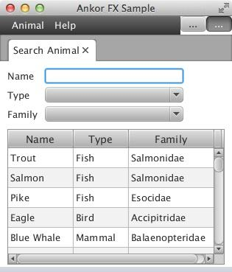
Ankor - Special Features
Ankor Annotations
Ankor Big Collections
BigList
BigMap
Ankor Flood Control
Pluggable Bean-Factory
Simple/Reflection
Spring
CDI (planned)
Collaboration Support
Stateless Model
Server
public class AnimalSearchViewModel {
private AnimalSearchFilter filter;
@ChangeListener(pattern = {".filter.**"})
public void reloadAnimals() {
this.animals
= animalRepository.searchAnimals(filter);
}
Client

Slide 28
Ankor - Special Features
Ankor Annotations
Ankor Big Collections
BigList
BigMap
Ankor Flood Control
Pluggable Bean-Factory
Simple/Reflection
Spring
CDI (planned)
Collaboration Support
Stateless Model
Server
public class AnimalSearchViewModel {
private List<Animal> animals
= new ArrayList<Animal>(10000);
@AnkorBigList(chunkSize = 10)
public List<Animal> getAnimals() {
return animals;
}
send 10 rows at once -on demand only!
Client

Slide 29
Ankor - Special Features
Ankor Annotations
Ankor Big Collections
BigList
BigMap
Ankor Flood Control
Pluggable Bean-Factory
Simple/Reflection
Spring
CDI (planned)
Collaboration Support
Stateless Model
Server
public class AnimalSearchViewModel {
@ChangeListener(pattern = {".filter.**"})
@AnkorFloodControl(delayMillis = 100L)
public void reloadAnimals() {
this.animals
= animalRepository.searchAnimals(filter);
}
Client

Slide 30
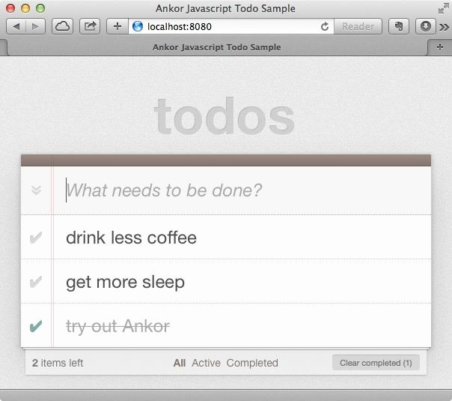
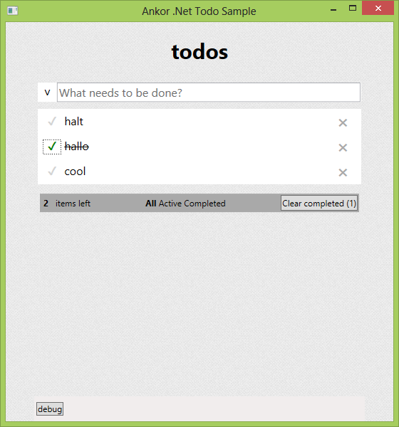
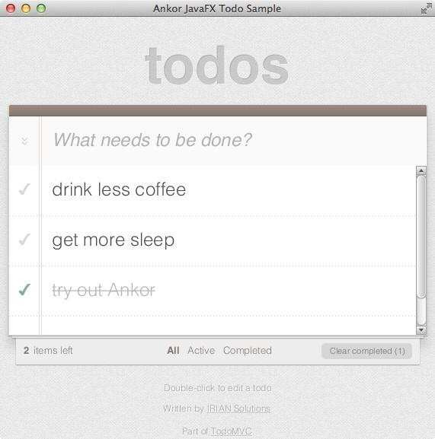
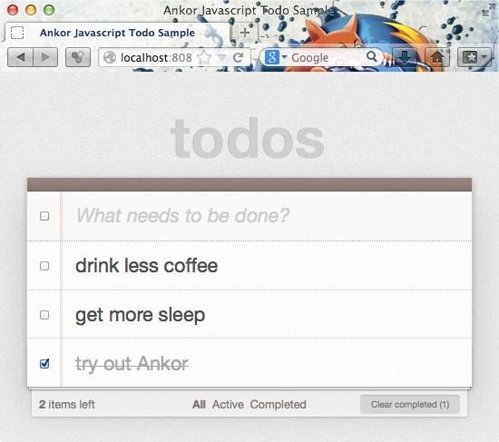
Ankor - Special Features
Ankor Annotations
Ankor Big Collections
BigList
BigMap
Ankor Flood Control
Pluggable Bean-Factory
Simple/Reflection
Spring
CDI (planned)
Collaboration Support
Stateless Model
Server
Shared ViewModel

Slide 31
Ankor - Special Features
Ankor Annotations
Ankor Big Collections
BigList
BigMap
Ankor Flood Control
Pluggable Bean-Factory
Simple/Reflection
Spring
CDI (planned)
Collaboration Support
Stateless Model
send state information
Server
public class TaskListModel {
@StateHolder
private Filter filter;
public void setFilter(String filter) {
this.filter =
Filter.valueOf(filter);
initCalculatedFields();
}

Slide 32
Ankor.io
Further information, documentation & tutorials
http://ankor.io
http://github.com/ankor-io
Thomas Spiegl
Manfred Geiler

