Slide 1
Production Debugging @ 100mph

Slide 2
About Me
Co-founder – Takipi (God mode in Production Code).
Co-founder – VisualTao (acquired by Autodesk).
Director, AutoCAD Web & Mobile.
Software Architect at IAI Aerospace.
Coding for the past 16 years - C++, Delphi, .NET, Java.
Focus on real-time, scalable systems.
Blogs at takipiblog.com

Slide 3
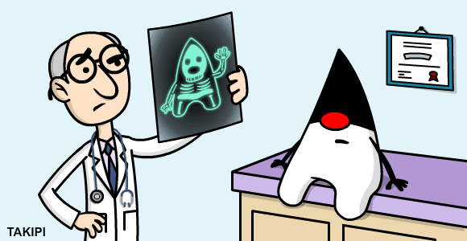
Overview
Dev-stage debugging is forward-tracing.
Production debugging is focused on backtracing.
Modern production debugging poses two challenges: state isolation and data distribution.
Direct correlation between quality of data to MTTR.

Slide 4
Agenda
Distributed logging – best practices.
Preemptive jstacks
Extracting state with BTrace
Extracting state with custom Java agents.

Slide 5
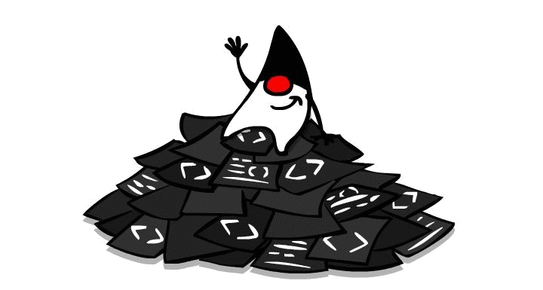
Solid Logging Practices
Make sure these are baked into your logging context –
1. Code context.
2. Time + duration.
3. Thread ID (preferably name).
4. Transaction ID (for async & distributed debugging).

Slide 6
Transaction ID
Logging is usually a multi–threaded / process affair.
Generate a UUID at every thread entry point into your app – the transaction ID.
Append the ID into each log entry.
Try to maintain it across machines – critical for distributed / async debugging.

Slide 7
Thread Names
Thread name is a mutable property.
Can be set to hold transaction specific state.
Some frameworks (e.g. EJB) don’t like that.
Can be super helpful when debugging in tandem with jstack.

Slide 8
Thread Names (2)
Transaction ID
Servlet parameters
Queue message ID
Start time
"pool-1-thread-1" #17 prio=5 os_prio=31 tid=0x00007f9d620c9800 nid=0x6d03 in Object.wait() [0x000000013ebcc000]
”MsgID: AB5CAD, type: Analyze, queue: ACTIVE_PROD, TID: 5678956, TS: 11/8/20014 18:34 "
#17 prio=5 os_prio=31 tid=0x00007f9d620c9800 nid=0x6d03 in Object.wait() [0x000000013ebcc000]

Slide 9
Global Exception Handlers
Your last line of defense - critical to pick up on unhandled exceptions.
Setting the callback:
public static void Thread.setDefaultUncaughtExceptionHandler(UncaughtExceptionHandler eh)
void UncaughtExceptionHandler.uncaughtException(Thread t, Throwable e) {
logger.error(“Uncaught error in thread “ + t, e);
}
Again, this is where thread Name + TLS are critical as the only surviving state.

Slide 10
External Calls
When a call leaves the JVM via JNI chances of exception increase dramatically.
This includes Http, SQL, IO, OS calls. Treat each as if it will explode (it most likely will).
try { return s3client.generatePresignedUrl(request);
} catch (Exception e) {
String error = String.format(“Error generating request: %s bucket: %s key: %s. method: %s", request, bucket, path, method);
throw new IllegalStateException(error, e); // OR: logger.error(error, e);
}

Slide 11
Preemptive jstack
A production debugging foundation.
Presents two issues –
Activated only in retrospect.
No state: does not provide any variable state.
Let’s see how we can overcome these with preemptive jstacks.

Slide 12
Preemptive jstack - Demo
github.com/takipi/jstack

Slide 13
BTrace
An advanced open-source tool for extracting state from a live JVM.
Uses a Java agent and a meta-scripting language to capture state.
Pros: Lets you probe variable state without modifying / restarting the JVM.
Cons: read-only querying using a custom syntax and libraries.

Slide 14
BTrace - Restrictions
Can not create new objects.
Can not create new arrays.
Can not throw exceptions.
Can not catch exceptions.
Can not make arbitrary instance or static method calls - only the public static methods of com.sun.btrace.BTraceUtils class may be called from a BTrace program.
Can not assign to static or instance fields of target program's classes and objects. But, BTrace class can assign to it's own static fields ("trace state" can be mutated).
Can not have instance fields and methods. Only static public void returning methods are allowed for a BTrace class. And all fields have to be static.
Can not have outer, inner, nested or local classes.
Can not have synchronized blocks or synchronized methods.
can not have loops (for, while, do..while)
Can not extend arbitrary class (super class has to be java.lang.Object)
Can not implement interfaces.
Can not contains assert statements.
Can not use class literals.

Slide 15
BTrace - Demo

Slide 16
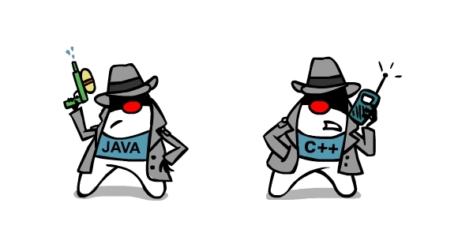
Custom Java Agents
An advanced technique for instrumenting code dynamically.
The foundation for most profiling / debugging tools.
Two types of agents: Java and Native.
Pros: extremely powerful technique to collect state from a live app.
Cons: requires knowledge of creating verifiable bytecode.

Slide 17
Custom Agent - Demo
github.com/takipi/debugAgent

Slide 18
Thanks!
tal.weiss@takipi.com
@takipid
takipiblog.com

