Slide 2
Driving the Java Carputer Farther and Faster
(Or Carhacking With Duke)
Simon Ritter
Head of Java Evangelism, Oracle
Twitter: @speakjava
Copyright © 2014, Oracle and/or its affiliates. All rights reserved.
Notes:
This is a Title Slide with Java FY15 Theme slide ideal for including the Java Theme with a brief title, subtitle and presenter information.
To customize this slide with your own picture:
Right-click the slide area and choose Format Background from the pop-up menu. From the Fill menu, click Picture and texture fill. Under Insert from: click File. Locate your new picture and click Insert.
To copy the Customized Background from Another Presentation on PC
Click New Slide from the Home tab's Slides group and select Reuse Slides.
Click Browse in the Reuse Slides panel and select Browse Files. Double-click the PowerPoint presentation that contains the background you wish to copy.
Check Keep Source Formatting and click the slide that contains the background you want.
Click the left-hand slide preview to which you wish to apply the new master layout.
Apply New Layout (Important): Right-click any selected slide, point to Layout, and click the slide containing the desired layout from the layout gallery.
Delete any unwanted slides or duplicates.
To copy the Customized Background from Another Presentation on Mac
Click New Slide from the Home tab's Slides group and select Insert Slides from Other Presentation…
Navigate to the PowerPoint presentation file that contains the background you wish to copy. Double-click or press Insert. This prompts the Slide Finder dialogue box.
Make sure Keep design of original slides is unchecked and click the slide(s) that contains the background you want. Hold Shift key to select multiple slides.
Click the left-hand slide preview to which you wish to apply the new master layout.
Apply New Layout (Important): Click Layout from the Home tab's Slides group, and click the slide containing the desired layout from the layout gallery.
Delete any unwanted slides or duplicates.

Slide 3
Notes:
This is a Safe Harbor Front slide, one of two Safe Harbor Statement slides included in this template.
One of the Safe Harbor slides must be used if your presentation covers material affected by Oracle’s Revenue Recognition Policy
To learn more about this policy, e-mail: Revrec-americasiebc_us@oracle.com
For internal communication, Safe Harbor Statements are not required. However, there is an applicable disclaimer (Exhibit E) that should be used, found in the Oracle Revenue Recognition Policy for Future Product Communications. Copy and paste this link into a web browser, to find out more information.
http://my.oracle.com/site/fin/gfo/GlobalProcesses/cnt452504.pdf
For all external communications such as press release, roadmaps, PowerPoint presentations, Safe Harbor Statements are required. You can refer to the link mentioned above to find out additional information/disclaimers required depending on your audience.

Slide 4
Program Agenda
1
Introduction to the Carputer
More data
Heads up display/telematics
Driver analysis
Conclusions and resources
Demos
2
3
4
5
6

Slide 5
Introduction to the Carputer
Notes:
This slide can also be used as a Q and A slide

Slide 6
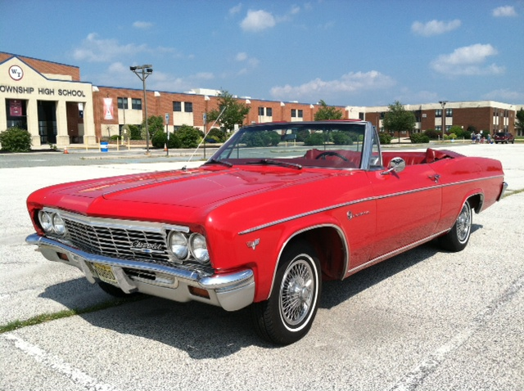
How Cars Used To Be
Zero lines of code

Slide 7
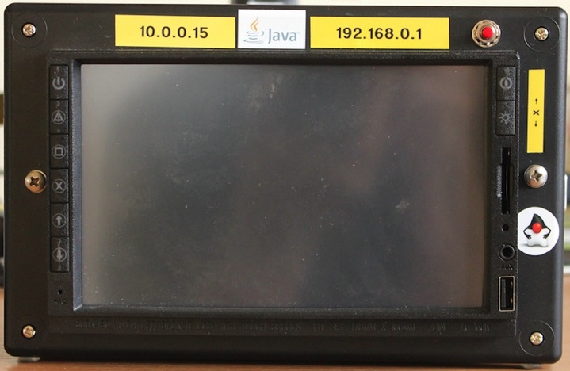
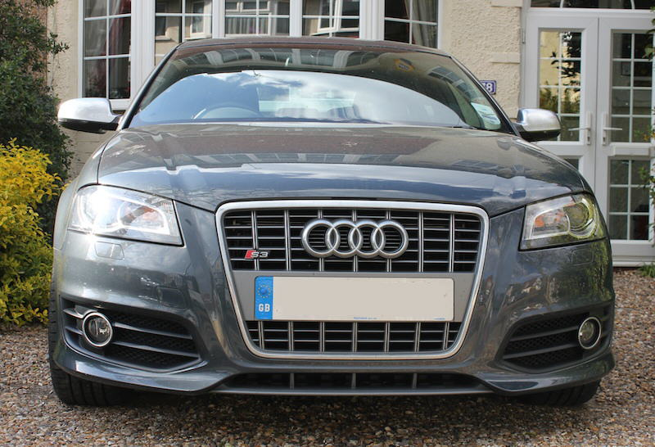
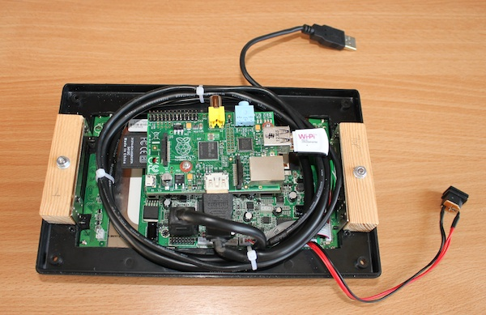
Last Years Carputer

Slide 8
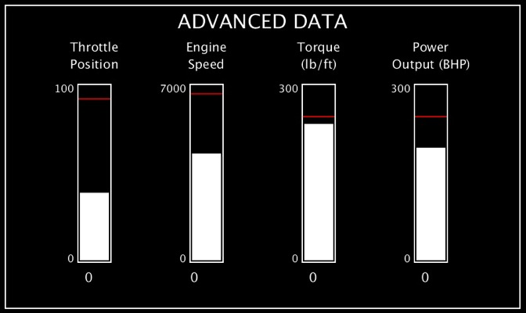
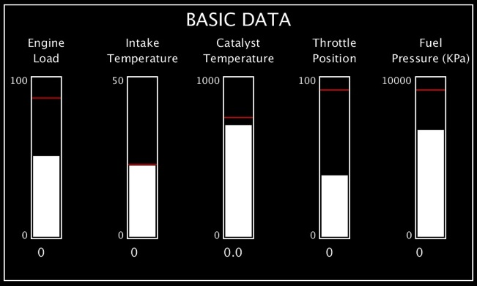
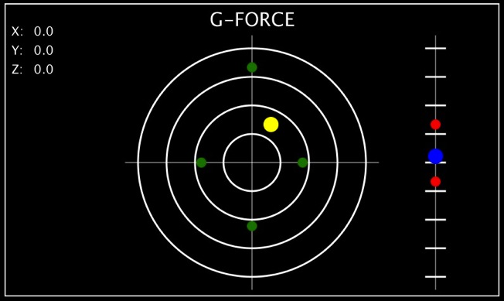
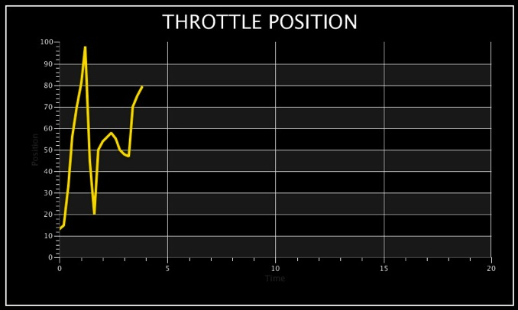
Last Year’s UI

Slide 9
Ideas For A Better Carputer
More car data via the CAN bus
Steering angle, gear selected, ABS data (individual wheel speed)
Controls (steering wheel buttons, indicators)
GPS data
Heart rate monitor for driver
Tyre pressure monitoring
Thermal sensor for brake or tyre temperature

Slide 10
Ideas For A Better Carputer
Different display method
Heads up projected onto windscreen
In-car camera recording forward view
Telematics
GPRS to get driving relevant data (speed limit) from the cloud
Use recorded data to let people post-drive analyse their driving
Insurance, training applications

Slide 11
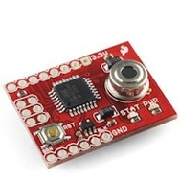
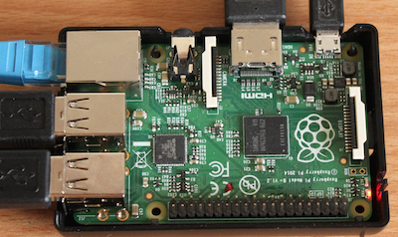
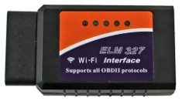
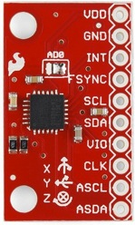
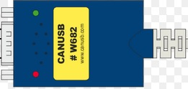
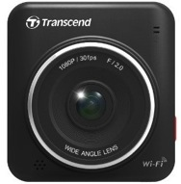
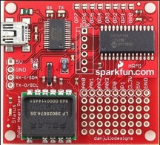
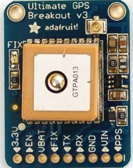
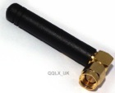
Carputer Architecture Concept
OBD2 Service Port
Crossover ethernet
USB via FTDI
Wi-Fi
USB
USB
Infra red Thermal sensor
I2C
Raspberry Pi Model B+
7” Touch secreen
Accelerometer/Gyro/Compass
CAN Bus
CAN High
CAN Low
USB
UART
Serial
SDR/TPMS
Video Camera
Heart Rate Monitor
GPS

Slide 12
More Data
Notes:
This slide can also be used as a Q and A slide

Slide 13
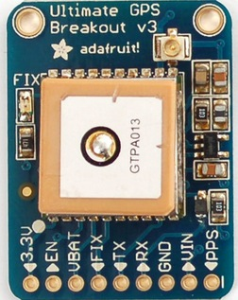
Tracking Position With GPS
AdaFruit Ultimate GPS breakout
10Hz read rate
Serial interface
Very simple configuration
Disable /dev/ttyAMA0 on Pi as console
9600 8N1
Read data using librxtx-java
Comma separated values $GPGGA and $GPVTG
Need to handle frequent data corruption

Slide 14
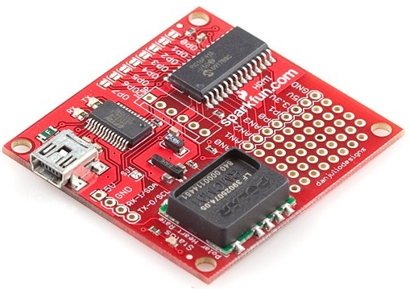
Heart Rate Monitoring of the Driver
Sparkfun board
USB interface, serial connection
Similar to GPS
Use librxtx-java
9600, 8N1
More complicated coding
Actually need to send a read request!
Some issues with wireless connection
80cm max, doesn’t work well through a Rapsberry Pi

Slide 15
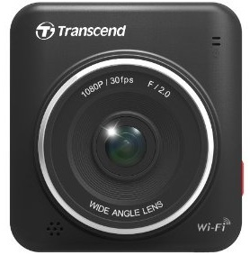
In-car Video
Becoming very common to avoid insurance issues
Transcend DrivePro 200
Built-in Wi-Fi
iPhone app
How to get video stream?
Approached Transcend tech support
Found VLC code
Wireshark
SYN/ACK, Yuck!
Camera | Application
192.168.0.1 | 192.168.0.2
Port 9000 | Port 43229
Port 9001 | Port 42719
Port 9002 | Port 58105
Port 8554 (RTSP) | Port 60583

Slide 16
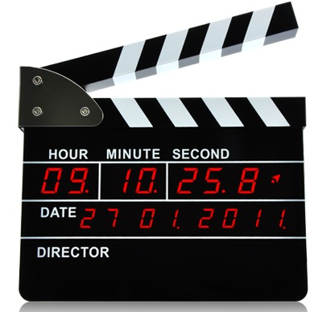
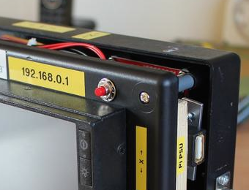
The Simplest Solution Is Often The Best
Push button using GPIO lines and Pi4J

Slide 17
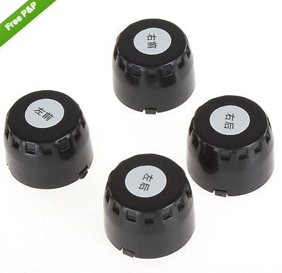
Tyre Pressure Monitoring System (TPMS)
All US vehicles must have a TPMS
Post-Firestone issues
TREAD act
Not mandatory in EU
My Audi has TPMS based on ABS sensors
Tyre deflates, wheel gets smaller, detect speed differential
After market TPMS are cheap
Notes:
TREAD Transportation Recall Enhancement Accountability and Documentation Act

Slide 18
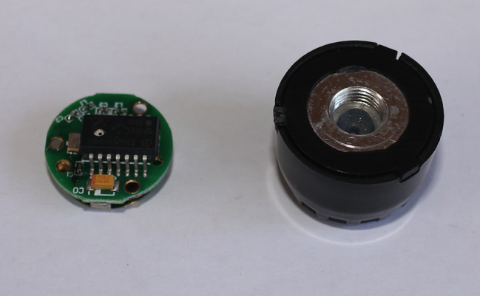
TPMS Decoding
Bought some sensors on eBay
Documentation states they use 433MHz
Dismantle them to find they use an SP37 chip from Infineon
Software Defined Radio (SDR) receiver
eBay, $20
rtl_433 software from Github
Now for the fun part
Unfortunately, unable to decode data
Need to look at GNU Radio (future project)

Slide 19
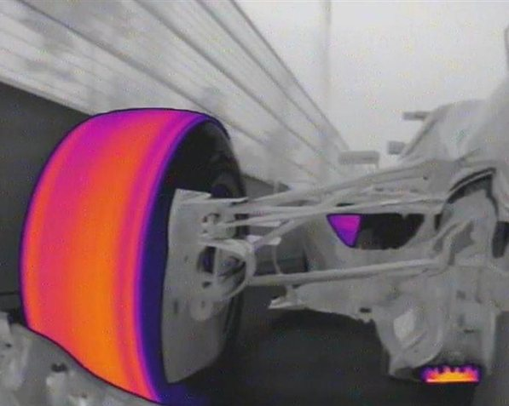
Thermal Sensors For Brakes and Tyres
The Goal

Slide 20
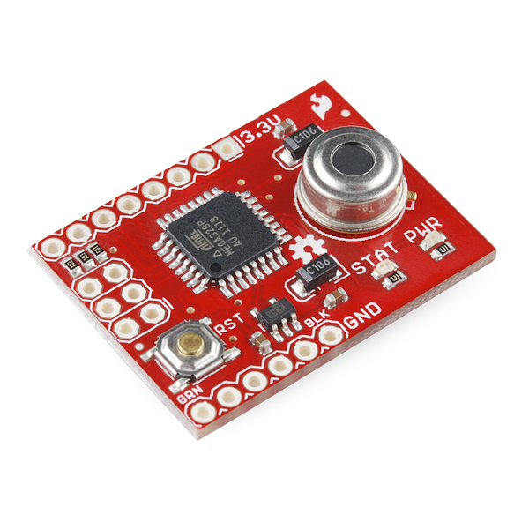
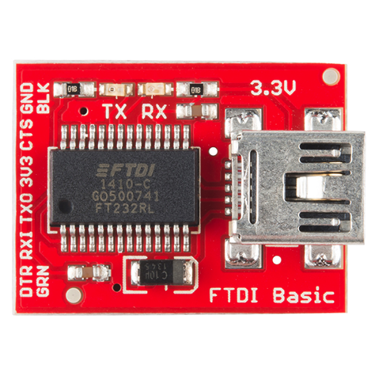
Infra-Red Thermometer
The Reality
MLX90614 breakout board
I2C interface seemed problematic on the Pi
Also has serial interface
Use FTDI breakout board
4 wires becomes simple serial interface

Slide 21
Thermal Sensor Data
Provides continuous reading as lines of text (e.g. 73.2F)
Don’t like Fahrenheit, wanted Celcius
Lambdas and Streams!
private double currentTemperature;
public void run() {
thermalReader.lines()
.mapToDouble(s -> Double.parseDouble(s.substring(0, s.length() - 1)))
.map(t -> ((t - 32) * 5 / 9))
.filter(t -> t != currentTemperature)
.peek(t -> listener.ifPresent(l -> l.temperatureChange(t)))
.forEach(t -> currentTemperature = t);
}

Slide 22
Thermal Sensor Data
Provides continuous reading as lines of text (e.g. 73.2F)
Don’t like Fahrenheit, wanted Celcius
Lambdas and Streams!
private double currentTemperature;
public void run() {
thermalReader.lines()
.mapToDouble(s -> Double.parseDouble(s.substring(0, s.length() - 1)))
.map(t -> ((t - 32) * 5 / 9))
.filter(t -> t != this.currentTemperature)
.peek(t -> listener.ifPresent(l -> l.temperatureChange(t)))
.forEach(t -> this.currentTemperature = t);
}

Slide 23
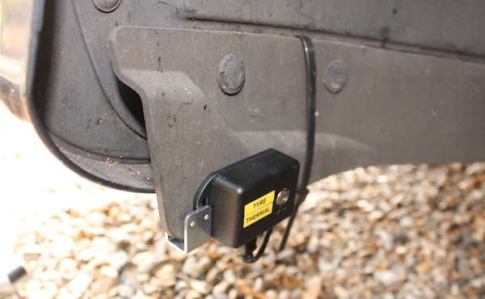
Fitting The Thermal Sensors
Tyre Sensor

Slide 24
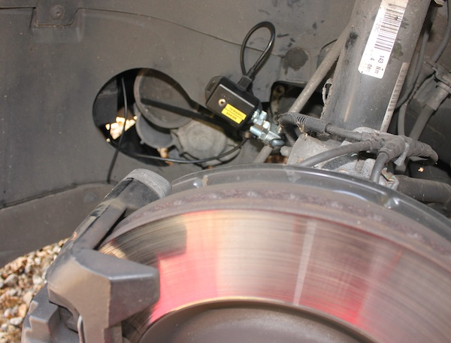
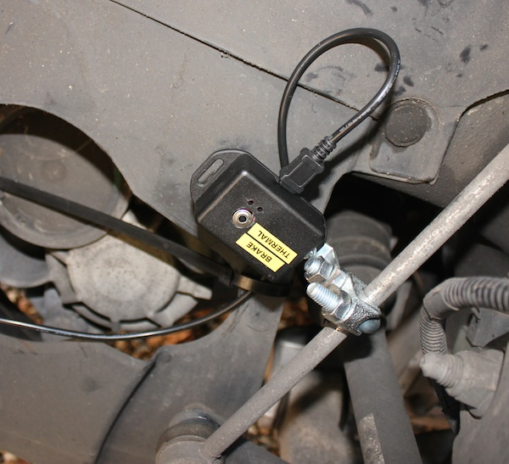
Fitting The Thermal Sensors
Brake Disk Sensor

Slide 25
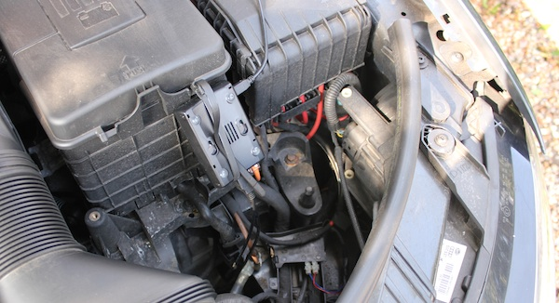
Fitting The Thermal Sensors
Separate Pi in Engine Bay

Slide 26
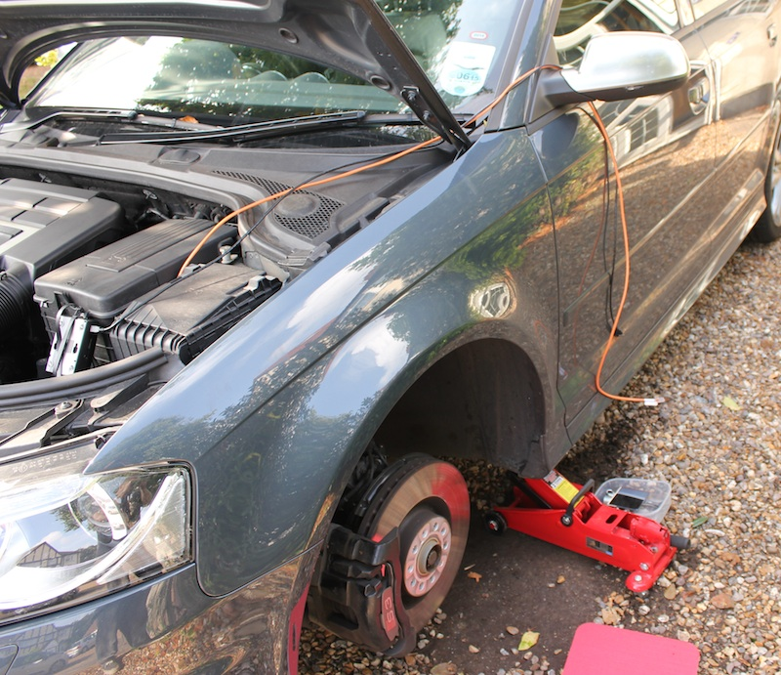
Fitting The Thermal Sensors
The Networked Car
Simple server listens on port
Carputer requests data
Couple of issues
Server needed reset for new connection (bug to be fixed)
How to tell which sensor is which (ttyUSB0/ttyUSB1)

Slide 27
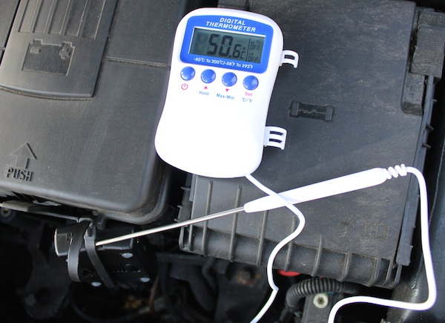
Fitting The Thermal Sensors
Internal Combustion Produces Heat
Rasperry Pi at over 50C
After 10 minute drive
New approach required
Longer USB cables
Put the Pi in the car

Slide 28
Getting Data From The CAN Bus
Controller Area Network
Used to connect many sensors, actuators and devices
Without huge amounts of wiring
Conveniently the CAN bus is connected to the OBD2 port
Yes, the wiring is there
No, the signals are not
Presumably security measure from car manufacturers
Boo!

Slide 29
Getting Data From The CAN Bus
Where There’s A Will There’s A Way
A search of the internet revealed some useful information
Wire Colour | Signal
Orange/Brown | CAN Low (for all buses)
Orange/Black | CAN Hi (Powertrain bus)
Orange/Green | CAN Hi (Convenience bus)
Orange/Violet | CAN Hi (Infotainment bus)

Slide 30
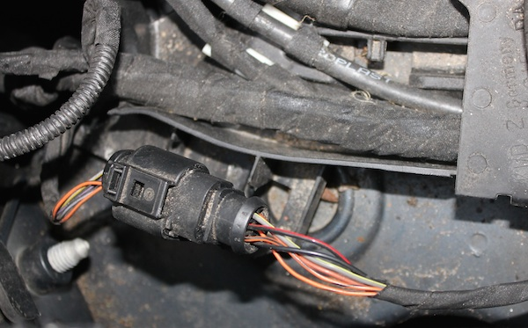
Getting Data From The CAN Bus
Where There’s A Will There’s A Way

Slide 31
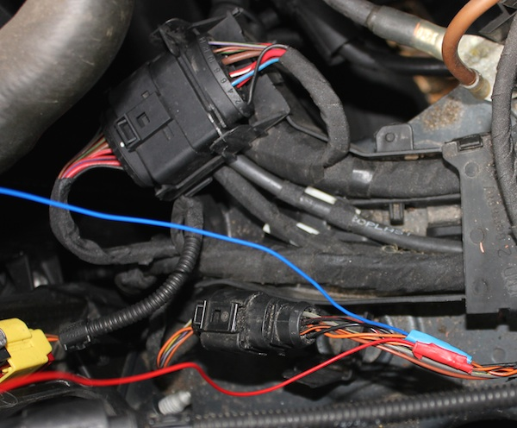
Getting Data From The CAN Bus
Where There’s A Will There’s A Way

Slide 32
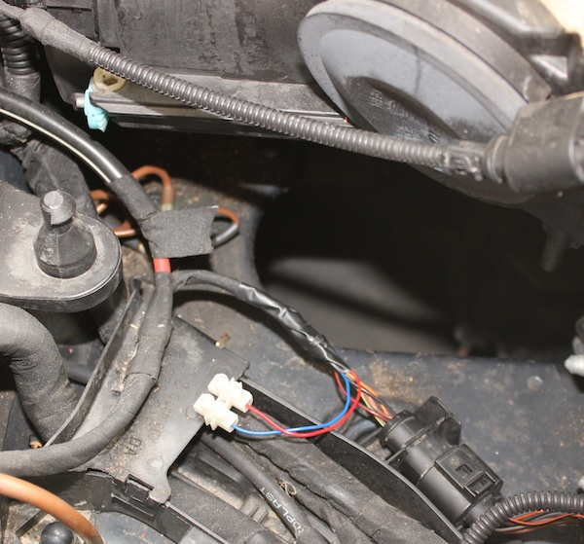
Getting Data From The CAN Bus
Where There’s A Will There’s A Way

Slide 33
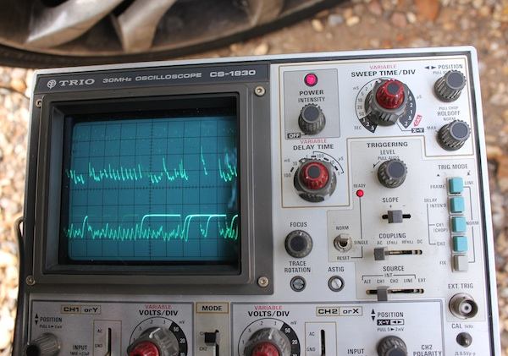
Getting Data From The CAN Bus
Where There’s A Will There’s A Way
Success!
(And the car still works)

Slide 34
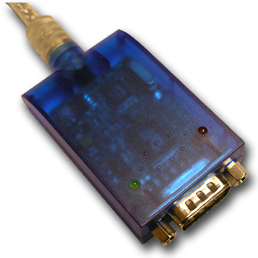
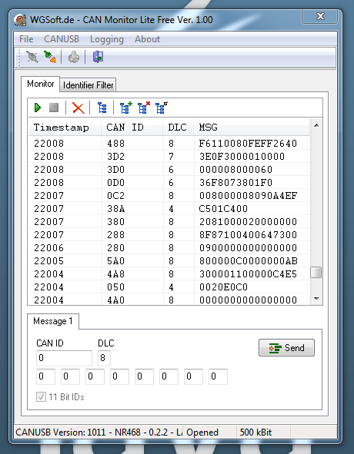
Getting Data From The CAN Bus
Electrical Connectivity Is Only The Start
Lawicel CAN bus to USB
Serial device
Sends decoded data
Need to write a Java library
CAN id
Message data
Then the hard part starts
Figuring it all out

Slide 35
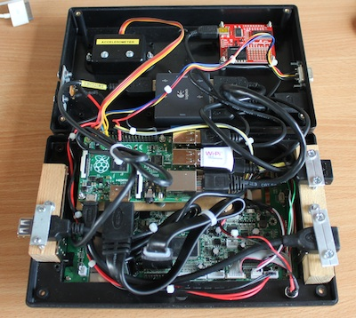
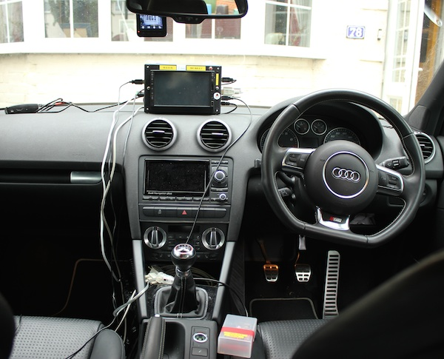
Finished Data Capture System

Slide 36
Heads Up Display/Telematics
Notes:
This slide can also be used as a Q and A slide

Slide 37
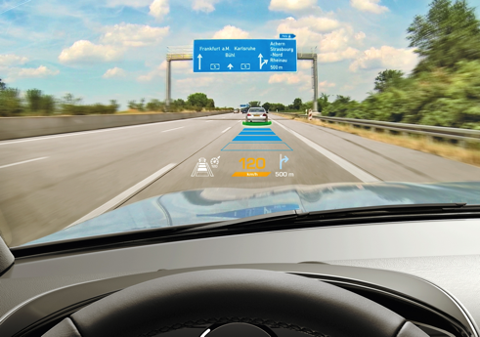
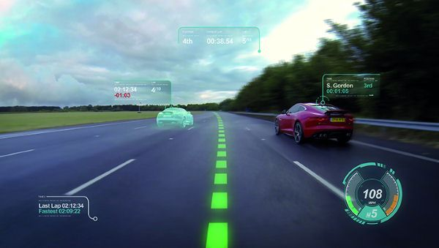
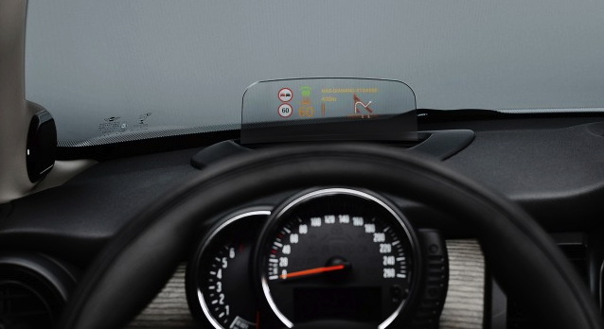
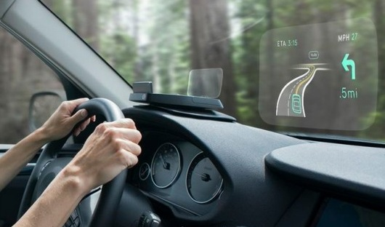
In Car Heads Up Displays Are Becoming A Reality
Continental
Jaguar Virtual Windscreen
Mini Cooper
NavTy

Slide 38
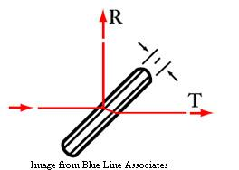
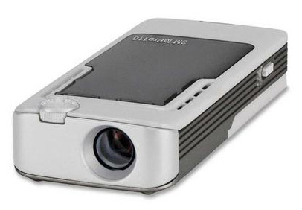
Build Your Own HUD
Turns out it’s not that simple
First iteration
3M MPro110 Micro Projector, half silvered film (from a cheap in-car HUD)
Didn’t really work
Too much reflection of projector lamp, not image

Slide 39
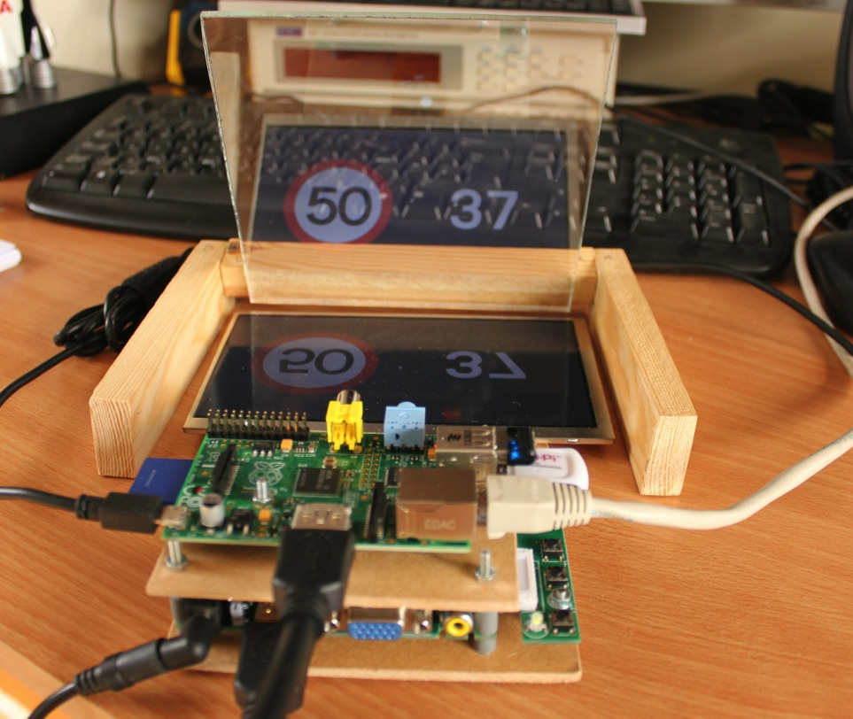
Build Your Own HUD
Second Attempt

Slide 40
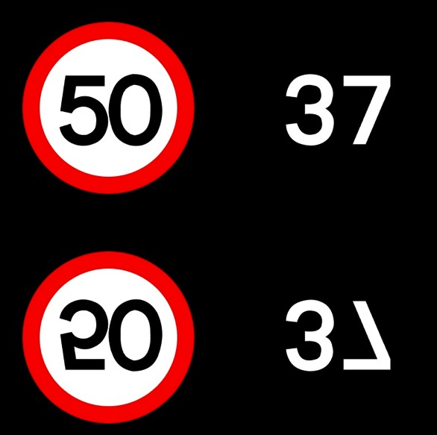
Raspberry Pi Heads Up Display
Cheap screen for the Pi
Use teleprompter glass rather than half-silvered perspex
70% transmission, 30% refection much better
Issue: How to produce an inverted image?
Answer: Use a refection effect
Reflection ref = new Reflection();
ref.setFraction(1.0);
ref.setBottomOpacity(1.0);
ref.setTopOpacity(1.0);

Slide 41
Data Display On HUD
Speed and engine RPM
Use OBD2 data
Wi-Fi dongle to access ELM327
Convert position (from GPS) into current speed limit
Bluetooth dongle for pairing with mobile phone
Configure Linux to provide network access via TCP/IP
Transmit position obtained from GPS
Write servlet to run on home Linux box (open port on firewall)
Servlet uses position and Ordanance Survey data to determine speed limit
(Future project)

Slide 42
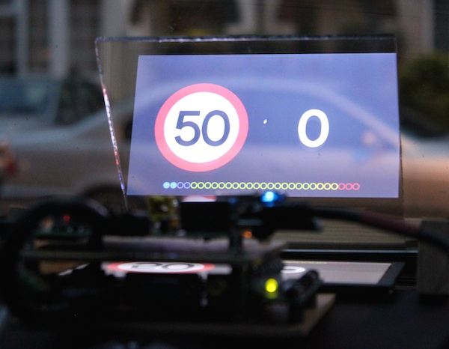
Hardware In Place

Slide 43
Driver Analysis
Notes:
This slide can also be used as a Q and A slide

Slide 44
Display Collected Data
JavaFX application
Video stream
Synchronised to data streams
Data recorded as sequence of text records
Comma separated values
One line per sensor
Time stamp
Read all data in at start of application
15 minutes of data takes about 100ms

Slide 45
Synchronisation Issue
Configured system to collect data four times a second
Thread.sleep(250), right?
Not quite
Data acquisition and storage doesn’t happen instantaneously
Raspberry Pi has limited resource footprint
Takes around 6ms to grab all data and write it to text file
Didn’t take this into account
Each minute data falls 1.4 seconds behind video
Apply a fudge factor correction during playback

Slide 46
Data To Display
Video (with controls)
G-forces
GPS co-ordinates/altitude
Map of current position
Speed (compare car and GPS)
Bearing
Engine load
Fuel pressure
Air intake temperature
Coolant temperature
Catalyst/exhaust temperature
Tyre temperature
Brake temperature
Throttle position
Engine RPM
Heart rate

Slide 47
User Interface Design
JavaFX
Use JFXtras library (Gerrit Grunwald’s dials and LEDs)
Formula 1 style
Throttle/brake/engine/gear display
LED tachometer
Heart rate number is not too exciting
Animations
Continuous pulses was a bit of a challenge (several parallel, offset transitions)

Slide 48
Conclusions and Resources
Notes:
This slide can also be used as a Q and A slide

Slide 49
Conclusions
Cars produce lots of data
Use of sensors with Java is simple to collect (most) data
Playback of data useful for insurance, fleet management, training
Java and JavaFX make UI design simple

Slide 50
Resources and Links
www.sparkfun.com
www.adafruit.com
www.raspberrypi.org
blogs.oracle.com/speakjava
Twitter: @speakjava

Slide 51
Demos
Notes:
This slide can also be used as a Q and A slide

