Slide 1
Java EE 6 Adoption in One of the World’s Largest Online Financial Systems [CON2789]
Hirofumi Iwasaki Arshal Ameen
Financial Services Department, Development Unit, Rakuten, Inc.
Notes:
Hello. Let’s get started.
Let me share about the result of our financial systems using Java EE 6.

Slide 2

Speaker Biography (1/2)
Hirofumi Iwasaki
Group Manager, Technology Manager
Financial Service Department, Development Unit, Rakuten, Inc.
Carrier
Planning, designing & implementation of huge enterprise systems for financial, manufacturing and public systems with enterprise middleware, especially Java EE & .NET in Japan for about 16 years.
Opus, Lectures, etc.
Conferences: Java Day Tokyo 2014, JJUG CCC Spring (2014), WebLogic roundtable (2012-2013), Rakuten Tech Conference (2013) etc.
Magazine: @IT (2005-2010), CIO Magazine (2009), IT Architect (2005-2009), Web+DB Press (2005), Java World (2001-2004), etc.
Notes:
This is Hirofumi Iwasaki speaking.
I'm a financial system group manager of Rakuten.
And a professional of enterprise financial system management, planning and development.

Slide 3
Agenda
1. Java EE 6 for Our Financial Systems Overview
3. JSF Appliance for Financial Front-End Systems
2. EJB Appliance for Financial Back-End Systems
Notes:
Today’s agenda. Firstly, overview of our renewed systems.
Secondly, about the back-end systems using EJB.
The last is front-end systems using JSF.

Slide 4
Agenda
1. Java EE 6 for Our Financial Systems Overview
3. JSF Appliance for Financial Front-End Systems
2. EJB Appliance for Financial Back-End Systems
Notes:
Started from overview.

Slide 5
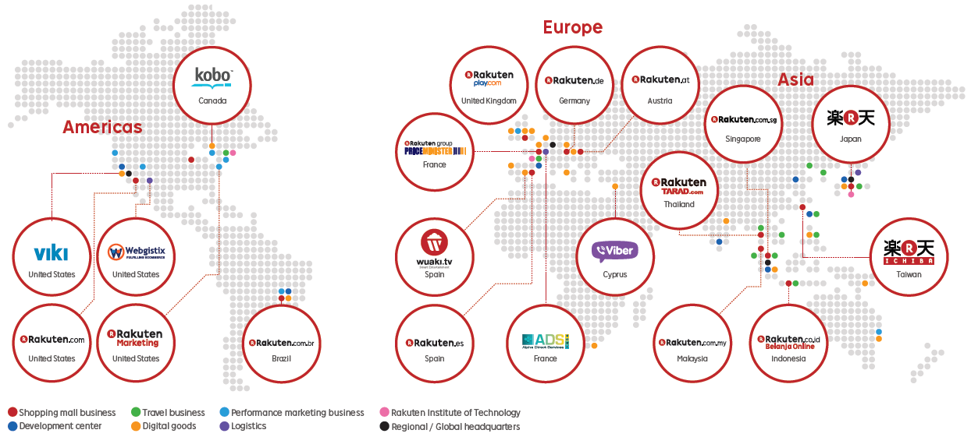
Global Rakuten Group
Notes:
The Rakuten group has many services around the world.
And we’re the Japan team for financial services groups.

Slide 6
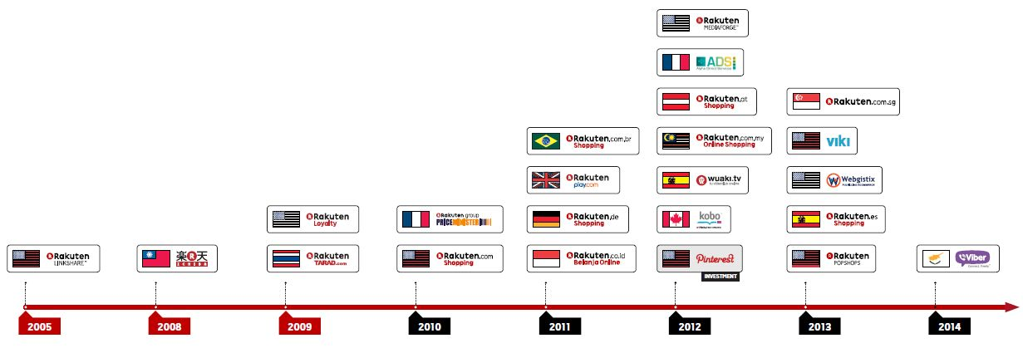
Rapidly Expanding Worldwide from 2010
E-commerce in 14 countries and regions
All services and businesses in 28 countries
Notes:
And the rapidly expanding worldwide from 2010. 14 countries for e-commerce, 28 countries fro all serves.

Slide 7

5248.976
Rakuten Group Consolidated GMS
(JPY B)
US $51.4B
Notes:
The Rakuten Group Consolidated Transaction Volume worldwide

Slide 8

































Expanding Business Portfolio
1997
2014
Internet Services
EC in
Malaysia
EC
In Austria
EC
In Singapore
EC
In Japan
Portal Site
Online Hotel Reservation
Internet Research
Internet Auction
EC in Taiwan
EC
In Thailand
EC in
France
EC in
UK
in Brazil
In Spain
Point Service
Online Golf
Reservation
Online Books, DVD Store
Performance Marketing
In USA
in USA
In Germany
Global Video
streaming
Global Video
Streaming
Real Café Service
Pay-per-view
Video Service
In Indonesia
Global eBook
Energy Service
Curation Service
(1997)
(2000)
(2001)
(2005)
(2006)
(2008)
(2009)
(2010)
(2011)
(2012)
(2013)
(2014)
Internet Finance
Online Security Brokerage
Credit Card
Internet Banking
E-money
Credit Card Payment
By Smartphone
Rakuten Life Insurance
(2003)
(2005)
(2009)
(2010)
(2012)
(2013)
Others
Professional Baseball
IP Telephony
Marriage Consultant
Phone Service
Global Social Messaging App
(2004)
(2007)
(2008)
(2013)
(2014)
Logistics
In France
(2012)
Notes:
In details, the Rakuten group was started from 1997, and expanding internet finance business as shown.

Slide 9
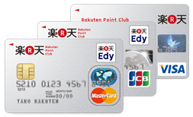





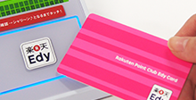
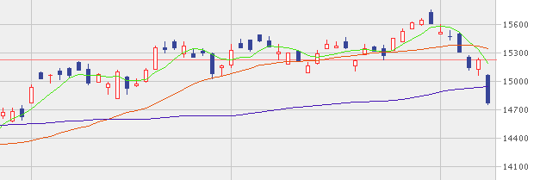


5 Financial Services of Rakuten Group in Japan
Credit Card
Bank
Financial Securities
E-Money
Life Insurance
Notes:
We have 5 big services of financial in Japan.
Rakuten Card, Rakuten Bank, Rakuten Edy, Rakuten Security, Rakuten Life, Rakuten Insurance.

Slide 10
5 Financial Services of Rakuten Group in Japan
Credit Card
Bank
Big 5 Services
Each has Huge Transactions
24/7 Non-Stop Services
Financial Securities
E-Money
Life Insurance
Notes:
Each service has huge financial transactions.
Additionally, the systems require the 24/7, non-stop services.
These requirements are tons of heavy implementation points for stable operations.

Slide 11


Requirements for Rakuten Financial Systems
Financial Systems Requires
1. Rapid business logic changeable as business model changes
2. Huge request capacity as business grows
3. Must be transactional
Notes:
Let's dig a little deeper. The big 3 requirement of Rakuten financial systems.
First, rapid changeable logics, Second, huge request expansion capacity, and last, transactional.
Very hard requirements for systems.

Slide 12

3 Big Issues of the Rakuten Card Systems
EOL
Credit Card
1. Outdated !
2. Complicated !
3. Difficult!
Notes:
And our credit card company, the Rakuten Card’s systems were very serious situation. 3 big issues.
Firstly, outdated. Used very special old technologies, and met the EOL. We cannot fix anymore.
Secondly, complicated. One action with many system relations and bucket relays.
Thirdly, difficult to change. There are many systems, files, and databases, and tightly related, mutual dependencies.
We decided to change them all.

Slide 13
3 Big Targets for New Architecture
Requirements
Sustainability
Flexibility
System Transparency
Notes:
We have 3 big targets for the new architecture.
Sustainability, flexibility, and system transparency.
These are for the concrete, long life cycle of the financial system

Slide 14


Why We Chose the Java EE ?
 | Portability | Results of Financial Sys | Vendor Support | Community
 | Excellent | Excellent | Excellent | Excellent
 | Nothing | Good | Not Bad | Mediocre
Notes:
The platform comparison of our future systems. We selected Java EE and dot NET framework.
Portability. Of course Java EE is excellent. Actually, .NET is poor environment limitation, only for Windows except for MONO project.
Result of financial systems. Both are good, but Java EE is excellent for its long running results of the world.
Vendor support. Java EE systems are supported by many platform vendors.
And the excellent community. We decided to chose the Java EE for our next systems.

Slide 15

Why We Chose WebLogic 12c
Product | Productivity | Reliability | Scalability | Support | Price | Operation | Development
WebLogic Server 12c | Excellent | Excellent | Excellent | Excellent | Not Good | Excellent | Excellent
Product A | Excellent | Excellent | Excellent | Excellent | Not Good | Not Good | Not Good
Product B | Excellent | Excellent | Not Good | Not Good | Not Good | Not Good | Excellent
Notes:
Next is platform. We selected 3 major commercial platform for the next systems.
Finally we chose the WebLogic Server, because of its stability and huge result for the financial systems.
Especially we focused the ease of development and operations. The key factors are the “Fast Swap” and “Production Redeployment” functions of WebLogic, the most suitable for our system development and operations.

Slide 16
Why We Chose the Oracle Exadata?
Product | Productivity | Data reliability | Scalability | HA | PCI DSS | Operation
Oracle Exadata | Excellent | Excellent | Excellent | Excellent | Excellent | Excellent
Product X | - | Not Good | - | - | - | Not Good
Product Y | Excellent | Excellent | - | Excellent | Not Good | Not Good
Notes:
The last was the database. We chose Oracle Exadata for our new systems.
Exadata is the engineered systems of Oracle, with Oracle Database and Real Application Cluster set.
We focused the scalability, PCI DSS and ease of operations, and lead to this selection.
Actually, the general financial systems require the transactional operations with ACID property for its data keeping, and the Exadata was the best solutions for our credit systems.

Slide 17
5 Big Issues to Apply New JEE Architecture
1.Policies
2. Education
5. Test
3. Architecture
4. Environment
Notes:
Next, architecture policies.
I planned the Java EE to real financial systems, with these 5 big issues.
1st, policies, 2nd, education, 3rd, architecture, 4th, environment, and 5th, test.

Slide 18



1. Policies: Case of Rakuten
1. Policies
2. Education
5. Test
3. Architecture
4. Environment
Internal Development First, no outsourcing to external SI vendors. (Group All)
Financial businesses are also the target for the application of this policy.
NO ORDER
Educate & Develop
External Vendors
In-House Development
Rare Case for Financial Systems in Japan
Notes:
1st, policies. In the case of Rakuten, we have a policy, "internal development first".
Of course, financial systems also. No basic policies to throw external vendors.
We must clear this core policies, and consider the next solutions to run.

Slide 19
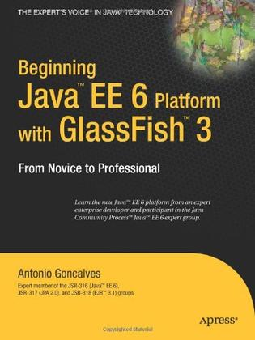



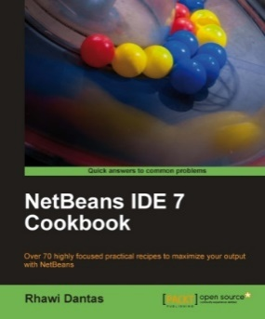
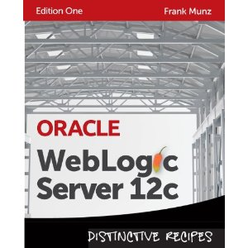
2. Education: Read, Read, Read!
1. Policies
2. Education
5. Test
3. Architecture
4. Environment
Start from HERE 4th Edition
Translated
Good & Only Japanese EE 6 book
Good Pocket Reference!
For NetBeans 7 with EE 6
RECOMMENDED for WebLogic 12c
Notes:
2nd, educational issues. Read, read, and read.
There's many good Java EE books in book stores, but English book only, not Japanese.
Fortunately, we already changed our standard language to English, and many programmer can read them.

Slide 20
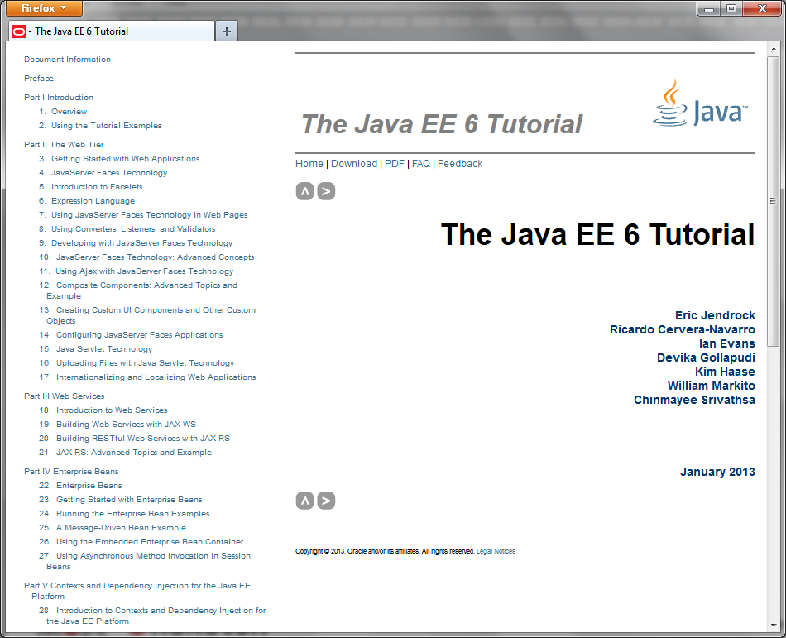
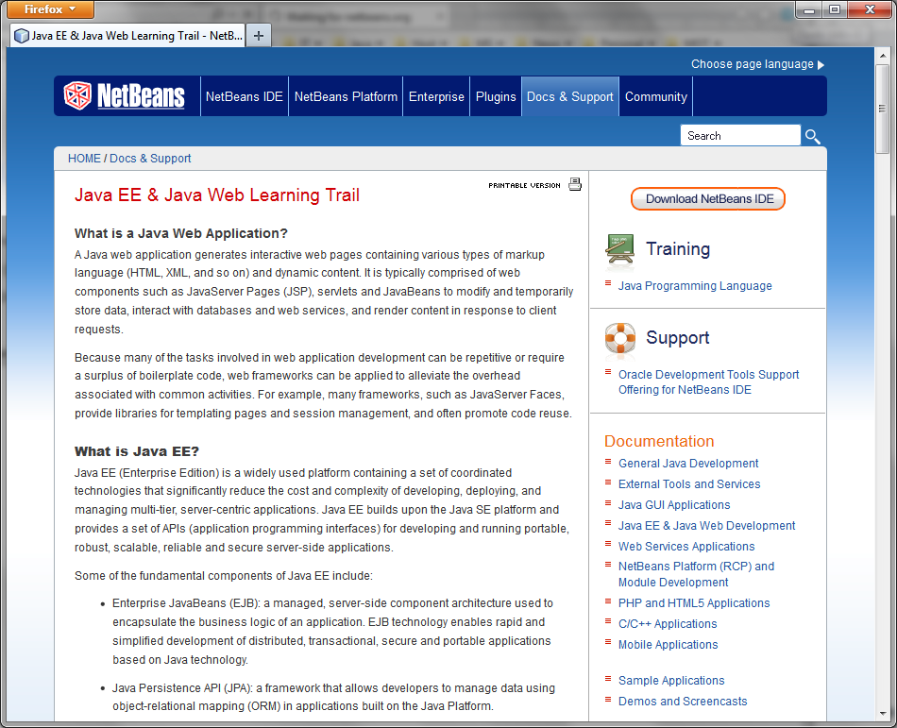
2. Education: Online Materials
1. Policies
2. Education
5. Test
3. Architecture
4. Environment
Original Tutorial for Newbies (Start here!)
NetBeans Java EE docs for Advanced Information
Notes:
And there are many useful articles in world wide web.
Thanks to the NetBeans team, nice tutorial are still in the web site.
Refer to this site if you want to start Java EE development.

Slide 21











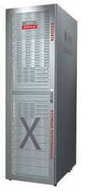

2. Education: Simplify to Learn
Old Architecture
Too difficult to learn many non-standard old technologies
New Architecture
Simple & Easy!
Notes:
In old architecture, we must learn many non-standard old technologies to develop.
These causes many resource management issues & high operational costs. In new architecture, we simplified to Java EE 6.

Slide 22



3. Architecture: Apply EE 6 Specs
1. Policies
2. Education
5. Test
3. Architecture
4. Environment
Web Presentation (no business logics)
Business Logic (no presentations)
Data Access
Call
DBs
Call
JPA
JSF
Messaging
Call
MQ
EJB
JMS
Rich Clients (no business logics)
Connection
Call
Other Servers
Call
Automatic Transaction
RMI-IIOP
JAX
EMail
Call
MTA
JTA
Java FX
JavaMail
There's no rich client
Notes:
3rd, I designed to apply Java EE 6 specs to the new architecture.
Basic structure is obeyed to standard architecture, and applied front-end to JSF.
And due to the no rich client requirement, I skipped JavaFX spec.

Slide 23
3. Architecture: Migrate from Old
1. Policies
2. Education
5. Test
3. Architecture
4. Environment
Old App Architecture
Front-End (Apache)
BEGIN
Back-End
External Services
Web Service
External Service
View PHP
Action with Business Logic
BL move to back-end
API Service
Data Service
COMMIT
Database
Transaction Boundary
Entity
New App Architecture
DMZ (Apache)
Front-End (WebLogic)
Back-End (WebLogic)
External Services
WebLogic Plug-In
Business Logic
External
View Facelet
Backing Bean (no business logic)
BEGIN
DAO
Static HTML, Images, CSS
Exadata
COMMIT
Entity
Transaction Boundary
Notes:
We had some older systems to integrate to the new architecture.
In the PHP case, we designed each from PHP business logics to the EJB API codes.
Full rewriting, 100% API-nized for re-use & collaborating services in the future.

Slide 24
3. Architecture: Simplified
1. Policies
2. Education
5. Test
3. Architecture
4. Environment
L7 Balancer
Front Real-time
Core
Reverse Proxy
Web Site A
Services (aka APIs)
System B
Gateway
Web Site B
Database
Internal Site
System C
Front Batch
Sub Proc
Batch Exec
Notes:
We also re-designed the application module blocks. Center API-nized logics, with many front-ends.
All business logic designed as API, with SOAP, REST, and IIOP protocol access
enabled for future service-oriented architectures to simplify.

Slide 25

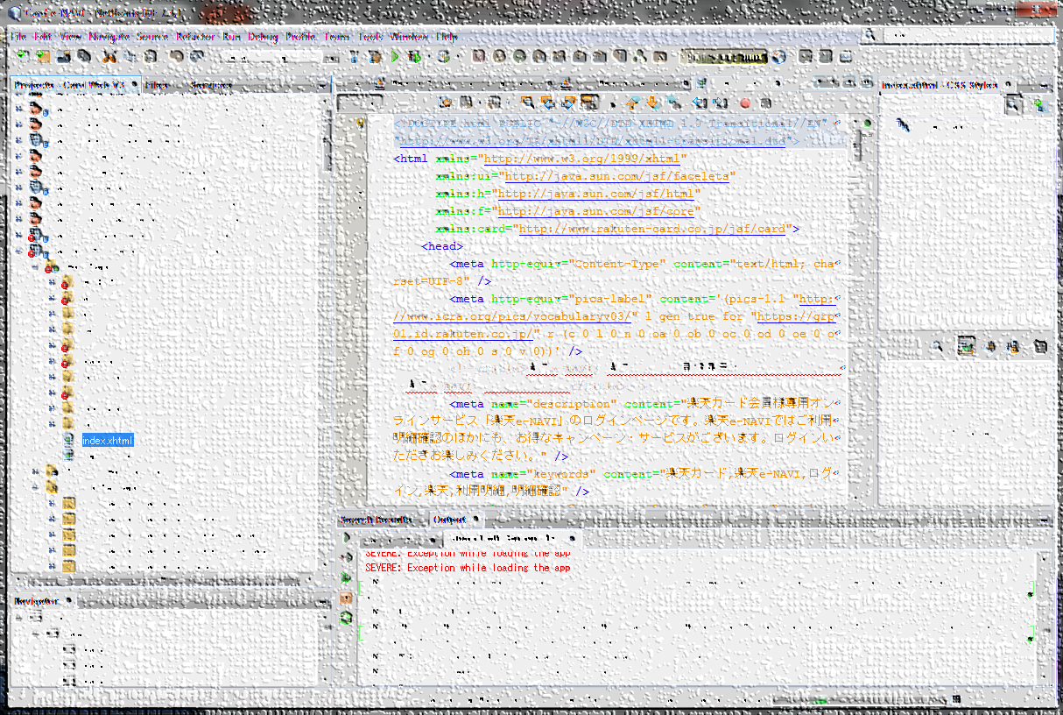


4. Environment: Ease of Dev.
1. Policies
2. Education
5. Test
3. Architecture
4. Environment
Centralized DEV DB Local Weblogic Server instance Code and Test with Fast-swap
=
X
X
Notes:
For the ease of development, we adopt the new IDE,
NetBeans 7 with Apache maven automatic building systems.
And we build full local programming environment to easy coding & run for rapid programming.

Slide 26



4. Environment: Easy Startup
1. Policies
2. Education
5. Test
3. Architecture
4. Environment
2. Download Code from Repository
4. Refer JIRA tickets for tasks
1. Join a project.
3. Install JDK, IDE, App servers -> Build -> Run on the local terminal
Notes:
We made the easy startup environment to reduce startup costs.
If some programmer attends the project,
2. just download from git server,
3. install tools,
and 4. refer to JIRA for his or her for today's task management.

Slide 27

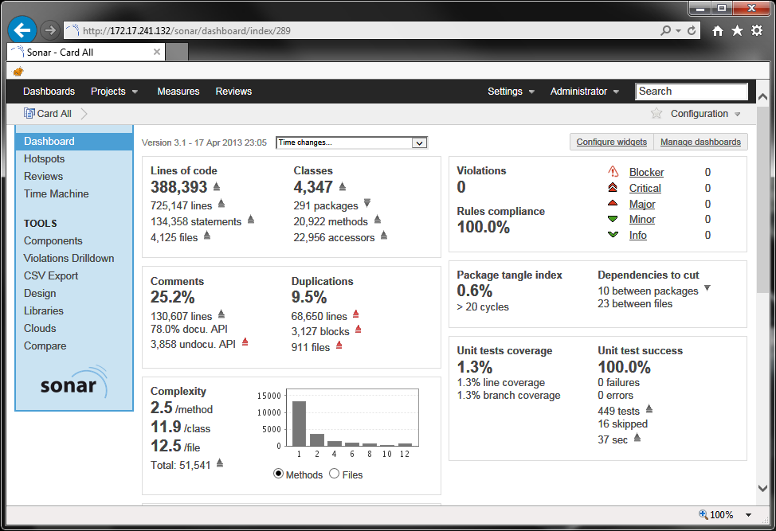


5. Test: Full Auto Testing &Validation.
1. Policies
2. Education
5. Test
3. Architecture
4. Environment
1. Auto PULL
Management Server
2. Auto Build & Test
3. Auto Validate
4. Report Hourly
ZERO Violations
Notes:
And to educate the accurate programming manners,
we introduced Jenkins auto-building server with static security analyzers, Sonar & VeraCode.
And we achieved zero violations before the new system release.

Slide 28
Speaker Biography (2/2)
Arshal Ameen
Core Engineer.
Development leader for Rakuten Card Member Services.
Team Leader and Trainer.
Carrier
3 Years as JEE engineer
App developer (iOS, Android and Win8).
Opus, Lectures, etc.
Conferences: JJUG Tokyo(2014)
Notes:
Hello everyone
This is Arshal speaking.
I am development leader of customer services for Rakuten Card.
So, allow me to disclose some secret ninja scrolls from japan, nah lets move on with agenda

Slide 29
Agenda
1. Java EE 6 for Our Financial Systems Overview
3. JSF Appliance for Financial Front-End Systems
2. EJB Appliance for Financial Back-End Systems
Notes:
Lets continue with the agenda
I am going to speak about use of EJBs and JSF in our financial systems.
The problems faced and solutions tackled for them.

Slide 30
Comparison between old and new system
Feature | Old | New(JEE6)
Dependency Injection | Spring DI | CDI
Web Framework | PHP(Symfony, Smarty) | JSF
REST | Servlets | JAX-RS
Transactions | Transactional(Spring) | EJB CMT(JTA)
Persistence | iBATIS | JPA
Batch | TERASOLUNA batch FW | EJB
WebSockets | ー | ー
Validation | ー | Bean Validation API
Security | ー | Java EE Security
Notes:
Allow me to do a simple comparison between our old architecture and the new one.
Spring DI was used previously which was changed to CDI (we lost the ability to inject lists, maps resources and also to programmatically inject but that’s OK)
Web framework was earlier based on php framework symfony with additional php template engine like smarty
REST services were based on Servlets, which thankfully were moved to use JAX-RS
Transactions were using Transactional of spring,
iBatis was used as persisitence API.

Slide 31
Leverages and advantages
Services | Old Architecture | EJB 3.x
Dependency Injection | Could inject almost anything, programmatically too | Can inject anything in the container including EJBs, data sources, JMS and JPA resources but only annotations.
Transaction management | Transactional of Spring | JTA
Persistence | iBatis | Tightly integrated through JPA
State management | Web container session management | Stateful Session Beans and Extended Persistence Context but we still stick to JSF based states
Web Services | By using XFire for registered beans. | JAX-WS 2.0
Messaging | JMSTemplate adds nice abstraction over JMS. | Message Driven Beans.
AOP | AspectJ and Spring AOP alliance. | Simple but limited support through interceptors.
Security | None | Declarative and programmatic security through JAAS.
Scheduling | Must add and configure Quartz for scheduling. None were used | Simple scheduling possible through EJB Timer service
Remoting | Remote transactions and security are not supported. Not standardized. | Integrated support through Session Bean remote interfaces.

Slide 32

Remote Interfaces
Application Server
JMS
Local Client
Remote Client
JMS Provider
Remote Client
JTA
EJB Container
Business Logic Tier
JNDI
Session Beans
Message Driven Beans
JDBC
Session Beans
Message Driven Beans
Session Beans
Message Driven Beans
RMI_IIOP
Persistence Tier
Threading
JPA Entities
Entity Manager
JPA Entities
Entity Manager
Pooling
Security
RDBMS
Web Services
Notes:
Currently we have EJB remote interfaces but our environment is not yet distributed
In Remote interfaces parameters are passed by value
where as in local interfaces it is done as passes by reference
so basically we are leveraging performance over scalability.
Since we have plans to distribute our system, this leverage is a fair deal.

Slide 33
JPA
Features | iBATIS | JPA
Simplicity | Best | Good
Complete ORM solution | Average | Best
Adaptability to data model changes | Good | Average
Complexity | Best | Average
Dependence on SQL | Good | Average
Performance | Best | Average
Portability across different relational databases | Average | Average
Portability to non-Java platforms | Best | Not Supported
Community support and documentation | Average | Good
Notes:
iBatis
1. loose coupling
This loose coupling allows the mapping to work for systems where the application and the database design are mismatched
2. Uses SQL directly
Simplicity is iBATIS's greatest advantage, as it provides a simple mapping and API layer that can be used to build data-access code.
This is because iBATIS uses a data mapper, which maps objects to stored procedures, SQL statements, or ResultSets via an XML descriptor, rather than a metadata mapper, which maps objects in the domain to tables in the database.
It's more effective to write your own SQL queries than to rely on ORM-generated SQL in some cases (eg batch operations where million records have to be copied)
Thus, iBATIS enables the data model and the object model to be independent of each other.
JPA
Standard Java-based persistence solution.
Supports inheritance and polymorphism,
The downside of JPA is that it requires a provider that implements it.
One such feature is support for caching, which is not clearly defined in JPA
Also, JPA is defined to work with relational databases only
Major plus point Complete ORM solution
JPA also supports SQL through the createNativeQuery()
but the downside is added step of compiling jpql to corresponding sql which is a major issue in some peculiar cases

Slide 34
JTA
Transaction rollback prevents data pollution
Timeout settings limits latency in EJB response
An ideal tool for resource management and data integrity.
XA enables global transaction a.k.a 2PC.
Notes:
Since we were using php framework with business logic divided among php side and spring side, the transaction boundary was limited so the 2 phase commit of transactions was impossible causing loss in data integrity
therefore we were greatly benefited from jta

Slide 35
Stateful Vs Stateless in EJB
Stateless EJBs !
States are managed by JSF.
Notes:
Stateless
State is managed b JSF context not EJB.
Stateful makes sense if clients are few, it means that application server knows each client

Slide 36
Managed Entities
Fetches same entity every time
Auto update entity on state change.
Performance is best with Exadata, with others……….
Notes:
before using this feature it was find, change, merge it back
access em multiple times in a transaction, it gets same entity every time, if state is changed entity is auto updated
commit -> compute deltas and push to DB
These are costly leverages since performance is seen best with Exadata

Slide 37
EJB Timer Service
The EJB 3 timer service allows to invoke a method by the container after a specified interval of time.
Timers are persistent and can survive a container crash or restart.
Timers are transactional.
Timers well actually are not that precise.
Managing multiple timer events in not possible
Notes:
The EJB 3 timer service allows to specify a method (called the timeout method) that is automatically invoked by the container after a specified interval of time.
Timers are persistent and can survive a container crash or restart.
Timers are transactional.

Slide 38
Agenda
1. Java EE 6 for Our Financial Systems Overview
3. JSF Appliance for Financial Front-End Systems
2. EJB Appliance for Financial Back-End Systems

Slide 39
Limitation of JSF 2.1
Flash one step traversal limitation doesn’t meet our requirements.
CSRF – No standardized implementation in 2.1.
No file(template) include feature from server i.e the file to include using ui:include is present on server not within war or ear.
No way to pass passthrough attributes or html5 data attributes used in JSF 2.2
Custom validators, custom tags and custom renderers

Slide 40
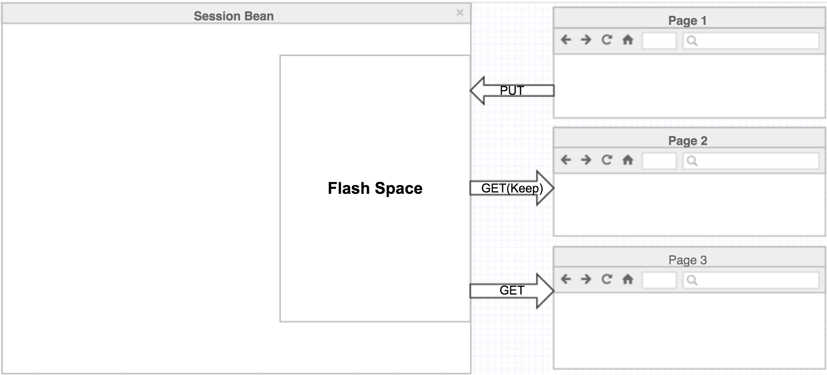
1. Flash
Notes:
Flash, what we need Is to pass parameters among view scoped managed beans, this can be done by storing them on session bean
But say if you have 700 web pages and corresponding managed beans, if each bean adds one parameter the session size will just expand and its not worth it.
So what we did is we used a part od session and called it as Flash space, whatever is put into Flash space is removed automatically after certain X traversals
Unkess you wanna keep it.

Slide 41
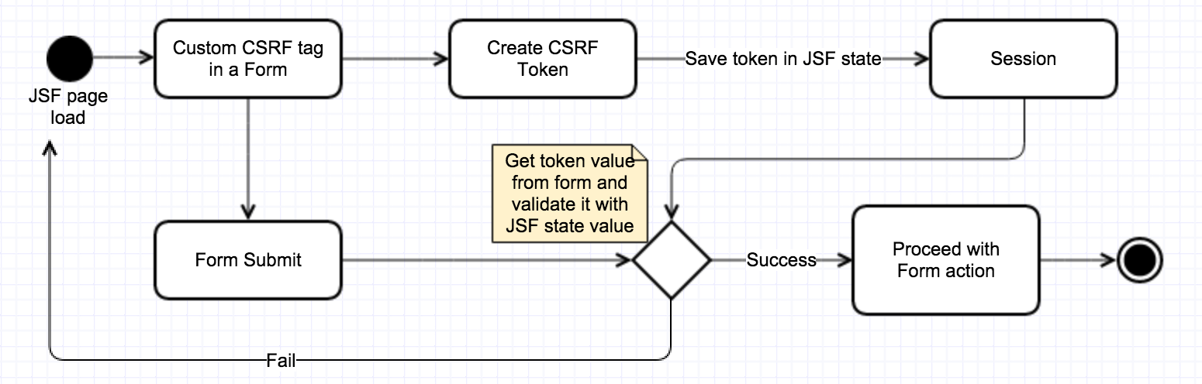
2. Csrf tag
Custom CSRF implementation into a JSF tag

Slide 42
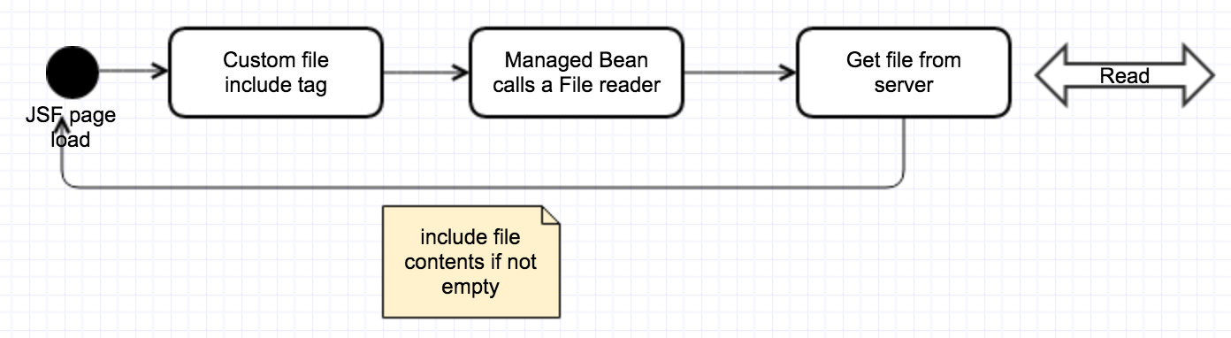

3. Custom template include tag
Get template file contents from server and include it in JSF facelet

Slide 43
4. Passthrough attributes
Custom renderers for common tags
Html5 attributes

Slide 44
5. Customization
Custom tags, UI components, validators, convertors and comparators.

Slide 45
Questions ?
Contact Hirofumi Iwasaki (@HirofumiIwasaki) Arshal Ameen (@AforArsh)

