Slide 1
Java on ios? yes you can!
Niklas Therning / @ntherning
Henric Müller / @henricmuller
Trillian Mobile AB
robovm.com

Slide 2
The RoboVM Project
Goal: Java on iOS
and other JVM languages: Scala, Groovy, Clojure, …
Open-source since Jan 2013
github.com/robovm
License allows closed source apps
www.robovm.com / @robovm

Slide 3
RoboVM Features
Java bytecode to machine code
Ahead Of Time, no interpreter, no JIT
Fast apps
Runtime classes based on Android
java.*, javax.*, etc incl. I/O, reflection
Supports 3rd party JAR files
Supports standard JNI (static)

Slide 4

RoboVM Features
Bindings for native iOS APIs
Full access to hardware, services, UI, etc

Slide 5
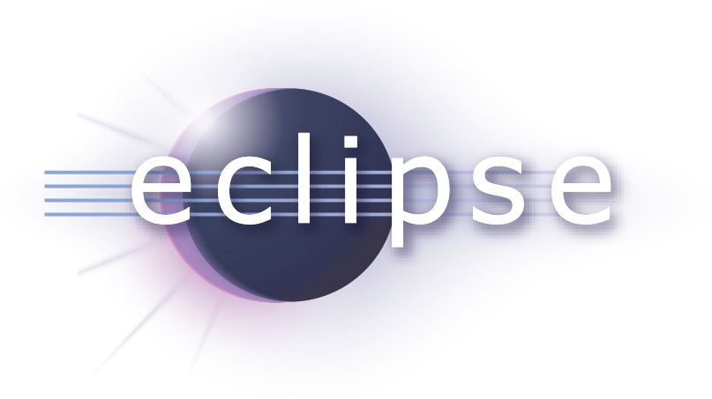


RoboVM Features
Integrates with popular Java tools
sbt
Leiningen

Slide 6
RoboVM is …
… not an Android to iOS app converter
… not a Java to Obj-C source translator
… not only for games*
* (Though it works great for games too!)

Slide 7
Current Status
100+ apps in App Store
Thousands of users
1.0 scheduled for late 2014

Slide 8
1.0 Alpha 2 just released!
λ
Introduces lambdas and default methods

Slide 9
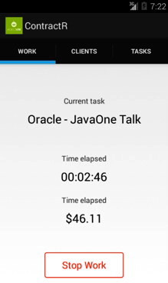
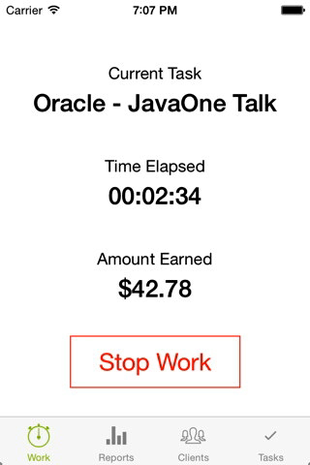
Showcase:
ContractR Punch clock for contractors

Slide 10
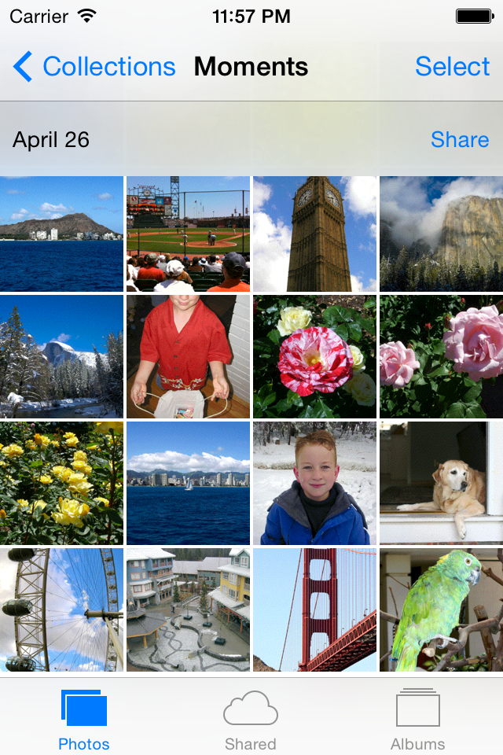
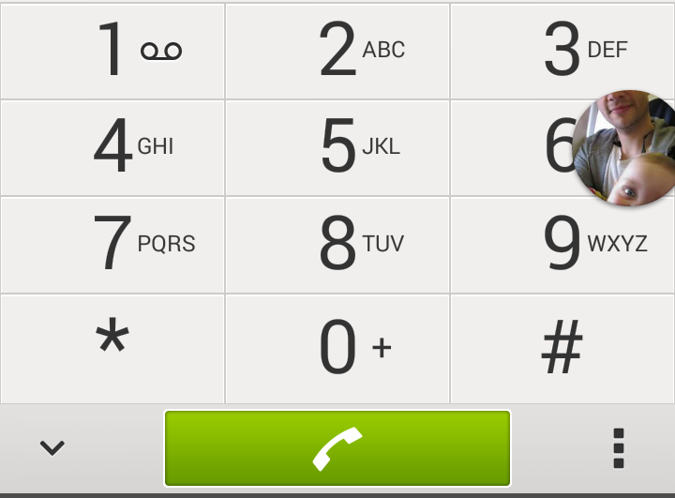
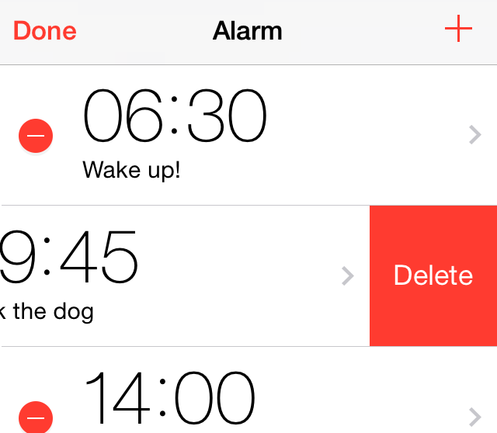
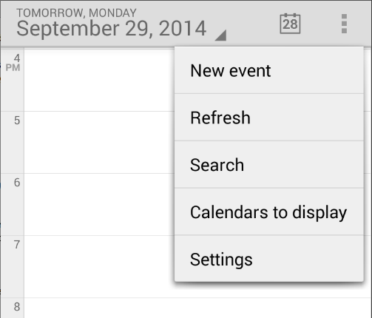

Cross-platform app development
Option #1 – Native UI

Slide 11
Cross-platform app development Option #1 – Native UI
Pros
User Experience
Performance
Cons
Less code reuse
Learning curve – API/tool differences

Slide 12
Cross-platform app development Option #1 – Native UI
Use patterns to maximize code reuse
MVC
MVVM
View model
Controller
View model
Controller
View
View
View
Model
View
Model
Model
Model

Slide 13
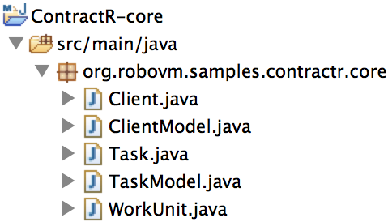
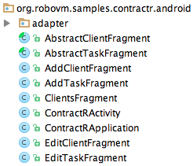
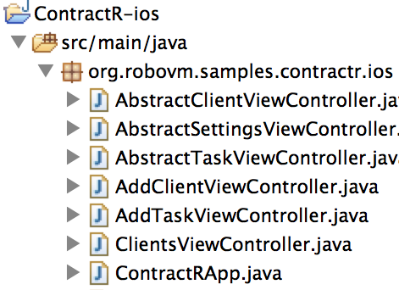
3 separate modules
Core
(model)
Android
iOS

Slide 14
Common model code:
public class ClientModel {
public Client create() { … }
public int count() { … }
public Client get(int index) { … }
…

Slide 15
iOS specific UI code:
UITableViewCell getRowCell(UITableView tableView, NSIndexPath indexPath) {
UITableViewCell cell = tableView.dequeueReusableCell("cell");
if (cell == null) {
cell = new UITableViewCell(UITableViewCellStyle.Value1, "cell");
cell.setAccessoryType(UITableViewCellAccessoryType.DisclosureIndicator);
}
Client client = clientModel.get((int) indexPath.getRow());
cell.getTextLabel().setText(client.getName());
return cell;
}

Slide 16
Android specific UI code:
public View getView(int position, View convertView, ViewGroup parent) {
View view= convertView;
if (convertView== null) {
view = inflater.inflate(android.R.layout.simple_list_item_1, parent, false);
}
Client client = clientModel.get(position);
TextView text= (TextView) view.findViewById(android.R.id.text1);
text.setText(client.getName());
return view;
}

Slide 17
Cross-platform app development Option #1 – Native UI
DEMO #1

Slide 18
Cross-platform app development
Option #2 – Cross Platform UI
JavaFX from the OpenJFX project

Slide 19
Cross-platform app development Option #2 – Cross Platform UI
Pros
Close to 100% code reuse
Cons
User Experience
Performance

Slide 20
Cross-platform app development Option #2 – Cross Platform UI
DEMO #2

Slide 21
ContractR and other samples can be found at
github.com/robovm/robovm-samples

Slide 22
Commercial Licenses
Launch late 2014
Standard Java debugger support
Support options
Open source version still lets you develop amazing apps for free without limitations!

Slide 23
?
Check out www.robovm.com and follow @robovm

