Slide 1
Platform Upgrades As A Service
Raj Nagarajan, Robert Enyedi

Slide 2
Why are we here?

Slide 3
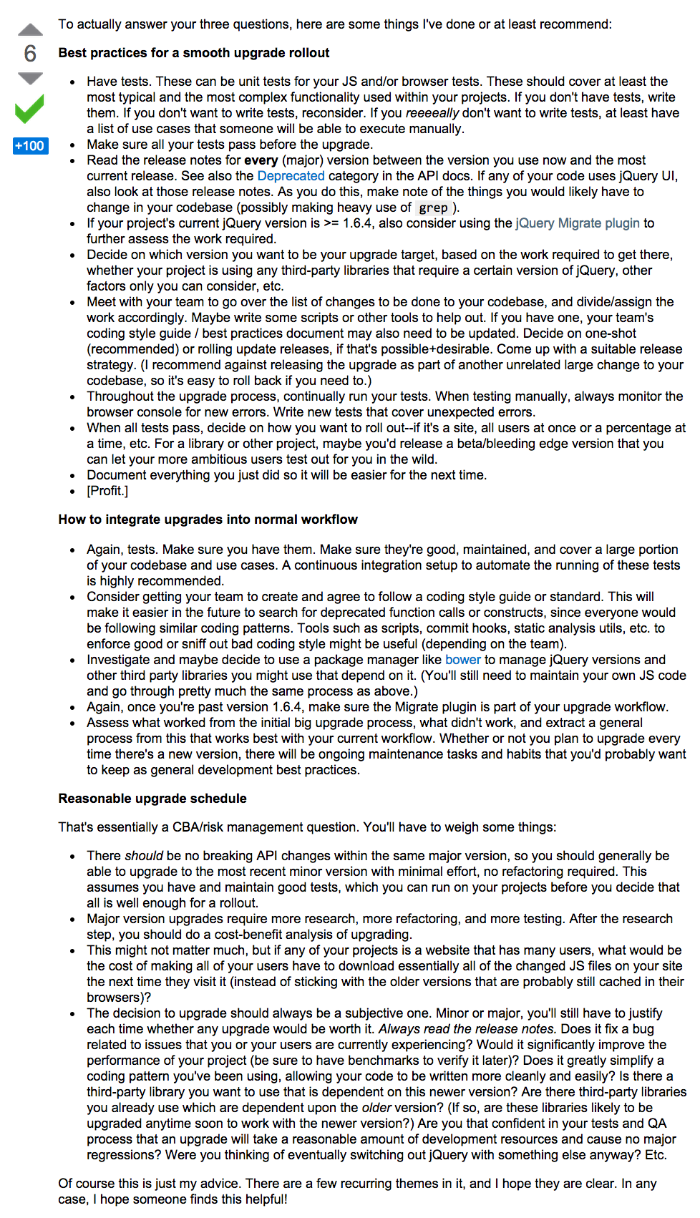
Software Upgrades - TODAY
Read release notes
Make changes
Fingers crossed
Test
Rinse and repeat
[StackOverflow] Practical approach to keeping jQuery up to date?
[jQuery] jQuery UI 1.9 Upgrade Guide%

Slide 4
Software upgrades – different perspectives
End Developers
Platform Developers
Developers
Painful – what were they thinking?
Managers
Costly – I have no time for this
Why this often?
Boring/vague release notes
Trial-n-Error
Testers
Upgrades breaks test cases
Long regression cycles
Collateral damage
When will my team’s feature-request rollout?
When will this bug be fixed?
Platform Developers
Cool new XYZ feature
Sorry about that bug ☹
Security
Fix this security issue NOW!
Ops
Who designed this? Let us rewrite.
How long should we maintain backwards compatibility?
This is a production P1 issue – what is the ETA for rollout?

Slide 5
Agility @ ebay scale
~900 deployments per week to 26000 nodes
~3000 deployments per month to 87000 nodes
Releases
Out-of-cycle releases for production issues, including security patches.
Adoption
Stack Overflow like forum based support model
Metrics
Multi-billion traffic hits / day
Deployment
Planned releases: 1 major, 3 minor, 20+ micro releases PER YEAR
1500+ developers spread across 4 continents (North America, Europe, Asia, Australia) and multiple time-zones
Thousands of production VM pools

Slide 6
A better way: Platform Upgrade Experience @ ebay

Slide 7
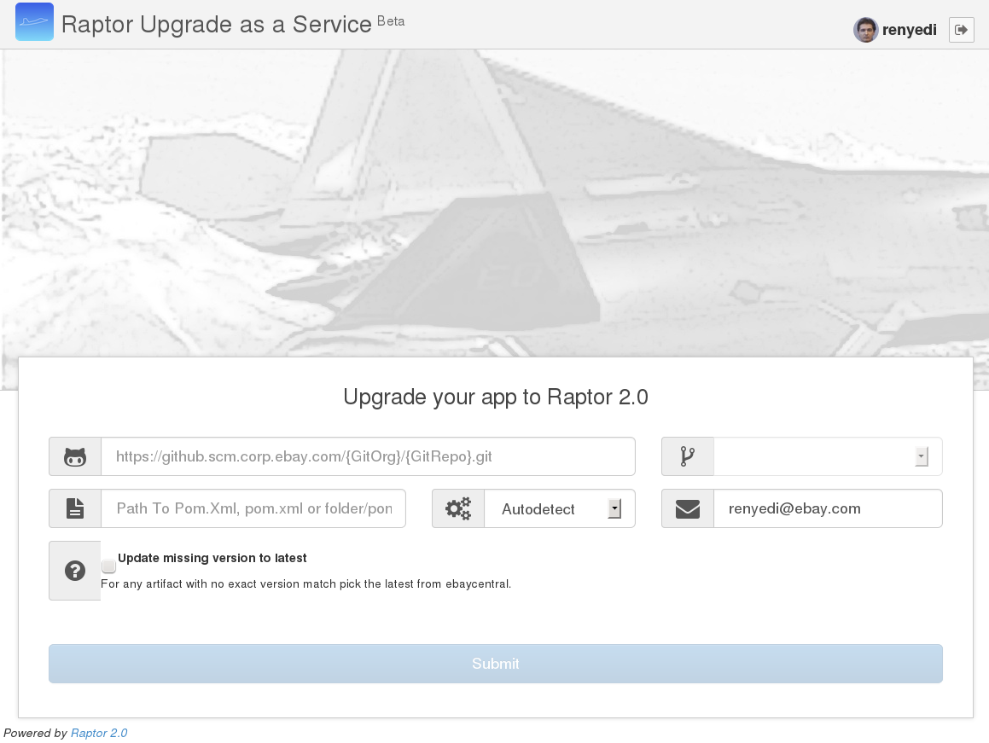
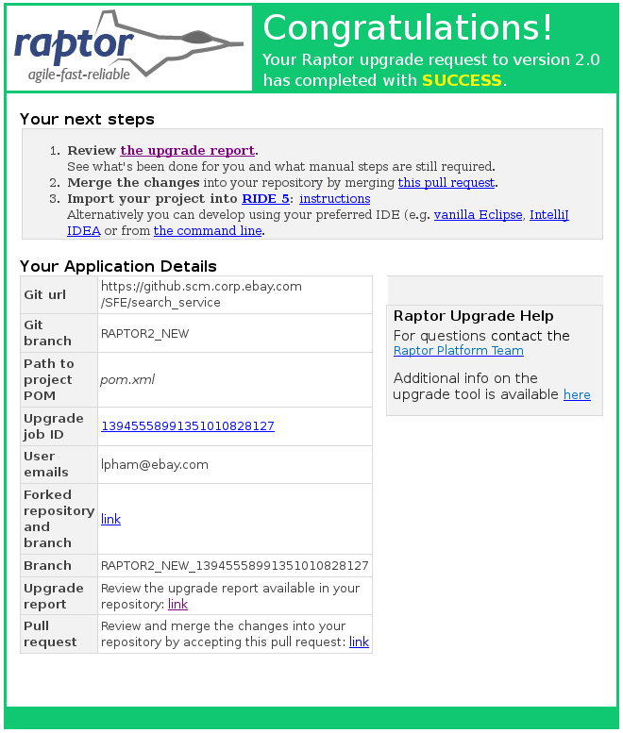
Streamlined User Interaction
Maven
Email
git
Pull request
Telemetry

Slide 8
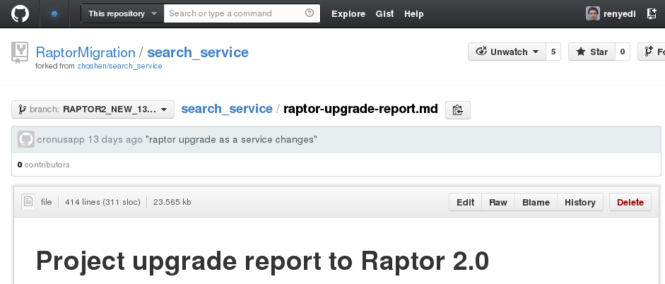
Personalized and Actionable Upgrade Report
Delivered as .md on Git
Early code analysis and fix
Detect and document manual changes
Application Health Check
Outdated JDK or system overrides
Misused APIs, non-optimal settings

Slide 9
Under the Hood
Architecture, data, community

Slide 10
Orchestration Service Architecture
Web UI
REST API
Repositories
Service Tasks
Maven
GitHub
Platform Upgrade
Emergency Patch
Jenkins
Service Commands
Application Bundles
GitHub
Maven
Jenkins
Cloud
Email
External Tool
Code
PAAS
App Config and Health
Upgrade Module
100% Java
RESTEasy

Slide 11
Upgrade Module Architecture
Platform versions
1.0
2.0
1.1
1.2
2.1
2.2
Add-ons
Package refactoring
Upgrade10to11
Example use case Upgrade project from platform version 1.1 to 2.2
Upgrade11to12
Logger upgrade
Upgrade12to20
Upgrade20to21
API refactoring
Upgrade paths
Chain of commands
Upgrade21to22
Code
90% Scala
10% Java
Eclipse JDT

Slide 12
Telemetry Driven Product Evolution
The journey so far: 8 months, 550+ projects, 99% adoption
Data
Data collection from Maven repository to facilitate move and cleanup
Statistics
Proactive upgrades
Full data about the submitted upgrade requests
Service usage, success rate, artifact usage
CI build detects usage of old platform version
Runs the upgrade
User receives a pull request with instructions
Full traceability
Use the Git log to identify upgrade pain points
Rely on hard data vs customer complaint to fine tune the upgrade service
Traceability for post-mortems and platform improvements
Effective troubleshooting

Slide 13
Open Source: Ostara
ebay platform upgrades
What does it do?
The core functionality of the ebay platform upgrade solution
Suitable for but not exclusive to Maven and Spring based Java projects
Development strategy
Keep generic non-ebay features in the Ostara code base
Incubation modules in both ebay and Ostara repositories
Build community & extend with more use cases
Ostara
ebay extensions
Code https://github.com/eBay/ostara
License Apache
Community https://groups.google.com/d/forum/ostaraoss

Slide 14
Future Directions
Emergency patches
On all affected applications, apply the patch in their Git repositories, build/test/deploy the patched applications
Deep API refactoring
Use semantic analysis of code to detect types
Apply all applicable refactoring patterns
Allows a more fast paced API cleanup, reduces lifetime of deprecated APIs
Polyglot use cases
Extend the project to non-Java platforms like node.js, Scala/Akka
Create a simple upgrade path with the patch

Slide 15
Q&A

Slide 16
Global Platforms and Infrastructure Raj Nagarajan ranagarajan@ebay.com Robert Enyedi renyedi@ebay.com Community https://github.com/eBay/ostara https://groups.google.com/d/forum/ostaraoss

