Slide 1
Getting Actionable Intelligence From The Internet of Things
Tim Kellogg (@kellogh)
JavaOne 2014

Slide 2
Internet of Things
Embedded
Internet
IoT
Notes:
Want to show this with application layer on top
Need to point out advantages here

Slide 3
Telemetry Data
Moving
Storing
Analyzing
Reacting

Slide 4
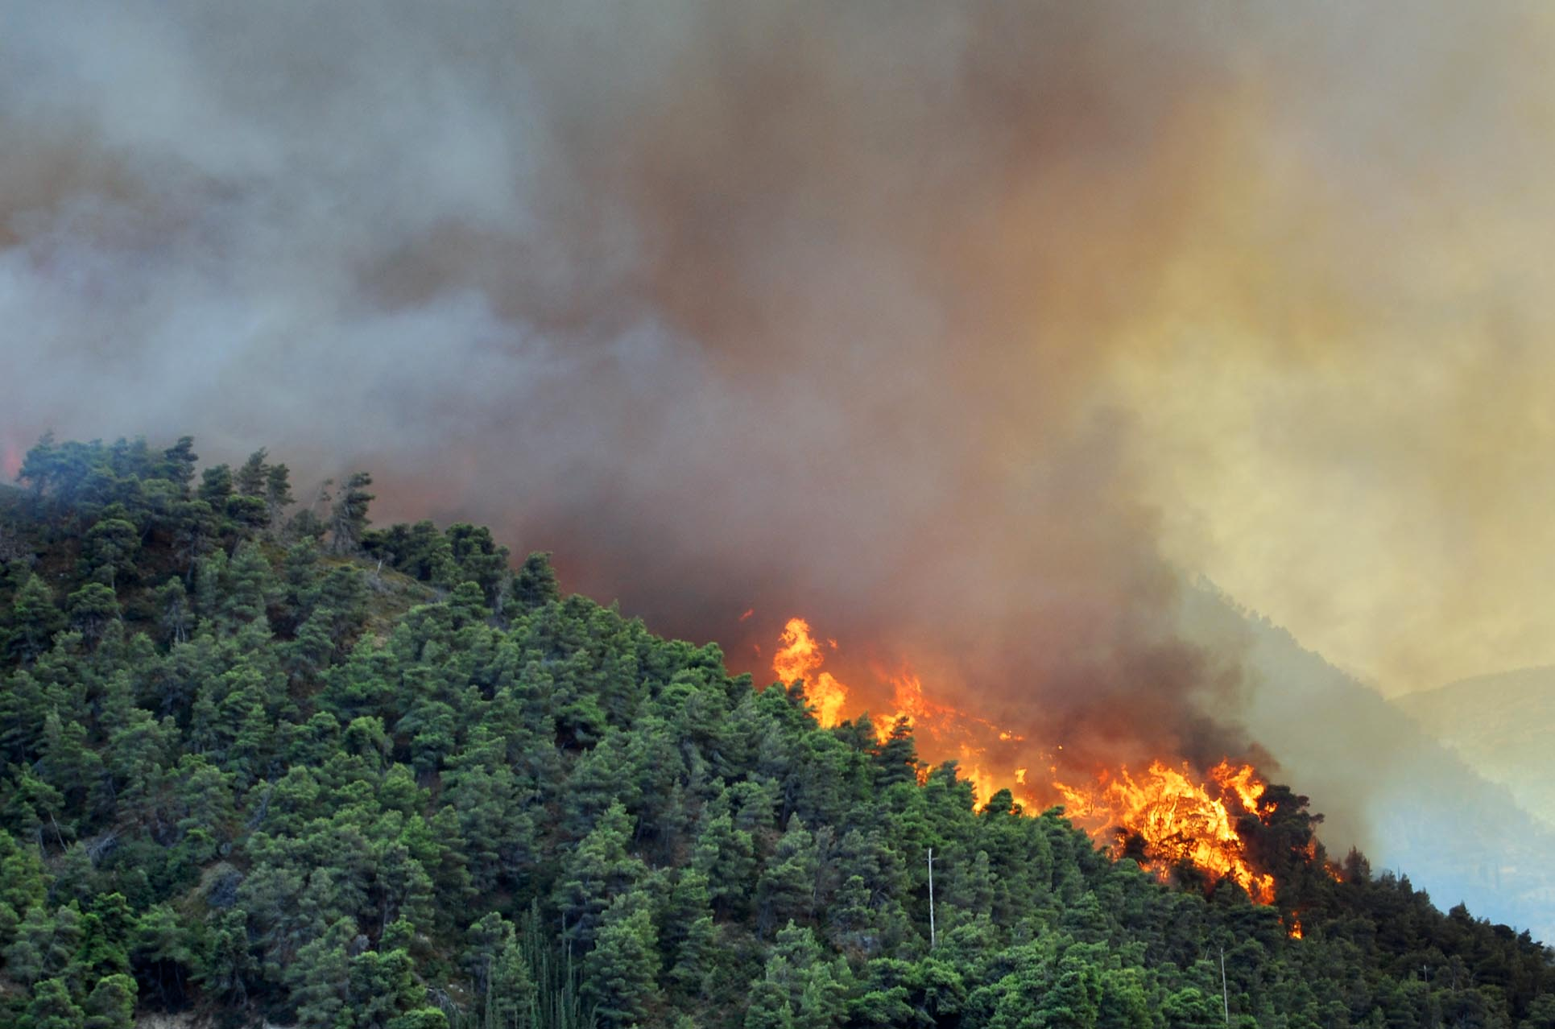
Notes:
Carbon dioxide, carbon monoxide, ammonia
Wireless networks
Distance => electricity
Power source

Slide 5
Environmental Monitoring
Geographically distributed
Electricity
Wireless communication
Hostile environment

Slide 6
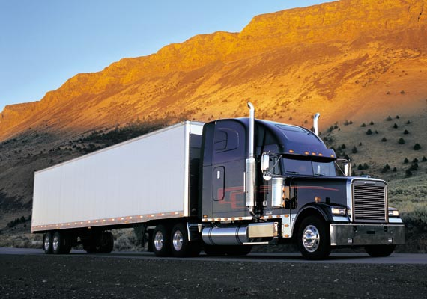

Slide 7
Monitoring Trucks
Larger bursts of data
Reliable energy source
Less reliable network

Slide 8
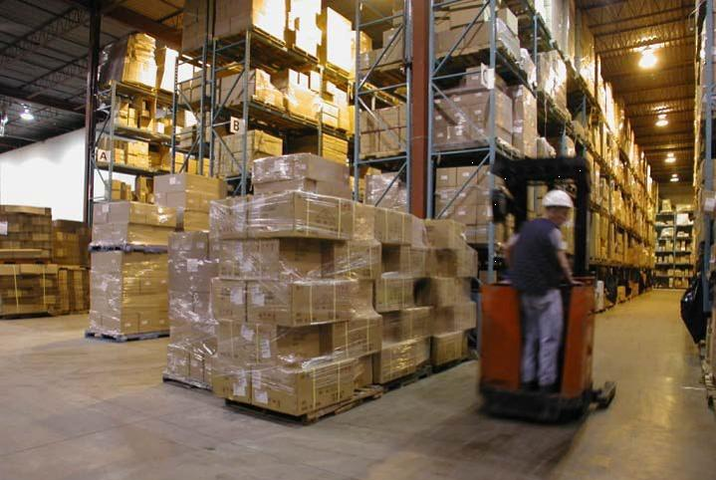

Slide 9
Monitoring Warehouses
Optimize driver routes
Analyze driver behavior
Diagnose problems
Maintenance schedules

Slide 10
MQTT
Message Queuing Telemetry Transport

Slide 11
MQTT 3.1.1
Open standard
Compact & efficient
Publish / subscribe
Durable connections & queuing

Slide 12
Java MQTT Clients
Paho
Fusesource
XenQTT
Notes:
Fusesource – throttling
XenQTT – clean Java code, mock brokers, etc.

Slide 13
Embedded C Clients
https://github.com/menudoproblema/libemqtt
Paho embedded
libemqtt

Slide 14
MQTT-SN
Lighter
UDP, 6LoPAN, ZigBee, etc.
Configuration-free discovery
Functionally compatible with MQTT

Slide 15
CoAP
Constrained Application Protocol
Lightweight REST
Device Management
Lightweight M2M
Publish/subscribe
CoAP-MQ

Slide 16
MQTT Alternatives
XMPP
AMQP
DDS
STOMP
REST
DataBus
LWM2M
DNP3
Modbus

Slide 17
Analyzing
Making sense of it all

Slide 18
Apache Spark
Data locality
Functional style
Multiple backends
HDFS
Cassandra

Slide 19

ElasticSearch
Lucene full-text search
Flexible schema database
Kibana

Slide 20
Kibana
Ad-hoc queries
Graphs & charts
Visualization
Browsing

Slide 21
Reacting
Removing the human component

Slide 22
AllSeen Alliance
Service auto-discovery
Multiple transports
WiFi
Bluetooth
Security & Identity

Slide 23
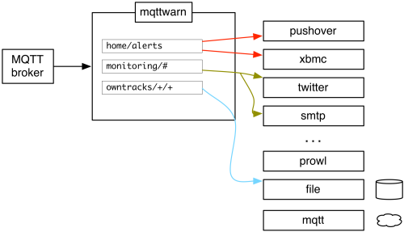
mqttwarn
Notes:
* Natural language converter

Slide 24
ThingFabric™ SQL
Filtering based on content
Joins, aggregation
Enterprise scale

Slide 25
Resources
Software
http://iot.eclipse.org/
https://app.thingfabric.com/
Nitinol Energy Harvester
http://www.kelloggsresearchlabs.com/PressReleaseGenerator
Natural language converter
Kura
Cooja

Slide 26
Thank you!
@kellogh

