Slide 1
Delivering Universal Javascript & Templating with Jahia’s Digital Factory

Slide 2
Presenters
SAJID MOMIN
SERGE HUBER
Sr. Solutions Architect
Founder/CTO

Slide 3
AGENDA
About Jahia
Serverside JavaScript
Demo
1
2
3
4
5
6
Digital Factory
JavaScript Framework & Template Engine
Q/A

Slide 4
About Jahia
Jahia is a leading open source User Experience Platform vendor, relentlessly working at transforming a siloed industry into a user-driven one, beyond technology constraints.

Slide 5
About Jahia
Jahia [pronounce J-I-Y-A] is a leading open source User Experience Platform vendor, relentlessly working at transforming a siloed industry into a user-driven one, beyond technology constraints.
Founded in 2002 and headquartered in Geneva, Switzerland, Jahia Solutions Group has its North American headquarters in Washington, D.C., with offices in Chicago, Houston, Toronto (Canada) and throughout Europe. Jahia counts hundreds of global brands and governmental organizations among its loyal customers in more than 20 countries across the globe.

Slide 6
Digital Factory
The leading open source Java UXP. Power and autonomy to the Digital Workers!

Slide 7
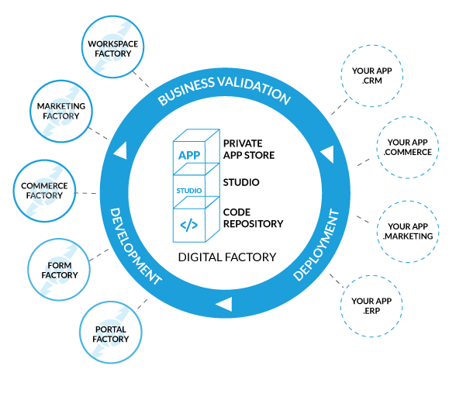
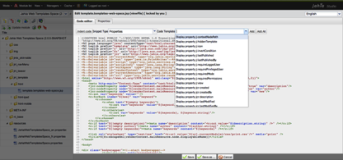
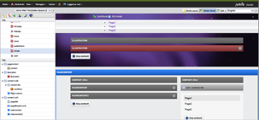
Digital Factory
Digital Industrialization answer

Slide 8
Digital Factory
Frameworks

Slide 9
Digital Factory
A CLOSER VIEW
A servlet container (Apache Tomcat, Oracle WebLogic, IBM WebSphere or others)
A set of filters and servlets that form the “outer layer” of Digital Factory
A set of Spring beans that make up the main architecture of Digital Factory
A set of modules that extend the basic functionality
A JCR implementation for storage of content (Apache Jackrabbit 2.x)
A portal container (Apache Pluto 2.x)
A scheduler (Quartz)
A workflow engine (jBPM)
A rules engine (Drools)

Slide 10
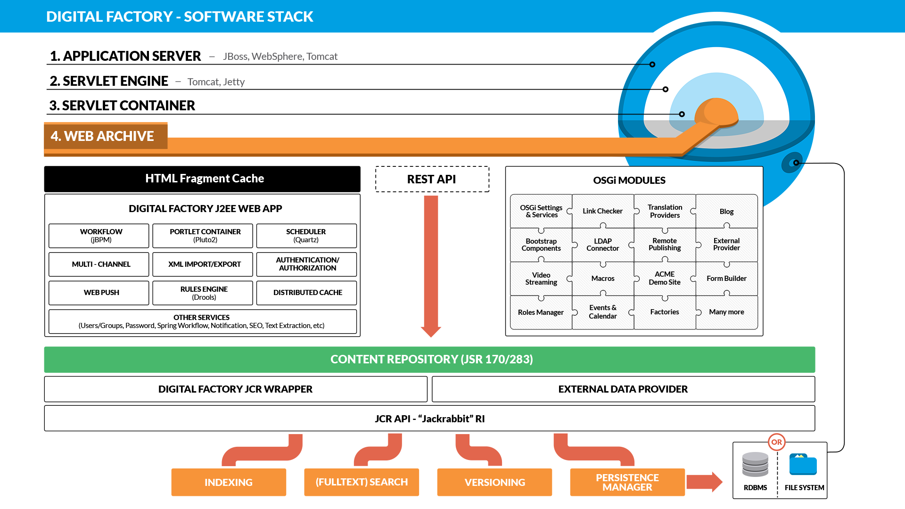
Digital Factory
SOFTWARE STACK

Slide 11
Digital Factory
WHAT IS A MODULE?
Modules are a very important part of Digital Factory, and may be thought of as Digital Factory’s plug-in infrastructure. Basically they are composed of directory and files that are packaged as an OSGi bundle JAR file
Content definitions
View scripts (JSP, JSR-286 compatible languages such as JavaScript, Velocity or Freemarker, or even PHP*)
Static resources (text file, images, CSS files, JavaScript files)
Resource bundles or other property files
Java classes or JAR libraries
Filters
Permission and role definitions
Rules
jBPM workflow definitions
Tag libraries
Spring Framework configuration files
Content import files (in XML format)
Nothing is mandatory (an empty module will do nothing)

Slide 12
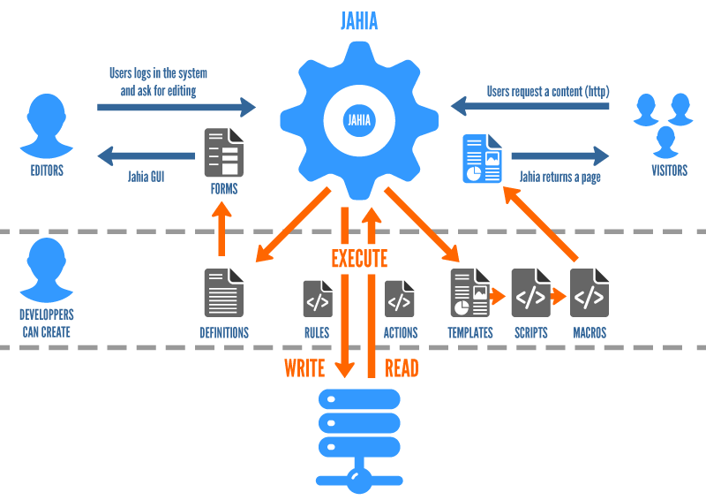
Digital Factory
Content Flow

Slide 13
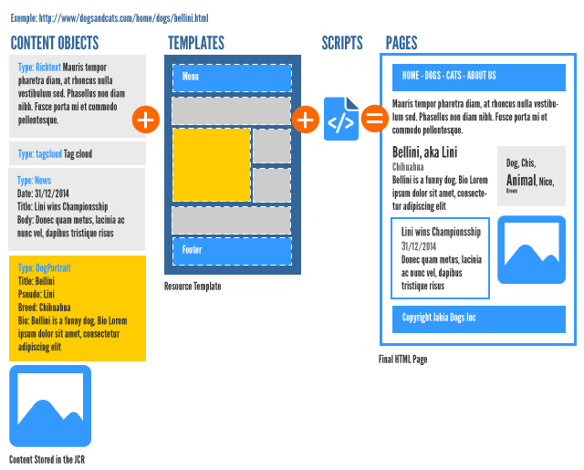
Digital Factory
Templates and Views

Slide 14
Serverside JavaScript
Homogenous Programming Experience

Slide 15
Serverside JavaScript
HISTORY & PRESENT
Rhino, First introduce by Netscape in 1998
Open source
Written in Java
Outdated
Slow
Oracle Nashorn, A Next-Gen JavaScript Engine
Ships with Java 8
Built from the ground up
Better runtime performance through invokedynamic
ECMA-compliant, run more elaborate snippets

Slide 16
Serverside JavaScript
ELAVATOR PITCH
Large pool of JavaScript resources in the market
Write code once for both Server and Client
Empower JavaScript developers to manage the client and server side view logic
Eliminates handoff from client side developers to server side developers
Popularity of Node.js

Slide 17
JavaScript Framework & Templating Engine

Slide 18
JavaScript Framework & Templating Engine
SOLUTIONS
Handlebars
Underscore
React

Slide 19
JavaScript Framework & Templating Engine
CONTENT OBJECTS
// Comments List Content Object
[javaone:comments] > jnt:contentList orderable + * (javaone:comment)
// Comment Content Object [javaone:comment] > jnt:content, mix:title - text (string, richtext)

Slide 20
JavaScript Framework & Templating Engine
HANDLEBARS
Abstracts Javascript from markup
Allows binding of data to mark up templates that are easy to manage.
Easily recognized by the use of {{expression}}
Logic less templates
Custom helper can provide extensibility
Support partials to reduce duplicate markups

Slide 21
JavaScript Framework & Templating Engine
HANDLEBARS: COMMENTS VIEW SCRIPT
load('classpath:/javascript/lib/handlebars-v3.0.3.js'); …. var source = FileHelper.loadFileContent("http://" + InetAddress.localHost.hostName + ":" + port + url.currentModule + "/javascript/handlebar/template.hbs"); var template = Handlebars.compile(source); …. print(template({ "title": title, "comments": items, "identifier": currentNode.identifier, "workspace": workspace }));

Slide 22
JavaScript Framework & Templating Engine
HANDLEBARS: COMMENTS TEMPLATE
<div id="comments-handlebar-content"> … <h2>{{title}}</h2> <div class="commentList"> {{#each comments}} <div class="comment"> <span>{{this}}</span> </div> {{/each}} </div> … </div>

Slide 23
JavaScript Framework & Templating Engine
UNDERSCORE
Abstracts Javascript from markup
Allows binding of data to mark up templates that are easy to manage.
Easily recognized by the use of <%=expression%>
Lots of built in helpers, no need to extend

Slide 24
JavaScript Framework & Templating Engine
UNDERSCORE: COMMENTS VIEW SCRIPT
load('classpath:/javascript/lib/underscore-min.js'); … var source = FileHelper.loadFileContent("http://" + InetAddress.localHost.hostName + ":" + port + url.currentModule + "/javascript/underscore/template.html"); var template = _.template(source); …
print(template({ "title": title, "comments": items, "identifier": currentNode.identifier, "workspace": workspace }));

Slide 25
JavaScript Framework & Templating Engine
UNDERSCORE: COMMENTS TEMPLATE
<div id="comments-underscore-content"> … <h2><%=title%></h2> <div class="commentList"> <% _.forEach(comments, function (comment) { %> <div class="comment"> <span><%=comment%></span> </div> <%})%> </div> …. </div>

Slide 26
JavaScript Framework & Templating Engine
REACT
Javascript library that is used by lots of people to deliver views
Server rendered markup bind with client side react templates to bind event handlers
Implements one way reactive data flow
Component based

Slide 27
JavaScript Framework & Templating Engine
REACT: COMMENTS VIEW SCRIPT
load("classpath:/javascript/lib/react-0.14.0.min.js"); load("http://" + InetAddress.localHost.hostName + ":" + port + url.currentModule + "/javascript/react/application.js"); … print("<div id='comments-content'>" + renderServer(title, items) + "</div>");

Slide 28
JavaScript Framework & Templating Engine
REACT: COMMENTS VIEW SCRIPT
…
print("<script type='text/javascript' src='" + url.currentModule + "/javascript/lib/jquery.atmosphere.js'></script>"); print("<script type='text/javascript' src='" + url.currentModule + "/javascript/lib/react-0.14.0.min.js'></script>"); print("<script type='text/javascript' src='" + url.currentModule + "/javascript/lib/react-dom-0.14.0.min.js'></script>"); print("<script type='text/javascript' src='" + url.currentModule + "/javascript/socketService.js'></script>"); print("<script type='text/javascript' src='" + url.currentModule + "/javascript/react/application.js'></script>"); … print("<script type='text/javascript'>$(function () {renderClient('" + title + "', [" + clientItems + "], '" + currentNode.identifier + "', '" + workspace + "');});</script>");

Slide 29
JavaScript Framework & Templating Engine
REACT: COMMENTS TEMPLATE
…
<div> <h2>{this.props.data.title}</h2> <CommentList data={this.state.data.items} /> <CommentForm onCommentSubmit={this.handleCommentSubmit} /> </div>
…
<div className="commentList">{commentNodes}</div>
…
<div className="comment"> <span>{this.props.children.toString()}</span> </div>

Slide 30
Demo
Comments Module

Slide 31
Demo
Comments ReactJS Code
https://github.com/Jahia/comments-reactjs

Slide 32
Q/A

