Slide 1
Jenkins & the Cloud
A Match Made in Heaven
Ryan Campbell
Kohsuke Kawaguchi
  CloudBees, Inc.
http://cloudbees.com/

Slide 2
Who are we?
Ryan Campbell
  @recampbell
  Main guy behind DEV@cloud
Kohsuke Kawaguchi
  @kohsukekawa
  Main guy behind Jenkins, Nectar, and helping other Jenkins efforts in CloudBees when I can

Slide 3
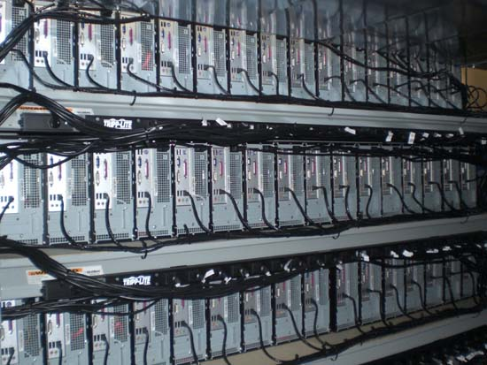
Jenkins, back in 2006
Distributed builds support

Slide 4


Elasticity

Slide 5
Cloud Ladder

Slide 6
Talking the talk
≠
Walking the walk

Slide 7

What is DEV@Cloud Private Edition?
Jenkins as a service, for intranet
Revolves around MetaNectar
  Controls many Jenkins
Same extensibility
Meta Nectar

Slide 8
What is DEV@Cloud Public Edition?
Jenkins as a Service
  1000’s of masters
  More than 1,000,000 build minutes served
Forge
  Git, SVN, Maven
Ecosystem
  Sonar
  SauceLabs
  Artifactory

Slide 9
Jenkins at scale:
Lessons learned

Slide 10
Problem: Configuration Management
What do we mean?
  Preparing slaves into the right shape
  Preparing masters into the right shape
  Keeping them in good shape

Slide 11
Jenkins does a lot
Tool installer extension point
  Automatically install build tools
  Grown from 3 to 8 in this year
Slave Setup Plugin
  Let you run arbitrary shell script upon the slave connection
  Great way to run Puppet

Slide 12
But Jenkins can’t do it all…
Base image configuration
Master provisioning
Other server types

Slide 13
How we did in DEV@cloud
Chef
  Declarative
  Idempotent
  Extensible
    Using Ruby
  Composable
package “httpd”
cookbook_file “/etc/httpd.conf” do
source “myconfig”
end
service “httpd” do
action :start
end

Slide 14

Chef architecture
chef-server
masters
slaves
web-tier

Slide 15
Chef Pro Tips
Build from source, but ship pre-baked images (ie, AMI’s in ec2) for fast, reliable provisioning
Let nodes self-register with Chef server for painless elasticity
  You can do this in /etc/chef/client.rb

Slide 16
Jenkins and Chef/Puppet
Checkout the Chef Recipes for Jenkins
  Configure masters, slaves, even jobs
Same for puppet

Slide 17
And DEV@cloud Private Edition
Clone templates in VMWare
  Works well with “dumb” approach
  Works well with puppet/chef, too
  Of course, this is pluggable

Slide 18
Problem: Slave Provisioning
Yes, we had extension points
But someone needs to implement them

Slide 19
OSS Implementations
EC2 Plugin
  Fully functioning, worked as example for others
Several provider-neutral plugins
  Delta Cloud API
  JClouds
VMWare Lab Manager, libvirt, etc.
Wish list: vagrant plugin!

Slide 20
Slave Provisioning - DEV@Cloud Public
Implements Cloud extension point
Providore!
Uses JClouds to talk to EC2
  Bonus tip: Use cloud libraries such as jclouds and fog instead of directly using provider’s API
Pools slave instances
Manages slave lifecycle

Slide 21
Provision from Pool
reuse
slave pool
request slave
providore

Slide 22
Or provision from ec2
request slave
provision
providore
ec2 api
  Cloud mantra:
  Degrade gracefully when cloud API’s are unavailable. Learn to live without them.

Slide 23
Initialize and authorize
1. Attach workspace
providore
2. Authorize master
slave

Slide 24
Attach slave to master
1. Notify master
providore
2. Connect via SSH
slave

Slide 25
Release and Recycle
1. Release slave
providore
2. Reset and recycle
slave

Slide 26
Demo

Slide 27
Slave Pooling in DEV@Cloud Private
Slaves can be owned by MetaNectar
Meta Nectar

Slide 28
Slave Pooling in DEV@Cloud Private
Then it gets leased to Jenkins
Meta Nectar

Slide 29
Slave Pooling in DEV@Cloud Private
After use it can go back to pool
Meta Nectar

Slide 30
Benefits
Even out use by different teams
  Works with not-so-elastic infrastructure
MetaNectar could scrub instances
  Anything from no-op to revert to snapshot

Slide 31
Monitoring
Why?
  CI is the heart of the dev process
  Trends, correlation
How?
  Nagios, Zenoss, Cacti, munin

Slide 32
DEV@Cloud Public Uses Nagios
Extensible – author your own commands
Text based configuration – generate configuration dynamically
Dependencies – prevents notification storms when core services go down
Pager Duty integration

Slide 33
What to monitor
Anything you want to work
What the user sees – the GUI/index page
Heap/Permgen
Load
Free disk space
Slave availability
  curl http://jenkins/computer/api/json

Slide 34
Groovy Queue Monitor
j = jenkins.model.Jenkins.instance
if(j.queue.items.length > 50)
println(“WARNING, queue clogging”)
$ curl -u “user:pass” -data-urlencode \
script@queue-monitor.groovy \
http://jenkins/scriptText |
grep WARNING

Slide 35
Problem: Managing Plugins
Particularly important aspect of configuration mgmt
Bigger environment often uses proprietary plugins
Consistency across masters help reduce the support overhead

Slide 36
Managing Plugins: How
Bundle them in the war
  WEB-INF/plugins/*.hpi
Lay them down during provisioning
  WEB-INF/init.groovy
  $JENKINS_HOME/init.groovy

Slide 37
What Jenkins offers
Remotely install plugins via CLI or REST API
$ export JENKINS_URL=http://my.jenkins/
$ java -jar jenkins-cli.jar install-plugin \
git subversion chucknorris
$ java -jar jenkins-cli.jar install-plugin \
./path/to/local.hpi

Slide 38
Internal: Update Center vs. Sites
Only one UpdateCenter
  Jenkins.getInstance().getUpdateCenter()
Aggregates Many Update Sites
  Can be local or remote
  Updated using user’s browser if remote
    Consider https

Slide 39
Custom Update Site
Use https://github.com/jenkinsci/backend-update-center2
Use Maven to find plugins
  Internal
  External
Signature is required
  Jenkins has to have your certificate, too
Also see: simple Update Site plugin
  More about this in lightning talk later

Slide 40
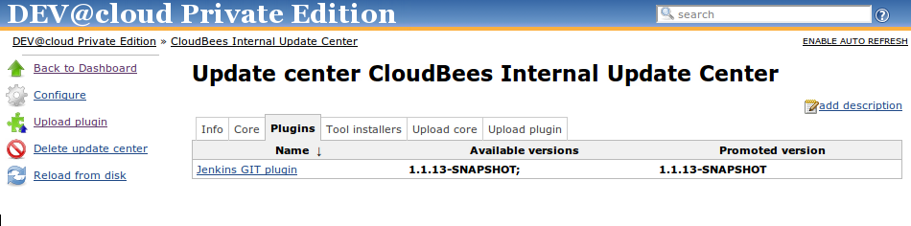
In DEV@PE
We’ve built UI around it

Slide 41
DEV@Cloud Private: Plugin Management
Blacklisting
  Known issues in your environment
Forced installation
  Sometimes with configuration

Slide 42
Problem: One-time work, or is it?
Setting up Jenkins is no longer one-time work if you have many masters
  Ripe for productivity gain
By “setting up” I mean:
  Seed SCM credentials
  Configure JIRA, Sonar, Sventon, … plugins

Slide 43
One-time work, or is it?
Groovy script can be used to configure plugins
Extension point to customize behaviors
  MailAddressResolver
  Subtyping existing plugins to reduce/infer config
  Custom ToolInstallers
import …;
j=Jenkins.instance
d=j.getDescriptorByType(JiraProjectProperty)
s=new JiraSite(“http://jira/”,”username”,”password”,…)
d.setSites(s);

Slide 44
More Improvements Needed
More improvements in core would help
  Installing plugins without restart
  Extension point for inferring SCM browser
Setting up push notification from SCM repository to Jenkins?

Slide 45
Conclusion
Jenkins at scale has interesting challenges
  Inevitable already in large organizations
  Soon for everyone as computers get cheap
What we did hopefully would inspire you
Any questions?

Slide 46







Thank You To Our Sponsors
Platinum Sponsor
Gold Sponsor
Silver Sponsor
Bronze Sponsors
Coming Soon: The CloudBees Newsletter for Jenkins
Please complete the Jenkins survey to help us better serve the community
(bonus: a chance to win an Apple TV!)

Slide 47
Nothing to see here beyond this page.
Please move on.

Slide 48
Even More So in CI
When you need it, you need it a lot
  Matrix builds
  Downstream builds
  Parallel tests
You want result now
http://www.flickr.com/photos/19188303@N02/4801131166/
http://www.flickr.com/photos/ingmar/3989770916/

Slide 49
But when you don’t
Sitting idle, wasting electricity
  Most weekends
  Late night and morning
http://www.flickr.com/photos/19188303@N02/4801131166/
http://www.flickr.com/photos/airdiogo/5655143413/

Slide 50
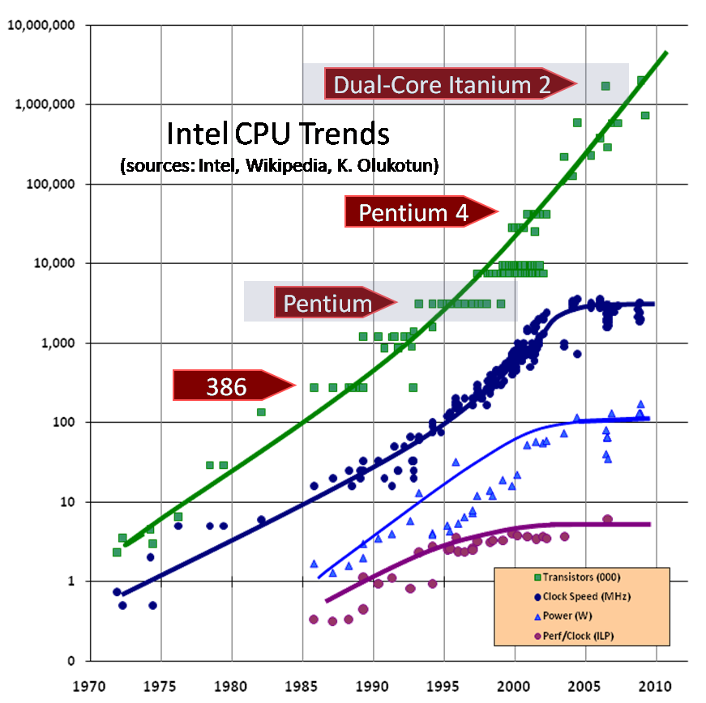

Slide 51
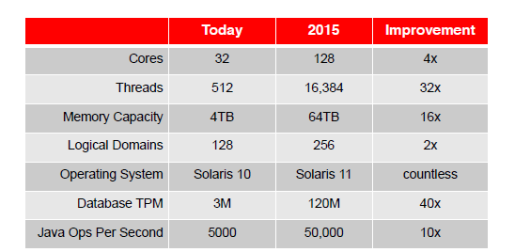
Sparc Roadmap

Slide 52
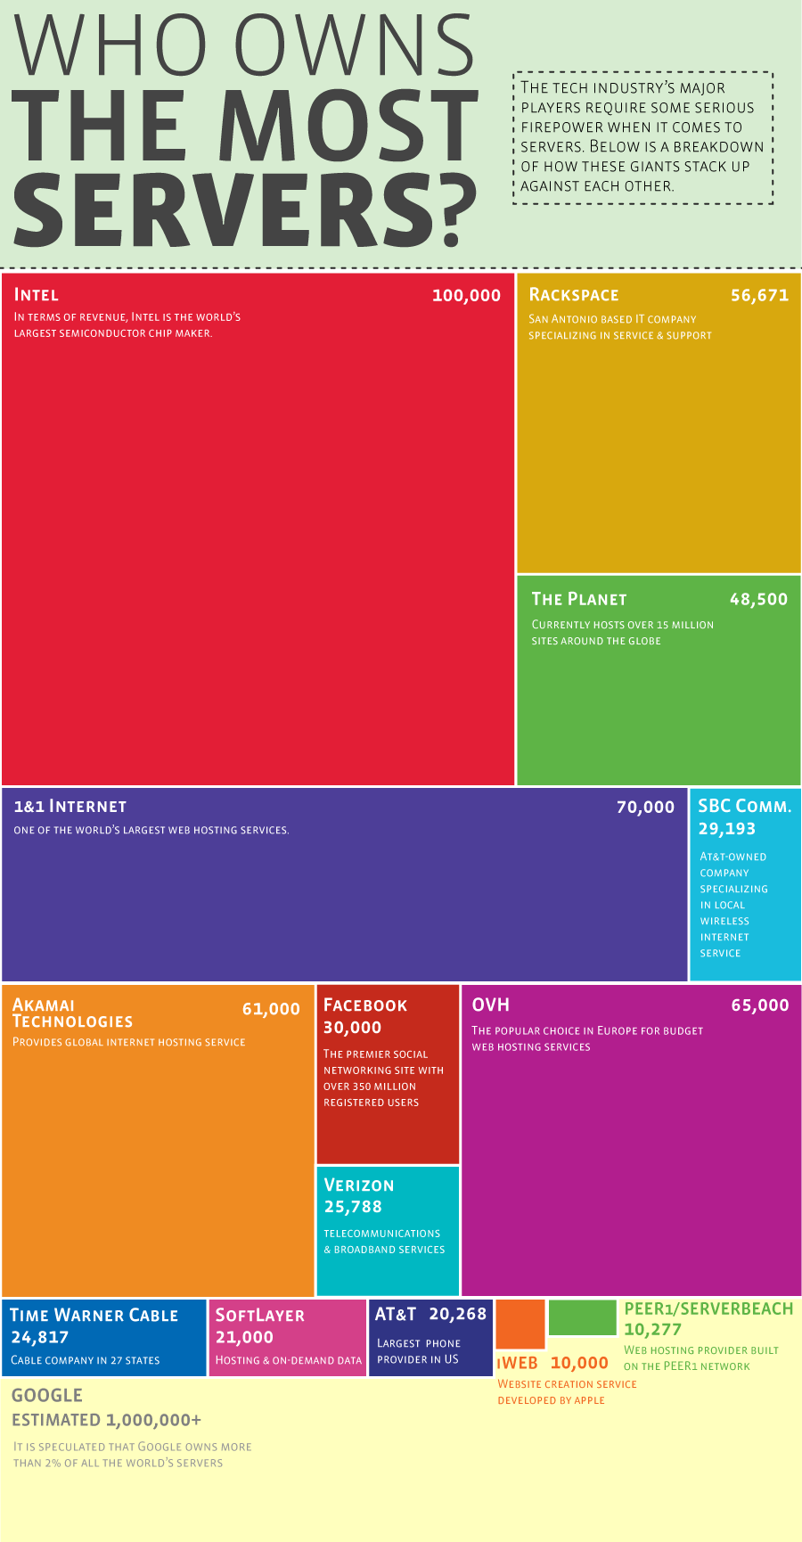
Horizontal Scaling
Google 1,000,000 (?)
Facebook 70,000
1&1 Internet 70,000
Rackspace 56,000
Microsoft, Amazon,
Yahoo, IBM, …

Slide 53

http://www.flickr.com/photos/19188303@N02/4801131166/

Slide 54
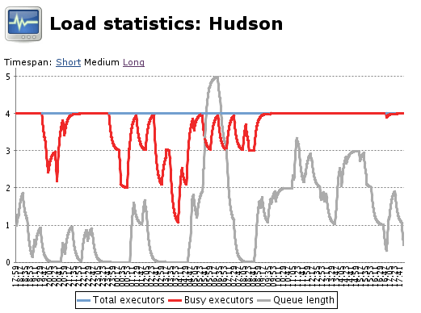
Jenkins, back in 2009

Slide 55
Dynamic Slave Provisioning
capacity
# of executors
usage
time

Slide 56
ALM integration
Spin up new projects quickly
Dynamically integrate ALM services as they are provisioned
Examples
  SCM, Sonar, mvn Repository Managers, or external tools like SauceLabs
Automatically install & configure plugin

Slide 57
SCM Repository Integration
Jenkins is a person identity, too!
  Separate from user identity
  Git
    SSH public/private keys
  SVN
    Implement SubversionCredentialProvider
Standard Commit Hooks
  DIE POLLING DIE
  Challenge: How do we automate this?

Slide 58
ALM Tool Integration Example
Sonar instance per Jenkins
Use CLI to install plugins
Use Groovy script to configure plugin
FIXME – the script below
Feature request ;-)
  Plugin installation without restart
S = new SonarInstallation(“mysql:url”,”username”,”password”)
Jenkins.instance.getDescriptorByName(“”)
sonarDescriptor.setInstallations(s);

