Slide 1
Jenkins Evolutions
Toomas Römer
ZeroTurnaround
Tartu, Estonia, 5500miles
@toomasr
http://dow.ngra.de/
Notes:
My usual Elbonia/Estonia introduction

Slide 2
Why Evolutions?
Testing

Slide 3
Why Evolutions?
Continuous Integration

Slide 4
Why Evolutions?
Continuous Deployment

Slide 5
Why Evolutions?
Workflow management
  Trigger jobs
  Join jobs
Building software
Testing builds
Propagating DVCS repositories
Updating website
  Changelog
  Documentation
  Nightly builds
Release management

Slide 6
Why Evolutions?
Authentication
Authorization
Logging
Notifications
Remote machines

Slide 7
Why Evolutions?

Slide 8
Why Evolutions?
Cron on Steroids

Slide 9
Agenda
Background
Stories
  Functional Tests
  Servlet Tests
  Random Thoughts

Slide 10
Background - 2008
First installation
Clicked “Run” when wanted to test stuff

Slide 11
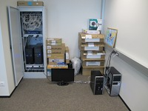

Background - 2011
200 jobs
5 dedicated machines
Amazon ~7000 instance-hour per month
3 in house plugins developed, 2 abandoned
Custom dashboard (35 x 215 grid)

Slide 12
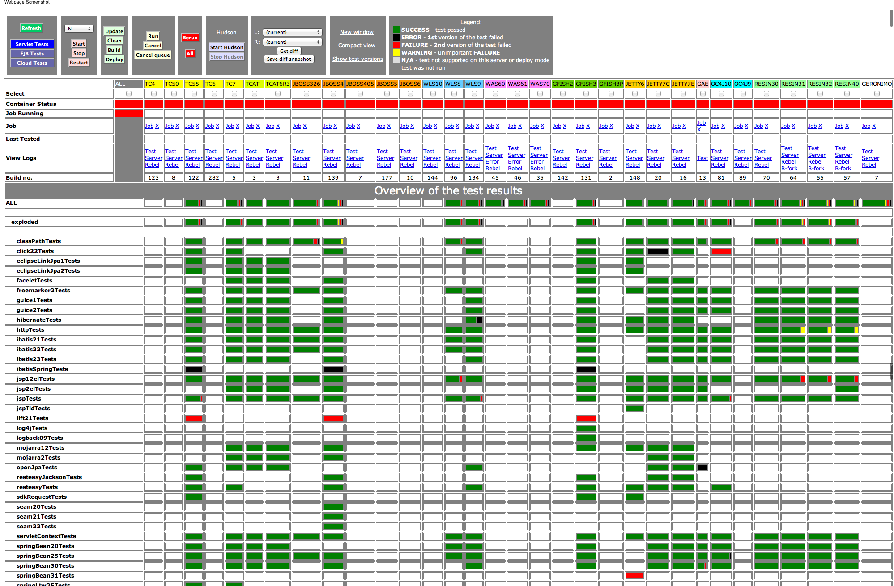
Custom Dashboard

Slide 13
Story of Functional Tests

Slide 14
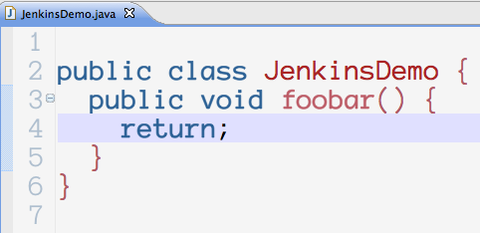
Functional JDK Tests

Slide 15
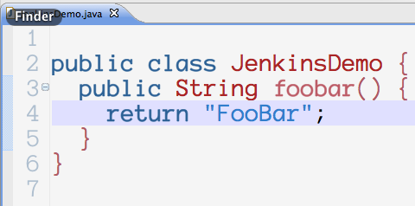
Functional JDK Tests

Slide 16
Functional JDK Tests
Per JDK
  Per functional test
    Compile couple of classes
    Run some methods and assert
    Recompile couple of classes
    Run some methods and assert
    …

Slide 17
Functional JDK Tests
Which Jenkins feature is the best fit here?

Slide 18
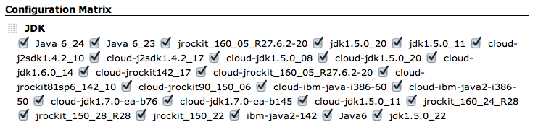
Functional JDK Tests

Slide 19
Functional JDK Tests
Creates about 10 000 new files
Compile about 1700 Java class files
Invoke the JVM 550 times

Slide 20
Functional JDK Tests
Groovy Script

Slide 21
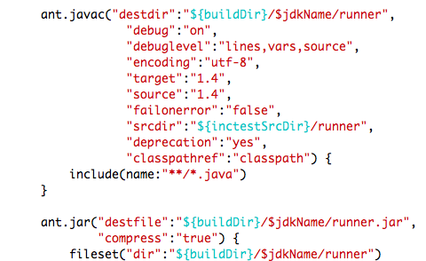
Functional JDK Tests

Slide 22
Functional JDK Tests
How to get test results? Jenkins feature…

Slide 23
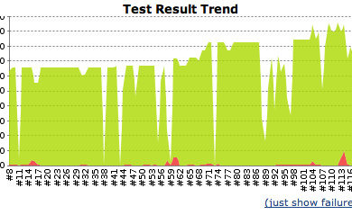
Functional JDK Tests

Slide 24
Functional JDK Tests
Sloooow

Slide 25
Functional JDK Tests
IO
CPU
Memory

Slide 26
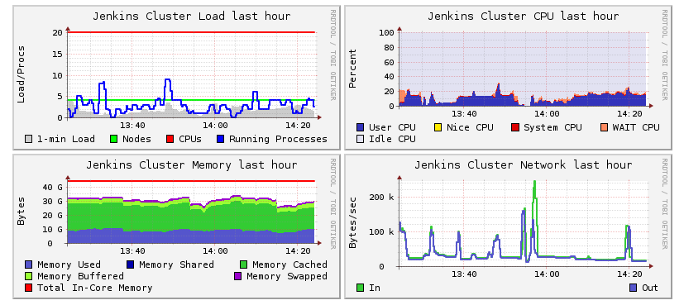
Functional JDK Tests

Slide 27
Functional JDK Tests
Cloud
  1 small instance per JDK
  Manual update of AMIs
  Slow
  Scales!

Slide 28
Functional JDK Tests
Which Jenkins plugin to use?

Slide 29
Functional JDK Tests
Which Jenkins plugin to use for results?

Slide 30
Functional JDK Tests
SSD
  30% gain in time, that’s it

Slide 31
Story of Servlet Tests

Slide 32
Servlet tests
Start a container version
  Websphere, Weblogic, Glassfish etc.
Deploy applications
Test results, reload changes, test results…
Notes:
Dynamic startup scripts – why not show a demo?
Deploy applications – get stats from Rein

Slide 33
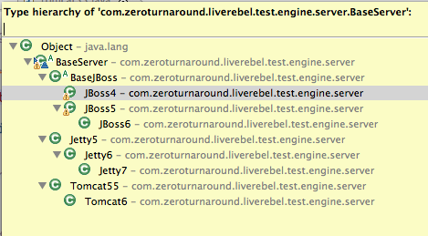
Servlet Tests

Slide 34
Servlet Tests
Interface aliases

Slide 35
Servlet Tests – 1 server, 2 jobs
Which Jenkins feature to use?

Slide 36
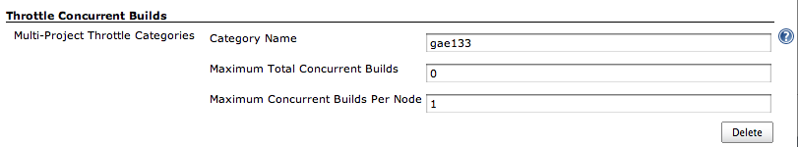
Servlet Tests – 1 server, 2 jobs

Slide 37
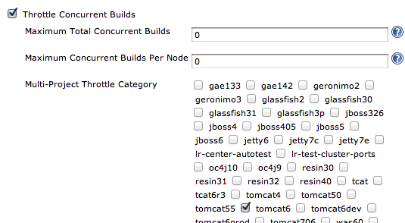
ServletTests – 1 server, 2 jobs

Slide 38
ServletTests
Deployment

Slide 39
Servlet test
Start Tomcat
Copy WAR files to webapps/
GET /some-url
Assert
Update application
GET /some-url
Assert

Slide 40
Sloooow

Slide 41
Servlet tests
Memory
IO
CPU

Slide 42
Testing Multiple Containers
Cloud
  1 Small instance per Container
  Need to update AMIs
  Slow
  Isolation

Slide 43
Single Machine
Port Hell
Memory Limits
Speed

Slide 44
Story of DVCS

Slide 45
Dev and stable
Continuous integration
  Slow feedback cycle
  Red results
  Envs impossible to duplicate

Slide 46
Dev and stable
2 phase continuous integration
  Subset of the full test suite
  On success propagate to stable
    hg push …
  Run full test suite

Slide 47
General observations
Fight for executors
  Don’t do multiple releases on the same day
Optimum utilization
Feedback should be quick

Slide 48







Thank You To Our Sponsors
Platinum Sponsor
Gold Sponsor
Silver Sponsor
Bronze Sponsors
Coming Soon: The CloudBees Newsletter for Jenkins
Please complete the Jenkins survey to help us better serve the community
(bonus: a chance to win an Apple TV!)

