Slide 1
Jenkins State of Union 2011
Kohsuke Kawaguchi, CloudBees, Inc.
Creator of Jenkins
@kohsukekawa
http://cloudbees.com/

Slide 2
Jenkins User Conference!
30 talk submissions
380+ registration
7 sponsors
Staff
Thank you!
Notes:
Round of applause to the organizing committee

Slide 3
2004 Summer
I broke one too many builds
Wouldn’t it be nice if …?

Slide 4
And so it began
build.sh
monitor.sh
Run from cron
#!/bin/bash -ex
exec 2>&1
cd /files/jaxb-ri
cvs update
ant
#!/bin/bash -ex
build.sh > build.log || mail …

Slide 5
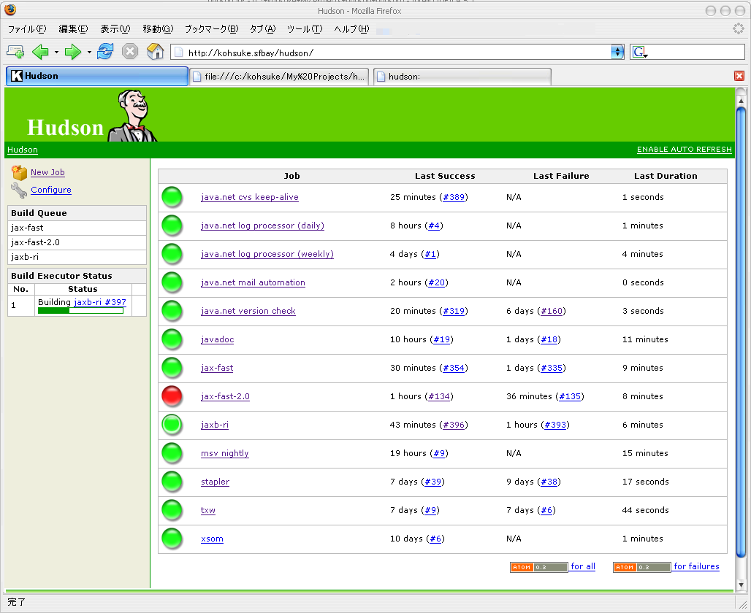
Then I wrote my version

Slide 6
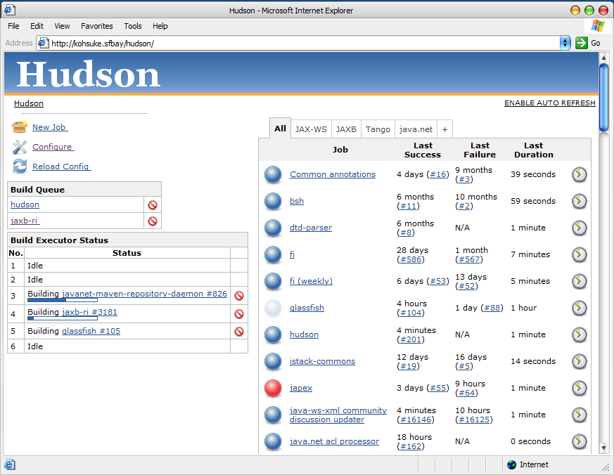
By 1.15 (Feb ‘06)

Slide 7
The culture was established early on
Weekly release cycles
Extensibility via plugin
Lower barrier to entry
Backward compatibility matters
And then we just kept on keeping on

Slide 8
Plugin Growth
470?
313
223
94
27
6

Slide 9
Ticket Activities
12000?
8200
5000
2600
950
40

Slide 10













































Slide 11
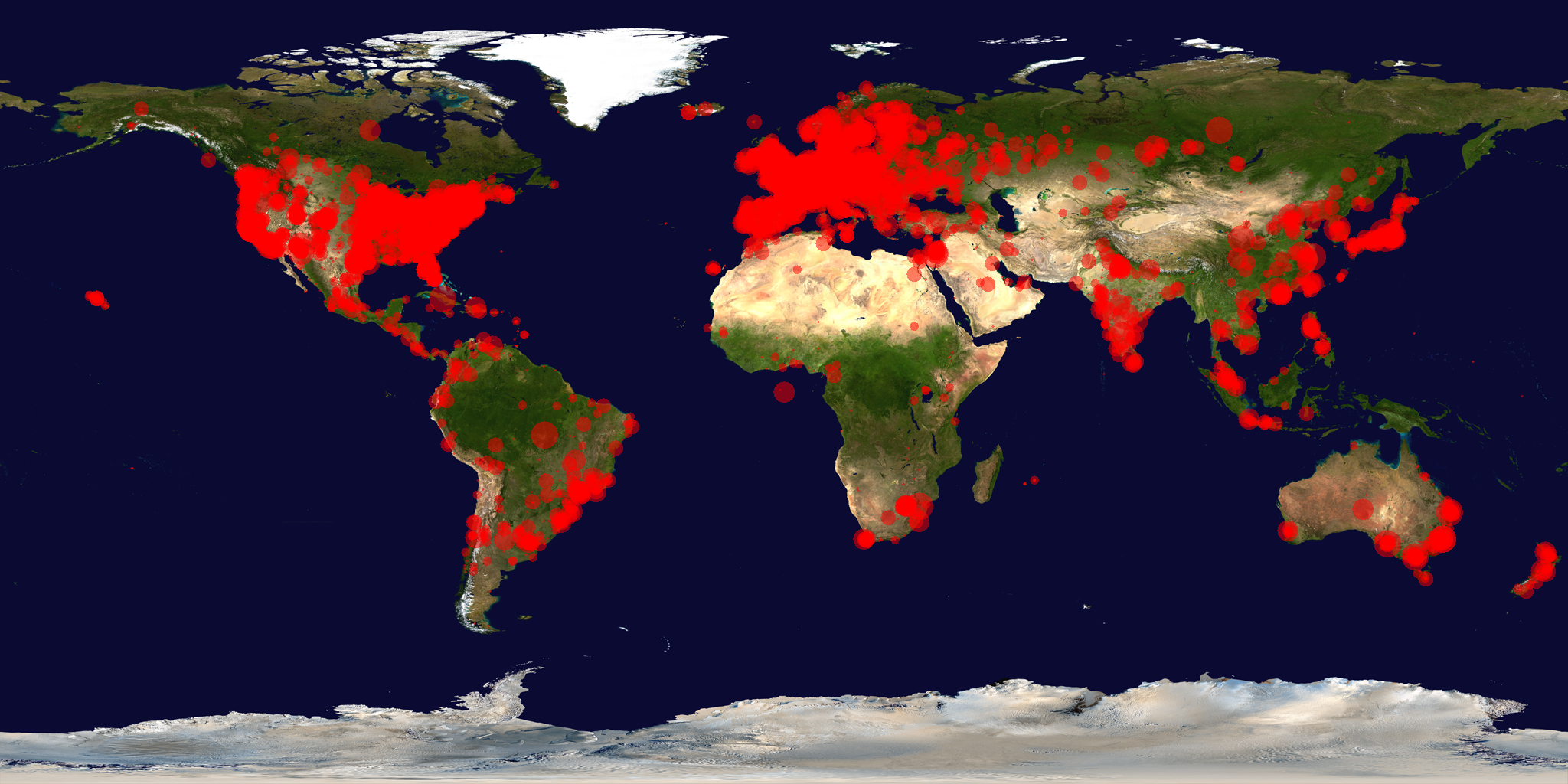
Usage All Around the World

Slide 12
2011 Jan: Divorce
Oracle: “you do it our way or highway”
Community chose highway: 214 to 14
That’s when we became Jenkins

Slide 13
8 months have passed.

Slide 14
Where are we now?

Slide 15
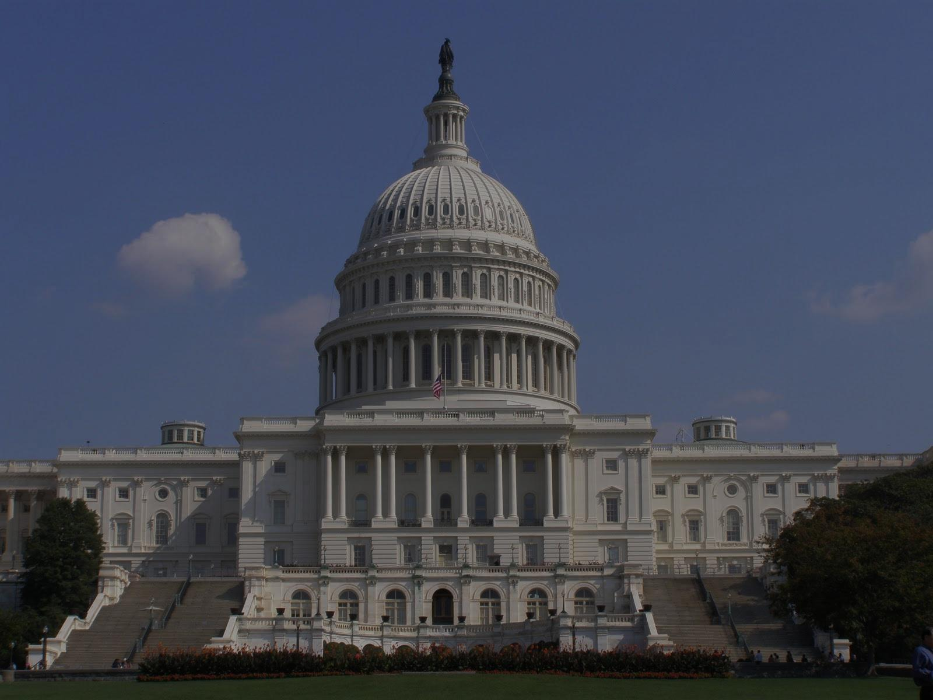
More Transparent/Formal Governance

Slide 16
Legal Entity
Jenkins now affiliated with Software in the Public Interest (SPI)
NPO to promote free and open software
Joined the likes of Debian, Drupal, PostgreSQL
Enables us to enter into contract, own assets, and live longer than individuals

Slide 17
Fundraising Drive
Through SPI, so tax deductible
jenkins-ci.org/donate
Raising $5130 (the bandwidth overage during summer)
Broad donation base is good for the project, so your help would be appreciated

Slide 18
Interim Governance Board
Myself, from CloudBees
Andrew Bayer, from Cloudera
Dean Yu, from Yahoo

Slide 19
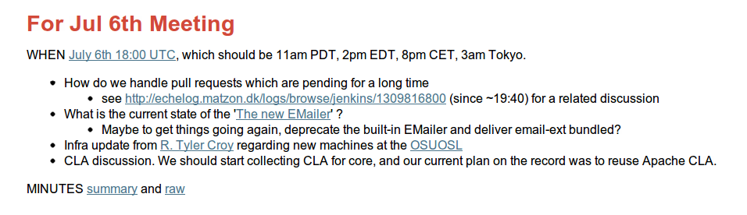
Project Meeting
Bi-weekly meetings
Held in IRC
Agenda/participation open to anyone
Logs available online

Slide 20
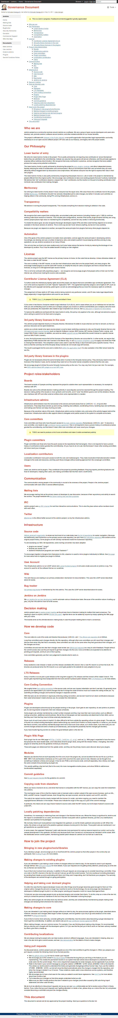
Governance Document
Today, we announce that we adopted an official governance document
Our implicit modus operandi, made explicit
https://wiki.jenkins-ci.org/display/JENKINS/Governance+Document

Slide 21
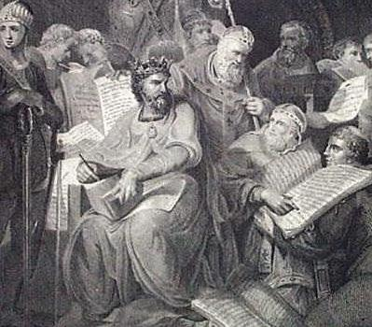
Governance Document
Clarifies how we work
Should make onboarding easier
License policies
Project roles
Name usage
Check list for pull requests

Slide 22
Contributor License Agreement
As a part of governance document, the project approved of collecting CLA for core
Based on CLA used by Apache
Further clarifies the rights associated with contributions
Protect users and projects from potential legal disputes

Slide 23

Infrastructures and Releases
http://www.flickr.com/photos/acmace/4410650624/

Slide 24




Diversity is good for project
We rely on diverse entities to run jenkins-ci.org
Thanks to

Slide 25
Server donation
cucumber.jenkins-ci.org
Runs jenkins-ci.org and other critical infrastructure services
Purchased by Tyler, Andrew, and myself
$2000 worth of the equipment
Today we announce that we are donating this to SPI

Slide 26
Our mirrors around the world
Thanks!
7 mirrors around the world
Nurnberg, Germany
Yokohama, Japan
Salt Lake City, Utah
Taipei, Taiwan
Madison, Wisconsin

Slide 27

More Open Infrastructure
For longest time, infra work was behind the closed door
We can’t just hand out system access to everyone
But now Tyler is pushing Puppet to work
http://github.com/jenkinsci/infra-puppet
“Open-sourcing” server setup
Send in pull requests to make changes
# of trusted admins is less of a bottleneck

Slide 28
Releases
Main line continues weekly releases
With same emphasis to compatibility
“Peter created his plugin against Hudson 1.129 … got it running on Jenkins 1.397 without recompiling”
--- Stephen Connolly

Slide 29
But with a lot of new features
Lazy loading HTML fragments in config page to speed it up
DWR-like JavaScript reverse proxy
View in Groovy and Ruby
Uniform macro expansion mechanism
JavaSE 7 support
Custom view properties
Systematic XSS prevention
Solaris packages, Mac OS X packages
Memory monitoring and auto restart on Mac OS X
Rebuilding matrix project subset
API token for REST API
SSH public key authentication for CLI
Syntax highlighted Groovy console
JRebel support in plugin/core development
More robust master/slave communication
1600 tickets resolved

Slide 30
Long-Term Support Releases
Pick good main release
Main release line
LTS release line
Backport proven fixes from main releases
June 2011
1.409.1
Sep 2011
1.409.2

Slide 31
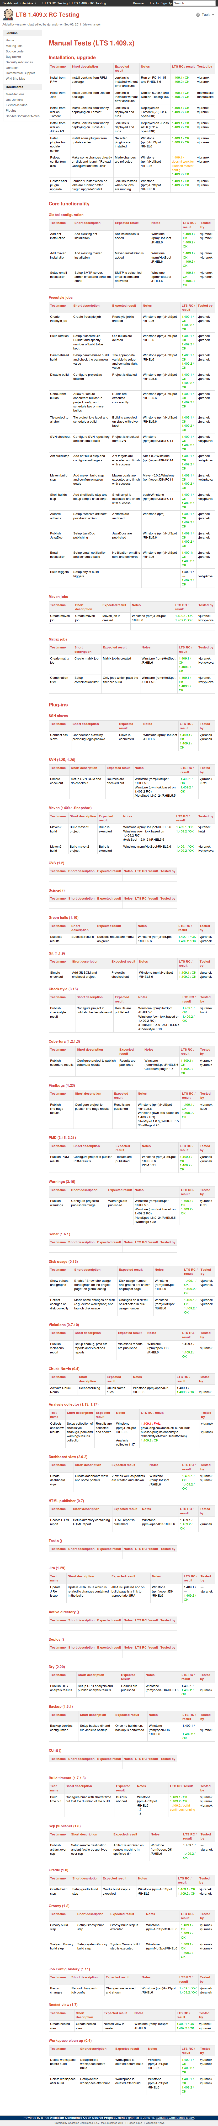
LTS Gets Extra Testing & Eyeballs

Slide 32
LTS - Even Hudson user likes it!
“Jenkins has introduced a Long Term Support release, with less new features but more stability. Copying Jenkins is maybe politically complicated, but it could be a good way to smooth the transition.”
--- in Hudson users list

Slide 33

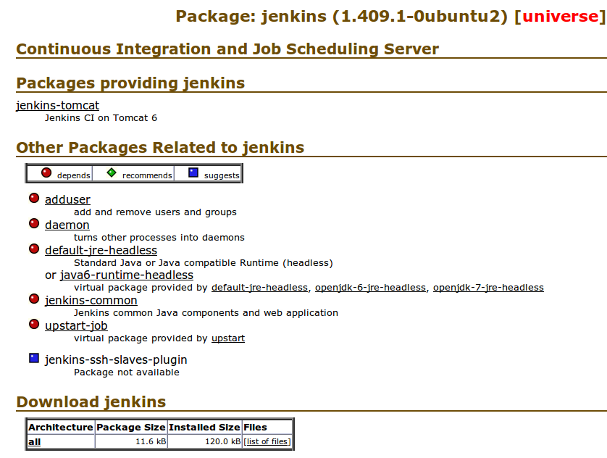
Jenkins is now in Ubuntu

Slide 34

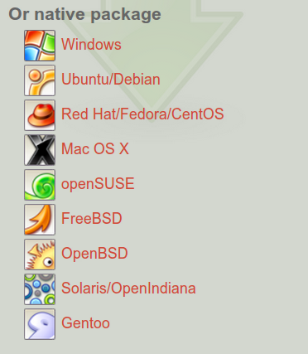
5 more native packages
Mac OS X and Solaris, especially new

Slide 35
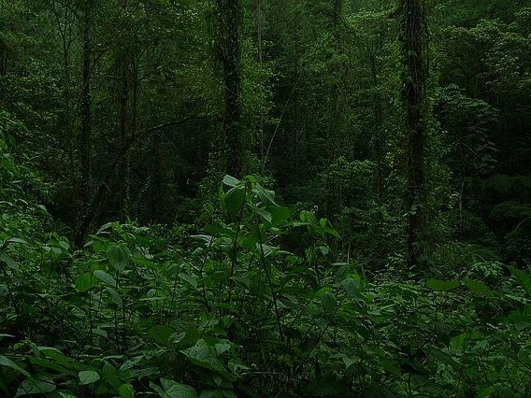
Ecosystem Expansion
http://www.flickr.com/photos/husein/2077933931/

Slide 36


Book
Nicely complements Wiki

Slide 37


Book
From the guy behind Jenkins-php.org
Another one in Japanese coming this year

Slide 38
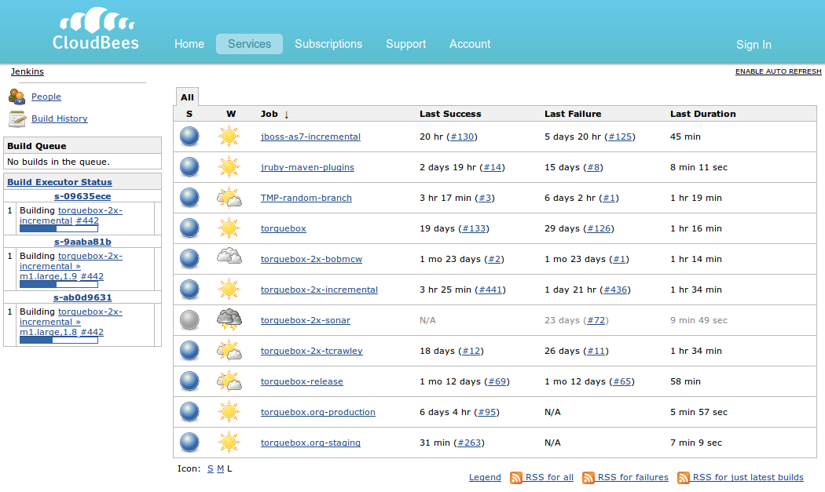
CloudBees

Slide 39
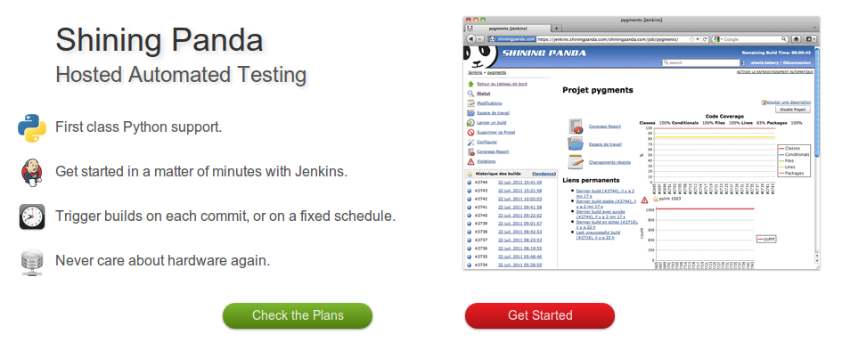
Shining Panda

Slide 40
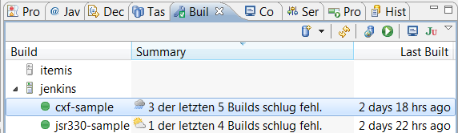
Tasktop - Mylyn Jenkins Connector

Slide 41
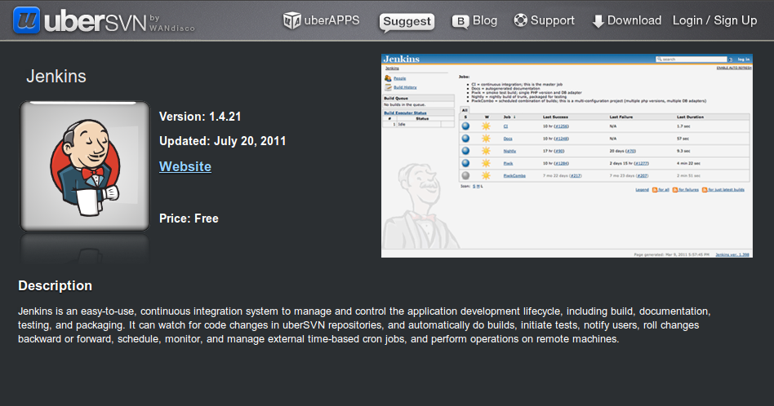
WANdisco - UberSVN

Slide 42

CollabNet
Next major release will ship Jenkins pre-bundled
Jenkins plugin to use lab management as cloud

Slide 43

Adoption Statistics
http://www.flickr.com/photos/st3f4n/2865510059/

Slide 44

Conversion rate tracking
In the last Hudson release we posted, we put up a sign post
Let the user chose between Hudson and Jenkins

Slide 45
Converging to about 85%
Eclipse move isn’t making any difference
Upgrades still happening
Only ~10% upgraded this way
Cumulative stack area chart
Y: # of conversions

Slide 46
Update Center Hits/wk
Counted UC data retrieval
Hudson Labs is where we used to run UC
Showing very rapid conversion to Jenkins
90% at this point
Cumulative stack area chart
Y: # of successful GET reqs

Slide 47
Anonymous Usage Statistics
Based on anonymous usage data collection
One-off instances are filtered out
~75% conversion from legacy to Jenkins
Adoption regaining momentum
Cumulative stack area chart
Y: # of unique installation IDs

Slide 48
Ticket activity: Jenkins vs Hudson
Counting # of filed tickets
Eclipse move isn’t making any dents
About 2300 vs 300 new tickets since split

Slide 49
Different stat, same story
# of commits in plugins/week
Area chart. Not stacked.
Avg 280
Avg 16

Slide 50
Different stat, same story
GitHub Repositories
586
38

Slide 51
Different stat, same story
Mailing List Traffic (user+dev)
1295/mo
vs
299/mo

Slide 52
Different stat, same story
Dev list subscribers

Slide 53
Different stat, same story
Users list subscribers

Slide 54

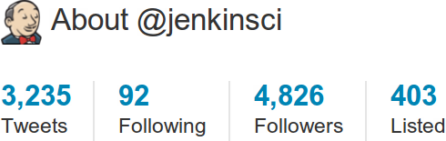

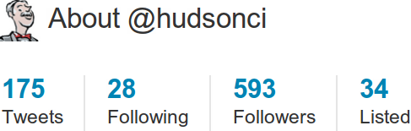
Different stat, same story
Twitter

Slide 55
Different stat, same story
Twitter followers

Slide 56

Upcoming Features

Slide 57
Core Internal Improvements
Guice integration
Using IoC to discover/inject components
JUnit4 test harness
More extensibility
Better performance
Better mocking

Slide 58
Core Improvements
Moving Core Java features into plugins
Done: Ant, javadoc
Maven, JUnit
More flexibility in Maven plugins
Adding build steps before/after

Slide 59
What I’d like to work on
Easier test parallelization
By taking advantages of slaves
Distributed execution assistance
Use Jenkins slaves as general-purpose computing grid
Adding new plugins without restart

Slide 60
Other Cool Projects
Jekins plugin development in Ruby
More about this from Charles later
Running slave agents on Android

Slide 61
Conclusions
Lots of progresses, in terms of
Governance
Adoption
Competition
Ecosystem
And lots more progress to come
Enjoy the rest of the day!

Slide 62







Thank You To Our Sponsors
Platinum Sponsor
Gold Sponsor
Silver Sponsor
Bronze Sponsors
Coming Soon: The CloudBees Newsletter for Jenkins
Please complete the Jenkins survey to help us better serve the community
(bonus: a chance to win an Apple TV!)

Slide 63
BACKUP

Slide 64
Update Center Hits/wk

Slide 65
Then it just gradually took on
2008 Update center implemented

