Slide 1
a picture is worth a thousand words
David Tolley
CI Architect Build/Release

Slide 2
A little about me
And maybe something about Groupon Engineering
Married… sorry for all the… lady… out there
Contact information:
dtolley@groupon.com
Twitter: DavidTolley
Groupon 400-20,000 engineers
300+ commits in a day to main app
Each commit triggers 9 jobs
Each job has between several hundred to several thousand tests
Many other jobs not associated with out primary application
https://engineering.groupon.com/
Were always hiring: http://www.groupon.com/techjobs/

Slide 3
A Little Selenium Timeline
Completely skewed from only my experiences
I run tests
I get failures
Developer says “ Works for me”
I print out the stack trace of failures from now on
Developer says “Only fails on Jenkins, that stack trace is a red herring”
I take a screenshot of the Browser at point of failure, archive it
Developer looks at stack trace
Developer finds the corresponding screenshot in the build’s artifacts
Developer says “This is cool but… I don’t like having to search for a screenshot”
I develop a plugin to insert screenshots into test failure details page
Developer says “Awesome! Now I easily know what to fix”

Slide 4
So what did I learn?
Data is awesome
But a selenium failure with out visual proof, or a picture without context is hard to digest

Slide 5
Words describing a picture
My “stack trace”
Giant
Monstrous
Absurd
15 Feet tall by 20 Feet Wide
Brown stuffed cat crammed into UFO
Hanging from the celling on 4th floor of Groupon’s Head Quarters
Giant tongue sticking out of its mouth
Cat haters worst nightmare
I feel bad for the person who has to clean it’s litter box
WTF?!?!
This has to be a joke…
Notes:
Let me give you a real life example
IM going to describe a picture, see if you would really believe me

Slide 6
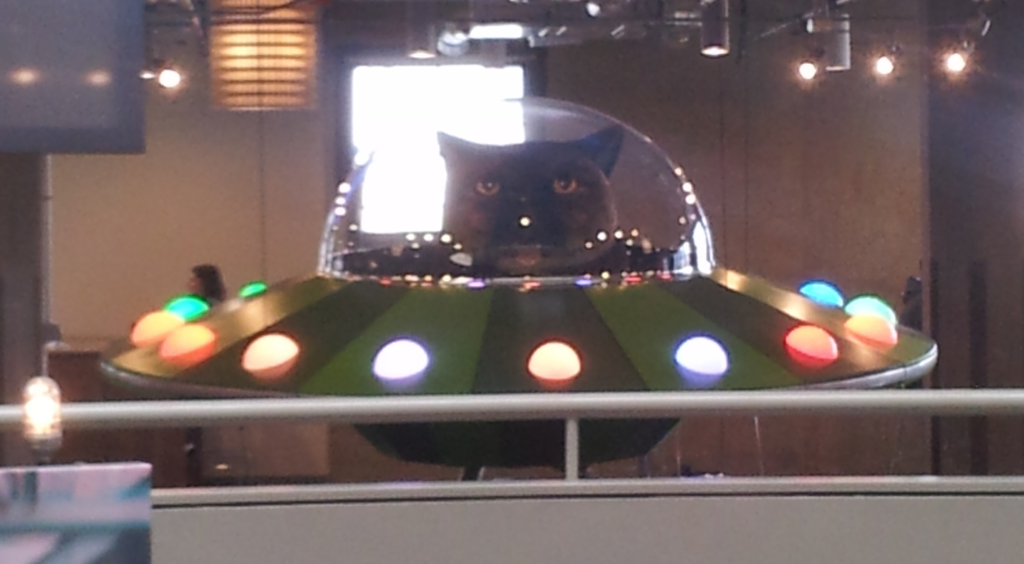
A picture with no context
My “screenshot”
Notes:
Maybe this is just a small desktop toy
Maybe a picture on a wall
Maybe just a desktop background
Almost worthless without context

Slide 7
When your powers combine…
I’m so excited!
Pause to build suspense

Slide 8
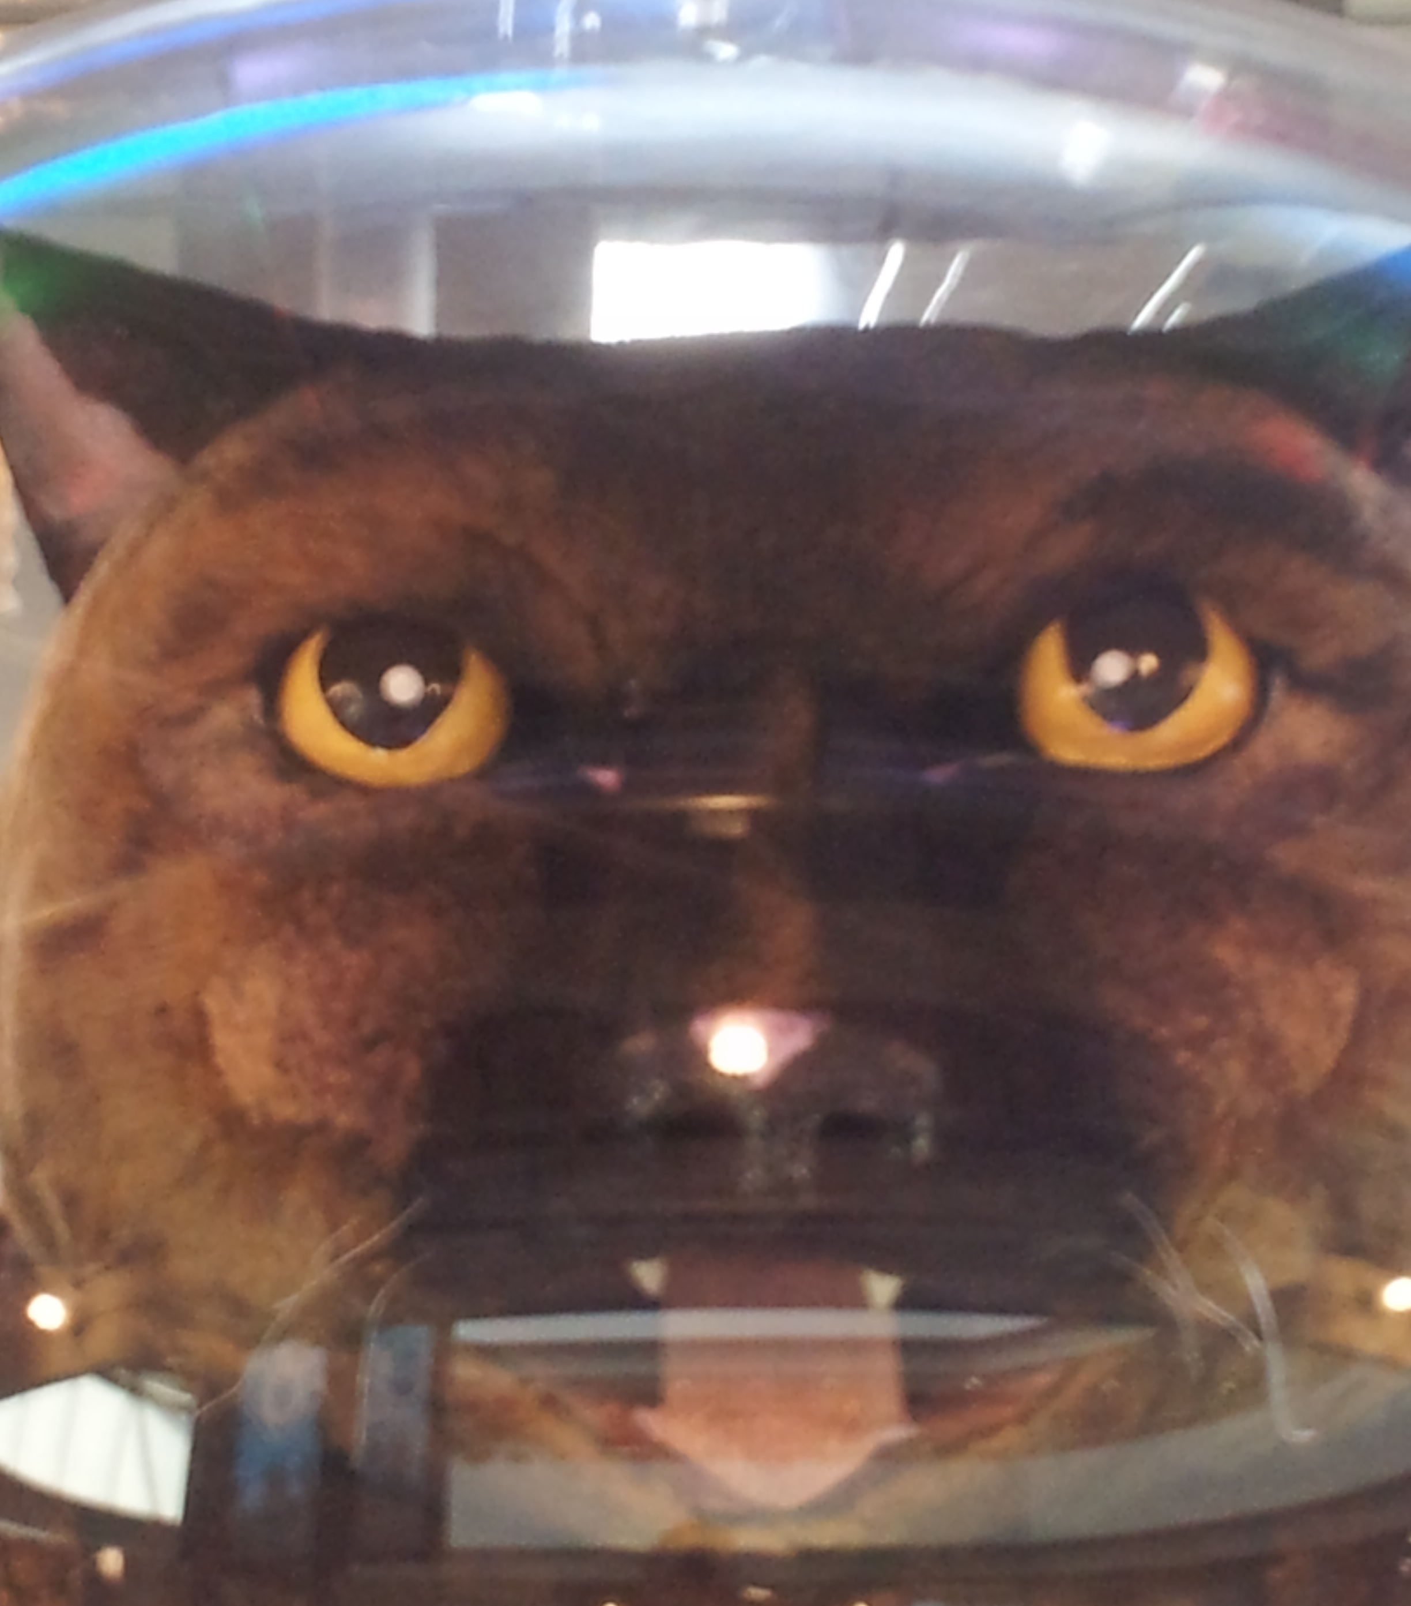
I’m sad to present… Groupon’s Mascot
Mind has been BLOWN
Giant
Monstrous
Absurd
15 Feet tall by 20 Feet Wide
Brown stuffed cat crammed into Silver UFO
Hanging from the celling on 4th floor of Groupon’s Head Quarters
Giant tongue sticking out of its mouth
Dog lovers worst nightmare
I feel bad for the person who has to clean it’s litter box
WTF?!?!
This IS real…

Slide 9
That’s cool…
But how does this fit into Jenkins?
TestDataPublisher and TestAction
Along with naming screenshots in accordance with the test that failed
Notes:
I built a plugin that does this all for you, relies on the TEstDataPublisher and TestActions

Slide 10
TestDataPublisher
If we have failures, try and find a corresponding screenshot
if(testObject instanceof CaseResult) {
CaseResult caseResult = (CaseResult)testObject;
String testName = caseResult.getClassName() + "." + caseResult.getName();
String regex = testName.replaceAll(" ", "_");
regex = regex.substring(regex.lastIndexOf(".") + 1, regex.length());
for (Run<?, ? extends AbstractBuild<?, ?>>.Artifact artifact : build.getArtifacts()) {
if(artifact.getFileName().contains(regex)){ //matches(regex)) {
String url = Hudson.getInstance().getRootUrl() + build.getUrl() + "artifact/" + artifact.getHref();
result.add(new ImageBadge(testName, url));
Notes:
TestDataPublisher, such as used by the JUnitXMLReporter
Lets you display errors in a useful way, through TestActions
I parse all of the failures,
Try and find a corresponding screenshot
If one exists, add a new TestAction

Slide 11
TestAction
When you view a failure, add this action.. Magic is in the Jelly
public ImageBadge(String testName, String imageUrl) {
this.testName = testName;
this.imageUrl = imageUrl;
}
<j:jelly xmlns:j="jelly:core">
<style>
img.failure {
cursor: url(${rootURL}/plugin/ImageBadge/zoom.png), auto;
max-height: 190px;
}
</style>
<a href="${it.imageUrl}" target="_blank">
<img class="failure" src="${it.imageUrl}"/>
</a>
</j:jelly>
Notes:
Pretty simple, just takes a name and an image url
Jelly inserts the image into the HTML of the error detail page

Slide 12
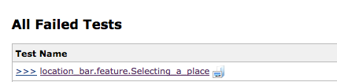
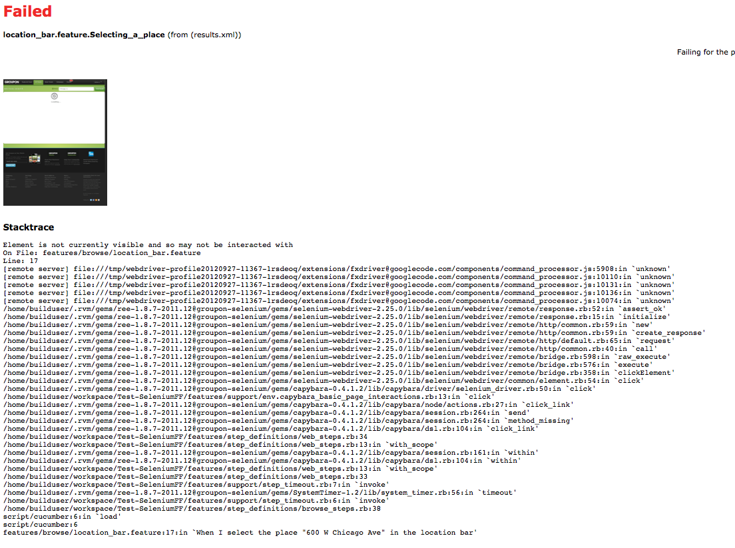
How this looks in Jenkins
Failure detail
Notes:
Find your build, click test failures, click a single failure to get more detail

Slide 13
Want to see a demo?
Of course you do!
So show it already…
Notes:
So here is why you decided to listen to me in the first place

Slide 14

Selenium can take screenshots…
And Jenkins can interact with them…
Notes:
So here is why you decided to listen to me in the first place

Slide 15
Screenshot Comparison with Jenkins & Selenium
Best thing since apple pie and ice-cream
Biggest number of bugs in a typical backlog are cosmetic
Hardest bugs to find are small cosmetic bugs
Manual testing doesn’t fit well in a lean, fast-paced environment
Impossible to fully cover UI manually on a Continuous Deployment schedule
Notes:
Hopefully you have test coverage that Jenkins runs on every commit
If something major breaks… you find out pretty damn fast
Require too many man hours of people manually looking at the ui

Slide 16
Screenshot Comparison
Some drawbacks… I mean guidelines.
Only ran on release candidates
Need to continually update the “image repo” – so automate this
Need’s to run with the same screen resolution each time it’s ran
Other then that it’s awesome!

Slide 17
Screenshot Comparison
Step 1: Auto-magicaly build an image archive
Create a selenium “crawler” – capture and store endpoints
Selenium already crawls your website, simply add the option to take a screenshot at the end of every test, name it what the test is named
SCP to repo (I chose userContent/imageArchive on our master)
Notes:
Selenium already crawls through your website, just add a takeScreenshot at the end of every test, and name it with that test

Slide 18
Screenshot Comparison
Step 2: Create a build that runs on release candidates
Create a Jenkins job that can automatically run on your release candidates
Much like your crawler job, except tied into your release pipeline
Takes the same picture of the same endpoints, and names them the same way
Configure ScreenshotComparison plugin, giving it your archive repo to compare against, and location of screenshots on the current run
Optionally set a % difference threshold
Notes:
Selenium already crawls through your website, just add a takeScreenshot at the end of every test, and name it with that test

Slide 19
Screenshot Comparison
Step 3: I’ve got the magic in me
Gets lists of files in the archive repo
Gets list of files in current workspace
Compares the files with the same name
Prints and stores the percent different
Percent Different = Different Pixels / Total pixels
Notes:
Selenium already crawls through your website, just add a takeScreenshot at the end of every test, and name it with that test

Slide 20
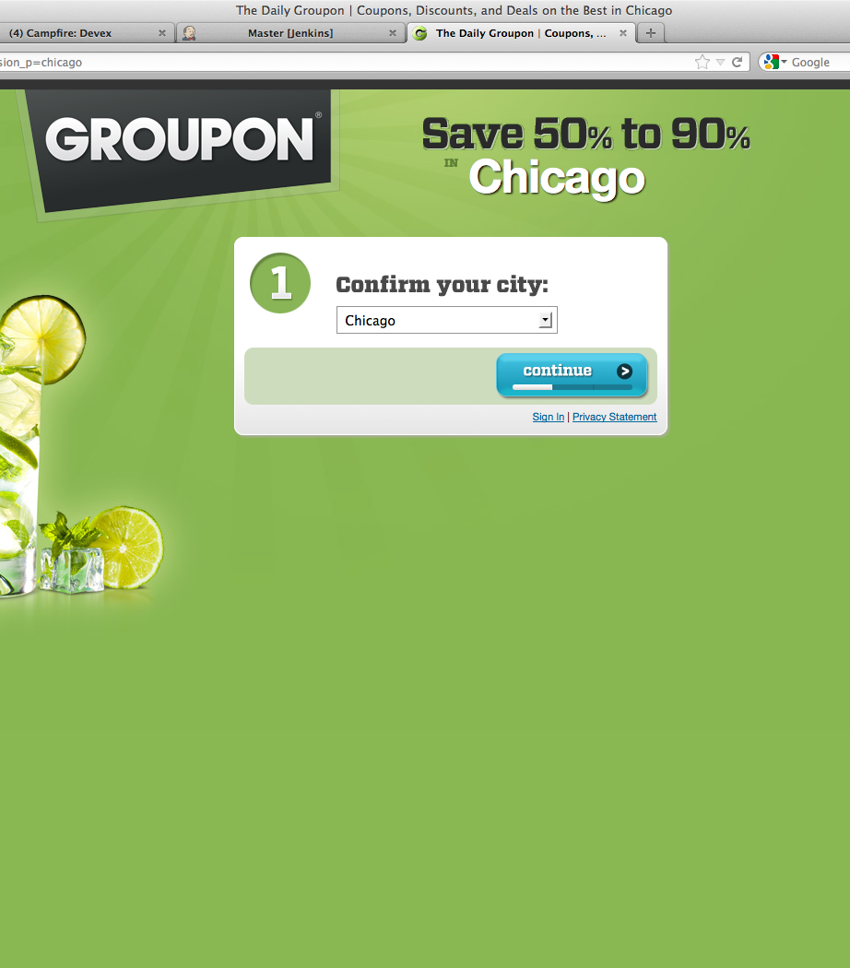

Screenshot Comparison
Step 4: Slightly different images.

Slide 21
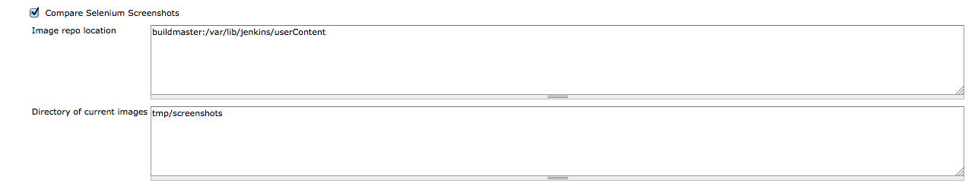
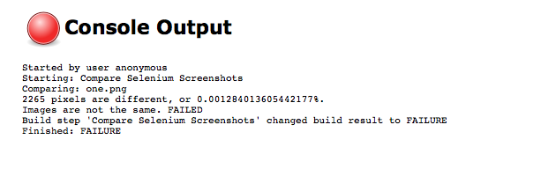
Screenshot Comparison
Step 5: All this for a little console output

Slide 22
Screenshot Comparison
What’s really compared?
Colors
Positioning
Text
Sizes
EVERYTHING – every pixel is compared to each other
Notes:
Selenium already crawls through your website, just add a takeScreenshot at the end of every test, and name it with that test

Slide 23
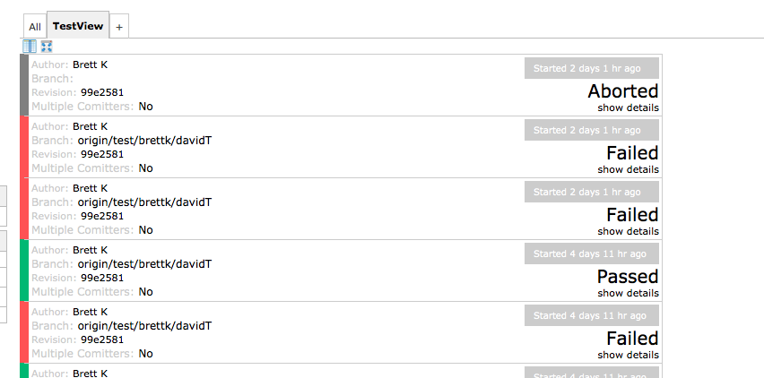
Last but not least
Tolleyvision
Notes:
One of the worst things about Jenkins is its UI

Slide 24












Thank You To Our Sponsors

