Slide 1


Planned Parenthood Introducing Inheritance between Jobs to Jenkins
Jenkins User Conference
San Francisco
#jenkinsconf
Martin Schröder / Norman Baumann
Intel Mobile Communications

Slide 2
About the speakers and company
Are working as System Engineers for the Wireless Platforms R&D division at Intel’s MCG
Current project:
Developing a continuous integration and testing framework
Scope: >50k builds/tests per day for ~4000 developers
Jenkins is the main tool used in this project
Strong interest in the capabilities and future of Jenkins

Slide 3
About our problem
>1000 job configurations needed
90% configuration overlap
Differ in their composition and parameters
What they use is similar, how they use it is not (Source Code Management, Build Steps, Publishers)
Need to keep what they share consistent!
Need to prevent misconfiguration; especially under high load

Slide 4
Agenda Overview
1.) Present state of Jenkins
1.1) Why use Jenkins at all?
1.2) Rationale for Inheritance
1.3) Existing Plugins
2.) Implementation
3.) Use Cases
4.) Concluding Remarks

Slide 5
1.1) Capabilities of Vanilla Jenkins
Can do:
Easy GUI-based configuration of jobs
Having thousands of jobs defined
Augmentable through plugins
Jobs with different settings and use-cases
Can not do:
Share settings across jobs → Independent config necessary
Build Environment
Concurrent Builds
Invoke Ant
Source Code Management
Execute Shell
E-Mail Notification
This build is parameterized

Slide 6
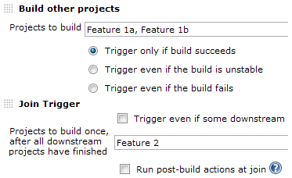
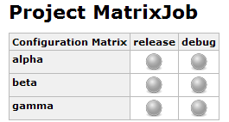
1.1) Capabilities of Vanilla Jenkins
Two workarounds available in Jenkins itself:
Downstream Jobs / Join Trigger
Capable of chaining jobs together
Allows limited re-use of build steps
But: Parameter assignment impossible
Matrix Build
Start jobs with different parameters / hosts
But: Always uses same build steps
➔ No meaningful sharing of settings

Slide 7
1.2) Rationale for Inheritance
Identical settings should be defined only once
Otherwise: Chance of divergence
Example: Source Code Management
Often: Settings identical except for repository name
But: In Jenkins, each project must redefine all settings
Natural way of doing this is inheritance:
Define common properties in isolation as a single job fragment
Other jobs then just reference this and set parameters
GIT
Job 1
Job 2
Job 3
Job 4
Job 5

Slide 8
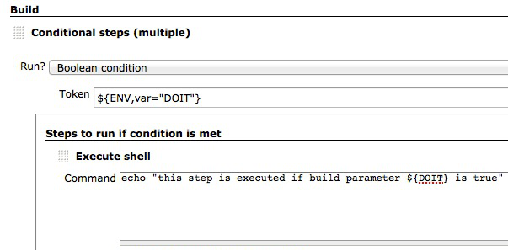
1.2) Existing Plugins (1/3)
Conditional BuildStep
Allows conditional execution of build steps
One job can fulfill multiple roles based on input values
But: No real sharing of all settings

Slide 9
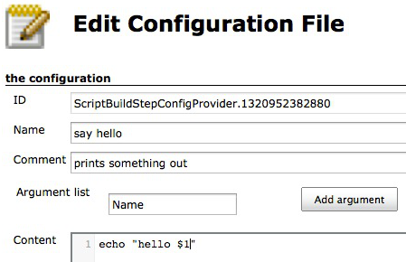
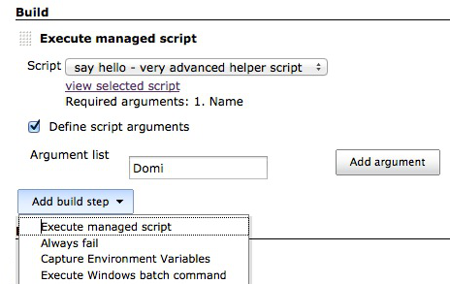
1.2) Existing Plugins (2/3)
Managed Scripts
Build steps globally defined; projects reference them
But: - Difficult to tell which steps are used by which job
- Covers only re-use of build-steps

Slide 10
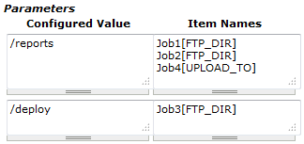
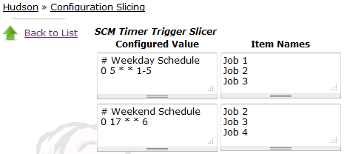
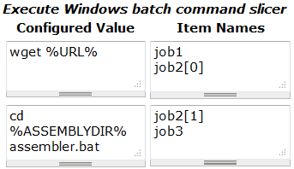
1.2) Existing Plugins (3/3)
Configuration Slicing
Change multiple jobs through one interface
Works on many kinds of settings
But: - Very difficult to use correctly and reliably
- Still no real sharing

Slide 11
Agenda Overview
1.) Present state of Jenkins
2.) Implementation
2.1) Jenkins Job Model
2.2) Inheritable Job Model
2.3) Parameters Enhancement
3.) Use Cases
4.) Concluding Remarks

Slide 12
2.1) Jenkins Job Model
Executable items in Jenkins are derived from Job class
Classes define settings for:
E.g. SCM, Parameters, Build Steps, etc.
Settings stored in fields of class & exposed via functions
public synchronized List<Builder> getBuilders() { ... }
Inheritance implemented by extending Project class
Job
AbstractProject
Project

Slide 13
2.2) Inheritable Job Model
Extending Project class involves:
Adding new fields for referencing other jobs
Add new GUI pages to display inheritance tree
Overriding functions exposed by Project to follow inheritance:
Project
public synchronized List<Builder> getBuilders() { ... }
InheritanceProject
public synchronized List<Builder> getBuilders() {
this.getBuilders(IMode.AUTODETECT);
}
public synchronized List<Builder> getBuilders(IMode mode) {
...
}

Slide 14
2.2) Inheritable Job Model
Two problems with Jenkins’ behaviour:
Jenkins does not distinguish building and configuring jobs
Values must not be inherited in case of configuration
Solved by Reflection to tell where the call comes from
Parameters with same name must be overridden or merged
Solved by new Parameter class that is aware of inheritance
Allows the user to choose how they are inherited
On build
Final
Conf A
Conf B
On configure
Conf C

Slide 15
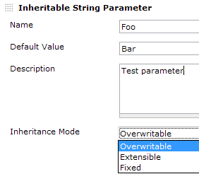
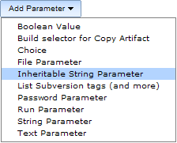
2.3) Parameters Enhancement
New parameter class extends String Parameter
Allows to fine-tune inheritance
Other setting types default to “overwrite”

Slide 16
Agenda Overview
1.) Present state of Jenkins
2.) Implementation
3.) Use Cases
3.1) Prerequisites / Requirements
3.2) Configuration Example
3.3) Comparison
4.) Concluding Remarks

Slide 17
3.1 Prerequisites / Requirements
Hypothetical task:
Compile and test a complex, modularized application
Modules implement different parts of the software
Developed separately, but used together
Examples: X.org, Gnome, etc.
Modules have virtually identical requirements:
Check them out from some SCM System (e.g. CVS, SVN, GIT)
Configure them with a particular tool (e.g. autotools)
Compile them as a library with a particular compiler suite
At the end: Link them together and test them
Modules might also be tested in isolation (e.g. static code analysis)

Slide 18
3.1 Prerequisites / Requirements
Approach for inheritance:
Move common settings into separate job “fragments”
Executable jobs reference fragments and set parameters
Jobs
Fragments
Monolithic
Project
SCM
split into
Project
Build
…

Slide 19
3.2) Configuration Example
GIT
Module A
repo = “mod_a”
ldflags = “-lm”
SCM
SVN
Module B
repo = “mod_b”
cflags = “-O0”
Make
Build
CMake
Module C
repo = “3p_mod_c”
external = “true”
Test
Lint
…
Executable

Slide 20
3.3) Comparison
Without inheritance, you have fewer jobs, but:
Identical settings are spread across all of them
Module owners could accidentally change important settings
Can’t isolate roles of projects and users
With inheritance, you have more jobs, but:
They take on specific roles → Less settings per job
Changing / adding jobs becomes much easier
Module owners don’t need to care about things beyond their scope
With more modules, overhead of job fragments shrinks
Using Inheritance is all about taking control!

Slide 21
Agenda Overview
1.) Present state of Jenkins
2.) Implementation
3.) Use Cases
4.) Concluding Remarks
4.1) Advantages
4.2) Getting started
4.3) Release Plan

Slide 22
4.1) Advantages
Structure jobs in a better way
Control access to specific, important settings
Simplified job definition
Define once – use multiple times
No copy/paste necessary anymore!
Enables more powerful features to be put on top
Versioning of Jobs (for taking even more control)
Job 1
Job 2
SCM
Job 3

Slide 23
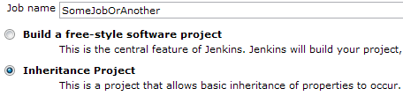
4.2) Getting started
Using this plug-in means re-creating all your jobs
Necessary because you need to select a new job-type
Sensible because you’ll re-organize jobs anyway
Automatic conversion possible, but not really useful
Currently, only “Free-style projects” can be converted
E.g. Matrix-Project and Maven-Project can’t inherit

Slide 24
4.3) Release plan
Plugin will be released under an Open Source licence
Already used at Intel MCG for internal project
Before external, open release, it needs:
clean-up and full stability tests,
some additional features to be added to it,
and internal review by Intel Corp.
Release is expected to happen in the next few months.

Slide 25
Contact us
If you wish to contact us for:
questions regarding these slides,
questions regarding the plugin or
wish to be informed when we do an open release,
you can contact us by sending a mail to:
jenkins.at.imc@gmail.com
That is, until we can make our @intel.com address public. ☺
… We’ll keep checking the above one, though.

Slide 26













Thank You To All JUC Sponsors

