Slide 1

Take Control. Write a Plugin. Part II
Baruch Sadogursky
JFrog
www.jfrog.com

Slide 2
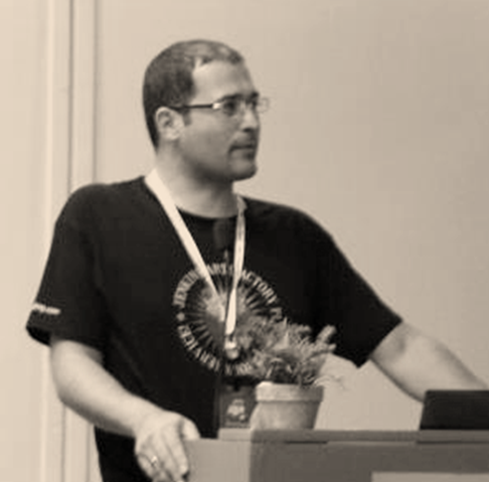
About me
Developer Advocate @JFrog
Job definition:
Write code
Talk about it
github.com/jbaruch
@jbaruch

Slide 3

JFrog & Jenkins
With Jenkins from day 1
Jenkins Artifactory Plugin
Hosted JUC Israel
repo.jenkins-ci.org
JavaOne DEMOzone

Slide 4
Agenda
Vote and guessing
Working with remote agents
Working in multiple operation systems
Creating UI using Groovy
Writing custom Jelly(?) tags
Maintaining backwards compatibility

Slide 5
Agenda
Vote and guessing
Working with remote agents
Working in multiple operation systems
Creating UI using Groovy
Writing custom Jelly(?) tags
Maintaining backwards compatibility

Slide 6
First, let’s vote
Who saw “Take Control. Write a Plugin” session on YouTube?
Let me guess…
one or two hands…

Slide 7
Previously in “Take Control. Write a Plugin”…
“Hello, my name is Noam Tenne”

Slide 8
Overview – Why plugins
What you can do with plugins
What you can’t do with plugins
Plugins statistics

Slide 9
What can I extend?
UI
SCM
Build Processes
Slave management
Tooling
... Many, many, more
You can even create new extension points!

Slide 10
Environment
IDE
All majors have good support
We love IntelliJ IDEA
Build tool
Can be Maven or Gradle

Slide 11
The “Motivation” Plugin
Target: Rewarding failing builds with insulting mockery
Global configuration: Motivation phrase
Project configuration: Is motivator enabled
Outcome: Message appears in log after failure
Notes:
Let it run
Overall structure
Global.jelly
Config.jelly
Code:
Extends Notifier
Databound constructor
Perform
Descriptor:
Extension
Serialization
XML

Slide 12
Back to our agenda
Nowdays…

Slide 13
Agenda
Vote and guessing
Working with remote agents
Working in multiple operation systems
Creating UI using Groovy
Writing custom Jelly(?) tags
Maintaining backwards compatibility

Slide 14
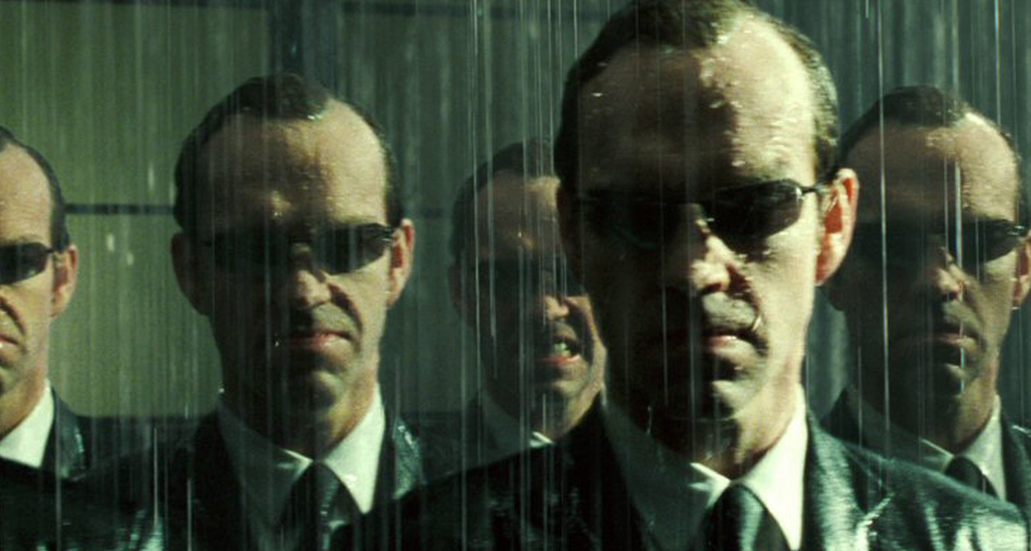
Working with remote agents
Jenkins has remote agents!

Slide 15

Working with remote agents
Send closures to remote agents
hudson.remoting.Callable
Java Serialization

Slide 16
Closure
Poor guy’s Java closure
Usually anonymous inner class (not always)

Slide 17
Cast your bread on the waters
Channel?

Slide 18
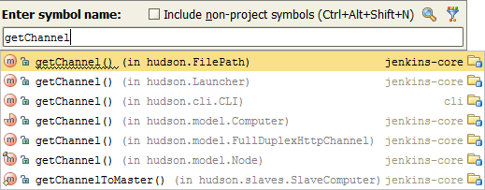
Channel
Represents a communication channel to the remote peer
Obtain from:

Slide 19

Distribution Abstractions – FilePath
Where is the file?
Notes:
MD5 digest

Slide 20
Distribution Abstractions – FilePath
hudson.FilePath
Much like java.util.File
Consider pushing logic to the file
Use FilePath.act(FileCallable)
Notes:
Represents file path, but may be local or remote
isRemote()
moveAllChilderenTo()
Etc.
Push – MD5

Slide 21

Distribution Abstractions – Launcher
Launch stuff remotely!
Notes:
MD5 digest

Slide 22
Distribution Abstractions – Launcher
hudson.Launcher
Much like java.lang.ProcessBuilder
Pick your environment variables wisely!
Notes:
Starts a process, but may be local or remote
Call to launch() returns builder
join() on builder actually starts the process
Don’t include machine specific ones, like PATH, TIMEZONE, etc.

Slide 23
Agenda
Vote and guessing
Working with remote agents
Working in multiple operation systems
Creating UI using Groovy
Writing custom Jelly(?) tags
Maintaining backwards compatibility

Slide 24
Working in multiple OSs
WORA. You know. But.
/ vs \
.sh vs .bat
Quotes around commands
Permissions
(wait for it…)

Slide 25
Running script…
Executing
file…
remotely…
platform independent…

Slide 26
Can You Spot The Error?
Executed locally!

Slide 27
Going Remote with File
Use FilePath – it will take care of all the details!
Execute FilePath.act(FileCallable)
If you need the File API, invoke() method has it, converted to remote file properly

Slide 28
Permissions Dance

Slide 29
Agenda
Vote and guessing
Working with remote agents
Working in multiple operation systems
Creating UI using Groovy
Writing custom Jelly(?) tags
Maintaining backwards compatibility

Slide 30

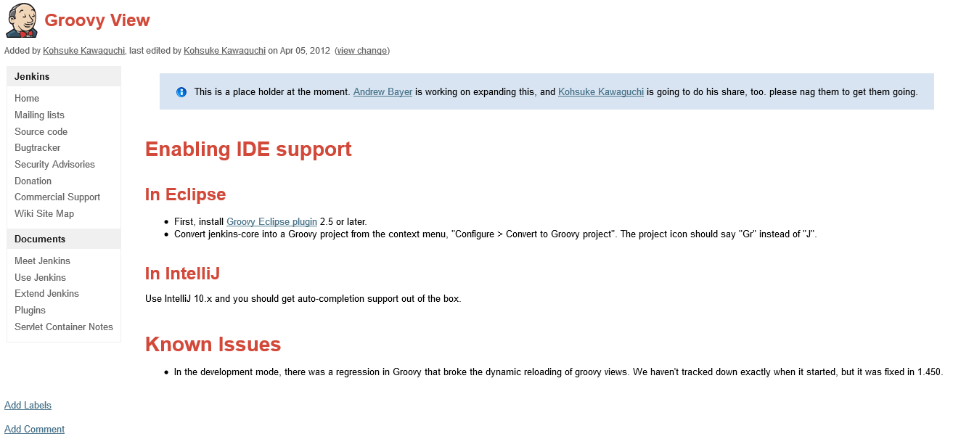
Creating UI using Groovy
First, let’s look at the docs:

Slide 31
Creating UI using Groovy
Analogous to Jelly
Can use Jelly tags and libraries
Kohsuke:
When | What
Lots of program logic | Groovy
Lots of HTML layout markup | Jelly

Slide 32
Creating UI using Groovy
Analogous to Jelly
Can use Jelly tags and libraries
me:
When | What
Always! | Groovy

Slide 33
Creating UI using Groovy
Jelly:
Groovy:

Slide 34
Creating UI using Groovy
Real code
Debuggable, etc.
(stay tuned…)

Slide 35
Agenda
Vote and guessing
Working with remote agents
Working in multiple operation systems
Creating UI using Groovy
Writing custom Jelly(?) tags
Maintaining backwards compatibility

Slide 36
Writing custom Jelly(?) tags
Documentation:

Slide 38
Writing custom Jelly(?) tags

Slide 39
Writing custom Jelly Groovy tags
Simple as 1,2…
that’s it.

Slide 40
1. Implement

Slide 41
2. Use!

Slide 42
Agenda
Vote and guessing
Working with remote agents
Working in multiple operation systems
Creating UI using Groovy
Writing custom Jelly(?) tags
Maintaining backwards compatibility

Slide 43
Maintaining backwards compatibility
Back to Motivation plugin…
Notes:
Show defaultMotivating method refactoring

Slide 44
Refactoring!
Rename defaultMotivatingMessage
to
motivatingMessage
What happens to existing configuration on users machines?

Slide 45
XStream Aliasing To The Rescue
Register field (or class) alias
In Initializer that runs before plugins started
More complex cases might reqiure XStream converter

Slide 46
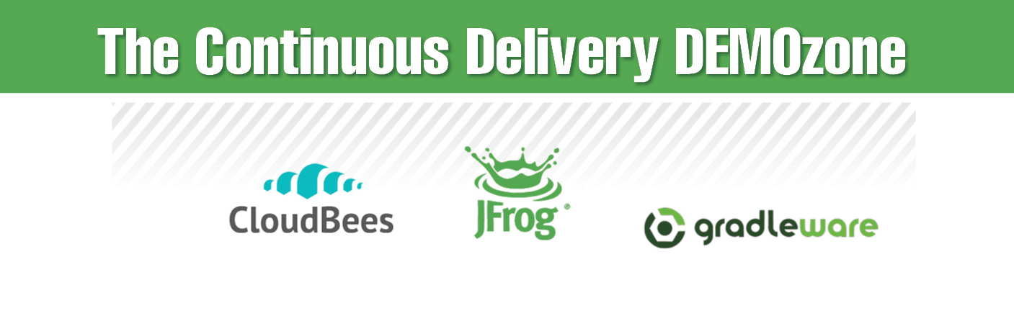
Thank you!
See you at our DEMOzone!

Slide 47













Thank You To Our Sponsors

