Slide 1
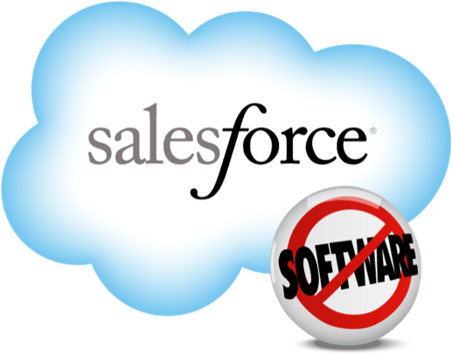
Testing Salesforce at Cloud Scale
Thomas Kim
@tksfz
Greg Wester
@gwestr

Slide 2
Agenda
History of CI at Salesforce
Adding elasticity with public clouds
Reducing cycle time with Jenkins-CI
Jenkins Everywhere

Slide 3
Continuous Testing at Salesforce
Multi-million line code base
Several major branches
200,000 tests
Mostly in-appserver functional tests
~3000 hours serialized runtime
Autobuilds - home-grown system
2000 VM's
Hundreds of changelists per day (Perforce)

Slide 4
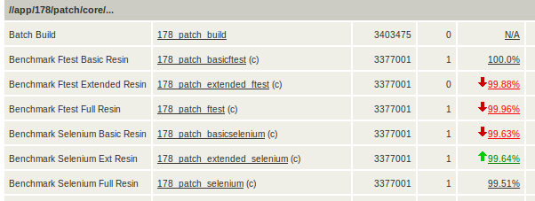
Luna

Slide 5
Autobuild System Design
luna
web
luna db
Autobuild Runner
Autobuild Runner
Autobuild Runner
Autobuild Runner
Assignment Runner
p4

Slide 6
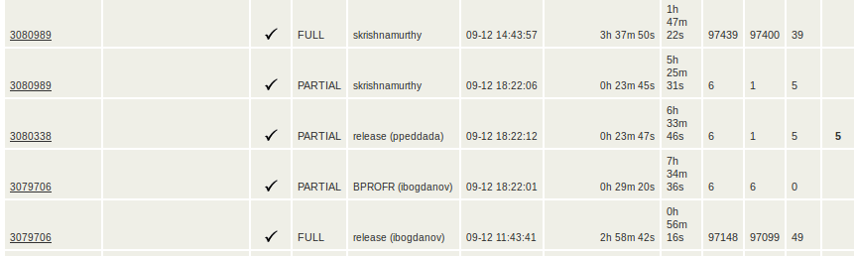
Test Failure Correlation
- Changelists are batched together
- Tests that failure are re-executed against the skipped changelists

Slide 7
VM Provisioning
VMware infrastructure
luna
web
luna db
Autobuild Runner
Autobuild Runner
Autobuild Runner
Autobuild Runner
VMware API
Assignment Runner
VM Pool Manager
p4

Slide 8
Autobuilds in the Cloud
EC2
luna
web
luna db
Autobuild Runner
Autobuild Runner
Autobuild Runner
Autobuild Runner
AWS API
Assignment Runner
EC2 Poolboy
p4

Slide 9
VM Provisioning Part II
Static allocation
Dynamic allocation
Predictive allocation
Elastic allocation

Slide 10
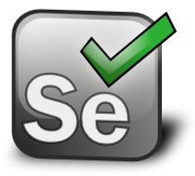
Selenium
Spawns a 2nd VM running Windows
RemoteWebDriver -> IE6,7,8,9; Firefox; Chrome; Safari
Selenium Browser Compatibility suite
35,000 UI tests; some Selenium1 debt
Tricky trifecta:
Chrome releases every 6 weeks
Firefox releases every 6 weeks; 3 week stagger
Selenium library updates
Selenium committer on staff (Jim Evans)

Slide 11

Great coverage at great cost
Multimillion dollar HA test infrastructure
Cycle time is 6 hours per changelist
[Automated] Continuous delivery not possible
Some manual "sign off" at release boundary
"Butterfly effect" changelists
which tests to run before pushing code?

Slide 12

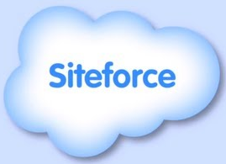


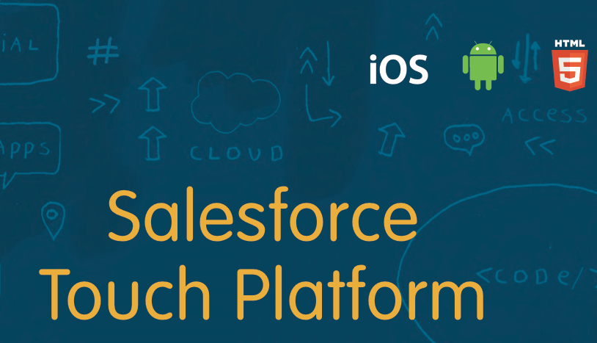
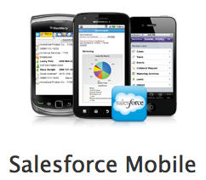

Salesforce + Jenkins =

Slide 13
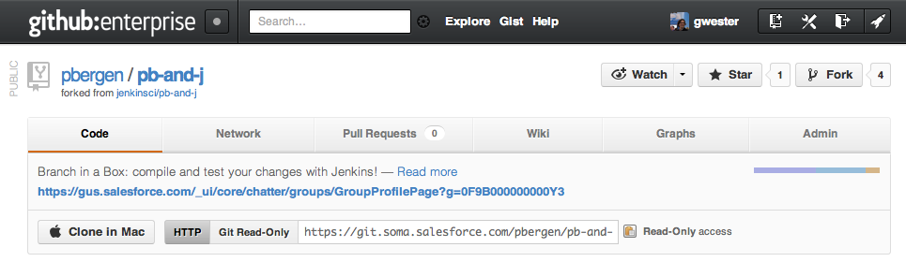
Jenkins Satellite Builds
Automated installer for automation
Shelve a changelist -> queue for CI run
Run static analysis, coverage reports
Faster cycle time, "release ready" mainline

Slide 14
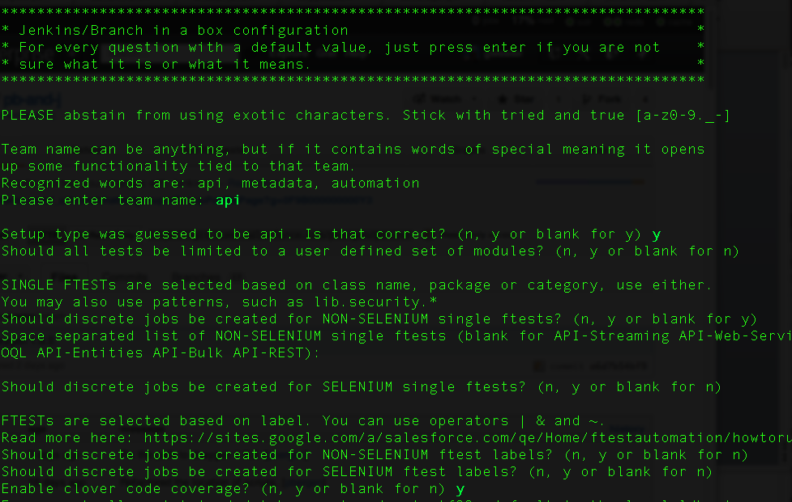

Slide 15
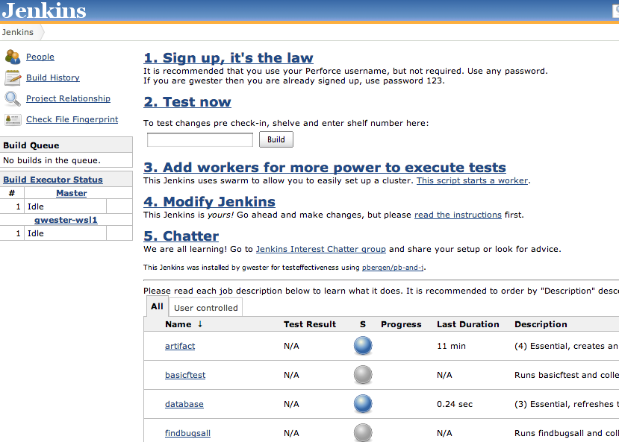

Slide 16

Linking src/main and src/test

Slide 17
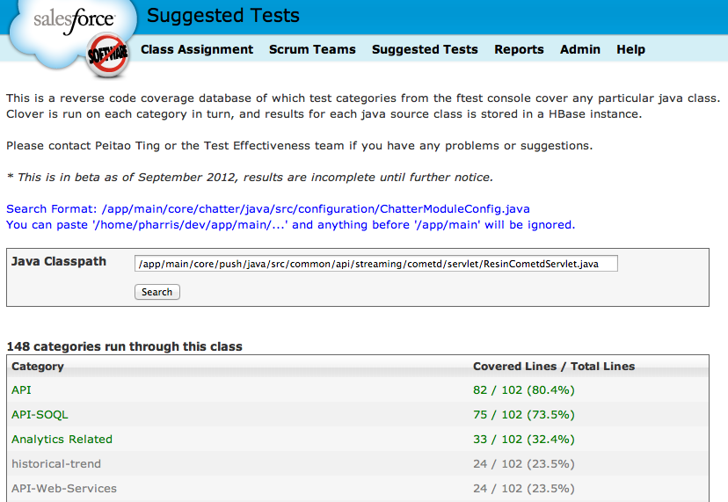
Linking src/main and src/test (2)

Slide 18
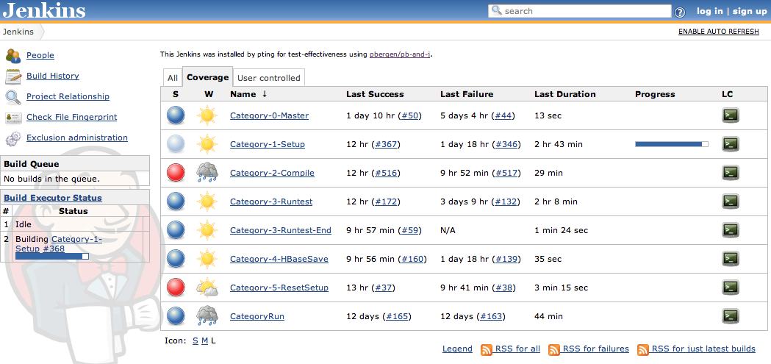
Future: Jenkins everywhere
Code base is rapidly modularizing
Jenkins CI continuously delivering jars
Jenkins as a Service
Option A: Cloudbees hosted
Option B: ad hoc "swarm"
Option C: Salesforce R&D hosted
Jenkins for metrics:

Slide 19
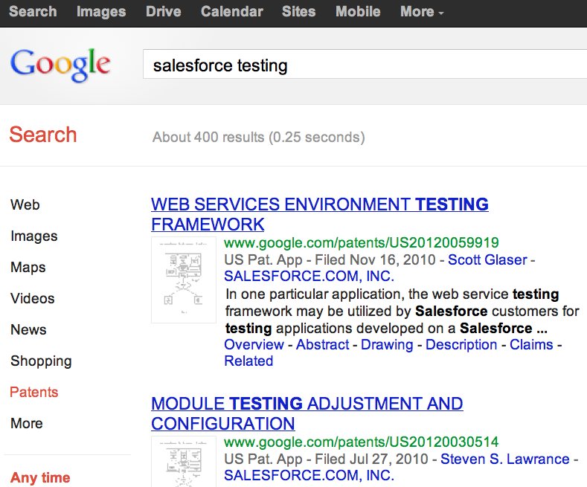
We invented Testing at Scale

Slide 20
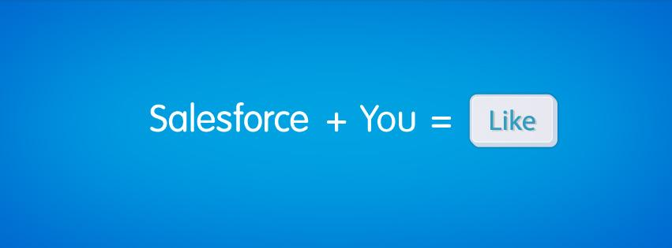
We're not close to done
Smarter VM provisioning
Build-anything platforms hard to test
Pixel perfect UI test framework
Headless browser testing (PhantomJS)
In memory computing for tests (high cost)
Massively parallel testing on Intel Atom HW
low cost, low power, natural isolation

Slide 21
Q&A
Follow @gwestr on Twitter
Follow @tksfz on Twitter

Slide 22












Thank You To Our Sponsors

