Slide 1
Using Jenkins for the build and deployment of .NET applications
Constantin Caraivan
Adobe Systems
http://www.businesscatalyst.com

Slide 2
Agenda
Business Catalyst
Migration from CruiseControl.NET to Jenkins
  CC.NET system architecture
  Jenkins system architecture
  Migration plan
  The good parts
  The bad parts
  And the ugly parts
  Supported features: CC.NET versus Jenkins
(Side note) Using Jenkins for deployment
Lessons learned
Q & A

Slide 3
Business Catalyst
Integrated platform for building online businesses
Just basic web technology knowledge needed

Slide 4
Business Catalyst
A collection of .NET applications
A lot of code
Server side languages | 1.2M LOC
Resources & client side languages | 2M LOC
Classes | Tens of thousands

Slide 5
Migration from CC.NET to Jenkins
  CC.NET system architecture
3x CruiseControl.NET
MSBuild & batch scripts
Scheduled tasks on machines

Slide 6
Migration from CC.NET to Jenkins
  CC.NET system architecture
MSBuild
CC.NET build machine
CC.NET integration test machine
MSBuild
CC.NET test environment „master”
CC.NET test environment instance 1
CC.NET test environment instance N
MSBuild
Batch
MSBuild
Batch

Slide 7

Migration from CC.NET to Jenkins
  CC.NET system architecture
Everything looked like a rundown house

Slide 8
Migration from CC.NET to Jenkins
  Jenkins system architecture
Jenkins master - slave system
MSBuild & Powershell & Python scripts
Lots & lots of jobs

Slide 9
Migration from CC.NET to Jenkins
  Jenkins system architecture
MSBuild
Jenkins integration test slave 1
Jenkins integration test slave N
MSBuild
Jenkins master
Jenkins test environment slave 1
Jenkins test environment slave N
Power
Shell & Python
Jenkins build slave (same machine)
Jenkins automated test runner slave 1
Jenkins automated test runner slave N
Jmeter
Selenium

Slide 10

Migration from CC.NET to Jenkins
  Jenkins system architecture
Much nicer!

Slide 11
Migration from CC.NET to Jenkins
Migration plan
Initially ran both systems in parallel
Moved every component gradually
Phased out CC.NET when we were sure

Slide 12
Migration from CC.NET to Jenkins
The good parts
.NET integration is easy (MSBuild, Nunit, Ncover, Powershell)
System easily accessible (AD login)

Slide 13
Migration from CC.NET to Jenkins
The good parts
Flexibility (master-slave, matrix jobs)
Security (Role-based Authorization Strategy)

Slide 14
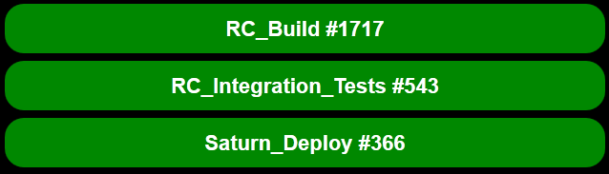
Migration from CC.NET to Jenkins
The good parts
Visibility

Slide 15

Migration from CC.NET to Jenkins
The bad parts
Compatibility problems
Upgrades can cause regressions
Jenkins getting stuck sometimes

Slide 16
Migration from CC.NET to Jenkins
The ugly parts
Connecting slaves
Memory usage (2GB RAM with 40 slaves)

Slide 17
Migration from CC.NET to Jenkins
  Supported features: CC.NET versus Jenkins
  * - Works better
Feature | CC.NET | Jenkins
Perforce | Yes | Yes
MSBuild | Yes | Yes
NUnit | Yes | Yes*
NCover | Yes | Yes
Tray application | Yes* | Yes
Mail notifications | Yes | Yes

Slide 18
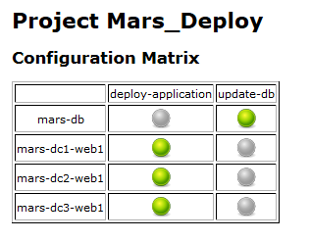
(Side note) Using Jenkins for deployment
Currently with matrix jobs
Cannot reuse a lot of configuration
Hard to scale

Slide 19
(Side note) Using Jenkins for deployment
Future plans
Goal: 1 execution scenario for all environments
NodeLabel Parameter
Parametrized Trigger plugins

Slide 20
Lessons learned
For a new .NET project definitely use Jenkins
If you’re want to a plugin, test it with slaves and matrix jobs
Don’t execute anything on the master

Slide 21
Lessons learned
Use one of the config versioning plugins
Separate your builds from your config
Don’t allow anonymous configuration acces

Slide 22
Lessons learned
A good Jenkins setup won’t save you from a bad build system
Try to rotate developers on „build duty”

Slide 23
Q & A & other stuff
Godsend:
  https://wiki.jenkins-ci.org/display/JENKINS/Installing+Jenkins+as+a+Windows+service
  https://wiki.jenkins-ci.org/display/JENKINS/Hudson+windows+service+fails+to+start
Thank you for watching!
http://www.adobe.com/products/business-catalyst.html

Slide 24













Thank You To Our Sponsors

