Slide 1
Using Jenkins in the Enterprise and the Cloud
Mark Prichard
Kohsuke Kawaguchi
CloudBees
Cloudbees.com

Slide 2
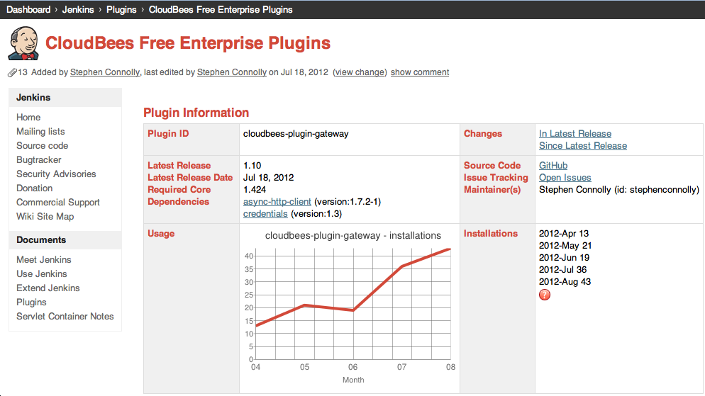
If there is one thing you take away from here…
Download the CloudBees Free Enterprise Plugins from Jenkins Update Center
Check out Nicolas de Loof’s wiki post:
CloudBees Free and Open Source Jenkins Plugins

Slide 3

Day: A period of 24 hours, mostly misspent…

Slide 4



Slide 5
CloudBees’ Mission - Eliminate Downtime
Eliminate time wasted due to
Jenkins issues
User issues
Lack of right tools…
Improve efficiency for administrators and developers
Rely on Jenkins…

Slide 6
“Good Management” of Jenkins
Managing it pro-actively

Slide 7
“Good management” in Jenkins…
Organize jobs better
Secure your jobs
Replicate good practices
Respond quicker to requests
Ensure compliance
Bounce back from failures
Prevent failures
Everything should be as fast as possible…if not faster

Slide 8
Organize Jobs Better: Folders
Huge list of all jobs on 1 page
Views, views and more views
Not namespace aware
Folders
Like OS folders
Namespace aware
Views within Folders
Free
(Download from CloudBees Free Enterprise Plugins from the Jenkins Update Center)

Slide 9
Folder Demo

Slide 10

Who has the keys to your castle?

Slide 11
Setting up the right authentication
But lets secure your server machine first
OS, Firewall, Patches
Out of the scope of this talk…
Setting up Authentication
Unix Pam
Internal Authentication
Primarily driven by your IT department
Out of scope of this talk…

Slide 12
Authorization Strategies
Core Jenkins extension point for Authorization
Responsible for deciding the permissions available to users.
Can only select one.
Default for clean install:
Unsecured

Slide 13

CloudBees’ RBAC Plugin (plugin)
Authentication Features
Provides group details (Optional)
Supports group lookup (Optional)
A simple matrix of click-boxes Row: role Column: permission
Define groups at any level
Assign roles to groups
Filter roles at any level
Feature
✓ | Per-project configuration
✓ | Per-object configuration
✓ | Subtractive permissions model
✓* | Supports external groups
✓ | Local group definition
✓ | Delegate management
Notes:
Hard to set up sophisticated Role-based access control permissions
Very difficult to setup secret projects
Permissions by projects or departments
Inheritance of roles
Solution: Role-based Access Control plugin

Slide 14
RBAC Demo

Slide 15
Replicate Good Practices, Respond quicker to user requests: Templates
Talk in the users domain specific language
Shield them
Capture sameness of jobs, build steps
Replicate them
Faster route to success
building plugins without writing code

Slide 16
Types of Templates
Builder Template
Job Template
Folder Template
Auxiliary Template

Slide 17
Templates Demo

Slide 18

Get everyone on the right page: Custom Update Centers
Teams often encounter the uh-oh moments
Uh-oh moments
Usually happen a week before release
Tester: Your stuff does not work
Developer: What do you mean? I tested this…
Tester: Does not work with foo 1.4
Developer: I tested this with foo 1.3
Tester: 1.4 is what we have committed to
Developer: uh oh…

Slide 19
Custom Update Center
Easy to create your own update center
Host your plugin or binaries
Inherit from upstream update centers
Specify version number of binaries or plugins to be promoted

Slide 20
Update Center Demo

Slide 21

Bounce back from failures
Backup your stuff…
Backup plugin from CloudBees
Backup to cloud
Free CloudBees Plugin Gateway

Slide 22
Bounce Back Faster: High Availability
Reverse Proxy
Reverse Proxy
Jenkins Cluster
Jenkins Cluster
Jenkins Master
Jenkins Master
Jenkins Master
MT
MT
JENKINS_HOME
JENKINS_HOME
NFS

Slide 23
Demo

Slide 24
Prevent Failures: Validated Merge
Shield your repository
Rely on Jenkins…
Push your code to Jenkins
Jenkins builds, verifies and merges with upstream
Result
No downtime due to bad commits
Tremendous productivity boost

Slide 25
Everything should be as fast as possible, if not faster…
Speed up builds
Provision faster
Fast Archiver
Throttle Build Execution
Even Load Strategy
VMWare Auto-scaling plugin

Slide 26
From Good to Smart
Smart Management of Jenkins

Slide 27


Slide 28
Offload to Cloud(Bees)
No machine management
Provisioning Jenkins masters faster
You work to Jenkins console
Not a VM management UI
Pay by the minute not by the hour
Code repositories
Maven repositories
Team based

Slide 29
Notes:
CloudBees Ecosystem:
Choose the best of breed solutions…

Slide 30
DEV@cloud Demo

Slide 31
Continuous Deployment
Continuous Integration is not enough
Once code is built it should be deployed automatically
You should move the entire development-deployment cycle to the cloud

Slide 32
Jenkins Enterprise: Quick Overview
Large Installation
Folders
Templates
Security
Roles-based Access Control
Wikitext Descriptions
Optimized Utilization
Auto-scaling for VMWare installations
Throttled Build Execution
Backup
Even Load Strategy
Skip Next Build
High Availability*
Custom Update Centers*
Fast Archiving*
Secure Copy*
Validated Merges*
* Latest Features

Slide 33
If there is one thing you take away from here…
Download the CloudBees Free Enterprise Plugins from Jenkins Update Center
Check out Nicolas de Loof’s wiki post:
CloudBees Free and Open Source Jenkins Plugins

Slide 34

There are better ways to spend your day…

