Slide 1
Connect your tools to Jenkins Using the basic Jenkins API’s
Jenkins User Conference
Israel, June 6 2013 #jenkinsconf
Nir Koren
DevOps & Integration Lead, SAP Labs Israel
June 2013

Slide 2
API connection
Jenkins provides several ways for getting and triggering actions directly on a Jenkins server.
We will review some methods which helps to connect your tools and scripts to Jenkins
CODE
SCRIPTS
REPORTS

Slide 3
CLI (Command-Line Interface)
Built-in command line client. JAVA Archive
Jenkins release dependent: http://<HOST>/jenkins/cli
Can do almost everything in Jenkins via CMD / SHELL.
Extendable

Slide 4
CLI DEMO

Slide 5
CLI USAGE
Scripts and Automation
“Jenkins as a Service”
Unique – short time cases

Slide 6
Remote access API
Machine-consumable Remote Access API.
A REST-like style.
XML …/api/xml
JSON …/api/json
PYTHON

Slide 7
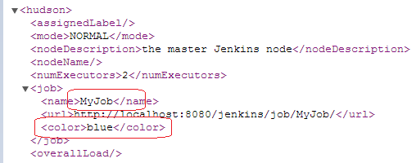
XML API
Works in almost any action by adding “/api/xml”

Slide 8
XML API cont.
Can specify xPath to control the results. Example: /api/xml?xpath=/*/*[0]
Controlling the amount of data you fetch. Example:
api/xml?depth=1
Parsed by any technology to your tools / Apps

Slide 9
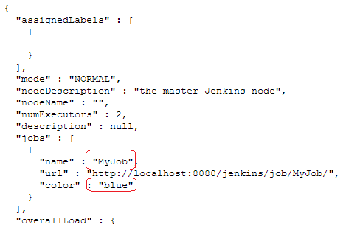
JSON API
Works in almost any action by adding “/api/json”

Slide 10
Additional Actions
Create and Copy jobs
Restart
Trigger a new build
http://<HOST:PORT>/jenkins/createItem
http://<HOST:PORT>/jenkins/restart

Slide 11
API DEMO

Slide 12
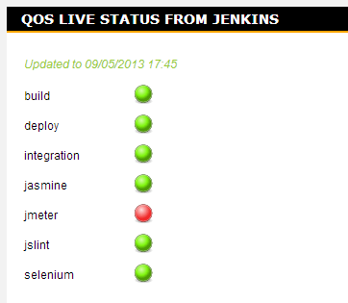
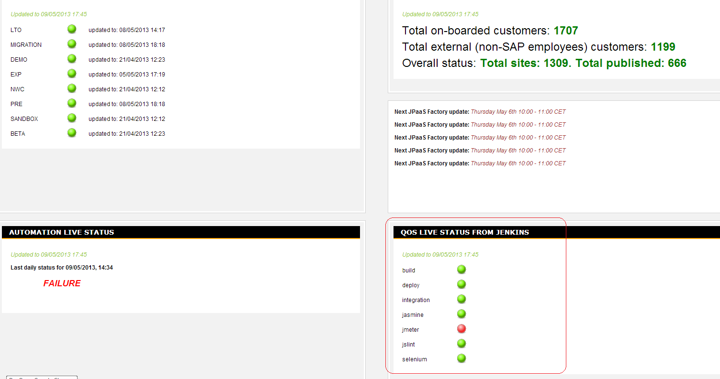
Usages in Jenkins API
Development live dashboard

Slide 13
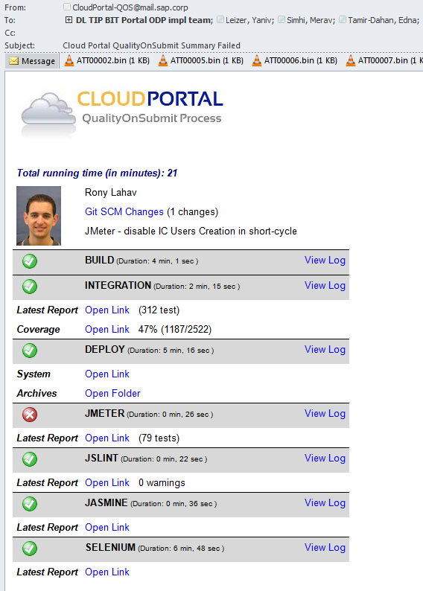
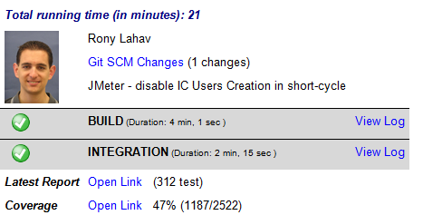
Usages in Jenkins API
Nice HTML mails

Slide 14
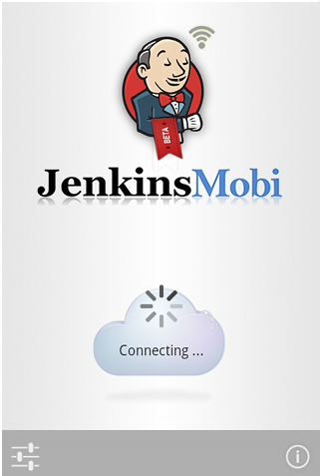
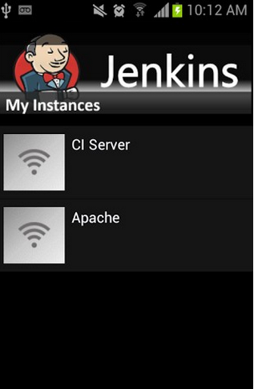
iPhone / Android / Desktop custom applications

Slide 15
Thank you!
Nir Koren @KorenNir
DevOps & Integration Lead
SAP Labs Israel | nir.koren@sap.com

