Slide 1
Jenkins: State of Union
Kohsuke Kawaguchi
@kohsukekawa
@jenkinsconf

Slide 2
Community!

Slide 3


Slide 4

1090
Notes:
1090

Slide 5


Slide 6

62/day
Notes:
22,592

Slide 8
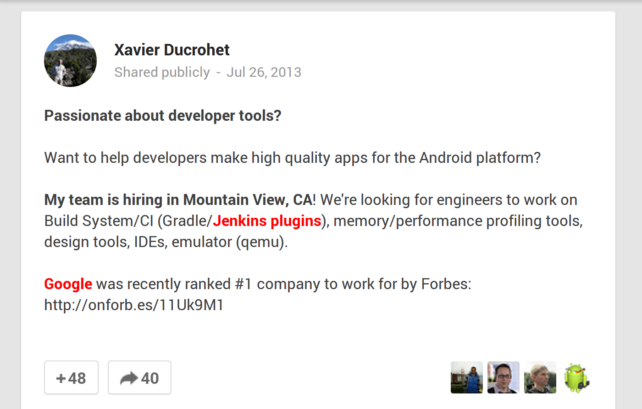
https://plus.google.com/+XavierDucrohet/posts/Fz89fWhGT6v
Emphasis is mine

Slide 9
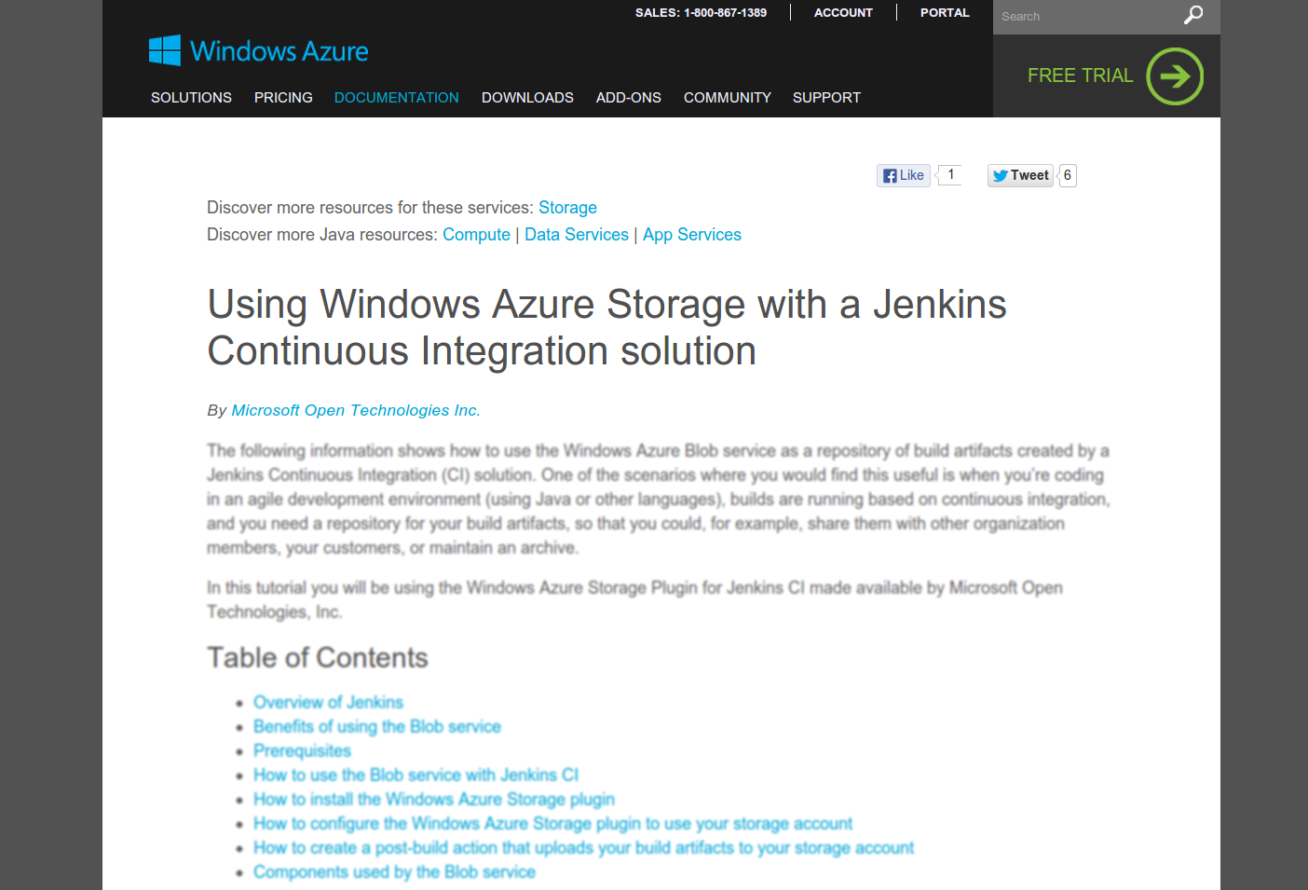

Slide 10











Holland/France
Switzerland
Israel
Holland/Germany
USA
Holland
Denmark
Belgium
France
United Kingdom
Japan

Slide 11

http://commons.wikimedia.org/wiki/File:World_map_blank_gmt.png
11/12
11/14
11/11
11/25
10/28
Dallas, Washington DC, London, SF Bay Area, Rotterdam

Slide 12
+45%

Slide 13
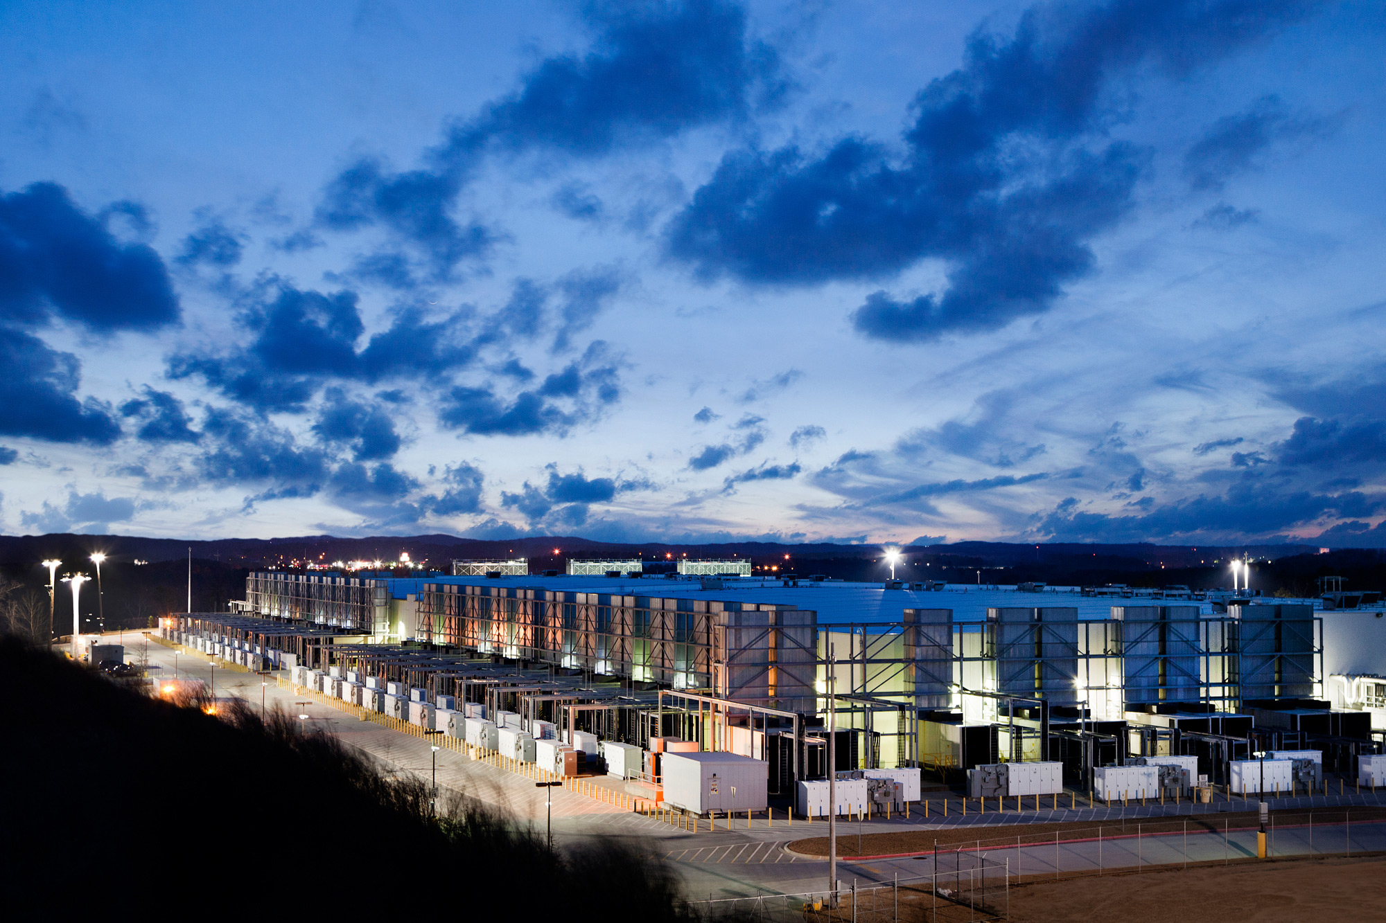
182,000
Photo copyrighted by Google

Slide 14

http://www.flickr.com/photos/21746901@N08/4491948497

Slide 15
2,500,000

Slide 17

Notes:
Community has grown tremendously / people move on in OSS projects

Slide 18


Slide 19

http://www.flickr.com/photos/52886895@N00/24397480/

Slide 20
#jenkins
Notes:
The heart and the soul / I haven’t put my finger on exactly what / lurk

Slide 21

Notes:
“events”

Slide 22
Notes:
Tutorials / Examples

Slide 23

Notes:
Struggle with pull requests

Slide 25

I want you to join us

Slide 26
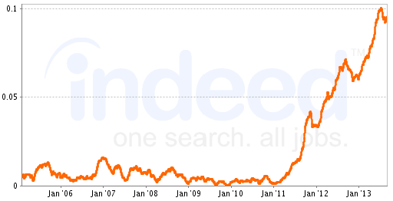
% of matching job postings
Jenkins is born

Slide 27

What’s New?
http://www.flickr.com/photos/randar/3879926596/

Slide 28
Demo

Slide 29

Winstone
Notes:
WebSocket / SPDY / Long keep alive

Slide 30


Slide 31
Credentials Plugin
Notes:
Same credential multiple plugins / access control / different implementations

Slide 32

2.0

Slide 33
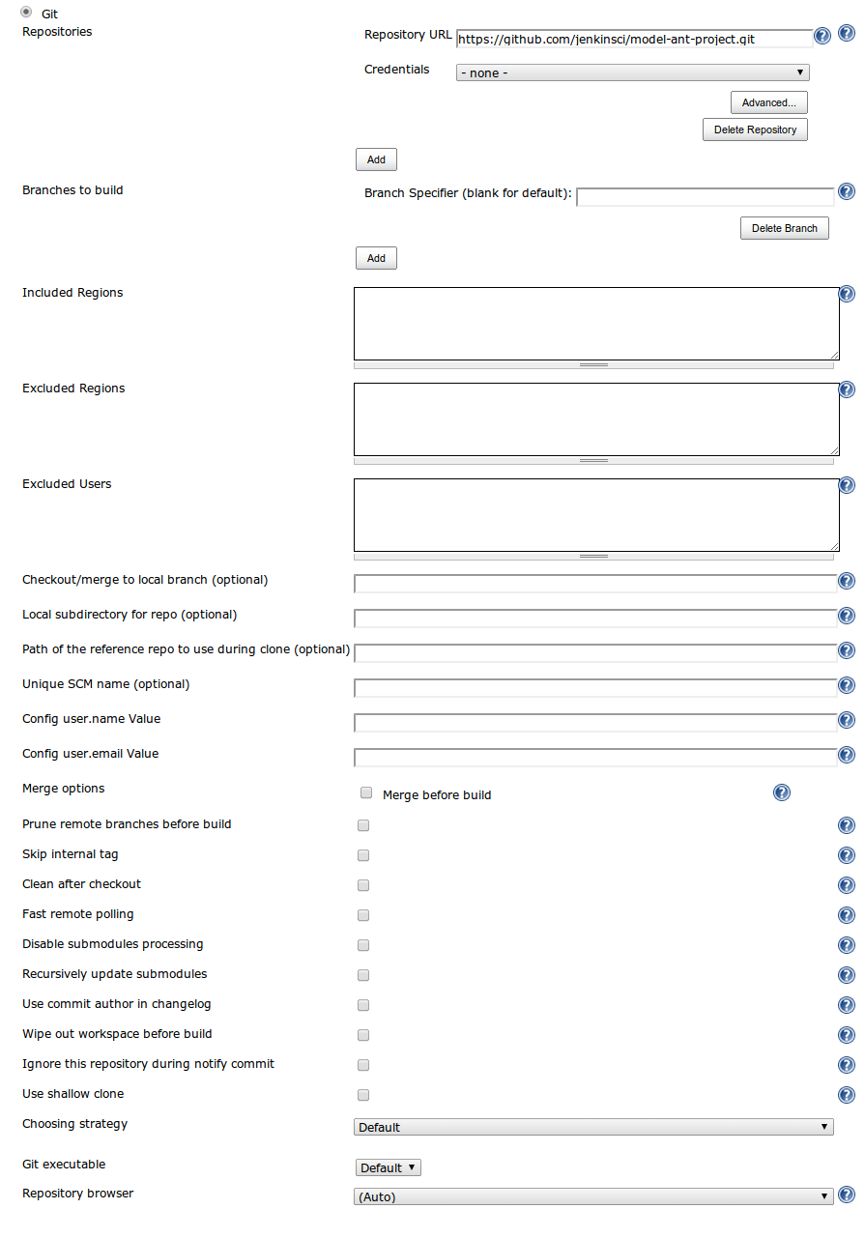

Slide 34
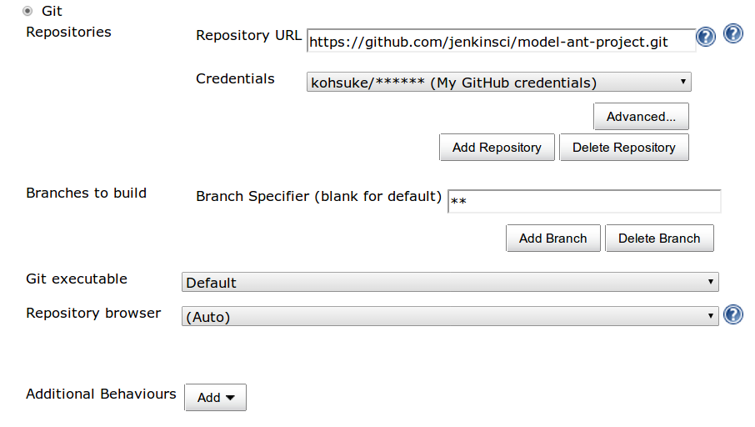
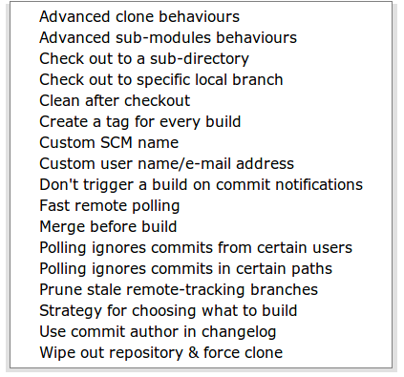

Slide 35



Slide 36
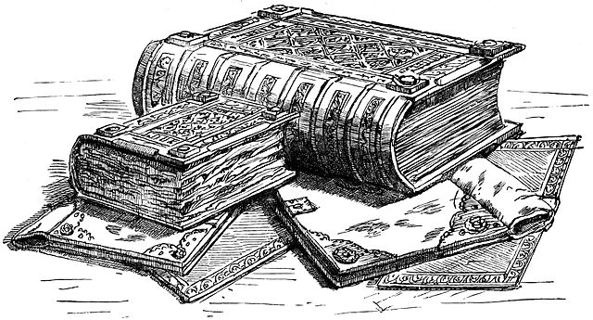

Slide 37
Demo

Slide 38
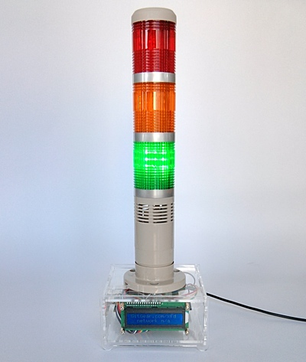
gitgear.com/xfd

Slide 39
X1K

Slide 41
2 × 100 slaves
+ 4 × 100 ssh slaves
+ 1 × 200 executors
= 800

Slide 42
1 × 100 slaves
+ 4 × 100 ssh slaves
+ 1 × 200 executors
= 700

Slide 43
1 × 100 slaves
+ 1 × 100 ssh slaves
+ 1 × 200 executors
= 400

Slide 44
1 × 100 slaves
+ 1 × 100 ssh slaves
+ 0 × 200 executors
= 200

Slide 45

Master/Slave Jar Caching
Master
Slave
Notes:
Half less chatty

Slide 46
SSH Flow Control
Master
Slave
Data
ACK
10MB/sec = 10KB/ms
10ms latency = 20ms roundtrip
Notes:
Half less chatty

Slide 47
SSH Flow Control
Master
200KB
Slave
128KB → 4MB
Notes:
Half less chatty

Slide 48
Memory
Large test reports
HTTP sessions
Lazy loading
Notes:
Fall out, mostly fixed / symlink

Slide 49

Stability
http://www.flickr.com/photos/tim_ellis/8507800715/

Slide 50
LTS 1.509.4
84

Slide 51
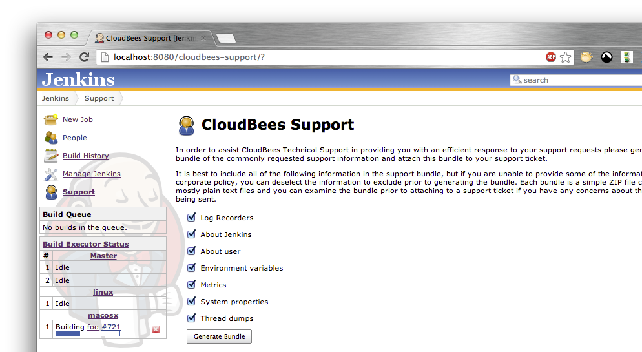
CloudBees OSS Support Plugin

Slide 52
Bug Bounty?

Slide 53

With My Day Job Hat On…
http://www.flickr.com/photos/sushicam/7211787664/

Slide 54
Demo

Slide 55
Conclusions
Community is getting bigger
Join us
We are working hard
Enjoy the day!

Slide 56












Thank You To Our Sponsors
Platinum
Gold
Silver

Slide 57
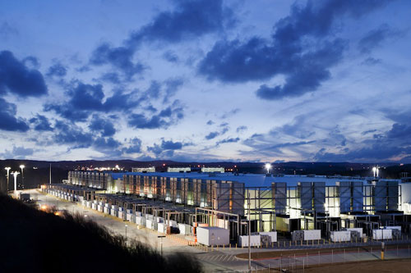
×3
Photo copyrighted by Google

Slide 58
Nagle’s Algorithm
Master
Slave
Kernel
Kernel
TCP

Slide 59
SSH Flow Control
Master
Slave
10MB/sec, 10ms latency
01010101
01010101
1ms = 10KB
ACK
Notes:
Half less chatty

