Slide 1

Supercharge your Test & Dev Process with Jenkins and the Cloud
Gil Hoffer
Ravello Systems
http://www.ravellosystems.com
@jenkinsconf

Slide 2




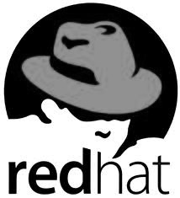
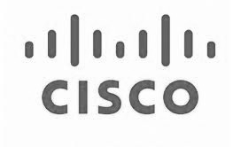

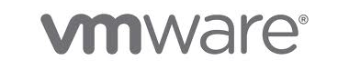

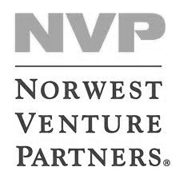

About Ravello Systems
Founding team track record
Ravello Systems
Founded in 2011
Corp. HQ - Raa’nana, Israel US HQ – Palo Alto, CA
Deep expertise in virtualization, networking and storage technologies
Employees
Investors

Slide 3
On-premise dev & test sucks
Project Demand
Resources
Sprint1
Sprint 2
Release Candidate
Product late to market and poor quality
Resources
Data center/private cloud capacity
Sprint1
Sprint 2
Release Candidate

Slide 4
#1 Lack of internal capacity
#2 Difficult to replicate/provision
environments quickly

Slide 5
A simple on-premise application
q
OS
fe1
be1
OS
OS
db1
OS
fe2
be2
router
firewall
load balancer
OS
OS
db2
OS
Front end
Back end
data tier

Slide 6
A simple development process
for every commit
for every commit
batched
Unit test “environments”
Integration test environments
System test environments

Slide 7
Assumption
As far as possible, you want to test on replicas of the production environment
Why?
Multiple node data consistency
Scaling (assure statelessness, …)
Server/OS configuration changes (test your CM with the app!)
Inter-server feedback
…

Slide 8
Fundamental question
How much capacity do you need to optimally develop and test your application?

Slide 9

Analysis Framework
Based on queuing theory (M-D-s queues) and real-life test suites run-time and commit rates
  See [Link-to-blog] for full details
Bottom-line: the load of automatic tests is very bursty
  When adding other project related envs
  (manual QA, demos, PMs, …) it is even
  burstier…

Slide 10
→ An “on-demand” consumption model for the bursty test/dev resources is A MUST
→ The cloud to the rescue!

Slide 11

#1 Lack of internal capacity
#2 Difficult to replicate/provision environments quickly

Slide 12
How to provision, replicate and manage environments easily?
DIY
  Configuration Management (Chef, Puppet, ControlTier, …)
  Deployment automation (Fabric, Capsitrano, LI’s glu, scripts, …)
  Use cloud APIs (or CLI) for server provisioning
Cloud management systems
Ravello

Slide 13
Configuration management tools
Pros:
  Good at maintaining infra as-code
  Lots of know-hows and premade “recipes” by the community
Cons:
  Testing can be painful
  Not easy to make cloud/OS agnostic, and eventually end up with a different server on each env.
  Manages single servers/services and not the whole “application”
  Has a rather steep learning curve
  Can be challenging to create for existing systems

Slide 14
Cloud management systems
Automate both cloud VM provisioning , and integrate (or define proprietary) with configuration management tools
Pros:
  “Single pane of glass”
  Support, knowledge base, …
Cons:
  Lock in (to specific public clouds and cloud management systems)
  The application is *different* on each cloud
  Quite impractical to use if your production is on-premise (or you want to keep your options open)

Slide 15
Ravello – a “cloud application hypervisor”
Formal definition of the application
Cloud Application hypervisor
web
OS
app
OS
web
db
OS
app
OS
OS
db
web
OS
OS
app
web
OS
OS
Any cloud: Public – Amazon, Rackspace, HP, …
Or private: openstack, vCloud, …

Slide 16
1. HVX – high performance nested hypervisor
app
app
app
app
app
app
app
OS
OS
OS
OS
OS
OS
OS
HVX
HVX
Hypervisor
Hypervisor
x86
x86
x86
1:1 physical server
virtualization
cloud application virt
Requires no changes to the application or Operating System
Run any VM (e.g. VMware) in any cloud (e.g. AWS/Xen)
Supports VM consolidation

Slide 17
2. IO overlay
Full overlay network (SDN)
  Mesh of interconnected HVXs
  Define any L2 and L3 network configuration without dependency on the underlying cloud
  Supports multicast, broadcast etc.
SDS - Supports storage abstraction and cloud specific optimization
app
app
OS
OS
HVX
app
OS
app
HVX
OS
HVX

Slide 18
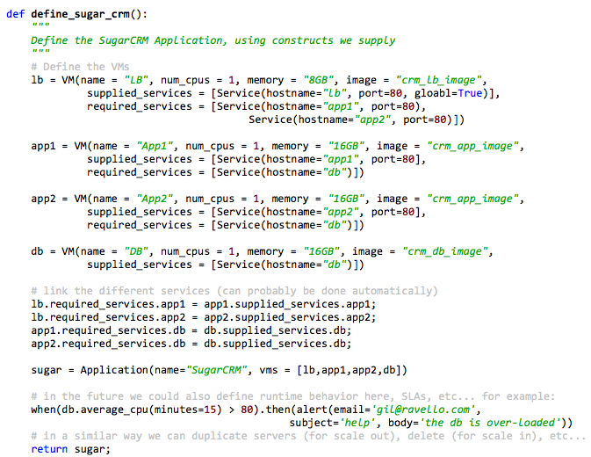
Application framework
Define an entire multi-VM/ application end-to-end
Describe relationship between application components, external interfaces, configuration, SLA etc.
Every aspect of a Cloud Application can be coded

Slide 19
#1 Lack of internal capacity
#2 Difficult to replicate/provision environments quickly
Okay, so what’s next???

Slide 20
Automate everything!
Run UT and various “smoke” runs on each commit on identical replicas of production
Run various types of system tests nightly, including destructive tests
Manual QA can provision new environments with the click of a button
Each *developer* can spin a full copy of the application in minutes

Slide 21
Automate some more!
Product management can easily demo new experimental features on their own app copy
Ops can easily use for a “poor man’s” multi-cloud DR solution
Supply copies of the app to contractors (e.g. pen-testing) with zero effort
Allows having an *identical* automatic deployment mechanism to all environments (including production)
…

Slide 22

The missing link…
We utilize Jenkins as the engine who drives the workflows (manually and automatically)
  Using Ravello to replicate the app
  Using the Build flow plugin to define workflows with parallel job runs
    E.g. parallelize huge suites on two applications in order to shorten run-time!
Using Jenkins for:
  Continuous Integration
  Application provisioning, deployment and upgrade
  Running manual processes

Slide 23

Feature toggles
Heavy utilization of feature toggles
  Build time configured from Jenkins through maven
Runtime toggles
Automatic feature toggle testing

Slide 24
Demo Time…
Notes:
Go over everything that we do with Jenkins (project configuration, DSL, toggles, parameters, radiator)

Slide 25


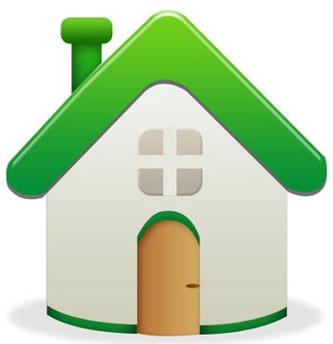
Questions?
@ravellosystems
http://www.ravellosystems.com

Slide 26


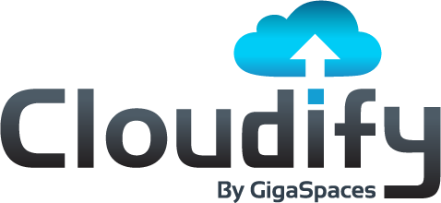

Thank You To Our Sponsors

