Slide 2
Artificial Intelligence and Machine Learning for Every .NET Developer
Cesar de la Torre
Principal Program Manager
.NET & ML.NET Product Group
Microsoft Corp.
cesardl@microsoft.com
Twitter: CESARDELATORRE

Slide 3
What is Machine Learning?

Slide 4
Machine Learning “Programming the UnProgrammable”
{
{
Is this a face?
Price of Shirt?
f(x)
f(x)
“It has exquisite buttons … with long sleeves …works for casual as well as business settings”

Slide 5
Machine Learning “Programming the UnProgrammable”
{
Machine Learning creates a
Face
Face
f(x) Model
Not a face
Not a face
Using this data
But it needs a lot of sample training data in order to predict properly… ;)

Slide 6
What problems can you solve with Machine Learning?

Slide 7
Many Machine Learning Tasks!
Supervised ML (Infers label)
Unsupervised ML (Infers structure)
Linear Discriminant Analysis
Clustering
Regression
Topic Modeling
( K-means
Mixture models
Hierarchical clustering)
Structured prediction
Naïve Bayes
Linear regression
Logistic regression
Dimensionality Reduction
Decision Trees
Anomaly detection
Binary Classification
Multi-class Classification
Latent variable models
Topic modeling
k-nearest neighbor
Neural Networks
(MultiLayer Perception, etc.)
Neural Networks
(Autoencoders,
Self-organizing maps, etc.)
Support Vector Machines

Slide 8
“Democratize Machine Learning and AI in general, for developers”
THE GOAL

Slide 9
What AI, Machine Learning and Deep Learning technologies can you use in .NET applications?

Slide 10
AI & ML portfolio for .NET applications
Consume pre-built/pre-trained models or build your own custom model?
AI, ML and DeepLearning technologies
Focus in today’s talk
Focus in today’s talk
Consume (Pre-built AI: Ready to use)
Build your own (Custom AI)
Azure
Cognitive Services
Pre-trained models
(ONNX, CoreML, WindowsML)
Azure Machine Learning
Studio
ML.NET
Integration
TensorFlow,
CNTK,
Torch,
ONNX, etc..
Easier / Less control
Harder / Full control
Client apps
Bots
(Bot Framework)
Web apps
(ASP.NET)
Mobile apps and IoT Edge devices
(Xamarin) (IoT Edge SDKS)
Visual Studio and .NET

Slide 11
Pre-built AI: Using Azure Cognitive Services in .NET applications

Slide 12
Microsoft Cognitive Services
Commoditized AI
Vision
From faces to feelings, allow your apps to understand images and video
Speech
Hear and speak to your users by filtering noise, identifying speakers, and understanding intent
Language
Process text and learn how to recognize what users want
Knowledge
Tap into rich knowledge amassed from the web, academia, or your own data
Search
Access billions of web pages, images, videos, and news with the power of Bing APIs
Labs
An early look at emerging Cognitive Services technologies: discover, try and give feedback on new technologies before general availability

Slide 13
Microsoft Cognitive Services
Commoditized AI
Demo for today
Computer Vision
Content Moderator
Emotion
Face
Video Indexer
Custom Vision Service
Bing Speech
Speaker Recognition
Custom Speech Service
Bing Spell Check
Linguistic Analysis
Text Analytics
Translator Text & Speech
Web Language Model
Language Understanding
Academic Knowledge
Entity Linking
Knowledge Exploration
Recommendations
QnA Maker
Custom Decision Service
Bing Autosuggest
Bing Image Search
Bing News Search
Bing Video Search
Bing Web Search
Bing Entity Search
Bing Custom Search
Project Prague (gesture)
Project Cuzco (events)
Project Johannesburg (routing)
Project Nanjing (isochrones)
Project Abu Dhabi (distance matrix)
Project Wollongong (location)
Vision
Speech
Language
Knowledge
Search
Labs
Demo for today

Slide 14
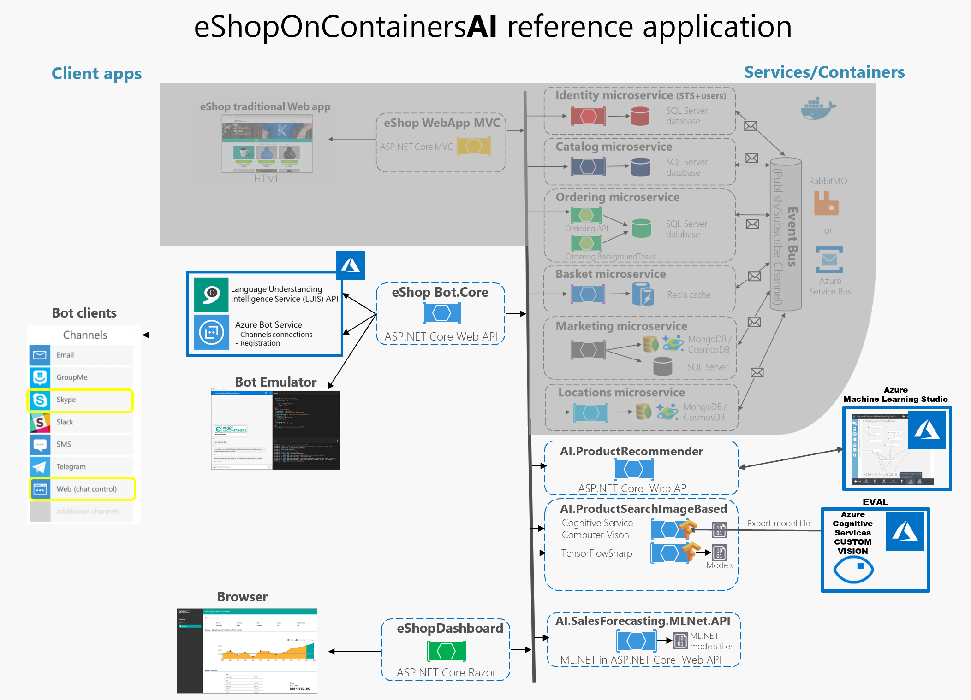
Using Cognitive Services:
Demo
Computer Vision & Custom Vision in eShopOnContainersAI app

Slide 15
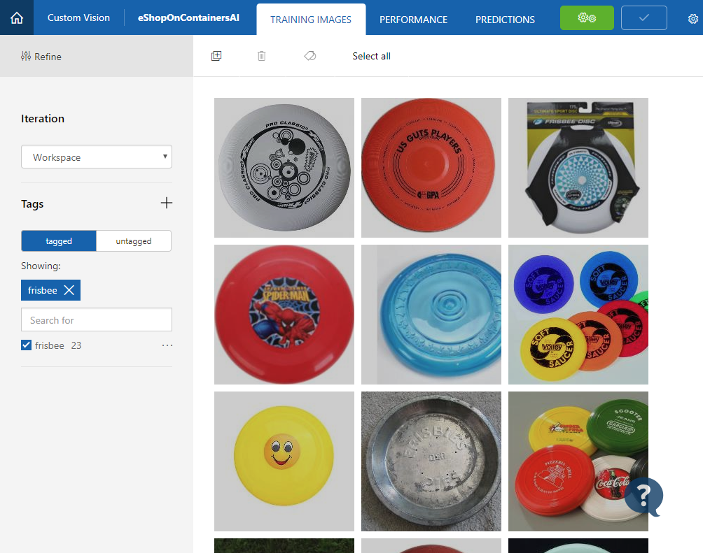
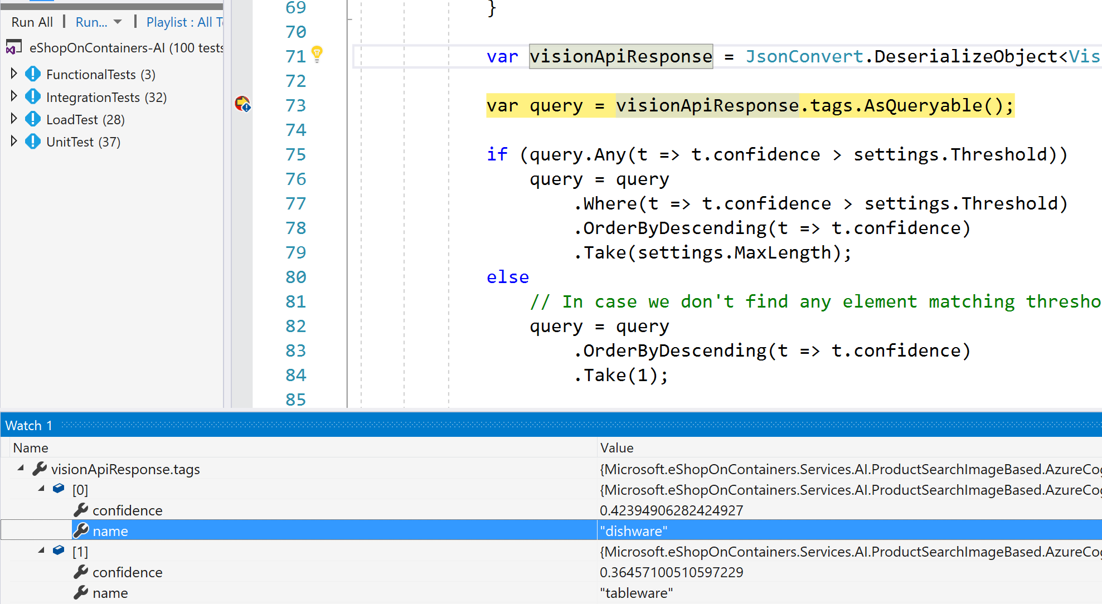
EXAMPLE: When to use “Azure Custom Vision”
If using Azure ComputerVision (which is always online), it doesn’t recognize a “Frisbee” picture. Recognizes it as “Dishware”, not a good identification → Need Custom Vision for these cases:

Slide 16
Custom Machine Learning: Using ML.NET

Slide 17
Is pre-trained/pre-built Machine Learning enough for you? i.e. Azure Cognitive Services, etc.
As always.. the answer is… :
“It depends…” ;)

Slide 18
Pre-built ML Models (Azure Cognitive Services)
e.g. Sentiment Analysis using Azure Cognitive Services
TextAnalyticsAPI client = new TextAnalyticsAPI();
client.AzureRegion = AzureRegions.Westus;
client.SubscriptionKey = "1bf33391DeadFish"; client.Sentiment(
new MultiLanguageBatchInput(
new List<MultiLanguageInput>()
{
new MultiLanguageInput("en","0", "This is a great vacuum cleaner")
}));
Vision
Speech
Language
Labs
Knowledge
Search
96% positive
Consume (C#, VB, F#)
Easy / Less Control
Full Control / Harder

Slide 19
Pre-built ML Models (Azure Cognitive Services)
e.g. Sentiment Analysis using Azure Cognitive Services
TextAnalyticsAPI client = new TextAnalyticsAPI();
client.AzureRegion = AzureRegions.Westus;
client.SubscriptionKey = "1bf33391DeadFish"; client.Sentiment(
new MultiLanguageBatchInput(
new List<MultiLanguageInput>()
{
new MultiLanguageInput("en","0", "This vacuum cleaner sucks so much dirt")
}));
Vision
Speech
Language
Labs
Knowledge
Search
9% positive
Consume (C#, VB, F#)
Easy / Less Control
Full Control / Harder

Slide 20
Build your own (custom) ML Models
Prepare Your Data
Build, Train
& Evaluate
Run
Full Control / Harder
Easy / Less Control

Slide 21
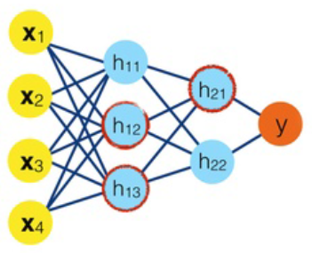
Processes for Building your own (custom) ML Models
Historic
Data
Web apps /
Services
Mobile apps
ML model
file
Run /
Predict
Build & Train
Machine Learning
lifecycle
Desktop apps
?
(Trained)
Bots
Test /
Evaluate
IoT
Prepare Data, Build and Train an ML model
Run/consume the ML model in app

Slide 22
Introducing ML.NET
Currently in v0.5 preview Sept-2018
Machine Learning framework made for .NET developers
(Supported on Windows, Linux, and macOS)
Build your own
Developer Focused
Proven & Extensible
Open Source
&
Cross Platform
https://github.com/dotnet/machinelearning

Slide 23
ML.NET is a framework for custom ML
Historic
Data
Business Application
(Web/Service/Desktop/Mobile)
.csv files
etc.
.NET Core
or
.NET Framework
ML model
.ZIP file
Live
User’s
Data
Build &Train
Machine Learning
lifecycle
ML.NET
.NET Core
or
.NET Framework
API to consume
the model
(Trained)
ML model
file
Test /
Evaluate
Run /
Predict
?
.NET Core
or
.NET Framework
Prepare Data, Build and Train an ML model
Predict: Run/consume the ML model
ML Tasks, Data Transforms, Learners/Algorithms
API to run the model
ML.NET Model Builder
(UI Desktop Tool)
ML.NET API
(.NET Console app, etc.)
nuget
ML.NET API
(.NET app)
nuget

Slide 24
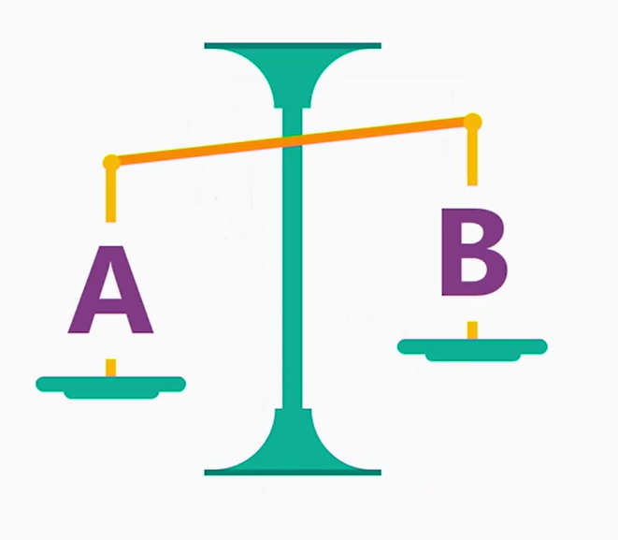
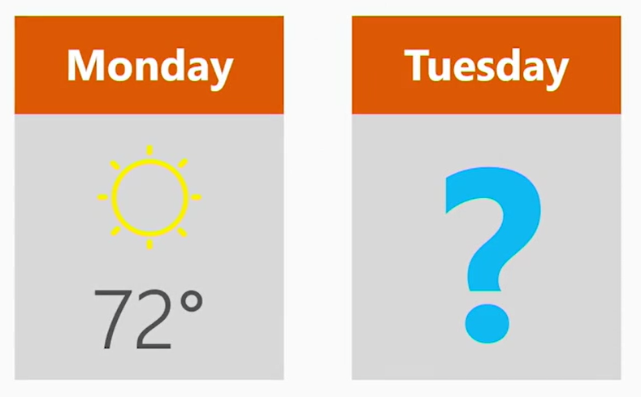
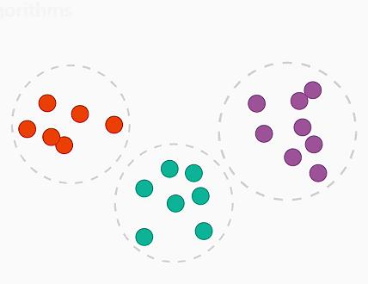
A few problems you can solve with ML.NET
Is this A or B?
How much? How many?
How is this organized?

Slide 25
Mapping from Problems to ML Tasks
Problems
ML Tasks
Predict value (price, forecast, etc.)
Time Series
Something is A or B
Clustering
Detect issues/problems
Recommendations
Group similar objects into sets
Multi-class Classification
Predict relevance of objects
Regression
Predict values based on time/seasons historic data
Binary Classification
Advice on products/movies/etc.
Ranking
Classify things across multiple categories
Anomaly Detection

Slide 26
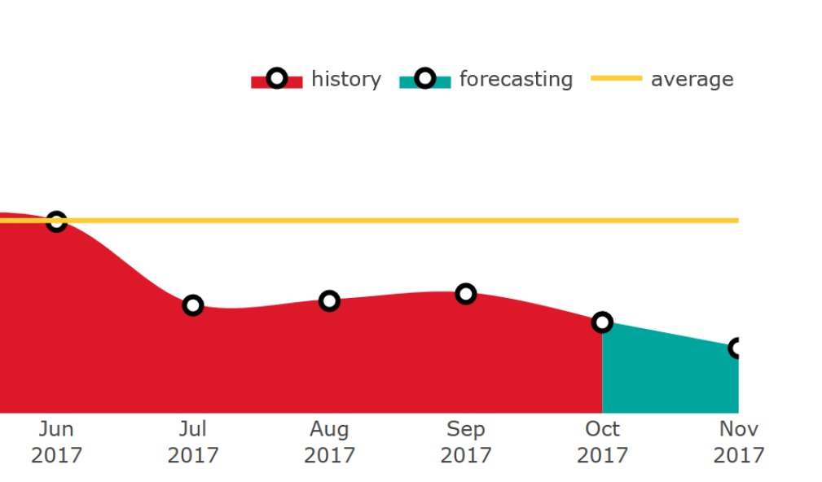
Sales forecast – eShopDashboardML (Regression problem predicting sales forecast)
Demo
Sales Forecasting

Slide 27
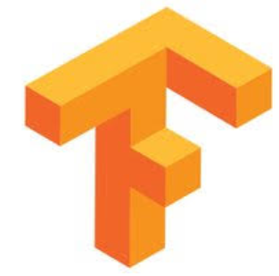
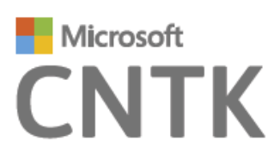
ML.NET is a framework first
Developer-friendly ML APIs to:
.NET Standard
.NET Core
.NET Framework
nuget
Build & Train ML.NET models
Run any model
Preliminary support of TensorFlow scoring in ML.NET is available since v0.5
Transforms
Learners
Misc.
Future Extensions
Text
Linear
ML Data framework
Schema
Boosted Trees
Evaluators
Missing values
Svm
Calibrators
TensorFlow
Categorical
K-Means
Data loaders
Normalization
Feature Selection

Slide 28
ML.NET: Proven at large scale in Microsoft
Bing Ads
Excel
Power Point
Windows 10
+ more!

Slide 29
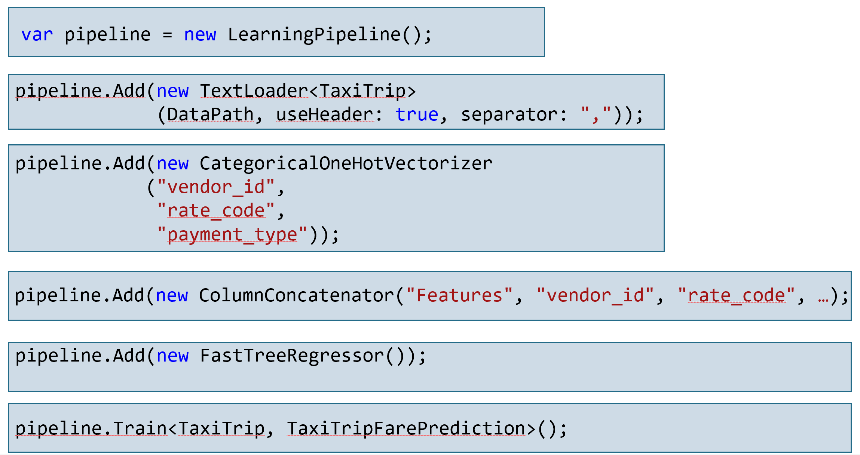
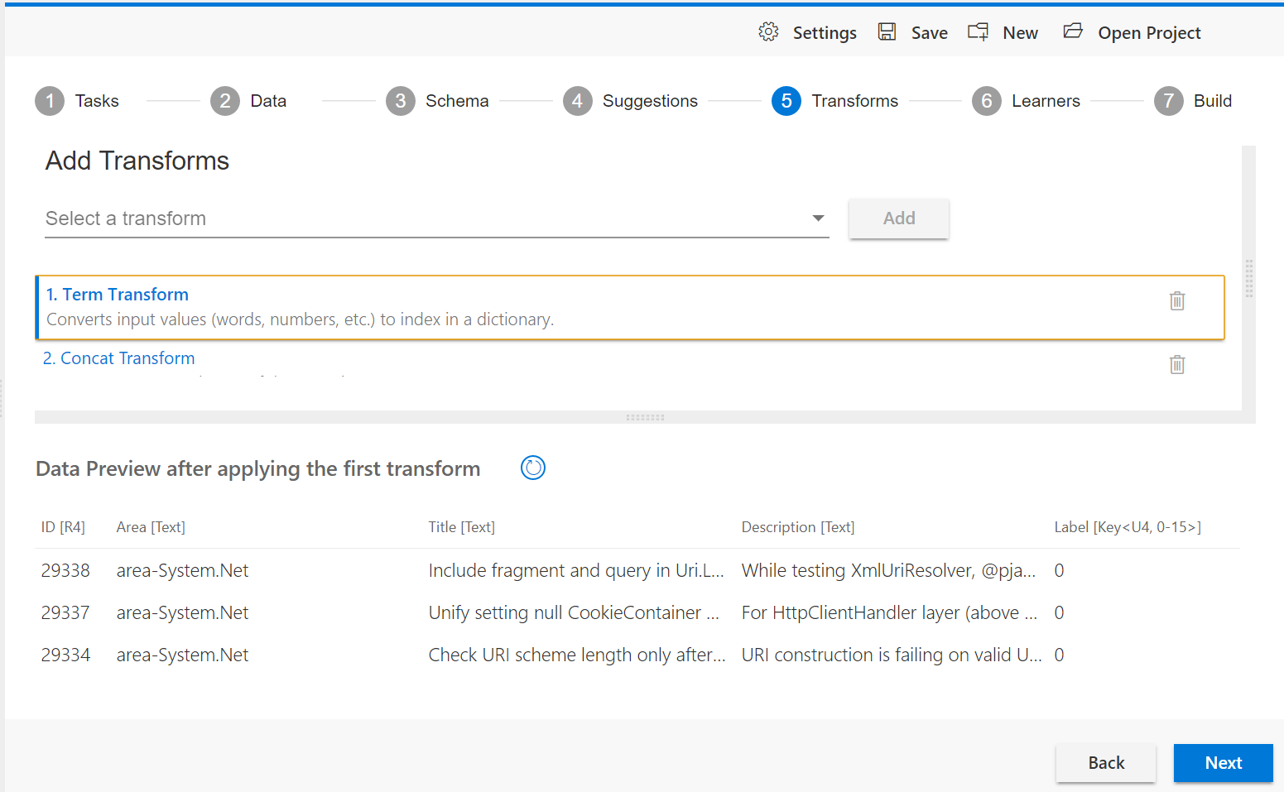
Democratize Machine Learning custom models for .NET developers with a framework and tools especially tailored for developers
The Goal for ML.NET ?
.NET code-first approach to build & train custom models
UI tool,
easy to get started for .NET developers
(*) To be released

Slide 30
Enterprise innovation goes across all technologies, not just AI…
State-of-the-art applications
Just ML.NET Hello-World samples? Or…
Comprehensive list of samples
End-to-end reference applications
Cloud-Native applications + AI/ML
Cloud-Native: Microservices
Cloud
Containers
CI/CD
AI/ML Bots
The enterprise

Slide 31
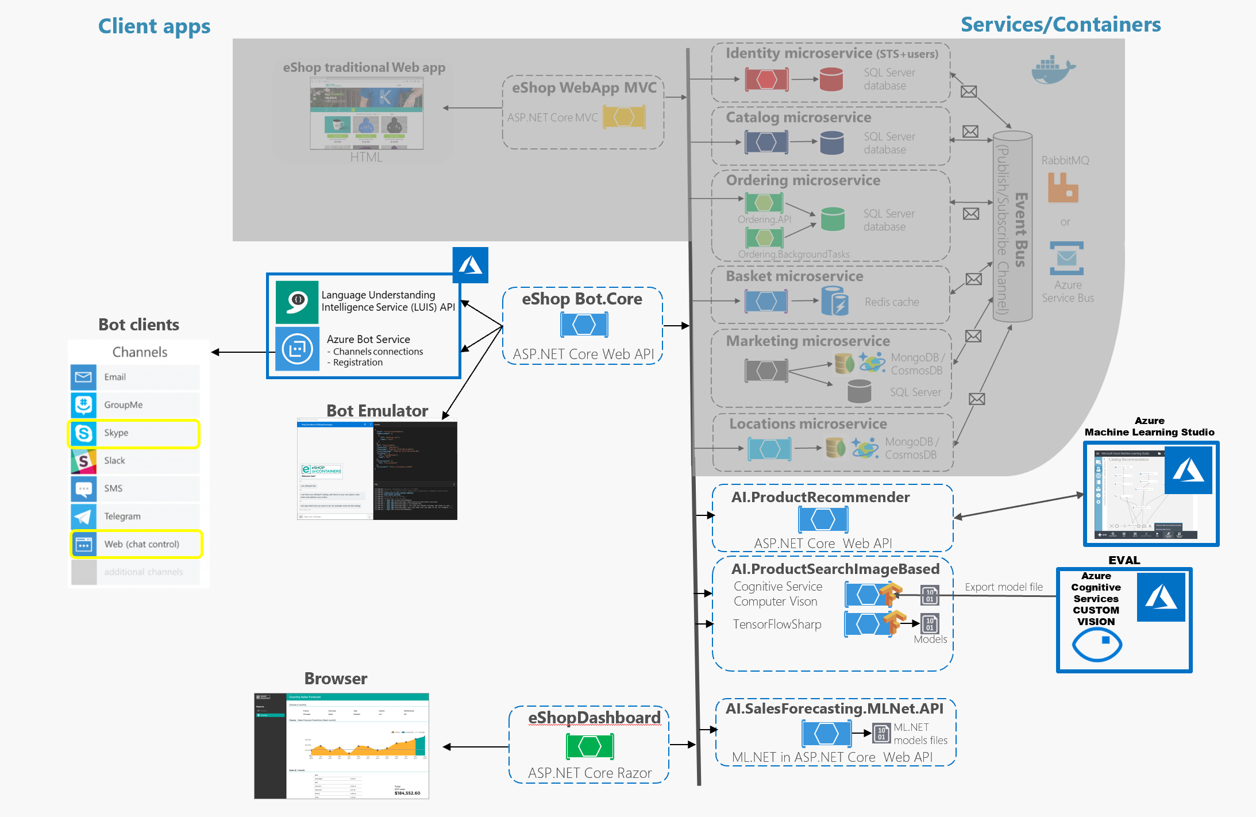
Demo: Surfacing AI with Microsoft Bot Framework + L.U.I.S.
https://github.com/dotnet-architecture/eShopOnContainersAI/
Client
Apps
DEMO

Slide 32
eShopOnContainersAI: End-to-end AI scenario: Cloud-Native + AI/ML
Demo
+ ML.NET
+ Cognitive Services
Custom Vision
+ Bot Framework
+ LUIS (Language
Understanding)
https://github.com/dotnet-architecture/eShopOnContainersAI/

Slide 33
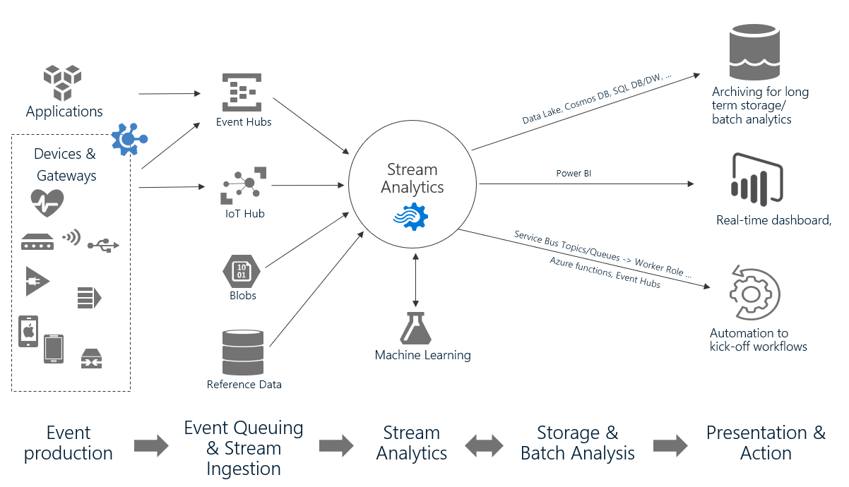
Azure Stream Analytics
Generally Available
Fully managed PaaS service for real-time analytics and complex event processing with built-in integration with over dozen services in Azure
Author powerful queries with simple SQL like language
Available in the cloud and on Azure IoT Edge runtime
Key solution scenarios:
Remote monitoring
Predictive maintenance
Real-time dashboarding
Fleet monitoring and connected cars
IT infrastructure and network monitoring
Monitor online gaming

Slide 34
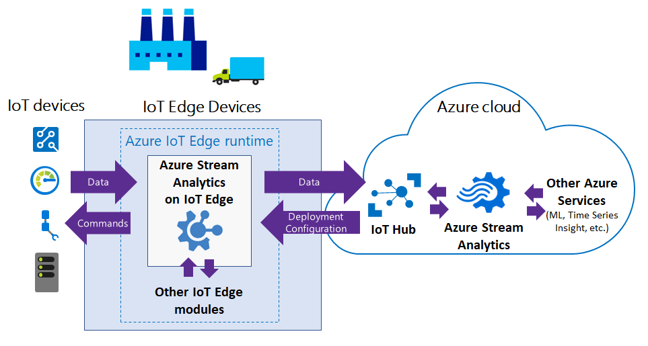
.NET extensibility in ASA on IoT Edge
Request access to Preview
Private Preview
https://aka.ms/ASApreview1
Extend existing query language with C# UDF (User defined functions) to enable new possibilities:
Complex math functions
Machine learning on Edge w/ ML.NET
String/Date manipulations
Data imputation
Custom De-serializers can support any data formats including:
Protobuf
Parquet
XML etc,
ASA module
C# function with
ML.NET model
for scoring

Slide 35
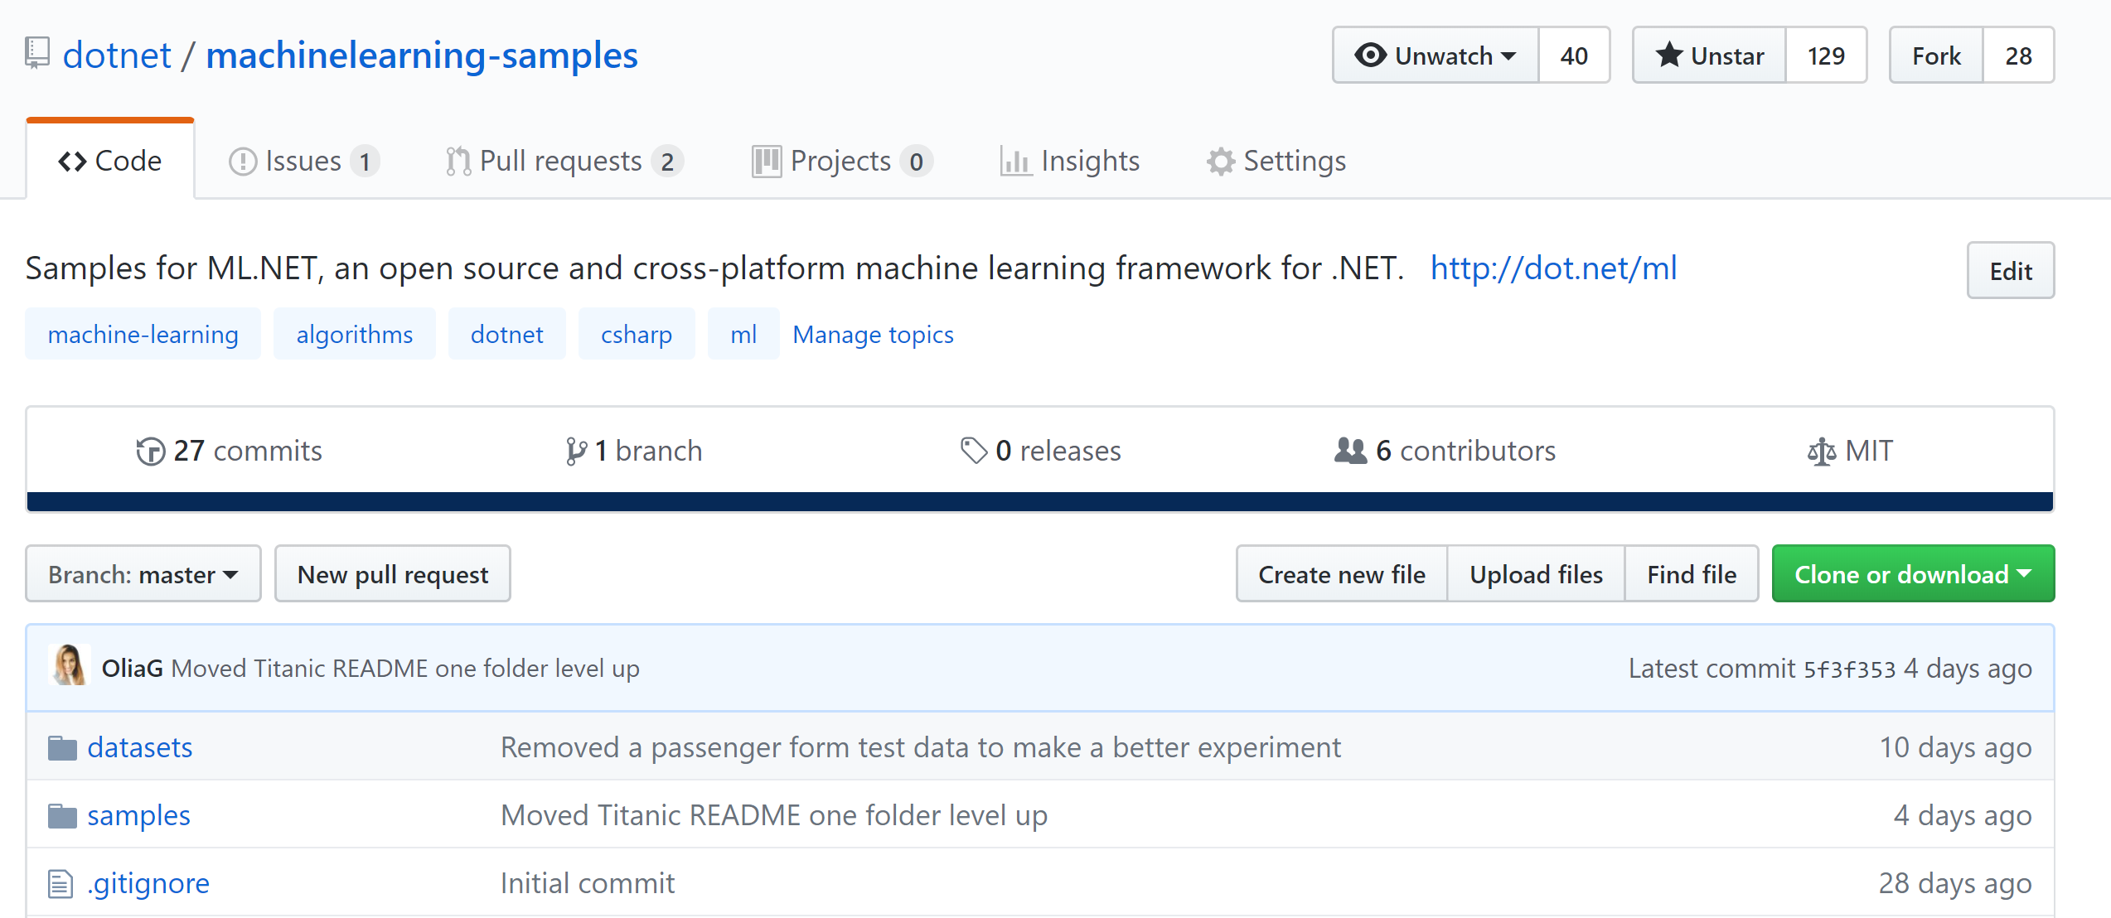
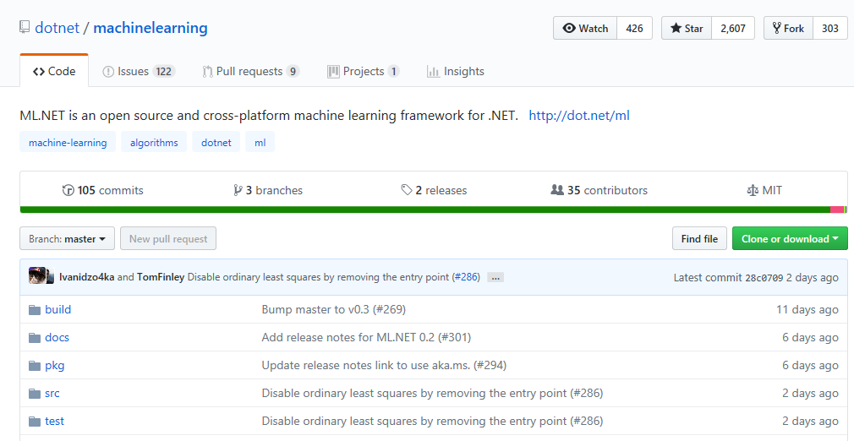
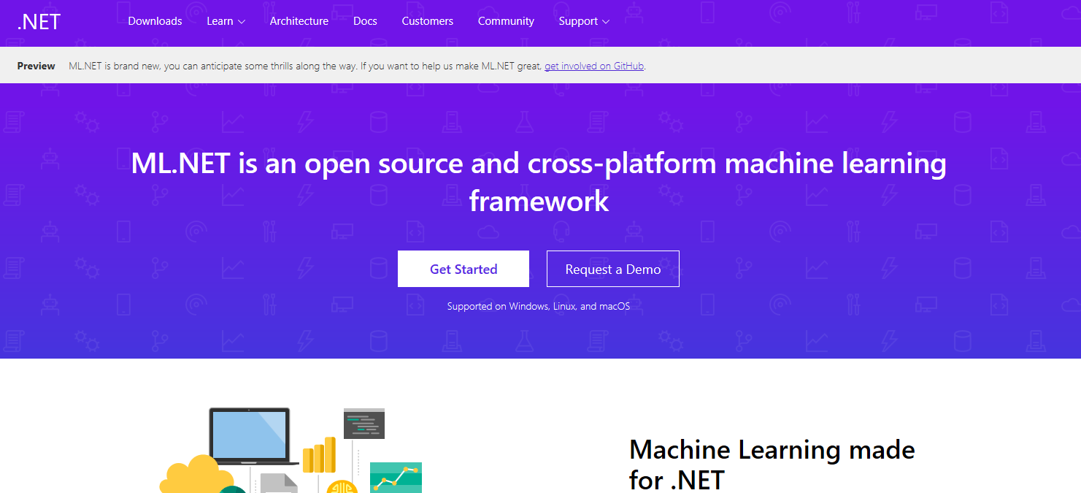
Resources
Get Started dot.net/ml
ML.NET Samples
(eShopDashboard, etc.) http://github.com/dotnet/machinelearning-samples
Get Involved in OSS http://github.com/dotnet/machinelearning/
http://aka.ms/newapifeedback/
End-to-end Native App eShopOnContainersAI:
https://github.com/dotnet-architecture/eShopOnContainersAI

Slide 36
Related sessions in .NET Conf 2018
Machine Learning in .NET (ML.NET) - Ankit Asthana Gal Oshri
Cognitive Services in Xamarin Applications - Veronika Kolesnikova
Artificial Intelligence and Machine Learning for Every .NET Developer - Cesar De la Torre Llorente

Slide 37
Cesar de la Torre
Principal Program manager
.NET & ML.NET Product Group
cesardl@microsoft.com
Twitter: CESARDELATORRE

Slide 38
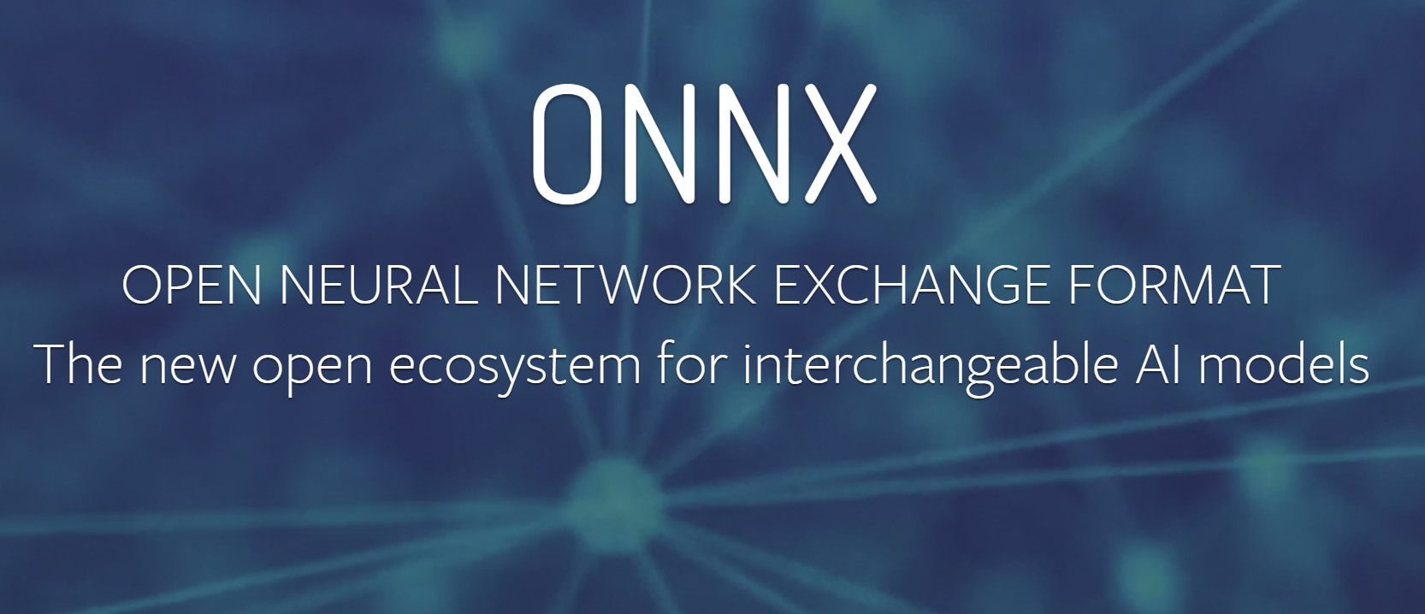
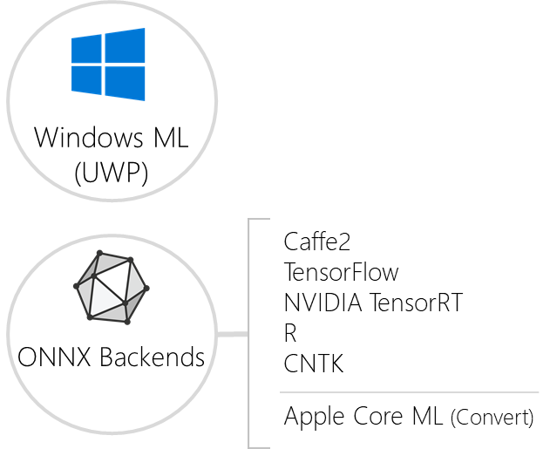
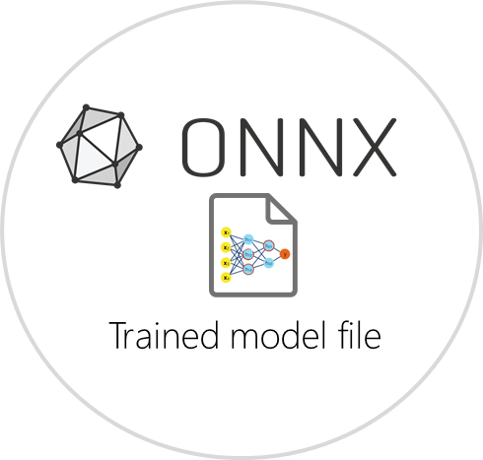
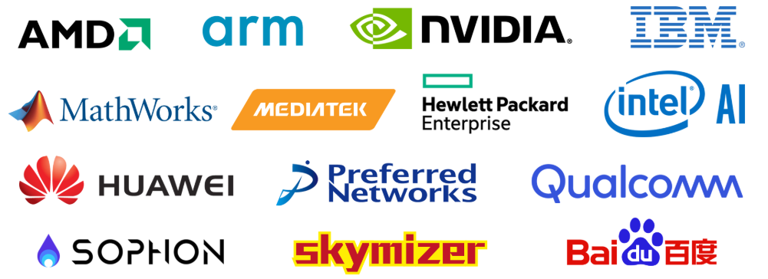
ONNX for Deep Learning / DNN models
TensorFlow
Keras
PyTorch
Caffe
Torch
...
https://onnx.ai/
ONNX-ML support since ML.NET v0.3
“Open, interoperable and standard format to represent deep learning and machine learning models“.
AI developers can more easily move models between platforms.
Two variants of the standard:
- ONNX → Deep Learning / DNN
- ONNX-ML → Classical Machine Learning
Apple CoreML and other ONNX backends will be coming for ML.NET export.

Slide 39
Your platform for building anything
DESKTOP
WEB
CLOUD
MOBILE
GAMING
IoT
ML
.NET
Roadmap
.NET Core 3.0 timeframe

Slide 40
What is Machine Learning & Deep Learning
AI
Machine Learning: Uses mathematical algorithms that can teach itself to evolve while data changes.
Example: Data classification, predict data values in data series
Deep Learning: Specialization within Machine Learning, that uses the model of human neural networks (DNN) to make predictions.
Example: Image recognition, etc.
Deep Learning
AI
Machine Learning
AI

Slide 41
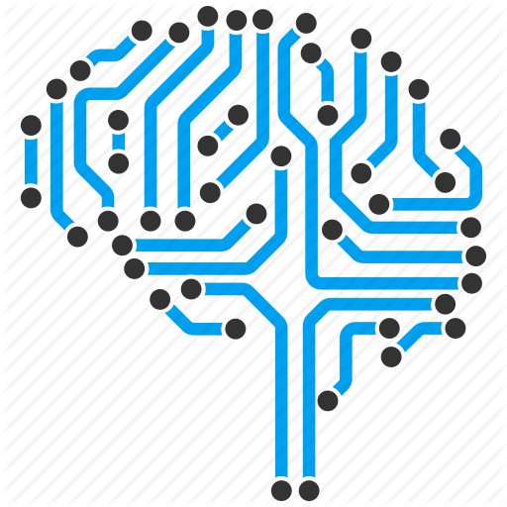
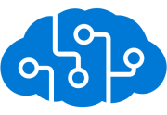
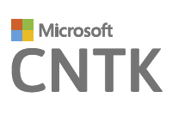
 | BUILD & TRAIN | PREDICT | CONSUME
RECOMMENDATION MODELS (Product Catalog recommendations)
COMPUTER VISION (Product search image-based)
NATURAL LANGUAGE PROCESSING (conversation + data)
REGRESSION MODELS (Sales Forecast prediction)
Azure Machine
Learning
custom
module
Matchbox
Recommender
model
Azure Machine
Learning
web
services
BOT
MVC webapp
Cognitive
Services
Computer
Vision
Demo scenarios (eShopOnContainersAI)
technology map
BOT
TensorFlow
MVC webapp
Keras
TensorFlow
CNTK
CNTK
Cognitive
Services
L.U.I.S.
BOT
MVC webapp
https://github.com/dotnet-architecture/eShopOnContainersAI/

Slide 42
Recap - Positioning the AI technologies along with .NET
Artificial Intelligence (AI)
Machine Learning (ML)
Intelligent Search
AI level
Traditional ML
Deep Learning
Cognitive
Services
Speech
Cognitive
Services
Cognitive
Services
Pre-built AI
Vision API
Custom Vision Service
Emotion API
Face API
Video API
(Cognitive Services &
Pre-trained models)
Bing Autosuggest API
Bing Image Search API
Bing News Search API
Bing Video Search API
Bing Web Search API
Bing Custom Search API
Bing Entity Search API
Language
(i.e. LUIS)
Computer
Vision
Knowledge
Search
Custom AI
Azure Machine
Learning
Studio
CNTK
TensorFlowSharp &
Microsoft.ML.Scoring
TensorFlow
(Build and train
your custom models)
Python
Keras
TensorFlow
CNTK
PyTorch

Slide 43
Solve problems with
Two sample scenarios/demos for today:
Sales Forecasting
Issue Classification

Slide 44
Sample ML Problem:
Classify things across multiple categories
Multi-class Classification

Slide 45
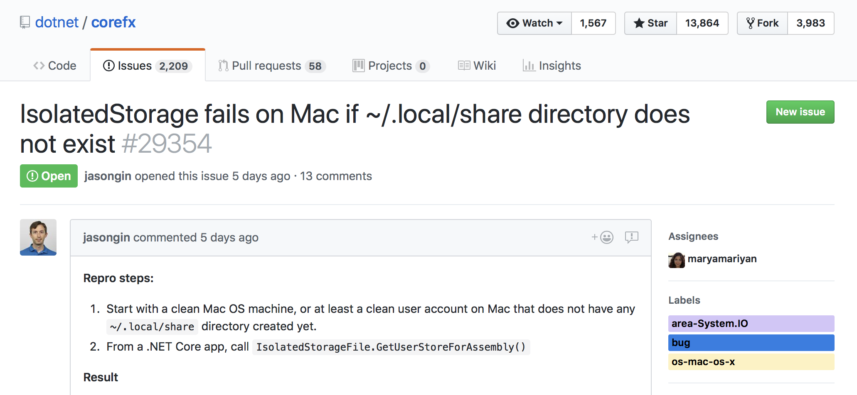
GitHub Issue Example

Slide 46
Features (Input)
Features
Title
Description

Slide 47
Label (Output)
Label

Slide 48
Reviewing code using the new upcoming API (v0.6 and later)
Build/train the model (Console app)
Run the model to predict (Scoring/Inferencing)
var env = new TlcEnvironment(new SysRandom(0), verbose: true);
string dataPath = "corefx-issues-train.tsv";
// Create reader with specific schema.
// string :ID, string: Area, string:Title, string:Description
var reader = TextLoader.CreateReader(env, ctx =>
(area: ctx.LoadText(1),
title: ctx.LoadText(2),
description: ctx.LoadText(3),
dataPath,
useHeader: true));
var estimator = reader.MakeEstimator()
.Append(row => (
// Convert string label to key.
label: row.area.Dictionarize(),
// Featurizes 'description'
description: row.description.FeaturizeText(),
// Featurizes 'title'
title: row.title.FeaturizeText()))
.Append(row => (
// Concatenate the two features into a vector.
features: row.description.ConcatWith(r.title),
// Preserve the label
label: row.label))
.Append(row => r.label.PredictSdcaMultiClass(row.features));
// Read the data
var data = reader.Read(dataPath);
// Fit the data (Train the model)
var model = estimator.Fit(data);
// Save the model to a file
await model.WriteAsync(“github-Model.zip");
Web app, Desktop app, etc.
var model = await PredictionModel.ReadAsync(“github-Model.zip");
var predictor = model.MakePredictionFunction<IssueInput, IssuePrediction>();
var prediction = predictor.PredictSdcaMultiClass(new IssueInput
{
ID = "29338\t",
Title = "Include fragment in Uri.LocalPath on Unix\t",
Description = "While testing XmlUriResolver, @pjanotti discovered that any segments of a file path following a '#' symbol will be cut out of Uri.LocalPath on Unix. Based on additional tests, this also occurs for the '?' symbol. This is happening because the Unix specific case for local path only uses the path component of the URI});
}

Slide 49
How to Improve a model? → Experimenting!
Machine Learning is Iterative.
More/different data
Larger datasets
Mixed datasets
Different pipeline
Different learners
Different transforms
Different hyperparameters
Specialized datasets
“Programming the Unprogrammable” “Programming the Unprogrammable”

Slide 50
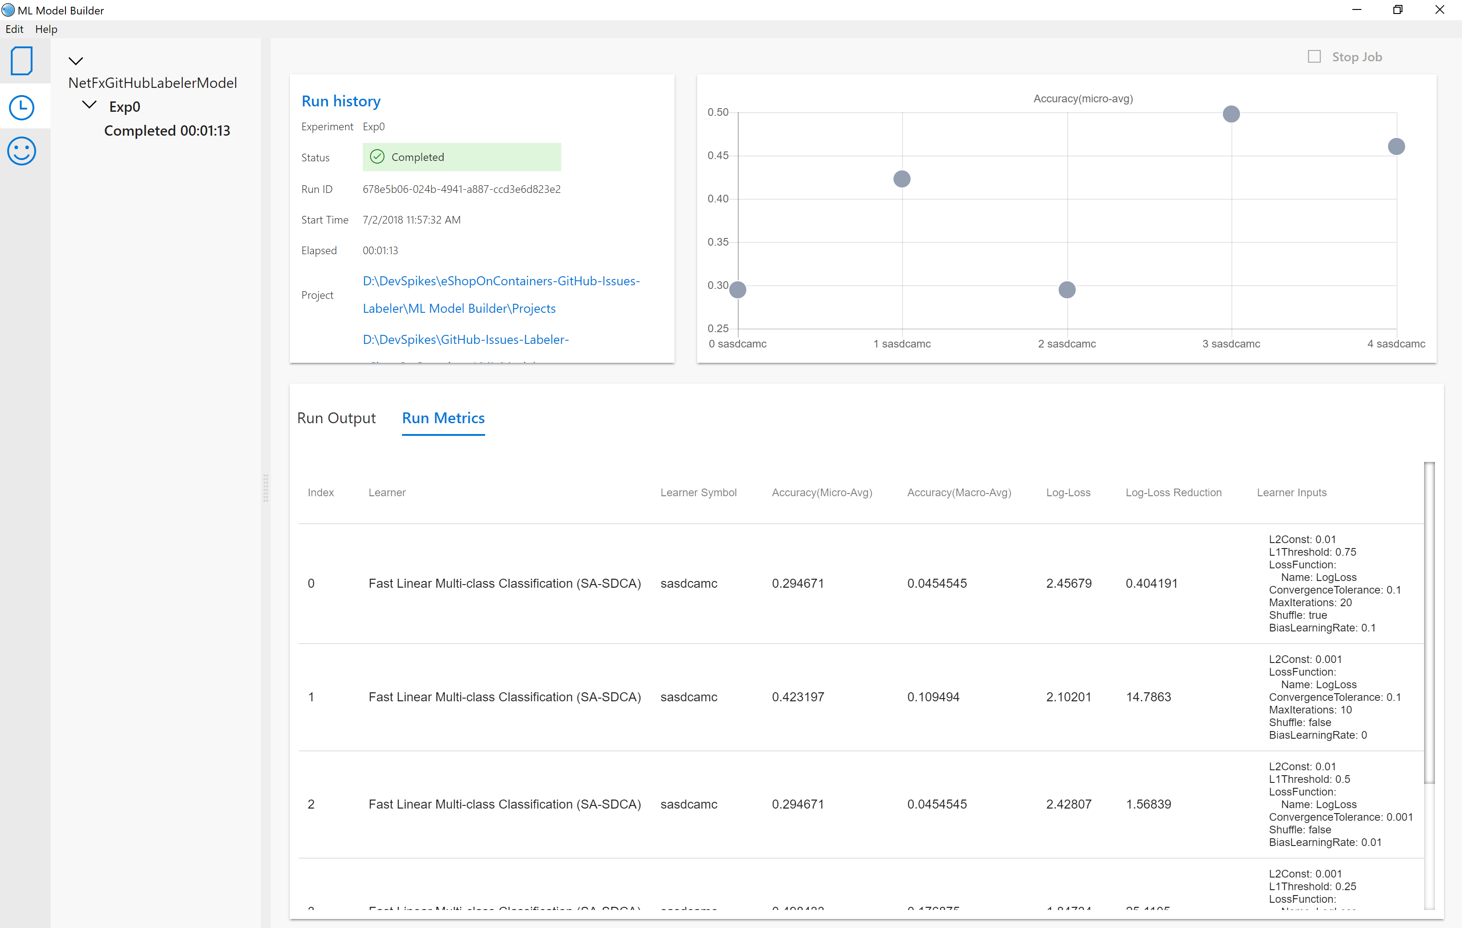
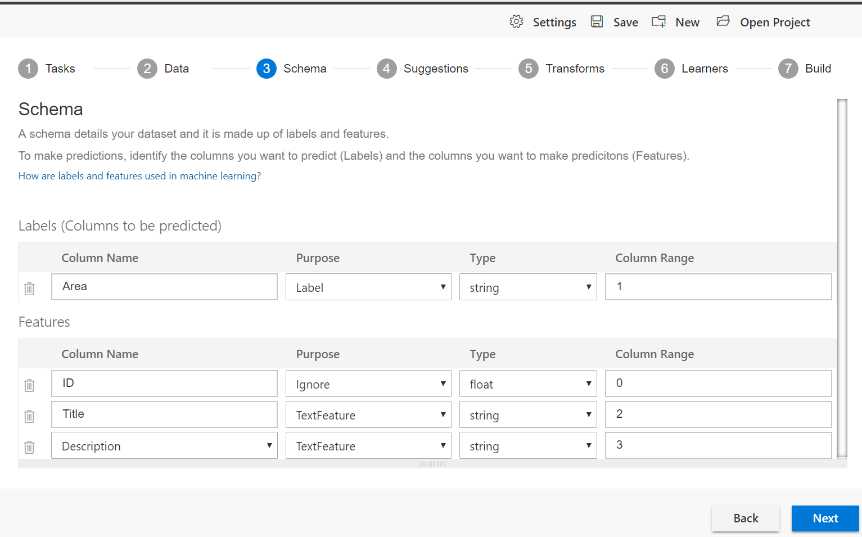
ML.NET Model Builder tool (Currently in internal-preview phase)
Great for experimenting with datasets, learners and multiple trainings
Outputs:
Model file (.ZIP)
Source code (C#)
Training code
Running code
Goals:
UI tool for experiments
Simplify data-transforms and training ML tasks experiments
Build your own ML models through a guided experience (.ZIP file)
Auto-generate C# code for model training and consumption
Full Control / Harder
MICROSOFT CONFIDENTIAL – INTERNAL ONLY

Slide 51
ML Model Builder tool with the GitHub Labeler sample

