Slide 1
Humanity-Scale Information Security
Smári McCarthy
<smarimccarthy@thoughtworks.com>
<smari@mailpile.is>
PGP: B221 6FD2 779A E5B5 9D79 743C D5DC 2A79 C2E4 AE92

Slide 2
The views expressed in this talk are my own,
and not necessarily those of my employer.

Slide 3
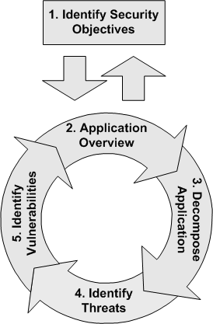
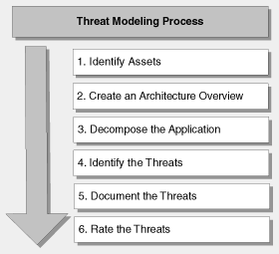
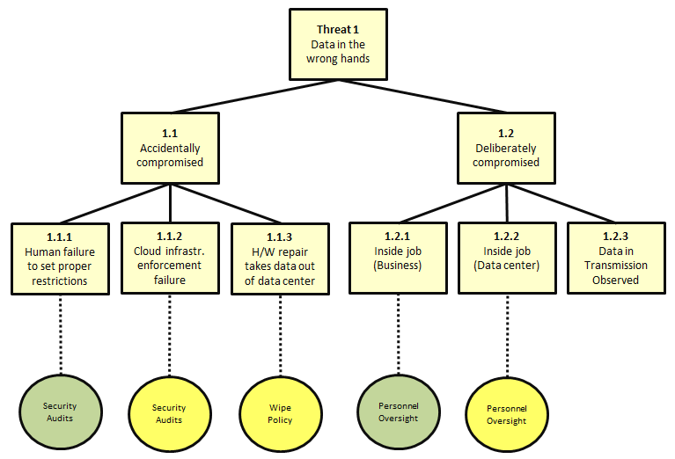
Notes:
Most approaches to information security focus on a product, a standard, or an organization. The goal is to secure a relatively small group of people against a relatively narrow set of fairly well understood threats, while relegating any existential, political, economic or other extreme threats to the category of insurance policies and forlorn hope.

Slide 4
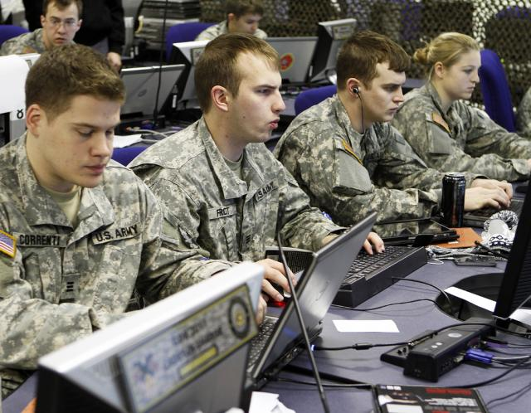
Notes:
The largest threat models are constructed on a national scale, in the form of defense policies for military situations and increasingly medical, economic, humanitarian or natural disasters. These frequently factor in many non-threats for political purposes, as is common when referring to terrorist threats or “cyberwar”, neither of which has anywhere near the annual effect as other much more severe threats to society, such as ischaemic heart disease, stroke, car accidents or curable poverty-driven diseases.

Slide 5
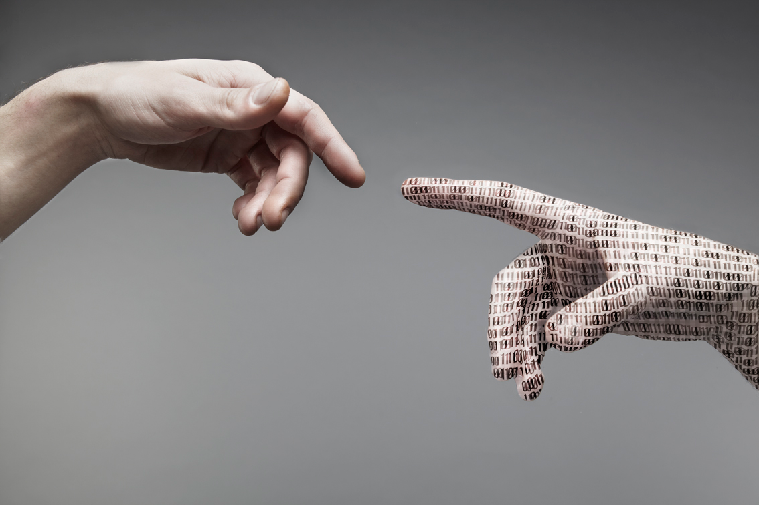
Notes:
I’m going to explore a humanity-scale approach to information security, and argue that such approaches are needed in order to protect humanity against vast threats, whether they be political, corporate, or systemic. Although information security is merely one form of security, it increasingly forms a basis for other kinds, as critical infrastructure and other aspects of modern life globally are increasingly heavily dependent on information systems.

Slide 6
4
Running into the Arms of Empire

Slide 7
Population of the Internet
World Regions | Population (2012 est) | Internet users 2000 | Internet users 2012 | Growth 2000-2012
Africa | 1,073,380,925 | 4,514,400 | 167,335,676 | 3,606.7%
Asia | 3,922,066,987 | 114,304,000 | 1,076,681,059 | 841.9%
Europe | 820,918,446 | 105,096,093 | 518,512,109 | 393.4%
Middle East | 223,608,154 | 3,284,800 | 90,000,455 | 2,639.9%
North America | 348,280,154 | 108,096,800 | 273,785,413 | 153,3%
Latin America | 593,688,638 | 18,068,919 | 254,915,745 | 1,310.8%
Oceania | 35,903,569 | 7,620,480 | 24,287,919 | 218.7%
Total | 7,017,846,922 | 360,985,492 | 2,405,518,376 | 566.4%
Notes:
The current user base of the Internet is roughly 2.5 billion people. By virtually every estimate, this number is going to double in the next five years, as various parts of the world, in particular India, China and Sub-Saharan Africa come online in greater measure. As this happens, new economic opportunities are arising globally, both in the form of possibilities for electronic commerce, and in the form of service provision to those who are coming online. These of course then each have secondary and tertiary effects, which further compound and permeate through local and global economies.

Slide 8
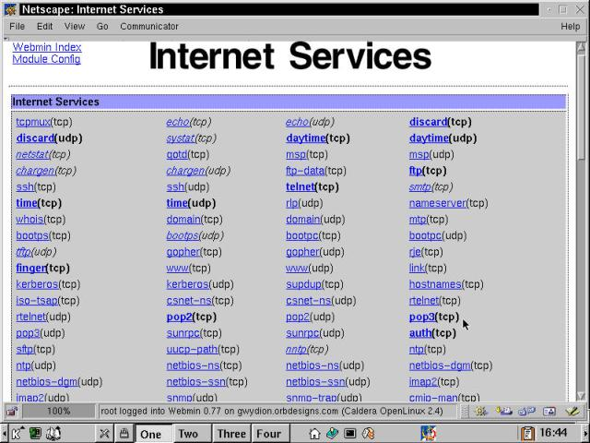
Notes:
Those people who join the Internet are faced with a smorgasbord of service options catering to a wide range of different activities and desires. Whether it is e-mail services or social networking, photo sharing services, social recommendation systems, electronic banking, news services, instant messaging, teleconferencing, collaborative document editing, file storage, or any number of other things, there are service providers out there that are willing to provide it.

Slide 9
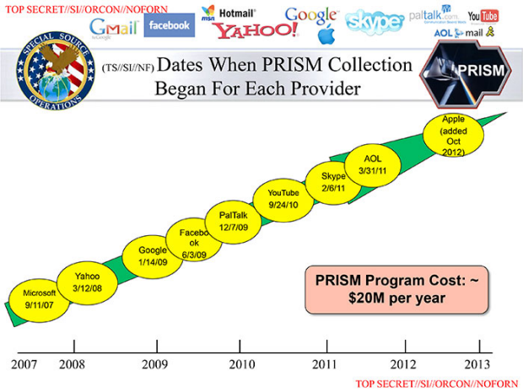
Notes:
But these service providers are predominantly large, predominantly American, and within a narrow margin of error, have no economic, political or social ties to the vast majority of countries where they provide service. Most of these do not care that through their provision of services, they are providing near global surveillance coverage to the governments of their countries at virtually zero cost as a side effect.

Slide 10
“Don’t make the mistake of thinking you’re Facebook’s customer, you’re not
– you’re the product”
- Bruce Schneier
Notes:
None of these has taken affirmative action to provide strong cryptographically guaranteed privacy to the people who are coming online, nor will they, because their customers are not asking for privacy - their customers are asking for impressions, clickthroughs and conversions. The people who are coming online are merely eyeballs for the advertising industry to market at, as far as these predominantly American, predominantly large corporations are concerned.

Slide 11
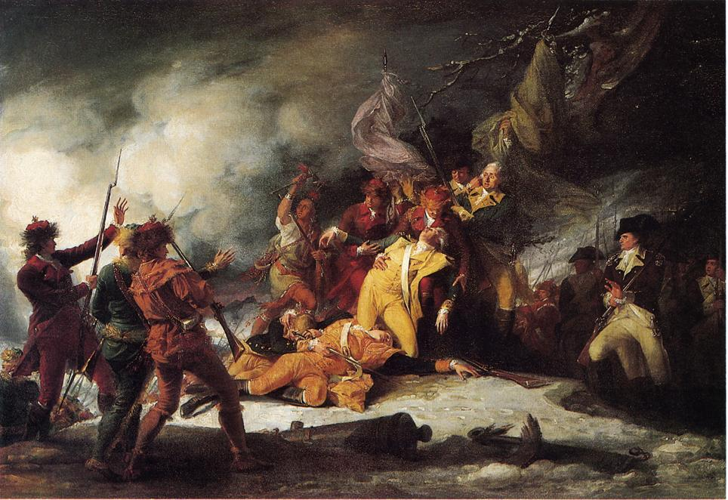
Notes:
Because of this, there is a risk that the next billion people who come online unwittingly subject themselves to empire. Not in the traditional sense of colonial superpowers invading foreign lands and extracting material resources to fuel the vapid consumer cultures of the western bourgeois, but in the more metamodernist sense of being subject to service determined vendor lock-in on a societal level.

Slide 12
Information Security is an expression of self-determination
Notes:
This is relevant to information security people such as ourselves in the same way as cloud computing is relevant to information security people such as ourselves. In fact, it’s the very same question, only framed slightly differently. When we talk about the security in the cloud, we talk about identity management, physical and personnel security, availability, application security, privacy; we talk about logging and controls, legal compliance and contractual compliance, we talk about business continuity and data recovery, and we go on and on about these things, only we never once admit to ourselves that what we are really talking about is sovereignty and self-determination.

Slide 13
“There was a time when we manufactured almost all we wanted. The process is now reversed, and we are dependent upon the outside world for most manufactured goods... It has therefore become necessary to define Swadeshi goods.”
- M. K. Gandhi, Young India (1931)
Notes:
At the end of the day, every individual who has no agency to make enlightened decisions about the services they are going to use, the environment they are going to operate in, and the political implications of their choices, is at risk of increasing centralization of humanity at the cost of everybody’s security.

Slide 14
Notes:
This is why I refer to humanity-scale information security as an economical problem. And the economics of information security at the hundreds of millions of people level or the billion person level are very different from the economics at the hundreds of persons level or even the millions of persons level.

Slide 15
Known private keys
P1 Q1
P2 Q2
P3 Q3
P4 Q4
P5 Q5
… …
Known public keys
N1
N2
N3
N4
N5
N6
N7
N8
N9
N10
N11
N12
N13
N14
N15
…
Super naïve algorithm:
for pub in pubkeys:
for factor in knownfactors:
if prime(pub // factor):
knownfactors.append(pub//factor)
print “Unravelled %s” % pub
pubkeys.delete(pub)
Notes:
A practical example of this is the SSL key unravelling attack. We know that there are an infinity of prime numbers, but we also know that there is merely a relatively large finite number of prime numbers within any given integer range. So if you pass me a 1024 bit RSA public key, I need to test a very large number of primes to find its factors. However, it turns out that if you pass me several million 1024 bit RSA public keys, the likelihood of any two keys sharing at least one factor grows pretty quickly. Then I just need to start off with a couple of dozen public keys and start testing them. Each time I find a new shared key, I add it to my list of knowns, and continue. This is an embarrassingly parallelizable activity. It is evidence that critical mass can weaken systems that are secure at smaller scale.

Slide 16
3
Who is Information Security For?

Slide 17

Notes:
Let us take the example of an enormously powerful existing adversary. Thankfully we do not need to conjure one up in our minds eye, as the governments of the Anglosphere have studiously provided us with five eyes with which to do it. The Office of the Director of National Intelligence in the United States has an annual budget of roughly 52 billion dollars.

Slide 18

Notes:
That covers NSA, CIA and some other things, but it does not include US Cyber Command, ONI (Office of Naval Intelligence), any US Airforce surveillance activities, research done at the National Defense University and other similar organizations.

Slide 19
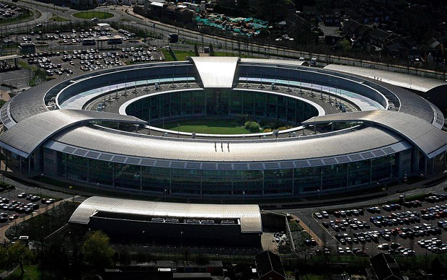
Notes:
If we use that as basis for extrapolation over the rest of the US surveillance-industrial complex, and the British, Canadian, Australian and New Zealand analogues, we come to a reasonable assumption of an upper bound to their budget being roughly 120 billion dollars per year.

Slide 20
Global e-mail users:
1.9bn – 2.4 bn
Notes:
Now as I said before, there are currently about 2.5 billion people who use the Internet, and that means there are about 2.5 billion people are affected by NSA's surveillance activities. To break this number down a bit, current conservative estimates put the number of users of e-mail globally at 1.9 billion individuals as a conservative estimate, with 2.4 billion being a more likely reality.

Slide 21
Facebook: 1.15 billion users
Skype: 600 million users
Twitter: 400-600 million users
Dropbox: 175 million users
Android: 1 billion devices
iOS: 250 million devices
Notes:
Facebook has 1.15 billion users, Skype has around 600 million users, Twitter is of similar size. Dropbox has 175 million users. Over a billion Android smartphones and tablets are in circulation, and over 250 million Apple iPhones and iPads.

Slide 22
Gmail: 435 million users
Outlook: 325 million users
Yahoo! Mail: 298 million users
...
The top ten e-mail providers in aggregate host between 70-90% of all (legitimate) e-mail accounts, with the top fifty providers accounting for close to an estimated 99% of the e-mail market.
Notes:
Amongst e-mail users, roughly 435 million people use GMail, 325 million use Outlook.com (formerly Hotmail), and 298 million using Yahoo! Mail. The top ten e-mail providers in aggregate host between 70-90% of all (legitimate) e-mail accounts, with the top fifty providers accounting for close to an estimated 99% of the e-mail market.

Slide 23
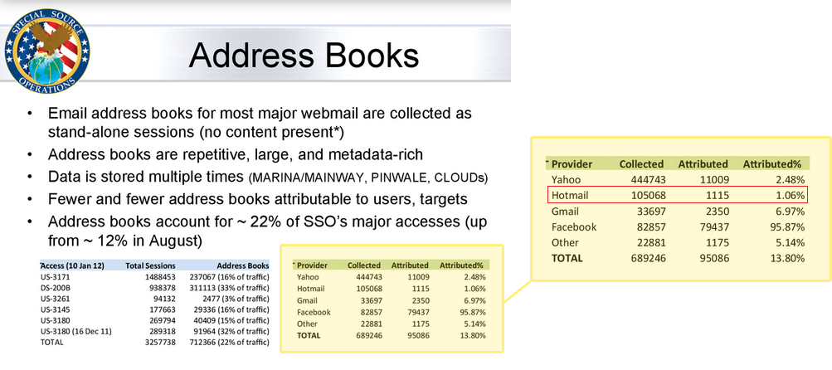
Notes:
Further: During a single day last year, the NSA's Special Source Operations branch collected 444,743 e-mail address books from Yahoo, 105,068 from Hotmail, 82,857 from Facebook, 33,697 from Gmail and 22,881 from unspecified other providers. This gives some idea of the relative internal security capacities of these core vendors. It has long been known that Yahoo’s operational security is quite bad as far as user privacy is concerned.

Slide 24
($120 bn/year) / (2.5 bn people)
= $0.13 / person / day
(Call this “PPV” = “Price per average Privacy Violation”)
Notes:
$120 billion over 2.5 billion people over 365 days a year gives us a cost estimation of this catch all surveillance of about $0.13 per person per day. Let's call that figure PPV: Price Per day of Violation. This is incredibly cost effective for the surveillance states. Of course, a lot of the $120bn are going to various tasks which are not directly related to spying on the general public – everything from keeping the floors clean at Fort Meade down to conducting drone strikes on people in Pakistan.

Slide 25
<caveat>
Notes:
But since we don't know the exact division and all of these things factor into the same system of systematic human rights violations, let's just use the total figure. Actually, this is also better for the following analysis because it assumes their capacity to be greater than it actually is, which is to say that the biased assumption that pervasive ubiquitous surveillance is bad leads us to want to overestimate rather than underestimate the total surveillance capacity. Of course, if it were possible, we would prefer to be accurate, but the asymmetric clandestine nature of the surveillance measures makes accuracy hard.

Slide 26
</caveat>
Notes:
Given this insanely low average figure - admittedly one that can and should be subjected to a large amount of scrutiny - we are forced to ask ourselves who, if anybody, the concept of information security that we work with is intended to protect. In order to make an assessment of that, a review of the ecosystem would help.

Slide 27
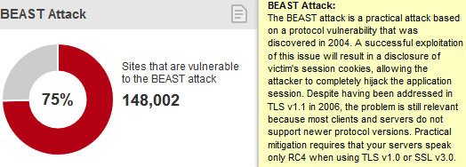
Notes:
A rudimentary scan of available software shows us some shocking things. To protect the transport layer, we have SSL, which is generally quite good as long as you don’t run into any of its numerous failure modes, all of which are subtle and none of which are easily communicated to end-users. It is the most commonly deployed security infrastructure, and yet only a narrow margin of users actually know what to do when they are faced with warnings generated by SSL. On top of that, statistics from 2012 showed that around 90% of the top million websites were vulnerable to the BEAST attack. This figure is unlikely to have changed much, and many SSL certificates and setups are still vulnerable to it out-of-the-box today.

Slide 28
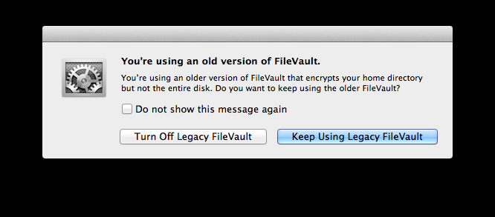
Notes:
Hard disk encryption software is becoming slightly more commonplace, in particular with MacOS’s inclusion of FileVault, which is off by default. Windows does not bundle Bitlocker unless you’re using their enterprise version. Some Linux flavors come with encryption out-of-the box. What this means is that nobody is going to encrypt their hard drives unless they are security-aware geeks or they are forced to by corporate policy.

Slide 29
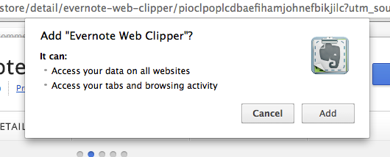
Notes:
So how about the application layer? We have browsers of course, which are relatively robust as long as you don’t install any plugins that get full privileges to your computer. The common user of course has a full understanding of the implications of allowing a plugin to access all data on all websites, access your bookmarks, your tabs, your history and inject arbitrary JavaScript wherever it wants.

Slide 30
You Are Statistical Noise
(or at least, for your sake, I hope so)
Notes:
I say no further: We could continue down this path ad nauseam - it isn’t far. But the conclusion we must come to is that information security has, until now, been for advanced computer scientists in a corporate environment, and for nobody else. Anybody else who has been even marginally secure can be discounted as statistical noise, or a happy accident.

Slide 31
2
Securing the Next Billions

Slide 32
What then?
Notes:
What then is to be done? It is clear that there are roughly 2.5 billion people on the Internet today, and that within five years there may be two billion more. The hardware is commonly compromised, the software is generally insecure, the protocols and standards we rely on have failure modes that most people cannot fathom.

Slide 33
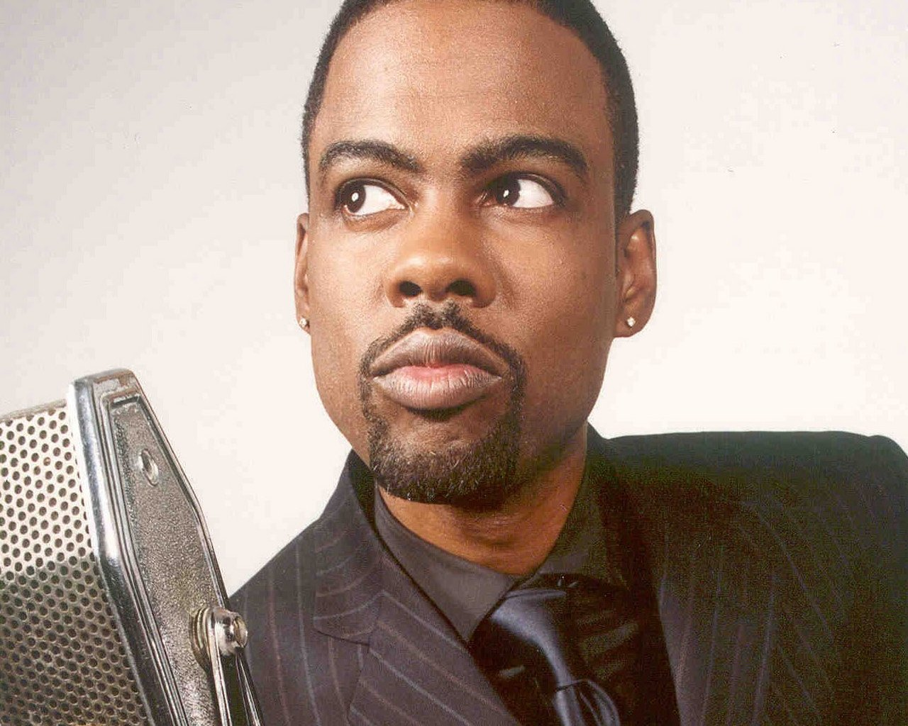
Notes:
But despite all this, I think there are some relatively simple steps that can be taken to price the attacker off the market for the generic case. Specifically, I’d like to suggest a programme by which we, the information security community, can reduce the general case attack viability to about 32.000 targeted people per day. That is still a large number, but it means that those who wish to target those people must put effort into it, and those 32.000 people should know that they had better up their game. This is similar to commedian Chris Rock's observation that if bullets cost $5000, there would be no innocent bystanders. If somebody gets shot, you know he really must have pissed somebody off.

Slide 34
Let's raise PPV to $10000
Notes:
So let's make the bullet cost $10000. I want us to raise the average price per privacy violation to $10000 per person per day. Does that sound exciting?

Slide 35
(psst: Keep doing what you're doing!)
Notes:
This is not a replacement for your focused efforts on application security, or your ongoing network security practices, or the efforts to prevent malware and close 0-days or anything else. This is a pure addition, but it is an addition which works to the benefit of everybody, while also hopefully making the more focused efforts a lot easiler.

Slide 36
Decentralize
Encrypt
Harden
Notes:
It is three pronged: decentralize, encrypt, and harden.

Slide 37
Notes:
Every large centralized service must be replaced by a peer-to-peer alternative. Every bit of information that is stored or transmitted must be strongly encrypted. And everey computational endpoint must be hardened against malicious attacks in such a way that it is language-theoretically verifiable.
These are ordered on the scale from easiest to hardest. Hardening is hard. Redecentralizing the Internet is comparatively easy.

Slide 38
1
Half a Century Without Innovation

Slide 39
New Everything?
Notes:
It would seem, at first glance, that any ambitious plan would necessitate a great amount of revision and innovation of new protocols for the Internet. The complexity would lie quite heavily in exchanging broken old systems for new ones. The 2.4 billion e-mail users of the world are not going to give up e-mail overnight, just to use some newfangled thing. In fact, as Facebook and others have discovered, even producing a newfangled thing is not necessarily going to move people off existing infrastructure.

Slide 40
E-mail
1965 -
Notes:
But let's think about this for a moment. Not many realize that e-mail is 49 years old this year. Since 1965 a lot has changed – we've stopped using bangpaths as an explicit addressing mechanism, we've got a lot more devices that are online on average, with fewer that clock in to do batch fetches. The devices we use to interact with e-mail have improved quite a lot. But for some reason, e-mail itself has hardly changed at all. As far as I can tell, there have only been three major innovations in e-mail since 1965.

Slide 41
RFC # 561 Abhay Bhushan (AKB) MIT-DMCG
NIC # 18516 Ken Pogran (KP) MIT-MULTICS
Ray Tomlinson (RST) BBN-TENEX
Jim White (JEW) SRI-ARC
5 September 73
Standardizing Network Mail Headers
One of the deficiences of the current FTP mail protocol is that
it makes no provision for the explicit specification of such
header information as author, title, and date. Many systems
send that information, but each in a different format. One
fairly serious result of this lack of standardization is that
it's next to impossible for a system or user program to
intelligently process incoming mail.
Although the long-term solution to the problem is probably to
add commands for specifying such information to the mail
protocol command space (as suggested in RFC 524 -- 17140,), we
hereby propose a more quickly implemented solution for the
interim.
We suggest that the text of network mail, whether transmitted
over the FTP telnet connection (via the MAIL command) or over a
separate data connection (with the MLFL command), be governed by
the syntax below:
Example:
From: White at SRI-ARC
Date: 24 JUL 1973 1527-PDT
Subject: Multi-Site Journal Meeting Announcement
Notes:
The first was in 1973, with the adoption of standardized e-mail headers, which lead to a massive increase in system interoperability.

Slide 42
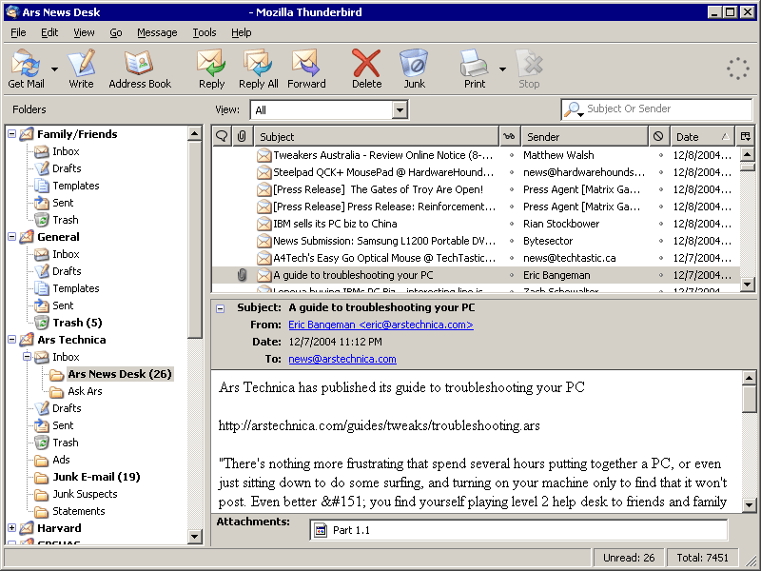
Notes:
The second was in the late eighties or early nineties, depending on how you count it. The original paradigm of e-mail was one where a list of mails was provided, and one could view them one by one. The early inventors of e-mail hardly envisioned that there'd be a future where people got more than twenty or thirty e-mail messages per day. How were they to know that their technology would, more so than even mobile phones, be the backbone of the global economy. Virtually nothing happens in an international context anymore without there being an e-mail trail. Thus, IMAP epitomizes the second great innovation – the transition to multiple inboxes, folders, filters, and upstream synchronization.

Slide 43
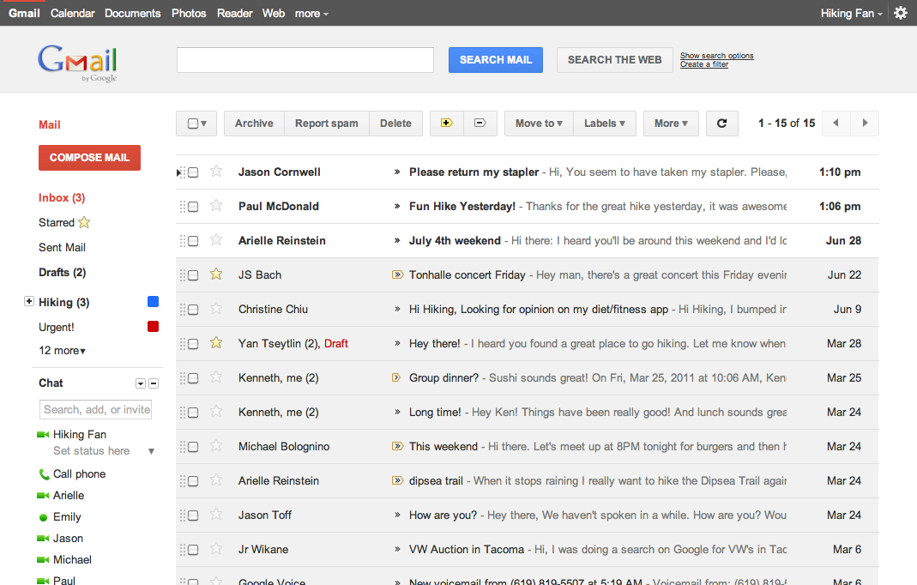
Notes:
The third major innovation on e-mail was unleashed in 2006, although it had been a long time coming. GMail, for all its ills, moved us away from the list-of-lists mutually exclusive folder paradigm to a search-and-tag based paradigm. There were many other things that made GMail interesting, but almost all else was a mere incremental improvement on Hotmail.

Slide 44
50 years, and that's it?
Notes:
It is rather shocking that over the course of nearly half a century, such a fundamentally important technology should have had so little in the way of improvement. There are reasons for this, of course. Chiefly amongst them was that e-mail was not a technology that anybody owned. The ability to market services on e-mail was always considered marginal, and those who tried were always bound to be interoperable with everybody else. The result was a competition between RTF and HTML to provide rich text formatting, which HTML won; and a competition between JavaScript and VBScript to provide interactivity in e-mail, which, it turns out, was more of a liability than a benefit. There was some improvement in spam filtering as well, a necessary evil that we were all too happy to outsource to upstream servers, ignoring the fact that blocking spam is a form of censorship, if a convenient one.

Slide 45
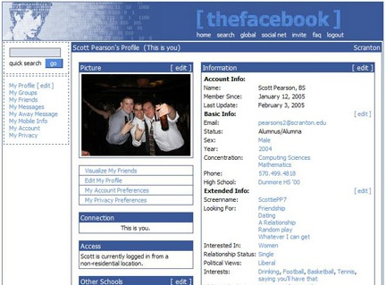
Notes:
Sensing this inertia, watching the downfall of Usenet, and hungry for new methods to communicate in the light of new technologies such as AJAX, my generation decided to start building the social networks. They argued that by providing a centralized alternative to the chaos that was e-mail, with more frills and more spying, better user experience but with more advertising, then everything would get better. And so we had MySpace and Facebook and Twitter and now Google+. Each of these represents a model of how the designers believed that social interactions in the twenty-first century.

Slide 46
Facebook: Childish
Twitter: Adolescent
Google+: Sociopathic
Notes:
The social model of Facebook is that of a five-year-old: “Hi, do you want to be my friend?” Twitter by contrast follows the friendship paradigm of a thirteen-year-old: “Wow, you're cool, I'm going to follow you.” Google+ has not gained much traction, perhaps because its understanding of friendship emulates that of a sociopath – the neurotic belief that explicit management of friendships is something that normal people want to actually spend time doing.

Slide 47
E-mail: Decentralized social network
Notes:
And despite all of this, it is e-mail, with its 2.4 billion users, that is the most popular social network. With its adult model of friendship, where you contact who you will when you will, and all else is implicit. Only nobody treats it as such. Everybody treats it as e-mail. Nobody owns it, nobody innovates on it, and nobody has prepared it for the future.

Slide 48
0
Defending the Free Internet

Slide 49
Invent Nothing New
Notes:
E-mail is just one example of many. It is relevant in that it is the most used, the most powerful, and the most disregarded. But it serves as a template: We don't have to reinvent the Internet. We do not have to make up new protocols. We can start by fixing what we’ve got.

Slide 50
Design Better Reality
Notes:
Oddly, this is mostly a user experience problem. There are some problems with the mathematics of security, but they are relatively few and relatively obscure. It is more so the economics of security that need to be fixed, and we do so by making security easy to use. If every peer-to-peer connection between mail servers was SSL encrypted, we'd be getting somewhere. If somebody was to come up with a simple way to provide end-to-end encryption on all e-mail, we'd be getting a lot farther. If we can get a hundred million people to use PGP, even if they are unaware that they are doing so, then we are starting to make real progress.

Slide 51
Remember to Educate
Notes:
I have over the last year been working on this, and intend to further this notion, hopefully with your help. The major categories of software that need to be fixed include e-mail, instant messaging, collaborative document editing, file storage and more, but for now I am focusing on two aspects of the total plan.
First, education. It is important that people understand that there is a problem and that it can be fixed, but it is also important that people feel empowered to use the solutions when they become available. There is a real risk that cloud computing will come upon a rainy day, and it is our duty to ensure that when that day comes, that everybody has a roof over their head.

Slide 52
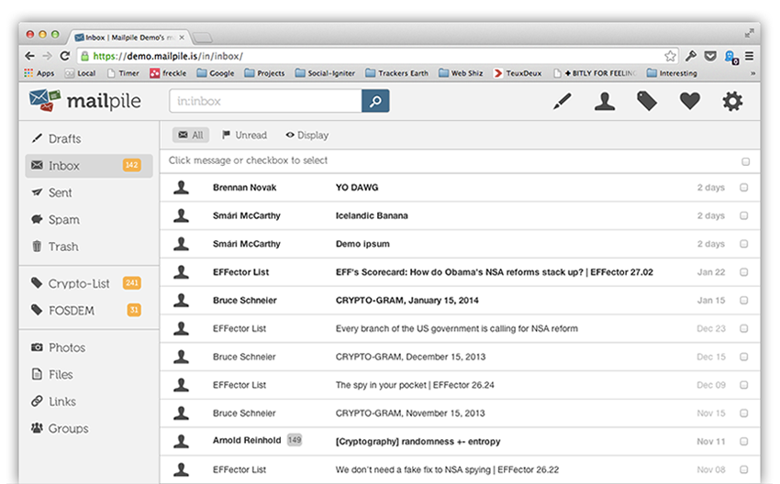
Notes:
But the most important single project I am involved in right now is Mailpile. It is a slightly less than humble attempt to take back e-mail. Mailpile is a web-based e-mail client that is free software. You can run it on your laptop, on your VPS, or on your Raspberry PI. You can store it in the cloud or on your person. It is written in Python – at last count, it is 14.000 lines of code. This includes an incredibly fast search engine, a Bayesian spam filter, a powerful tagging system, contact management, and much more. It is not ready yet. We launched the Alpha version two weeks ago now. Version 1.0 is due at the end of this summer.

Slide 53
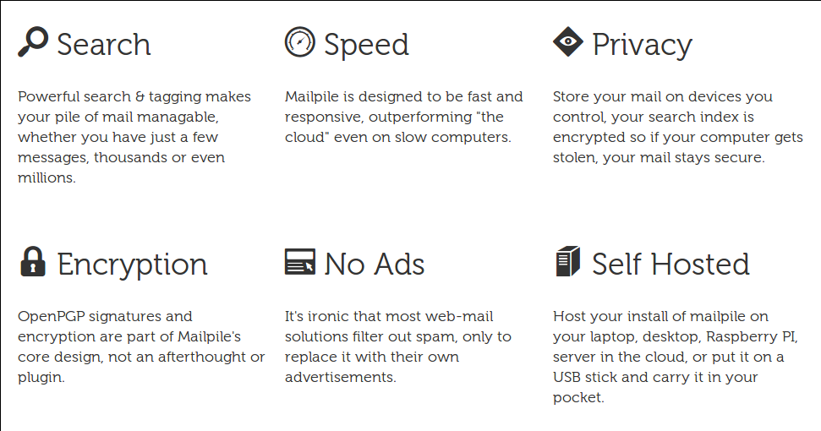
Notes:
When it is ready, we hope that it will serve as a new standard, while conforming with all of the old standards. Every file it will store, it will store encrypted. Every mail it will send, it will attempt to encrypt. It will be aggressive in proliferation of public keys, so as to give your interlocutors no excuse for not encrypting messages to you.

Slide 54

Notes:
I think Mailpile is exciting, but it is only one piece of the puzzle. Getting a hundred million people to use Mailpile will cause some lightening in the cloud cover, but it won't raise the cost of privacy violation to $10.000 per person per day. That will require much more effort. I propose Mailpile as the first $100 effort.

Slide 55
Help!
Thanks!
Notes:
I'd appreciate your assistance in helping us get the rest of the way.

