Slide 1

Halcyon
Building Custom Network Scans
Sanoop Thomas
@s4n7h0

Slide 2
Inspiration
Nmap – first infosec lessons
Started learning NSE
Wrote some NSEs
Seems difficult to write lengthy scripts

Slide 3
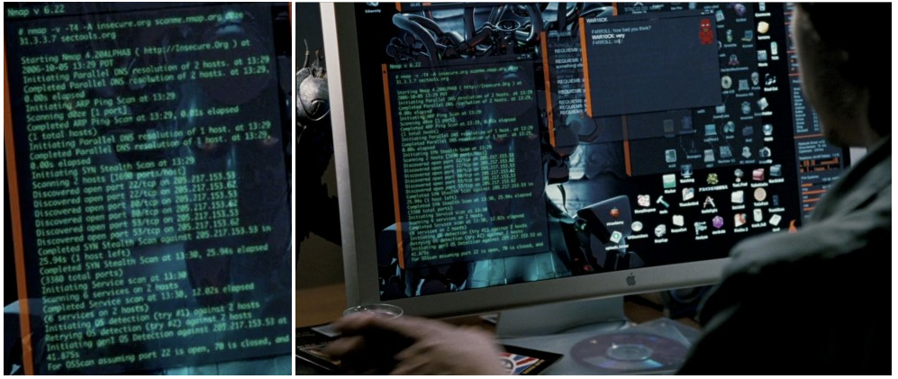
Nmap in Movies
http://nmap.org/movies/

Slide 4
Nmap Script Engine
Written in LUA
Very light weight language
Easy to learn and develop
Challenges while NSE writing
Response string parsing
Prototypes are documented nmap.org/nsedoc
Normally developed in traditional text editors

Slide 5
Halcyon
A Development Environment for NSE writing
Supports language intelligence
Features autocomplete code snippets
Easy debugging and code modification
After all, it’s a GUI
Available for free use
https://github.com/s4n7h0/Halcyon

Slide 6
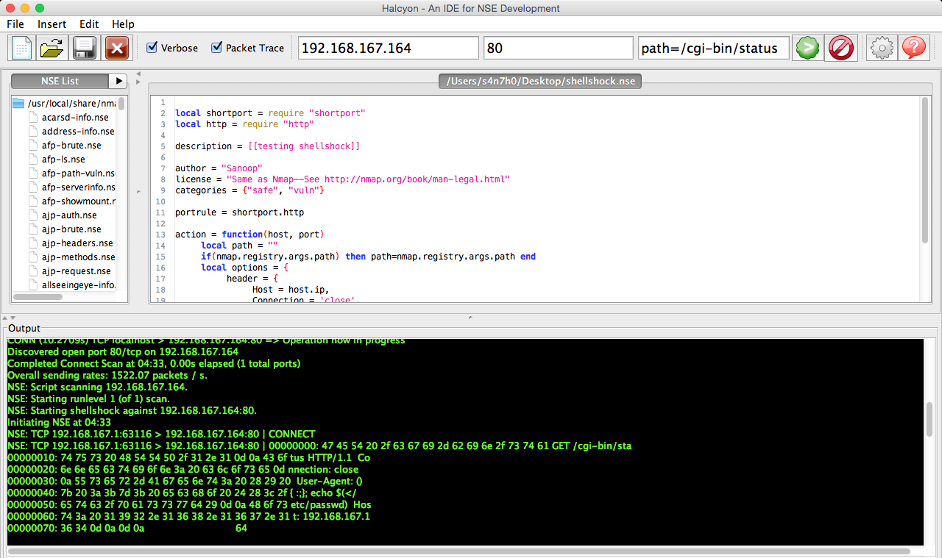

Slide 7
Let’s Explore

Slide 8
Thanks
Questions ?
Suggestions ?
Sanoop Thomas
@s4n7h0

