Slide 1
Executable Unpacking using Dynamic Binary Instrumentation
Shubham Bansal (iN3O)
Feb 2015
UndoPack
1
Notes:
1

Slide 2
Who am I ?
Under-graduate Student at IIIT-Hyderabad
Security Researcher
Currently pursuing B.Tech with honors in Computer Science
Regular CTF (Capture the Flag) player
Currently part of SegFault CTF team
Fields of interest – Reverse Engineering , Malware Analysis and Exploit Development
UndoPack
Notes:
2

Slide 3
What I did ?
Wrote a small CLI tool named Undopack to extract the packed code

Slide 4
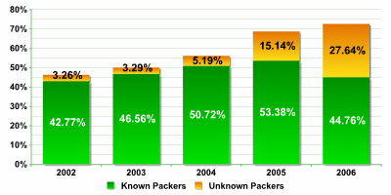
Motivation behind the tool
Code Packing is one of the most used technique to hinder the code analysis and its usage is still growing…

Slide 5
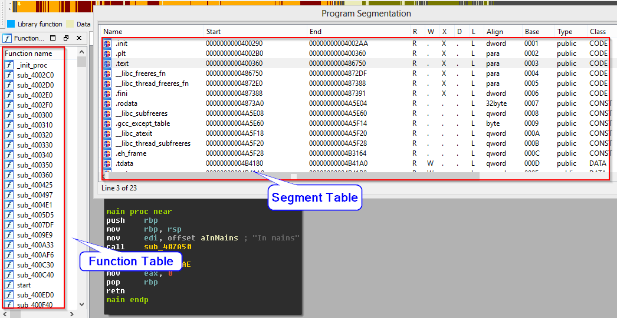
Original Binary

Slide 6
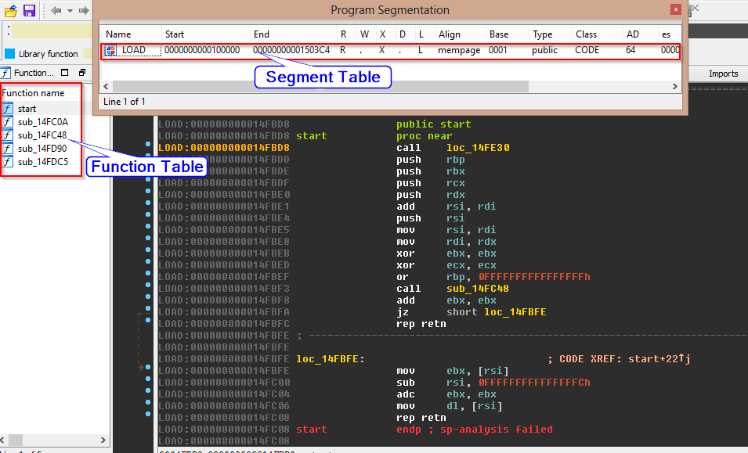
Packed Binary

Slide 7
Motivation behind the tool
No unpacking unless we know the packing algorithm
Common technique - Signature matching and Heuristics .
What if we don’t know the internal working of the packer?
What if we found an executable, packed with an unknown packer ?
Manual Unpacking
UndoPack
7

Slide 8

Undopack
Uses Intel’s - Dynamic binary instrumentation framework
Extracts multiple layers of packed code
Gives Original Entry point (OEP)
No additional information required
Different packers -- Same Extraction method
UndoPack
8

Slide 9
Why PIN ?
Best framework for Dynamic Binary Analysis
Works with both IA-32 and x86-64 ISA
Easy & Well documented API
Works in both windows and *nix systems
UndoPack
9

Slide 10
Key Assumptions
At certain point , Original hidden code will be present in the memory and get executed
Instruction pointer will jump to OEP of the restored code at each layer of unpacking
UndoPack
10

Slide 11
Approach
Instrument memory write instructions
Catch the transition point from restoration code to OEP of hidden code
Hidden Code and data are the newly written memory address
Written memory addresses are tracked using a very simple shadow memory implementation
Extract each layer of unpacked code for further analysis about the packer
UndoPack
11

Slide 12
System Design
Emulated Environment
Shadow Memory
Extraction Engine
UndoPack
12

Slide 13
System Design
UndoPack

Slide 14
Emulated Environment
Provided by Intel’s Framework
Instrument memory write instructions and build Shadow memory
Instrument execution flow changing instructions to catch transition point
Provides isolation between the extraction engine and the malicious program under analysis.
UndoPack

Slide 15
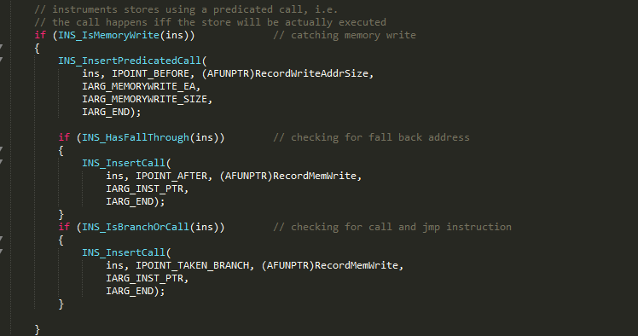
‘s implementation for instrumenting memory write instructions
UndoPack

Slide 16
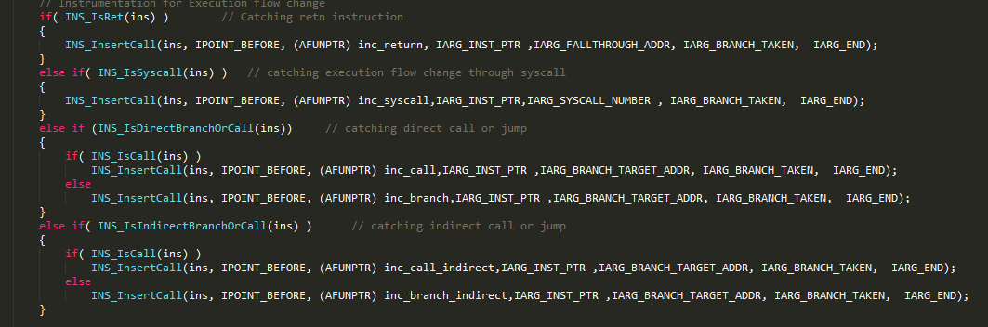
‘s implementation for instrumenting execution flow changing instructions
UndoPack
16

Slide 17
Shadow Memory
Technique used to track and store information on computer memory read/written by program during its execution.
Shadow memory consists of shadow bytes/bit that map to individual bits or one or more bytes in main memory.
Newly written memory addresses are mapped as dirty(1) and others as clean(0) in shadow memory.
UndoPack
17

Slide 18
Shadow Memory
UndoPack
18

Slide 19
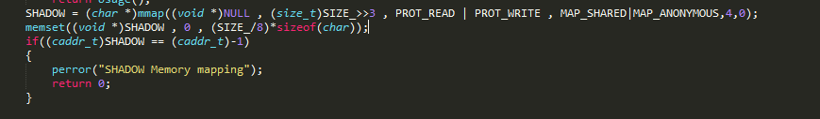
Extraction Engine
Initializes the whole shadow memory with clean bit(0)
UndoPack
19

Slide 20
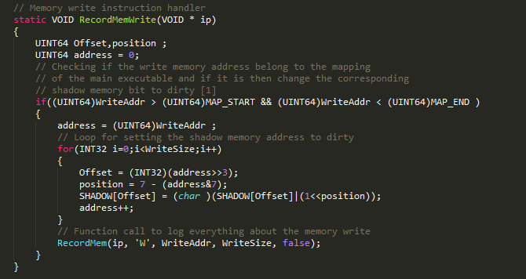
Every write at some particular address in program memory changes the corresponding bit in shadow memory to dirty(1)
UndoPack
20

Slide 21
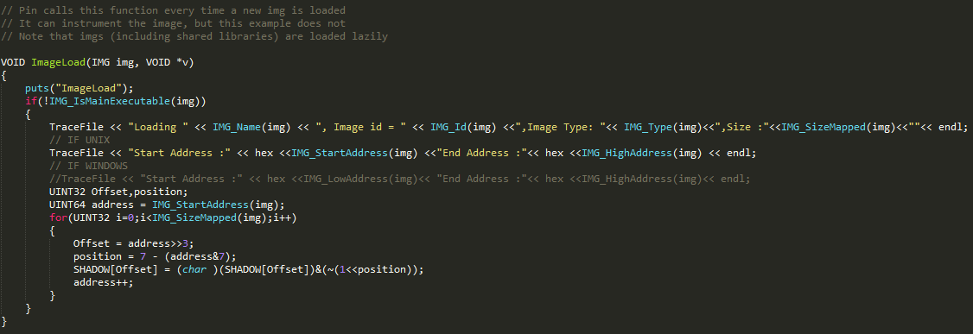
Each time a dynamic linked library is loaded into the program memory, we set the corresponding shadow memory to clean(0)
UndoPack
21

Slide 22
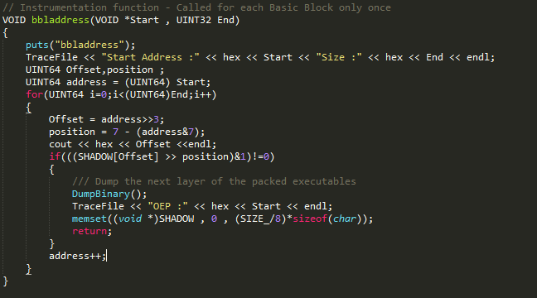
At the end of each Basic block, check if there is any dirty memory location present within the region covering the basic block.
UndoPack
22

Slide 23
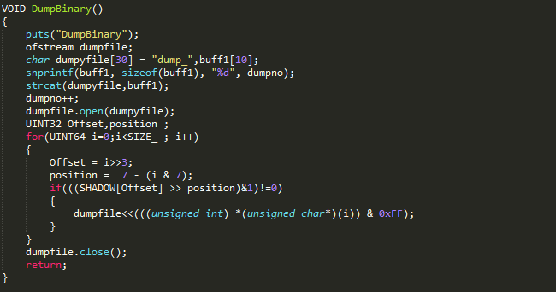
If it is then dumps the whole dirty memory address range which represents the next layer of packing and again initialises the shadow memory to clean(0)
UndoPack
23

Slide 24
Undopack on GitHub
https://github.com/3SLabs/undopack

Slide 25
Credits
Special thanks to Abhisek Datta , 3S Labs
Thanks to Intel’s PIN framework

Slide 26
Questions ?
UndoPack
26

Slide 27
Thank you!!!
UndoPack
27

