Slide 1
Hunting and Decrypting Ghost Communications using Memory forensics

Slide 2
Who AM I
Monnappa KA
Info Security Investigator @ Cisco
Core Member of SecurityXploded
Focus on Threat Intelligence
Reverse Engineering, Malware Analysis, Memory Forensics
Email: monnappa22@gmail.com
Twitter: @monnappa22
Linkedin: http://in.linkedin.com/pub/monnappa-ka-grem-ceh/42/45a/1b8
Blog: http://malware-unplugged.blogspot.in

Slide 3
Contents
Ghost RAT Introduction
Network communications of Ghost RAT
Video Demo 1 – Understanding Network Traffic Pattern of Ghost RAT
Video Demo 2 – Decrypting the Communications of Ghost RAT
Video Demo 3– Hunting Ghost RAT using Memory Forensics
References
Q&A

Slide 4
GhostRat Introduction
RAT (Remote Access Trojan)
used in many APT/targeted attacks like "Gh0stnet" against Private Office of the Dalai Lama
used to attack large corporations in the oil and gas industry dubbed as "Operation Night Dragon"
When a host is infected with Gh0stRat, the malware collects the system information, encrypts the collected information and sends it to the C2 (command and control) server

Slide 5
Demo 1 Understanding Network Traffic Pattern of Gh0st RAT

Slide 6
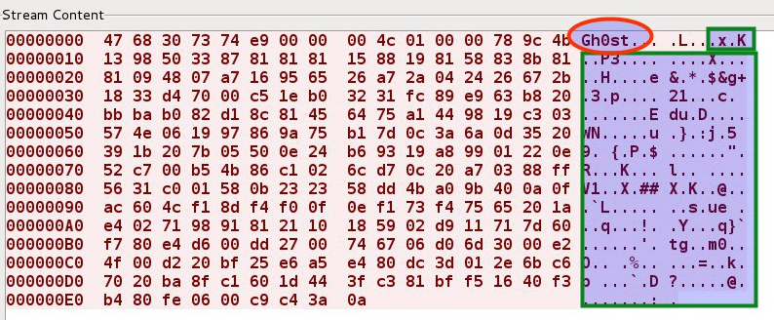
Network Communications of Gh0stRat
Traffic contains 13 byte header, the first 5 bytes (called the Magic header) is a keyword in clear text like 'Gh0st' and the rest of the bytes are encrypted using zlib compression algorithm

Slide 7
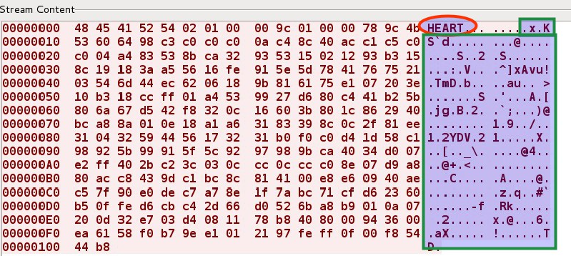
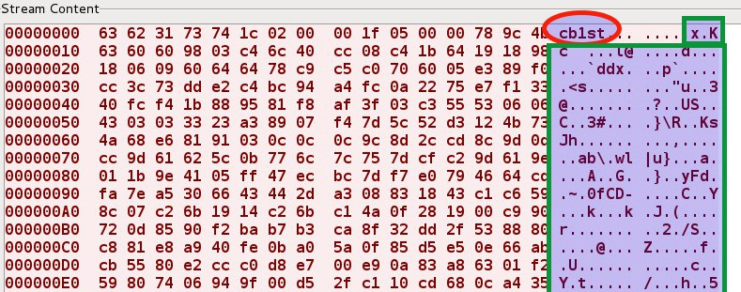
Network Communication of Different Gh0st Variant
Below screenshots shows variants of Gh0stRat using different magic headers

Slide 8
Demo 2 Decrypting the Communications of Gh0st RAT

Slide 9
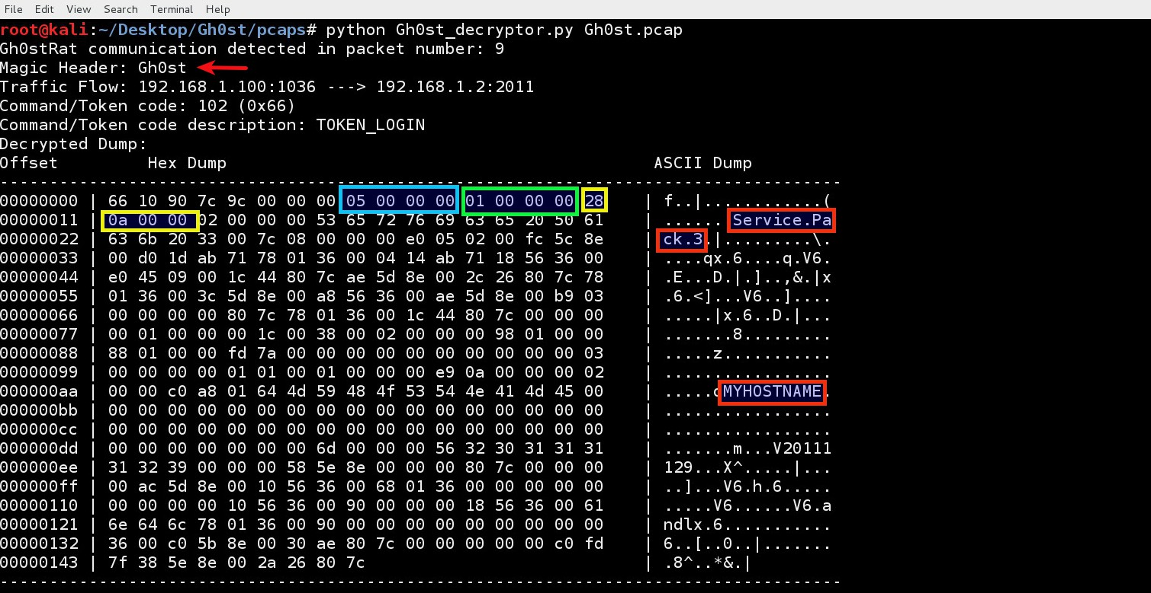
Decrypting the network communications of Gh0st
The malware sends the OS information and the hostname to the C2 server

Slide 10
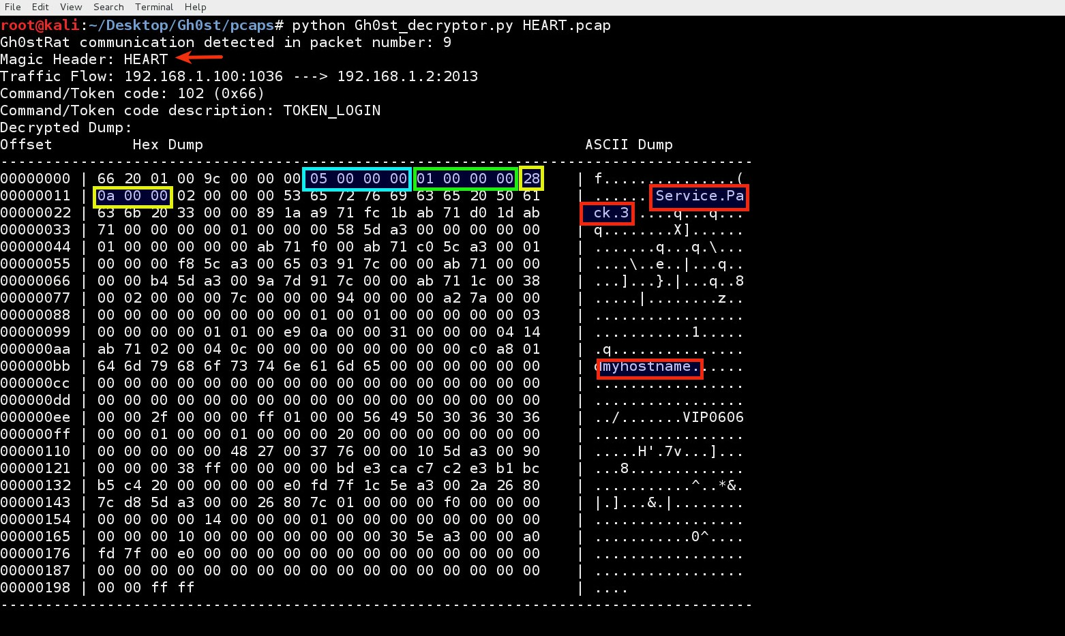
Decrypting the network communications of Gh0st variant (HEART)
The malware sends the OS information and the hostname to the C2 server

Slide 11
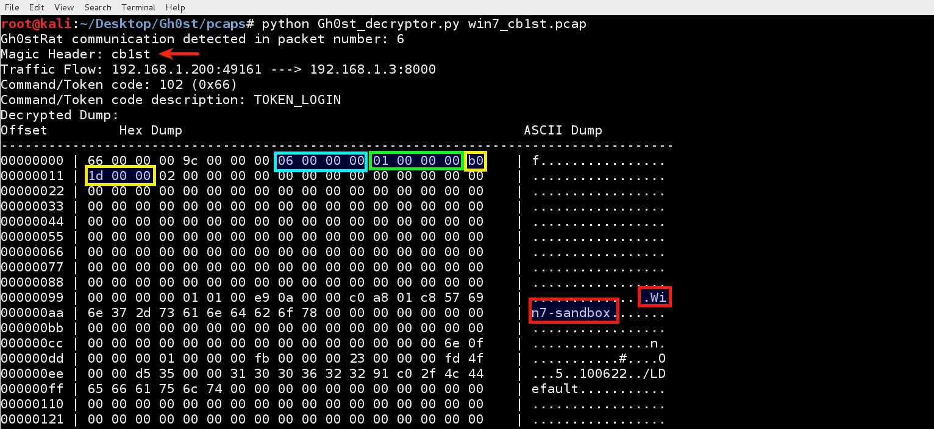
Decrypting the network communications of Gh0st variant (cb1st)
The malware sends the OS information and the hostname to the C2 server

Slide 12
Demo 3 Hunting Gh0st RAT using Memory Forensics

Slide 13
Why Volatility Plugin?
Organization might not have a full packet capture solution
It is not possible to trace back the malicious process even if the packet capture (pcap) is available
It is not possible to trace back the malicious DLL using the packet capture
Memory Forensics can help in overcoming above challenges.

Slide 14
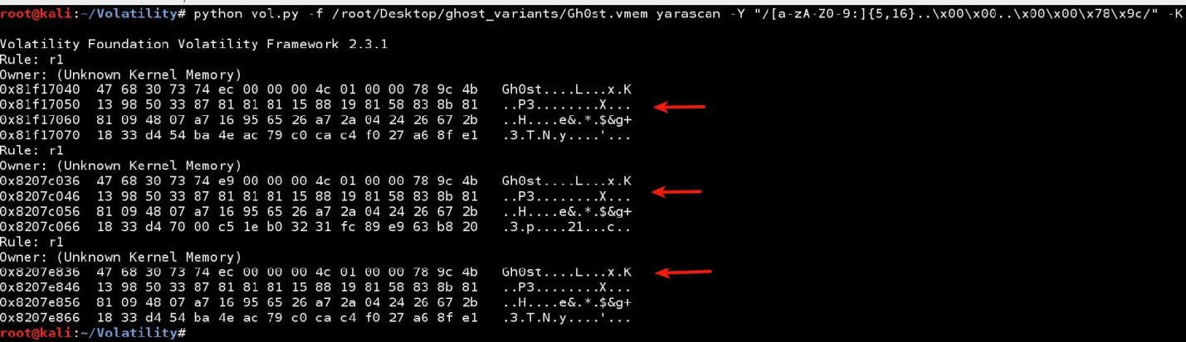
Detecting Gh0stRat manually using memory image
Gh0stRat follows a pattern in its network communication which can be detected using the regular expression.
/[a-zA-z0-9:]{5,16}..\x00\x00..\x00\x00\x78\x9c/

Slide 15
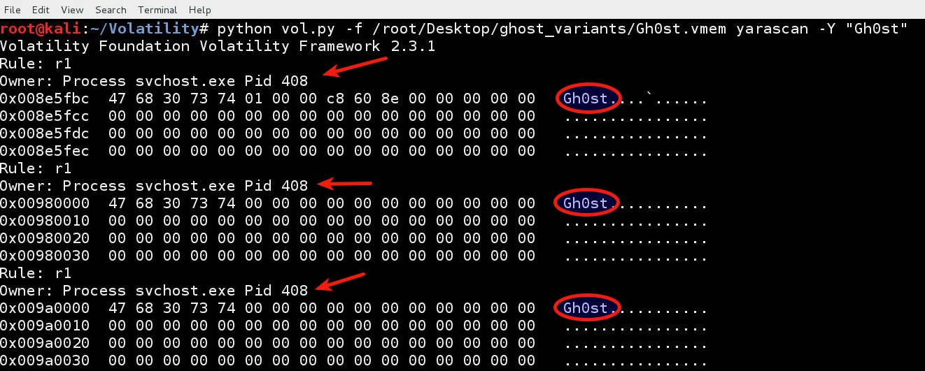
Detecting malicious Gh0stRat process
Once the magic header is determined the malicious process can be narrowed down. The below screenshot shows the process (svchost.exe with pid 408) which contains the magic keyword (Gh0st).

Slide 16
Automating Gh0stRat detection using Volatility plugin
I wrote a Volatility plugin (ghostrat), which automates the investigation process by:
Looking for the Gh0stRat network traffic pattern in kernel memory
Extracting the magic keyword from detected pattern and decrypting the communication.
Determining the malicious process by searching for the magic keyword in the user process memory
Determining the network connections made by the malicious process
Determine the DLL's loaded by the malicious process

Slide 17
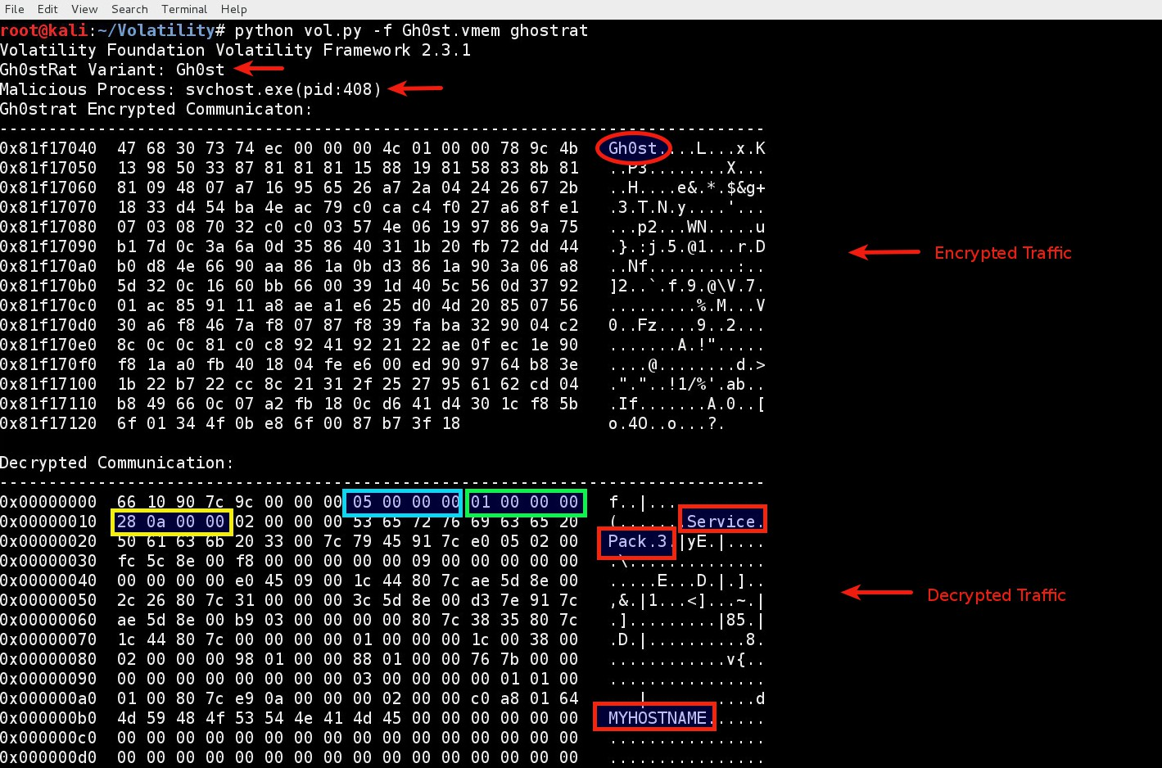
Gh0stRat plugin in action –First Sample

Slide 18
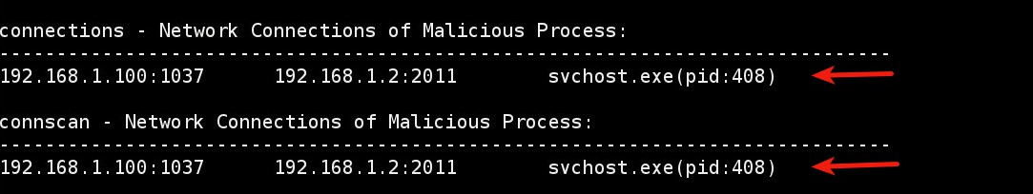
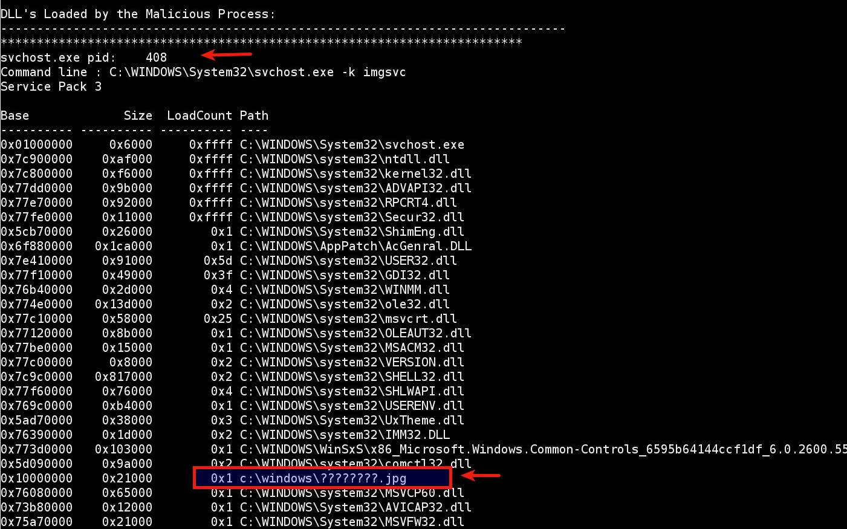
Gh0stRat plugin in action – First Sample (contd..)

Slide 19
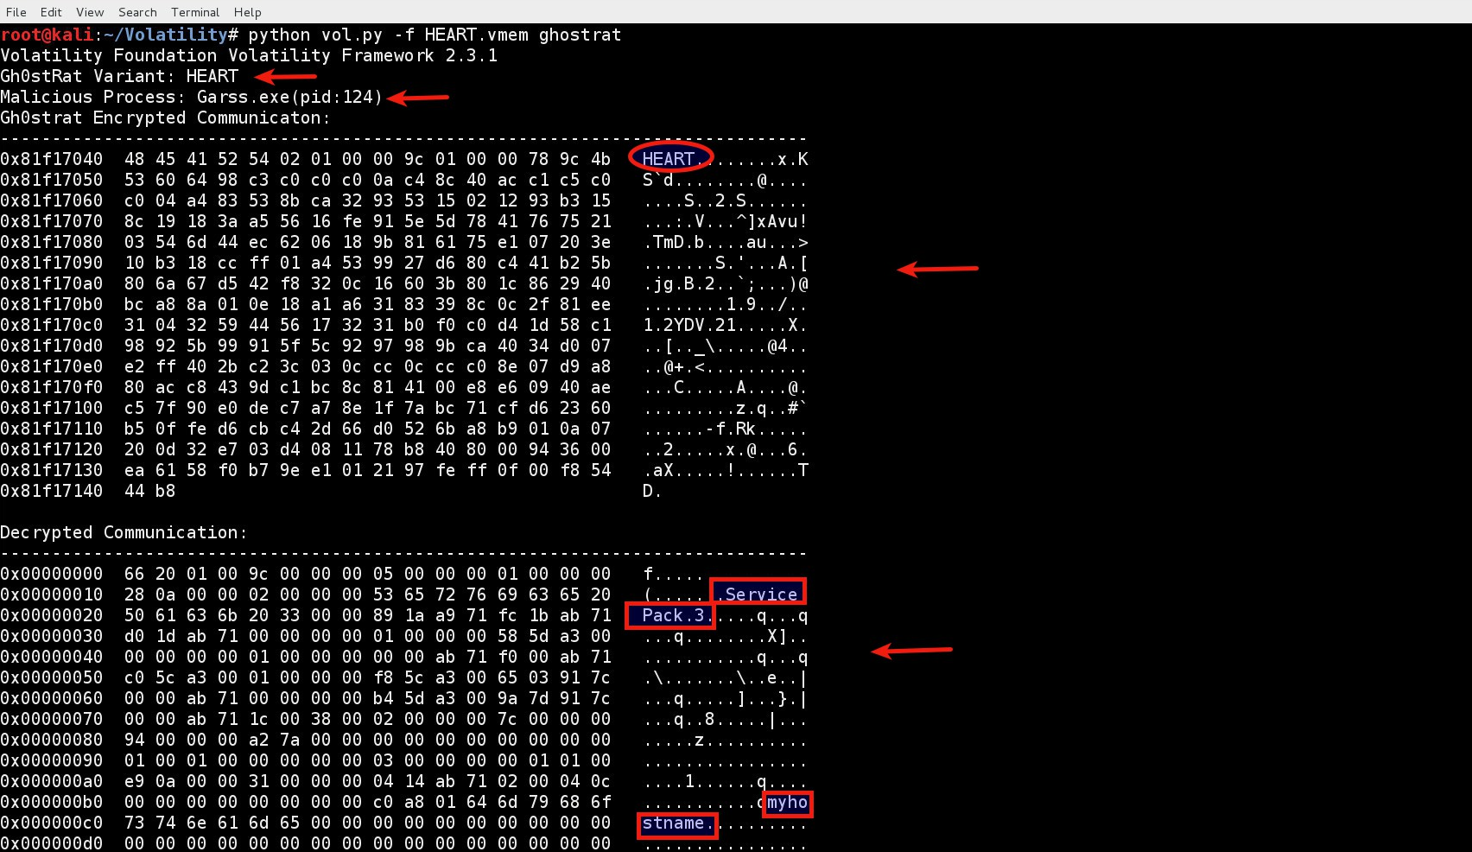
Gh0stRat plugin in action –Second Sample

Slide 20
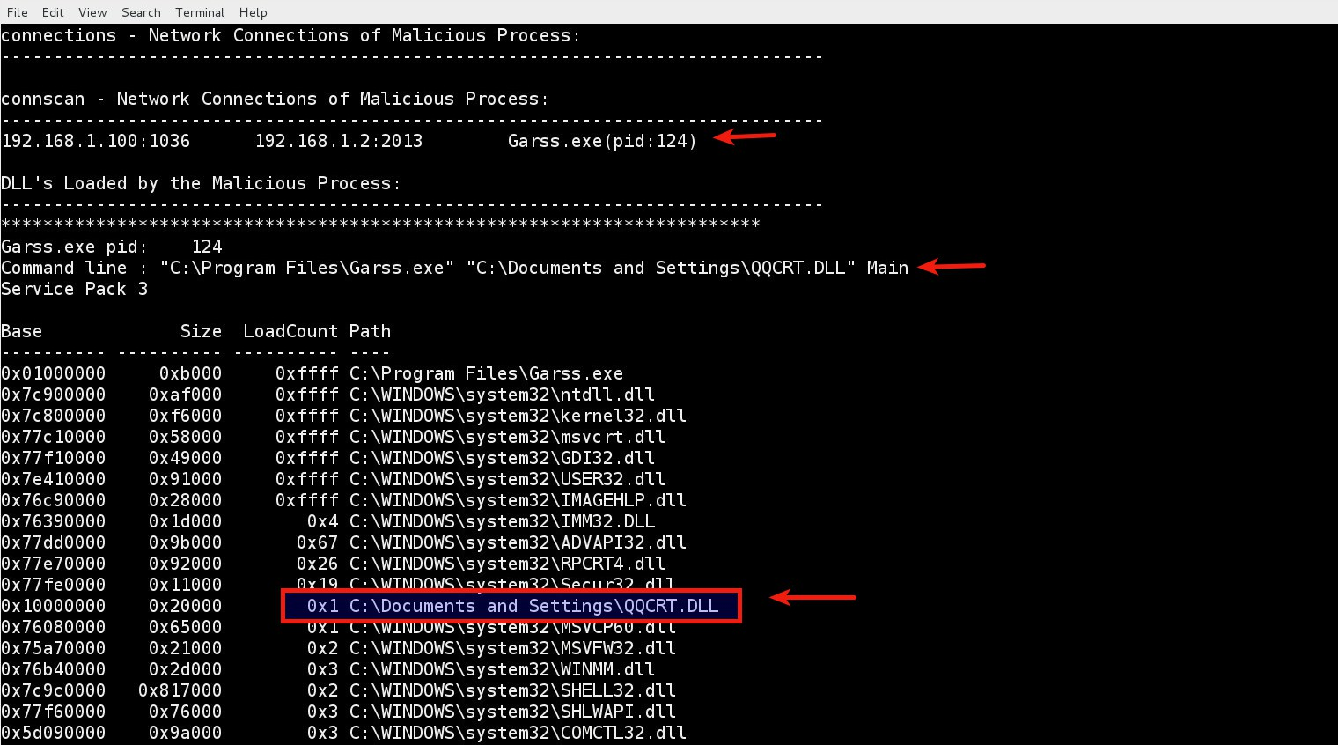
Gh0stRat plugin in action –Second Sample (contd.)

Slide 21
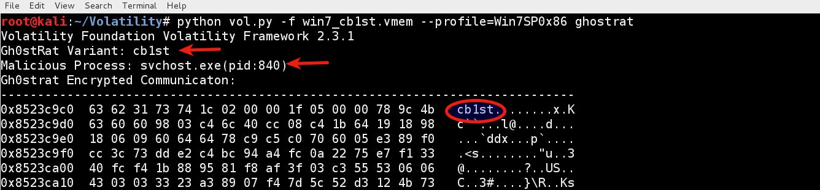
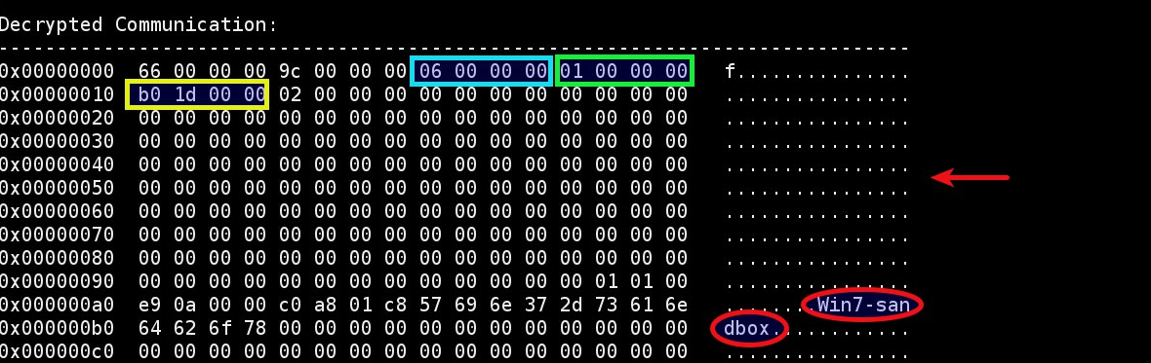
Gh0stRat plugin in action – Third Sample

Slide 22
Gh0stRat plugin in action –Third Sample (contd.)

Slide 23
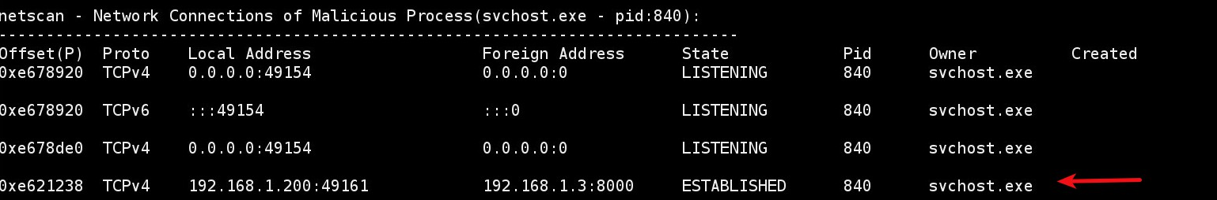
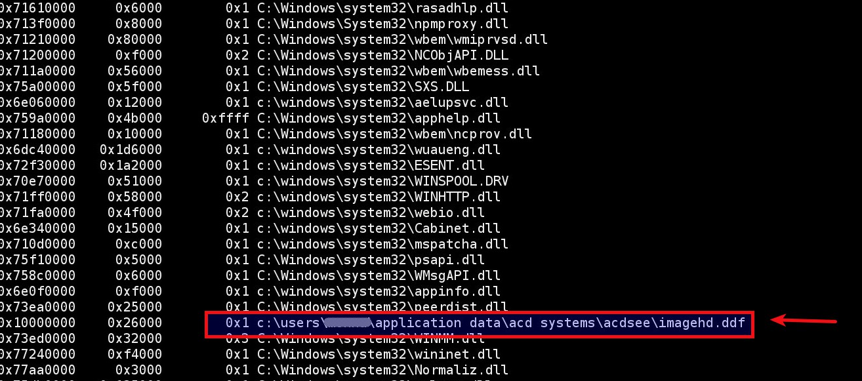
Gh0stRat plugin in action – Third Sample (contd.)

Slide 24
Special Thanks To
a) Michael Ligh (@iMHLv2)
b) Andrew Case (@attrc)
c) Jamie Levy (@gleeda)
d) Aaron Walters (@4tphi)

Slide 25
References
a) Hunting and Decrypting Communications of Gh0st RAT in Memory
http://malware-unplugged.blogspot.in/2015/01/hunting-and-decrypting-communications.html
b) 2014 Volatility Plugin Contest
http://www.volatilityfoundation.org/#!2014/cjpn
c) Ghost RAT Volatility Plugin Download
http://downloads.volatilityfoundation.org/contest/2014/MonnappaKa_Gh0stRat.zip
d) Tracking GhostNet
http://www.scribd.com/doc/13731776/Tracking-GhostNet-Investigating-a-Cyber-Espionage-Network
e) Know Your Digital Enemy
http://www.mcafee.com/in/resources/white-papers/foundstone/wp-know-your-digital-enemy.pdf

Slide 26

Q&A

Slide 27
Thank You

