Slide 1
ICS/SCADA Security
Analysis of a Beckhoff CX5020 PLC
Hans Hoefken

Slide 2

About
Gregor Bonney
Master Student at Aachen University of Applied Sciences (FH Aachen)
Hans Hoefken
Research Assistant at FH Aachen
Electrical Engineer, Ethical hacking, Pentesting
Benedickt Paffen
Master Student at Aachen University of Applied Sciences (FH Aachen)
Marko Schuba
Professor at FH Aachen
IT-Security, IT-Forensics

Slide 3
Agenda
Introduction
Structure SCADA System
Beckhoff CX 5020
TwinCAT
Automation Device Specification (ADS)
Security Investigation
Possible Attacks
Advisory for Suppliers

Slide 4
Introduction
globalization of business
growing number of decentralized companies
Industrial Control Systems (ICS) have to be network- and internet-enabled
essential part of ICS are SCADA systems
Supervisory Control and Data Acquisition
there are known attacks
number of attacks is growing

Slide 5
CIA vs. AIC
IT Security
confidentiality, integrity, availability
SCADA
availability, integrity, confidentiality

Slide 6
Design and Structure of a SCADA system
ERP
MES
SCADA
PLC/RTU
Sensor/Actuator
Enterprise Resource Planning
Manufacturing Execution System
Supervisory Control and Data Acquisition
Programmable Logic Controller
planning
retrieve data

Slide 7
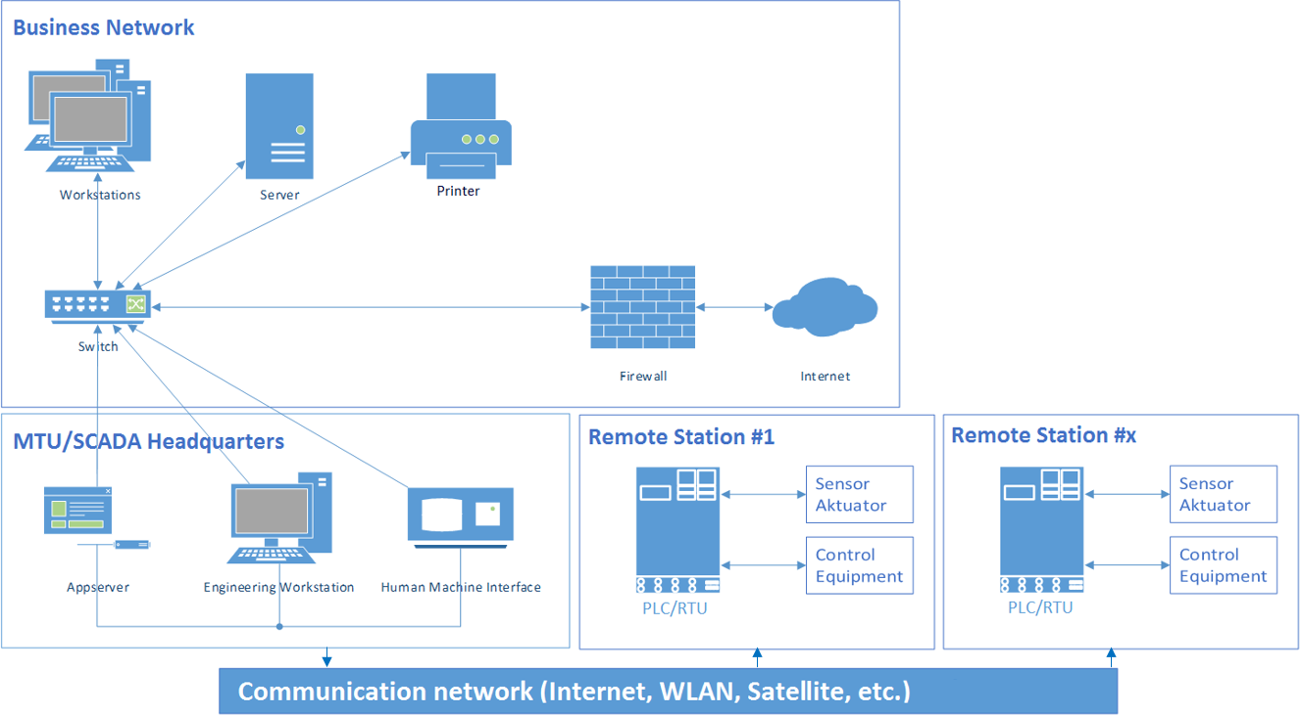
Design and Structure of a SCADA system

Slide 8
Security of SCADA devices
not engineered with security in mind
not engineered with remote connections in mind
many are 15 years and older
new devices have built-in security, BUT…
Beckhoff: 90% older systems in the field

Slide 9
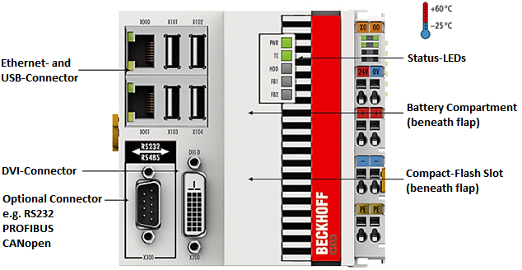
CX5020 – Brief overview
embedded PC
Dual Core Atom processor
1 GB RAM
flashcard serving as persistent memory

Slide 10
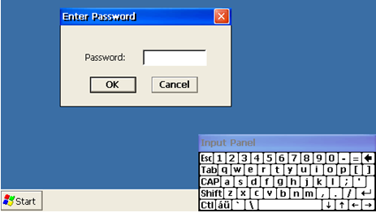
Operating system
customized Windows CE 6.0
keyboard and mouse
login password possible

Slide 11
TwinCAT Devices
every device has a unique ADS-NetID
enhancement of an IP address
e.g. 192.168.1.100.1.1
for communication between devices a route needs to be established
ADS packets will be transported over TCP Port 48898 and UDP Port 48899
ADS-NetID
Transport-Address
Hostname
192.168.2.100.1.1
192.168.2.100
Device1

Slide 12
Automation Device Specification
proprietary protocol from Beckhoff
used by TwinCAT (Management System)
optimized for throughput
encapsulated in TCP/IP
or serial connections
no encryption
authorization

Slide 13
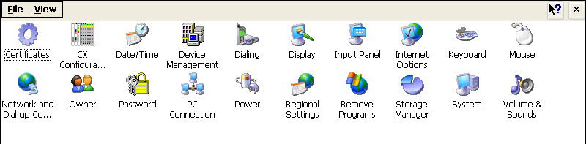
System Control on CX5020
important Control Software
CX Configuration Tool (FTP, VPN)
Network and Dial-up Connection (IP)
Password

Slide 14
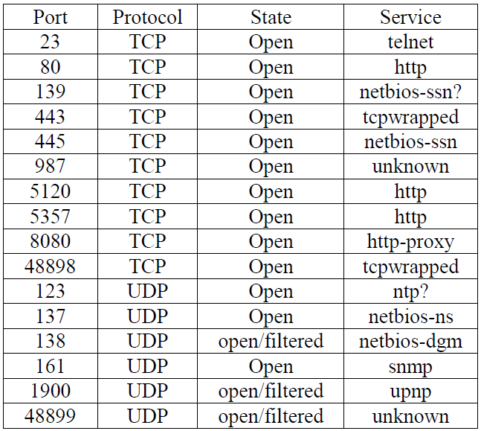
Security Analysis Results
nmap scan
16 open ports
well known
unknown services
48898 and 48899
maintenance
might be open in firewall

Slide 15
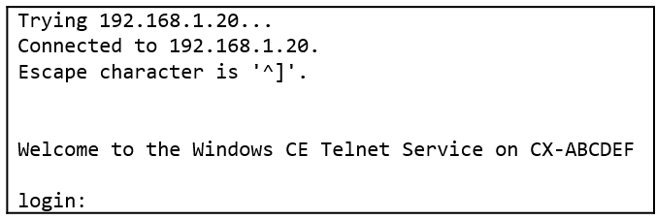
Telnet
enabled by default
greeting phrase at start of the connection
Welcome to Windows CE 6.0 Telnet service on CX-ABCDEF
CX-ABCDEF is the hostname of the device (MAC in ASCII)
default username/password
webguest/1
Windows CE 6.0 is a single user system
all accounts get full administration privileges
is able to create new accounts (CxAddUser)

Slide 16
Webserver
index file
Welcome to BECKHOFF CE device
special URL for administration interface
supports virtual directories
exports different hard disk paths
special URL for administration interface
<ip>:5120/config

Slide 17
Webserver: Virtual Directory
/remoteadmin
Microsoft’s Windows CE remote management tool
not documented in Beckhoff’s manual
activated and not preconfigured
on first visit
set a password
gives full control
network, time, file, and print server settings

Slide 18
CE Remote Display
remote desktop service for Windows CE
listens on TCP port 987
connection requires password
connection setup transmitted in plaintext
attackable via ARP-Spoofing (mitm)
authenticated user has full control

Slide 19
SCADA Service
Automation Device Specification (ADS)
proprietary protocol
TwinCAT System Manager
controls PLCs
discover PLCs
transmit programs to PLCs

Slide 20
Test Setup
EtherCAT
TCP/IP

Slide 21
ADS Search for Devices

Slide 22
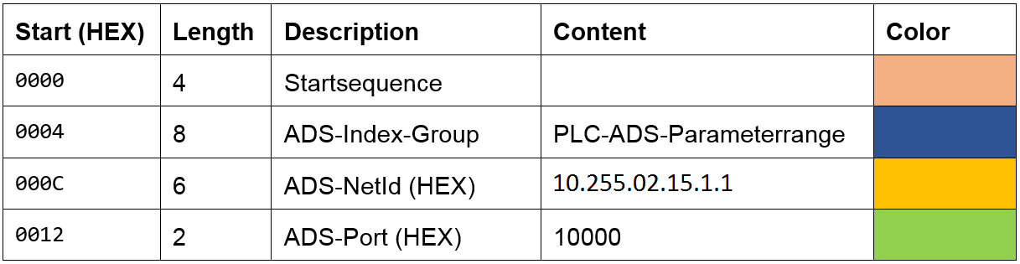
Search Devices
UDP Broadcast
can also be sent to a dedicated IP
the ADS-NetID can be random

Slide 23
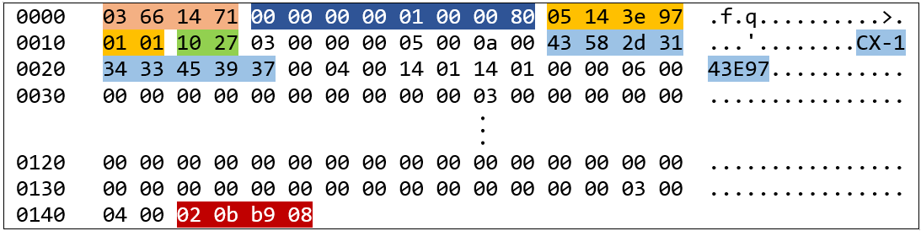
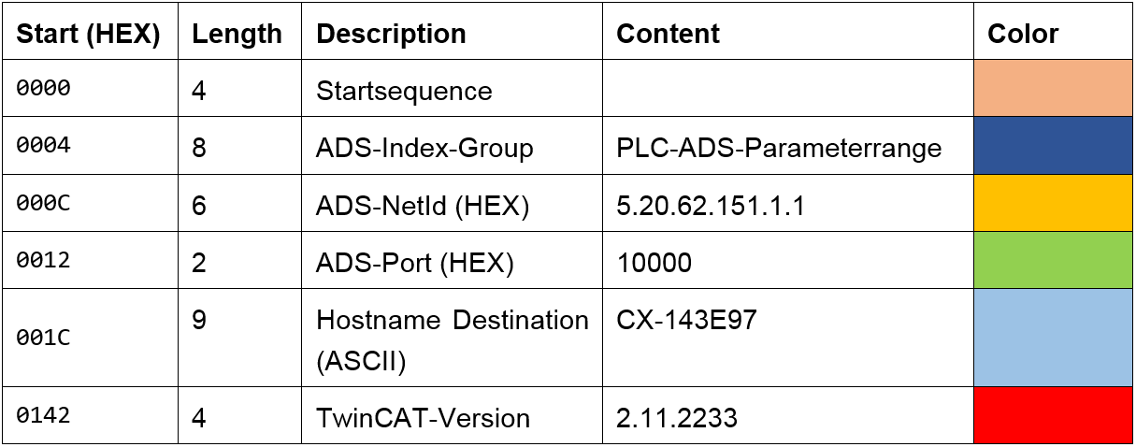
Response
PLC answers with its own ADS NetID

Slide 24
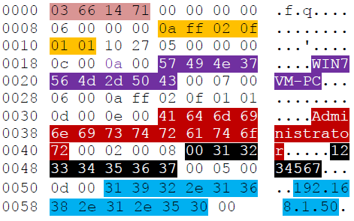
Creation of an ADS route
Source WIN7VM-PC
Destination CX5020 PLC
no encryption
username/password in plaintext
ADS packet header
ADS NetID
EWS hostname
Username
Password
EWS IP-Address

Slide 25
Login in to CX5020
if password is wrong
non zero error is returned (04 07)
if password is correct
zero error code is returend (00 00)
packets can easily be reverse engineered
attackers can create their own ADS route
Error code
Error code

Slide 26
Complete Message Flow

Slide 27
Possible Attacks
use of virtual directory /remoteadmin
after setting the initial password a new admin account is created
create a new VPN account
No blocking after too many wrong passwords
brute force/dictionary attack (UDP port 48899)
PCL answers very fast ☺
multiple connections in parallel possible
Python script achieved ~8000 pw/sec
Password allows full PLC control on port 987 & 48899

Slide 28
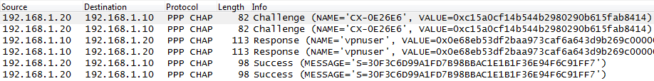
Possible Attacks
Attack on VPN connection
VPN connection to CX5020 with PPTP
authentication with mschapv2
mschapv2 is vulnerable
steps of the attack
mitm (with e.g. arpspoof)
sniff connection establishment

Slide 29
Possible Attacks
Attack on VPN connection
VPN connection to CX5020 with PPTP
authentication with mschapv2
mschapv2 is vulnerable
steps of the attack
mitm (with e.g. arpspoof)
sniff connection establishment
brute force crack (e.g. with asleap)

Slide 30
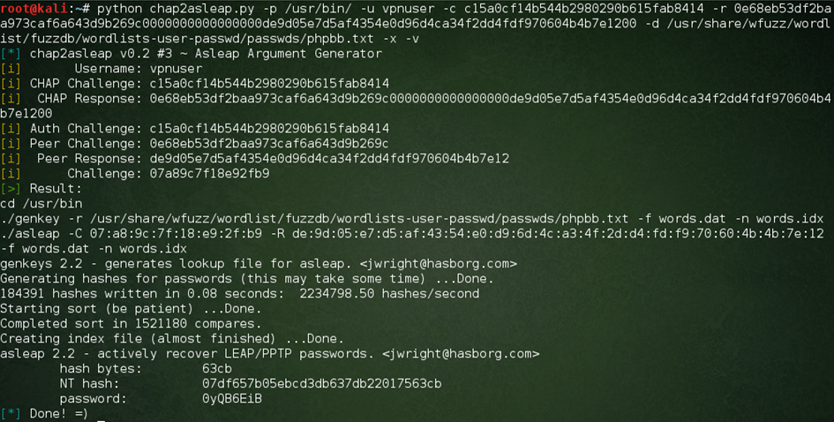
Attack mschapv2

Slide 31
Possible attacks
USB Port
WLAN adapter
built-in driver support for WLAN adapter with RT2501 chip
adapter is automatically connected
choose a WLAN
preconfigured registry entries are not used
after connection all PLC-services are accessible
bypass infrastructure firewalls (direct connection)

Slide 32
Advisory for Suppliers
disable /remoteadmin virtual directory
disable telnet by default
limit number of ADS packets per second
deliver the device with strong passwords
delete WLAN drivers (if not used)
use alternative VPN technology

Slide 33
Thank you!
Hans Hoefken
Aachen University of Applied Sciences
Germany
hoefken@fh-aachen.de

