Slide 1
Yuval Idan, Technical Director, APAC
Checkmarx
yuval.idan@checkmarx.com

Slide 2





About us
Founded in 2006
Enterprise Grade Application Security Solutions:
SAST | RASP | Application Security Education
Hundreds of Fortune 500 and SMB Customers
Fanatical support
Awards
“Leader” in the 2014 AST Wave
“Challenger “- 2014 AST Magic Quadrant & Only Vendor to score a perfect 5 in 2014 AST Critical Capabilities Report
Fastest Growing Security Company in Israel, 2014 Tech Fast 500
Red Herring EMEA Top 100 Winners

Slide 3
Warning Ahead: Security Storms are Brewing in Your JavaScript

Slide 4
About Me
Yuval Idan
Technical Director, APAC
Checkmarx
Notes:
Since we have visibility to a lot of customers data, and a lot of problems in JavaScript. And I am here to share it with you.

Slide 5

Agenda
Broken sandbox
Same old XSS becomes a monster
Watch out for your client side
“I know where you were last summer”
Notes:
exacerbate

Slide 6
HTML5 is booming
Report released in August 2013 has shown that 153 of the Fortune 500 U.S. companies already implemented HTML5 on their corporate websites.

Slide 7
Some of the additions in HTML5
WEB storage
WEB SQL database
Indexed DB
Application cache
Web workers
Web socket
CORS
Web messaging
Sandbox attribute
New HTTP headers
Server sent events
New and better semantic tags
New form types
Audio and video tags
Canvas
Inline SVG
New onevent attributes
Geolocation
New CSS selectors
New javascipt selectors
Custom data - attributes
Notes:
Explain each attribute concept

Slide 8
The
Sandbox Attribute

Slide 9
SOP Same Origin Policy
permits scripts running on pages originating from the same site based on combination of
scheme, hostname, and port number

Slide 10
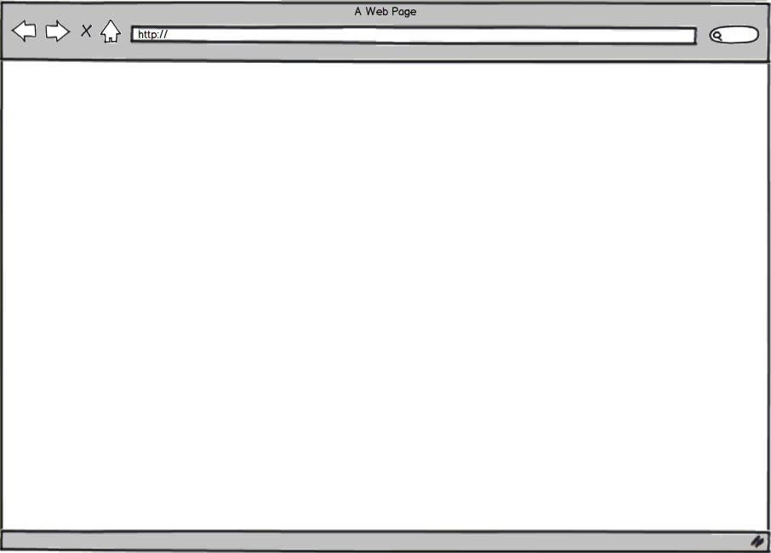

Same Origin Policy
main page
http://www.cnn.com/main
“Change background to green”
http://www.cnn.com/story1
Iframe
same origin

Slide 11
Same Origin Policy
main page
http://www.cnn.com/main
“Change background to green”
http://www.fox.com
Error!
Iframe
different origin

Slide 12
Markets
Recent trend - markets of extensions Salesforce.com, Microsoft 365, etc…
Extension is Javascript code written by a 3rd party but hosted and delivered from the very same server
So SOP doesn’t play well
Notes:
Additional reason for sand box invention

Slide 13
Sandbox concept
Sandbox concept?
Sandbox is a hardening of the basic SOP – so that any content running in the sandboxed iframe is treated as if it comes from a different origin, and it gives fine-grained control over what restrictions apply.

Slide 14
Sandbox syntax
Syntax
<iframe sandbox="value">
Attribute Values
Value | Description
"" | Applies all restrictions below
allow-same-origin | Allows the iframe content to be treated as being from the same origin as the containing document
allow-top-navigation | Allows the iframe content to navigate (load) content from the containing document
allow-forms | Allows form submission
allow-scripts | Allows script execution
Notes:
Let’s take a look at the granularity and what types of activities sandbox enables. Let’s look at the values, what it allows us. Even if you know it well let’s review it for the quize you are going to have at the end.

Slide 15

main page
http://www.server.com
http://www.server.com/iframe
Iframe / same origin
<script> alert(1) </script>
1

Slide 16
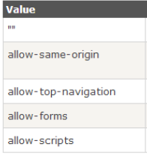
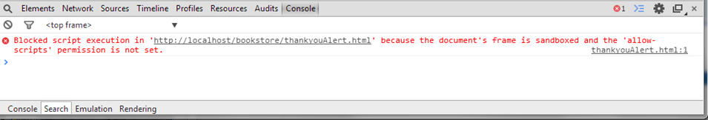
main page
http://www.server.com
http://www.server.com/iframe
Sandboxed Iframe
Default permissions
Same Origin
<script> alert(1) </script>

Slide 17
main page
http://www.server.com
http://www.server.com/iframe
Sandboxed Iframe
Allowing Scripts and SOP(Same Origin)
<script> alert(1) </script>
1

Slide 18
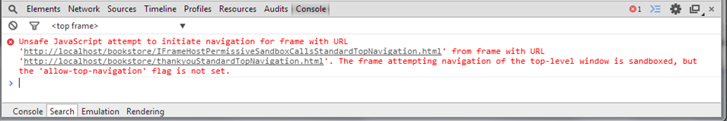
main page
http://www.server.com
http://www.server.com/iframe
Sandboxed Iframe
Allowing Scripts and SOP(Same Origin)
<script> top.navigate(…) </script>

Slide 19
main page
http://www.server.com
http://www.server.com/iframe
<script>
top.find(myself)
addPermission(myself, top_nav)
Refresh()
navigate(…)
</script>
Sandboxed Iframe
Allowing Scripts and SOP(Same Origin)
And
Top Navigation

Slide 20
main page
http://www.server.com
http://www.hacker.com
http://www.server.com/iframe
<script>
top.find(myself)
addPermission(myself, top_nav)
Refresh()
Navigate(http://www.hacker.com)
</script>
Sandboxed Iframe
Allowing Scripts and SOP(Same Origin)
And
Top Navigation
Notes:
Fix animation
Punchline: And with that we have defeded the whole concept of sandbox

Slide 21
Don’t just count on Sandbox!
Don’t assume that just because an iFrame is sandboxed, your code is secure.
What can you do?
Avoid granting a sandboxed iFrame with scripting and SOP capabilities.

Slide 22
How a single XSSed page
can be used to take
screenshots of other
non-XSSed page ?

Slide 23

Canvas Demo
Is the HTML5 element , used to draw graphics, on the fly, via scripting (usually JavaScript).

Slide 24
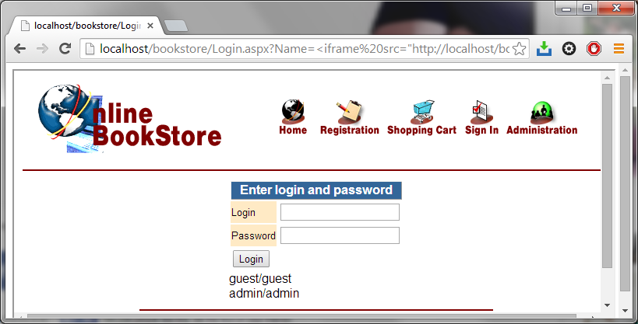
Monster XSS – Attack Steps
Step A – Use Bookstore project Login page vulnerable to Reflected XSS to embed itself in an iframe
    http://server/page.aspx?xss=<iframe src=“http://server/page.aspx”>
Iframe border
(left visible for demo purposes)

Slide 25
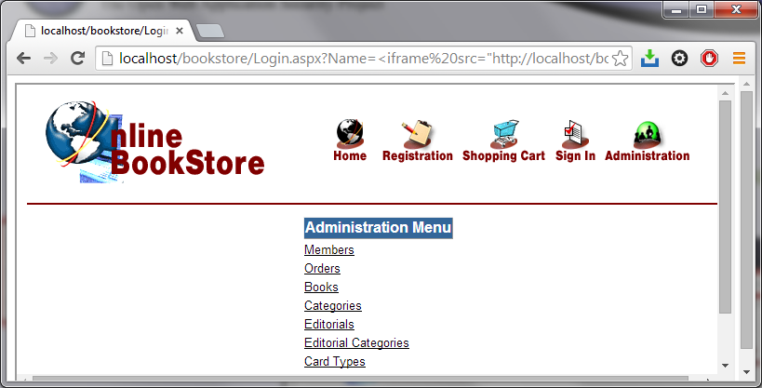
Monster XSS – Attack steps
Step B – The user logs in and browses the inside frame.
The outer page remains the same while it’s scripts can access the inner’s data
Iframe border
(left visible for demo purposes)
The user went to the admin page, but the URL is still the XSS’ed login page

Slide 26
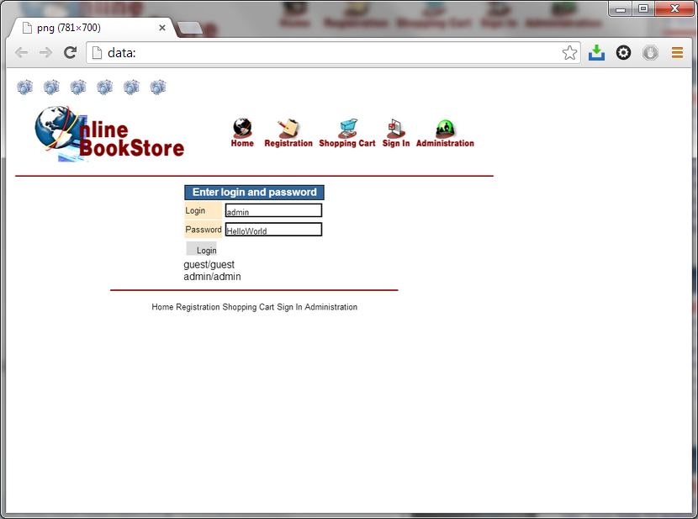
Monster XSS – The result
The attacker gets set of pictures representing all user activity( yes, including user name and password!)

Slide 27
Monster XSS – The technique
HTML5 introduced the concept of Canvas, which can be used to take screenshots
What is Canvas? (w3schools)
The HTML5 <canvas> element is used to draw graphics, on the fly, via scripting (usually JavaScript).

Slide 28
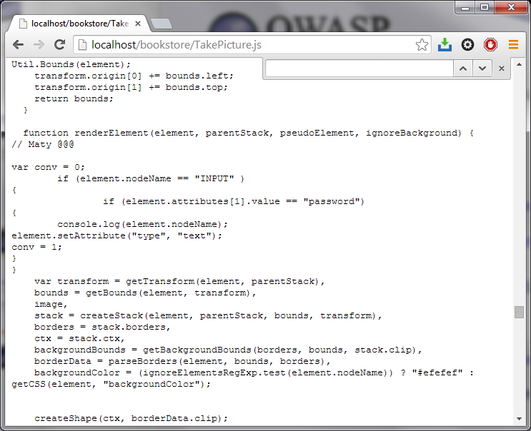
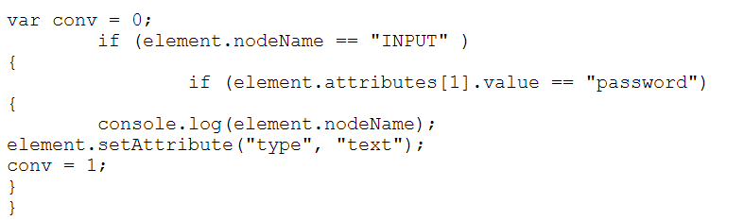
Monster XSS – The technique
Html2canvas - open-source script which builds screenshots based on DOM information.
We modify it a bit – to
reveal passwords
Notes:
s

Slide 29
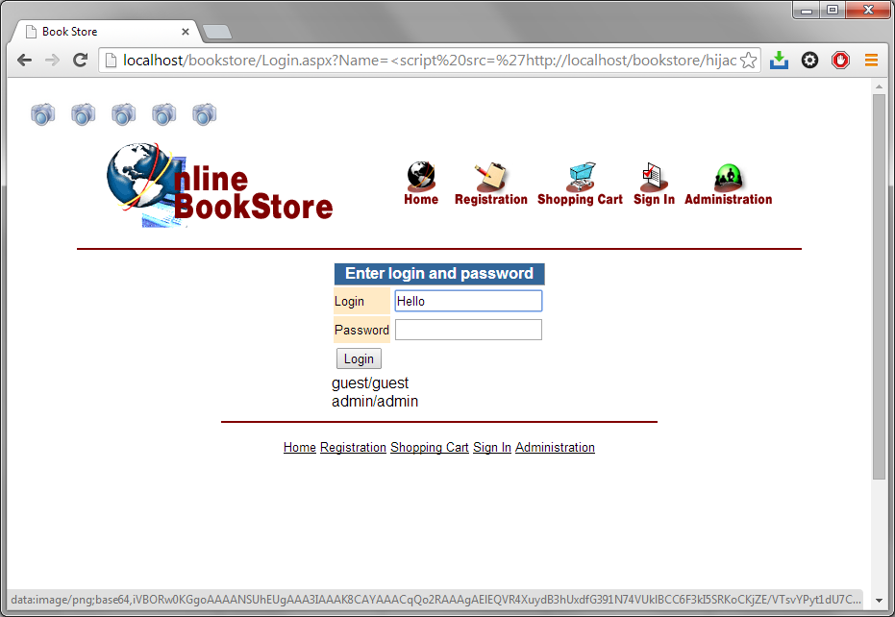
Monster XSS – The technique
Modified HTML2Canvas runs at the outer page and every 2 seconds takes screenshots of the iframe
XSS that takes
base64
screenshots

Slide 30
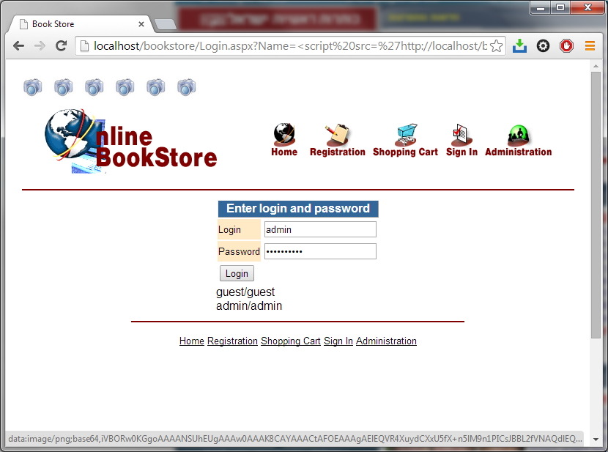
Monster XSS – The technique

Slide 31
New Tricks, Old Dog- hidden slide
Live
  Just an XSS
    http://localhost/bookstore/Login.aspx?name=<script>alert('hi')</script>
  Sticky
    http://localhost/bookstore/Login.aspx?Name=<iframe src="http://localhost/bookstore/login.aspx" width="100%" height="100%“>
  Now, we can use a component called HTML2Canvas to take screenshots
    http://localhost/bookstore/TakePicture.js
  This gives the following:
    http://localhost/bookstore/Login.aspx?Name=<script src='http://localhost/bookstore/hijackpage.js'></script>
  But we can further manipulate the component to even…. (Login page)

Slide 32
Monster XSS – bottom line
So, what can you do ?
Get rid of XSS!!!

Slide 33
WebSockets

Slide 34
Web Socket
WebSocket – allows persistent connection between the client and the server , when both parties can start sending data at any time.

Slide 35
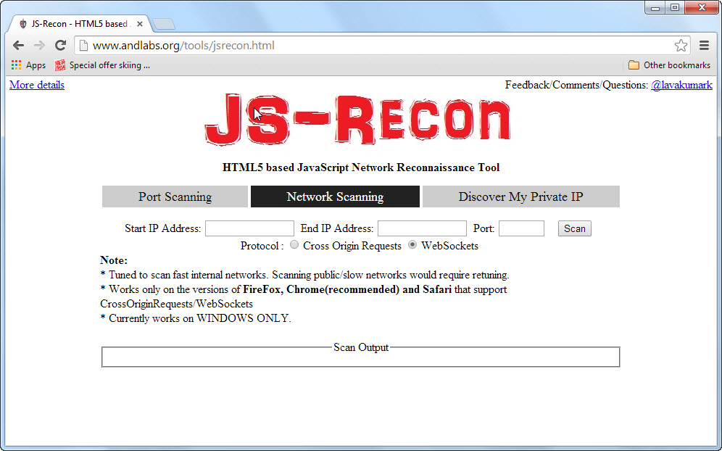
Super-charged XSS
    http://www.andlabs.org/tools/jsrecon.html

Slide 36





New Tricks, Old Dog
XSS can be used as an agent to map the structure of a network behind a firewall
Super-charged XSS
  Advanced port scanning (WebSockets)
    http://www.andlabs.org/tools/jsrecon.html

Slide 37
Websocket
  Fast and efficient network mapping process
  Firewall bypass into organization

Slide 38
Client-Side Business Logic

Slide 39
Pacman - winning the odds
Client site business logic helps to gain efficiency.
Efficiency brings along security costs

Slide 40
Pacman Demo

Slide 41
Pacman – recommendations
Don’t trust the client: validate user input
Do not ever store business logic on the client

Slide 42
GeoLocation

Slide 43
A Variant of Clickjacking
How to trick victims into turning on their PC cameras without them even realizing?

Slide 44
A Variant of Clickjaking
Demo
http://localhost/bookstore/k2.html

Slide 45
A Variant of Clickjaking
Against attacks focused on social engineering
There is only one solution
Awareness

Slide 46
Summary
HTML5 brings enhancements to Web development
…which comes with some great enhancements to security vulnerabilities

Slide 47
Demo

Slide 48
Thank You!
Yuval Idan | yuval.idan@checkmarx.com

