Slide 1

When the Sky is Falling
Network-Scale Mitigation of High-Volume
Reflection/Amplification DDoS Attacks

Slide 2
Introduction & Context

Slide 3
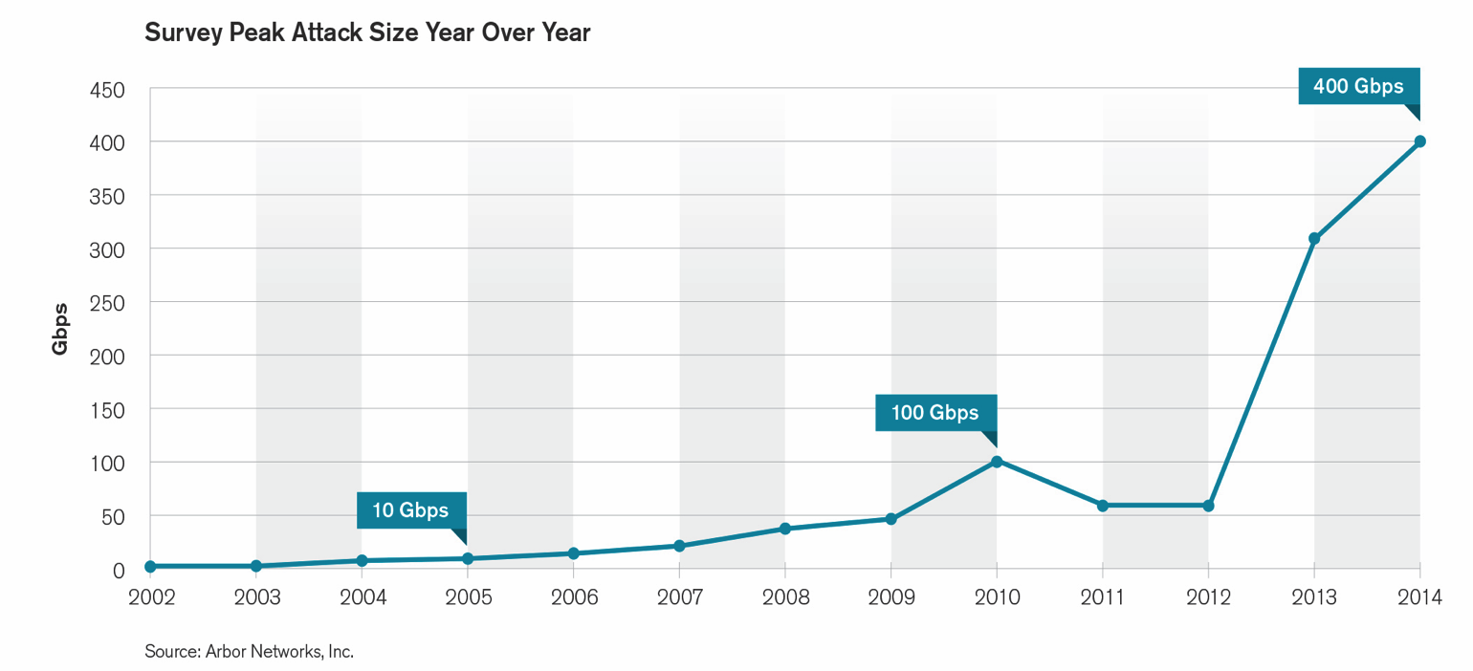
Substantial Growth in Largest Attacks
Largest reported attacks ranged from 400Gbps at the top end, through 300Gbps, 200Gbps and 170Gbps
Some saw multiple events above 100Gbps but only reported largest
Notes:
Continued year-on-year growth in peak reported attacks size.
The trend we saw in 2013 of attackers leverage large volumetric attacks to effectively ‘cut-off’ their targets from the Internet by saturating their Internet connectivity has continued and grown in 2014.
Plateaued between 2010 and 2012 at 100Gbps. 309Gbps last year. 400Gbps this year.
Ten years ago the first iteration of the WISR described peak attack sizes ranging from 5Gbps to 8Gbps. This represents 4,900 percent growth over that 10-year period, illustrating how the DDoS threat has escalated.
Also, as last year, multiple respondents reported very large events – some indicating that they had seen multiple event over the 100Gbps threshold. In fact almost 20 percent of respondents reported peak attack sizes over 50Gbps during this survey period.
Regarding the targets of the largest attacks nearly three-quarters of respondents saw their customers being hit — an increase from just under two-thirds last year. The proportion of respondents seeing infrastructure being the target has also stayed high at 15 percent, but is down from 20% last year. Ties in with anecdotal information.
All of the largest reported attacks used UDP traffic targeted at NTP, DNS, SNMP, HTTP or HTTPS ports — likely indicating the use of a reflection/amplification mechanism to generate the traffic.

Slide 4
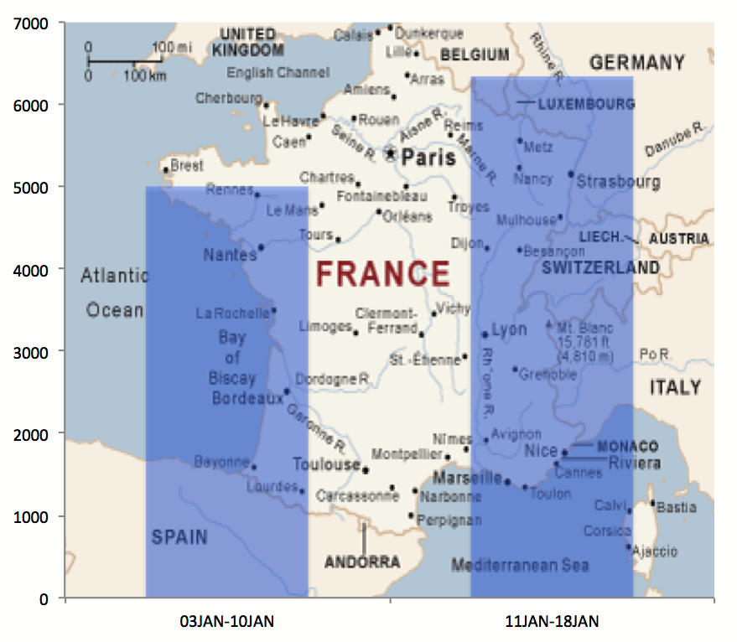
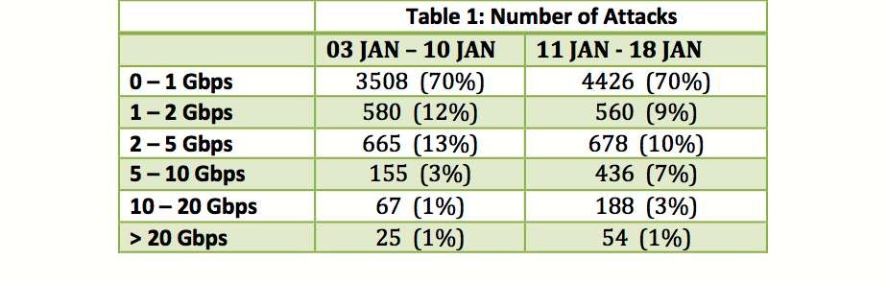
DDoS Attacks in the Wake of French Anti-terror Demonstrations
On January 15th, France’s chief information systems defense official, Adm. Arnaud Coustilliere, announced a sharp rise in online attacks against French web sites:
Notes:
An NTP amplification attack begins with a server controlled by an attacker on a network that allows source IP address spoofing (e.g., it does not follow BCP38). The attacker generates a large number of UDP packets spoofing the source IP address to make it appear the packets are coming from the intended target. These UDP packets are sent to Network Time Protocol servers (port 123) that support the MONLIST command.
If an NTP server has its list fully populated, the response to a MONLIST request will be 206-times larger than the request.
Check out openntpproject.org

Slide 5

Hong Kong Protest attack
11/20/2014 @ 10:40AM 23,072 views
The Largest Cyber Attack
In History Has Been Hitting
Hong Kong Sites
The distributed denial of service (DDoS) attacks have been carried out against independent news site Apple Daily and PopVote, which organised mock chief executive elections for Hong Kong. Now the content delivery network Cloudflare, which protects Apple Daily and PopVote, says the DDoS attacks have been unprecedented in scale, pounding the sites with junk traffic at a remarkable 500 gigabits per second.
“We’re seeing over 250 million DNS requests per second, which is probably on par with the total DNS requests for the entire Internet in a normal second,” said Prince.
Notes:
An NTP amplification attack begins with a server controlled by an attacker on a network that allows source IP address spoofing (e.g., it does not follow BCP38). The attacker generates a large number of UDP packets spoofing the source IP address to make it appear the packets are coming from the intended target. These UDP packets are sent to Network Time Protocol servers (port 123) that support the MONLIST command.
If an NTP server has its list fully populated, the response to a MONLIST request will be 206-times larger than the request.
Check out openntpproject.org

Slide 6
North Korea Goes Offline- SONY attack
12/22/2014
It was reported earlier today that North Korea was having Internet connectivity issues.
Given recent events involving Sony Pictures Entertainment (SPE), these reports are of particular interest.
Port Analysis
– All attacks on the 18th, 19th and 20th target port 80
– All attacks (except for one) on the 21st and 22nd target port 53 (DNS) from either port 123 or 1900 (indicating NTP or SSDP reflection amplification).
– – The one exception, the first attack on the 21st, was from 1900 to 80.
Peaks
Peak Attack Size (bps) = 5.97 Gbps on 12/20/14
Peak Attack Size (pps) = 1.70 Mpps on 12/20/14 (same attack)
Peak Duration: 55m 53s
Notes:
An NTP amplification attack begins with a server controlled by an attacker on a network that allows source IP address spoofing (e.g., it does not follow BCP38). The attacker generates a large number of UDP packets spoofing the source IP address to make it appear the packets are coming from the intended target. These UDP packets are sent to Network Time Protocol servers (port 123) that support the MONLIST command.
If an NTP server has its list fully populated, the response to a MONLIST request will be 206-times larger than the request.
Check out openntpproject.org

Slide 7
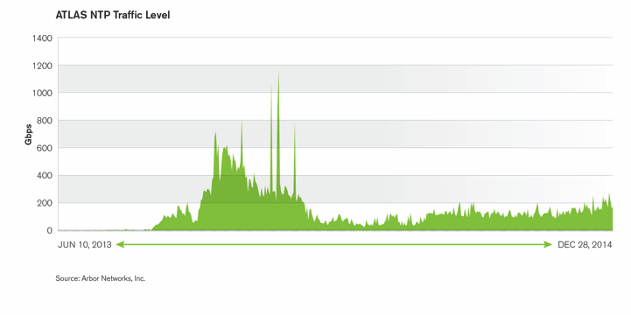
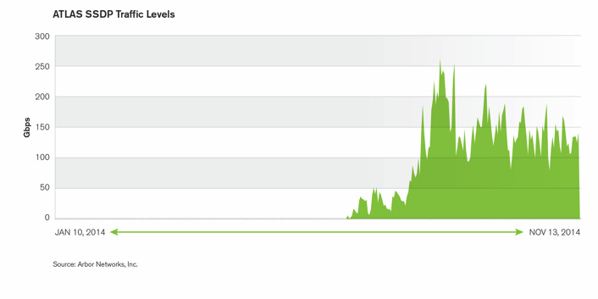
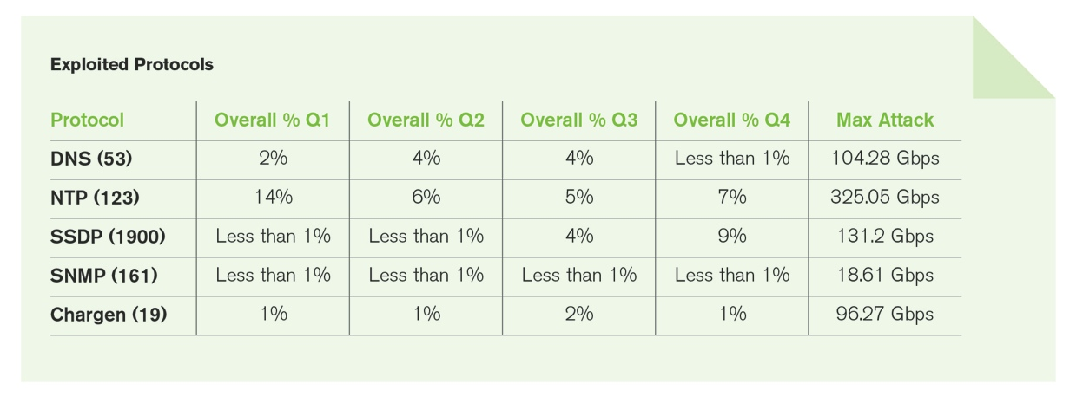
2014, A Time of Reflection…..
DNS has historically been the ‘leading’ protocol used for reflection amplification
NTP significant throughout 2014
93 attacks over 100Gbps, 5 over 200Gbps.
SSDP significant post Q3
25K attacks per month in Q4
Largest at 131Gbps
Other protocols still a concern
Notes:
DNS has historically been the protocol well know for use in reflection amplification attacks.
Although the use of NTP as a reflection/amplification attack vector is not new, the publicity around the attacks targeting various gaming operators in late 2013
— some of which focused on the attack vector itself — led to widespread adoption within the attacker community. Cybercriminals developed and shared attack tools; built capabilities into botnets; launched DDoS services that offered NTP reflection as an attack option; and made available lists of exploitable servers.
In 2014 we saw 93 NTP reflection attacks over 100Gbps and 5 over 200Gbps – but – that doesn’t tell the whole story. To illustrate how much of this there was we can look at how much traffic ATLAS monitored on the Internet as a whole – both good and bad traffic.
If we consider the October 2013 traffic level as our baseline, prior to the proliferation of NTP attacks, the average NTP traffic monitored for that month was 1.01Gbps cumulatively across all ATLAS participants. The average for February 2014 was 466.46Gbps, with March and April showing a gradual decrease (376.65Gbps and 298.89Gbps respectively). By October 2014, the level had decreased to an average of around 120Gbps, but this is still 100X the level monitored in October 2013. This growth is purely due to attack traffic.
Service providers put mechanisms in place to proactively deal with NTP, and thus DNS started to pick up again. And then in Q3 SSDP gained favor. Simple service discovery protocol is normally seen on home networks, not the Internet.
Prior to September we saw a handful of SSDP reflection attacks per month. In Q4 we saw more than 25K per month, the largest being 131Gbps targeting a destination in Sweden.
To further illustrate this, in June of this year, ATLAS monitored almost no SSDP traffic on the Internet. By October 2014, however, the average traffic level had risen to 150.42Gbps.
So this year we have seen NTP being used extensively at the start of the year to create the biggest burst of large volumetric attacks ever seen on the Internet. We have seen DNS continue to be used. And in Q4 we have seen the rise of SSDP usage. There are however other protocols that can be used, and some like chargen are – but not as extensively.
Given the latent capability that is out there it is highly likely that we will continue to see large attacks through 2015, maybe over the 0.5Tbps level.

Slide 8
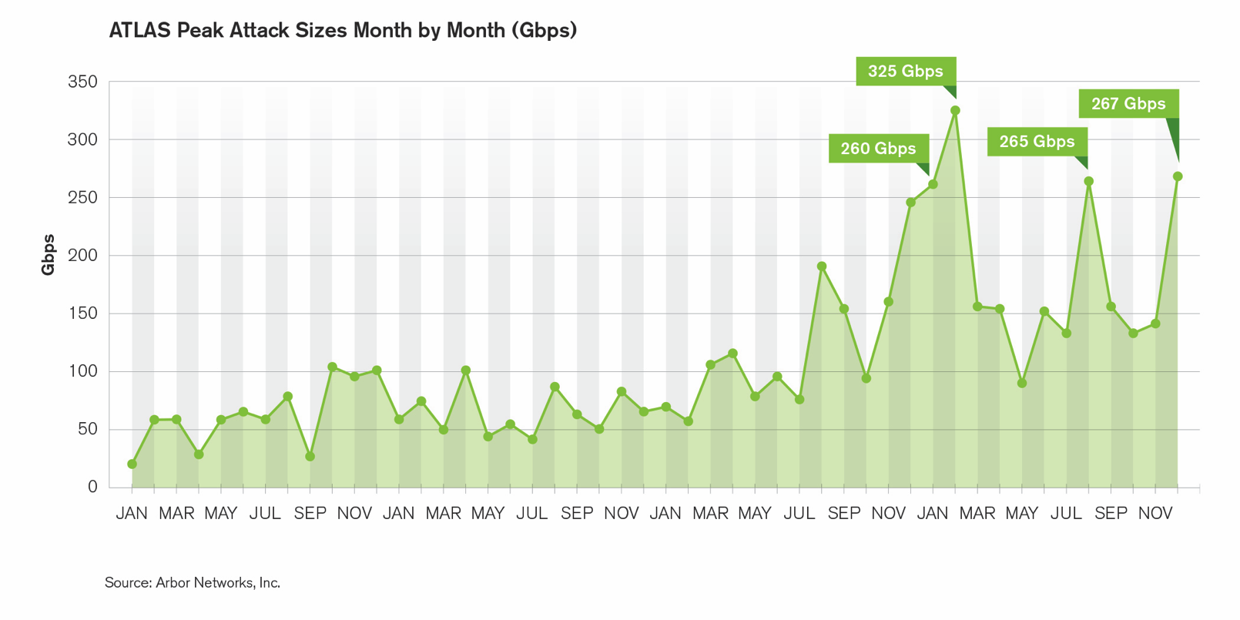
ATLAS – Unprecedented Flood of Attacks
Peak monitored attack at 325Gbps, up 32% on last year
Attacks larger than 2013 peak in January, February, August and December 2014
ATLAS also monitored more than 4x the number of attacks over 100Gbps in 2014, as compared to 2013
Notes:
ATLAS overview.
Peak monitored attack at 325Gbp – up 32% from last year – same growth level as in WISR responses.
Attacks larger than peak seen in 2013 seen in Jan, Feb, Aug and Dec 2014
In 2013, ATLAS recorded 39 attacks over the 100Gbps threshold. In 2014 we monitored 159 events– a more than four fold increase
The increased frequency and scale of large attacks and the continued use of varying reflection/amplification mechanisms to generate attack traffic are key concerns. Service providers need to scale their mitigation infrastructure and processes to deal with attacks of over 100Gbps

Slide 9
2014 ATLAS Initiative : Anonymous Stats, IN, APAC & WW
Contrasting IN and APAC with world-wide data
 | IN Average | APAC Average | World Average
Q3 | 1.24Gbps/468.74Kpps | 588.74Mbps/170.38Kpps | 858.98Mbps/238.35Kpps
Q4 | 1.66Gbps/483.33Kpps | 500.68Mbps/137.08Kpps | 843.98Mbps/260.17Kpps

Slide 10
2014 ATLAS Initiative : Anonymous Stats, IN, APAC & WW
Contrasting IN and APAC with world-wide data
Peak attacks show NTP reflection still prevalence this quarter.
 | IN Peak | APAC Peak | World Peak
Q3 | 98.89Gbps / 132.04Mpps NTP reflection attack to port 80, 31 min | 98.89Gbps / 26.44Mpps to India, NTP reflection attack to port 80, 31 min | 264.61Gbps / 98.93Mpps, UDP flooding to all ports, 1 hr 4 min
Q4 | 117.15Gbps / 31.26Mpps NTP reflection attack to port 22, 15 min 37 sec | 117.15Gbps/31.26Mpps to India, NTP reflection attack to port 22, 15 min | 267.21Gbps/27.21Mpps to Germany, UDP flooding to port 2398,2396, 7 min

Slide 11
2014 ATLAS Initiative : Anonymous Stats, IN
Other Protocols for Amplification
Given the huge storm of NTP reflection activity, there has been some focus on other protocols that can be used in this way.
Looking at attacks with source-ports of services used for reflection.
DNS has been used by attackers for several years.
Significant growth in attacks with source port 1900 (SSDP)
462 attacks in Q4 vs 64 in Q3
Exploited Protocol | % Q3 | Max attack Q3 | % Q4 | Max attack Q4
DNS (53) | 2.12 | 48Gbps | 1.80 | 9.5Gbps
NTP (123) | 2.83 | 98Gbps | 6.42 | 117Gbps
SSDP (1900) | 1.27 | 13Gbps | 6.65 | 34Gbps
Chargen (19) | 1.62 | 7Gbps | 5.49 | 15Gbps

Slide 12
Reflection/Amplification
DDoS Attacks

Slide 13
Evolution of Reflection/Amplification DDoS Attacks
Many varieties of reflection/amplification DDoS attacks have been observed ‘in the wild’ for 18 years or more.
Beginning in October of 2013, high-profile NTP reflection/amplification DDoS attacks were launched against various online gaming services.
With tens of millions of simultaneous users affected, these attacks were reported in the mainstream tech press.
But these attacks aren’t new – the largest observed DDoS attacks are all reflection/amplification attacks, and have been for years.
Reflection/amplification attacks require the ability to spoof the IP address of the intended target.
In most volumetric DDoS attacks, throughput (pps) is more important that bandwidth (bps). In most reflection/amplification DDoS attacks, bps is more important than pps – it fills the pipes!

Slide 14
Components of a Reflection/Amplification DDoS Attack
Amplification
Attacker makes a relatively small request that generates a significantly-larger response/reply. This is true of most (not all) server responses.
Reflection
Attacker sends spoofed requests to a large number of Internet connected devices, which reply to the requests. Using IP address spoofing, the ‘source’ address is set to the actual target of the attack, where all replies are sent. Many services can be exploited to act as reflectors.

Slide 15
Impact of Reflection/Amplification DDoS Attacks
Servers, services, applications, Internet access, et. al. on the target network overwhelmed and rendered unavailable by sheer traffic volume – tens or hundreds of gb/sec frequent.
Complete saturation of peering links/transit links of the target network.
Total or near-total saturation of peering links/transit links/core links of intermediate networks between the reflectors/amplifiers and the target network – including the networks of direct peers/transit providers of the target network
Widespread collateral damage – packet loss, delays, high latency for Internet traffic of uninvolved parties which simply happens to traverse networks saturated by these attacks.
Unavailability of servers/services/applications, Internet access for bystanders topologically proximate to the target network.

Slide 16






Effects of a 300gb/sec Reflection/Amplification DDoS Attack on Network Capacity
Peer A
IXP-W
Peer B
IXP-E
Peer D
Peer A
Peer B
Peer C
Mobile Infrastructure
Video, Music, Gaming etc.)
NOC

Slide 17
Effects of a 300gb/sec Reflection/Amplification DDoS Attack on Network Capacity
Peer A
IXP-W
Peer B
IXP-E
Peer D
Peer A
Peer B
Peer C
Mobile Infrastructure
Video, Music, Gaming etc.)
NOC

Slide 18
Effects of a 300gb/sec Reflection/Amplification DDoS Attack on Network Capacity
Peer A
IXP-W
Peer B
IXP-E
Peer D
Peer A
Peer B
Peer C
Mobile Infrastructure
Video, Music, Gaming etc.)
NOC

Slide 19
Effects of a 300gb/sec Reflection/Amplification DDoS Attack on Network Capacity
Peer A
IXP-W
Peer B
IXP-E
Peer D
Peer A
Peer B
Peer C
Mobile Infrastructure
Video, Music, Gaming etc.)
NOC

Slide 20
Effects of a 300gb/sec Reflection/Amplification DDoS Attack on Network Capacity
Peer A
IXP-W
Peer B
IXP-E
Peer D
Peer A
Peer B
Peer C
Mobile Infrastructure
Video, Music, Gaming etc.)
NOC

Slide 21
The Two Main Factors Which Make These Attacks Possible
Failure to deploy anti-spoofing mechanisms such as Unicast Reverse-Path Forwarding (uRPF), ACLs, DHCP Snooping & IP Source Guard, Cable IP Source Verify, ACLs, etc. on all edges of ISP and enterprise networks.
Misconfigured, abusable services running on servers, routers, switches, home CPE devices, etc.

Slide 22
The Two Main Factors Which Make These Attacks Possible
Failure to deploy anti-spoofing mechanisms such as Unicast Reverse-Path Forwarding (uRPF), ACLs, DHCP Snooping & IP Source Guard, Cable IP Source Verify, ACLs, etc. on all edges of ISP and enterprise networks.
Misconfigured, abusable services running on servers, routers, switches, home CPE devices, etc.

Slide 23
Additional Contributing Factors
Failure of network operators to utilize flow telemetry (e.g., NetFlow, cflowd/jflow, et. al.) collection and analysis for attack detection/classification/traceback.
Failure of ISPs and enterprises to proactively scan for and remediate abusable services on their networks and to scan for and alert customers/users running abusable services – blocking abusable services until they are remediated, if necessary.
Failure to deploy and effectively utilize DDoS reaction/mitigation tools such as Source-Based Remotely-Triggered Blackholing (S/RTBH), flowspec, and Intelligent DDoS Mitigation Systems (IDMSes).
Failure to fund and prioritize availability equally with confidentiality and integrity in the security sphere.
Failure of many enterprises/ASPs to subscribe to ‘Clean Pipes’ DDoS mitigation services offered by ISPs/MSSPs.

Slide 24
What Types of Devices Are Being Abused?
Consumer broadband customer premise equipment (CPE) devices – e.g., home broadband routers/modems with insecure (and sometimes insecurable!) factor default settings
Commercial-grade provider equipment (PE) devices – e.g., larger, more powerful routers and layer-3 switches used by ISPs and enterprises
Servers (real or virtual) running misconfigured, abusable service daemons – home servers set up by end-users, commercial servers set up by ISPs and enterprises.
Embedded devices like network-connected printers (!), DVRs, et. al.
The Internet of Things is rapidly becoming the Botnet of Things!

Slide 25
Reflection/Amplification Attack Terminology
Attack source – origination point of spoofed attack packets.
Reflector – nodes through which spoofed attack packets are ‘reflected’ to the attack target and/or to a separate amplifier node prior to reflection to the target.
Amplifier – nodes which receives non-spoofed attack packets from reflector nodes and then generate significantly larger response packets, which are sent back to the reflectors.
Reflector/Amplifier – nodes which performs both the reflection and amplification of attack packets, and then transmit the non-spoofed, amplified responses to the ultimate target of the attack. Many (not all) reflection/amplification attacks work this way.
Attack leg – the distinct logical path elements which attack traffic traverses on the way from the attack source to reflectors/amplifiers, and from reflectors/amplifiers to the attack target.

Slide 26
Spoofed vs. Non-spoofed Traffic
Attack source – reflector/amplifier source IP addresses are spoofed. The attacker spoofs the IP address of the ultimate target of the attack.
If separate reflectors and amplifiers are involved, the traffic from the reflector to the amplifier is not spoofed, the traffic from the amplifier back to the reflector is not spoofed, and the traffic from the reflector to the attack target is not spoofed.
If combined reflectors/amplifiers are involved, the traffic from the reflectors/amplifiers to the attack target is not spoofed.
This means that the attack target sees the real IP addresses of the attack traffic pummeling it on the ultimate leg of the attack.
This fact has significant positive implications for the mitigation options available to the attack target – but the sheer number of source IPs is often a complicating factor.

Slide 27
Five Common Reflection/Amplification Vectors
chargen – 30-year-old tool for testing network link integrity and performance. Seldom (ever?) used these days for its original intended purpose. Senselessly, absurdly implemented in the modern age by clueless embedded device vendors.
DNS – the Domain Name System resolves human-friendly names into IP addresses. Part of the ‘control-plane’ of the Internet. No DNS = no Internet.
SNMP – Simple Network Management Protocol. Used to monitor and optionally configure network infrastructure devices, services, etc.
NTP – Network Time Protocol provides timesync services for your routers/switches/laptops/tablets/phones/etc. The most important Internet service you’ve never heard of.
SSDP- Simple Service Discovery protocol, UPNP devices

Slide 28
Reflection/Amplification Isn’t Limited to These five Vectors
Many protocols/services can be leveraged by attackers to launch reflection/amplification DDoS attacks.
These five – DNS, chargen, SNMP, and NTP, SSDP – are the most commonly-observed reflection/amplification vectors.
Most (not all) reflection/amplification attacks utilize UDP.
The same general principles discussed with regards to these five vectors apply to others, as well.
There are protocol-/service-specific differences which also apply.
Attackers are investigating and actively utilizing other reflection/amplification vectors, as well – be prepared!

Slide 29
Four Common Reflection/Amplification Vectors
Abbreviation | Protocol | Ports | Amplification Factor | # Abusable Servers
CHARGEN | Character Generation Protocol | UDP / 19 | 18x/1000x | Tens of thousands (90K)
DNS | Domain Name System | UDP / 53 | 160x | Millions (27M)
NTP | Network Time Protocol | UDP / 123 | 1000x | Over One Hundred Thousand (128K)
SNMP/SSDP | Simple Network Management Protocol/Simple Service discovery protocol | UDP / 161/1900 | 880x/30x | Millions (5M)/Millions

Slide 30
NTP Reflection/Amplification

Slide 31
Amplification Factor - NTP
Abbreviation | Protocol | Ports | Amplification Factor | # Abusable Servers
CHARGEN | Character Generation Protocol | UDP / 19 | 18x/1000x | Tens of thousands (90K)
DNS | Domain Name System | UDP / 53 | 160x | Millions (27M)
NTP | Network Time Protocol | UDP / 123 | 1000x | Over One Hundred Thousand (128K)
SNMP | Simple Network Management Protocol | UDP / 161 | 880x | Millions (5M)

Slide 32
Characteristics of an NTP Reflection/Amplification Attack
The attacker spoofs the IP address of the target of the attack, sends monlist, showpeers, or other NTP level-6/-7 administrative queries to multiple abusable NTP services running on servers, routers, home CPE devices, etc.
The attacker chooses the UDP port which he’d like to target – typically, UDP/80 or UDP/123, but it can be any port of the attacker’s choice – and uses that as the source port. The destination port is UDP/123.
The NTP services ‘reply’ to the attack target with non-spoofed streams of ~468-byte packets sourced from UDP/123 to the target; the destination port is the source port the attacker chose when generating the NTP monlist/showpeers/etc. queries.

Slide 33
Characteristics of an NTP Reflection/Amplification Attack (cont.)
As these multiple streams of non-spoofed NTP replies converge, the attack volume can be huge – the largest verified attack of this type so far is over 300gb/sec. 100gb/sec attacks are commonplace.
Due to sheer attack volume, the Internet transit bandwidth of the target, along with core bandwidth of the target’s peers/upstreams, as well as the core bandwidth of intermediary networks between the various NTP services being abused and the target, is saturated with non-spoofed attack traffic.
In most attacks, between ~4,000 - ~7,000 abusable NTP services are leveraged by attackers. Up to 50,000 NTP services have been observed in some attacks.

Slide 34


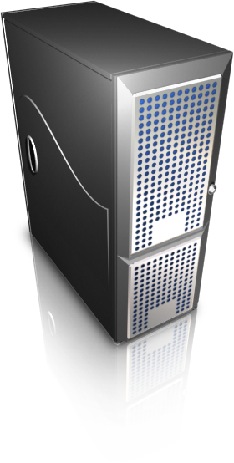
NTP Reflection/Amplification Attack Methodology
Abusable
NTP
Servers
Internet-Accessible Servers, Routers, Home CPE devices, etc.
172.19.234.6/32

Slide 35
NTP Reflection/Amplification Attack Methodology
Abusable
NTP
Servers
UDP/80 – UDP/123, ~50 bytes/packet
Spoofed Source: 172.19.234.6
Destinations: Multiple NTP servers
NTP query: monlist
172.19.234.6/32

Slide 36
NTP Reflection/Amplification Attack Methodology
Abusable
NTP
Servers
Impact
Impact
Impact
Impact
UDP/123 – UDP/80, ~468 bytes/packet
Non-Spoofed Sources: Multiple NTP Servers
Destination: 172.19.234.6
Reply: Up to 500 packets of monlist replies
Impact
172.19.234.6/32

Slide 37
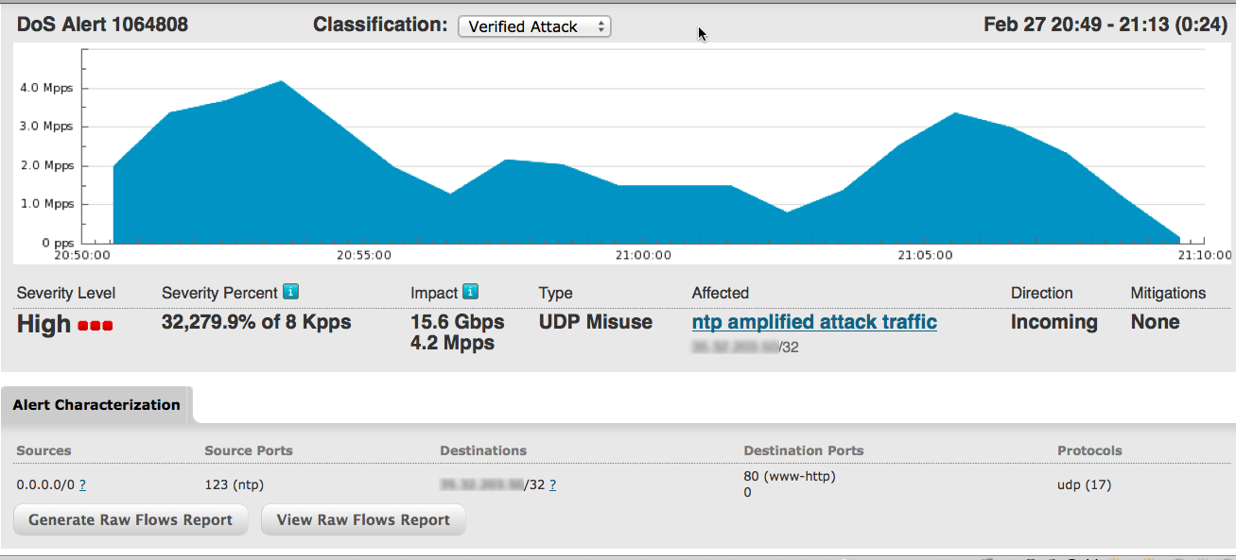
NTP Reflection/Amplification Attack - Netflow Analysis

Slide 38
NTP Reflection/Amplification Attack - Netflow Analysis

Slide 39
NTP Reflection/Amplification Attack - Netflow Analysis

Slide 40
NTP Reflection/Amplification Attack - Netflow Analysis

Slide 41
NTP Reflection/Amplification Attack - Netflow Analysis

Slide 42
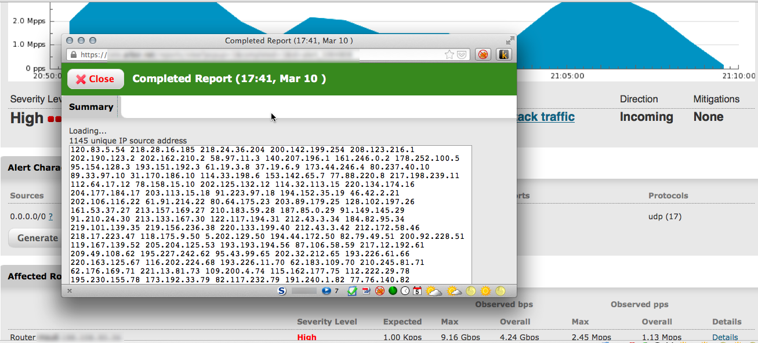
NTP Reflection/Amplification Attack - Netflow Analysis

Slide 43
NTP Reflection/Amplification Attack - Netflow Analysis

Slide 44
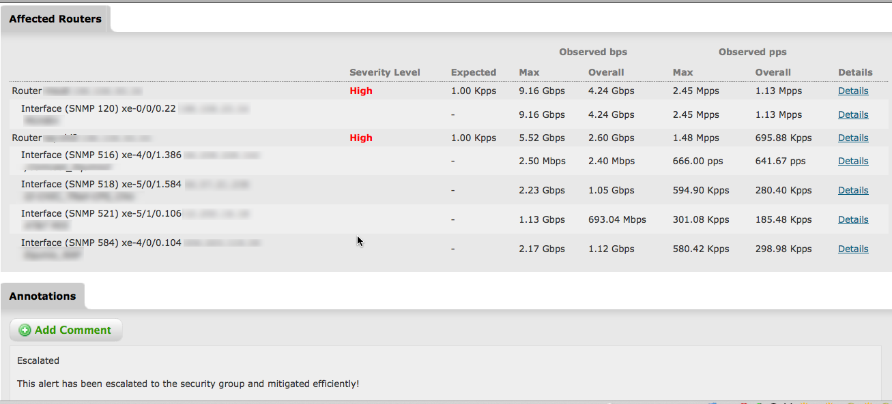
NTP Reflection/Amplification Attack - Netflow Analysis

Slide 45
NTP Reflection/Amplification Attack - Netflow Analysis

Slide 47
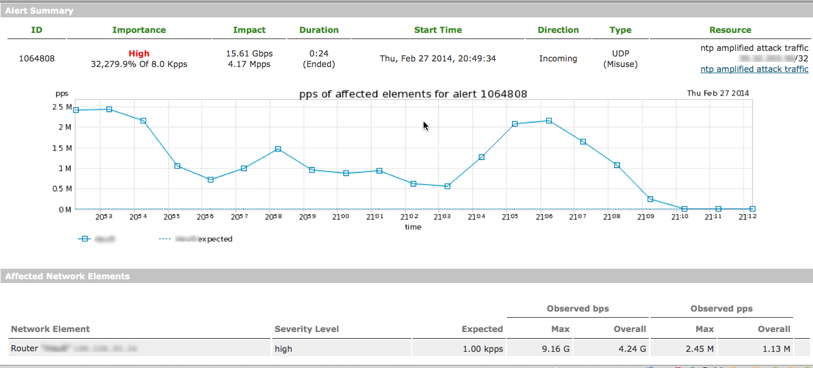
NTP Reflection/Amplification Attack - Netflow Analysis

Slide 48
NTP Reflection/Amplification Attack - Netflow Analysis

Slide 49
NTP Reflection/Amplification Attack - Netflow Analysis

Slide 50
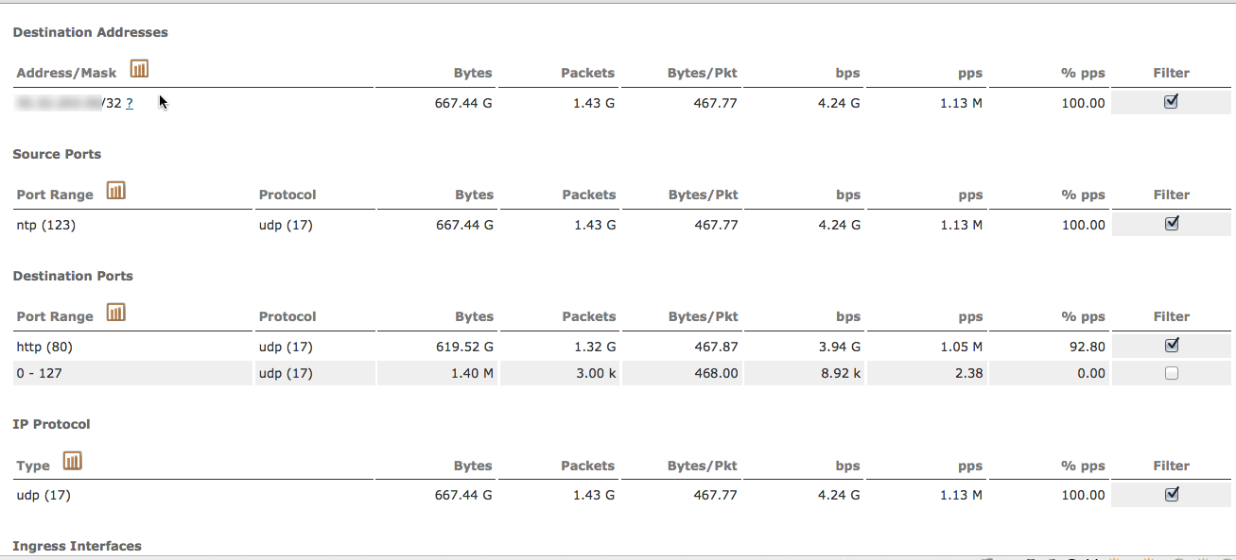
NTP Reflection/Amplification Attack - Netflow Analysis

Slide 51
NTP Reflection/Amplification Attack - Netflow Analysis

Slide 52
NTP Reflection/Amplification Attack - Netflow Analysis

Slide 53
NTP Reflection/Amplification Attack - Netflow Analysis

Slide 54
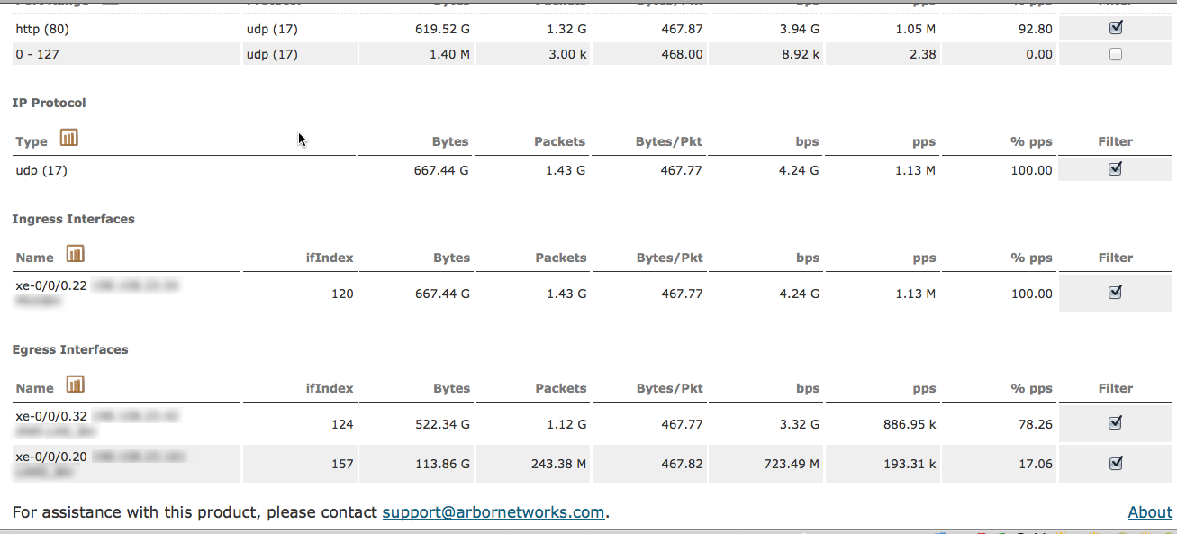
NTP Reflection/Amplification Attack - Netflow Analysis

Slide 55
NTP Reflection/Amplification Attack - Netflow Analysis

Slide 56
NTP Reflection/Amplification Attack - Netflow Analysis

Slide 57
DNS Reflection/Amplification

Slide 58
Amplification Factor - DNS
Abbreviation | Protocol | Ports | Amplification Factor | # Abusable Servers
CHARGEN | Character Generation Protocol | UDP / 19 | 18x/1000x | Tens of thousands (90K)
DNS | Domain Name System | UDP / 53 | 160x | Millions (27M)
NTP | Network Time Protocol | UDP / 123 | 1000x | Over One Hundred Thousand (128K)
SNMP | Simple Network Management Protocol | UDP / 161 | 880x | Millions (5M)

Slide 59
Characteristics of a DNS Reflection/Amplification Attack
The attacker spoofs the IP address of the target of the attack, sending DNS queries for pre-identified large DNS records (ANY records, large TXT records, etc.) either to abusable open DNS recursive servers, or directly to authoritative DNS servers.
The attacker chooses the UDP port which he’d like to target – with DNS, this is typically limited to either UDP/53 or UDP/1024-65535 The destination port is UDP/53
The servers ‘reply’ either directly to the attack target or to the intermediate open DNS recursive server with large DNS responses – the attack target will see streams of unsolicited DNS responses broken down into initial and non-initial fragments.
Response sizes are typically 4096 – 8192 bytes (can be smaller or larger), broken down into multiple fragments.
Packet sizes received by the attack target are generally ~1500 bytes due to prevalent Ethernet MTUs – and there are lots of them.

Slide 60
Characteristics of a DNS Reflection/Amplification Attack (cont.)
As these multiple streams of fragmented DNS responses converge, the attack volume can be huge – the largest verified attack of this type so far is ~200gb/sec. 100gb/sec attacks are commonplace.
Internet transit bandwidth of the target, along with core bandwidth of the target’s peers/upstreams, as well as the core bandwidth of intermediary networks between the various DNS services being abused and the target, are saturated.
In most attacks involving intermediate open DNS recursive servers are reflectors, between ~20,000 – 30,000 abusable recursive DNS are leveraged by attackers. Up to 50,000 abusable open recursive DNS servers have been observed in some attacks.
In attacks leveraging authoritative DNS servers directly, hundreds or thousands of these servers are utilized by attackers.
Many well-known authoritative DNS servers are anycasted, with multiple instances deployed around the Internet.

Slide 61
DNS Reflection/Amplification Attack Methodology #1
Authoritative
DNS Servers for
example.com
172.19.234.6/32

Slide 62
DNS Reflection/Amplification Attack Methodology #1
Authoritative
DNS Servers for
example.com
UDP/32764 – UDP/53, ~70 bytes
Spoofed Source: 172.19.234.6
Destinations: Multiple Authoritative DNS servers
DNS query: ANY EXAMPLE.COM
172.19.234.6/32

Slide 63
DNS Reflection/Amplification Attack Methodology #1
Authoritative
DNS Servers for
example.com
Impact
Impact
Impact
Impact
UDP/53 – UDP/32764, ~4096 bytes, fragmented
Non-Spoofed Sources: Multiple Authoritative DNS Servers
Destination: 172.19.234.6
DNS Response: ANY RR for EXAMPLE.COM
Impact
172.19.234.6/32

Slide 64
DNS Reflection/Amplification Attack Methodology #2
Authoritative
DNS Servers for
example.com
Abusable
Recursive
DNS
Servers
Internet-Accessible Servers, Routers, Home CPE devices, etc.
172.19.234.6/32

Slide 65
DNS Reflection/Amplification Attack Methodology #2
Authoritative
DNS Servers for
example.com
Abusable
Recursive
DNS
Servers
UDP/1988 – UDP/53, ~70 bytes
Spoofed Source: 172.19.234.6
Destinations: Multiple Authoritative DNS servers
DNS query: TXT PGP.EXAMPLE.COM
172.19.234.6/32

Slide 66
DNS Reflection/Amplification Attack Methodology #2
Authoritative
DNS Servers for
example.com
Abusable
Recursive
DNS
Servers
UDP/50112– UDP/53, ~70 bytes
Non-Spoofed Sources: Multiple Recursive DNS Servers
Destinations: Multiple Authoritative DNS servers
DNS query: TXT PGP.EXAMPLE.COM
172.19.234.6/32

Slide 67
DNS Reflection/Amplification Attack Methodology #2
Authoritative
DNS Servers for
example.com
Abusable
Recursive
DNS
Servers
UDP/53 – UDP/50112, ~8192 bytes, fragmented
Non-Spoofed Sources: Multiple Authoritative DNS Servers
Destination: Multiple Recursive DNS Servers
DNS Response: TXT RR for PGP.EXAMPLE.COM
172.19.234.6/32

Slide 68
DNS Reflection/Amplification Attack Methodology #2
Impact
Impact
Authoritative
DNS Servers for
example.com
Impact
Abusable
Recursive
DNS
Servers
Impact
Impact
Impact
UDP/53 – UDP/1988, ~8192 bytes, fragmented
Non-Spoofed Sources: Multiple Recursive DNS Servers
Destination: 172.19.234.6
DNS Response: TXT RR for PGP.EXAMPLE.COM
Impact
172.19.234.6/32

Slide 69
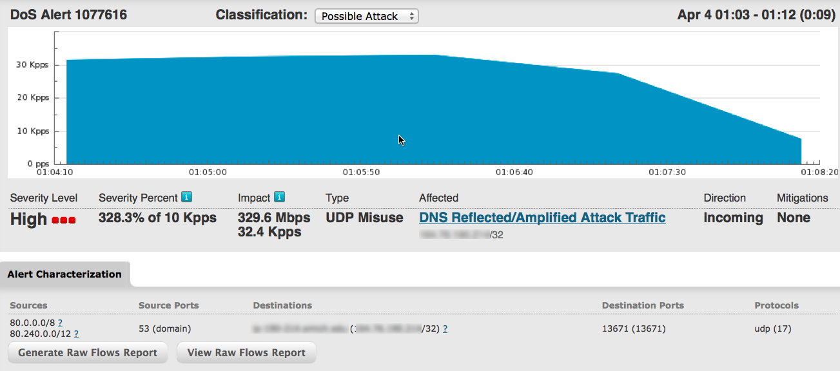
DNS Reflection/Amplification Attack Netflow Analysis – UDP Misuse Anomaly

Slide 70
DNS Reflection/Amplification Attack Netflow Analysis – UDP Misuse Anomaly

Slide 71
DNS Reflection/Amplification Attack Netflow Analysis – UDP Misuse Anomaly

Slide 72
DNS Reflection/Amplification Attack Netflow Analysis – UDP Misuse Anomaly

Slide 73
DNS Reflection/Amplification Attack Netflow Analysis – UDP Misuse Anomaly

Slide 74
DNS Reflection/Amplification Attack Netflow Analysis – UDP Misuse Anomaly

Slide 75
DNS Reflection/Amplification Attack Netflow Analysis – UDP Misuse Anomaly

Slide 76
DNS Reflection/Amplification Attack Netflow Analysis – UDP Misuse Anomaly

Slide 77
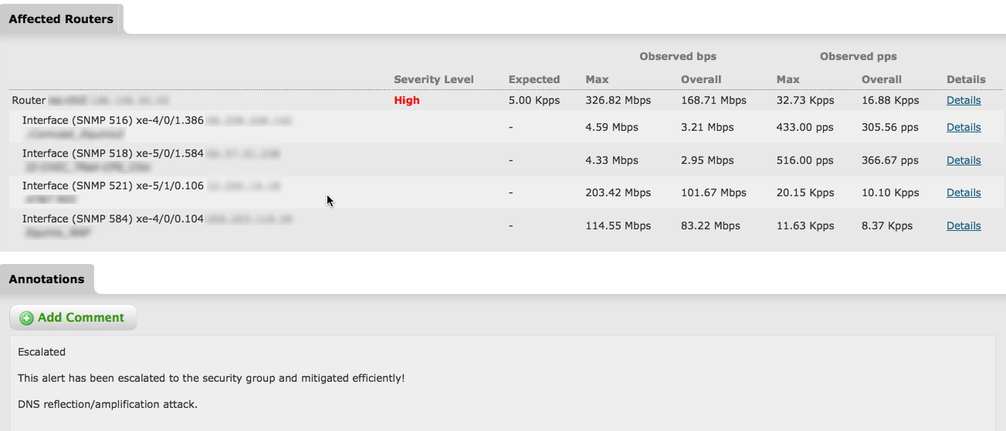
DNS Reflection/Amplification Attack Netflow Analysis – UDP Misuse Anomaly

Slide 78
DNS Reflection/Amplification Attack Netflow Analysis – UDP Misuse Anomaly

Slide 79
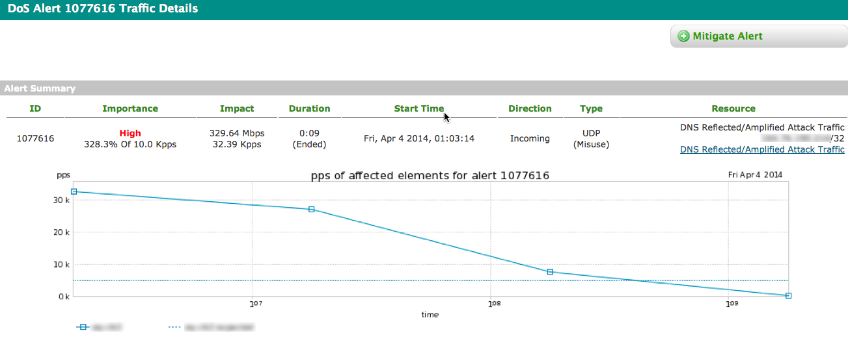
DNS Reflection/Amplification Attack Netflow Analysis – UDP Misuse Anomaly

Slide 80
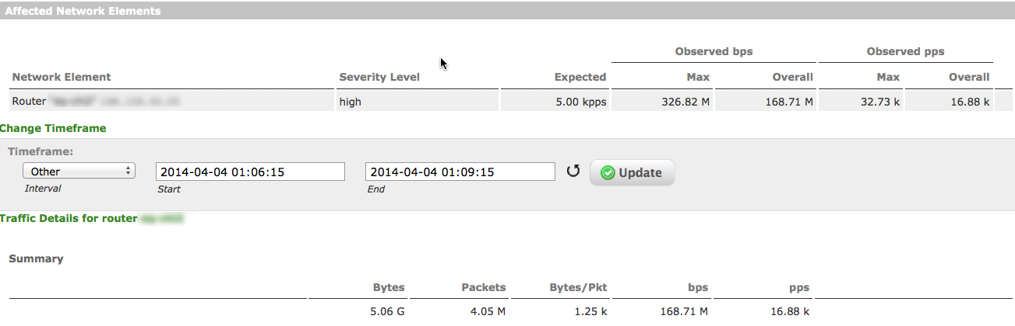
DNS Reflection/Amplification Attack Netflow Analysis – UDP Misuse Anomaly

Slide 81
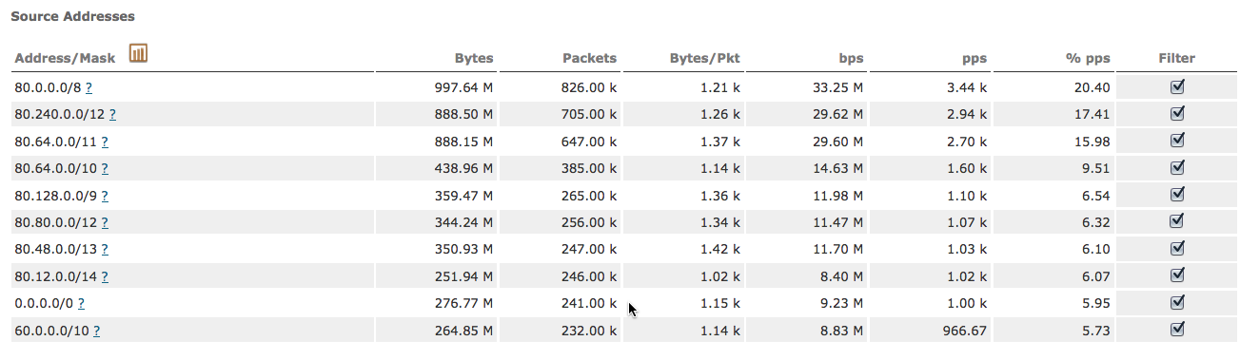
DNS Reflection/Amplification Attack Netflow Analysis – UDP Misuse Anomaly

Slide 82
DNS Reflection/Amplification Attack Netflow Analysis – UDP Misuse Anomaly

Slide 83
DNS Reflection/Amplification Attack Netflow Analysis – UDP Misuse Anomaly

Slide 84
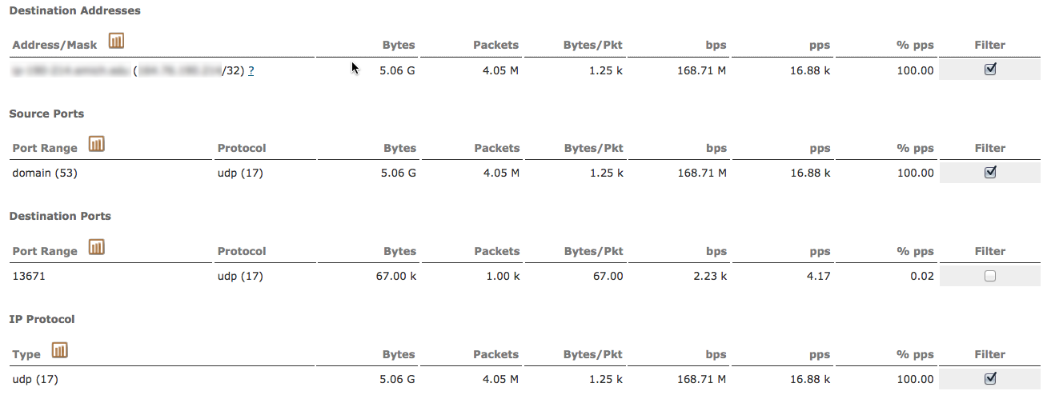
DNS Reflection/Amplification Attack Netflow Analysis – UDP Misuse Anomaly

Slide 85
DNS Reflection/Amplification Attack Netflow Analysis – UDP Misuse Anomaly

Slide 86
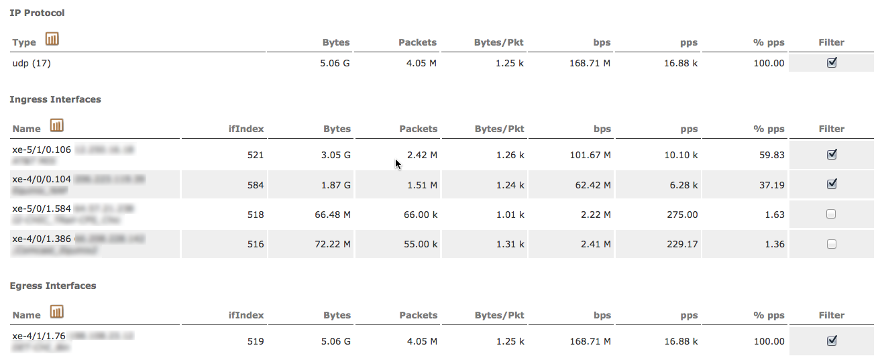
DNS Reflection/Amplification Attack Netflow Analysis – UDP Misuse Anomaly

Slide 87
DNS Reflection/Amplification Attack Netflow Analysis – UDP Misuse Anomaly

Slide 88
DNS Reflection/Amplification Attack Netflow Analysis – UDP Misuse Anomaly

Slide 89
DNS Reflection/Amplification Attack Netflow Analysis – UDP Misuse Anomaly

Slide 90
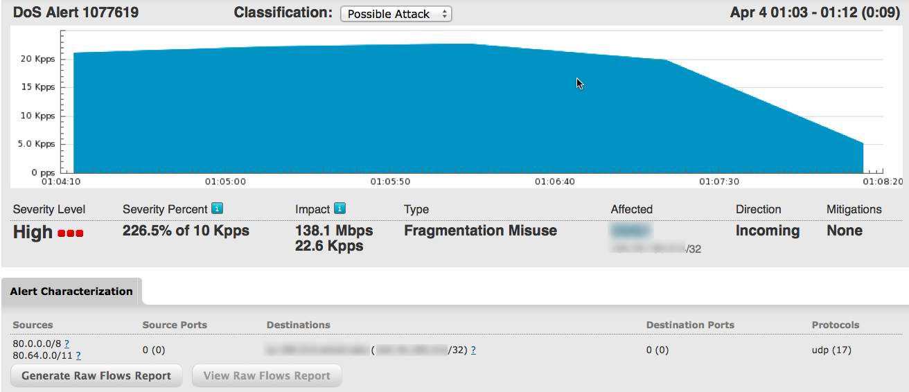
DNS Reflection/Amplification Attack Netflow Analysis – Fragmentation Misuse Anomaly

Slide 91
DNS Reflection/Amplification Attack Netflow Analysis – Fragmentation Misuse Anomaly

Slide 92
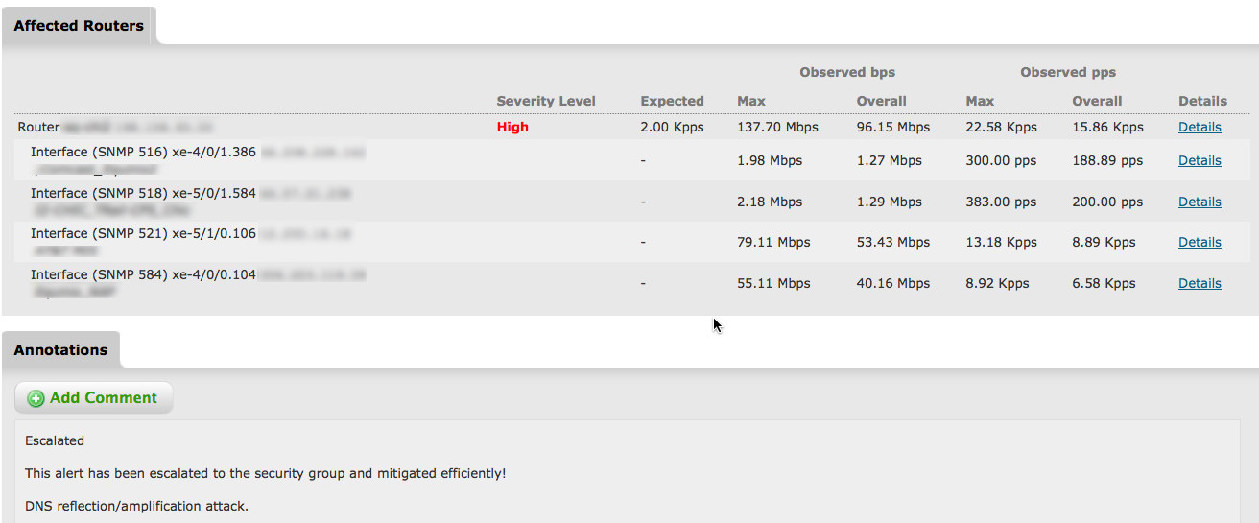
DNS Reflection/Amplification Attack Netflow Analysis – Fragmentation Misuse Anomaly

Slide 93
DNS Reflection/Amplification Attack Netflow Analysis – Fragmentation Misuse Anomaly

Slide 94
DNS Reflection/Amplification Attack Netflow Analysis – Fragmentation Misuse Anomaly

Slide 95
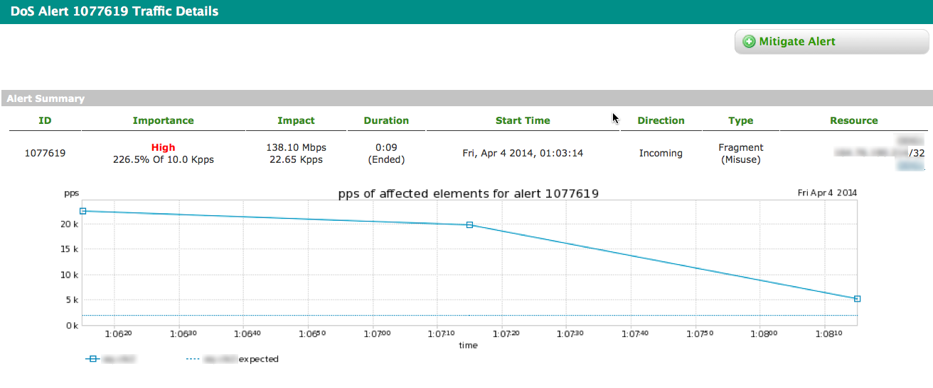
DNS Reflection/Amplification Attack Netflow Analysis – Fragmentation Misuse Anomaly

Slide 96
DNS Reflection/Amplification Attack Netflow Analysis – Fragmentation Misuse Anomaly

Slide 97
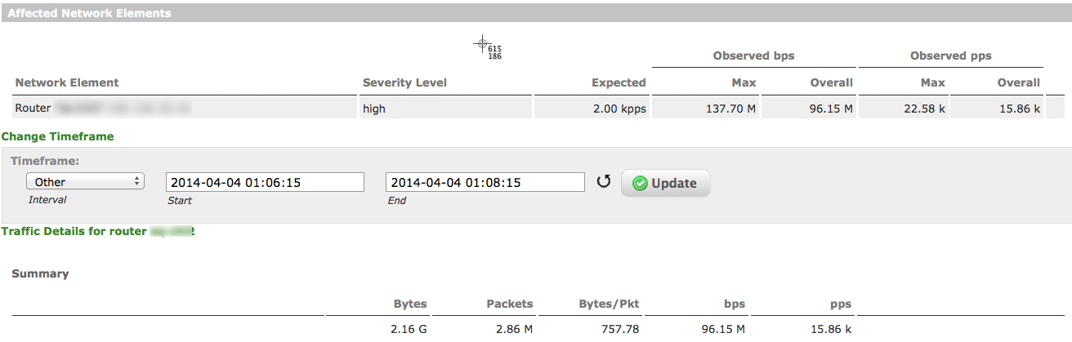
DNS Reflection/Amplification Attack - Netflow Analysis

Slide 99
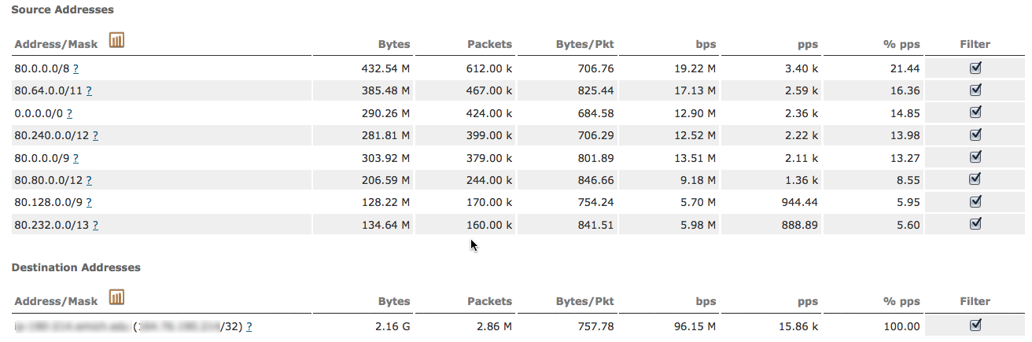
DNS Reflection/Amplification Attack Netflow Analysis – Fragmentation Misuse Anomaly

Slide 100
DNS Reflection/Amplification Attack Netflow Analysis – Fragmentation Misuse Anomaly

Slide 101
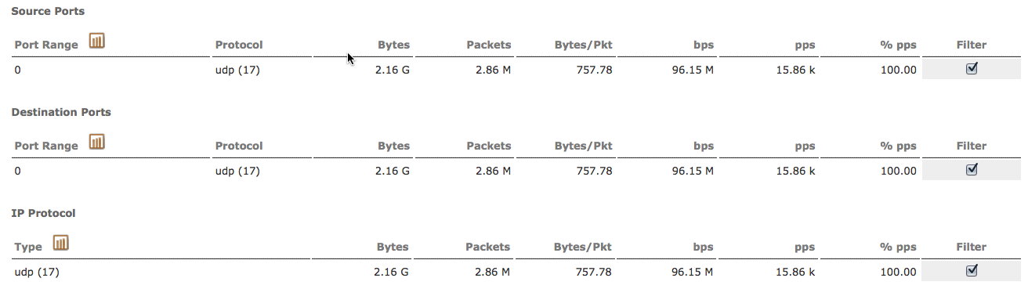
DNS Reflection/Amplification Attack Netflow Analysis – Fragmentation Misuse Anomaly

Slide 102
DNS Reflection/Amplification Attack Netflow Analysis – Fragmentation Misuse Anomaly

Slide 103
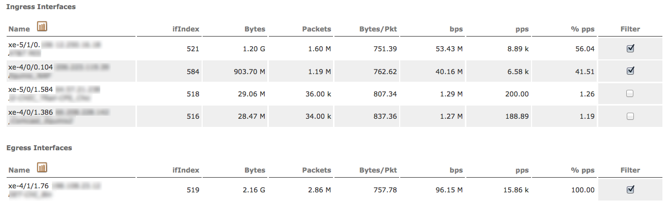
DNS Reflection/Amplification Attack Netflow Analysis – Fragmentation Misuse Anomaly

Slide 104
DNS Reflection/Amplification Attack Netflow Analysis – Fragmentation Misuse Anomaly

Slide 105
DNS Reflection/Amplification Attack Netflow Analysis – Fragmentation Misuse Anomaly

Slide 106
SNMP Reflection/Amplification

Slide 107
Amplification Factor - SNMP
Abbreviation | Protocol | Ports | Amplification Factor | # Abusable Servers
CHARGEN | Character Generation Protocol | UDP / 19 | 18x/1000x | Tens of thousands (90K)
DNS | Domain Name System | UDP / 53 | 160x | Millions (27M)
NTP | Network Time Protocol | UDP / 123 | 1000x | Over One Hundred Thousand (128K)
SNMP | Simple Network Management Protocol | UDP / 161 | 880x | Millions (5M)

Slide 108
Characteristics of an SNMP Reflection/Amplification Attack
The attacker spoofs the IP address of the target of the attack, sends an SNMP GetBulkRequest query to abusable SNMP services running on home CPE devices, large ISP and enterprise routers, servers, etc. These packets are typically between 60 – 102 bytes in length
The attacker chooses the UDP port which he’d like to target – it can be any port of the attacker’s choice – and uses that as the source port. The destination port is UDP/161.
The SNMP services ‘reply’ to the attack target with streams of 423-byte – 1560-byte packets sourced from UDP/161; the destination port is the source port the attacker chose when generating the SNMP queries.

Slide 109
Characteristics of an SNMP Reflection/Amplification Attack (cont.)
As these multiple streams of SNMP replies converge, the attack volume can be very large – the largest verified attack of this type so far is over 60gb/sec. 20-30gb/sec attacks are commonplace.
Due to sheer attack volume, the Internet transit bandwidth of the target, along with core bandwidth of the target’s peers/upstreams, as well as the core bandwidth of intermediary networks between the various SNMP services being abused and the target, are saturated.
More savvy attackers will enumerate the individual SNMP Object IDentifiers (OIDs) on the abusable SNMP services, and enumerate each one with iterative parallel spoofed SNMP queries. Lots of non-initial fragments in this scenario, a la DNS.
In most attacks, between ~2,000-4,000 abusable SNMP services are leveraged by attackers. Up to 10,000 SNMP services have been observed in some attacks.

Slide 110
SNMP Reflection/Amplification Attack Methodology
Abusable
SNMP
Services
Internet-Accessible Servers, Routers, Home CPE devices, etc.
172.19.234.6/32

Slide 111
SNMP Reflection/Amplification Attack Methodology
Abusable
SNMP
Services
UDP/1711 – UDP/161 ,~70 bytes
Spoofed Source: 172.19.234.6
Destinations: Multiple SNMP Services
SNMP query: GetBulkRequest OID enumeration
172.19.234.6/32

Slide 112
SNMP Reflection/Amplification Attack Methodology
Abusable
SNMP
Services
Impact
Impact
Impact
Impact
UDP/161 – UDP/1711, ~60000 bytes, fragmented
Non-Spoofed Sources: Multiple SNMP Services
Destination: 172.19.234.6
SNMP Response: GetBulkRequest output
Impact
172.19.234.6/32

Slide 113
chargen Reflection/Amplification

Slide 114
Amplification Factor - chargen
Abbreviation | Protocol | Ports | Amplification Factor | # Abusable Servers
CHARGEN | Character Generation Protocol | UDP / 19 | 18x/1000x | Tens of thousands (90K)
DNS | Domain Name System | UDP / 53 | 160x | Millions (27M)
NTP | Network Time Protocol | UDP / 123 | 1000x | Over One Hundred Thousand (128K)
SNMP | Simple Network Management Protocol | UDP / 161 | 880x | Millions (5M)

Slide 115
Characteristics of a chargen Reflection/Amplification Attack
The attacker spoofs the IP address of the target of the attack, sends packets padded with at least 18 bytes of payload (all-zeroes; 70-byte packet) to multiple abusable chargen services running on servers, printers, home CPE devices, etc.
The attacker chooses the UDP port which he’d like to target – it can be any port greater than 1023 – and uses that as the source port. The destination port is UDP/19.
The chargen services ‘reply’ to the attack target with ~1000-byte - ~1500-bytes packets sourced from UDP/19 to the target; the destination port is the source port the attacker chose when he generated the chargen queries. Most chargen services generate one response packet for each request packets, but some non-RFC-compliant chargen services send more packets/query.

Slide 116
Characteristics of a chargen Reflection/Amplification Attack (cont.)
As these multiple streams of chargen replies converge, the attack volume can be quite large – the largest verified attack of this type so far is over 137gb/sec. 2-5gb/sec attacks are commonplace.
Due to sheer attack volume, the Internet transit bandwidth of the target, along with core bandwidth of the target’s peers/upstreams, as well as the core bandwidth of intermediary networks between the various chargen services being abused and the target, can be saturated.
Non-RFC-compliant chargen services can provide an amplification factor of up to 1000:1 (most are 18:1).
In most attacks, between ~20 - ~2,000 abusable chargen services are leveraged by attackers. Up to 5,000 chargen services have been observed in some attacks.

Slide 117
chargen Reflection/Amplification Attack Methodology
Abusable
chargen
Services
Internet-Accessible Servers, Routers, Home CPE devices, etc.
172.19.234.6/32

Slide 118
chargen Reflection/Amplification Attack Methodology
Abusable
chargen
Services
UDP/21880– UDP/19 ,~70 bytes
Spoofed Source: 172.19.234.6
Destinations: Multiple chargen Services
chargen query: 18 bytes of zero-padding
172.19.234.6/32

Slide 119
chargen Reflection/Amplification Attack Methodology
Abusable
chargen
Services
Impact
Impact
Impact
Impact
UDP/19 – UDP/21880, ~1500 bytes/packet
Non-Spoofed Sources: Multiple chargen Services
Destination: 172.19.234.6
chargen Response: chargen output
Impact
172.19.234.6/32

Slide 120
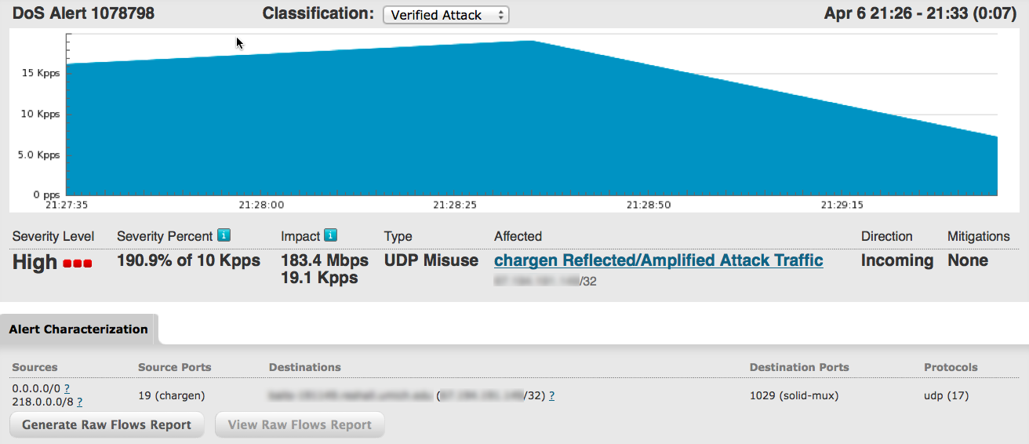
chargen Reflection/Amplification Attack - Netflow Analysis

Slide 121
chargen Reflection/Amplification Attack - Netflow Analysis

Slide 122
chargen Reflection/Amplification Attack - Netflow Analysis

Slide 123
chargen Reflection/Amplification Attack - Netflow Analysis

Slide 124
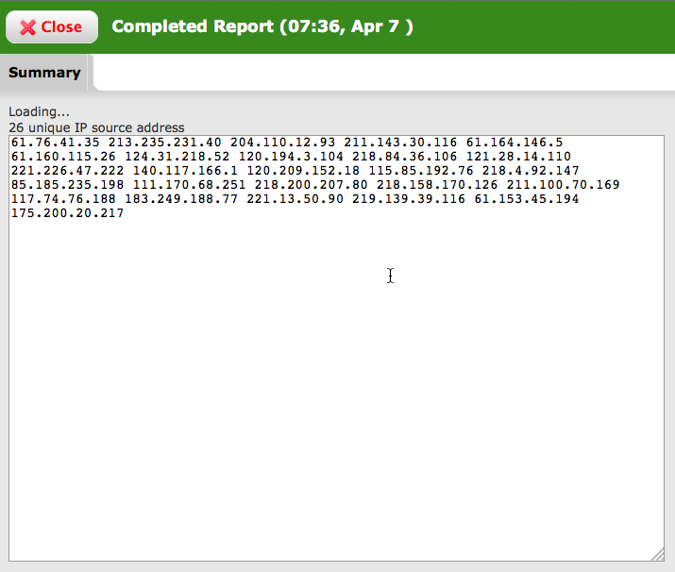
chargen Reflection/Amplification Attack - Netflow Analysis

Slide 125
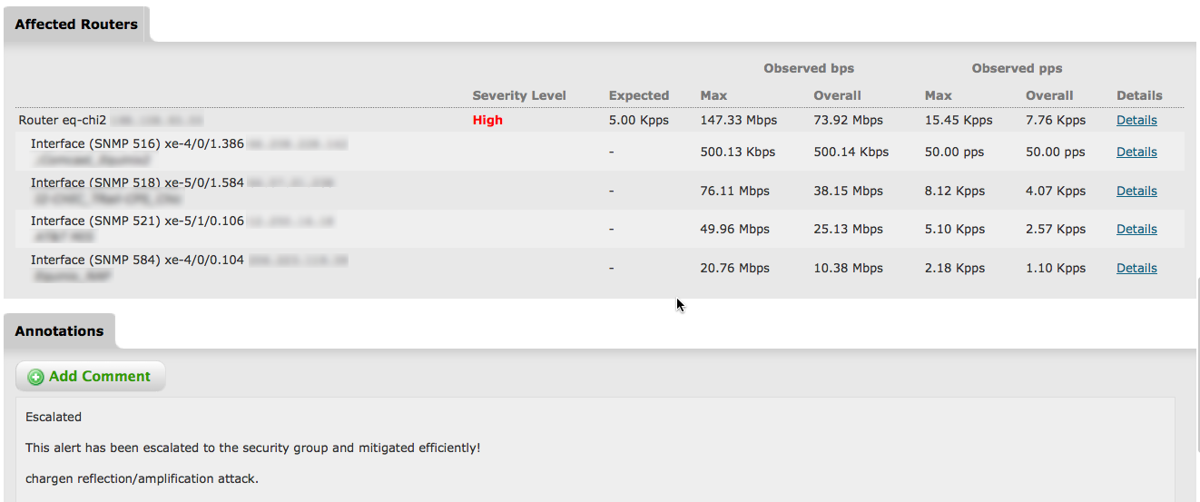
chargen Reflection/Amplification Attack - Netflow Analysis

Slide 126
chargen Reflection/Amplification Attack - Netflow Analysis

Slide 127
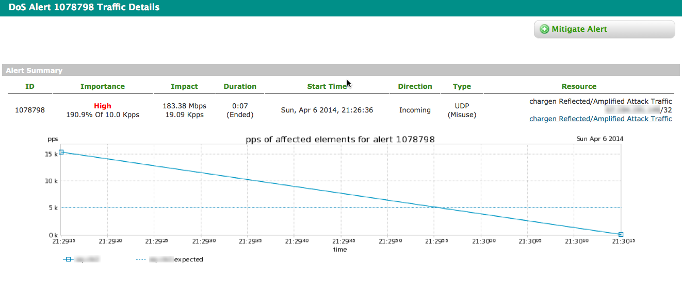
chargen Reflection/Amplification Attack - Netflow Analysis

Slide 128
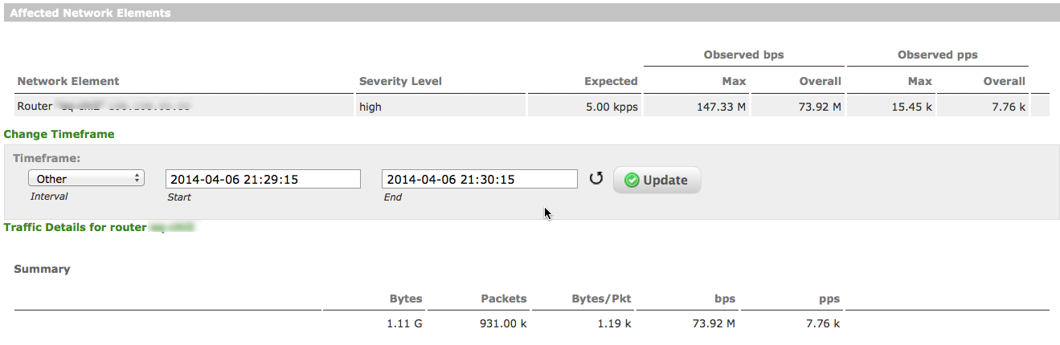
chargen Reflection/Amplification Attack - Netflow Analysis

Slide 129
chargen Reflection/Amplification Attack - Netflow Analysis

Slide 130
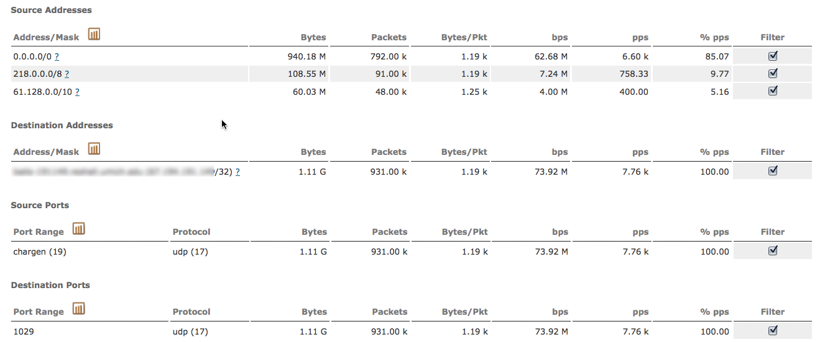
chargen Reflection/Amplification Attack - Netflow Analysis

Slide 131
chargen Reflection/Amplification Attack - Netflow Analysis

Slide 132
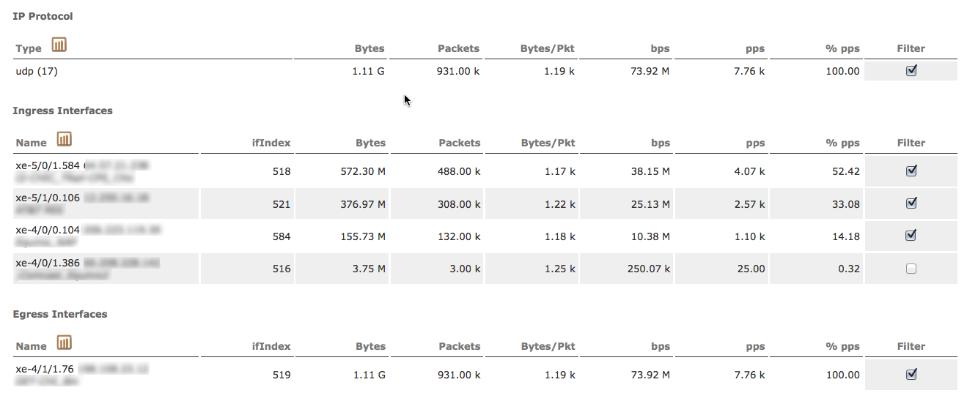
chargen Reflection/Amplification Attack - Netflow Analysis

Slide 133
chargen Reflection/Amplification Attack - Netflow Analysis

Slide 134
chargen Reflection/Amplification Attack - Netflow Analysis

Slide 135
SSDP Reflection/Amplification

Slide 136
Amplification Factor - chargen
Abbreviation | Protocol | Ports | Amplification Factor | # Abusable Servers
CHARGEN | Character Generation Protocol | UDP / 19 | 18x/1000x | Tens of thousands (90K)
DNS | Domain Name System | UDP / 53 | 160x | Millions (27M)
NTP | Network Time Protocol | UDP / 123 | 1000x | Over One Hundred Thousand (128K)
SNMP/SSDP | Simple Network Management Protocol/Simple Service Discovery protocol | UDP / 161/1900 | 880x/30x | Millions (5M)/Millions

Slide 137
Characteristics of a SSDP Reflection/Amplification Attack
The Simple Object Access Protocol (SOAP) is used to deliver control messages to UPnP devices and pass information back from the devices
The attacker spoofs the IP address of the target of the attack, sends Msearch packets padded with at least 40 bytes of payload to multiple abusable UPNP services running on servers, printers, home CPE devices, etc.
The attacker chooses the UDP port which he’d like to target – it can be any port– and uses that as the source port. The destination port is UDP/1900.
The size of the response and amplification factor may vary depending on the contents of the device description file, such as response header, banner, operating system and UUID. Average Amplification is 30x
sourced from UDP/1900 to the target; the destination port is the source port the attacker chose when he generated the SSDP queries.

Slide 138
Mitigating Reflection/Amplification DDoS Attacks

Slide 139
What Not to Do!
Do not indiscriminately block UDP/123 on your networks!
Do not indiscriminately block UDP/53 on your networks!
Do not block UDP/53 packets larger than 512 bytes!
Do not block TCP/53 on your networks!
Do not indiscriminately block UDP/161 on your networks!
Do not indiscriminately block UDP/19 on your networks!
Do not indiscriminately block fragments on your networks!
Do not block UDP/1900 on your networks!
Do not block all ICMP on your networks! At the very least, allow ICMP Type-3/Code-4, required for PMTU-D.
If you do these things, you will break the Internet for your customers/users!

Slide 140
Don’t Be Part of the Problem!
Deploy antispoofing at all network edges.
uRPF Loose-Mode at the peering edge
uRPF Strict Mode at customer aggregation edge
ACLs at the customer aggregation edge
uRPF Strict-Mode and/or ACLs at the Internet Data Center (IDC) aggregation edge
DHCP Snooping and IP Source Verify at the IDC LAN access edge
PACLs & VACLs at the IDC LAN access edge
Cable IP Source Verify, etc. at the CMTS
If you get a reputation as a spoofing-friendly network, you will be de-peered/de-transited and/or blocked!

Slide 141
Don’t Be Part of the Problem! (cont.)
Proactively scan for and remediate abusable services on your network and on customer/user networks, including blocking traffic to/from abusable services if necessary in order to attain compliance
Check http://www.openntpproject.org to see if abusable NTP services have been identified on your networks and/or customer/user networks
Check http://www.openresolver.project.org to see if abusable open DNS recursors have been identified on your network or on customer/user networks.
Collateral damage from these attacks is widespread – if there are abusable services on your networks or customer/user networks, your customers/users will experience significant outages and performance issues, and your help-desk will light up!

Slide 142
Detection/Classification/Traceback/Mitigation
Utilize flow telemetry (NetFlow, cflowd/jflow, etc.) exported from all network edges for attack detection/classification/traceback
Purpose built Netflow Analysis provides automated detection/classification/traceback and alerting of DDoS attacks via anomaly-detection technology
Enforce standard network access policies in front of servers/services via stateless ACLs in hardware-based routers/layer-3 switches.
Ensure recursive DNS servers are not queryable from the public Internet – only from your customers/users.
Ensure SNMP is disabled/blocked on public-facing infrastructure/servers.
Disallow level-6/-7 NTP queries from the public Internet.
Disallow SSDP/UPNP queries from public internet
Disable all unnecessary services such as chargen.
Regularly audit network infrastructure and servers/services.

Slide 143
Detection/Classification/Traceback/Mitigation (cont.)
Deploy network infrastructure-based reaction/mitigation techniques such as S/RTBH and flowspec at all network edges.
Deploy intelligent DDoS mitigation systems (IDMSes) in mitigation centers located at topologically-appropriate points within your networks to mitigate attacks.
Ensure sufficient mitigation capacity and diversion/re-injection bandwidth – IDMS, S/RTBH, flowspec. Consider OOB mitigation center links from edge routers to guarantee ‘scrubbing’ bandwidth.
Enterprises/ASPs should subscribe to ‘Clean Pipes’ DDoS mitigation services from ISPs/MSSPs.
Consumer broadband operators should consider minimal default ACLs to limit the impact of service abuse on customer networks.
User the power of the RFP to specify secure default configurations for PE & CPE devices – and verify via testing.
Know who to contact at your peers/transits to get help.
Participate in the global operational security community.

Slide 144
Detection/Classification/Traceback/Mitigation (cont.)
ISPs should consider deploying Quality-of-Service (QoS) mechanisms at all network edges to police non-timesync NTP traffic down to an appropriate level (i.e., 1mb/sec).
NTP timesync packets are 76 bytes in length (all sizes are minus layer-2 framing)
NTP monlist replies are ~468 bytes in length
Observed NTP monlist requests utilized in these attacks are 50, 60, and 234 bytes in length
Option 1 – police all non-76-byte UDP/123 traffic (source, destination, or both) down to 1mb/sec. This will police both attack source – reflector/amplifier traffic as well as reflector/amplifier – target traffic
Option 2 – police all 400-byte or larger UDP/123 traffic (source) down to 1mb/sec. This will police only reflector/amplifier – target traffic
NTP timesync traffic will be unaffected
Additional administrative (rarely-used) NTP functions such as ntptrace will only be affected during an attack
Enterprises/ASPs should only allow NTP queries/responses to/from specific NTP services, disallow all others.

Slide 145
Scaling Mitigation Capacity - 4tb/sec and Beyond
Mitigator – 40gb/sec per Mitigator
16 mitigator/cluster (CEF/ECMP limit) = 640gb/sec per cluster
Multiple clusters can be anycasted
100 mitigator per deployment = 4tb/sec of mitigation capacity per deployment, 10x more than largest DDoS to date.
Deploy mitigators mitigation centers at edges - in/out of edge devices.
Deploy mitigators in regional or centralized mitigation centers with dedicated, high-capacity OOB diversion/re-injection links. Sufficient bandwidth for diversion/re-injection is key!
S/RTBH & flowspec leverage router/switch hardware, hundreds of mpps, gb/sec. Leveraging network infrastructure is required due to ratio of attack volumes to peering and core link capacities!

Slide 146
Conclusion

Slide 147
Reflection/Amplification DDoS Attack Summary
Abusable services are widely misimplemented/misconfigured across the Internet
Large pools of abusable servers/services
Gaps in anti-spoofing at network edges
High amplification ratios
Low difficulty of execution
Readily-available attack tools
Extremely high impact – ‘The sky is falling!’
Significant risk for potential targets and intermediate networks/bystanders
Notes:
Implemented in all major operating systems, network infrastructure, and embedded devices
Availability of over a hundred thousand of abusable NTP servers with admin functions incorrectly open to the general Internet
Gaps in anti-spoofing deployment at network edges
High amplification ratio
Low difficulty of execution
Readily-available attack tools
High impact
Significant risk for any potential targets

Slide 148
Are We Doomed?
No! Deploying existing, well-known tools/techniques/BCPs results in a vastly improved security posture with measurable results.
Evolution of defenses against these attacks demonstrates that positive change is possible – targeted organizations & defending ISPs/MSSPs have altered architectures, mitigation techniques, processes, and procedures to successfully mitigate these attacks.
Mitigation capacities are scaling to meet and exceed attack volumes – deployment architecture, diversion/re-injection bandwidth, leveraging network infrastructure are key.
Automation is a Good Thing, but it is no substitute for resilient architecture, insightful planning, and smart opsec personnel, who are more important now than ever before!

Slide 149
Discussion

Slide 150
Thank You!
Manish Sinha
Solution Architect-Arbor Networks
msinha@arbor.net
9818689971.

