Slide 1

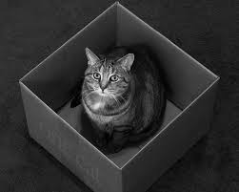
Everything is Quantum
Jaya Baloo
CISO
KPN

Slide 2
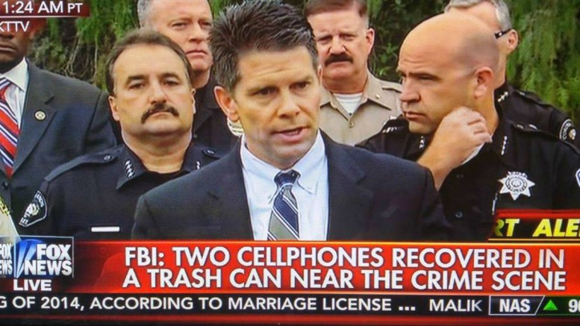
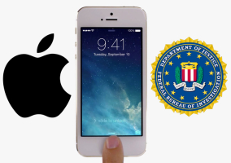
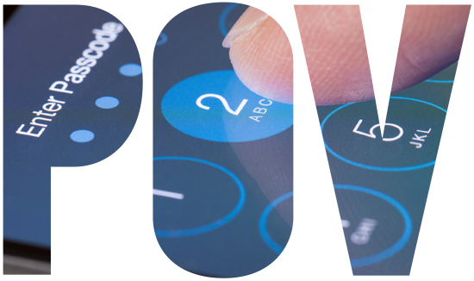
Apple Vs. FBI

Slide 3
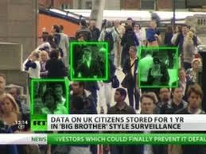
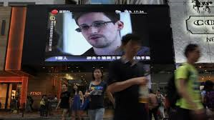
A golden age for global surveillance
Intelligence agencies possess total information awareness - 2011
  Location ; contacts & confederates; digital life dossier;
Intelligence agencies fear of crypto – Going Dark problem
Despite Snowden revelations - lack of informed public opinion

Slide 4

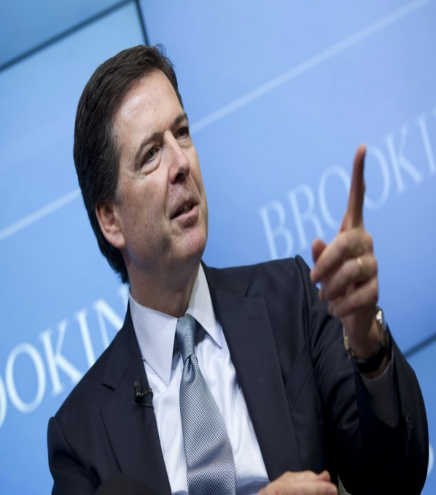
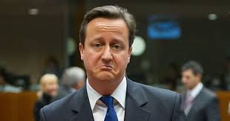
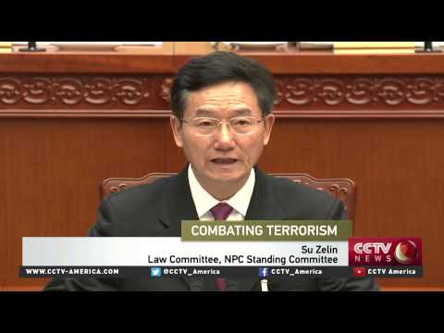
To Ban or Cripple Strong Encryption?
The original crypto wars
What do Freeh / Comey / Cameron / Chinese govt. want?
Chinese proposed anti terrorism law
On backdoors, front doors, and golden key management
Notes:
Who remembers the crypto wars of the 1990s?

Slide 5
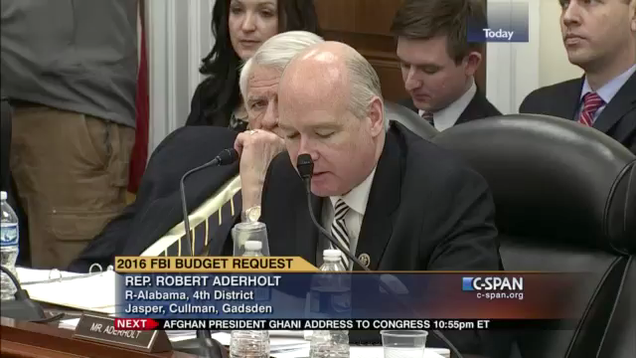
Apple or AT&T Needed?
Notes:
Lazy thinking? – we know that cryptography will not really impair efforts – he doesnt understand issues and quick to jump on crypto as the bad guy -
Am making a case not just because i am worried about privacy issues because I am worried about security issues and the threat to securing my company and our customers and by extension, the country – that s a lot harder without crypto
Is it true you cant build a picture without all the data ? NO! Even with a few dark spots you still have more than enough other data
Judge Carter –

Slide 6
Other Alternatives: Why doesn’t the FBI drop some acid & get lazered?
Secure Enclave & Secure ROM & Device Firmware update
Decapping technique –
  strong acid to remove the chip’s encapsulation, and then physically, drill down into the chip using a focused ion beam, then, micron by micron, attempt to expose the portion of the chip containing UID target data – then copy + crack
Infrared Laser Glitching-
  microscopic drill bit to pierce the chip and then use an infrared laser to access UID-related data stored on it, then copy + crack
Super Shenzen Market method – copy and swap chip

Slide 7

Super Shenzen Market

Slide 8
Alternatives: Why doesn’t the FBI drop some acid & get lazered?
Why can’t the NSA help here?
Need for Precedent creation
Conclusion
NOT Apple Vs. FBI/ NOT privacy Vs. surveillance/ but Liberty versus control

Slide 9
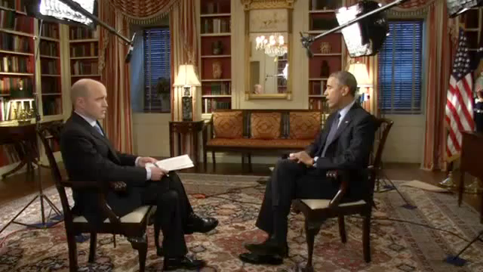
What if the FBI wins?
Self Imposed Economic Sanction

Slide 10
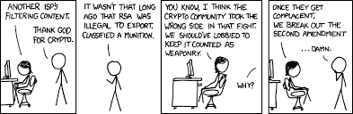
The Right to Bear Arms –
Weaponized Crypto ?
Free Speech / Press
Fair Trial
Freedom of Association
Right to dissent
Fair Competition
Etc.

Slide 11
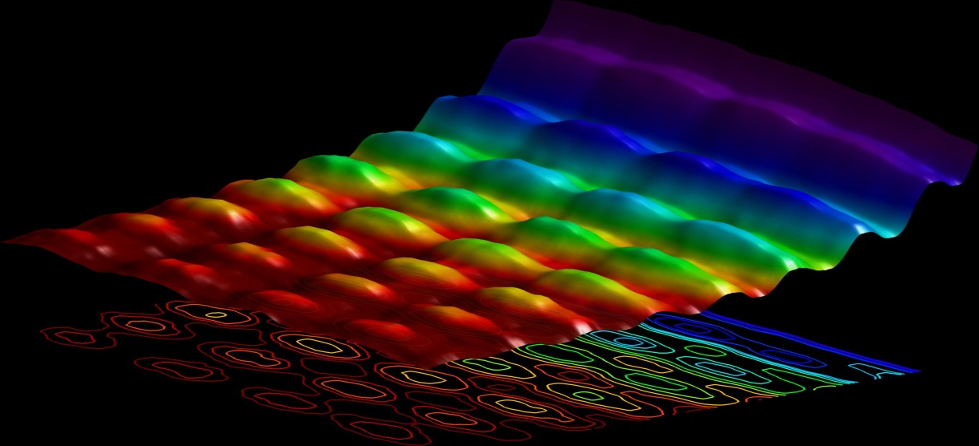
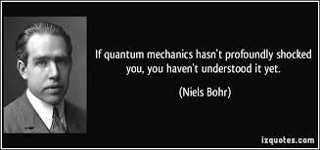
What about Quantum stuff?
What is it?
Background – LI & Quantum interest **
Stuff that can’t be explained by classical physics
Study of the small - subatomic
Properties of light – photons
Experimentation and study of probabilistic outcomes

Slide 12
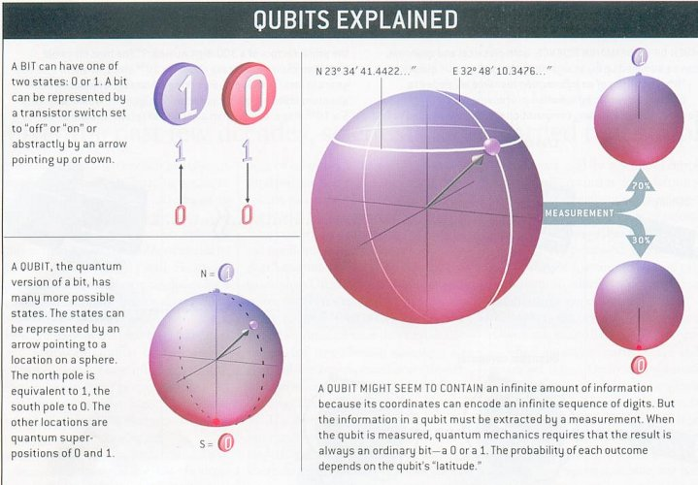
Qubit & superposition

Slide 13
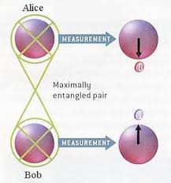
Entanglement
It thus appears that one particle of an entangled pair "knows" what measurement has been performed on the other, and with what outcome, even though there is no known means for such information to be communicated between the particles, which at the time of measurement may be separated by arbitrarily large distances

Slide 14
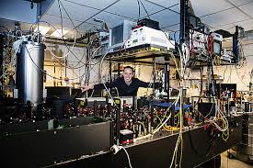
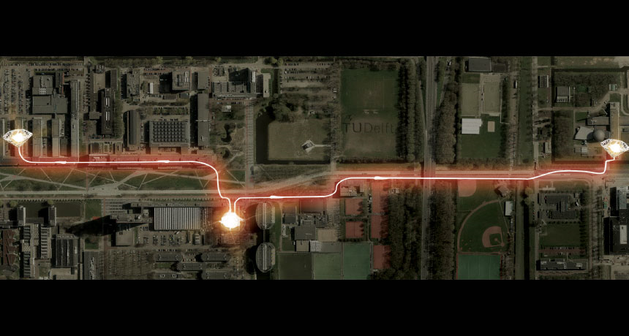
Entanglement

Slide 15
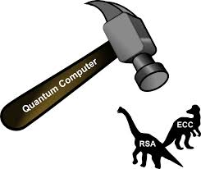
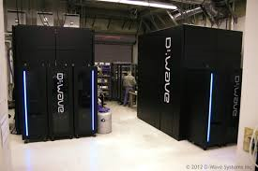
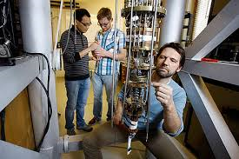
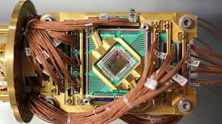
Quantum Computing
Amdahl’s Law & processing power
Shor – integer factorization
Grover – database
Other really cool stuff
Everyone is trying to do this – globally –
European Commission

Slide 16
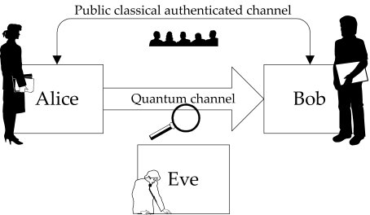
Quantum Key Distribution
spooky action at a distance

Slide 17
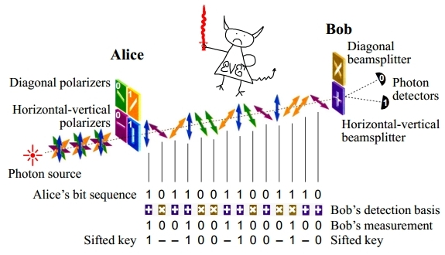
Quantum Key Distribution
spooky action at a distance

Slide 18
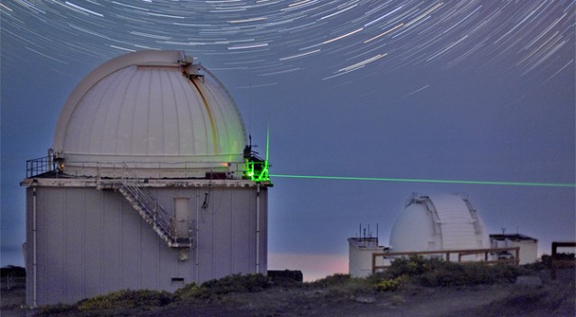
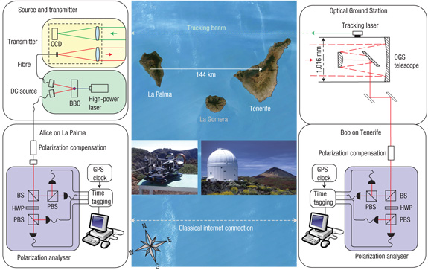
But hey what about Free Space Quantum?

Slide 19
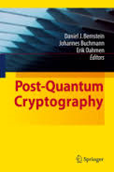
Post Quantum
Lattice based crypto?
Mcelise = Nphard non-deterministic polynomial-time hardsince 1978
Without quantum-safe encryption, everything that has been transmitted, or will ever be transmitted, over a network is vulnerable to eavesdropping and public disclosure. ETSI

Slide 20
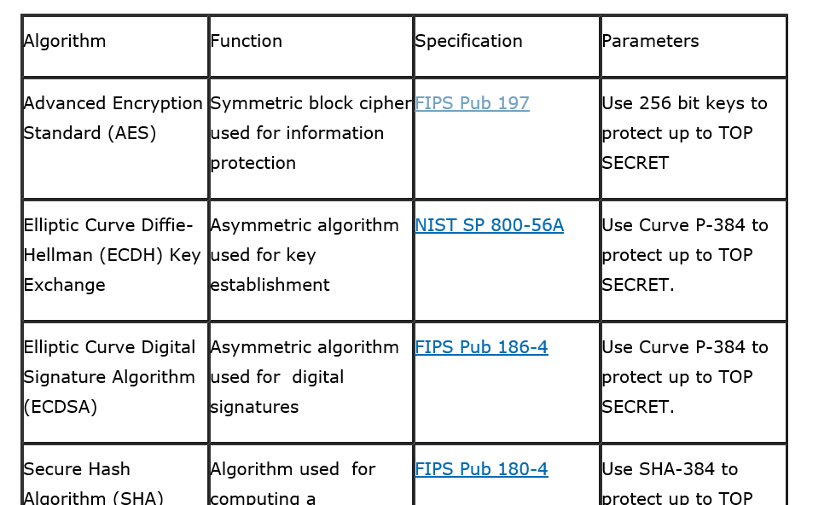
NSA – advises that ... Aug 2015 (1 of 2 )
IAD will initiate a transition to quantum resistant algorithms in the not too distant future. Based on experience in deploying Suite B, we have determined to start planning and communicating early about the upcoming transition to quantum resistant algorithms. Our ultimate goal is to provide cost effective security against a potential quantum computer

Slide 21
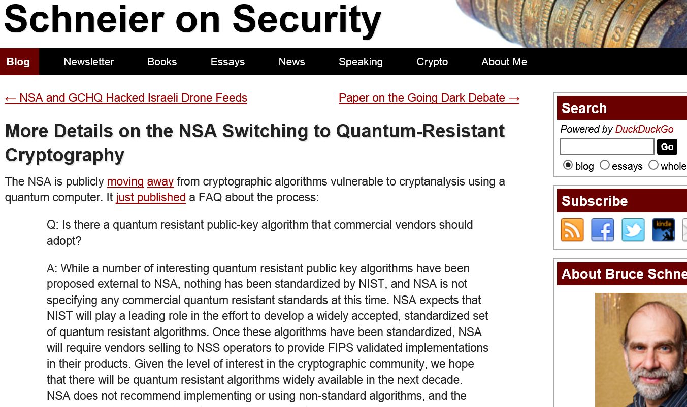
NSA – advises that …. ( 2 of 2)

Slide 22
What is our common quantum future ?
Without quantum-safe encryption, everything that has been transmitted, or will ever be transmitted, over a network is vulnerable to eavesdropping and public disclosure. ETSI
FINISH BY 2020!
Who’s ready for the post quantum world?

Slide 23

Q & A?
Go ahead, ask me anything.

