Slide 1
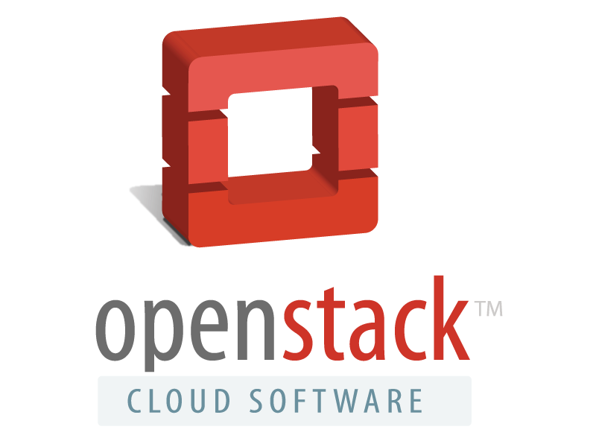
BEST PRACTICES FOR INTEGRATING A THIRD PARTY PORTAL WITH OPENSTACK Campbell McNeill – Lead Architect @campbellmcneill 16th April 2013 @ Havana Design Summit

Slide 2
INTRODUCTION
We have Horizon, why would we need anything else?
What does it take to build a platform for a service provider?
How do we focus on user experience around OpenStack?
OpenStack blueprint opportunities
Notes:
Talk about what a portal is, and what it means in the service provider and the enterprise world.

Slide 3
WE HAVE HORIZON, WHY DO WE NEED SOMETHING ELSE?
Horizon is a consumption Portal
It allows the consumption of resources but in terms of being an IT infrastructure it doesn’t provide the integration required for enterprise management
Leaves OpenStack as an island in the enterprise
Gapped in terms of service provider requirements
Management of consumption is gapped
Operational tooling is missing

Slide 4
NIST CLOUD REFERENCE ARCHITECTURE

Slide 5
NIST CLOUD REFERENCE ARCHITECTURE (Cont.)

Slide 6
EXAMPLE OPENSTACK SERVICE PROVIDER ARCHITECTURE

Slide 7
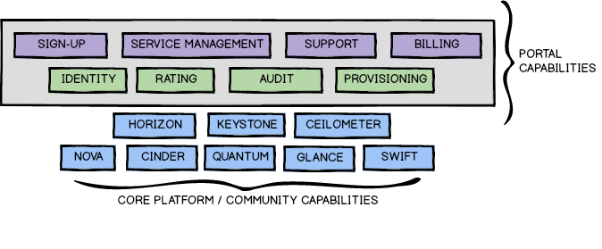
EXAMPLE OPENSTACK SERVICE PROVIDER ARCHITECTURE

Slide 8
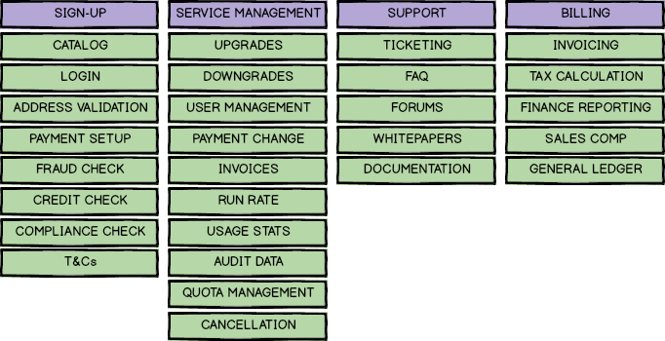
SERVICES DECOMPOSED

Slide 9
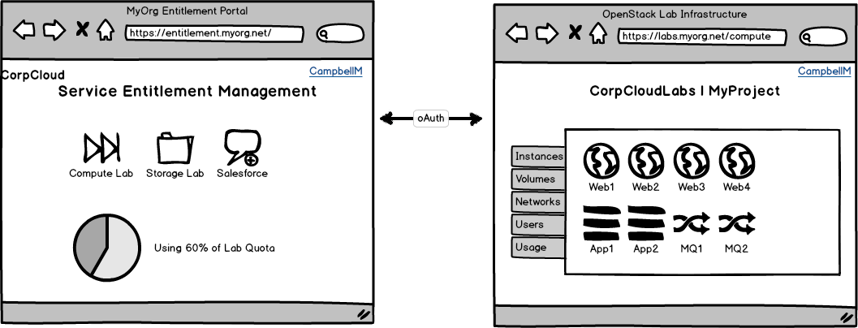
EXAMPLE OPENSTACK ENTERPRISE ARCHITECTURE

Slide 10
EXAMPLE OPENSTACK ENTERPRISE ARCHITECTURE

Slide 11
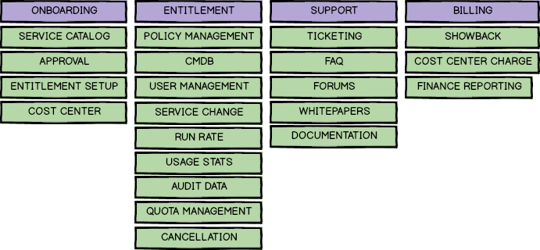
SERVICES DECOMPOSED

Slide 12
USER EXPERIENCE CONSIDERATIONS
Consumption Operations
OpenStack (and RESTful) APIs can be chatty
Build extensions to provide shortcuts for common operations
Leverage caching under shortcuts for performance increase
Supporting consumption
Provided as transparent cost management as possible
Leverage automation for customer facing tasks such as onboarding and service modification
Simplify user experience around common interactions

Slide 13
DISCUSSION / LINKS
Campbell McNeill
me@campbellmcneill.com
@campbellmcneill
Federation and oAuth
http://bit.ly/17w63jH
http://bit.ly/154h8sy
NIST Cloud Reference Architecture
http://1.usa.gov/10W097V
Dell
http://www.dell.com/OpenStack
https://cloudconsole.dell.com/Online/Signup/Products

