Slide 1


Slide 2
OpenStack in Production

Slide 3




Telco & Public Cloud
carrier grade

Slide 4



Enterprise Private Cloud
And others:
Major US Retailers
Major US Media Networks
Major global financial
Major petrochem services

Slide 5
























































Industry / Telco
Tech
Finance
Industry
Industry
Healthcare
Public sector
Education

Slide 6


25%
20%
15%
10%
5%
0%
2009
2010
2011
2012
2013

Slide 7



many many many many many many many many many many many many many many many many many many many many many many many many many many many many many many many many many many many many many many many many small servers deal with much more data
Hadoop HBase Condor MongoDB RIAK Node.js
Bigger servers deal with more transactions
Oracle, SAP, J2EE, SQL
Server Performance
Scale UP
Scale OUT
Data Volume

Slide 8
SCALE economics : tools : ecosystem

Slide 9
High Availability Ubuntu OpenStack HA by default

Slide 10

Fully certified.

Slide 11

Fully certified.

Slide 12
#1
Fast
Easy
Standard
Stable
Reference OS for OpenStack development Default IAAS in Ubuntu since 'Bexar'

Slide 13
KVM
First enterprise platform to ship KVM
Largest install base of host & guest

Slide 14
XEN
Majority of workloads on Amazon EC2
Full support for OpenStack with Xen

Slide 15

ESX ESX ESX ESX ESX ESX ESX ESX ESX ESX ESX ESX ESX ESX ESX ESX ESX ESX ESX ESX ESX ESX ESX ESX ESX ESX ESX ESX ESX ESX ESX ESX ESX ESX ESX ESX ESX ESX ESX ESX ESX ESX ESX ESX ESX ESX ESX ESX ESX ESX ESX ESX ESX ESX ESX ESX ESX ESX ESX ESX ESX ESX ESX
vSphere
+
+
Ubuntu OpenStack connects to vSphere & ESX fully certified and supported by Vmware & Canonical

Slide 16

+

Slide 17



Ubuntu is #1 Public Cloud Guest Linux

Slide 18
OpenStack matches Ubuntu cadence
I
Ubuntu 14.04 LTS
April 2014
H
Ubuntu 13.10
October 2013
“Grizzly”
G
Ubuntu 13.04
April 2013
“Folsom”
F
Ubuntu 12.10
October 2012
“Essex”
E
Ubuntu 12.04 LTS
“Diablo”
D
Ubuntu 11.10
“Cactus”
C
Ubuntu 11.04
OpenStack Release
Regular Ubuntu Release
Ubuntu LTS Release

Slide 19
Long-Term Support
M
Supported upgrade paths for OpenStack on Ubuntu
16.04
I
J
K
L
14.04 LTS
E
F
G
H
12.04 LTS

Slide 20


Slide 22
MAAS / Nova
Juju
diskimage-builder
os-config-applier
os-refresh-config
HEAT
Puppet / Chef
Packages
Provisioning Software Configuration State Orchestration

Slide 23



plug-in ecosystem

Slide 24
Ubuntu underpins 4 major fields of innovation
IAAS PAAS SDN SOSS

Slide 25
Management compliance – audit – updates – monitoring

Slide 26
Evolution experiment - evaluate - test & dev - production

Slide 27
20,000,000 users openstack uptime is our business

Slide 28
Predictable Pricing
Small <100 nodes $75k
Medium 100-499 nodes $180k
Large 500+ nodes $350k

Slide 29
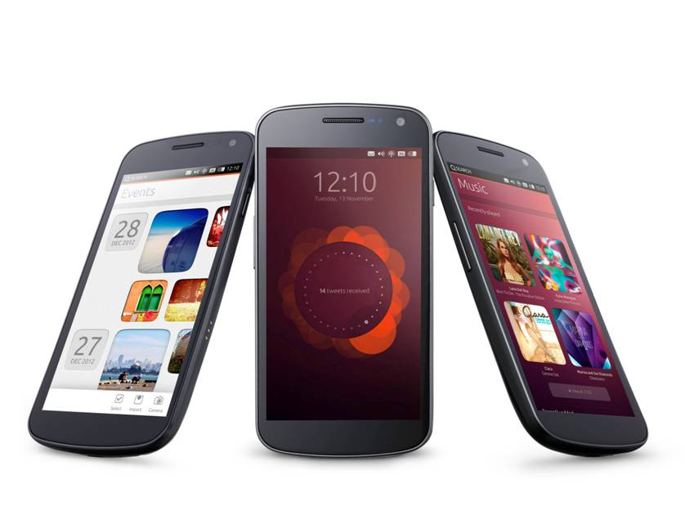
= VM Density

