Slide 1
Deploying from OpenStack Trunk into a Production Environment
Rick Lopez, Director of Quality Engineering
Rainya Mosher, Dev Manager, Deploy Infrastructure

Slide 2
Rackspace Deployment Goal
Deploying from OpenStack Trunk
To be able to deploy code from OpenStack trunk on demand to a multi-cell region in a reasonable amount of time with no customer impact
Notes:
Reasonable is an evolving definition that will continue to be refined and defined. No customer impact means the Public API remains 100% available and in-flight operations are able to successfully complete after a service restart (if required.)

Slide 3
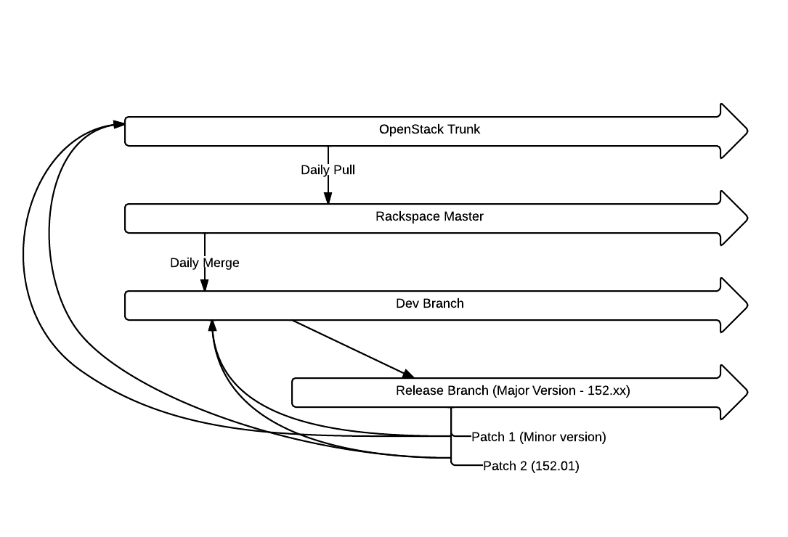
Deploying from OpenStack Trunk
Branch and Merge Strategy
resolve conflicts

Slide 4
Merge and Branch Strategy
Deploying from OpenStack Trunk
The most recent Rackspace release branch took over 50 minor tags make to work in production
Rackspace Development branch is about 40 patches on top of OpenStack trunk for internal service compatability
Notes:
Check out Wednesday’s session at 430p on how Rackspace is “Learning to Scale OpenStack” for the story behind the most recent internal release branch!

Slide 5
Package and Distribute Strategy
Deploying from OpenStack Trunk
Package
per-project venv
Distribute
seed .torrent
Execute
.tar of project venvs + configs
verify completion
verify completion
distribute fact files
run puppet
sync databases
switch version

Slide 6
Deploy and Test Strategy
Deploying from OpenStack Trunk
Dev
pre-code check-in validation
Integration
smoke tests
QA
functional tests
Pre-Prod
Production
regression tests
smoke tests
unit tests
integration tests
build tests
build tests

Slide 7
Benefits and Challenges
Deploying from OpenStack Trunk
Why We Do It (Benefits)
Why It’s Hard (Challenges)
Issue Resolution
Early detection of issues and conflicts
Shorter feedback loop within the community
Faster resolution of issues
Early Feature Delivery
Smaller, incremental periodic releases
More stable release candidates at end of cycle
Code Management
Merge conflicts with local patches
Disruptive DB migrations
Service restarts
Temporary version skew
Testing
Devstack-based testing vs testing at scale
Rework when issues found in RAX deploy pipeline
Process
CI/CD vs Release methodology
Time to merge patches

Slide 8
Looking Ahead
Deploying from OpenStack Trunk
Code Management
Rackspace is actively working to remove local patches that lead to conflicts
Non-disruptive DB migration pattern throughout OpenStack projects
Zero downtime service upgrades
API versioning for rolling upgrades
Testing
Provide way for deployer integration tests to move upstream
Engage community in bug fixes earlier
Process
Work with OpenStack Infrastructure Team on improving CI/CD into trunk
Look for opportunities to keep OpenStack trunk continuously deployable

Slide 9
Related Sessions in Portland
Deploying from OpenStack Trunk
TUESDAY, APRIL 16th
2:40pm in B110: Gating/Validation of OpenStack Deployments
5:20pm in B110: Beyond the API - End to End Testing of OpenStack
WEDNESDAY, APRIL 17th
2:40pm in B110: Rackspace testing engine case study/overview
4:30pm in C120/121/122: Learning to Scale OpenStack: A Case Study in Rackspace's Open Cloud Deployment
THURSDAY, APRIL 18th
9:00am in B119: Continuous-deployment for upstream Openstack

Slide 10
Deploying from OpenStack Trunk
Questions?

Slide 11
RACKSPACE® HOSTING | 5000 WALZEM ROAD | SAN ANTONIO, TX 78218
US SALES: 1-800-961-2888 | US SUPPORT: 1-800-961-4454 | WWW.RACKSPACE.COM
RACKSPACE® HOSTING | © RACKSPACE US, INC. | RACKSPACE® AND FANATICAL SUPPORT® ARE SERVICE MARKS OF RACKSPACE US, INC. REGISTERED IN THE UNITED STATES AND OTHER COUNTRIES. | WWW.RACKSPACE.COM

