Slide 1

Accelerating Cloud Innovation with OpenStack®

Slide 2

SDN

Slide 3
Cloud Computing

Slide 4
WHO IS HP?

Slide 5

HP INDEMNIFIED
LINUX
AGAINST SCO
2003

Slide 6
1
LINUX SERVER
EVERY MINUTE
Today

Slide 7

LAUNCHED
OPENSTACK
PUBLIC CLOUD
2011

Slide 8
HELPED CREATE
OPENSTACK FOUNDATION
2012

Slide 9
HOW DOES HP HELP
THE OPENSTACK ECOSYSTEM?

Slide 10
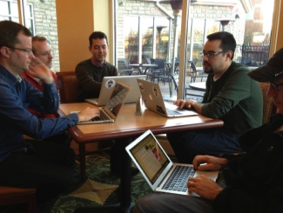







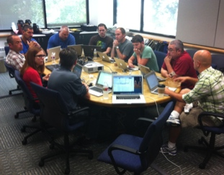




Slide 11
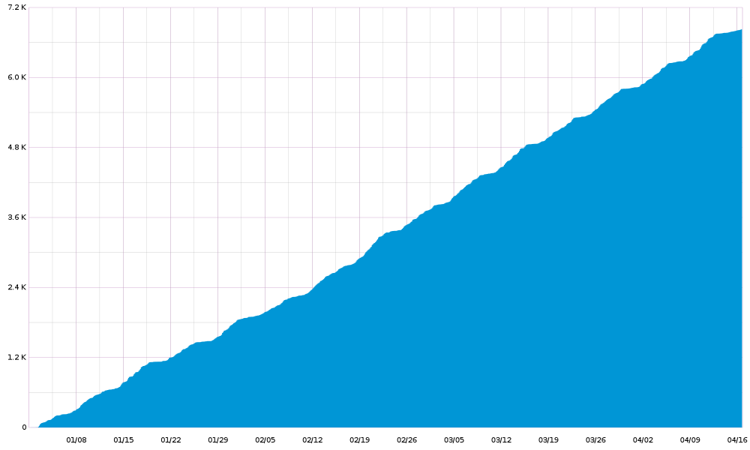
Continuous Integration

Slide 12




Enterprise-Grade Hardening helps make OpenStack work for Customers
Infrastructure scale and testing
Hardened security
Operations enhancements

Slide 13
Triple O: OpenStack On OpenStack
OpenStack
Nova on Metal
Base OS
diskimage builder
Nova Nodes
Heat
os config applier
OpenStack
os config refresh

Slide 14
Heat: Orchestration for OpenStack
OpenStack
REST API
Nova
Heat Engine
Template
Pluggable Interpreter
Cinder
Template
Networking
Pluggable Interpreter
Template
Etc…

Slide 15
Core Work
Nova Affinity Scheduler
Cinder Backup
Increased Tempest tests 28%

Slide 16



Nova
Glance
Swift

Slide 17
Nova
Horizon
Glance
Networking
Keystone
Swift

Slide 18
Nova
Horizon
Block Storage
Databases
Account maintenance
DNS
Alarming
Automation
Glance
Load Balancing
Billing
Networking
Orchestration
Messaging
Keystone
Metering
Monitoring
Swift

Slide 19
DNS as a Service
REST Calls
API
Manager
DNS Service
Nova & Quantum Events
Sink
DNS Lookup

Slide 20
Relational Database as a Service
Nova
Container
REST API
Manager
Agent
Service

Slide 21
HP CloudSystem 7.2
HP’s pre-integrated server, storage, networking, and software cloud solution
OpenStack support for Nova, Keystone, Glance
Private cloud bursting into public cloud

Slide 22
Delivering OpenStack
Private
Managed
Public

Slide 23


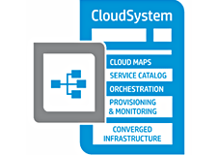

Delivering OpenStack into the future
HP SDN Cloud Extensions
Top Secret
HP’s Portfolio on OpenStack
Top Secret
HP
CloudSystem 7.2
HP Public Cloud
HP 3PAR Storage
2011
2012
2013
2014

Slide 24
Thank You

