Slide 1
Interactive Visual Orchestration With Curvature and Donabe
Sam Betts John Davidge Jack Fletcher Bradley Jones
Mentors:
Debo Dutta
Lew Tucker
Office of the Cloud CTO
OpenStack Summit April 2013 - Portland

Slide 2
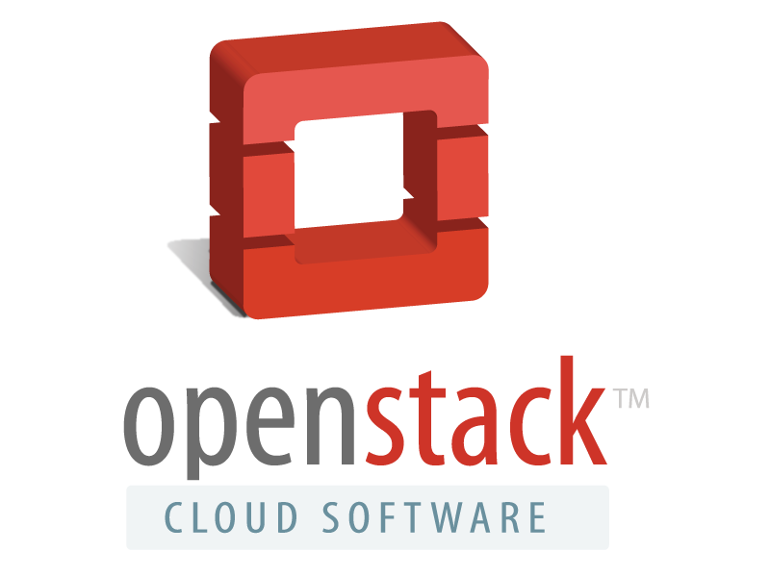
Curvature and Donabe - Agenda
How did we get here?
What is Curvature?
What is Donabe?
Questions?

Slide 3
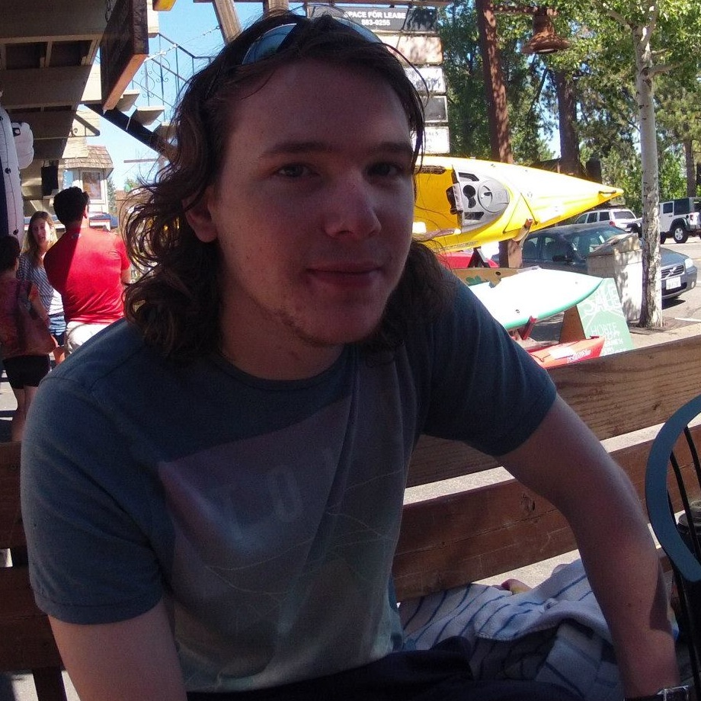
Speaker Background
Software Engineering Interns in the Office of the Cloud CTO
Sam Betts
John Davidge
Jack Fletcher
Bradley Jones
Computer Science Undergraduates
University of Kent, Canterbury, UK

Slide 4
Curvature - Concept Work
Early exploration of virtual network visualization

Slide 5
Curvature - Concept Work
Even basic visualization can be very powerful for understanding your virtual network
A system that can represent a virtual network visually and communicate it to the user is the first step
What if we can make this work both ways?

Slide 6
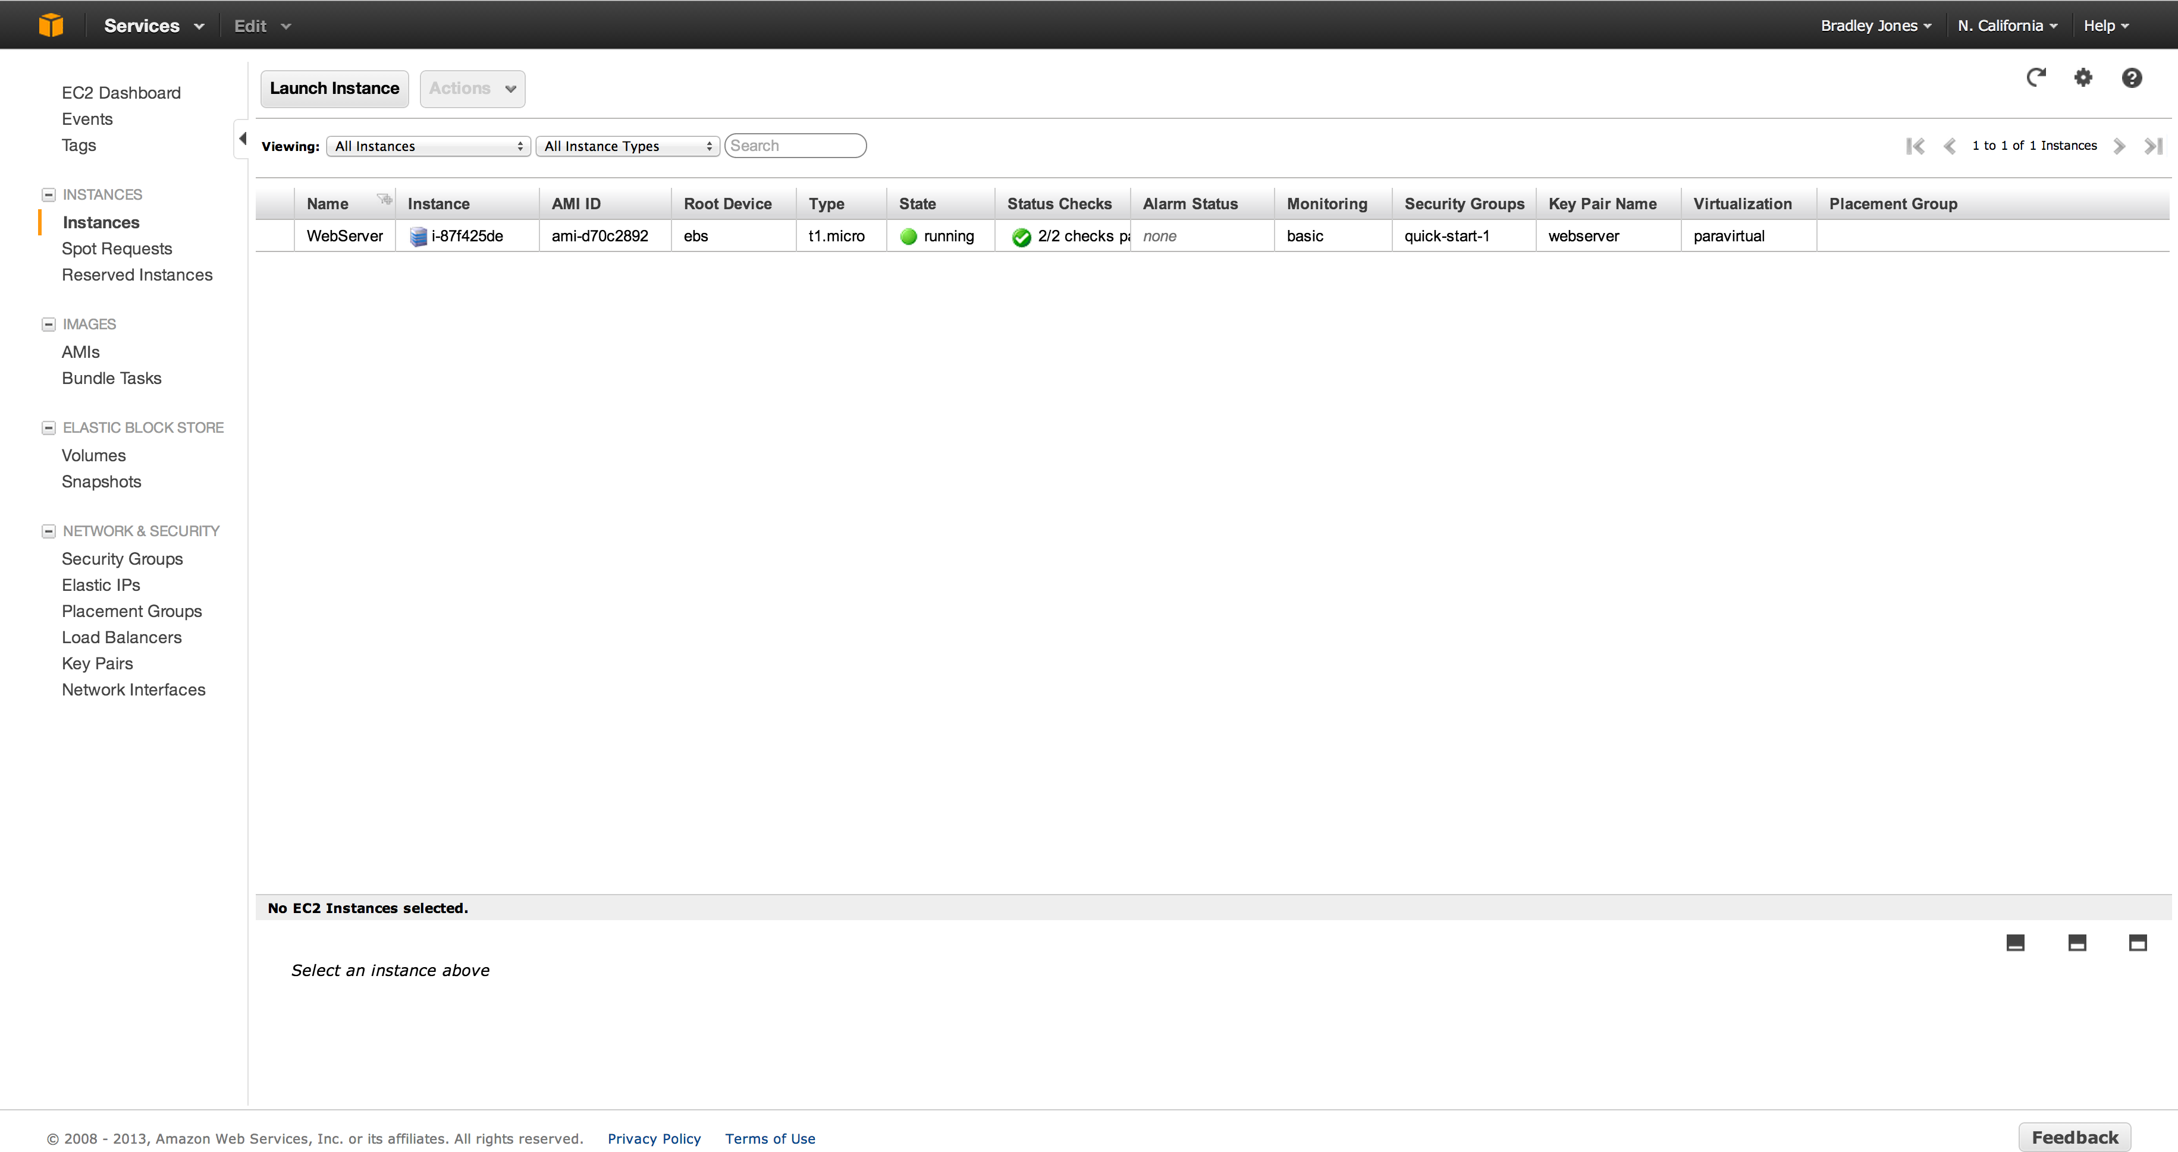
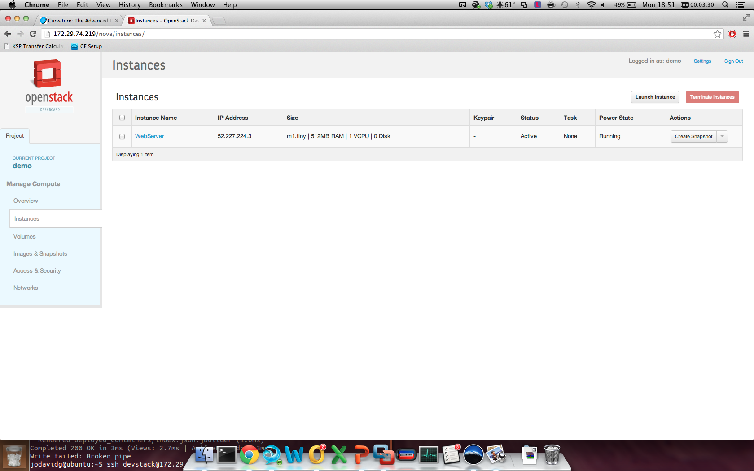
How do users interact with clouds?
Amazon EC2
OpenStack Horizon

Slide 7
Curvature & Donabe
Two services, one philosophy:
Make OpenStack Easier to Use

Slide 8
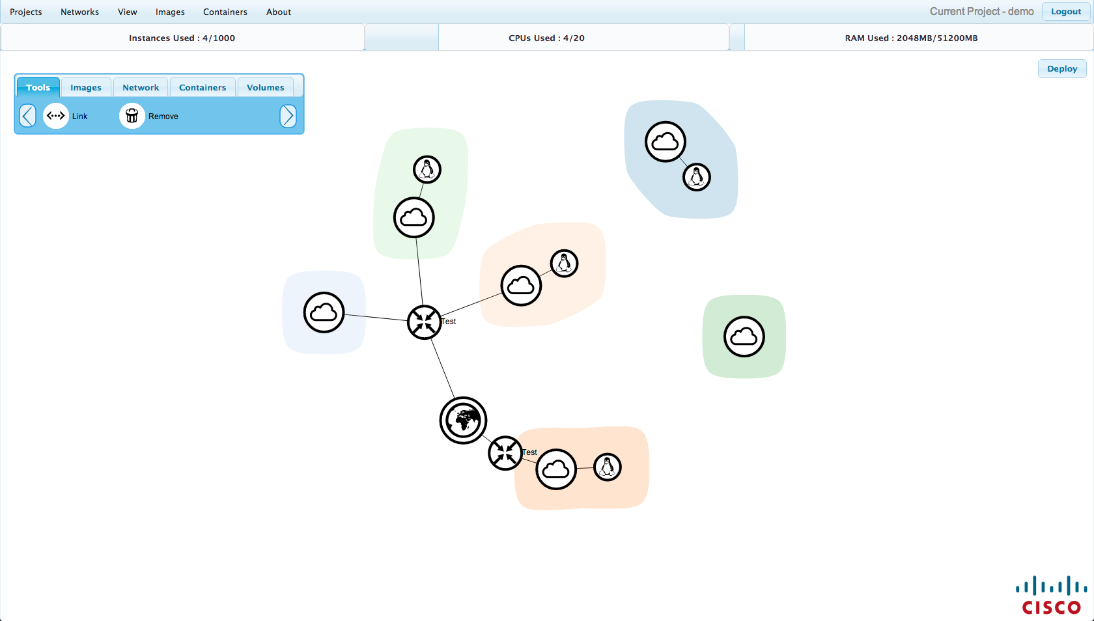
Curvature
Interactive / Tactile
Visual / Logical
Extensible / Adaptable

Slide 9
Demo
Curvature

Slide 10
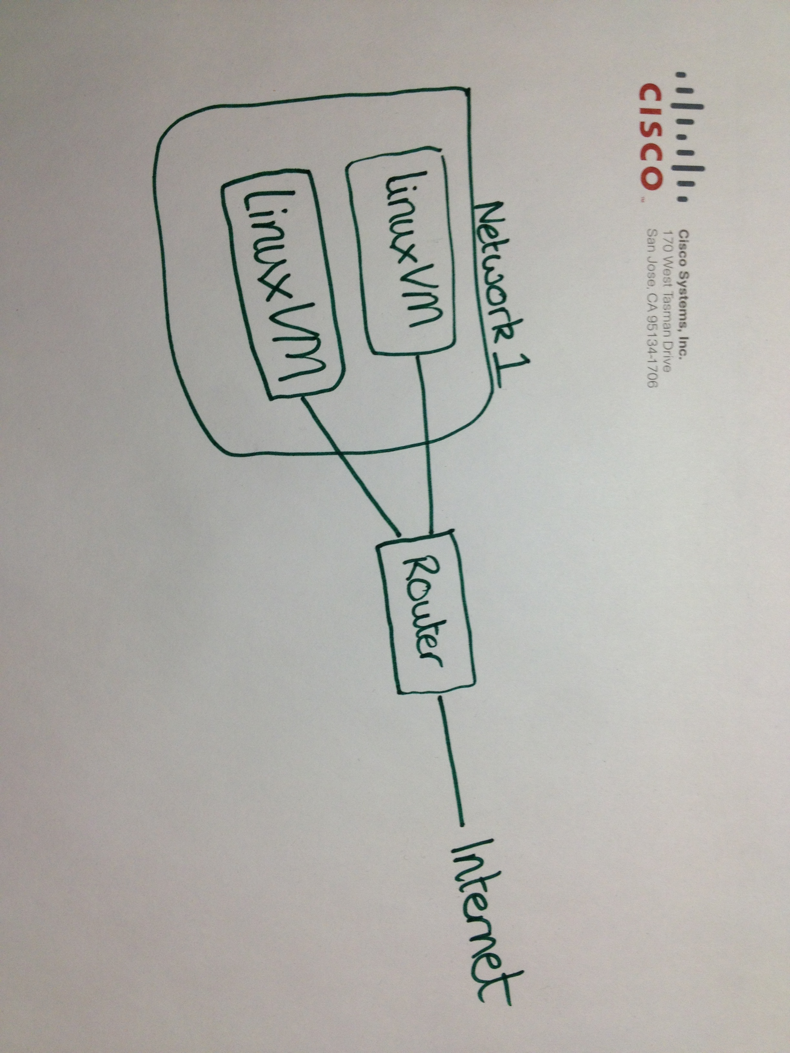
Curvature

Slide 11
Curvature – Lessons Learned
Visual network design turned out to be a great success in user trials within Cisco
People using Curvature to interact with Quantum for the first time just got it – it took away the mystery of Horizon or the CLI
Building complex application topologies became a trivial task. A need to exploit this by making these topologies repeatable was identified

Slide 12
Donabe - Origins
First proposed at the Essex summit in 2011 by Debo Dutta and Rick Clark
https://wiki.openstack.org/wiki/Donabe
Defines a system of application ‘containers’ that describe the virtual topology of an application
Notes:
Our manager, Debo Dutta, already had experience with the idea of saving repeatable application designs
Formalized these ideas in the proposal for Donabe in 2011

Slide 13
Donabe – Container Structure
A container can have zero to many
Routers (Quantum)
Networks (Quantum)
Virtual Machines (Nova)
Containers (Donabe)
Notes:
Similar to HEAT, but much simpler
Focuses on the virtual application topology, rather than the applications running on the VMs

Slide 14
Donabe – Container Structure
Endpoints
Any node within a container can be defined as an endpoint
Allows connectivity to nodes outside the container
Notes:
Similar to HEAT, but much simpler
Focuses on the virtual application topology, rather than the applications running on the VMs

Slide 15
Donabe
Completely separate from Curvature
Interaction via REST API
Notes:
Similar to HEAT, but much simpler
Focuses on the virtual application topology, rather than the applications running on the VMs

Slide 16
Demo
Curvature with Donabe

Slide 17
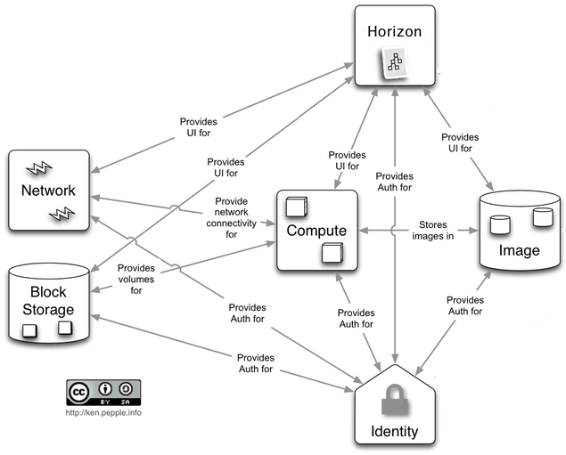
Current Conceptual Architecture
Source: http://docs.openstack.org/trunk/openstack-compute/admin/content/conceptual-architecture.html

Slide 18
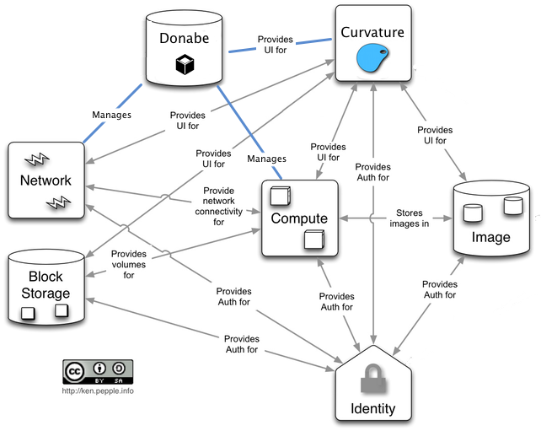
New Conceptual Architecture

Slide 19
Planned Features
Curvature
Saving & Sharing Network Designs
Donabe
Modification of live containers
Meta-data Service

Slide 20
In Summary
Curvature
Designed to be extensible
Donabe
Designed to work with services like Curvature via REST API
To be open-sourced soon

Slide 21
Sam Betts
John Davidge
Jack Fletcher
Bradley Jones
sambetts@cisco.com
jodavidg@cisco.com
jafletch@cisco.com
bradjone@cisco.com
Thank you

