Slide 1
OpenStack at NSA
Infrastructure as a Service
Nathanael I Burton
National Security Agency
15 April 2013

Slide 2
Thank You
Notes:
Thank you giving me the opportunity to speak today and share the story of how NSA implemented our private IaaS cloud
We very infrequently have an opportunity to talk in public about what we do
Thank you NASA and Rackspace for partnering and founding OpenStack
Thank you for fostering an inclusive and thriving community
Thank you for releasing the project as open source
Revolutionary and paradigm changing
The “cloud” deserves to be built on open standards and apis
Thank you for allowing innovation and specialization by both open source and commercial.

Slide 3
Introduction
National Security Agency
IT Challenges
Private, IaaS Cloud – OpenStack
Notes:
Today I’m going to talk about the National Security Agency (NSA) and what we do
The challenges and problems we faced with our IT Environment
Lastly, I’ll walk through a story about how we built a private Infrastructure as a Service (Iaas) cloud that helped us address some of those challenges

Slide 4
[[REDACTED]]
Number of users:
Number of systems:
Number of servers:
Storage capacity:
Applications used:
Favorite color:
Notes:
But … there are some things I won’t be able to talk about.

Slide 5
National Security Agency
http://www.nsa.gov/about/_images/pg_hi_res/NeverSleeps_071310.jpg
Notes:
I work at the NSA as a Computer Scientist
I’ve worked there for a little over 10 years
Our headquarters is located in Fort Meade, MD

Slide 6
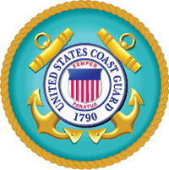
NSA: Intelligence Community
Notes:
The NSA is one of 16 agencies and organizations in the Intelligence Community under the Office of the Director of National Intelligence (ODNI).

Slide 7
NSA: Mission
Signals Intelligence
Information Assurance
Notes:
Signals Intelligence:
Intelligence gathering and analysis of signals for Foreign Intelligence purposes
Information Assurance: - Protecting and securing U.S. Government systems

Slide 8
NSA: Areas of Innovation
Computer Science
Mathematics
Cryptanalysis
Foreign language analysis
Notes:
Technical workforce:
In contrast to many other government agencies, the NSA has a large technical workforce with an active technical civilian population
Augmented by military and contractor employees
Fields such as Computer Science, Mathematics, Cryptanalysis, and Foreign Language Analysis
Foreign language: - Leading place to work in foreign language analysis and research
Machine learning, machine translation, linguists

Slide 9
NSA: Technology
All the Technologies!
Commercial
Open Source
In-House
Notes:
We use all types of technology
Commercial
Open Source
In-house developed software
Everything including:
Operating systems
Virtualization technology
Programming languages
Application frameworks
Hardware
Build vs. Buy:
Make build vs. buy decisions on a case by case basis
If product exists that meets all our requirements we’ll use it
Open Source:
However, some of our challenges and unique problems related to security, scale, performance, etc necessitate custom solutions
Open source gives us the flexibility to augment and tweak the system to suit our needs

Slide 10
“Cloud”?
http://www.flickr.com/photos/dexxus/5454005272
Notes:
Most people think of clouds (the kind in the sky), when they hear the term cloud.
In the media (TV, news, Internet), cloud is everything – a panacea!
Technology Industry:
In the technology industry, the common usage of ‘cloud’ is for software, platform, infrastructure, everything as-a-service.
Things like email, databases, web application platforms, virtual machines, etc.

Slide 11
“Cloud” at NSA
Big Data
Notes:
Big Data:
Being able to take data and enrich it across other data sets
Scaling beyond traditional ingest, index, and search workflow
Provides more flexible and agile data analysis

Slide 12
Big Data at NSA
Hadoop
Accumulo
Developed by NSA
Inspired by Google BigTable Paper
Open Source, Apache Software Foundation
Images: Licensed under the Apache License, Version 2.0
Apache Hadoop , Apache Accumulo are trademarks of the Apache Software Foundation
Notes:
Hadoop:
Legacy technologies hitting the wall
Need improved scale & agility
Accumulo

Slide 13
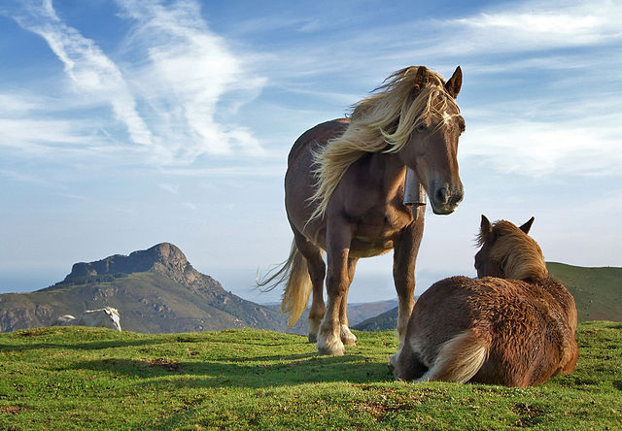
Carbon-based IaaS
Manually Intensive
Stovepipes of Excellence!
SOMEDAY YOU’LL BE A UNICORN!
http://commons.wikimedia.org/wiki/File:Biandintz_eta_zaldiak_-_modified2.jpg
http://commons.wikimedia.org/wiki/File:Traffic_cone.png
Notes:
Manually intensive:
Very little end to end automation and orchestration
Within a component things are automated, but …
Stovepipes of excellence:
Separate teams or entire organizations for the main technical components:
DNS, IP addressing, Network connectivity, Storage, Virtualization, OS installation, …
Lots and lots of tickets between the teams/orgs
Which means lots of humans

Slide 14
Carbon-based IaaS: An Example
I have an idea!
http://www.flickr.com/photos/goopymart/8521955193
Notes:
An example of a user going through the previous hosting process

Slide 15
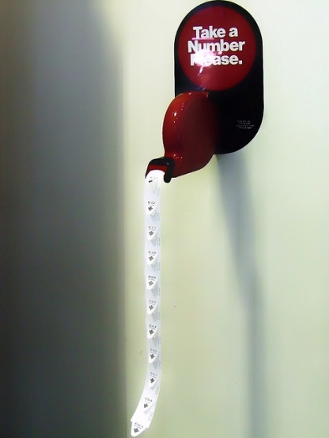
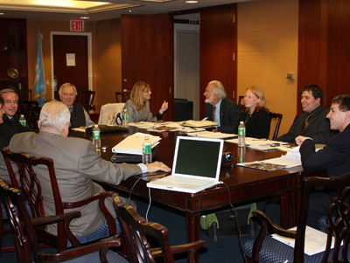
Carbon-based IaaS: An Example
http://www.flickr.com/photos/ipdegirl/7827785878
http://www.flickr.com/photos/andresrueda/3259487071
http://commons.wikimedia.org/wiki/File:Board-Meeting.png
Notes:
An example of a user going through the previous hosting process
Hosting request form
Capacity management board
Deployment queues, many of which were serial processes
Hardware / virtual
IP
DNS
Storage
OS installation
Software configuration
Security Approval

Slide 16
Carbon-based IaaS: An Example
Weeks or months later…
Notes:
An example of a user going through the previous hosting process

Slide 17
Carbon-based IaaS: An Example
What was my idea again?
Notes:
An example of a user going through the previous hosting process

Slide 18
The Problem
Too much time from
idea to capability
Needed scale, agility
Notes:
Large bureaucracy:
Large government agency
Lots of organizations, teams, enclaves
Fragmented development and production hosting
Too much lag time from idea to capability
Like our reasons for using Big Data systems, needed scale and agility

Slide 19
Proposed Solution
Lower barriers to entry
Self-service, on-demand
Elastic
API access
Private OpenStack IaaS Cloud
Notes:
I’ve described our background, our challenges, and a hypothesis for how to fix them; now I’m doing to walk through our story of going from carbon-based IaaS to silicon-based.

Slide 20
OpenStack Pilot
Diablo Summit
Two mad scientists
Repurposed Stole a rack
Lab
Notes:
I started our pilot by attending the Diablo Design Summit in Santa Clara, CA in April 2011
As a techie, I was excited and invigorated by new technology being created and the enthusiastic community
However, I was a bit uncertain that it would work since this was still the early days
Based on my previous example of the process to build a new system, to get started on our pilot we stole a rack in one of our labs and repurposed it for the OpenStack pilot

Slide 21
OpenStack Pilot: Goals
Try out OpenStack
Offer flexible hosting
Automate lab infrastructure
Notes:
Our goals were fairly simple
We wanted to try out OpenStack by offering much quicker and more flexible hosting by automating the lab infrastructure and management

Slide 22
OpenStack Pilot: Results
Working Pilot in two weeks:
Cactus
API / CLI
10’s of users
Improved service delivery time
Limited capabilities:
Lab
Firewall / network isolation
Toys
Notes:
Within about two weeks we had a working system and feedback from users who were using it.
The users were amazed that they didn’t have to go through nearly as much trouble to simply host something as they had in the past.
This was the first sign that we might have a way of solving our IaaS problems.

Slide 23
Patient Zero
http://www.flickr.com/photos/origamiancy/6137629982
Notes:
Surprisingly, OpenStack worked
It didn’t take heroics, but it did take a fair amount of knowledge to install, configure, and operate.

Slide 24
What Next?
Let’s go bigger!
Notes:
Given that patient zero was a success and in order to really be able to tell how the system would work in our environment, we had to go bigger

Slide 25
Beyond the Lab
More hardware
More users
More use cases
More data
http://www.flickr.com/photos/goopymart/616618169
Notes:
Obviously we wanted access to:
more hardware
more users
more use cases
more data
To this end, we decided to co-locate our first operational OpenStack system with one of our Big Data systems

Slide 26
Beyond the Lab
Co-located with Big Data system
Started with half rack
Access to mission data
Use cases:
RDBMs
Web applications
Non-Hadoop processing
Notes:
Started with half a rack, tripled over time
This time we had access to slightly bigger and better servers
Access to real data. Instead of building “toy” applications, users were actually able to get access to real mission data and talk to external systems and users.
This was our first operational OpenStack system.

Slide 27
Results
100’s of users
“Fail fast” model
Generous with capacity
Huge potential
Notes:
Over a period of six months we gained 100’s of users
We started seeing more of the “fail fast” model of development, where developers would try out ideas to determine if there was value in pursuing them in more depth
With this second system, we were fairly generous with capacity, but we would playfully shame abusers or hoarders of capacity, to make the system useful for everyone.
As users were able to develop using real data and access to real systems, we really began to see the huge amount of potential and general applicability of making our environment more efficient and flexible.

Slide 28
Patient One
MORE unicorns!
http://commons.wikimedia.org/wiki/File:Invisible_Pink_Unicorn.svg
Notes:
This became known as patient one, and had more unicorns.

Slide 29
Making It Real
Production
http://commons.wikimedia.org/wiki/File:Compass_Barnstar_Hires.png
Notes:
At this point if we really wanted to change the IT environment we had to think very strategically
We needed to think about how to overcome some of the obstacles to broader adoption
Organizational challenges
Resource challenges
We had to plan our path for launching a production system with general availability, something that could operate within the NSA IT environment.

Slide 30
Automation
Puppet / Kickstart
Installation
Configuration
Enforcement
Management
Bare metal to OpenStack in 20 minutes!
Notes:
Prior to going production, we had to automate the installation, configuration, configuration enforcement, management, etc of the system
We are now at the point where we can go bare metal to OpenStack in about 20 minutes

Slide 31
Our Middle Name
Harden the system:
Operating System
OpenStack APIs
Database
Message Queue
Guest OS
SSL Everywhere!
Notes:
Especially since the previous implementations (patient 0 and 1) were more isolated, we had to start thinking hard about the security of the system.
Ensure protection of the users, data, and applications
Securing the guest OS via image instrumentation:
Baked in security, logging, auditing, and standard practices

Slide 32
Accounts? $$$?
Amazon, Dreamhost, Rackspace …
NSA
PKI!
http://www.flickr.com/photos/9731367@N02/7113235069
Notes:
We had to figure out how we were going to manage accounts, and billing, or at least have some way to determine accountability via metering and showback
With public cloud providers, such as Amazon, Dreamhost, Rackspace, etc, it’s easy!
They simply take a credit card upfront and bill you based on usage.
Inside the NSA that simply isn’t possible today (maybe in the future)
But what’s really awesome is that NSA, and actually most of the Department of Defense community, has a ubiquitous PKI system
Everyone has a PKI certificate, which makes building systems that need to do authentication of users really easy
It also gives us accountability in order to track resources and tie them to people, organizations, or projects.

Slide 33
Free Tier
Have PKI? You’re in!
Auto-account creation
Notes:
Since every user has a PKI certificate we were able to create a “free tier” within our OpenStack system
Where without submitting a ticket or asking your boss for approval, you get a “free” account in the system with a limited quota
Really enables developer creativity and eliminates barriers to trying out ideas.
Remember the weeks or months that requests would take before in the carbon-based IaaS system, now with the “free tier” users are able to provision themselves a new VM within minutes.
And they never had to talk to anyone!

Slide 34
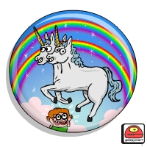
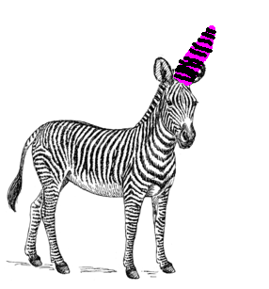
Outbreak
http://www.flickr.com/photos/goopymart/6917974213/
http://commons.wikimedia.org/wiki/File:Unicorn_llama.jpg
http://commons.wikimedia.org/wiki/File:Zebra_%28PSF%29.png
http://www.flickr.com/photos/bulius/4839345269

Slide 35
An Epidemic
Opened for general availability:
Silent launch, viral growth:
100’s of users in first weeks
Production workloads
Migrated from Diablo to Folsom
Still managed by a small team!
Notes:
When we finally went general availability and went live, we didn’t even announce or market our system and we had 100’s of users within the first few weeks – simply through word of mouth.
We’ve now been running production systems for almost a year and we’ve migrated from Diablo to Folsom
We received incredible feedback from the users of the system about how it drastically made their development lives better.

Slide 36
Changing Behavior
Development patterns:
“In a box” recipes
System lifecycle
Common environment
Better collaboration
Better development
Notes:
As usage of the system grew, we started seeing changing development patterns
Use and sharing of automated recipes of application stacks such as httpd, jboss, tomcat, “in a box”
Changed the system lifecycle from rigid dev, test, production workflow each their own separate environment, to now each user or project chooses the system lifecycle that works best for them and allow users to leverage paradigms like devops.

Slide 37
Disruptive Change
We broke things
Change or eliminate process
Rethink problems
Notes:
We broke lots of things along the way, from things like scaling VlanManager (vlan limitations, such as the vlan port instance limits).
We hit roadblocks with external systems that didn’t have APIs or automated interfaces
Certification and Accreditation:
Paradigm shift in how systems were certified and accredited
Used to very rigid and formal process
- Collect documentation and artifacts
- Engineering diagrams
- Standard operating procedures
- Data flow
- Software list
- Network information

Slide 38
Changing the Game
Agility
Flexibility
Scalability
Better mission systems!

Slide 39
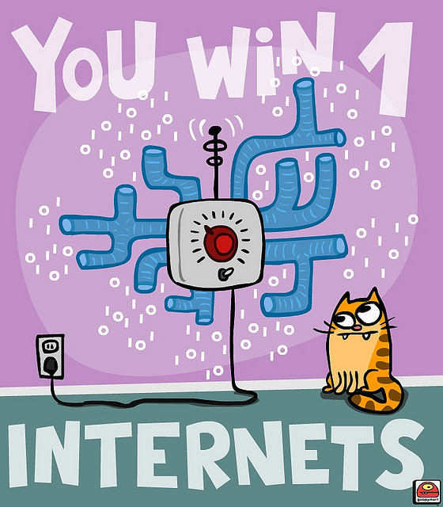
Win Win!
http://www.flickr.com/photos/goopymart/3125898045

Slide 40
Win Win!
Lowering risk,
while increasing flexibility
Trust but verify
Security
Accountability
Central reporting
Logging
Metrics
APIs on everything

Slide 41
IT Efficiency = Time = $$$
Notes:
Implementing a private IaaS cloud based on OpenStack has completely transformed IT at NSA
There’s a large activity to stand up an IC-wide cloud environment and NSA is pioneering for the ODNI that effort and will be rolling out an OpenStack-based cloud across the entire IC within the next few months

Slide 42
Next Steps
Continued growth, scaling
Folsom to Grizzly ++
Open source contributions
More community participation
We’re Hiring!
Notes:
As we look to our future with OpenStack we intend to continue growing and scaling out the system as demands require and follow the upstream development cycle
Over the past six months we’ve slowly begun making contributions back to OpenStack, with the bulk of that time being spent on sorting out our internal processes for working with the open source community.
We’ve released a little under a dozen contributions, but hope to increase that going forward and also participate more with the community
Lastly, we’re hiring!

Slide 43
Thank You
Nathanael I Burton
National Security Agency
15 April 2013
Notes:
KTHXBAI!

