Slide 1


Orchestration of Fibre Channel Technologies for Private Cloud Deployments
OpenStack Summit; Ecosystem Track
April 15th, 2013
Oregon Convention Center
777 NE Martin Luther King Jr Blvd
Portland, OR 97232

Slide 2
Agenda
Why are we adding Fibre Channel support to OpenStack?
What’s available in Grizzly?
What’s being planned for Havana?
How can you get involved?

Slide 3

Adding OpenStack Fibre Channel Support

Slide 4
Why are we here?
Development group came together at the Grizzly Design Summit – Oct ’12
Purpose:
Extend OpenStack with the ability to provision infrastructure using Fibre Channel SAN interconnect
Cross industry participation
HP, Brocade, EMC, IBM

Slide 5
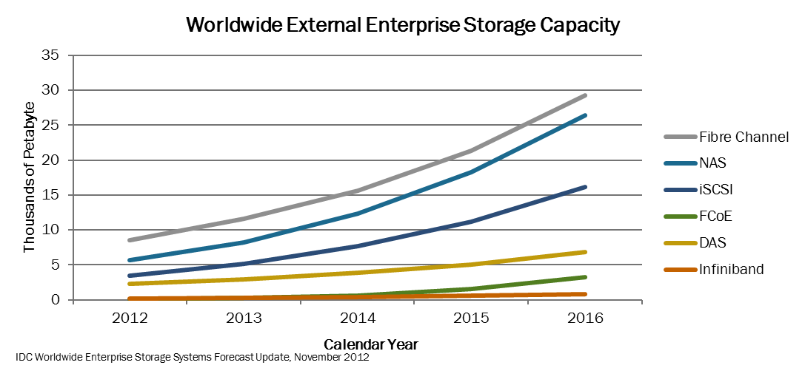
FC storage (PB) predicted to have 36% CAGR (2012-2016)

Slide 6
Why are we bringing FC into OpenStack?
To make it easier for enterprise data center private cloud deployments to use OpenStack
Option for enterprise data centers to leverage their established storage infrastructure & expertise
Leverage the performance, resiliency and security associated with FC SAN for private cloud deployments
Support application requirements for block storage
FC in addition to iSCSI

Slide 7
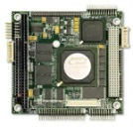
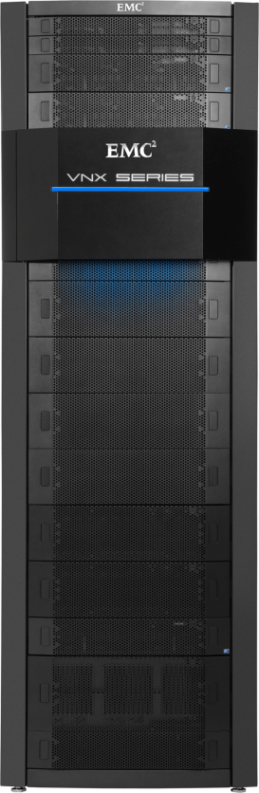


OpenStack FC Use Case
Embracing customer options where alternatives exist
Application Use Case: Low Latency transactional workloads:
Migration of legacy workloads to OpenStack private cloud
New applications leveraging enterprise class infrastructure
Benefits:
Share existing resources and infrastructure
HA/High Perf QOS Storage Configs within Cinder
Remote replication
OpenStack
Legacy
Legacy
Migrate
Nova
Cinder
Orchestration
IP
FC
WAN

Slide 8
What have we accomplished?
Created two Fibre Channel blueprints under the Cinder initiative
Fibre Channel Block Storage
Blueprint approved and implemented in the Grizzly release
Fibre Channel Zone Manager
Blueprint submitted as a discussion item for Havana
First Fibre Channel Session at an OpenStack Summit

Slide 9
Fibre Channel Grizzly Support

Slide 10
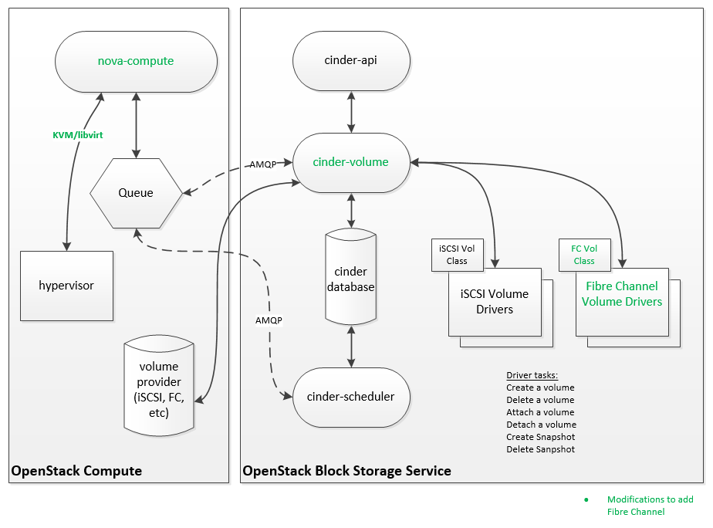
Fibre Channel – Grizzly Changes
Cinder changes to add support for FC volume class driver
Cinder changes to add support for FC volume attach
Nova changes to support FC volume attach
KVM hypervisor only
Reference Cinder FC volume driver
HP 3Par FC array driver

Slide 11
Infrastructure Support
Single or multi-path infrastructure supported
SCSI initiator & target WWN’s exchanged between nova/cinder on storage attach to configure into hosts/storage
Hypervisor responsible for attaching disks to VM’s (same as iSCSI)
VMs
Linux / KVM
FC SAN
Storage Arrays
Hosts
FC
HBA
FC SAN

Slide 12
What can be done with Grizzly?
Vendors can develop Cinder drivers for arrays exporting Fibre Channel storage
HP 3Par FC driver is a reference implementation
Enterprises & Service Providers can run OpenStack using Fibre Channel SAN infrastructure connecting servers & storage
Users create & attach volumes to VMs in the same way as with iSCSI block storage.
No change to the user experience

Slide 13
Known limitations
What about SAN zoning?
In Grizzly release, no automated SAN zoning support was added
Requires FC SANs to be either pre-zoned or Open zoned.
Being addressed in Havana release
Security
iSCSI volume attach secures volume access to hosts via CHAP username/secret configured on initiator and target
No equivalent mechanism in FC to secure per-volume attaches
Volume access control tied to host initiator WWN’s on arrays
NPIV on hosts allows masquerading to occur for host to gain access to unintended volumes
FC solution is only secure when users do not have access to alter FC initiator address WWN’s
Hypervisor Support
Grizzly implementation supports KVM
VMware support coming in Havana release

Slide 14
Havana Cinder FC SAN Zone/Access Control Manager Proposal
Orchestrator
(OpenStack)
OpenStack
Volume Manager
(Cinder extended for FC/FCoE)
FC SAN Zone Manager
Storage
SAN

Slide 15
FC SAN Zone/Access Control Manager
Fibre Channel block storage support was added in Grizzly but there is no support for automated SAN zoning (FC SANs are either pre-zoned or open zoned)
Add support for FC SAN Zone/Access Control management feature – allowing automated zone lifecycle management in the attach/detach entry points of the volume manager (when fabric zoning is enabled)
Introduce Fibre Channel Zone Manager plug-in interface API for automated zone lifecycle management – enables SAN vendors to add support for pluggable implementations
SAN context option in Nova

Slide 16
Requirements/Use Cases
Defaults and capabilities - support for FC SAN configuration settings (e.g. zoning mode, zone grouping policy, zoning capabilities etc.)
Add active zone interface to add the specified zone to the active zone set
Remove active zone interface to remove the specified zone from the active zone set
Support for provisioning and enumerating SAN/Fabric contexts

Slide 17
Fibre Channel Zone Manager
Simplified zone management
Active zone set management
Small and medium deployments
Enhanced zone management (post Havana)
Support for full zone life cycle management
Large enterprise (managed) deployments
Fibre Channel Volume Driver integration
VolumeManager uses FibreChannelZoneManager for zone lifecycle management (in the attach/detach entry point) when fabric zoning mode is enabled

Slide 18
Storage Vendor work being done with Fibre Channel

Slide 19
EMC FC / OpenStack Havana
EMC FC Volume Driver contributions to OpenStack in Havana pending
VMAX family
VNX family
Built atop iSCSI support already in Grizzly
Related Futures
Multiple QOS support per volume driver
Testing with FC Zone Manager Havana effort

Slide 20
Havana FC Design Sessions
Cinder: FC SAN Zone/Access Control Manager
Thursday, April 18th; 3:20pm – 4pm; room B110
Cinder: Multi-Attach and Read Only Volumes
Thursday, April 18th; 9:50am – 10:30am; room B110
Nova: VMware compute driver roadmap session
Thursday, April 18th; 9:50am – 10:30am; room B113

Slide 21
Summary
Fibre Channel SAN technology is utilized by most Enterprise data centers today
With Grizzly release, OpenStack can now be used with Fibre Channel SAN infrastructure
Additional Fibre Channel work coming in Havana
If you want to plug into the Havana Fibre Channel development effort, contact:
Andre Beausoleil abeausol@Brocade.com – Brocade
Gary Thunquest gary.thunquest@hp.com – HP
Edgar StPierre edgar.stpierre@emc.com – EMC

Slide 22
Thank you!

