Slide 1
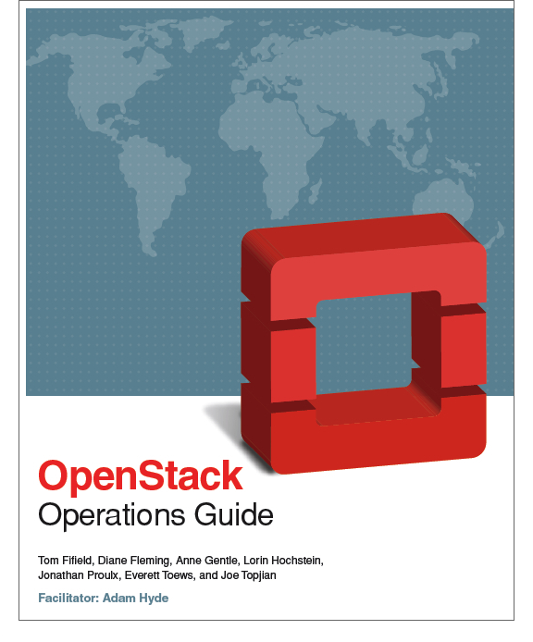
Writing the OpenStack Operations Guide in 5 Days

Slide 2
Anne Gentle
OpenStack Doc Lead
Technical Committee
Rackspace
@annegentle

Slide 3
Joe Topjian
Sys Admin
Cybera
@jtopjian

Slide 4
Lorin Hochstein
Lead Architect
Nimbis Services
@lhochstein

Slide 5
Jonathan Proulx
Sys Admin
MIT Comp. Sci. AI Lab
@sudo_jon

Slide 6
Tom Fifield
Cloud Architect
U of Melbourne
NeCTAR
@EvilTomFifield

Slide 7
Everett Toews
Developer Advocate
Rackspace
@everett_toews

Slide 8
docs.openstack.org/ops/

