Slide 1




Networking in the cloud: An SDN primer
Ben Cherian
Chief Strategy Officer
@bencherian
Midokura

Slide 2
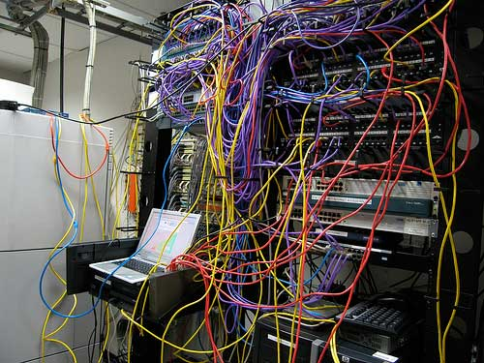
The current state of networking is too manual
Notes:
Networking is not built for a self-service cloud world

Slide 3
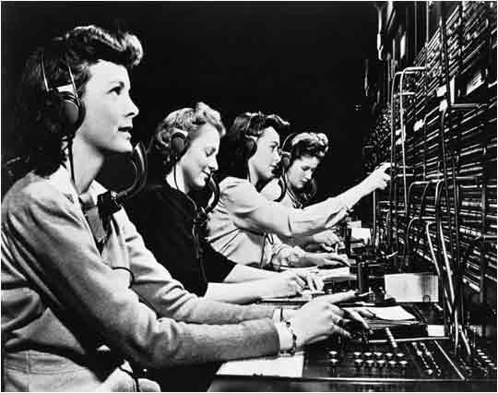
Telecom has this problem before

Slide 4
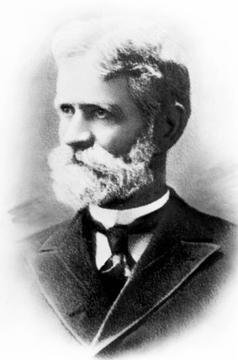
Almon Strowger – mortician, inventor, and possibly paranoid
Notes:
Patron saint of SDN
Undertaker from Topeka, Kansas
Rumor has it:
Almon believed calls sent to “the undertaker” weren’t being routed to him
Thought the competition had a relative working at the switching office
Moved to Kansas City. Thought the operators were giving his customers a busy signal
Became convinced that manual switching (with a switchboard operator) should be eliminated

Slide 5
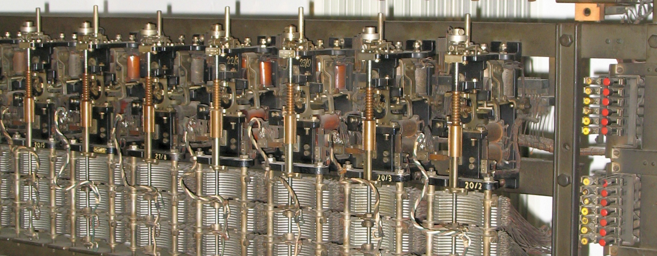
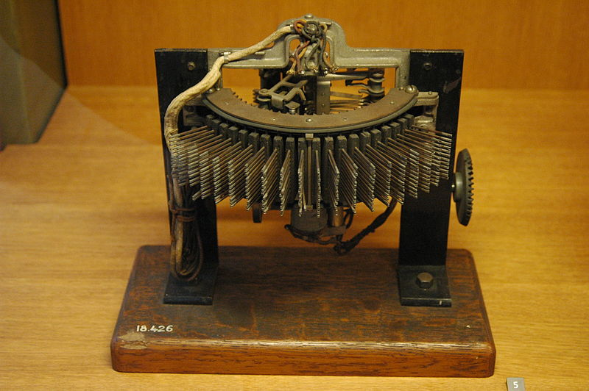
Strowger’s switches
Notes:
Example of the Strowger switches
His work led to fully automated switching centers

Slide 6
Wanted to solve:
Privacy
Intended human errors
Solved these too:
Unintended human errors
Speed of connections
Lowering operational costs of running a local exchange

Slide 7

What is SDN?

Slide 8
Traditional networks

Slide 9
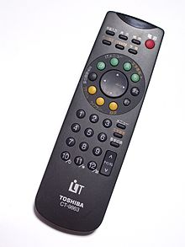
Control Plane:
Responsible for making decision on where the traffic is sent
Notes:
Examples of control protocols:
ICMP
ARP
DHCP

Slide 10

Data Plane:
Responsible for forwarding traffic to the selected destination

Slide 11

The network needs better abstraction
Notes:
Core concept in CS
Abstraction lends to good design, good scaling properties
OOP vs. Functional
Operating Systems

Slide 12
A basic example of SDN

Slide 13

Categories of SDN
Definition
Example
Cloud Service Providers
(CSP／CAP)
IaaS Cloud
Distributed control plane
Software solution for IaaS Cloud use
Midokura
VMWare/Nicira
Nuage
Enterprises
SDN
Fabric
Centralized control plane
Hardware solution for DC use
Juniper Qfabric
NEC Programmable Flow
Big Switch
Carrier/WAN
Hybrid control plane (CP)
Distributed CP with BGP
Centralized CP using OpenFlow
Google
Notes:
3 broad categories of SDN
Virtual networking for or IaaS clouds
Central control of data center network fabric
Carrier network
Replace or augment distributed signaling
Edge only?

Slide 14
Iaas Cloud Networking Requirements
Multi-tenancy
L2 isolation
L3 routing isolation
VPC
Like VRF (virtual routing and forwarding)
Scalable control plane
ARP, DHCP, ICMP
NAT (Floating IP)
ACLs
Stateful (L4) Firewall
Security Groups
VPN
IPSec
BGP gateway
REST API
Integration with CMS
OpenStack
CloudStack, etc.
Notes:
The requirements for virtual networking for IaaS clouds are broad
A variety of features

Slide 15
Iaas Cloud Networking Requirements
Typical Network Topology
Notes:
Typical virtual topology of OpenStack cloud
Multiple projects/virtual data centers
L2 isolation inside VDC
L3 isolation between network, and between provider and tenants
Just like in a real data center!
May want to connect customer site

Slide 16
Candidate models
Traditional network
Centrally controlled OpenFlow based hop-by-hop switching fabric
Edge to edge overlays
Notes:
Multiple candidates for IaaS virtual networking
Each vendor touts their own solutions as being appropriate
Let’s examine them

Slide 17
Traditional Network
Ethernet VLANs for L2 isolation
4096 limit
VLANs will have large spanning trees terminating on many hosts
High churn in switch control planes doing MAC learning non-stop
Need MLAG for L2 multi-path
Vendor specific
VRFs for L3 isolation
Not scalable to cloud scale
Expensive hardware
Not fault tolerant
Notes:
Only option for L2 isolation in traditional network is VLAN
L3 isolation option is VRF or virtual appliance

Slide 18
OpenFlow Fabric
State in switches
Proportional to virtual network state
Need to update all switches in path when provisioning
Not scalable, not fast enough to update, no atomicity of updates
Not good for IaaS cloud virtual networking
Notes:
doesn’t change the fact that the switches hold lots of network state
Proportional to virtual domain network state

Slide 19
Edge to Edge IP Overlays
Isolation not using VLANs
IP encapsulation
Decouple from physical network
Provisioning VM doesn’t change underlay state
Underlay delivers to destination host IP
Forwarding equivalence class (FEC)
Use scalable IGP (iBGP, OSPF) to build multi-path underlay
Inspired by VL2 from MSR
Notes:
Physical network state doesn’t change
Virtual network state only at the edges
FEC

Slide 20
Market trends supporting overlay solutions
Packet processing on x86 CPUs (at edge)
Intel DPDK facilitates packet processing
Number of cores in servers increasing fast
Clos Networks (for underlay)
Spine and Leaf architecture with IP
Economical and high E-W bandwidth
Merchant silicon (cheap IP switches)
Broadcom, Intel (Fulcrum Micro), Marvell
ODMs (Quanta, Accton) starting to sell directly
Switches are becoming just like Linux servers
Optical intra-DC Networks
Notes:
There are several trends supporting the edge to edge overlay model
Clos Network (spine and leaf) can be built with IP
Standard and proven IGP
Virtual network state only at edge
Physical network config doesn’t change

Slide 21
Example of an overlay solution
Logical Topology
vPort
Tenant A
Virtual
Router
Virtual
Switch A1
vPort
vPort
Provider
Virtual
Router
Virtual
Switch A2
vPort
vPort
Tenant B
Virtual
Router
Virtual
Switch B1
vPort
MN
VM
Internet
BGP
Multi
Homing
BGP
To ISP1
MN
VM
Private IP Network
MN
VM
BGP
To ISP2
MN
VM
BGP
To ISP3
Tunnel
MN
MN
VM
VM
MN
MN
MN
Physical Topology
Network State Database

Slide 22
Overlays are the right approach!
But not sufficient.
We still need a scalable control plane.
Notes:
I hope that you’re convinced that edge to edge overlays are the right approach to satisfy IaaS cloud networking requirements
But is that enough?
Not quite.

Slide 23
Questions?

