Slide 1
Techniques for Managing your OpenStack Cloud
Ryan Geyer - @rjgeyer
04/15/2013

Slide 2
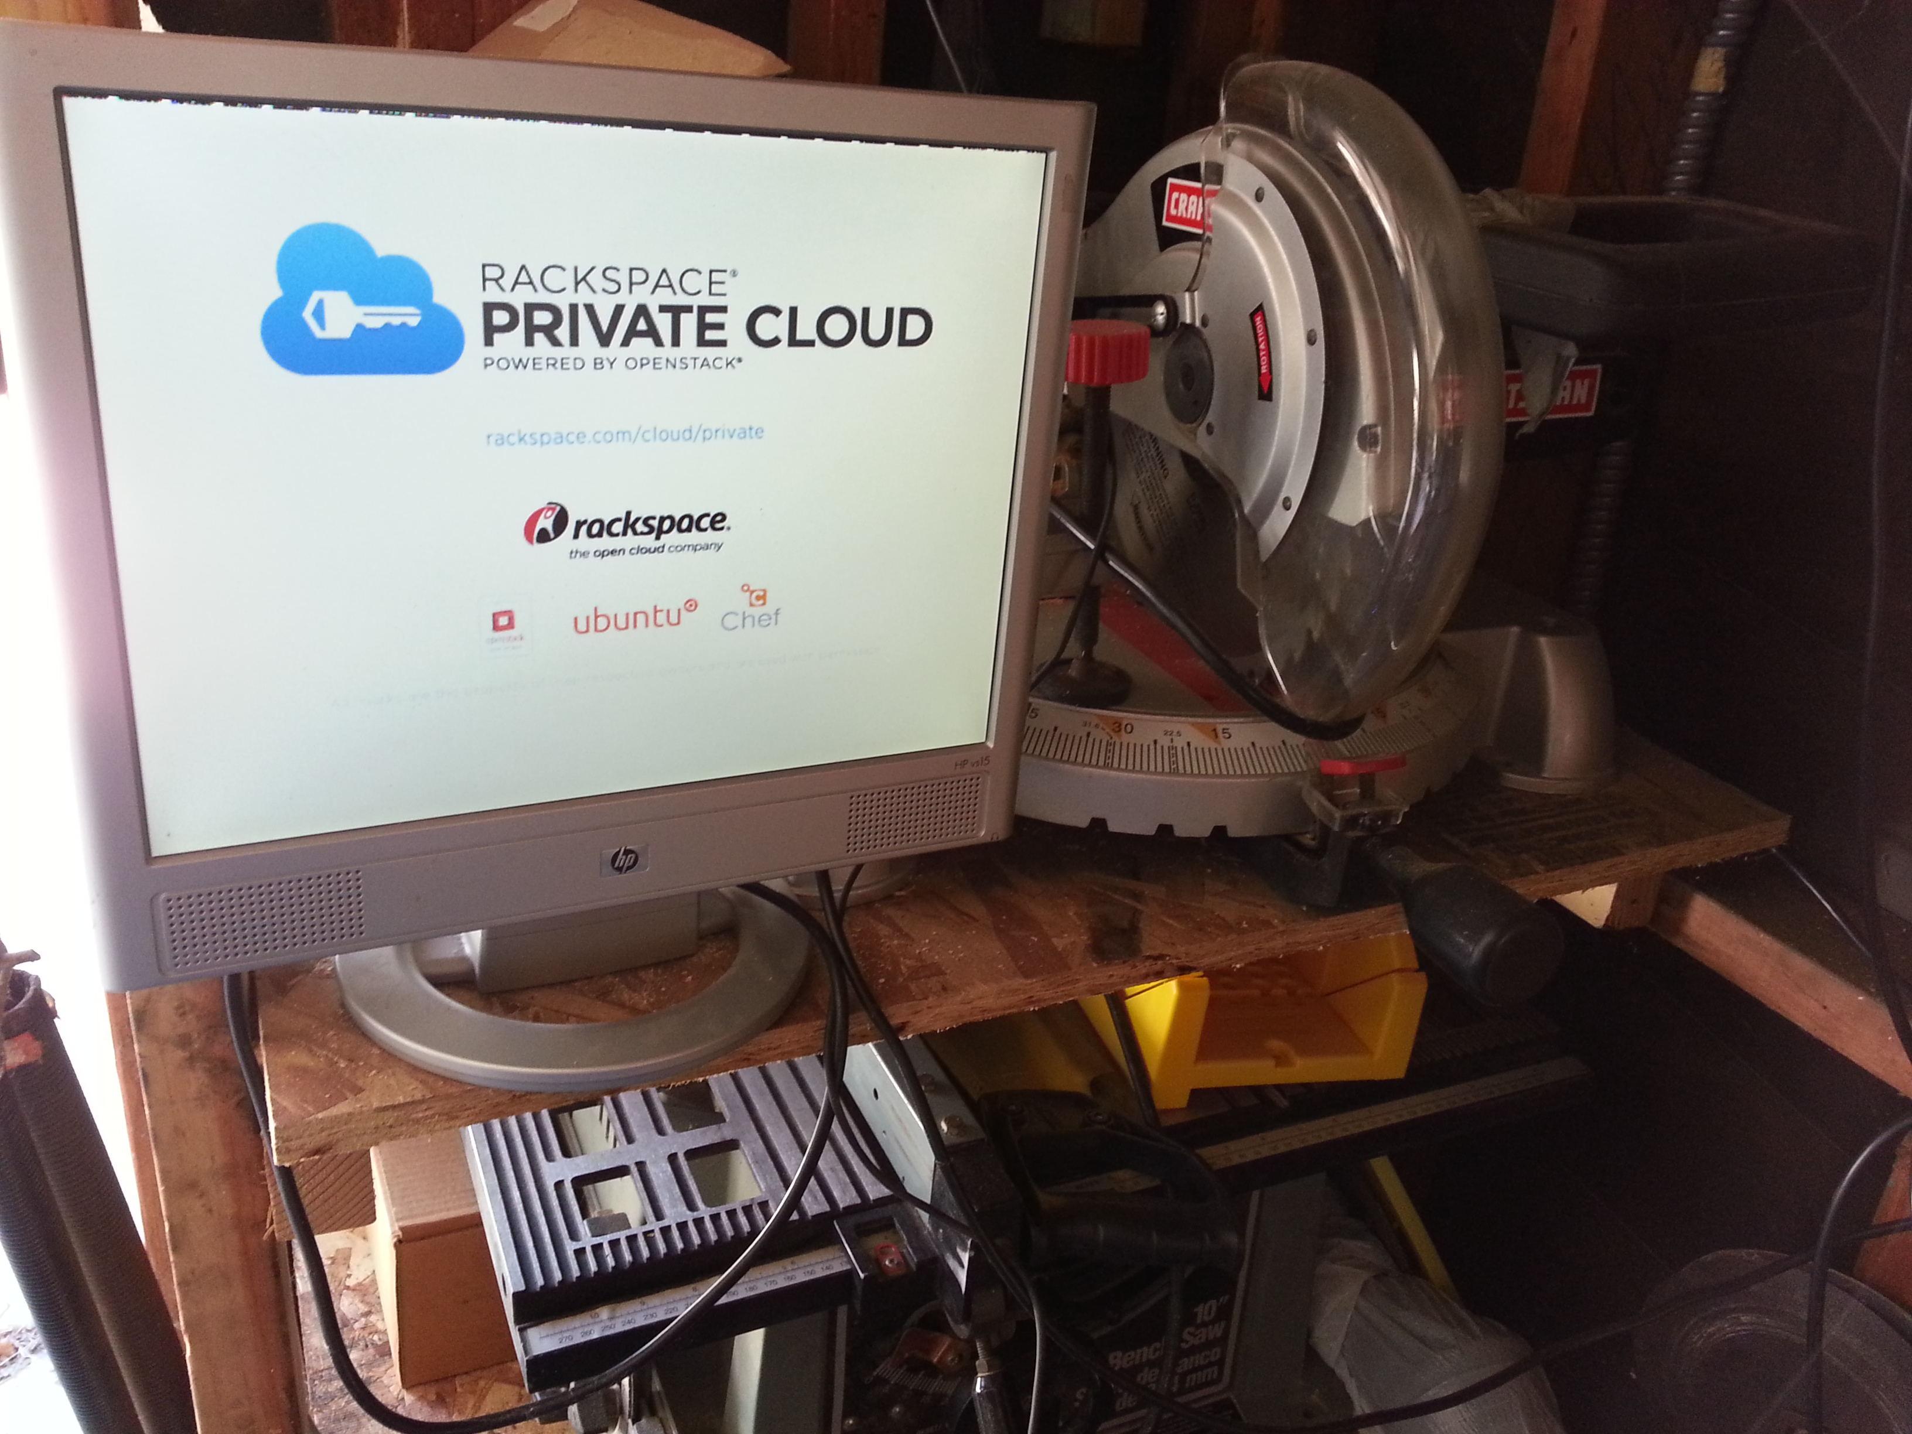
My Garage Datacenter

Slide 3
The best management for your OpenStack cloud,
is no management at all.

Slide 4
Agenda
Managing your cloud hardware and software
Managing your cloud enabled applications

Slide 5
Managing Hardware
Rack & Stack
Initial Installation & Configuration

Slide 6
Managing Hardware
Rack & Stack
Initial Installation & Configuration

Slide 7
Managing Hardware
Rack & Stack
Initial Installation & Configuration

Slide 8
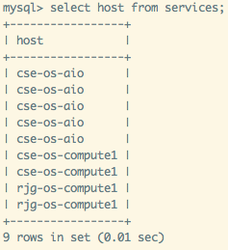
Managing Hardware
Rack & Stack
Initial Installation & Configuration

Slide 9
Managing Software

Slide 10
The best management for your OpenStack cloud,
is no management at all.

Slide 11
Managing Cloud Enabled Application

Slide 12
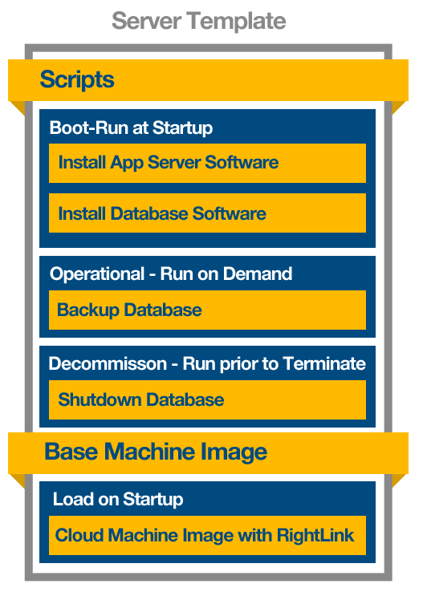
ServerTemplates
Dynamic configuration
Abstract role and behavior from cloud infrastructure
Predictable deployment
Cloud agnostic / portable
Object-oriented programming for sysadmins

Slide 13
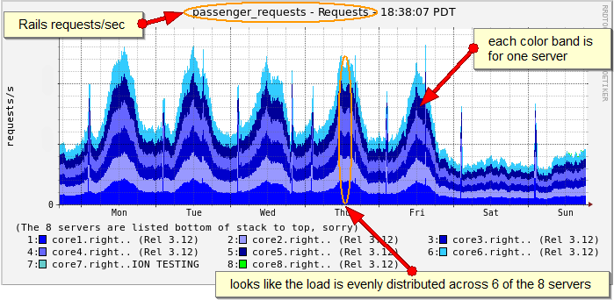
Automation Engine
Monitoring and alerting
Server and application
Escalations and triggers
Auto-scaling
Operational automation
Database backup, failover, recovery
Script execution
Code deploys and patches

Slide 14
DEMO

Slide 15
The best management for your OpenStack cloud,
is no management at all.

Slide 16
Summary
Is managing your OpenStack installation and operations your core competency?
Go register your OpenStack cloud with RightScale
http://bit.ly/134A0Ut
@rjgeyer – ryan.geyer@rightscale.com

