Slide 1
Using OpenStack In A Traditional Hosting Environment
Jun Park (Ph.D.), Sr. Systems Architect
Mike Wilson, Sr. Systems Architect
EIG/Bluehost
OpenStack Summit 2013
Notes:
Love!
30 mins talk + 10 mins qna ➔ during the main talk we have short answers, have longer answers in qna. May have off-line chats for more details.
Take a quick poll: How many people with openstack and cloudstack?
Time: Tell our story… main tasks remaining …

Slide 2
Scale @10x what we were in about a year’s time
Needed a system to manage it all
Provisioning these systems had to be automated
System had to scale to multiple data centers
Btw, we have 2 months to come up with this

Slide 3
High level requirements
Centralized management, horizontal scalability.
Abstractions for physical and logical deployments of devices and resources.
Open-source project with lots of support and momentum
Typical Cloud features (migration, imaging, provisioning, etc.)
Easy transition into future cloud offering with support for industry standard APIs
=
OpenStack!
Notes:
Quick poll, how many nodes?

Slide 4
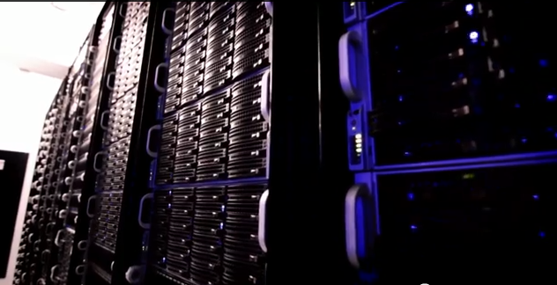
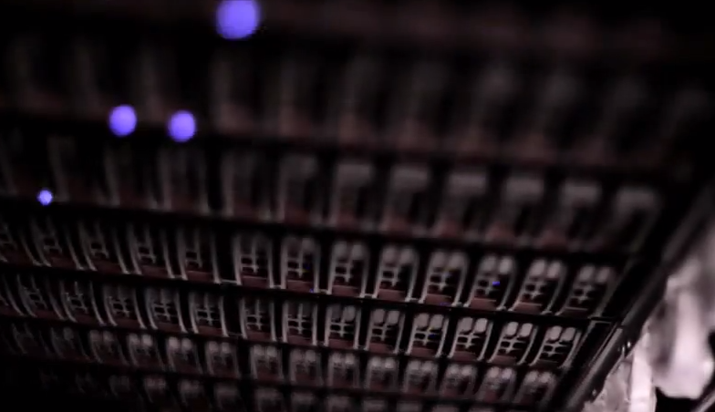
Bluehost Environment
Scale
More than 10,000 physical
servers
Adding hundreds of nodes
per day
Network
Public network directly attached to VMs
Plan on adding private network later
OpenStack/Folsom Components
Nova (compute, api, scheduler)
Quantum (network)
AMQP: Qpid (messaging)
Mysql (db)
Notes:
Quick poll : how many nodes?

Slide 5
Outline
Scalability/Stability
Rethink Quantum Network
Operational Issues
Wrap-up/Conclusions

Slide 6
Why Difficult To Scale up?
Components that don’t scale
Messaging system
Mysql server
Heavy APIs
Hard to Diagnose
No simulator/emulator for high scalability testing
No quantitative guide as to how to scale up
No detailed error message or even not at all
Requires detailed knowledge of codebase
Look at that line!

Slide 7
Nova Enhancements
Monitoring/troubleshooting
Added service ping (similar to grizzly)
Additional task_states
Better errors to instance_faults
Functionality
Added LVM resize and injection
Added stop_soft and stop_hard similar to reboot
Stability/Scalability
Some bug fixes to OVS VIF driver
Added custom scheduler

Slide 8
MySQL/Innodb Concurrency
Nova behavior
Direct connection to DB (addressed in grizzly though)
Too MANY queries; much more read than write
Some queries often return huge number of results
Periodicity of loads due to periodic tasks
Mysql behavior
innodb_thread_concurrency = num of threads that can execute queries in the queue
innodb_concurrency_tickets = number of rows you can return before requeue (default 500!)
With default settings your mysql server will fall over with a few thousand compute nodes

Slide 9
So the answer is just increase concurrency and tickets right?
Sadly, no.
Tuning concurrency and tickets is a must! But we still requeue.
We don’t know why, but we have a workaround.
Our workaround:
Send most read queries to a cluster of mysql slaves.
I say most because many queries would be sensitive to possible slave replication lag

Slide 10
Messaging System
Qpid Chosen
Speed and easy cluster ability
Incredibly unstable at large scale (Even at small scale)
Possibly poorly configured
Older release in CentOS6
Problem
Broker bottleneck
Unnecessarily complex
Recommendation
AVOID BROKER!
ZeroMQ as replacement

Slide 11
BlueHost OpenStack
Group of Controllers
Nova-api
Nova-scheduler
Quantum-server
Keystone
mysql master
Read-only mysql slave
Read-only mysql slave
Read-only mysql slaves
Load Balanced
Server Farm
> 10,000 physical servers
Qpid servers
Host
BH-enhanced OVS Quantum Plugin
BH-enhanced Nova-compute

Slide 12
Rethink Quantum Network
Problem
Quantum API only for DB; no efficient API for Nova
No API-around design for actual network objects
Premature OpenvSwitch
(OVS) quantum plugin
Our approach
Adding intelligence to OVS plugin
Optimizing API
E.g., get_instance_nw_info() in nova; Python-level join operation
Expand current implicit communication with nova-compute (although not ideal)
Notes:
LOVE!!!
Just a small step for us to try to help community and share what we’ve done.

Slide 13
OpenvSwitch (OVS)
Support
OpenFlow 1.0 (1.2, 1.3 in experiment)
Various Hypervisors including KVM
Merged into main stream since Linux 3.3
Functionality
Filtering rules and associated actions
E.g., anti-IP spoofing, DMAC filtering
Replacement or superset of ebtables/iptables/linuxbridge
QoS or Linux traffic control (TC)
Various third party controllers for full-fledged OF functionality
Notes:
Quick poll: how many people know about OVS plugin? How many people use OVS in production?

Slide 14
Quantum With Nova-Compute
Implicit communication
with nova-compute
1. Nova boot API
Why nova-compute
still create tap?
Controller
Nova-api server
Host
2. Call quantum-api to create port
Nova-compute
Quantum-server
4. Create OVS tap
6. Do the rest of steps for creating a new VM
5. Set up external-ids on tap
3. Create port in DB
1. Monitor any change of external-ids of the existing taps
Quantum-agent
Quantum DB
2. Call quantum-api to get port info
3. Modify external-ids on tap & setup OVS flows
Notes:
The main motivation of quantum network is to pull out network functionality from nova-compute as much as possible. Because of this, nova-compute still needs to know all the details of OVS. No code reuse, confusing, and causing inconsistency, succinct failures when VMs do not have network connectivity.
With some garbled taps, quantum-agent thinks it needs to do something even for them.

Slide 15
BH-Enhanced OVS Quantum Plugin
Idiosyncratic Requirements
Focus on a Zone; plan on addressing multiple-datacenters issue
Direct public IP using flat shared provider network with No NAT
Still required to be isolated while allowing intra-traffic among VMs
Our Approach
Developing “Distributed OpenFlow controller” using OVS plugin
Either no-tag or 24bit ID (e.g., QinQ, VxLAN, GRE), but NO VLAN
Caveats: Neither API-around approach nor Virtual Appliance
New Features
Anti-IP/ARP spoofing OF flows
Multiple-IPs per public port
Network bandwidth throttling (QoS)
Optimal Intra-traffic flows
Notes:
Let me introduce our BH-enhanced OVS plugin.
NO NAT, WHY? Avoid single point of failure, easy to diagnose, meet some specific software requirement such as cPanel.

Slide 16
BH-Enhanced OVS Quantum Plugin
DMAC matching for internal traffic to VMs
Deploy QoS for outgoing packets
DMAC matching for incoming packets
TPA matching in ARP query
Anti-IP spoofing: SRC IP matching for outgoing packets
VM1
Tag=1 (MTU size bug)
tap1
pair of veth
br-int-eth0
phy-br-eth0
10 Mbps
br-int
br-eth0
eth0
50 Mbps
Public Networks
VM2
tap2
Int-loopback
phy-loopback
pair of veth
Tag=2
DMAC matching for internal traffic to VMs
Notes:
Vlan tagging
➔ No tag or double-tag or VxLAN whatever…
Avoiding O(n^2) solution….

Slide 17
Operational Issues
Reboot hosts
Problem
Circular dependencies between libvirtd and nova-compute
OVS bug, allows to add non-existing tap interfaces
Solution
A simple workaround to restart services in rc.local
Restart services
Problem
Quantum recreates taps, resulting in network hiccups
Solution
Check out existing taps, no touch when unnecessary

Slide 18
Operational Issues
Monitor Health
Problem
Hard to track down
Solution
Adding health check APIs
XML customization
Problem
No way to modify XML on the fly
Not even allowed for static customization
Solution
Add more parameters

Slide 19
Wrap-up/Conclusions

Slide 20
Problem vs. Solution
Problem
Solution
Nova
Monitoring/troubleshooting
Service ping, task_states, etc.
No LVM
Add LVM driver
Overloaded scheduler
Custom scheduler
OVS VIF driver issue
Fix bugs
Mysql
Overloaded
Read-only Mysql slave server
Innodb issue
Optimized confs
Qpid
Instability issue
Clustered qpid
Future plan
No broker, ZeroMQ
Quantum
Heavy API
Optimized API
Premature OVS plugin
Add features (Anti-IP, No-tag flows, QoS)
Operations
Reboot, restart of services
Simple workarounds
XML
XML customization (cpu custom)

Slide 21
For True OpenStack Success
Scalability
➔ Scalable Messaging System & DB Infra
Networks
➔ Good Networks Abstraction
So … We don’t do live demo until …
Notes:
Let’s get this straightened out!
Structurally means most distributed structure among all other cloud platforms.

Slide 22
We’re sorry, we haven’t had time to contribute a whole lot YET. But here’s some code:
https://github.com/upoopoo for BH nova
https://github.com/JunPark for BH Quantum (as in live production)
Browse the branches, many have to do with features discussed today

